Slide 1
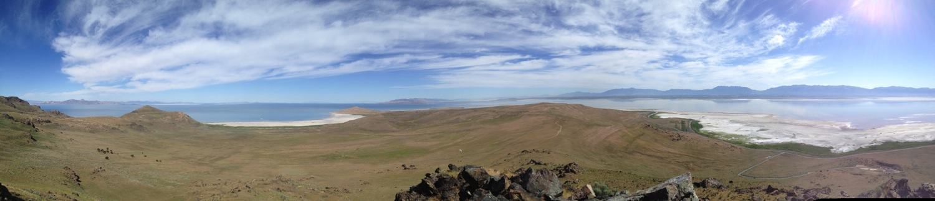
Advancing Numerical Weather Prediction of Great Salt Lake-Effect Precipitation
John D McMillen

Slide 2
Questions and Hypotheses
How and why does the choice of microphysical parameterization in numerical weather prediction models affect quantitative GSLE precipitation forecasts at convection-permitting (~1 km) grid spacing comparable to those likely to be available to forecasters during the next decade?
We hypothesize quantitative GSLE precipitation forecasts will be affected by the choice of microphysics parameterizations at convection-permitting grid spacing for three reasons.
  Microphysical parameterizations were designed to simulate specific phenomena
  The tendency equations within each different microphysical parameterization are frequently unique
  Even when hydrometeor tendency equations are theoretically the same, the way they are used may yield a different result

Slide 3
Research Methods - MP Study
GSLE simulation sensitivity to microphysics choice
  Case study of 27 Oct 2010 event
  Control Run WRF ARW 3.4
    1.33 km inner domain (3rd single nested domain)
    NAM LBC, Cold start
    35 vertical levels
    8 sec integration time step
    Thompson microphysics parameterization
    Kain-Fritsch convective parameterization on outer domains, none on inner domain
    YSU PBL parameterization
    NOAH LSM parameterization
    RRTM (SW) and RRTMG (LW) radiation parameterizations
    Simple second order diffusion
    2D Smagorinsky eddy coefficient

Slide 4
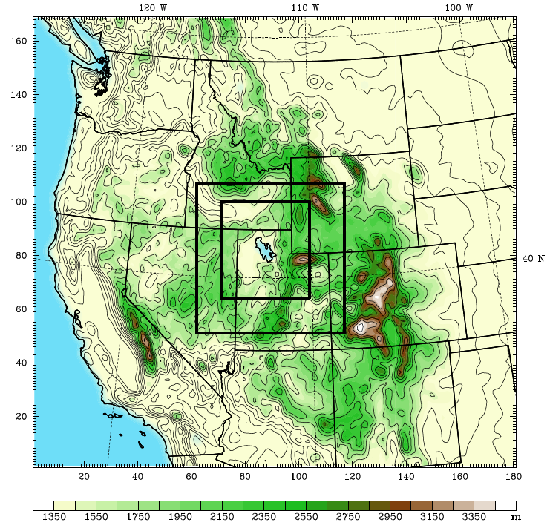
D1 12 km
D2 4 km
D3 1.3 km

Slide 5
GSLE Precip Subdomain
MP Subdomain
B
A

Slide 6
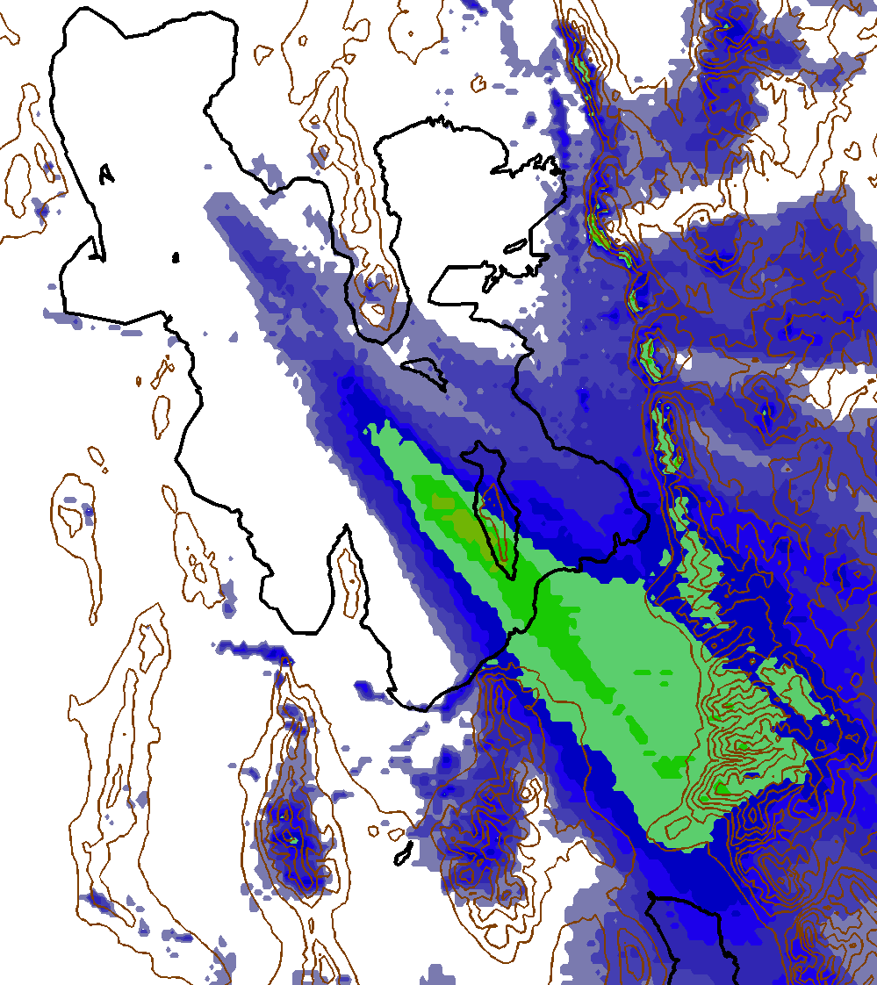
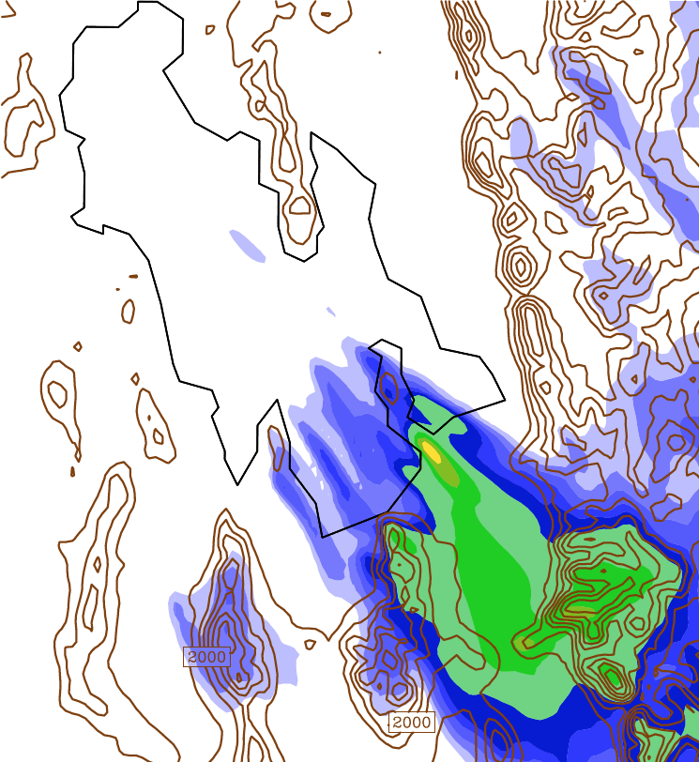

Total Precipitation
0230-1700 UTC 27 October 2010
NEXRAD
Thompson
Liquid equivalent precip derived from NEXRAD with Z = 75S² relationship
NEXRAD plot compares well with surface observations over the valley, but underestimates liquid equivalent precip over the high Wasatch

Slide 7
Research Methods - MP Study
All simulations generated similar synoptic fields
  Moisture was similar
  Over-lake convergence bands were generated in every simulation
This consistency implies that GSLE precipitation distribution and amount differences between simulations are caused by the choice of MP scheme

Slide 8
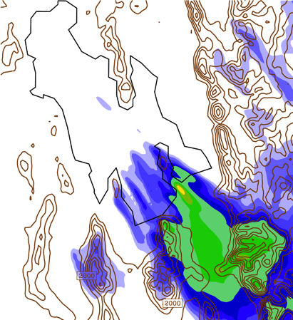
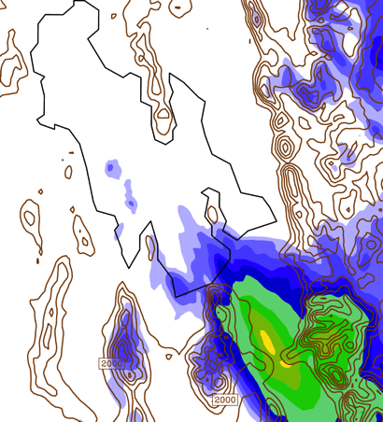
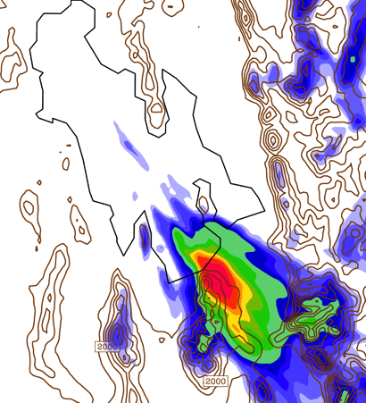
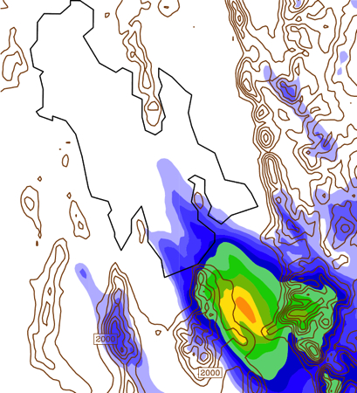
Total Precipitation
0230-1700 UTC 27 October 2010
Thompson
Goddard
WDM6
Morrison

Slide 9
Precipitation Statistics
0230-1700 UTC, 27 October 2010
Microphysics Parameterization | Max Precip (mm) | Mean Precip (mm) | Percent Change in Mean Precip | Area GTE 10 mm Precip (km²) | Area GTE 15 mm Precip (km²) | Area GTE 20 mm Precip (km²)
Thompson | 24.43 | 1.23 | N/A | 739 | 63 | 11
Goddard | 20.95 | 1.35 | 9.39 | 1023 | 359 | 33
Morrison | 28.08 | 1.32 | 6.99 | 950 | 530 | 238
WDM6 | 52.49 | 1.50 | 22.25 | 905 | 583 | 391
Statistics calculated over GSLE Precip Subdomain

Slide 10
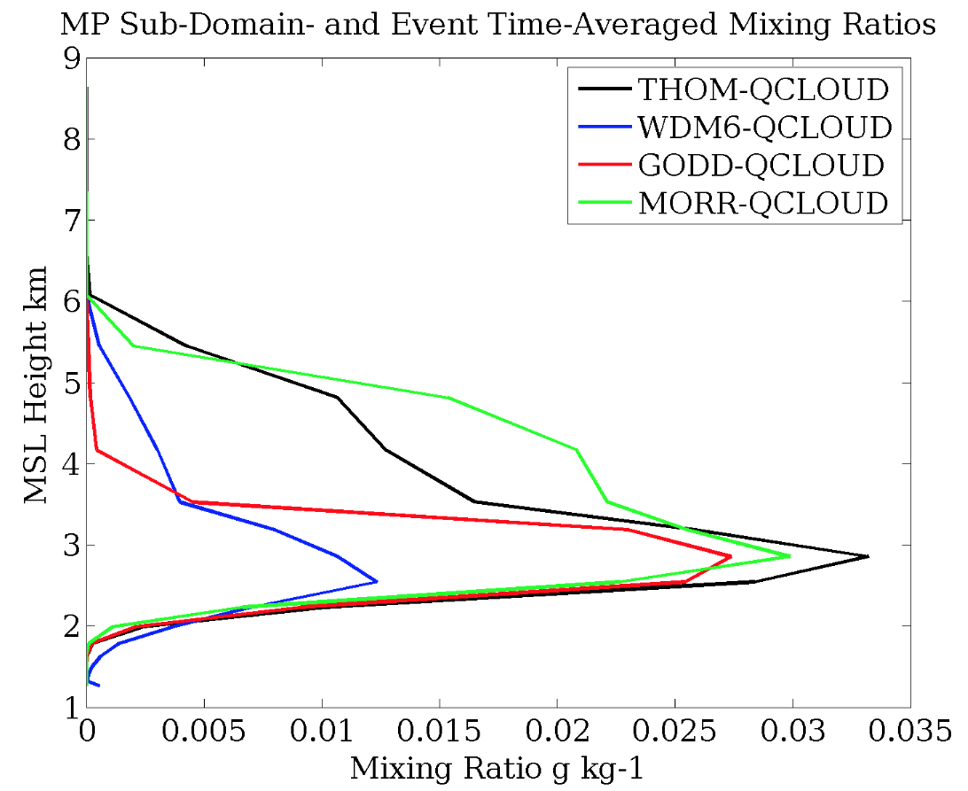
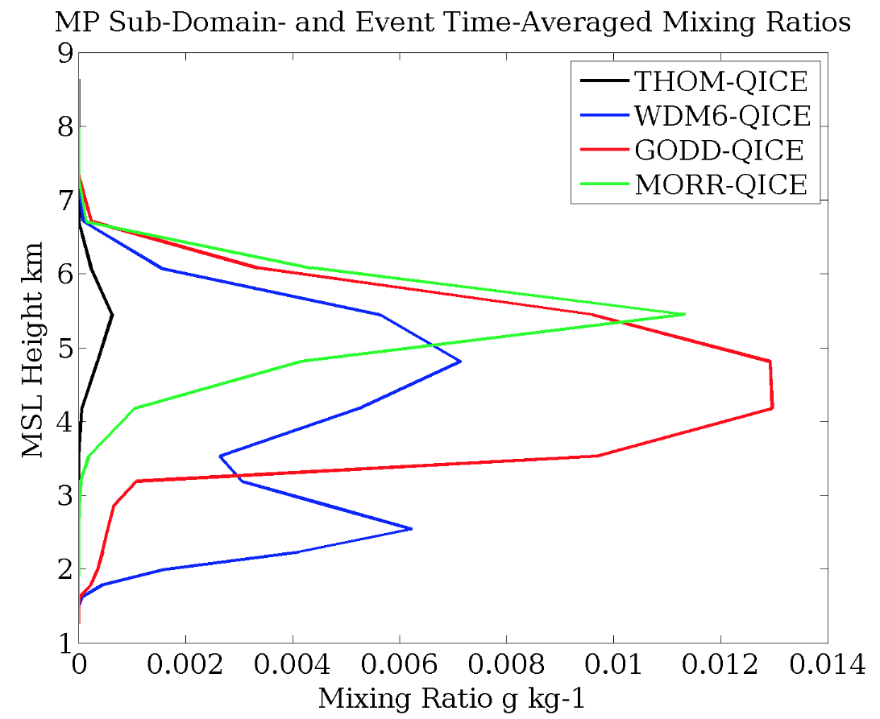
Hydrometer Mass Profiles
Values averaged over MP Subdomain from 0230-1700 UTC

Slide 11
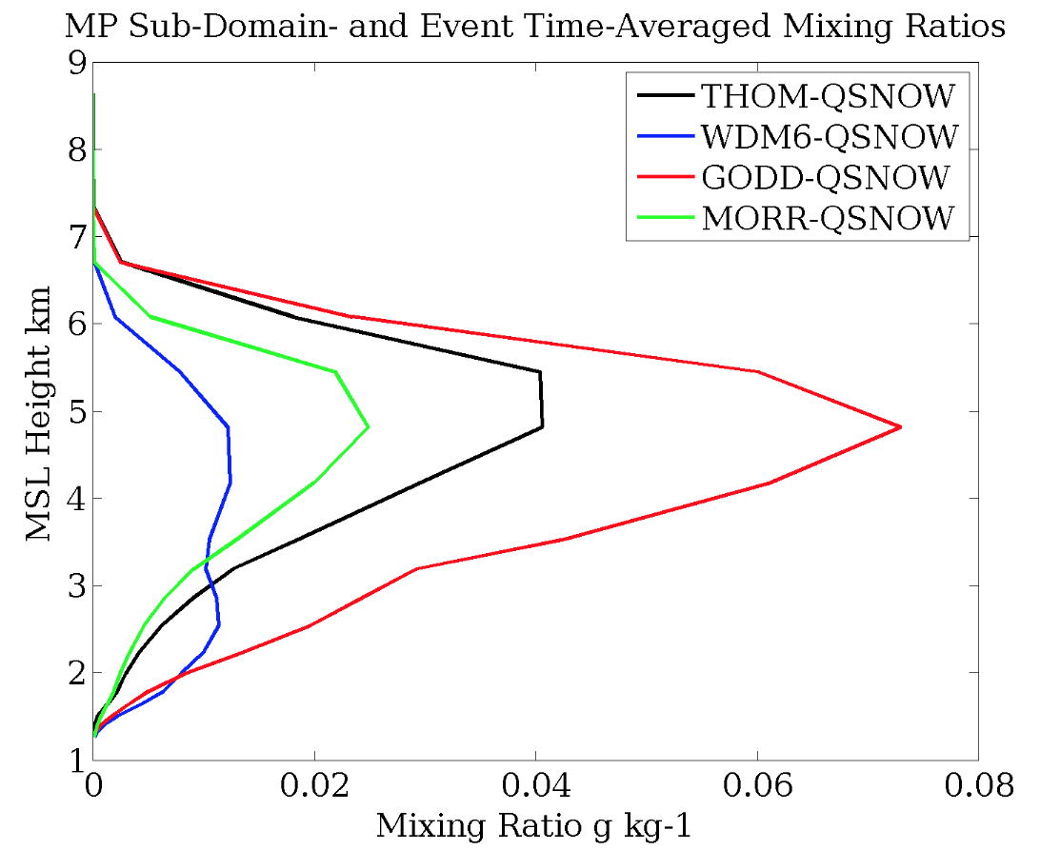
Hydrometer Mass Profiles
Values averaged over MP Subdomain from 0230-1700 UTC

Slide 12
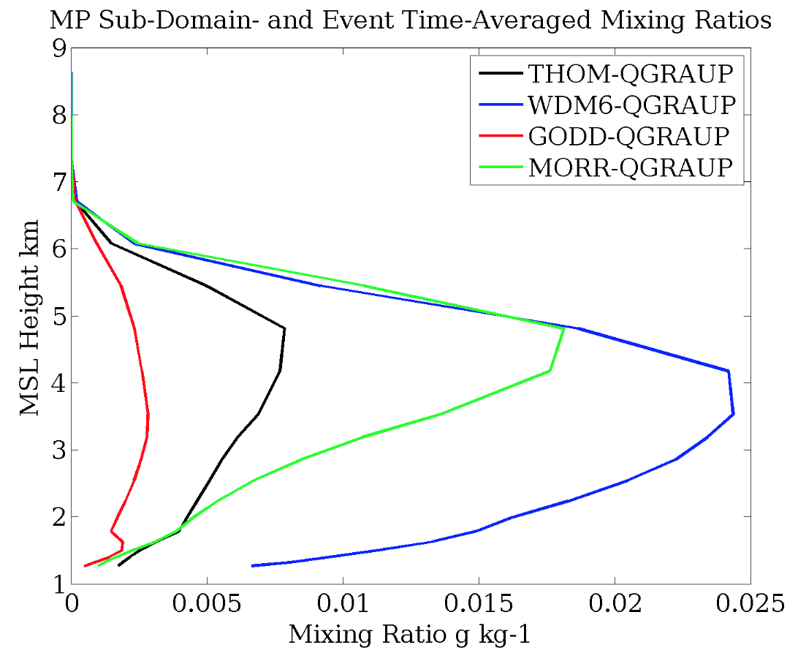
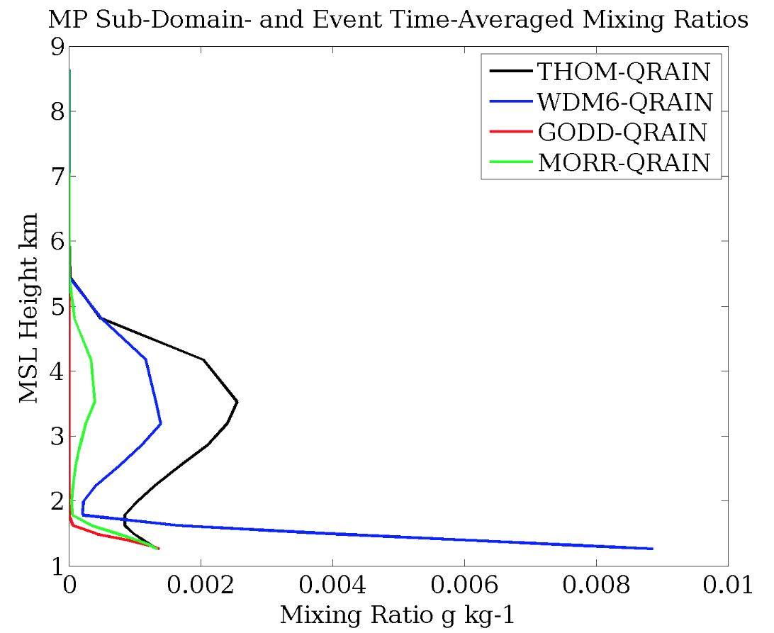
Hydrometer Mass Profiles
Values averaged over MP Subdomain from 0230-1700 UTC

Slide 13
Hydrometeor Tendency Equations
We extracted the source and sink terms of the snow hydrometeor tendency equations
  THOM
    qsten(k) = qsten(k) + (prs_iau(k) + prs_sde(k) + prs_sci(k)
    + prs_scw(k) + prs_rcs(k) + prs_ide(k) - prs_ihm(k)
    - prr_sml(k))*orho
  WDM6
    qrs(i,k,2) = max(qrs(i,k,2) + (psdep(i,k) + psaut(i,k) + paacw(i,k)
    - pgaut(i,k) + piacr(i,k)*delta3 + praci(i,k)*delta3
    + psaci(i,k) - pgacs(i,k) - pracs(i,k)*(1. - delta2)
    + psacr(i,k)*delta2)*dtcld , 0.)

Slide 14
Hydrometeor Tendency Equations
We extracted the source and sink terms of the graupel hydrometeor tendency equation
  THOM
    qgten(k) = qgten(k) + (prg_scw(k) + prg_rfz(k) + prg_gde(k)
    + prg_rcg(k) + prg_gcw(k) + prg_rci(k) + prg_rcs(k)
    - prg_ihm(k) - prr_gml(k))*orho
  WDM6
    qrs(i,k,3) = max(qrs(i,k,3) + (pgdep(i,k) + pgaut(i,k)
    + piacr(i,k)*(1.-delta3) + praci(i,k)*(1. - delta3)
    + psacr(i,k)*(1.-delta2) + pracs(i,k)*(1.-delta2) + pgaci(i,k)
    + paacw(i,k) + pgacr(i,k) + pgacs(i,k))*dtcld, 0.)

Slide 15
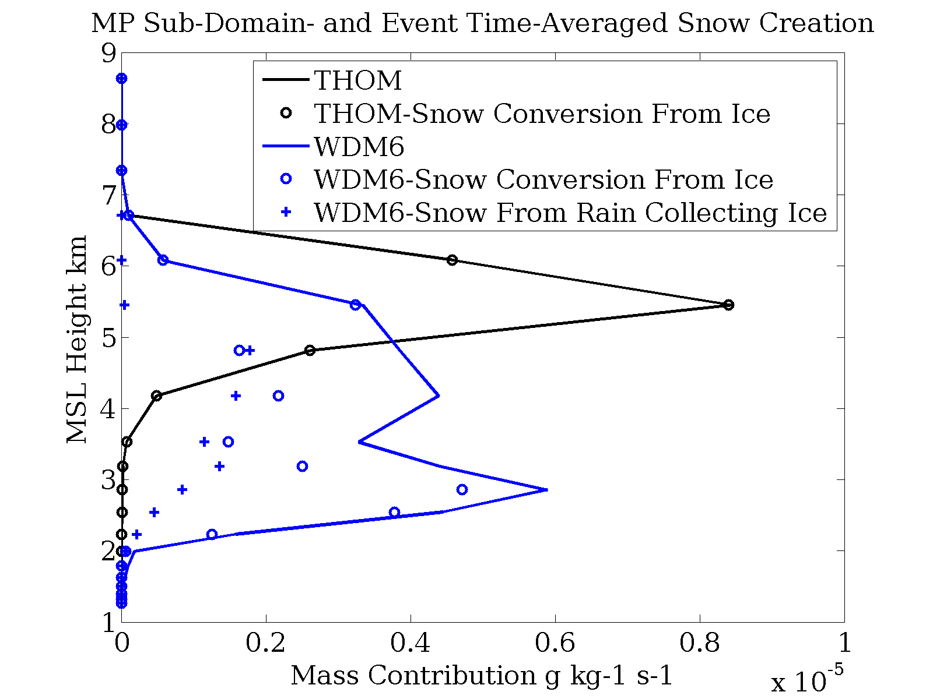
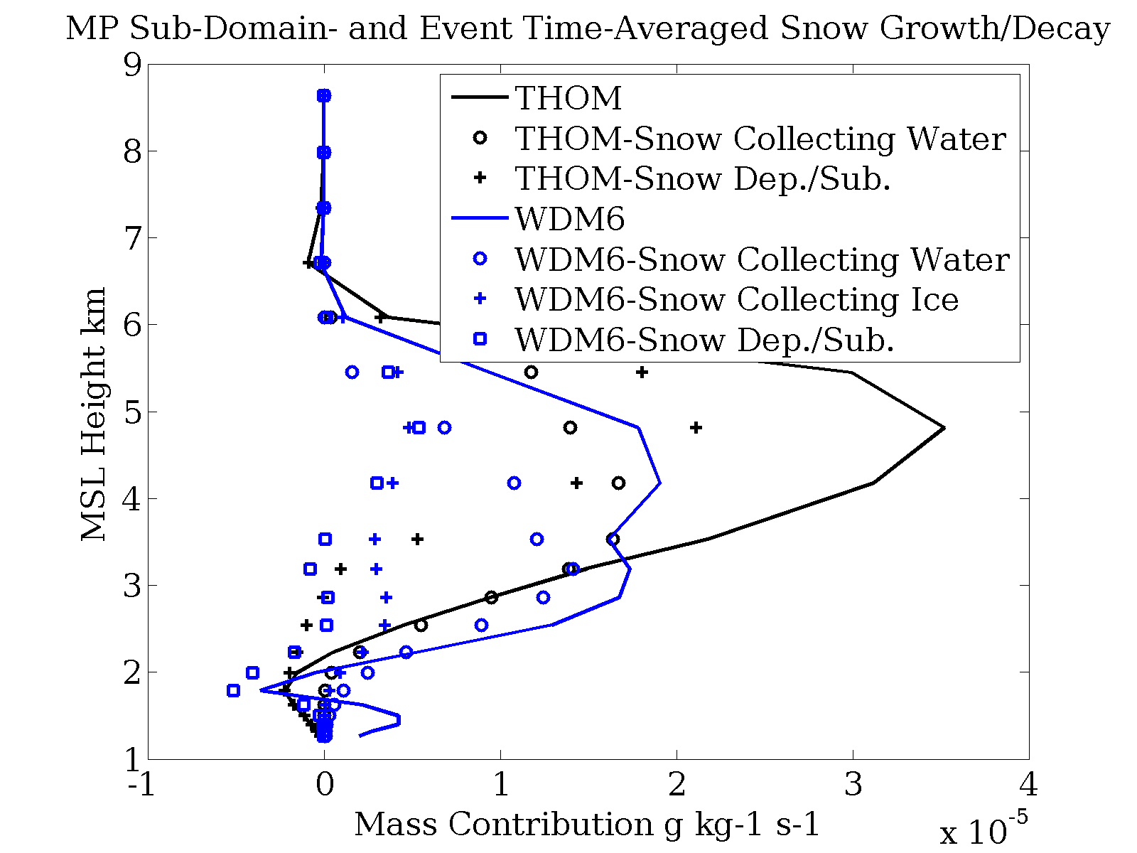
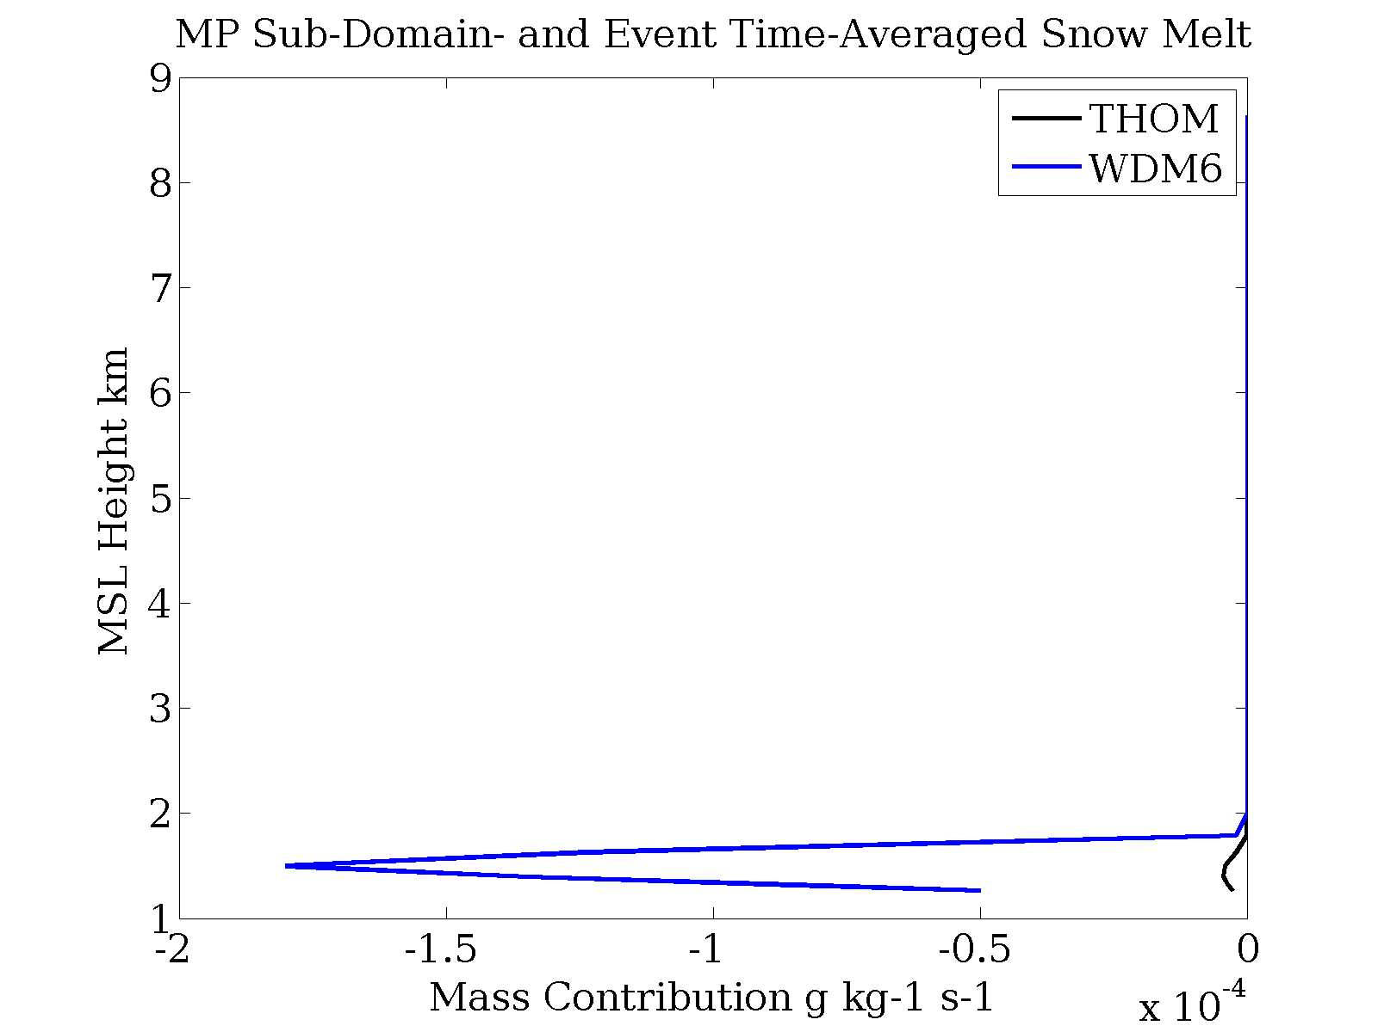
Snow
Tendency Profiles
Values averaged over MP Subdomain from 0230-1700 UTC
Solid lines are the sum of all terms

Slide 16
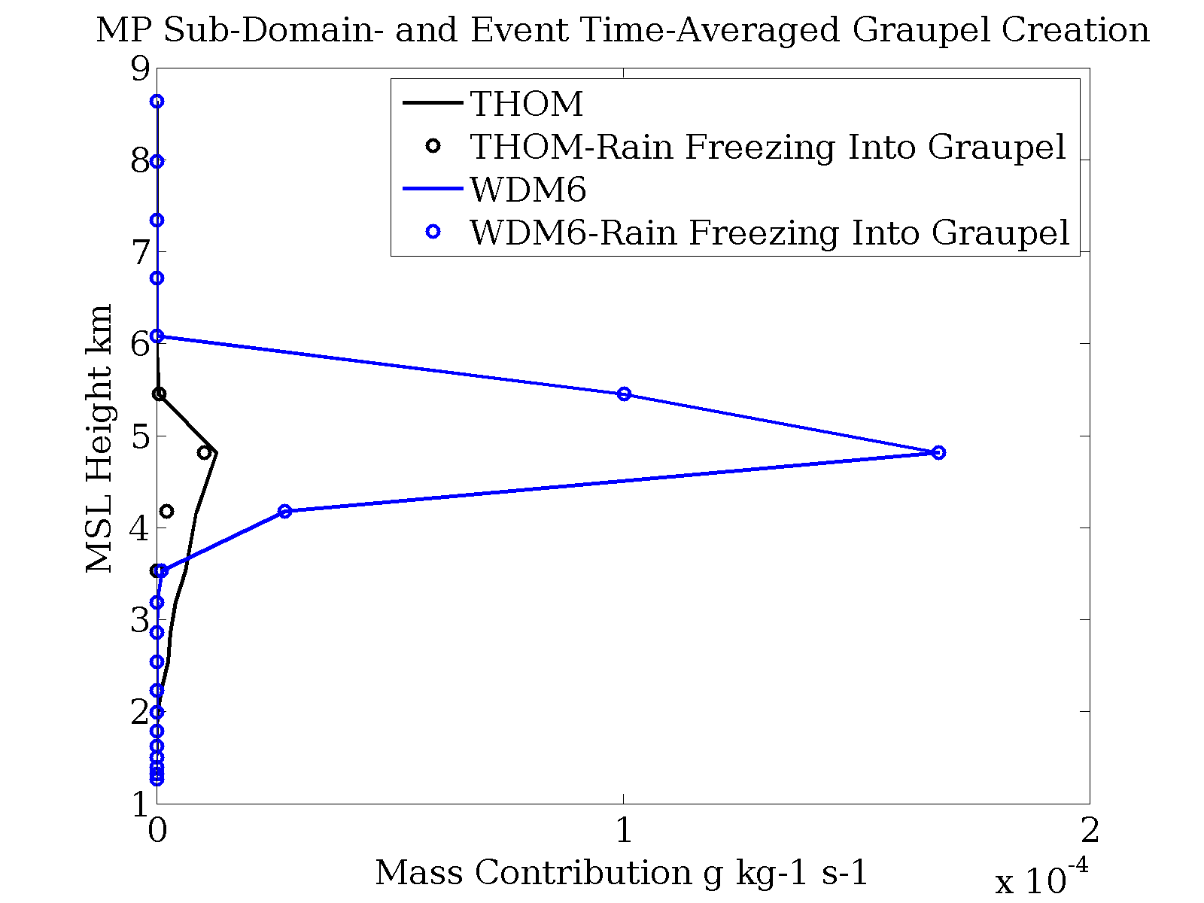
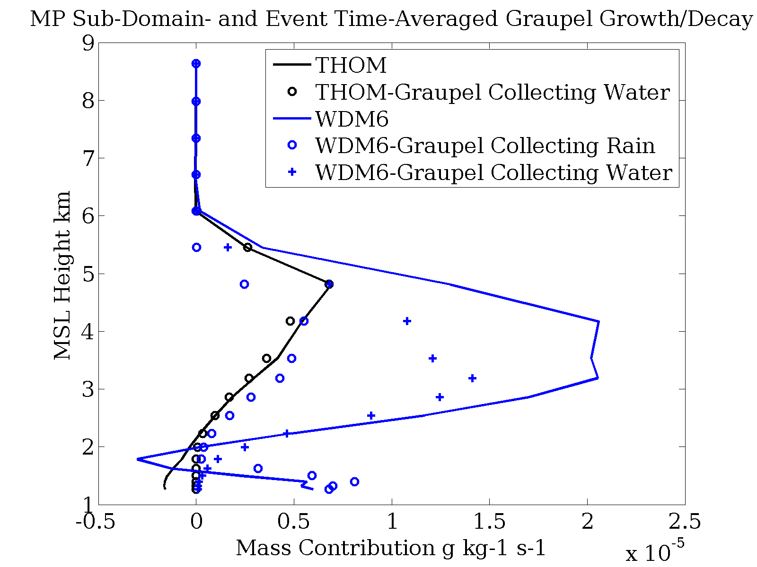
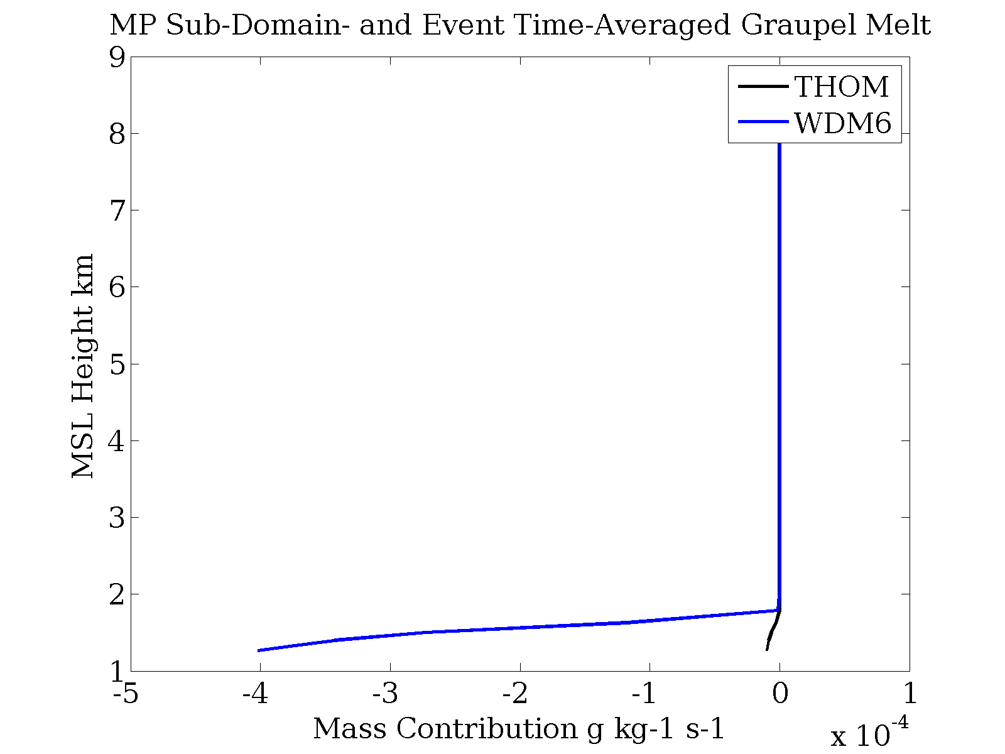
Graupel
Tendency Profiles
Values averaged over MP Subdomain from 0230-1700 UTC
Solid lines are the sum of all terms

Slide 17
Total Graupel
0230-1700 UTC 27 October 2010
WDM6
Thompson

Slide 18
Total Precipitation
0230-1700 UTC 27 October 2010
Thompson
Goddard
WDM6
Morrison

Slide 19
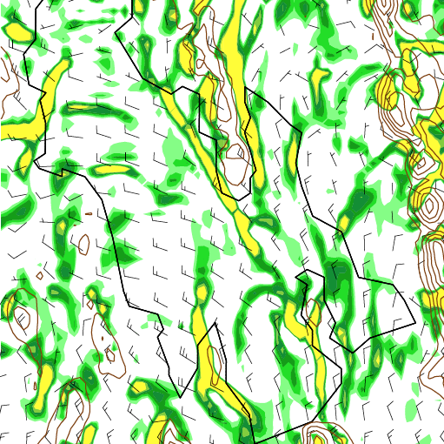
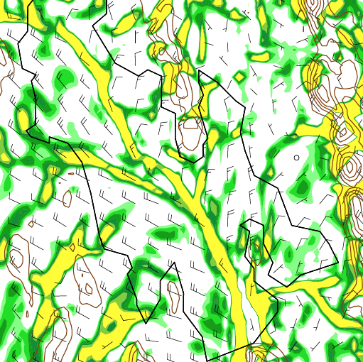
Precipitation Pattern
All schemes displace the band of maximum precipitation to the southwest compared to observations
Thompson is closest to observations, but still displaced
The precipitation location is driven by the convergence axis
Thompson
WDM6
Divergence averaged through the lowest 2 sigma levels ( green < 0 s⁻¹ ; yellow < -110 s⁻¹ ; interval -30 s⁻¹) and lowest sigma level winds (full barb = 5 m s⁻¹) 0230 UTC 27 Oct 2010

Slide 20
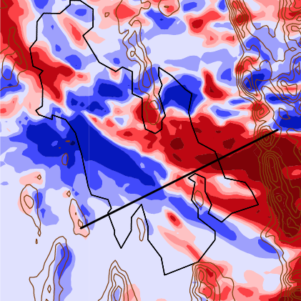

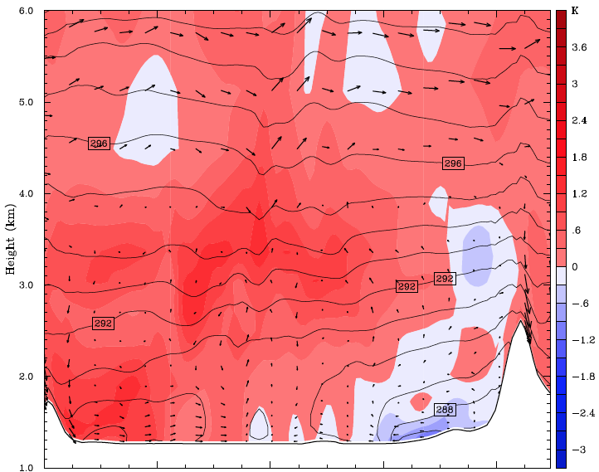
Predecessor Precipitation
Precipitation produced by a baroclinic trough before 0230 UTC differs between schemes
WDM6
WDM6
B
A
A
B
Precipitation difference 1800 UTC 26 Oct through 0230 UTC 27 Oct
WDM6 – Thompson
8 km horizontal average circulation and potential temp over potential temp difference WDM6 – Thompson

Slide 21
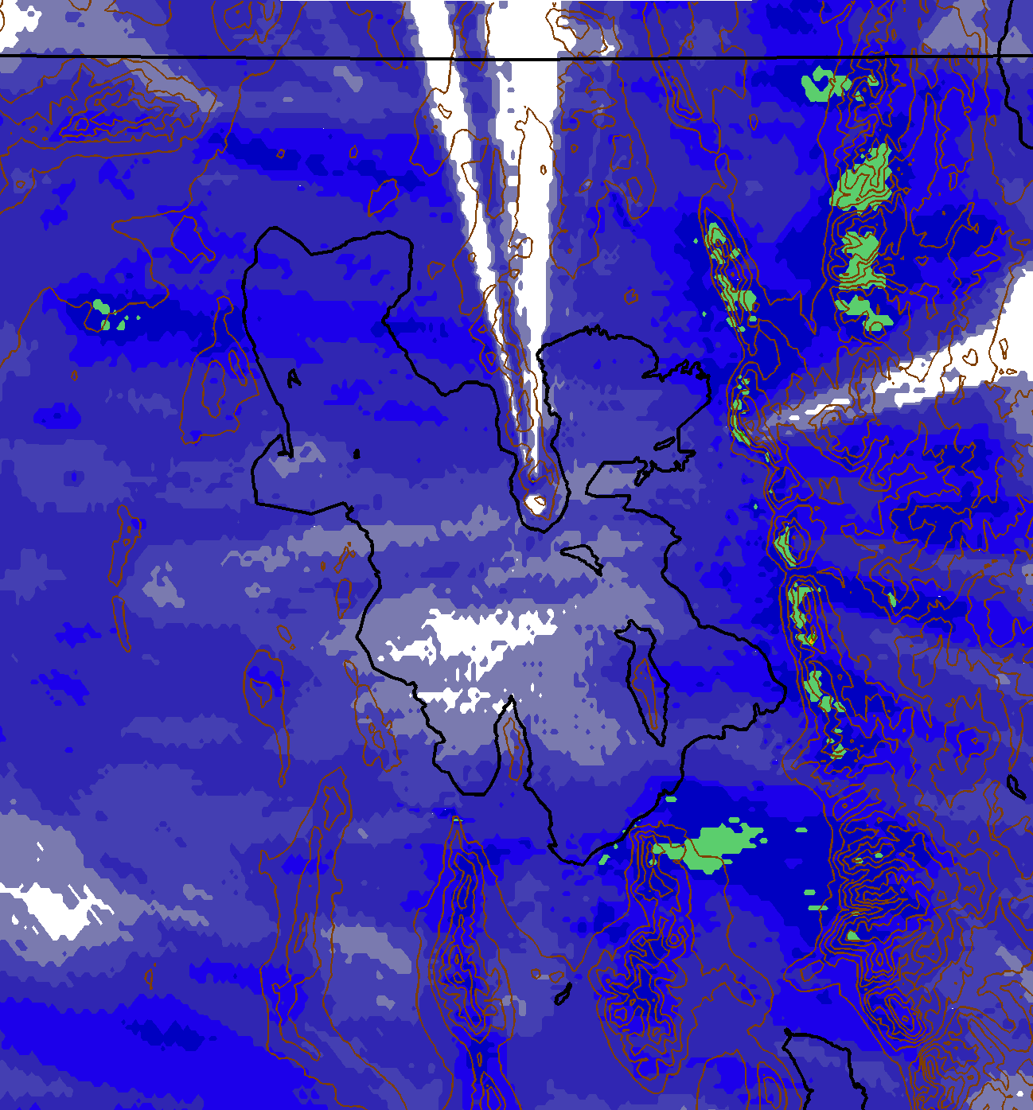
Predecessor Precipitation
All Schemes produce poor precipitation from the baroclinic trough compared to NEXRAD
Poor synoptic precipitation distribution affects GSLE precipitation distribution
NEXRAD
Thompson

Slide 22
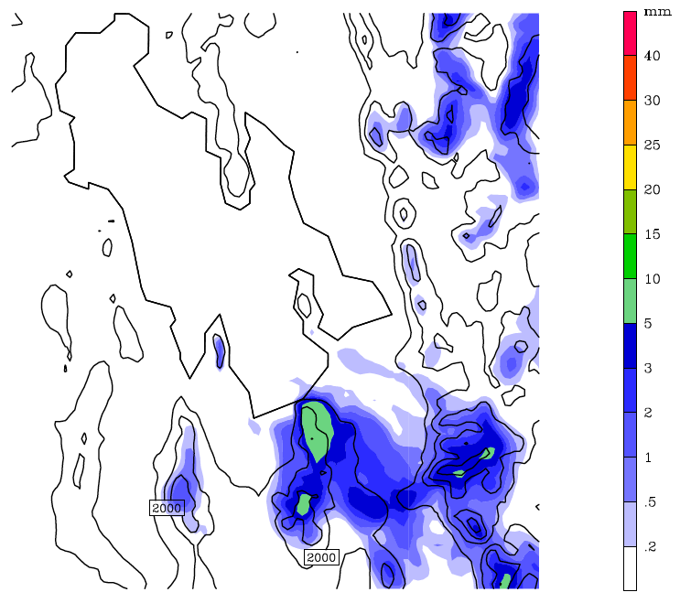
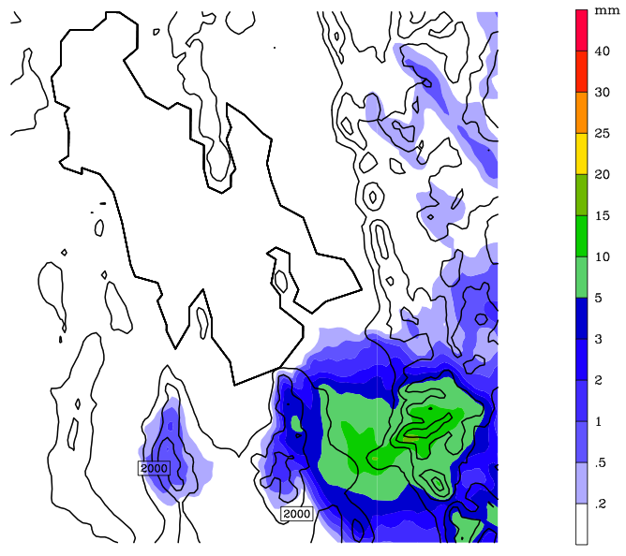
Snow
WDM6
Thompson

