Slide 1
Accuracy of Early GFS and ECMWF Sandy Track Forecasts: Evidence for a Dependence on Cumulus Parameterization
Nick Bassill
Supported by DOE grant DEFG0208ER64557

Slide 2
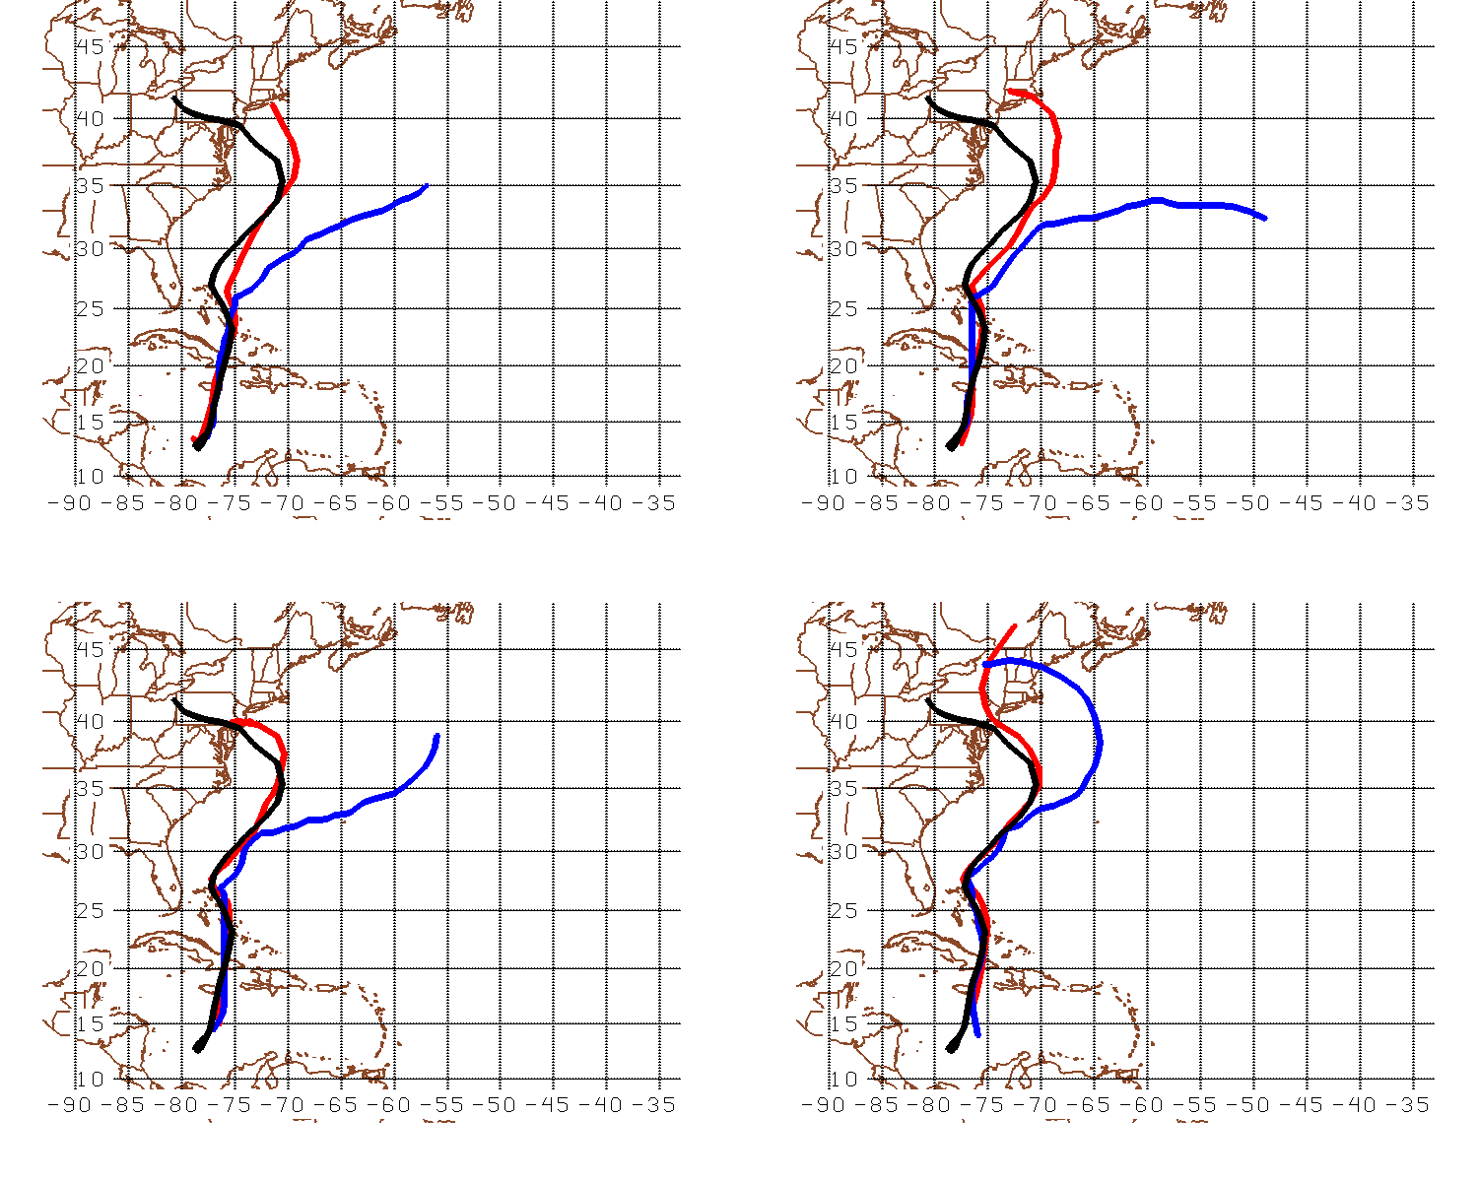
Sample Track Differences
0000 UTC 23 October
1200 UTC 23 October
BLACK = Best Track RED = ECMWF BLUE = GFS
0000 UTC 24 October
1200 UTC 24 October

Slide 3
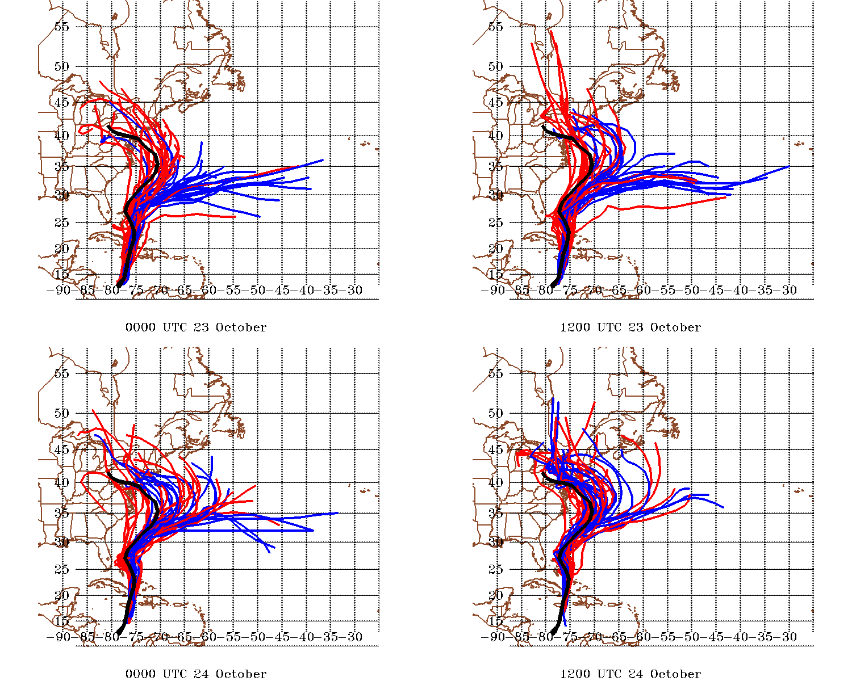
Best Track
EPS
GEFS
From TIGGE archive
(found at http://apps.ecmwf.int/datasets/data/tigge )

Slide 4
How Often Have You Heard?
The ECMWF outperformed the GFS because …
  … it’s a higher resolution model.
  … it ingests more or better data.
  … its data assimilation scheme is superior.
  … perhaps it was lucky

Slide 5
Alternative Possibility: Choice of Cumulus Parameterization Was Key
Experiment: recreate both global ensembles using exclusively GFS (or GEFS) initial conditions, but with CPs representative of those used by the global models
WRFv3.3.1 is run in Global mode for the previous four initialization times using the 20 (+1 control) GEFS ensemble members
Two ensembles are created per time – one using the Simplified Arakawa-Schubert CP (identical to the operation GFS), and one using the Tiedtke CP (nearly identical to that used in the ECMWF)
All else is held constant:
  88.9 km grid spacing, 50 vertical levels
  YSU PBL, Ferrier microphysics, RRTM longwave, Dudhia shortwave
  All simulations run 180 hours

Slide 6
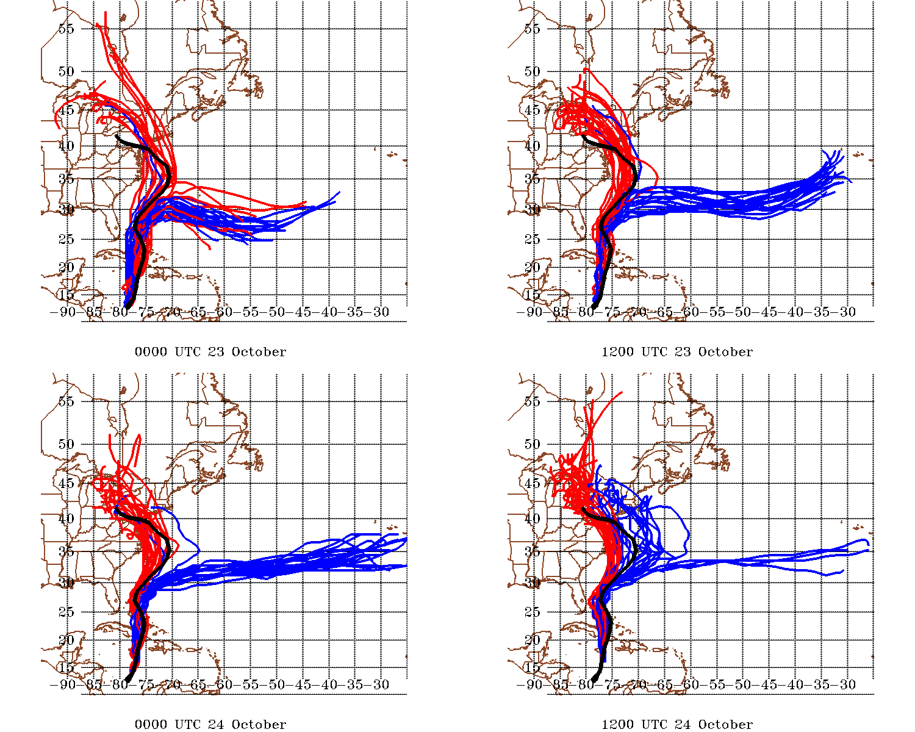
Best Track WRF ECMWF WRF GFS

Slide 7
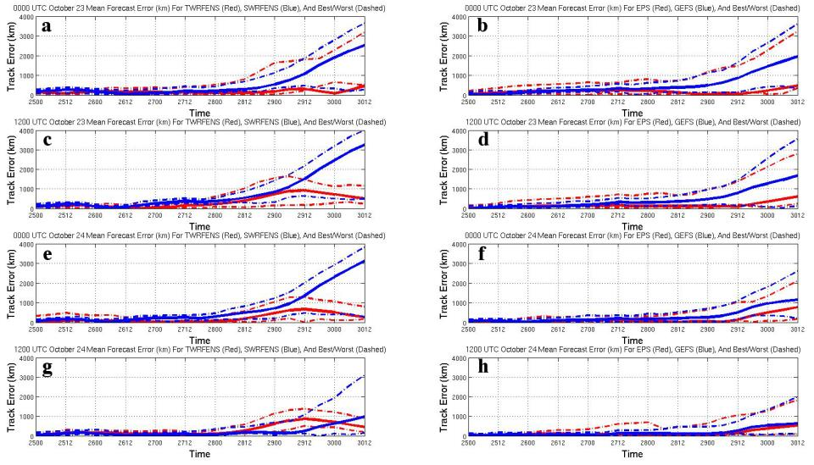
Track Errors for WRF Ensembles (left) and Operational Ensembles (right)

Slide 8
This behavior can be observed across multiple horizontal grid spacings using a limited area model instead
Columns 1 (30 km), 2 (60 km), and 3 (90 km) are all very similar for a given initialization time
Best Track, ECMWF, GFS, WRF ECMWF, WRF GFS

Slide 9
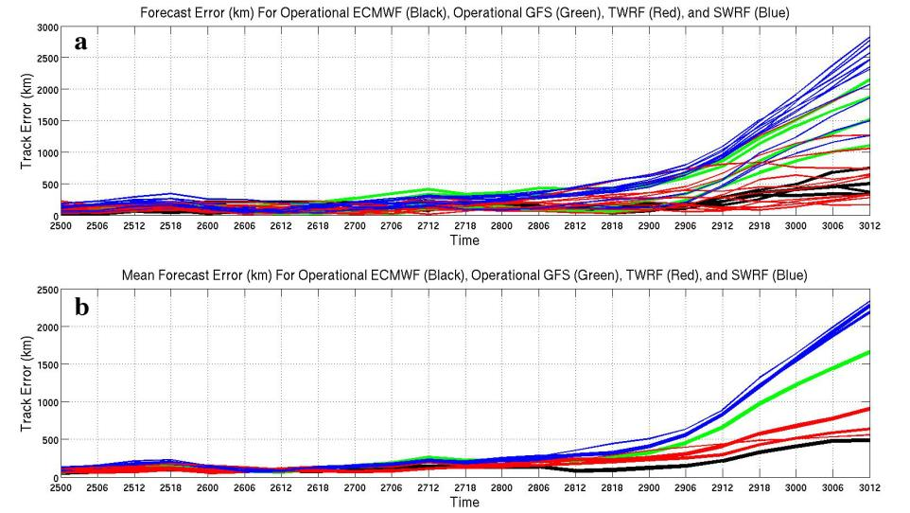
Track Errors for Individual Forecasts

Slide 10
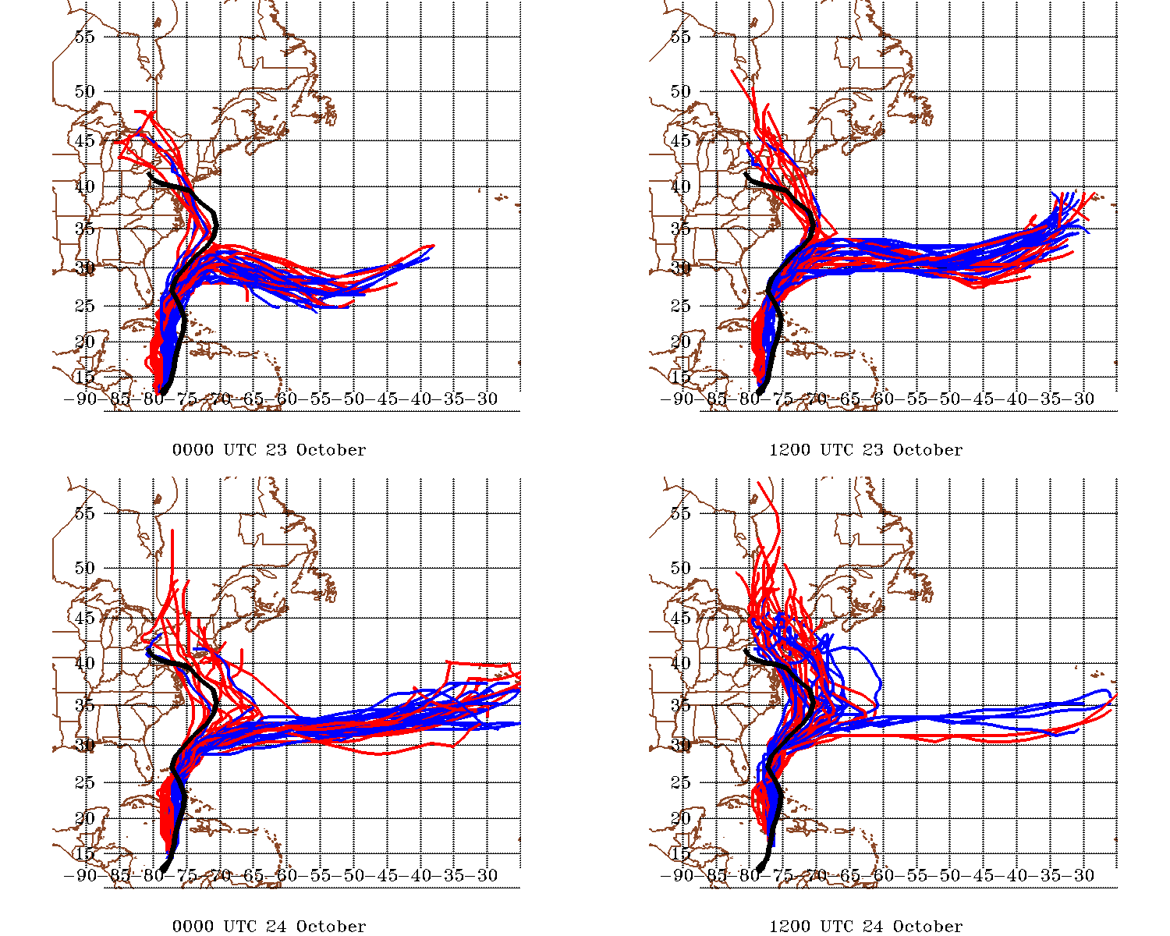
Best Track
WRF OLD GFS WRF GFS

Slide 11
Best Track WRF ECMWF WRF GFS

Slide 12
Major Changes Between GFS CP Iterations
According to (Han and Pan 2011), changes to the deep convection scheme were made, in order to reduce ‘grid-point storms’
“For deep convection, the scheme is revised to make cumulus convection stronger and deeper to deplete more instability in the atmospheric column and result in the suppression of the excessive grid-scale precipitation” (Han and Pan 2011)
One way to scale back (or exaggerate) this change is to modify the amount of sub-cloud entrainment for deep convective clouds
More entrainment than the default allows the CP to create less/shorter clouds, while less entrainment allows more/deeper clouds

Slide 13
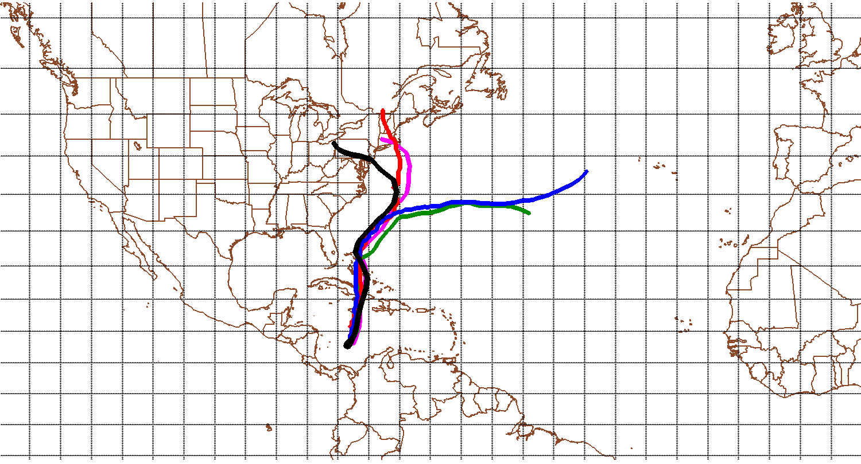
All entrainment-modified simulations use the domain shown below
All simulations use a 30 km horizontal grid spacing, and the 1200 UTC 23 October GFS operational forecast for initial and boundary conditions
For reference, shown here is the Best Track, GFS, ECMWF, WRF GFS, and WRF ECMWF

Slide 14
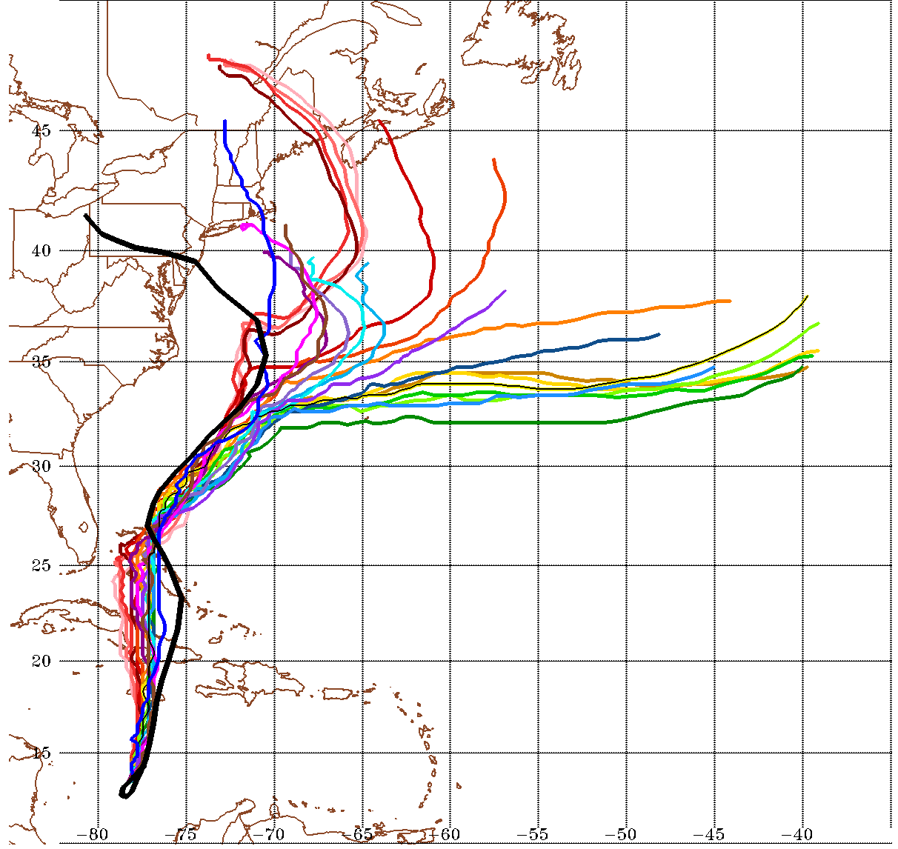
The default entrainment of .10 is modified over a series of recreated WRF GFS simulations
Values from .01 through .30 are used for the recreated fake GFS simulations (all else held constant)
Best Track, WRF ECMWF

Slide 15
A tri-modal distribution of forecast tracks occurs when these forecasts are analyzed together, with the tracks clustering according to different entrainment values

Slide 16
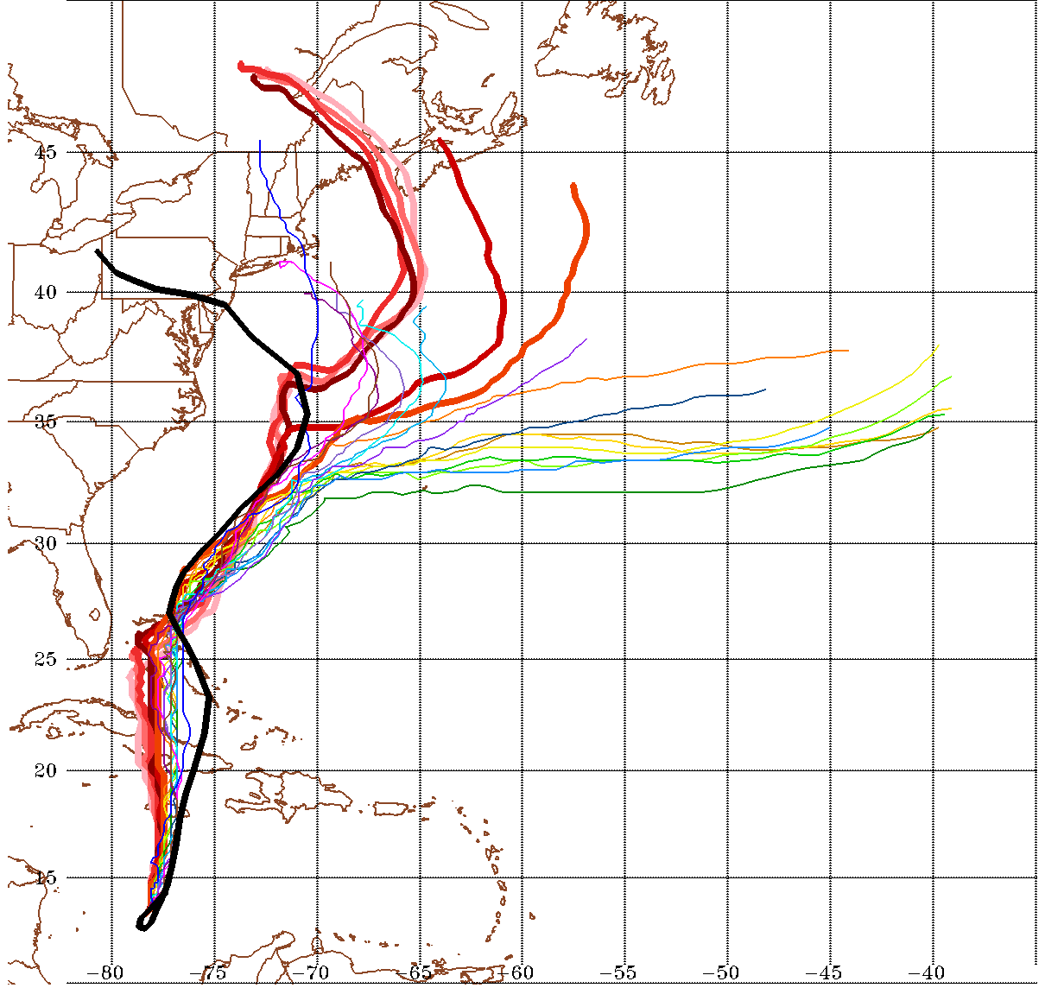
Warm colored tracks (values between .01 and .06) take a northward track

Slide 17
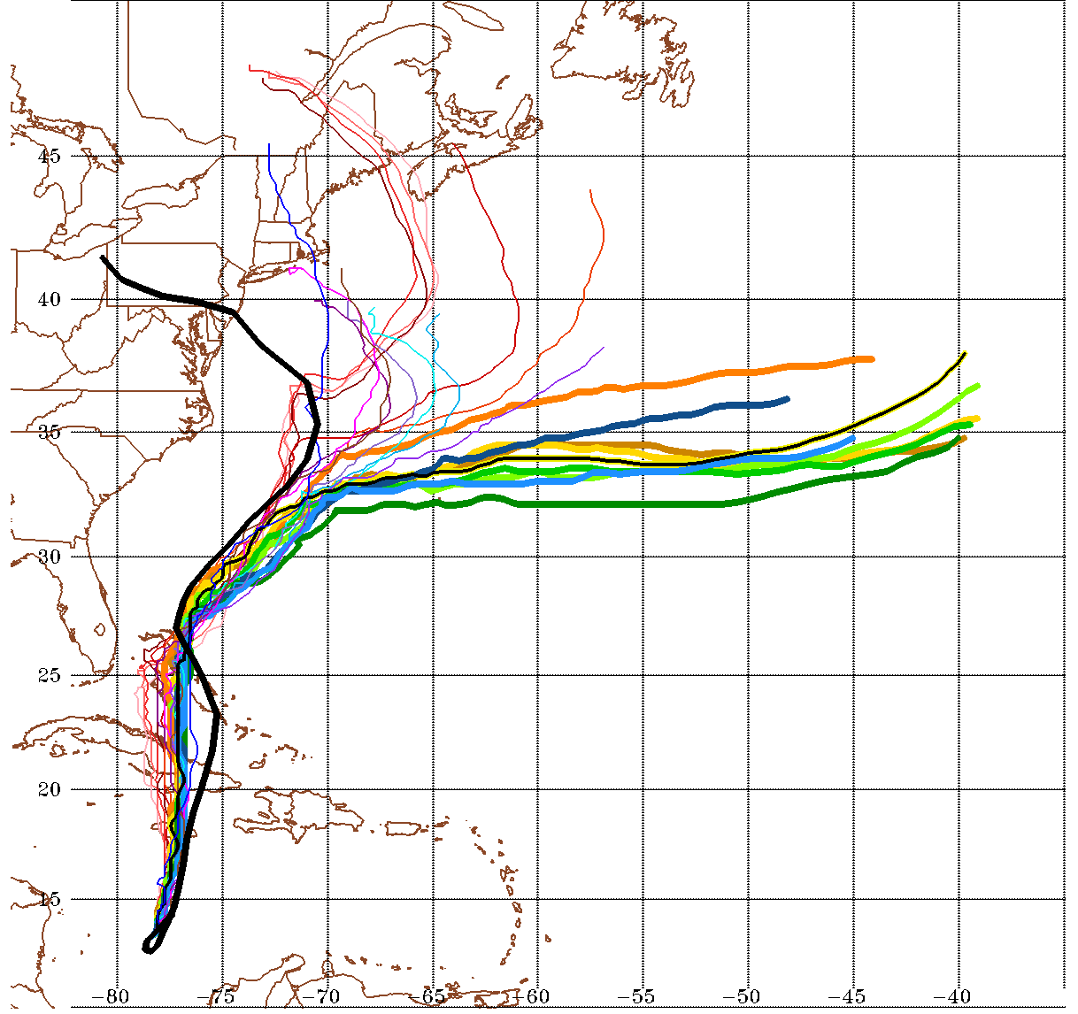
Values between .07 - .15 follow a track very similar to the original WRF GFS (.10, shown in yellow with black inlay)

Slide 18
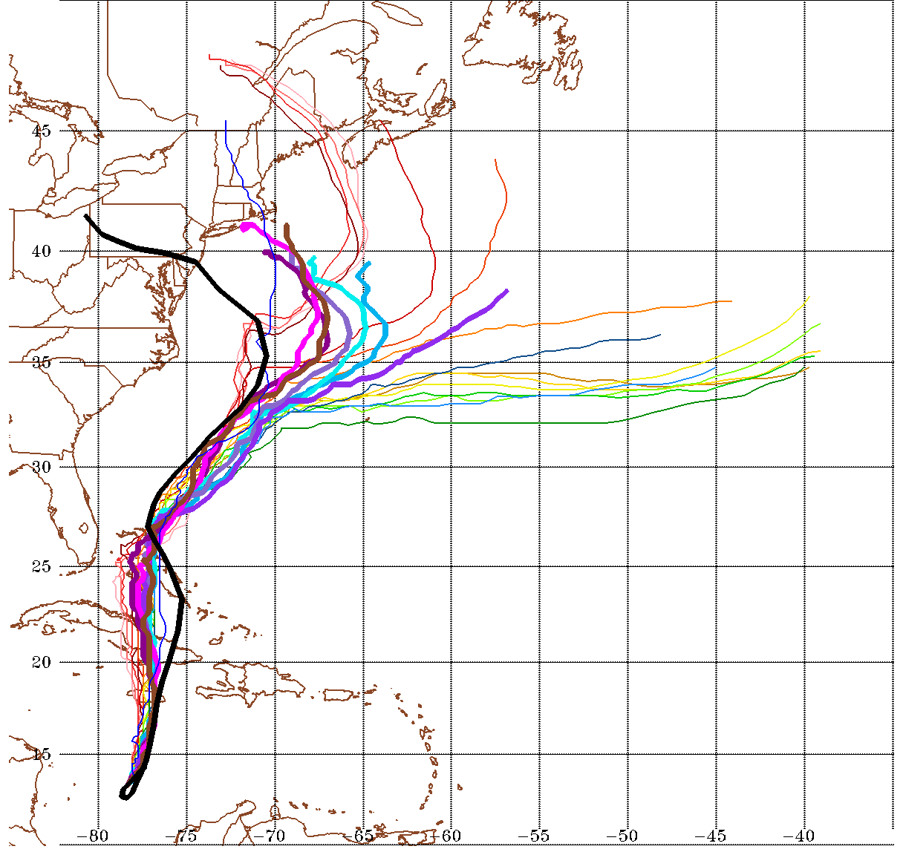
Values of .16 or greater follow a track more similar to that of the WRF ECMWF track

Slide 19
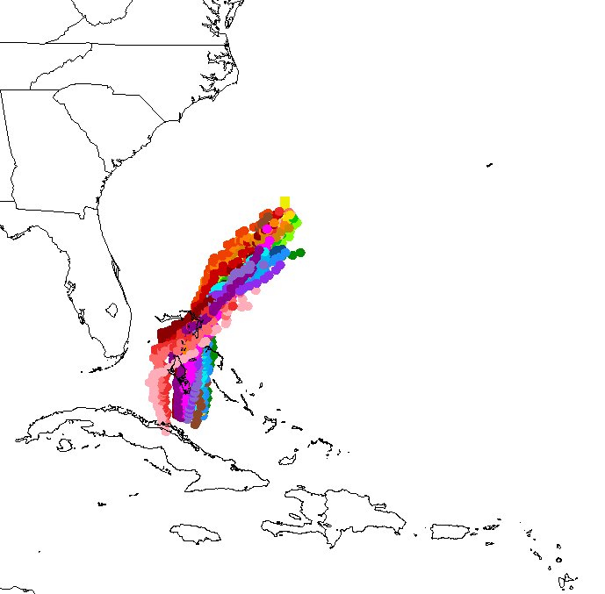
Storm-Centered Composites
For the forecast hours between 50 and 100 (tracks shown at left), storm-centered composites are created (using all forecast hours)
After this is done, the forecasts representing the three track modes are also averaged
1400 UTC 25 October through 1600 UTC 27 October

Slide 20
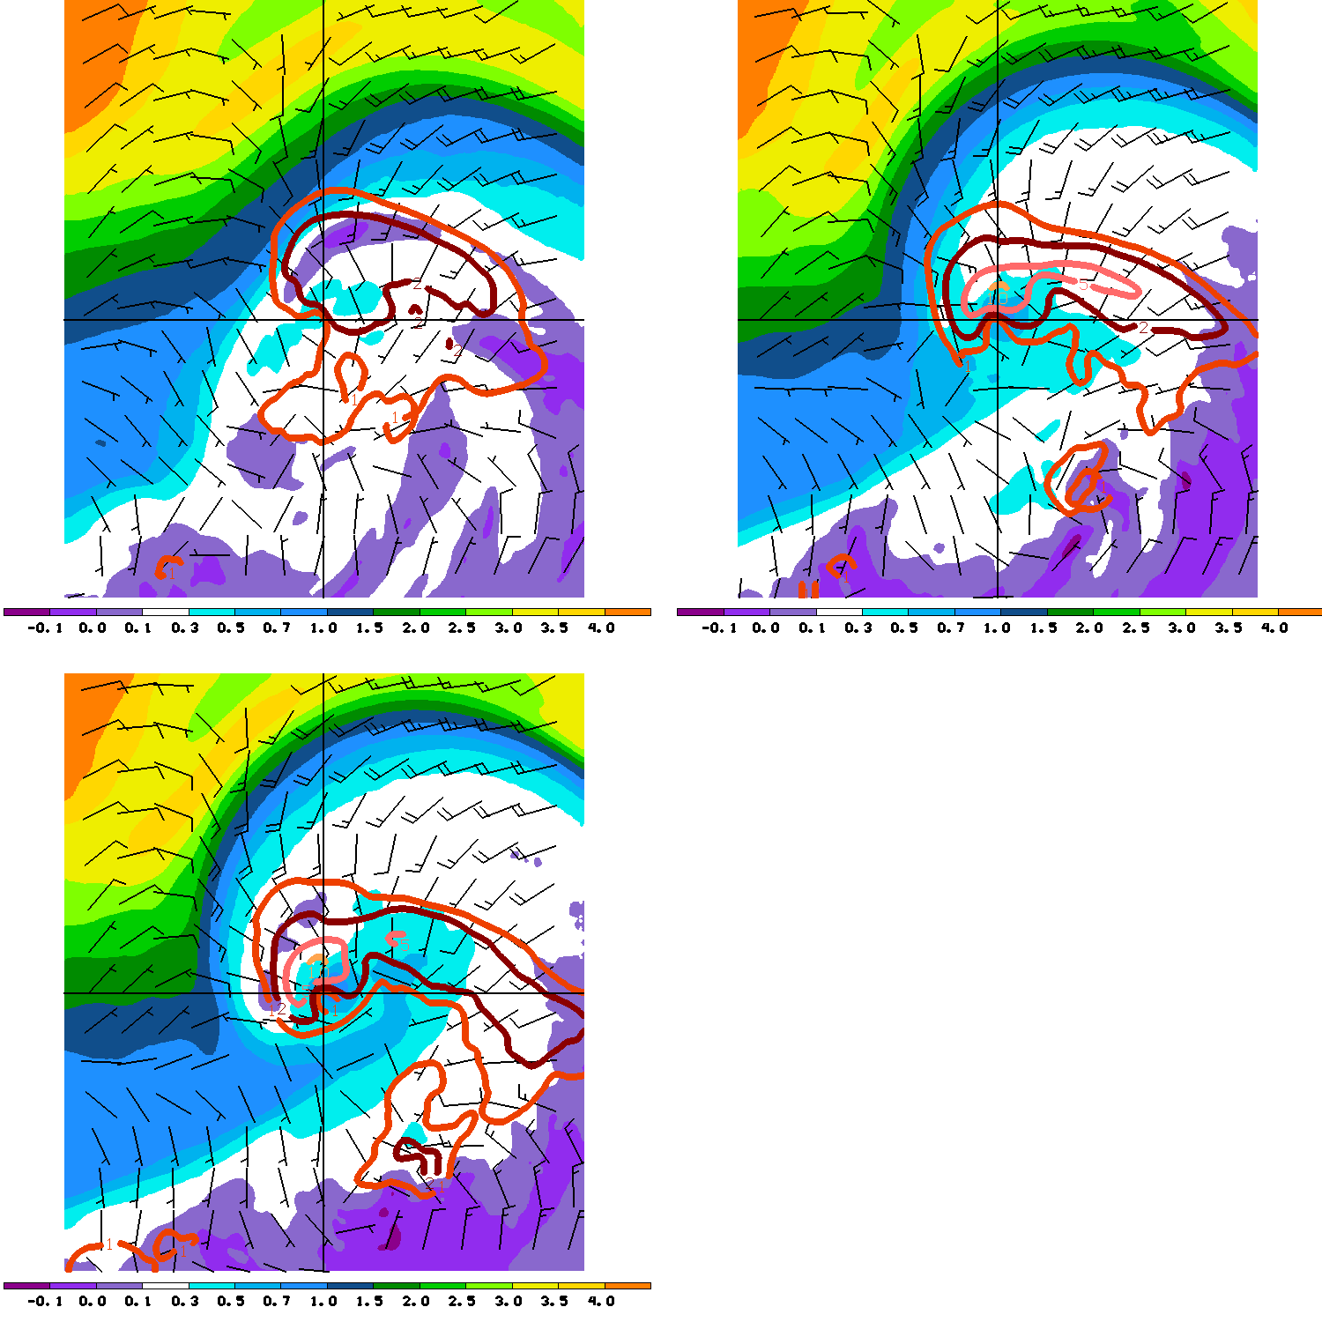
.01-.06 track
GFS-like track
Mean 175 hPa potential vorticity (fill, PVU), mean 200 hPa ageostrophic wind (barbs, m s⁻¹), and mean 1 hour rainfall (contour, mm h⁻¹)
Note the more negative tilt of the lower-left composite as well as the low PV values indicative of diabatic PV erosion
ECMWF-like track

Slide 21
A
A’
Mean 175 hPa potential vorticity (fill, PVU), mean 200 hPa ageostrophic wind (barbs, m s⁻¹), and mean 1 hour rainfall (contour, mm h⁻¹)
Note the more negative tilt of the lower-left composite as well as the low PV values indicative of diabatic PV erosion

Slide 22
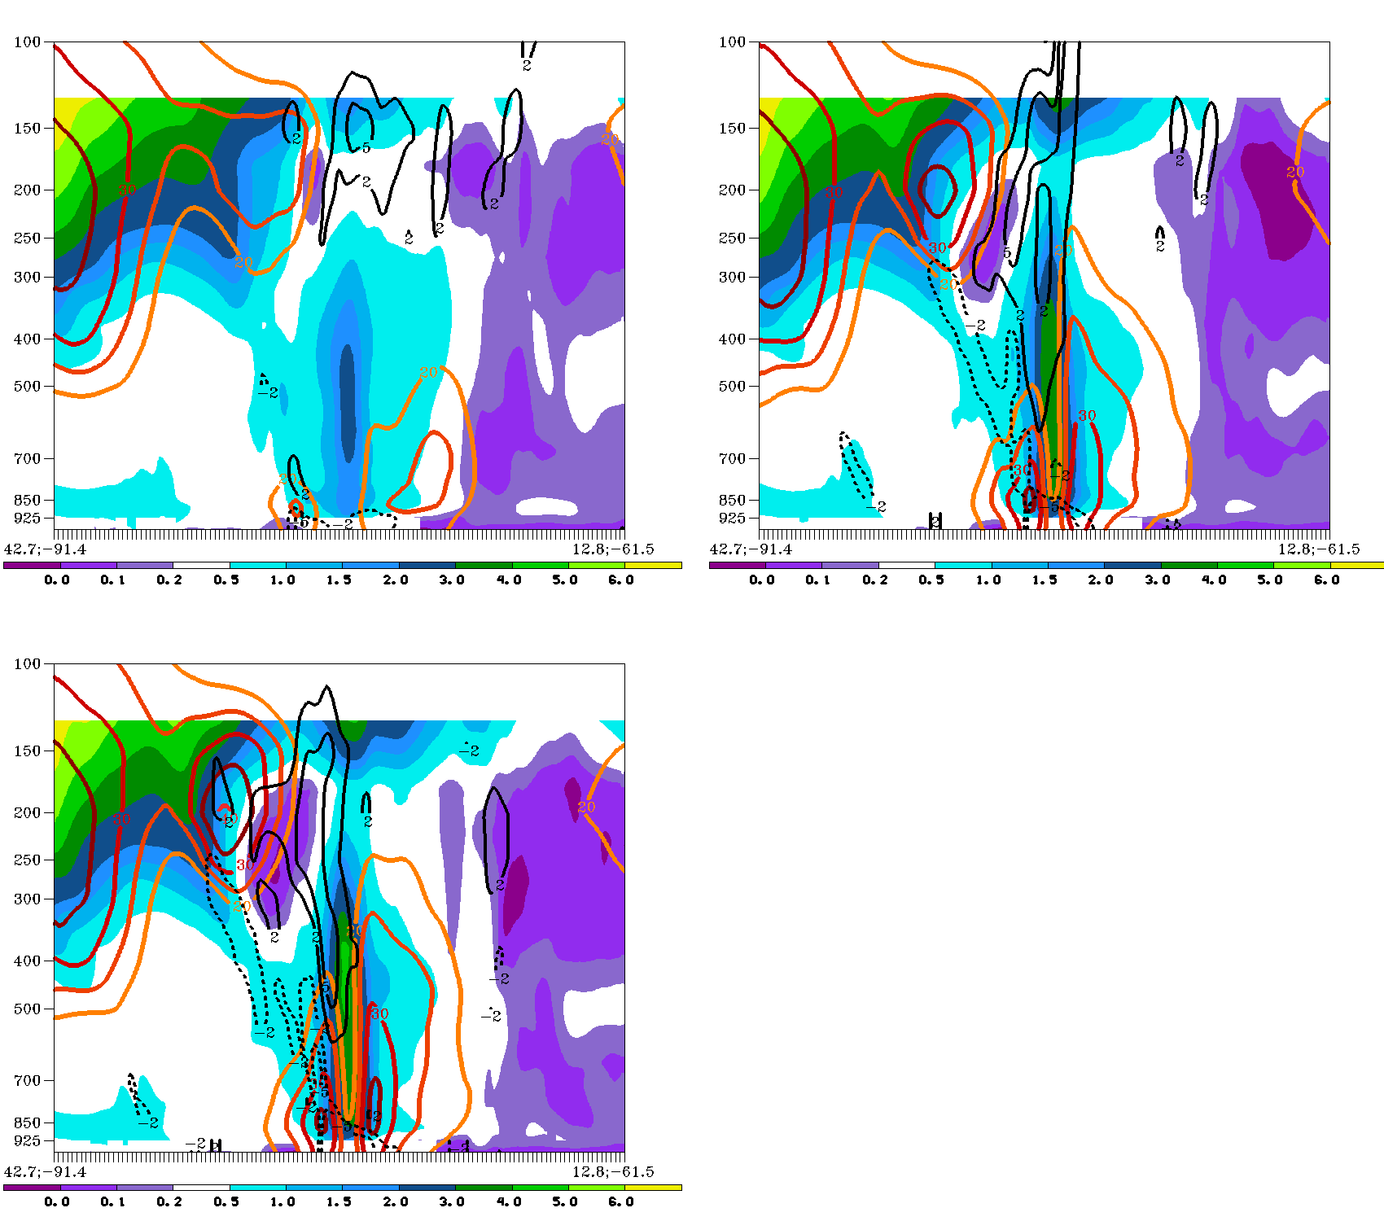
A
A’
A
A’
.01-.06 track
GFS-like track
Mean potential vorticity (fill, PVU), mean magnitude horizontal wind (ms⁻¹,color contour, above 20), and mean smoothed divergence (solid black contour, 10 ⁻⁵ s⁻¹)
Note the intensified upper jet adjacent to diabatically eroded PV and increased divergence in the lower-left composite
A
A’
ECMWF-like track

Slide 23
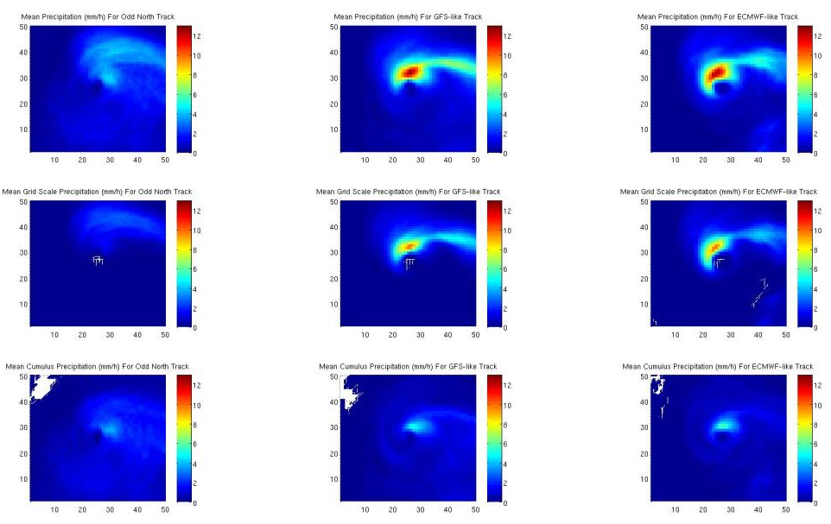
Mean Hourly Precipitation

Slide 24
Mean Hourly Precipitation

Slide 25
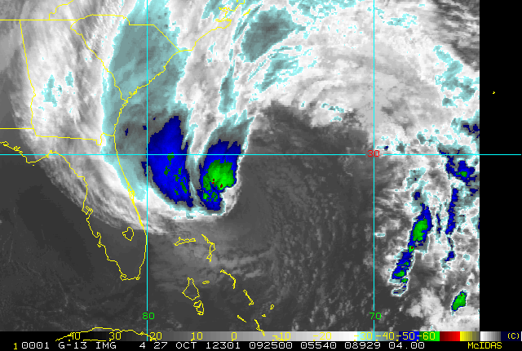

Slide 26
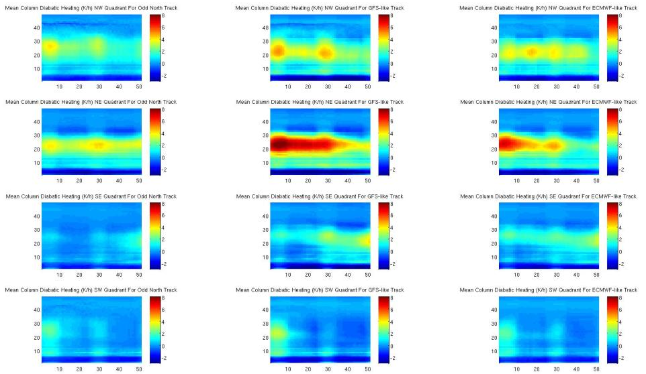
Mean Hovmöller of Total Diabatic Heating By Quadrant (K/h)
NW
NE
SE
SW
NW
NE
SE
SW

Slide 27
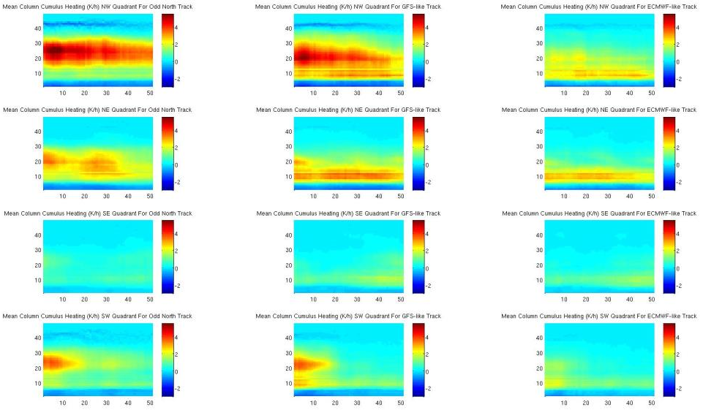
Mean Hovmöller of CP Diabatic Heating By Quadrant (K/h)
NW
NE
SE
SW
NW
NE
SE
SW

Slide 28
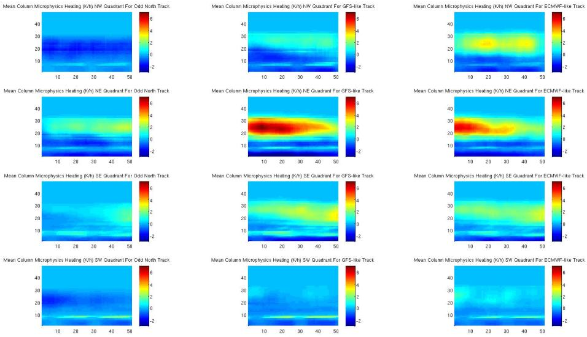
Mean Hovmöller of MP Diabatic Heating By Quadrant (K/h)
NW
NE
SE
SW
NW
NE
SE
SW

Slide 29
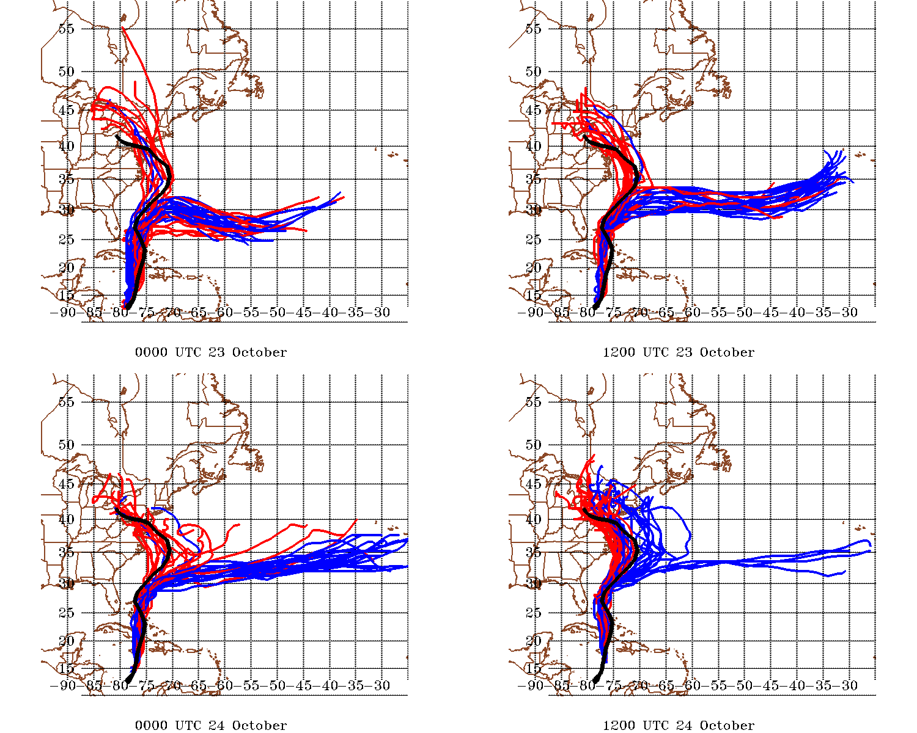
Best Track
“new” WRF GFS (.30)
“old” WRF GFS (.10)

Slide 30
Conclusions
For this case, cumulus parameterization is the dominant driver of forecast track accuracy (by means of altering the distribution of latent heating)
Poor track forecasts by the GFS/GEFS are not “baked in” to the initial conditions, nor are they consequences of the differences in model resolution between the GFS (GEFS) and ECMWF (EPS)
For this case, much improved forecasts are as simple as changing a model constant from .1 to .3
These types of examples serve to emphasize the importance of parameterization development as a necessary condition for forecast improvement

Slide 31
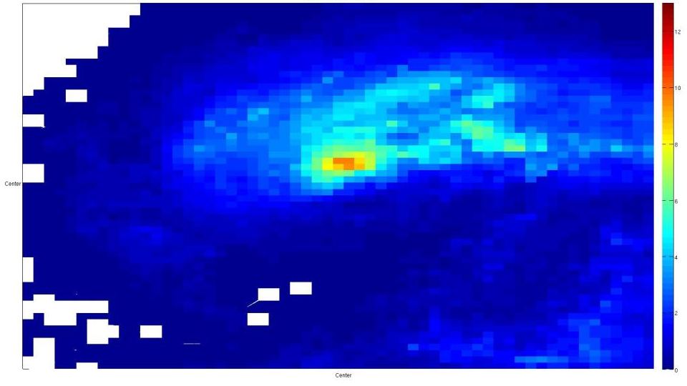

Slide 32
x
y
L
CP Convection
When entrainment is small, (CP induced) deep convection is plentiful, and is very efficient at removing instability over a deep atmospheric column, which makes grid-scale condensation less likely
z
x, y

Slide 33
x
Some instability remains
y
L
CP Convection
When entrainment is large, (CP induced) deep convection is not plentiful, and is only efficient at removing instability over a shallow atmospheric column, which makes grid-scale condensation more likely
z
x, y

Slide 34
Upper-level forcing for ascent (approaching trough, jet entrance, etc.)
Grid-Scale condensation
L
x
y
z
When entrainment is large, (CP-induced) deep convection is not plentiful, and is only efficient at removing instability over a shallow atmospheric column, which makes grid-scale condensation more likely
x, y

Slide 35
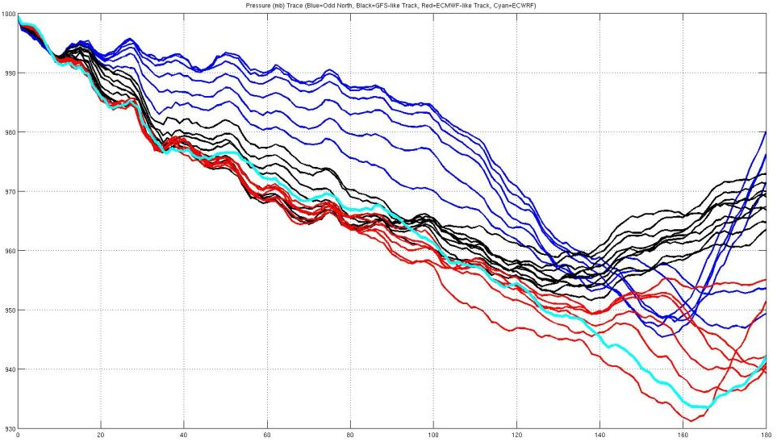
Pressure Trace

Slide 36
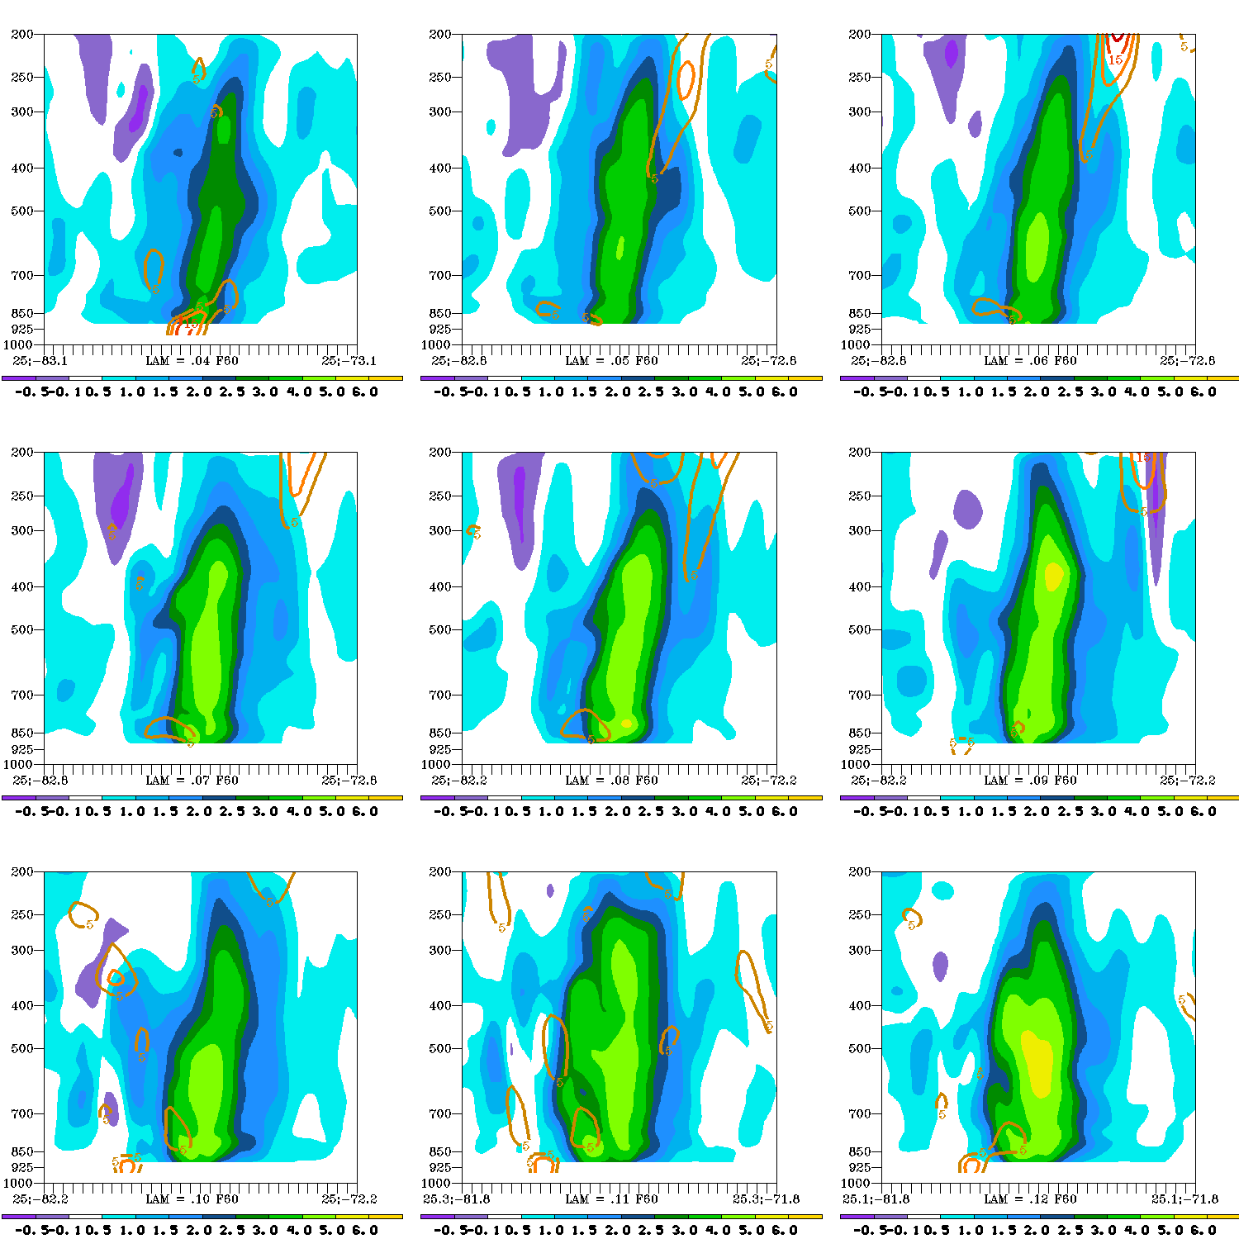
.04 | .05 | .06
.07 | .08 | .09
.10 | .11 | .12
A 10° west-to-east cross-section of potential vorticity (PVU) and smoothed divergence (10⁻⁵/s)

Slide 37
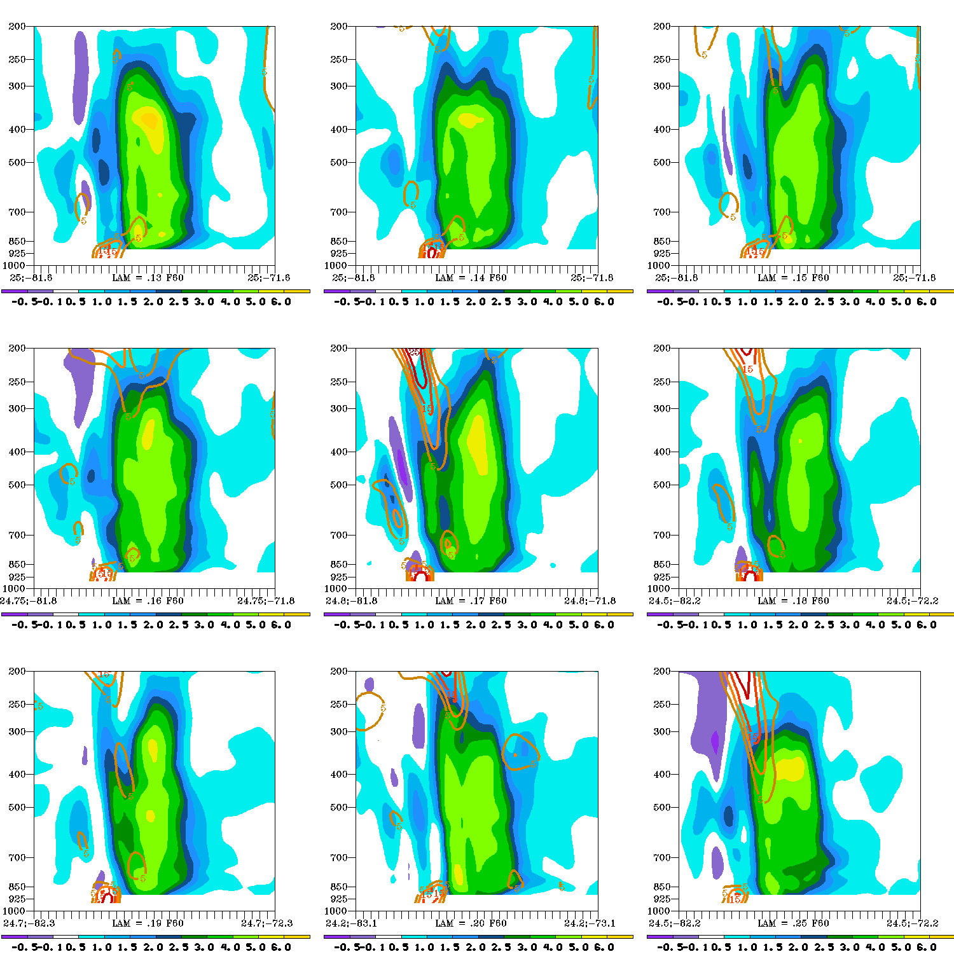
.13 | .14 | .15
.16 | .17 | .18
.19 | .20 | .25
A 10° west-to-east cross-section of potential vorticity (PVU) and smoothed divergence (10⁻⁵/s)

Slide 38
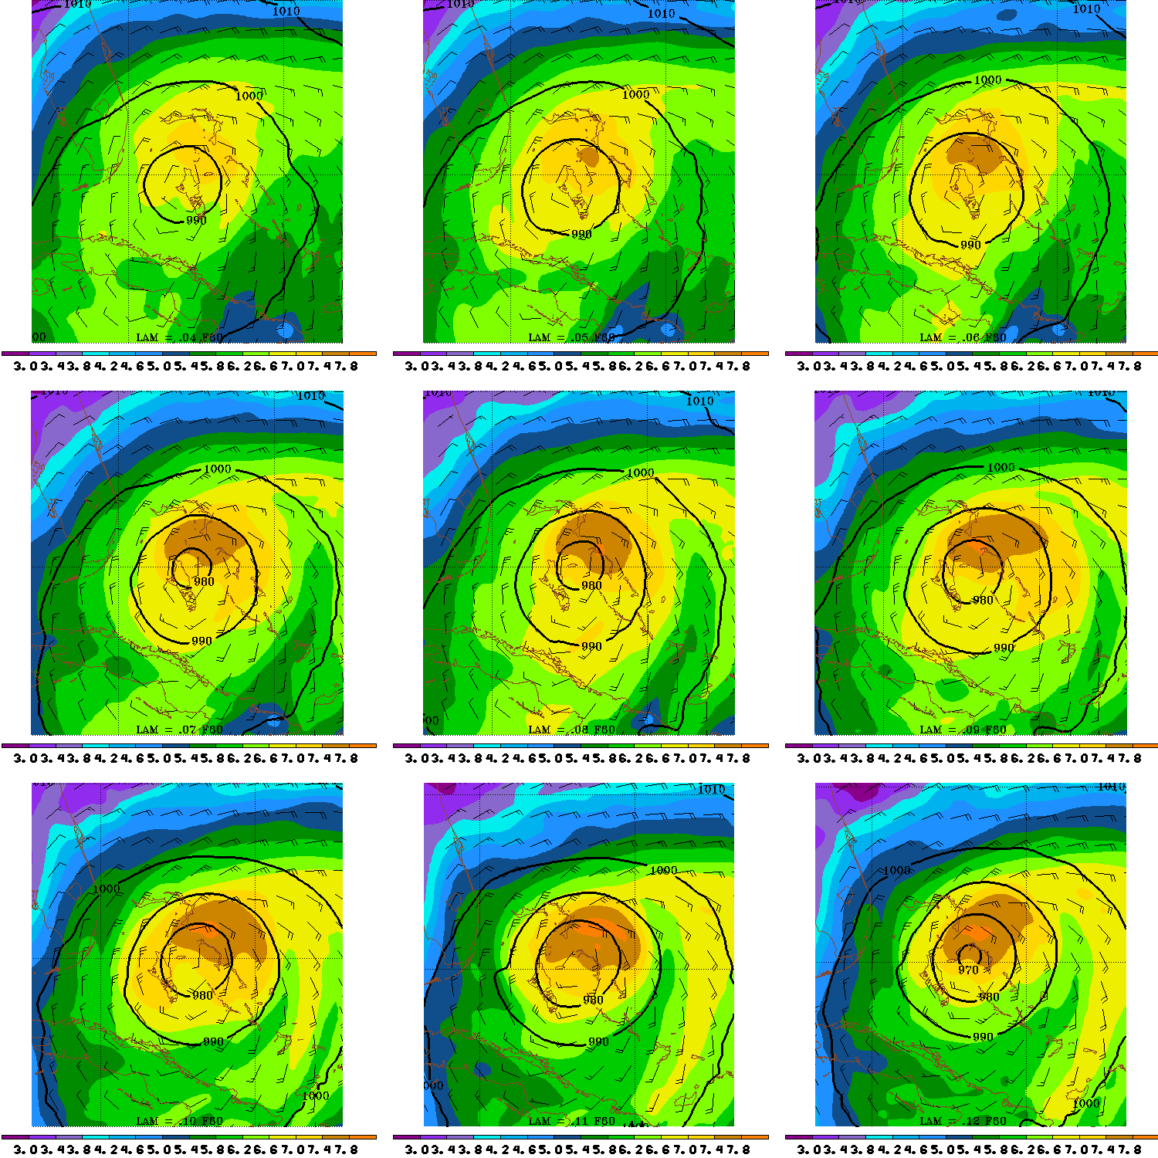
.04 | .05 | .06
.07 | .08 | .09
.10 | .11 | .12
10°x10° Precipitable Water (cm), sea level pressure, and surface winds
Scale goes from 3 cm to 7.8 cm

Slide 39
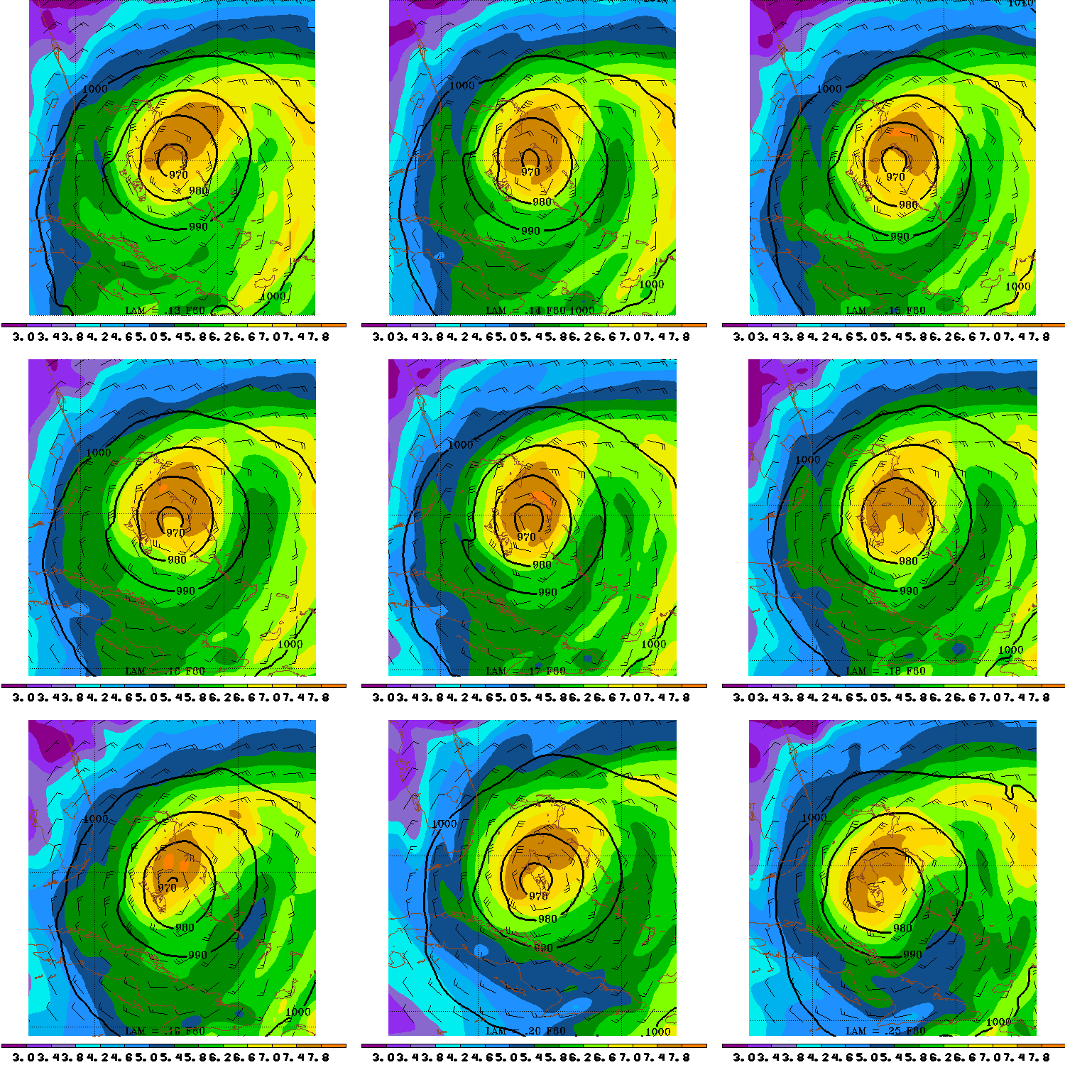
.13 | .14 | .15
.16 | .17 | .18
.19 | .20 | .25
10°x10° Precipitable Water (cm), sea level pressure, and surface winds
Scale goes from 3 cm to 7.8 cm

Slide 40
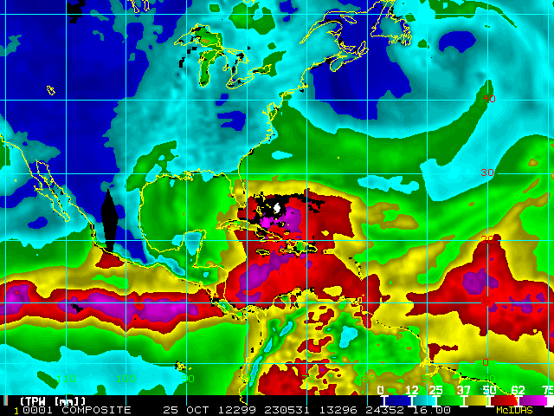

Slide 41
Questions/Answers
Can a single set of initial conditions and one dynamical core (WRF) reproduce observed forecast tracks from two global models? Definitely yes.
Why is this possible? Rather than differences being due to resolution or initial conditions, differences arise from CP formulation
What is the critical difference? It appears to be due to placement of heating in the vertical (CP+MP), specifically such that coupling to the approaching upper trough/jet is sufficient
Further questions (probably not appropriate for this specific study):
  Are the global model tracks reproducible for other storms using this technique, and if so, what does that imply for (TC) forecasting?
  Does the current GFS rely on the CP too much and the MP too little? Would altering the CLAM parameter improve other forecasts?

Slide 42
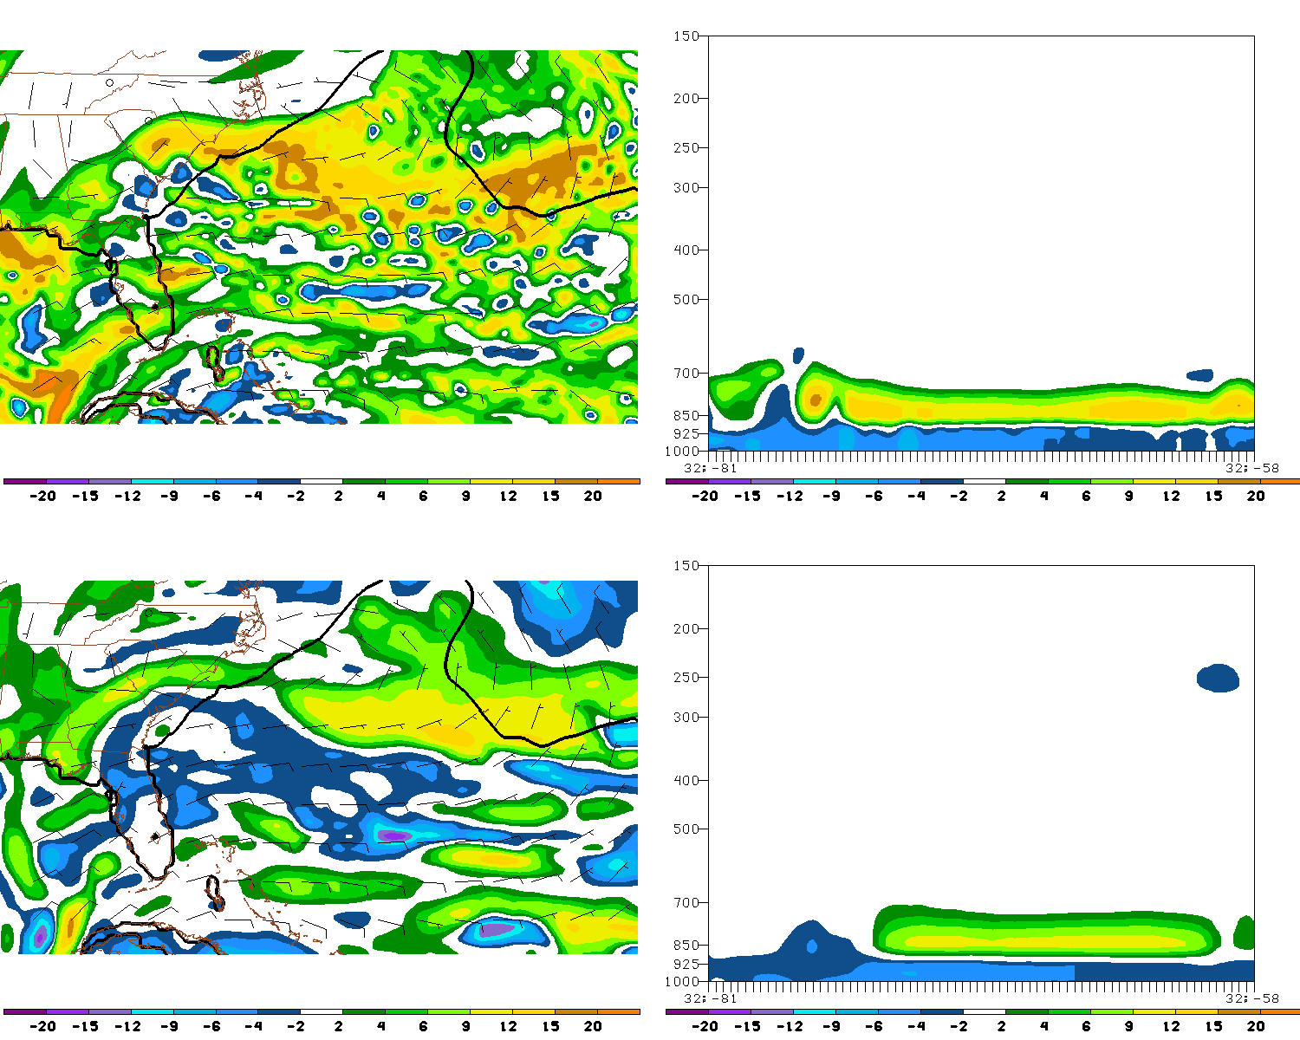
Shown to the left are the 850 hPa theta-e differences between fake ECMWF and fake GFS (top) and real ECMWF and real GFS (bottom). Also on those plots are the 10 m winds and the 26° SST isotherm. All data is from forecast hour 30.
Shown on the right are cross-sections of the respective theta-e differences along the line indicated to the left

Slide 43
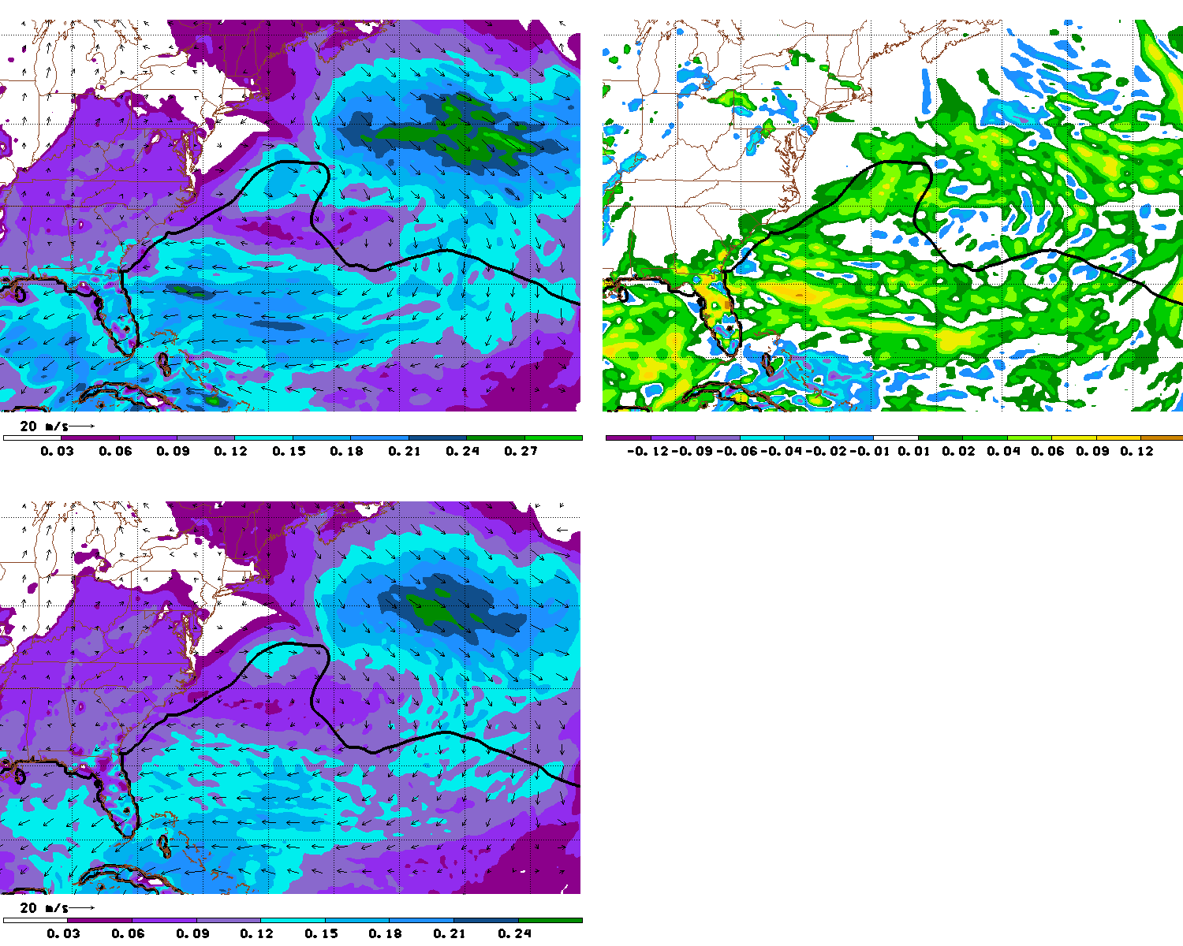
Shown at left is surface moisture flux (g/m²) for fake ECMWF (top) and fake GFS (bottom). Also shown are the 10 m wind vectors and the 26° SST isotherm.
Shown above is the difference in surface moisture flux as well as (fake ECMWF-fake GFS). All data is from forecast hour 30, as in the previous slide the 26° SST isotherm.
Note that the enhancement of the surface moisture flux is coincident with the theta-e differences shown earlier.

Slide 44
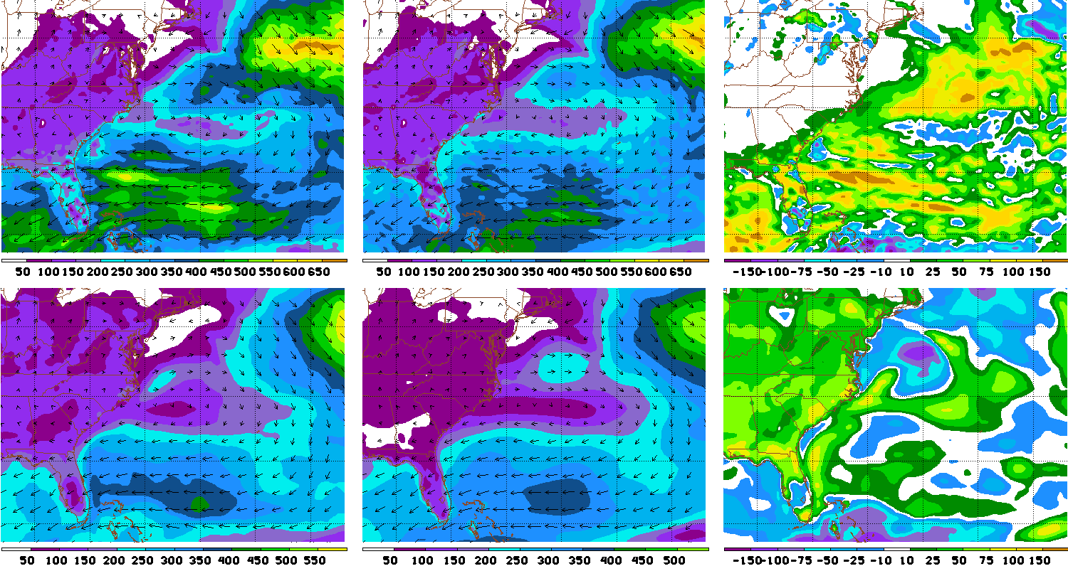
Latent Heat Flux from surface at hour 27 :
Fake ECMWF Fake GFS Difference
Real ECMWF Real GFS Difference

Slide 45
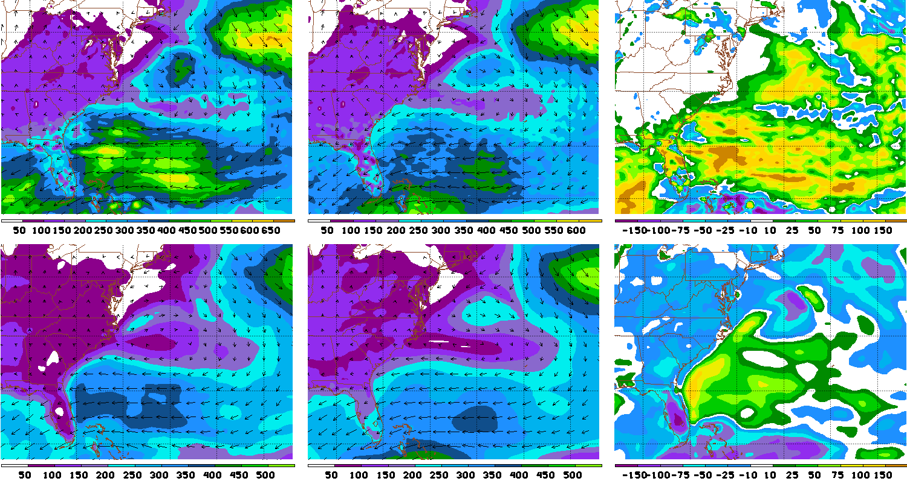
Latent Heat Flux from surface at hour 39 :
Fake ECMWF Fake GFS Difference
Real ECMWF Real GFS Difference

Slide 46
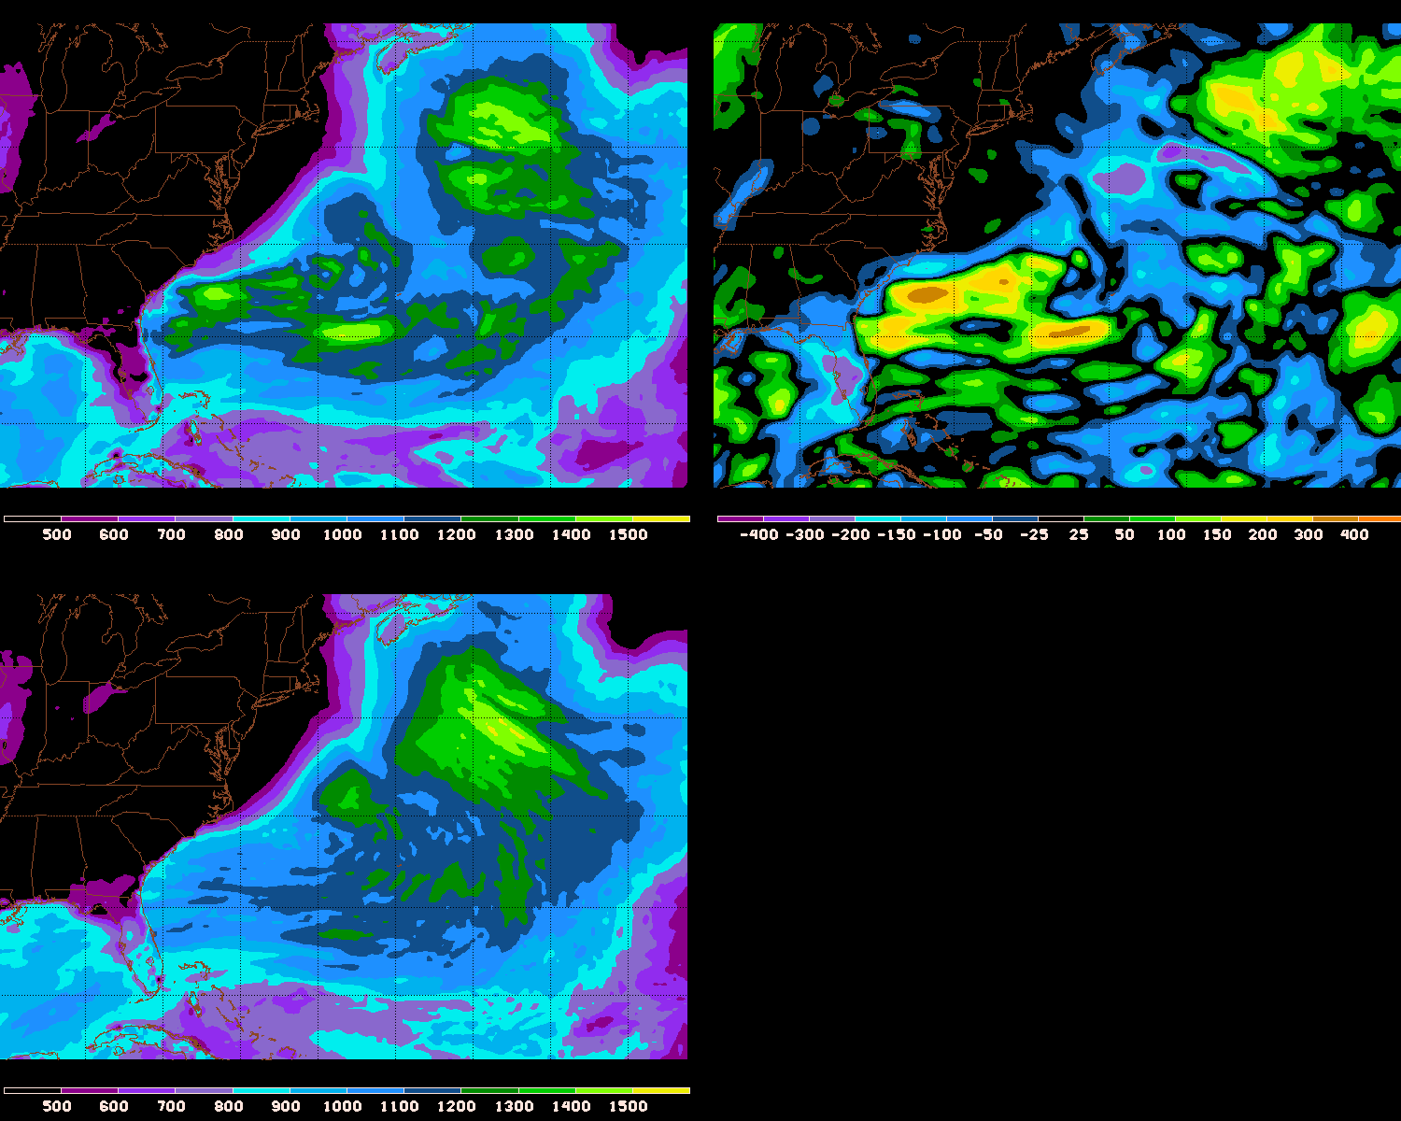
PBL Height Difference, mean 06-42 hours

Slide 47
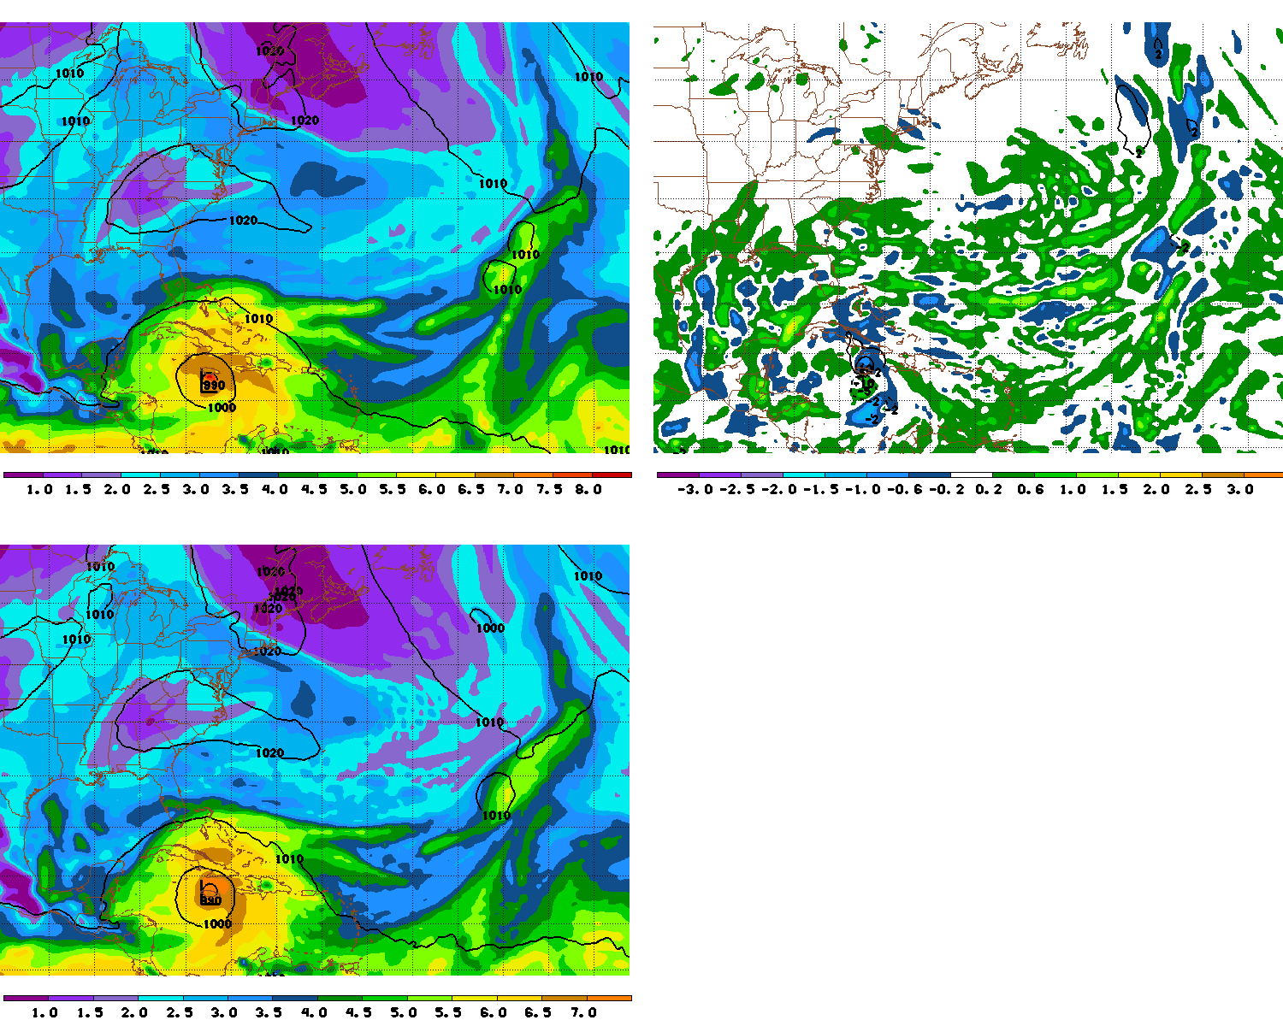
Shown at left is precipitable water (cm) for fake ECMWF (top) and fake GFS (bottom). Also shown is sea-level pressure.
Shown above is the difference in precipitable water as well as sea-level pressure (fake ECMWF-fake GFS). All data is from forecast hour 30, as in the previous slides.
Note the positive precipitable water anomalies to the north of the cyclone

Slide 48
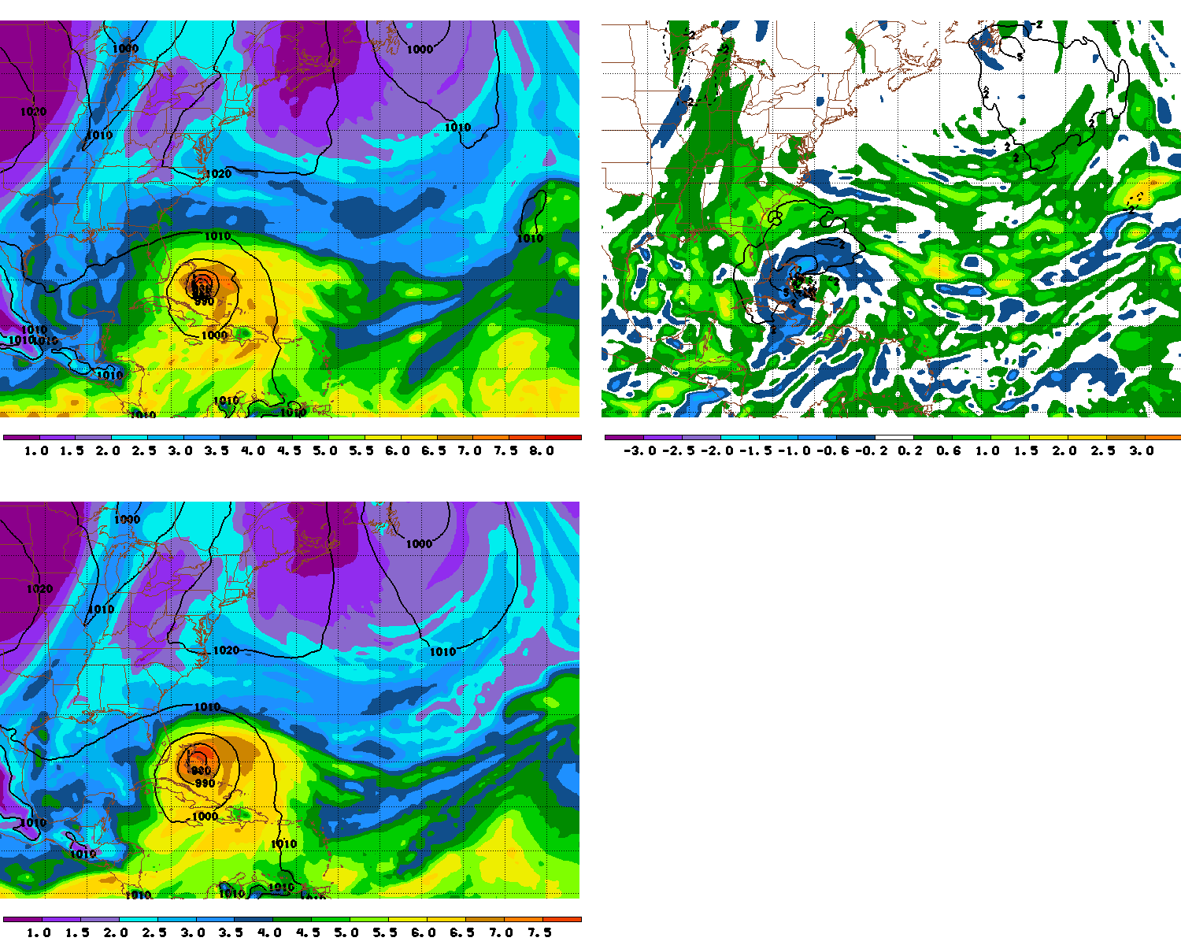
Shown at left is precipitable water (cm) for fake ECMWF (top) and fake GFS (bottom). Also shown is sea-level pressure.
Shown above is the difference in precipitable water as well as sea-level pressure (fake ECMWF-fake GFS). All data is from forecast hour 60.
Note the positive precipitable water anomalies have generally rotated to the west of the cyclone

Slide 49
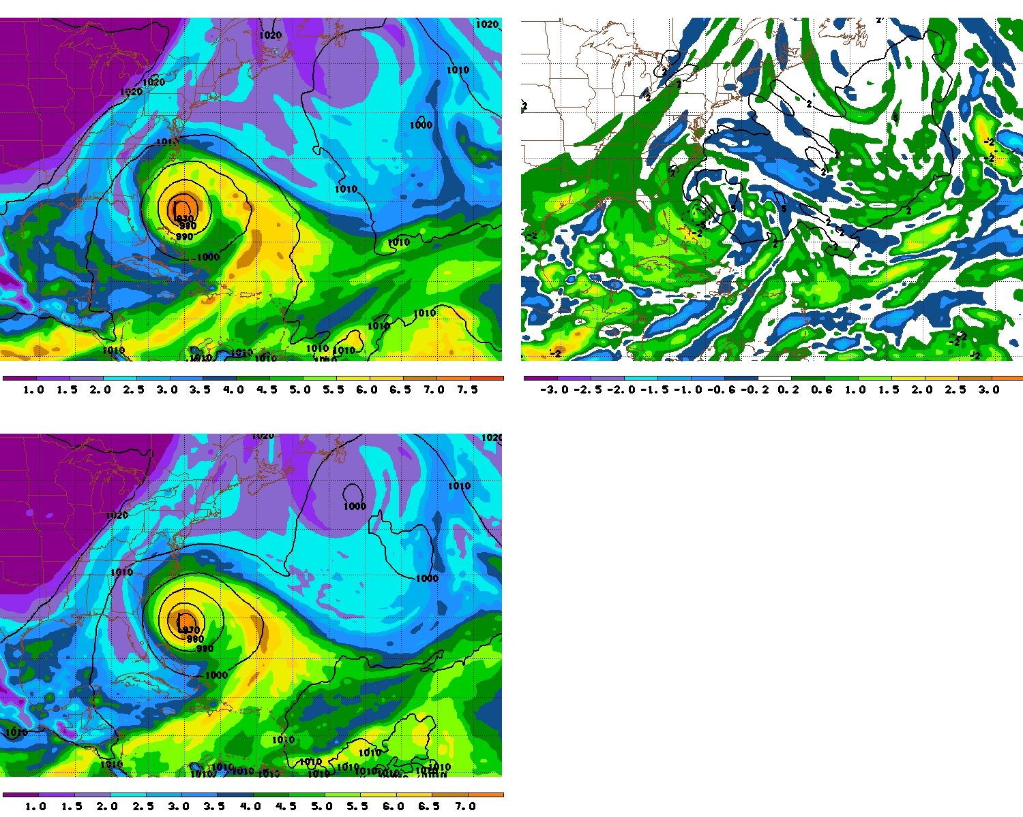
Shown at left is precipitable water (cm) for fake ECMWF (top) and fake GFS (bottom). Also shown is sea-level pressure.
Shown above is the difference in precipitable water as well as sea-level pressure (fake ECMWF-fake GFS). All data is from forecast hour 90.
Note the positive precipitable water anomalies have generally rotated to the southwest of the cyclone near the center

Slide 50
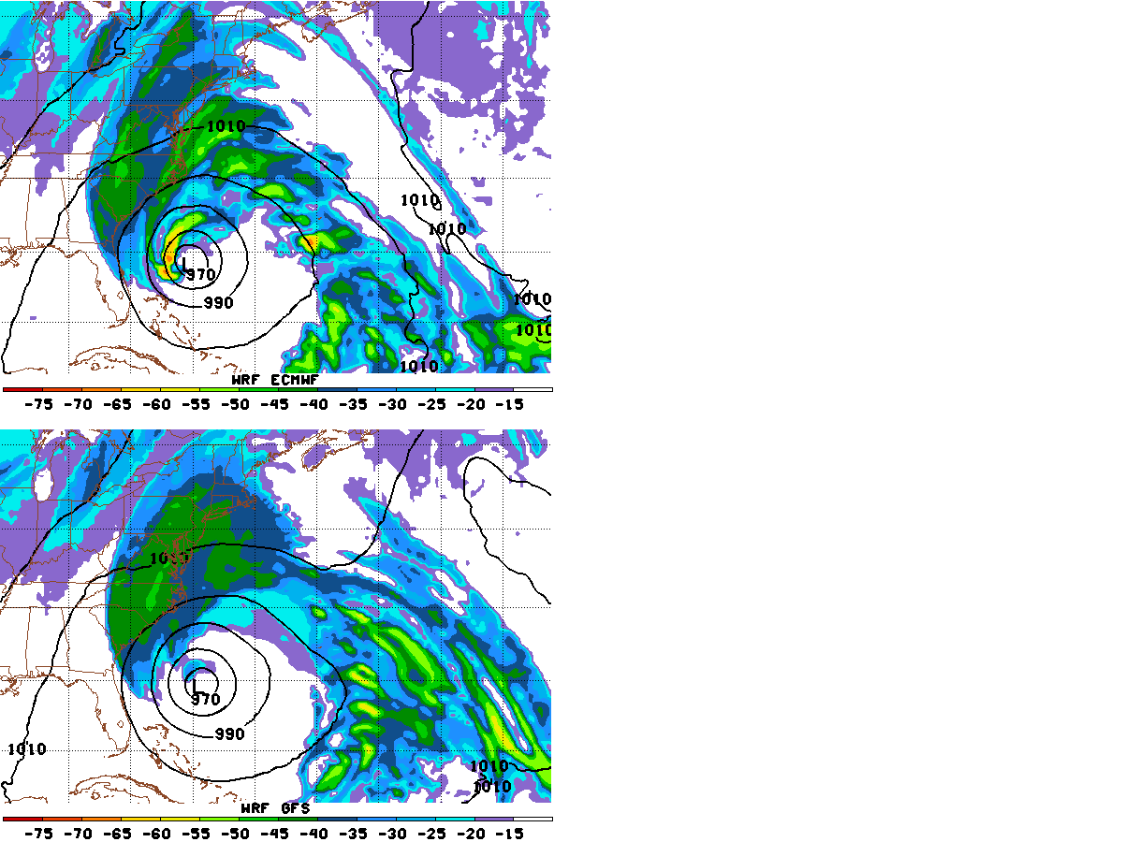
Shown at left are model-generated IR imagery for fake ECMWF (top) and fake GFS (bottom). Also shown is sea-level pressure. All data is from forecast hour 93. Shown above is an IR image¹ from the same time (09 UTC on the 27th)
Note the extremely well-reproduced convection near the cyclone center in the fake ECMWF
¹http://rammb.cira.colostate.edu/products/tc_realtime/products/storms/2012AL18/4KMIRIMG/2012AL18_4KMIRIMG_201210270925.GIF

