Slide 1
GSL Model Sensitivity Studies
A Guide to Removing Unwanted Mountain Ranges and Water Bodies

Slide 2
Goals
Analyze the respective roles of the lake and surrounding terrain in Great Salt Lake-Effect events.
Simulate the real conditions as accurately as possible
Create fictitious scenarios as realistically as possible
Remember that there are synergistic interactions between lake and orographic processes, and complete factor separation is impossible.

Slide 3
Basic Model Configuration
ADVERTISEMENT
Modelers hate him
Salt Lake City man discovers new trick to remove terrain in WRF. Click here to find out more and download a virus.

Slide 4
Gory Details
WRF Version: 3.1.1
One-way nesting
Cumulus: KFv2 (12- and 4-km domains only)
PBL: YSU
Microphysics: Thompson
LSM: Noah
Radiation: RRTM – SW and LW

Slide 5
Model Initialization
Boundary conditions: 12-km, 6-h NAM analysis
General problem: this is the NAM analysis
Specifically:
Moist bias at low levels
Salt Lake is not “salty”
Snow cover analysis is poor
Lake temperature is off by at least 10°C
USGS land use has permanent ice on the salt flats

Slide 6
A pinch of salt
! (FROM: module_sf_sfclay.F)
! MODIFIED 30 MAR 2011 BY TREVOR ALCOTT
! TO REDUCE SATURATION VAPOR PRESSURE OVER GSL
! FOLLOWING ONTON AND STEENBURGH 2001
! WATER POINTS IN THE INNERMOST DOMAIN
if (( ite .GT. 185.00 ) .and. ( xland(i) .GT. 1.5 )) then
! GREAT SALT LAKE POINTS
if ((i .gt. 100.00) .and. (i .lt. 180.00) .and. &
(j .gt. 120.00) .and. (j .lt. 215.00)) then
if (j .gt. 168.00) then
! NORTH ARM – Es reduced by 33%
SVP1=0.67*SVP1
else
! SOUTH ARM – Es reduced by 8%
SVP1=0.92*SVP1
endif
endif
else
! ALL OTHER POINTS
SVP1=SVP1
end if
E1=SVP1*EXP(SVP2*(TGDSA(I)-SVPT0)/(TGDSA(I)-SVP3))

Slide 7
Model Initialization: Snow Cover
Adjusted based on SNOTel and satellite imagery:
snowc: binary snow cover (1=snow, 0=no snow)
snow: mm of snow-water equivalent
snowh: snow depth in m
! (FROM: module_initialize_real.f)
! Set snow depth, SWE and cover
!
if ( ( grid%xlat(i,j) .GT. 39.5 ) .and. &
( grid%xlat(i,j) .LT. 43.5 ) .and. &
( grid%xlong(i,j) .GT. -115.5 ) .and. &
( grid%xlong(i,j) .LT. -108.0 ) ) then
if ( grid%ht(i,j) .LT. 1900 ) then
grid%snowc(i,j) = 0.0
grid%snow(i,j) = 0.0
grid%snowh(i,j) = 0.0
else if (( grid%ht(i,j) .GE. 1900 ) .and. &
( grid%ht(i,j) .LE. 2900 )) then
grid%snowc(i,j) = 1.0
grid%snow(i,j) = ( grid%ht(i,j) - 1900. ) / 20.
grid%snowh(i,j) = ( grid%snow(i,j) * ( grid%ht(i,j) - 900. )) / 200000.
else if ( grid%ht(i,j) .GT. 2900 ) then
grid%snowc(i,j) = 1.0
grid%snow(i,j) = 50.0
grid%snowh(i,j) = 0.5
endif
endif

Slide 8
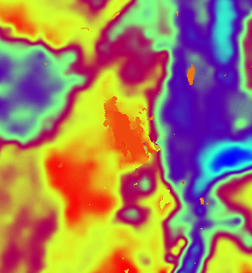
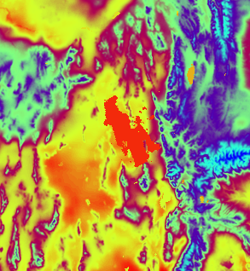
Model Initialization: Lake Temperature
NAM Analysis:
Modified based on MODIS:
285.3 K in met_em files
286.5 K in first wrfout file
! (FROM: module_initialize_real.f)
! Set GSL Temp
!
if ( ( grid%xlat(i,j) .gt. 38.0 ) .and. &
( grid%xlat(i,j) .lt. 43.0 ) .and. &
( grid%xlong(i,j) .gt. -120.0 ) .and. &
( grid%xlong(i,j) .lt. -110.0 ) .and. &
( grid%ivgtyp(i,j) .eq. 16 ) ) then
! print*,'at ijk ',i,' ',j,' ',k
! print*,'sst changed from ',grid%tsk(i,j)
grid%tsk(i,j) = 286.5
grid%sst(i,j) = 286.5
! print*,'to ',grid%tsk(i,j)
endif

Slide 9
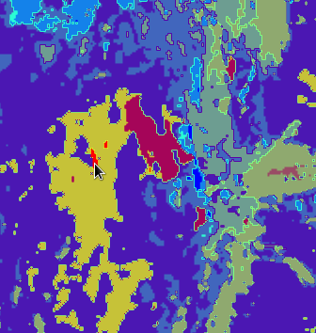
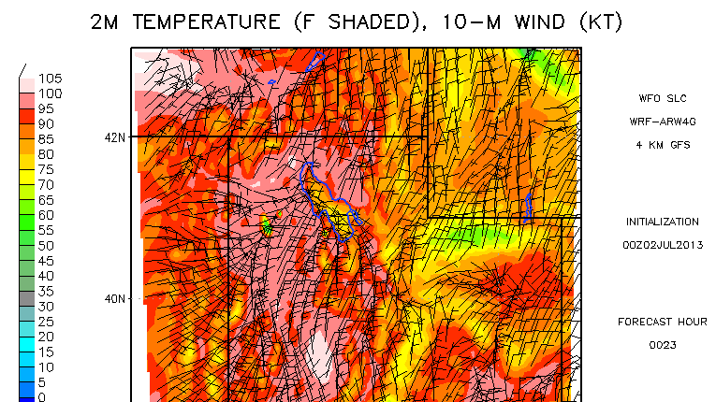
The Salt Flats Glacier
! (FROM: module_initialize_real.f)
! Fix stupid Salt Flats glacier... seriously, WTF??
!
if ( ( grid%xlat(i,j) .gt. 39.0 ) .and. &
( grid%xlat(i,j) .lt. 42.0 ) .and. &
( grid%xlong(i,j) .gt. -115.0 ) .and. &
( grid%xlong(i,j) .lt. -112.0 ) .and. &
( grid%ivgtyp(i,j) .eq. 24 ) ) then
print*,'at ijk ',i,' ',j,' ',k
print*,'ice changed to playa'
grid%ivgtyp(i,j) = 19
grid%lu_index(i,j) = 19
endif

Slide 10
Removing terrain

Slide 11
Removing terrain
! (FROM: smooth_module.F)
if ((ix .GT. 20) .AND. ( ix .LT. 155) .AND. & (iy .GT. 175) .AND. (iy .LT. 310)) then
if ( array(ix,iy,iz) .GT. 1300.00 ) then
array(ix,iy,iz)=array(ix,iy,iz)-0.99*(array(ix,iy,iz)-1300.0)
END if
END if
Flatten to near lake level
Smooth the reduction over 10 grid points to avoid steep slopes
Smooth the corner to avoid steep slopes or narrow valleys

Slide 12
Removing terrain: caveats
Loss of snow cover (if elevation dependent)
Void is filled in with standard atmosphere
Is the volume small enough to not matter?
Is this airmass advected away?
Changes in soil temperature and land use?
Bottom line: perform additional sensitivity studies to examine the effects of these changes
Change the soil temperature, snow cover, etc. without adjusting terrain height

Slide 13
Removing a lake
Not as simple as it sounds
Adjustments were made to the met_em netCDF input files, not in any fortran code
Key fields:
soil type (scbdom/sctdom/soilcbot/soilctop)
land use (lu/landusef)
land/sea mask (landsea/landmask)
soil moisture (sm/sm100200/sm040100 etc.)
soil temperature (st/st100200/st040100 etc.)
albedo (albedo12m)
green fraction (greenfrac)

Slide 14
Removing a lake
Matlab used to adjust values in netCDF files
Method was not elegant
values from adjacent land pixels were smoothed across the lake area
lake surface changed to lu=8 (barren/sparse veg)

Slide 15
Removing a lake: caveats
Is the new land use realistic?
For deep lakes, is the new atmosphere realistic?
Without the lake, initial thermodynamic structure could be much different at low levels
Snow cover in place of water?
Possible effects:
higher wind speeds due to reduced friction
changes to sensible and latent heat fluxes
lake-effect precipitation, lake/land breezes, downstream effects due to airmass modification

Slide 16
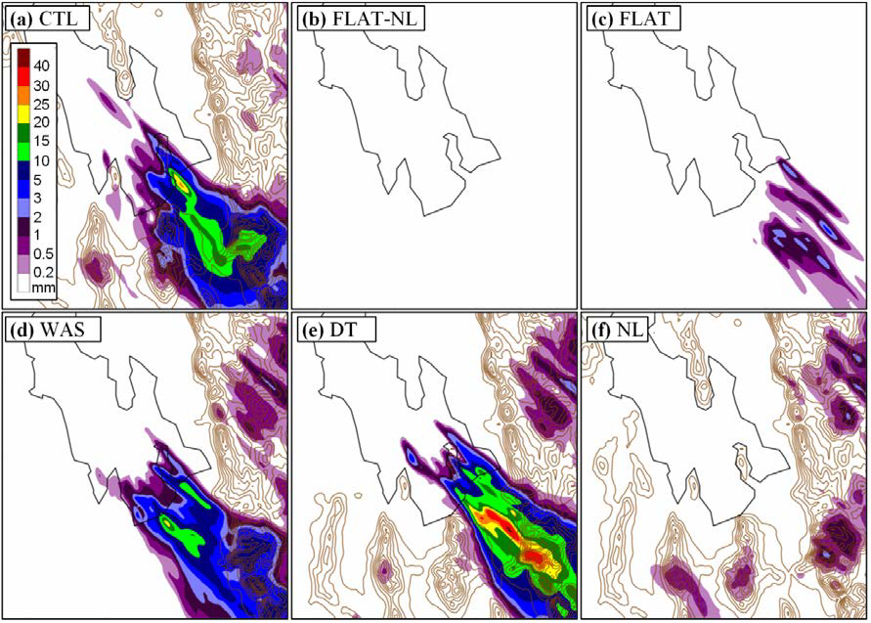
One Case

