Slide 1
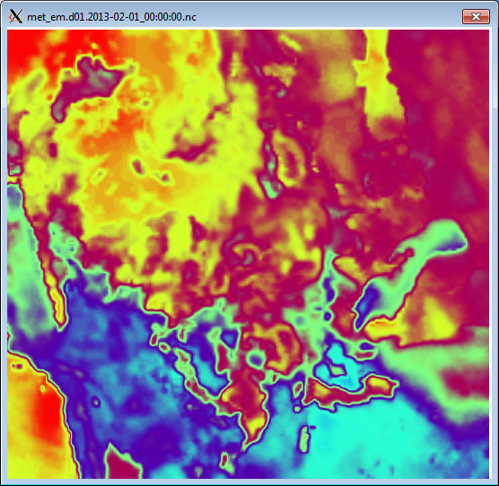
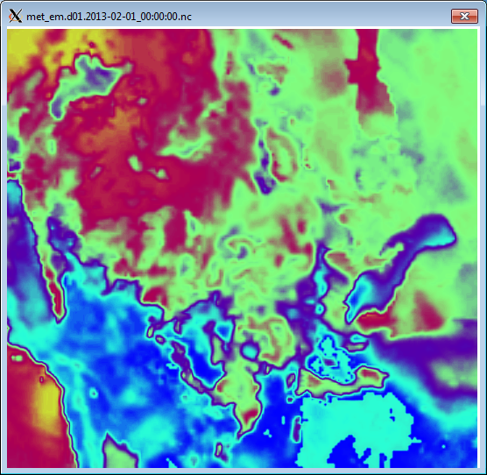
Changing WRF input files (met_em…) with MATLAB
NAM Relative Humidity
Relative Humidity reduced 20%

Slide 2
1 - Copy met_em files into matlab folder
2 - Create new folder to output edited files into
3 - Copy met_em files into output folder
Allows edited variables to be overwritten by MATLAB
If you don’t complete step 3, MATLAB will only write the edited variables into the new netcdf file
4 - Run MATLAB to edit desired variables and carefully check to make sure the it was executed properly
5 - Remove old met_em links from WRF/test/em_real
6 - Create new links to edited met_em files
ln -sf /uufs/chpc.utah.edu/common/home/horel_data/eneemann/matlab/output/met_em.d0*
7 - Run real.exe and check for any errors
8 - If all is good, run wrf.exe with edited met_em files!

