Slide 1
Introduction to Running the WRF in LES Mode
Jeff Massey
April 1, 2014
University of Utah WRF Users Group

Slide 2
What is LES mode?
Running the WRF at high resolutions with the PBL scheme turned off and full diffusion turned on. The effects of sub-grid scale turbulence on the state variables is no longer parameterized.
Why Run in LES mode?
Capture a very turbulent or small scale phenomena
Capture all scales of turbulence >= model grid and their effects implicitly instead of parameterizing them with a PBL scheme
Run a high resolution run (<500m)
Loss of faith in the current WRF PBL parameterizations

Slide 3
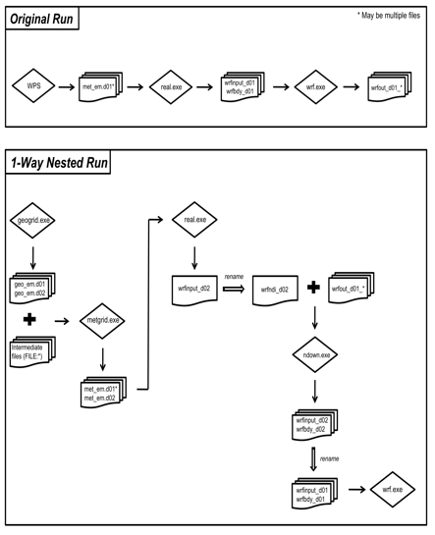
Process
Run the outer domains as a regular WRF simulation. The innermost domain (1-2 km) will be the parent domain for the LES domain
Make met_em files for parent WRF domain and LES domain.
Run real.exe for parent and LES domains.
Rename the LES wrfinput_d02 file wrfndi_d02 and wrfout_d03 to wrfout_d01 in the run directory
Run ndown.exe to create new wrfbdy and wrfinput files
Run v_interp if you want to adjust the vertical levels
Run wrf with the PBL scheme turned off and diff_opt =2

Slide 4
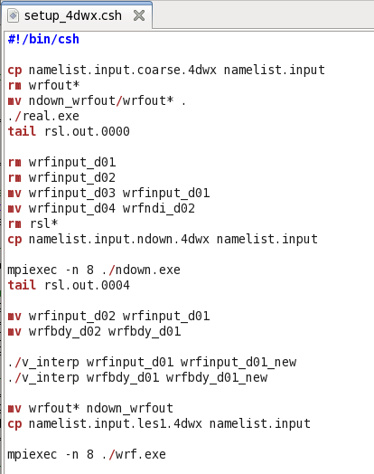
Process
Need 4 namelists:
Namelist describing the parent domains and LES domain.
Namelist describing the innermost parent domain and the LES domain
Namelist listing the new vertical levels for v_interp
Namelist describing the LES domain with appropriate physics.
Note: the first 2 namelists must have the same vertical levels

Slide 5
Important considerations
Vertical levels must match between parent WRF run and LES domain for the real.exe and ndown.exe namelists.
Vertical levels can be changed after ndown.exe, but the lowest half-eta level must be higher than the parent domain and the highest half-eta level must be lower than the parent domain.
Namelist.input for real and ndown
Namelist.v_interp for v_interp
e_vert = 37,
eta_levels =
1.000000, 0.996200, 0.989737, 0.982460, 0.974381,
0.965422, 0.955498, 0.944507, 0.932347, 0.918907,
0.904075, 0.887721, 0.869715, 0.849928, 0.828211,
0.804436, 0.778472, 0.750192, 0.719474, 0.686214,
0.650339, 0.611803, 0.570656, 0.526958, 0.480854,
0.432582, 0.382474, 0.330973, 0.278674, 0.226390,
0.175086, 0.132183, 0.096211, 0.065616, 0.039773,
0.018113, 0.000000,
&newlevels
nvert = 54,
nlevels = 1.0000,0.9876,0.9815,0.9631,0.9450,0.9272,0.9097,
0.8924,0.8754,0.8586,0.8421,0.8258,0.8098,0.7940,
0.7733,0.7479,0.7231,0.6990,0.6755,0.6526,0.6302,
0.6085,0.5873,0.5667,0.5466,0.5270,0.5080,0.4895,
0.4714,0.4539,0.4368,0.4036,0.3722,0.3425,0.3145,
0.2880,0.2631,0.2396,0.2175,0.1967,0.1772,0.1588,
0.1416,0.1254,0.1103,0.0961,0.0829,0.0706,0.0590,
0.0483,0.0383,0.0290,0.0204,0.0000,

Slide 6
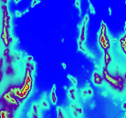
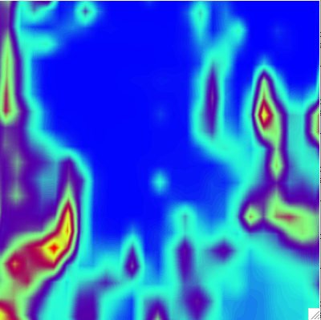
Important considerations
There is a fine balance between the lowest sigma level and the resolution of the terrain. For my domain ~100m vertical resolution and 5min terrain resolution worked.
The closer the parent WRF terrain and the LES terrain the better. I run the parent domain with 5 min terrain so they match perfectly. Ndown.exe will do a terrain mesh on the edges of the LES domain if the terrain does not match
30 sec terrain
5 min terrain

Slide 7
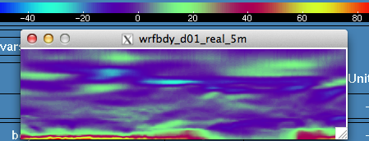
Important considerations
Initialize the LES run after the parent WRF run is fully spun up. I allowed 6 hours. If you don’t do this the boundary conditions will get shocked and cause the run to crash
Bad wrfbdy file since bounday layer is getting shocked from model spinup
A good looking wrfbdy file

Slide 8
Important considerations
There are some namelist.input variables that will help and/or are necessary
&domains
time_step = 2
&physics
sf_sfclay_physics = 11,
sf_surface_physics = 2,
bl_pbl_physics = 0,
&dynamics
w_damping = 1,
diff_opt = 2,
km_opt = 2,
diff_6th_opt = 2,
diff_6th_factor = 0.3,
mix_isotropic = 1,
mix_upper_bound = 0.1,
time_step_sound = 8,
mix_full_fields = .true.,

Slide 9
LES crash over terrain
22 sec in
My runs would crash within the first minute of the model run. Errors would start on steep slopes and then propagate throughout the whole domain
Typical reasons for the errors:
Terrain resolution was too high
Low level vertical resolution was too high
Boundary condition forcing was too strong
24 sec in
26 sec in

Slide 11
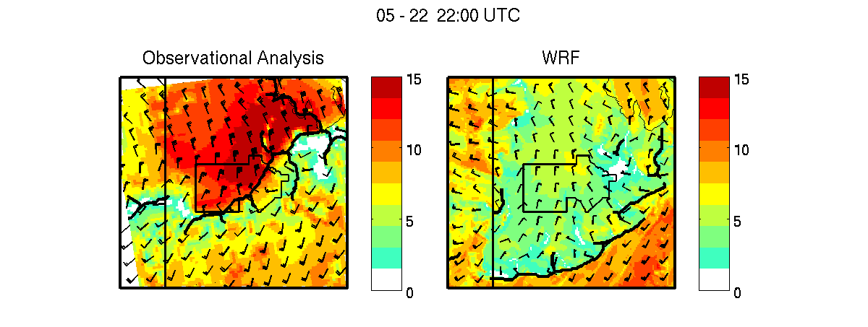
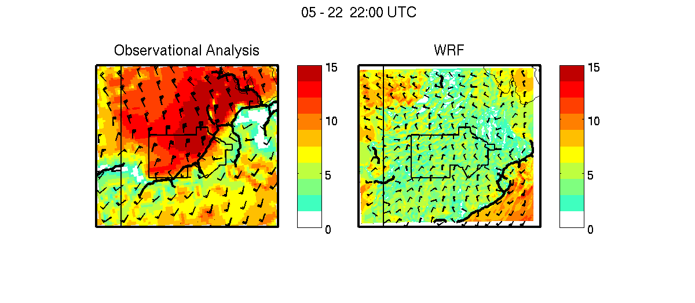
WRF-PBL
LES

Slide 12
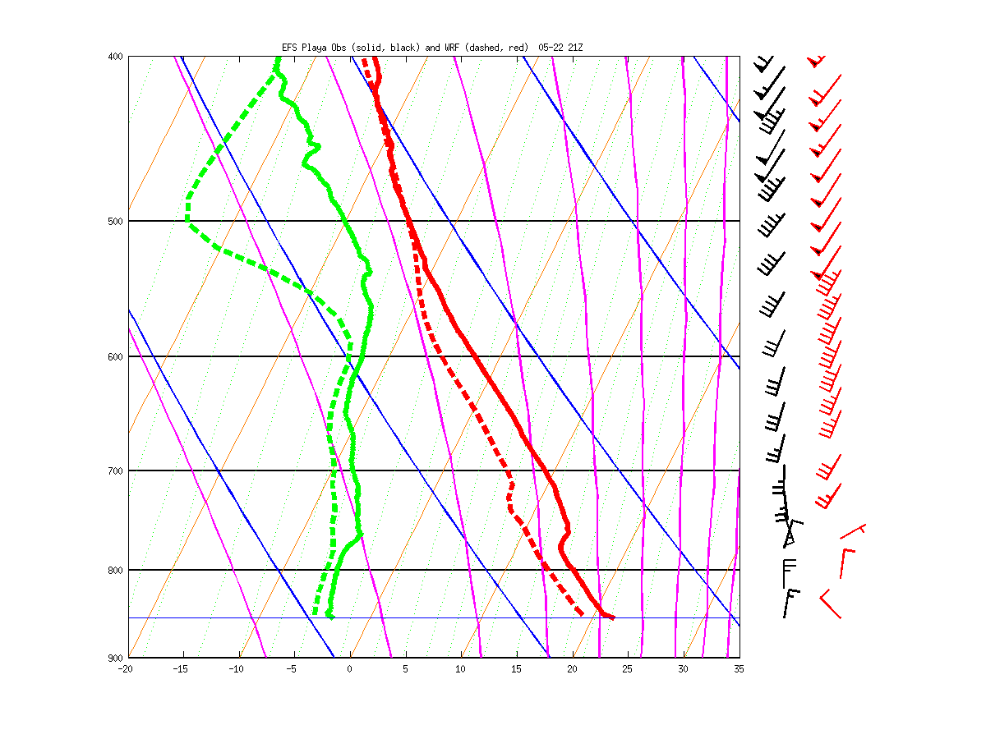
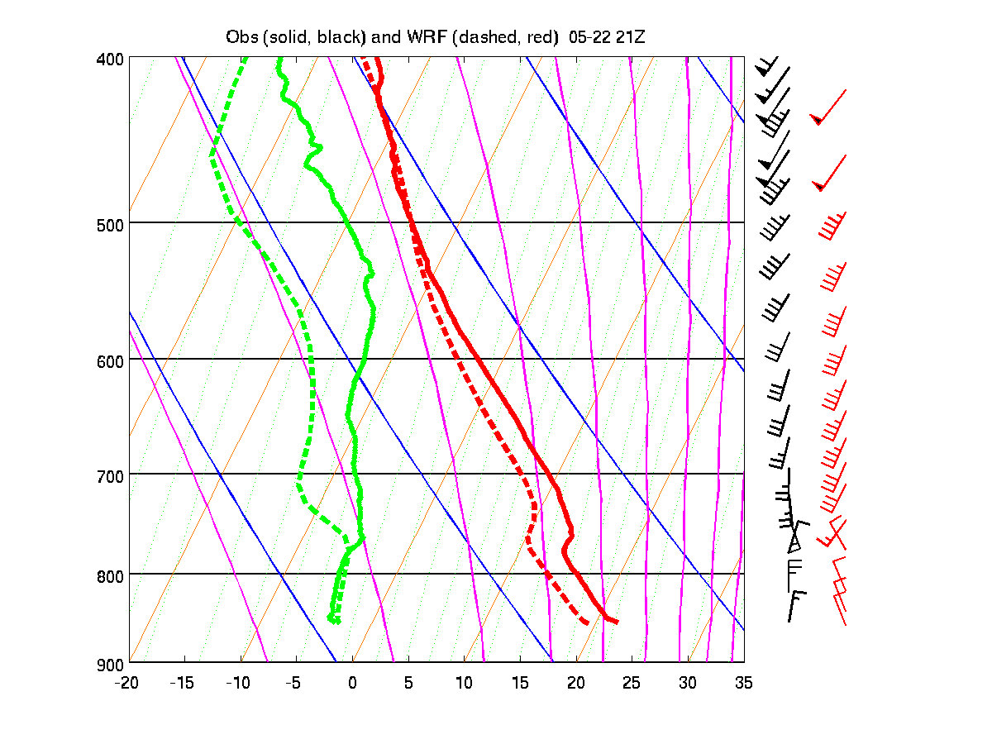
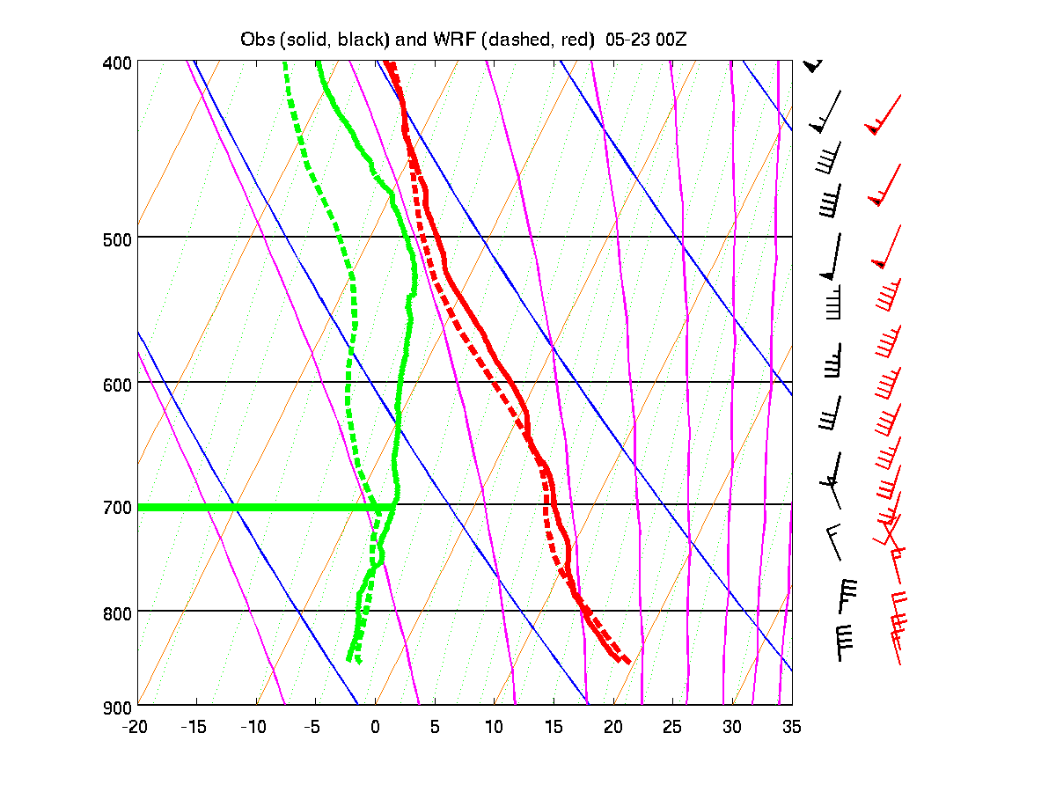
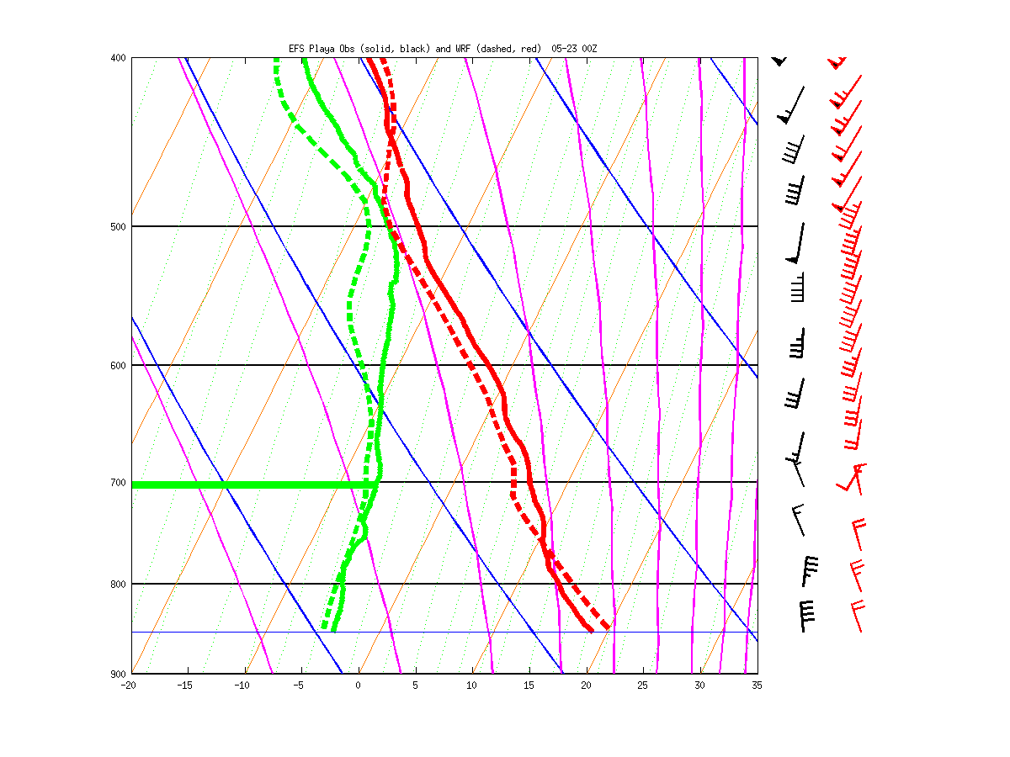
WRF-PBL run
LES run

