Slide 1
The new Thompson & Eidhammer ‘aerosol-aware’ microphysics scheme
Greg Thompson & Trude Eidhammer
Research Applications Laboratory
National Center for Atmospheric Research
Special thank you to:
Dave Gill
Michael Duda
Wei Wang
Jimy Dudhia
Kelly Keene
15th Annual WRF Users’ Workshop

Slide 2
Goals/Motivation
incorporate fundamental, 1st order aerosol treatment:
activation of CCN & IN
depletion of aerosols - precip scavenging
simplistic aerosol replenishment (surface emissions)
ensure physics consistency between prior scheme and new scheme
directly couple with radiation for direct/indirect effects
make it low-cost

Slide 3
Methodology
Create aerosol dataset for input & lateral boundary conditions - GOCART, 7–year simulation, monthly climo
Add 3 species to Thompson et al (2008) scheme:
Number of water-friendly aerosols (Nwfa) created by summing sulfates, sea salts, and organic carbon
Number of ice-friendly aerosols (Nifa) created by summing 5 size bins of dust
Number concentration of cloud droplets (2-moment)
Activate CCN using look-up table created using detailed parcel model (Feingold & Heymsfield, 1992), depending upon:
Number of available aerosols (not yet nucleated)
Updraft strength
Temperature
Aerosol mean size (already assumed geometric standard deviation)
Aerosol hygroscopicity parameter
Activate IN following DeMott et al (2010) and Phillips et al (2008) based on dust larger than 0.5 microns
Explicitly compute (internally consistent) cloud water, cloud ice and snow radiative effective diameter to pass to radiation scheme (RRTMG)
Include 3-d aerosol scavenging by rain, snow, and graupel
Install simplistic surface aerosol flux - in lieu of full emission inventory (future goal)
Added cost is +16% over mp_physics = 8
New mp_physics = 28
Unified module_mp_thompson.F source code
Can easily utilize idealized input aerosol profiles
Notes:
Strong recommendations for namelist.input REAL cases: scalar_pblmix=1, moist_adv_opt=2, scalar_adv_opt=2

Slide 4
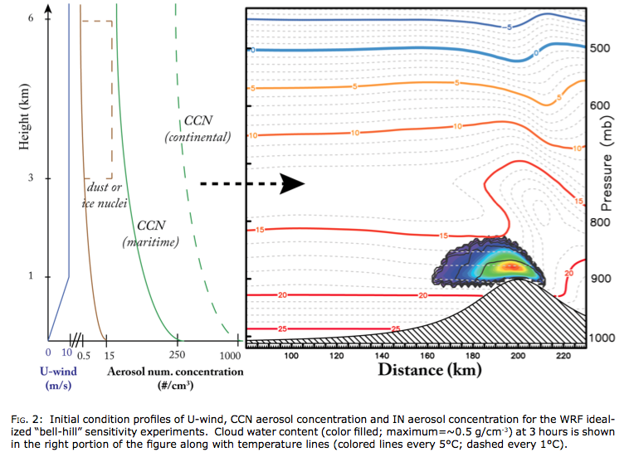
Simple/idealized aerosols
If newly added QNWFA & QNIFA variables not found in wrfinput file(s), then a default aerosol vertical profile is assumed
horizontally uniform
evolves with model simulation therefore not constant
no surface-based aerosol replenishment (surface emissions)
profile created in subroutine thompson_init
pseudo PBL following, not height AGL or MSL-based
can pass “xland” and/or “ivegtyp” variables to connect easily with maritime vs. continental characteristics

Slide 5
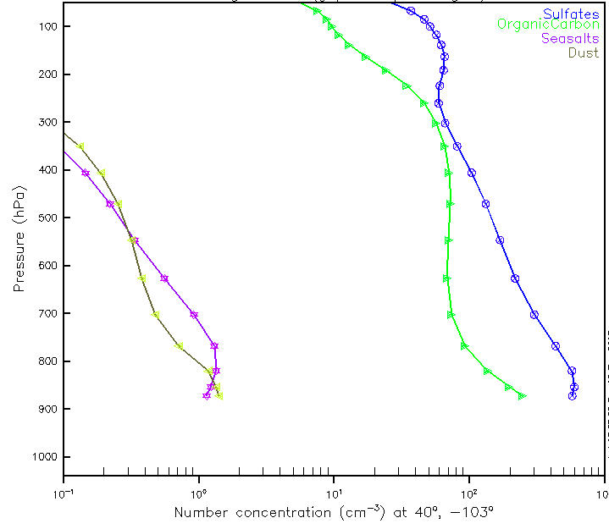
Monthly climo aerosols
requires processing thru WPS
http://www2.mmm.ucar.edu/wrf/users/wrfv3.6/mp28.html
GOCART: Goddard Chemistry Aerosol Radiation and Transport model
species: sulfates, seasalts, organic & black carbon, dust
mass mixing ratio of various size bins of each species
7-year simulation - averaged to monthly values
moderate resolution (0.5 x 1.25º)
Sulfates
Organic
Carbon
Sea Salts
Dust

Slide 6
WRF simulation
72-h: 31Jan-02Feb2011
Model set-up:
Version 3.4.1⁺⁺
1200 x 825 horizontal points (entire ConUS)
4-km grid spacing
72 vertical levels to ~73mb
first level: 25m AGL; 50 to 250 m spacing to tropopause
RUC analyses for initial and lateral boundary conditions
also simulated using GFS I.C. & L.B.C.
Physics Options:
RRTMG radiation: newly coupled water/ice/snow effective radii
NOAH LSM
YSU-PBL: newly coupled turb mixing of aerosols & Nc
No convective parameterization
Sensitivity experiments:
Nc50 = constant 50/cc
Nc750 = constant 750/cc
Control = climo aerosols, present-day
Clean = 1/10th reduced everywhere
Polluted = 10x increased everywhere

Slide 7
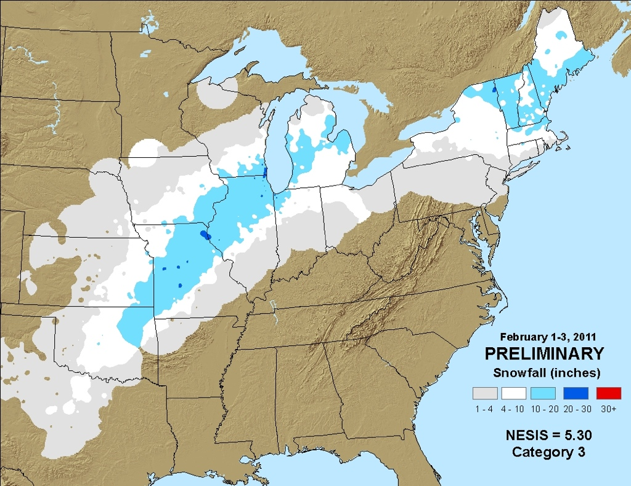
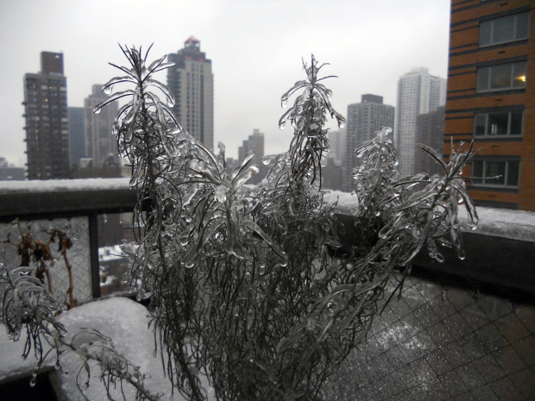
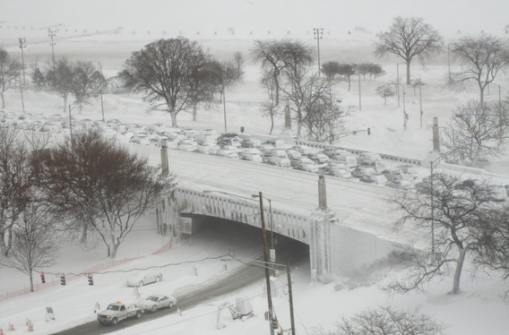
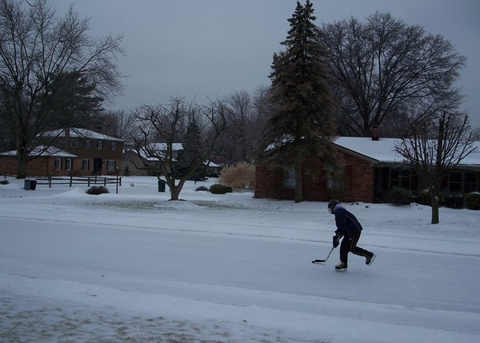
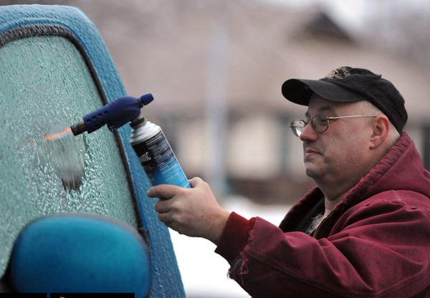
Blizzard and ice storm
New York City
Indiana
Chicago:
Lake Shore Drive

Slide 8
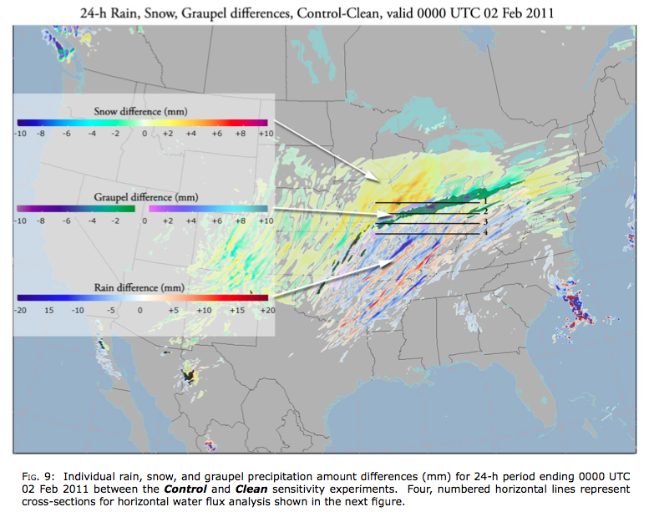
Results: a glimpse

Slide 9
Case study conclusions
1st aerosol indirect effect
More aerosols result in more droplets with overall smaller size.
Smaller droplet effective radius increases cloud albedo (+5.4% outgoing shortwave, TOA).
Increased cloud thickness in higher aerosols resulting in higher (0.47%) downward longwave IR and lower (-0.11%) outgoing LW-IR, TOA.
2nd aerosol indirect effect
More aerosols suppresses warm-rain
Largest impact to very light hourly precipitation amounts (< 2.5 mm h^{–1})
Overall decrease of total precipitation as rain reduced (3-8%) more than snow increased (2-5%)
Cloud lifetime effect not studied (yet)
Thompson, G. and T. Eidhammer, 2014: A Study of Aerosol Impacts on Clouds and Precipitation Development in a Large Winter Cyclone, J. Atmos. Sci., early online release.

Slide 10
Future improvements
surface emissions inventory
vertical velocity variance
surface dust emission (wind)
aerosol direct radiation (absorb/scatter)
couple with WRF-Chem

Slide 11
Acknowledgements
We gratefully acknowledge the support/contributions of:
FAA Aviation Weather Research Program office
Alison Nugent & Ron Smith (Yale Univ.)
Yaitza Luna (Howard Univ.)
Mukul Tewari, Changhai Liu, & Kyoko Ikeda (NCAR-RAL)
Roy Rasmussen & Marcia Politovich (NCAR-RAL)
Stan Benjamin et al (NOAA/ESRL/GSD)
Dave Gill, Jimy Dudhia, Michael Duda and the entire WRF development team
This research is in response to requirements and funding by the Federal Aviation Administration. The views expressed are those of the authors and do not necessarily represent the official policy or position of the FAA
Thank you!!

