Slide 1

The Role of Aerosols in Thermally Driven Orographic Precipitation
Yale: Alison D. Nugent, Campbell Watson, Ronald B. Smith
NCAR: Gregory Thompson
Funded by NSF
Grant 0930356

Slide 2
Motivation
Dominica (16N, 61W)
U
Why do low wind days have less precipitation?
(2011)

Slide 3
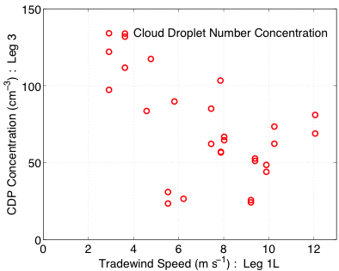
Microphysical Cause?
Cloud Number Concentration
Cloud Droplet Diameter
Low Wind
High Wind
Low Wind
~10 μm
Collision and coalescence is less efficient in clouds with small numerous droplets which may retard precipitation development.
This could be due to 2 potential drivers.
Hypothesis:

Slide 4
Aerosols?
Higher aerosol concentrations measured over Dominica at 1.7 km height on low wind days
First indirect effect in action?
RF7
RF8
More aerosols ➔ More smaller cloud droplets ➔ Retarded Precipitation
Small particles (0.1- 3 μm) measured by the PCASP internal optical system

Slide 5
Aerosol Modeling
How do aerosols impact precipitation formation in thermally driven orographic convection?
Method:
  Impose two different aerosol sources from the surface of an idealized mountain
  Use a double-moment microphysical scheme with aerosol activation physics and an aerosol loss mechanism
  Study how the precipitation formation processes change based on the surface aerosol source microphysically and dynamically

Slide 6
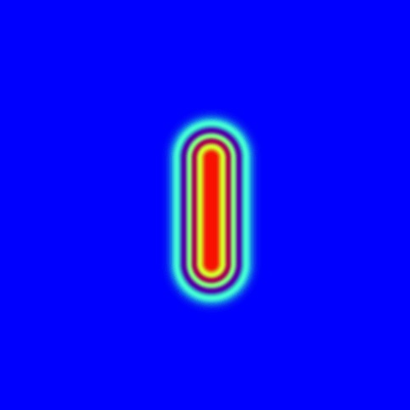
WRF Setup
200 m grid spacing
Periodic B.C.s
3d (200 km x 200 km) domain with ridge shaped mtn
  h=1 km and a=10 km
Conditionally unstable sounding
Comparison of No source (NS) and Aerosol source simulations (AS)
200 Wm⁻² SH flux over terrain
New Thompson aerosol-aware microphysics scheme
200 km
50 km
200 km
10 km

Slide 7
New Thompson Microphysics
Microphysics scheme including aerosols
Background aerosol concentration
Constant surface aerosol “emissions” over terrain
  5 aerosols cm⁻³ s⁻¹ over lowest model level
  Flux = 1.4 x 10⁸ aerosols m⁻² s⁻¹
Aerosols interact with microphysics
  Activate based on #, w, T, r, and hygroscopicity
  Determine initial cloud Nc
  Removed by moist processes
All aerosols are the same type
Background Aerosol Concentration

Slide 8
Aerosol / Cloud Properties
After 3 hrs in the X-Z plane
Aerosol (# cm⁻³)
Cloud (# cm⁻³)
Droplet Diameter (μm)
No Aerosol
Source
Aerosol
Source

Slide 9
Aerosol / Cloud Properties
After 3 hrs in the X-Z plane
Aerosol (# cm⁻³)
Cloud (# cm⁻³)
Droplet Diameter (μm)
No Aerosol
Source
Aerosol
Source

Slide 10
Aerosol / Cloud Properties
After 3 hrs – average at 1.7 km height
 | Obs | No Source | Aerosol Source
LWC (g kg⁻¹) | 1.1 | 1.20 | 1.18
Aero (# cm⁻³) | 200-300 | 35 | 381
Cloud (# cm⁻³) | 100-150 | 34 | 283
Cloud MPD (μm) | 15 | 15 | 12
Aerosol # (cm⁻³)
Cloud # (cm⁻³)
Droplet Diameter (μm)
Aerosol
Source

Slide 11
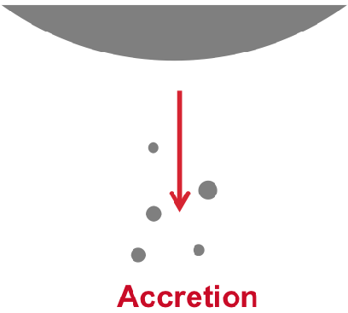
Cloud and Rain Formation
No Source = solid, Aerosol Source = dashed
Cloud water mass
Rain water mass
Dominant terms:
Condensation and Accretion
Collision and Coalescence has an extremely minor role
Collison & Coalescence

Slide 12
Self enhancing precipitation
System precipitates on top of developing clouds
Cloud droplet size and number matter less to accretion than to collision & coalescence
If each cloud needed to develop precipitation on its own, aerosols would have a larger impact
Cloud LWC (g kg⁻¹)
Rain LWC (g kg⁻¹)

Slide 13
Conclusions
Large microphysical differences but minor dynamical differences with and without a surface aerosol source
Rain formation is dominated by accretion
Aerosols modify the cloud droplet number and size
Accretion is not sensitive to cloud droplet number and size
Because accretion dominates, aerosols have no impact on surface precipitation accumulation
With a background wind speed to reduce residence time, aerosols may have a larger impact if C&C is more dominant
Accretion limits the role of aerosols
Notes:
"because after the first hour, the rain formation mechanism is dominantly accretion and bc cloud droplet size has little effect on accretion process, and bc role of aerosoles is usually to modify the cloudu droplet size, we conclude that in this particular configuration, aerosols have no role on precipitation.”

Slide 14
Thompson Microphysics
See Thompson WRF_workshop slides in separate PPT and Thompson and Eidhammer, 2014.

Slide 15
Thompson Microphysics
Source Code:
WRFV3.6.1/WRFV3/phys/module_mp_thompson.F
Namelist: mp_physics
Regular Thompson microphysics = 8
Aerosol aware microphysics = 28

Slide 16
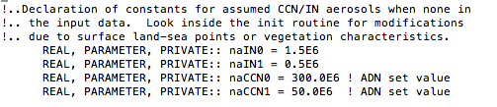
Inside the code
Line 80: Set background idealized profile of aerosols
ncCCN0 = surface value
naCCN1 = upper atmospheric value
Exponential distribution from one to the other

Slide 17
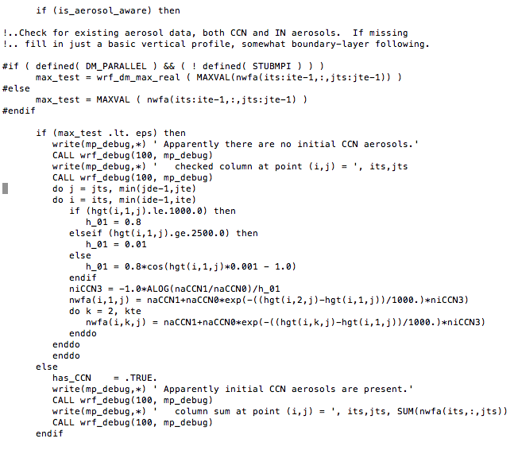
Line 438:

Slide 18
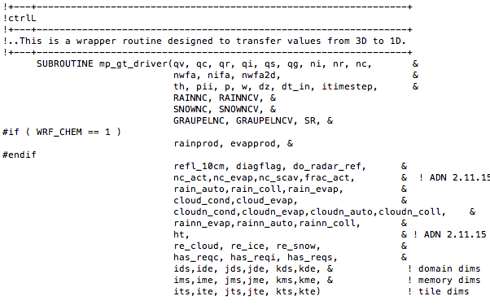
mp_gt_driver
Microphysics scheme works on one column at a time...

Slide 19
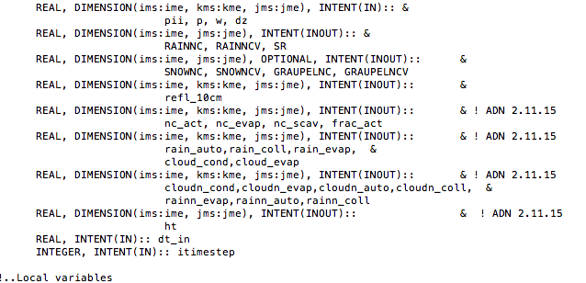
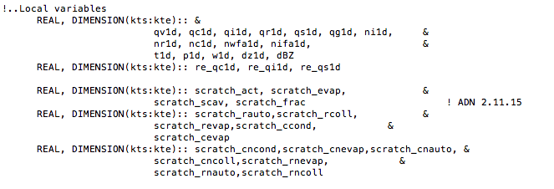
mp_gt_driver cont.
mp_gt_driver reads in the full sized variables and creates “scratch” versions of their columns to pass to mp_thompson

Slide 20
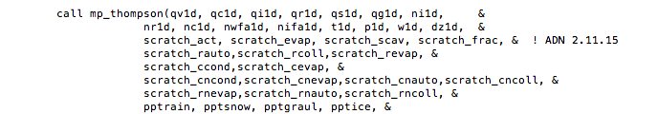
Mp_gt_driver is a 3D-1D wrapper routine, mp_thompson is called on 1d variables only and works one column at a time

Slide 21
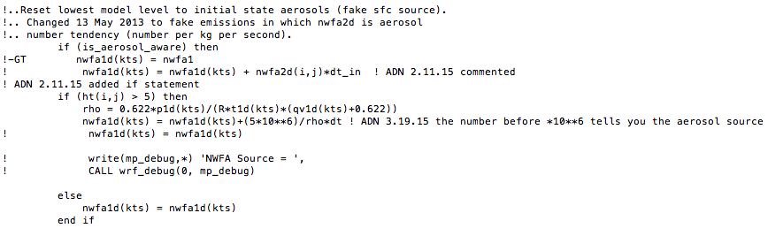
Line 1262: Input aerosol surface source
If the height is >5, add in a source of 5E6 aerosols/m3
All units within the scheme are in kg/kg/s so you need rho and dt to get into the units you want
If the height is <=5, the surface value is set to the current surface value and no change is made.

Slide 22
Scheme naming guideline:
Tendency variables are labeled in the form xxx_yyy
The first part tells you what variable you're looking at: p for production, then n or r for number or mass, and v for vapor, w for cloud water, r for rain, s for snow, g for graupel etc.
The second part tells you how it happened. For example, vcd=vapor condensation or rcw = rain collecting cloud water. Three examples:
prr_rcw= productions of mass of rain water via rain collecting cloud water
prr_wau=production of mass of rain via cloud water autoconversion
prw_vcd= production of mass of cloud water via vapor condensation
Reminder: All "pr" variables are in units kg/kg/s

Slide 23
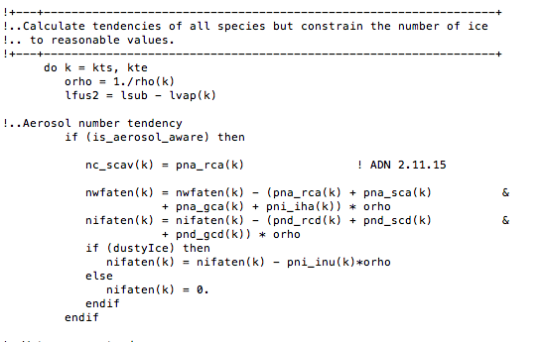
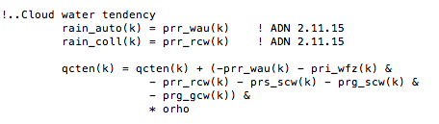
Line ~2700: update tendency terms - good place to grab variables

Slide 24
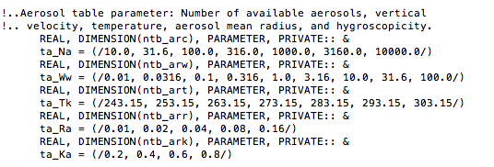
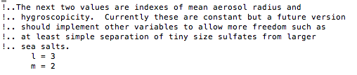
Line 306: Lookup Table Values
Line 4510: set the lookup table values:

Slide 25
Outputting Values from Thompson to your Netcdf file
Files requiring modification:
1. WRF/Registry/Registry.EM_COMMON – Add variable, remember h
2. WRF/dyn_em/solve_em.F
3. WRF/phys/module_microphyiscs_driver.F
4. WRF/phys/module_mp_thompson.F
An example set of files is given to output the variable prr_rcw or “process of rain mass formation through rain collecting cloud water”
Look for ‘Nugent 2015’ within the “_add_output” files. The first two require only one line change, the third has a few places and the last obviously has extensive changes.
The module_mp_thompson.F file that I use for my current research is also included (called module_mp_thompson_surfacesource.F) so you can see the locations where I add a surface source, marked by “ADN” and the date. All of the variables added would need to be added to the output stream as in files 1-3 above.

