Slide 1
Terrain-mapped Cross Sections in MATLAB
Erik Neemann
15 April 2014

Slide 2
Objective
Create cross sections visually similar to what is produced in RIP
Add capability to plot time-averaged data

Slide 3
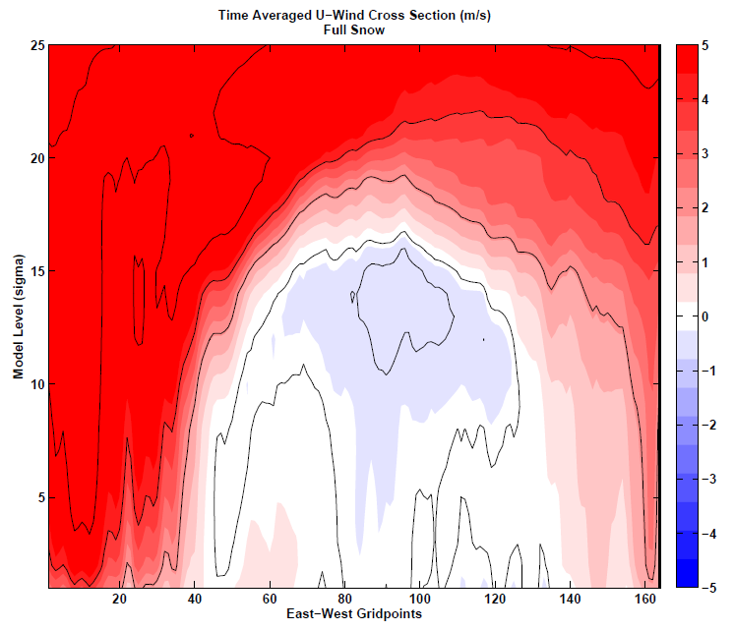
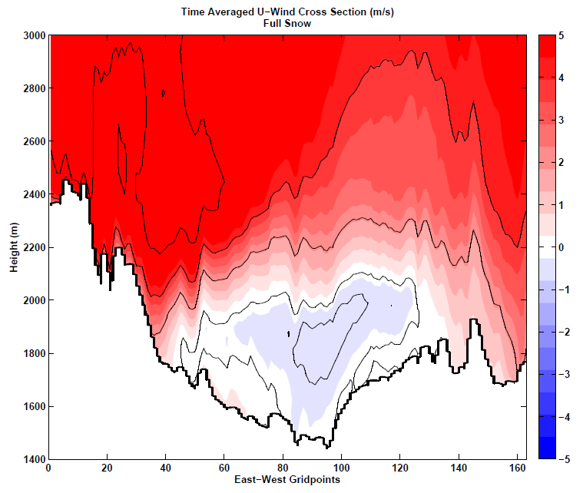
Before
After

Slide 4
Notes
Code built to produce cross section of zonal wind component in Uintah Basin
Data is time-averaged
Based on wrfout files every 6 hours with 6 times each (hourly data)
Data is spatially averaged over 10 points on each side of cross section centerline (customizable)
Depth of cross section originally set to 25 model levels (customizable)
If deeper than 5000 m code will need minor modification
Produces multi-page pdf for figures and requires ps2pdf function, found here:
http://www.mathworks.com/matlabcentral/fileexchange/19516-ps2pdf

Slide 5
Options & Editable parameters
Can skip time-average part and just use on single wrfout time
Must create formula for “line” where cross section will be taken along
Use algebra to get slope & y-intercept from (i,j) points
slope (-.1411) - from your derived equation
yintercept (184.44) - form your derived equation
crsa (74) - i gridpoint to start xsect
crsb (237) - i gridpoint to end xsect
depth (25) - to cover all data along xsect (model levels)
width (10) - grid point avg on each side of xsect

Slide 6
Basic Steps of Code
Cut angled xsect through 3D domain
→ Results in 2D array of data
Find height of each model level along xsect
Plot data value in new array at model level height
→ New array has 5000 vertical levels of 1 meter each
Linearly interpolated in vertical direction between data points for gridpoint along xsect
“Outline” terrain by making all data below ground level = -9999
Plot final data

Slide 7
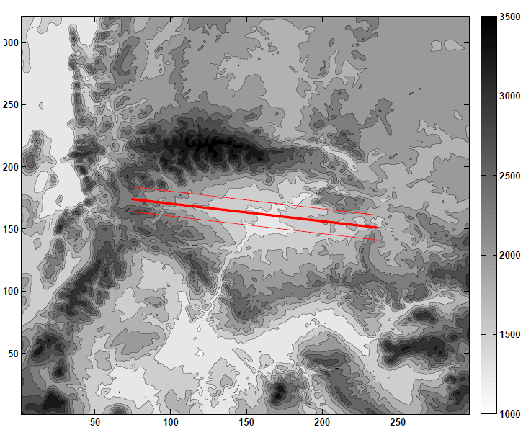
Output
Displays location of cross section and outer bounds for spatial average

Slide 8
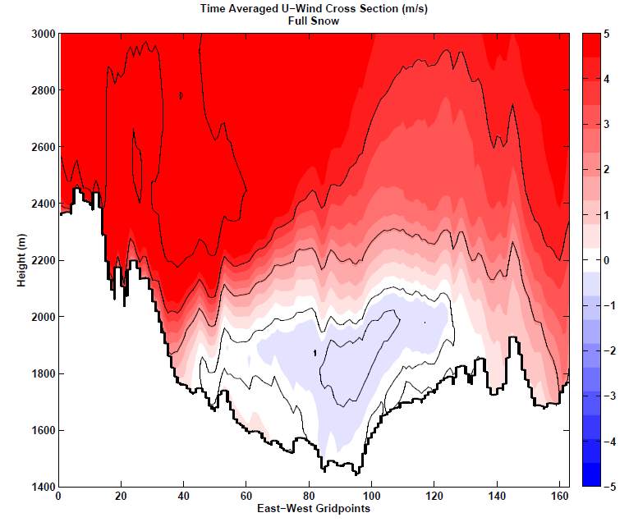
Output
Final “terrain-mapped” cross section

