Slide 1
Modules, Compiling WRF, and Running on CHPC Clusters
Adam Varble
WRF Users Meeting
10/26/15

Slide 2
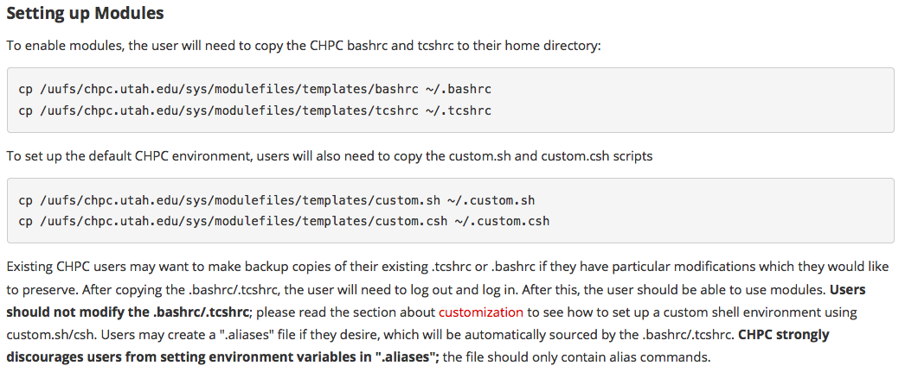
Use Modules: new .tchsrc and .custom.csh files
https://www.chpc.utah.edu/documentation/software/modules.php

Slide 3
Loading Modules Rather than Sourcing
https://www.chpc.utah.edu/documentation/software/modules.php
Key Commands
module: lists available commands and help
module avail: lists available software modules that can be loaded
module spider: list all available software modules
module spider (software): gives more details on specific software build versions
module list: lists current modules loaded
module load (software): loads a module
module swap (software/version) (software/version): switches from one module version to another
module unload (software): unloads a module

Slide 4
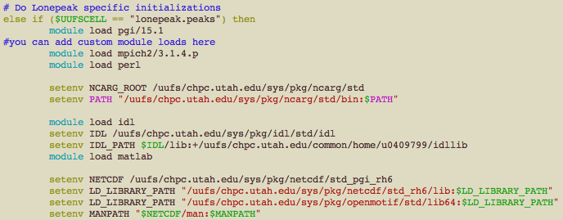
Lonepeak (meteo, atmos nodes) .custom.csh settings

Slide 5
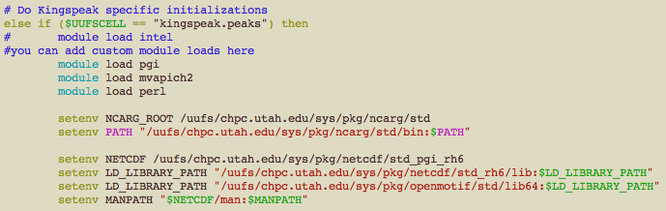
Kingspeak .custom.csh settings

Slide 6
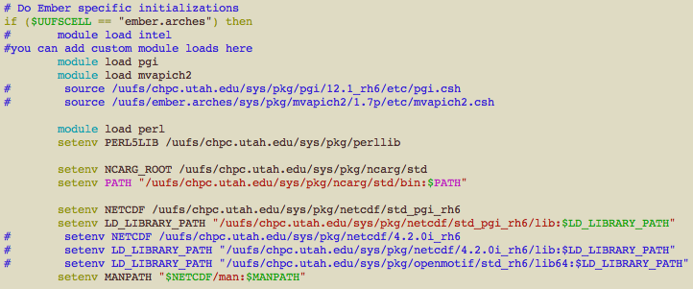
Ember .custom.csh settings

Slide 7
WRF Compilation
./configure (use setting 3: PGI w/gcc (dmpar))
./compile (case (e.g., em_real)) >& compile.log
For “real” case, you do not need to compile WPS in parallel if you don’t want to – easy to compile in serial on a group node and make met_em* files
Can run ./real.exe in serial, even if WRF compilation is parallel
Submit WRF run using SLURM (no longer PBS)

Slide 8
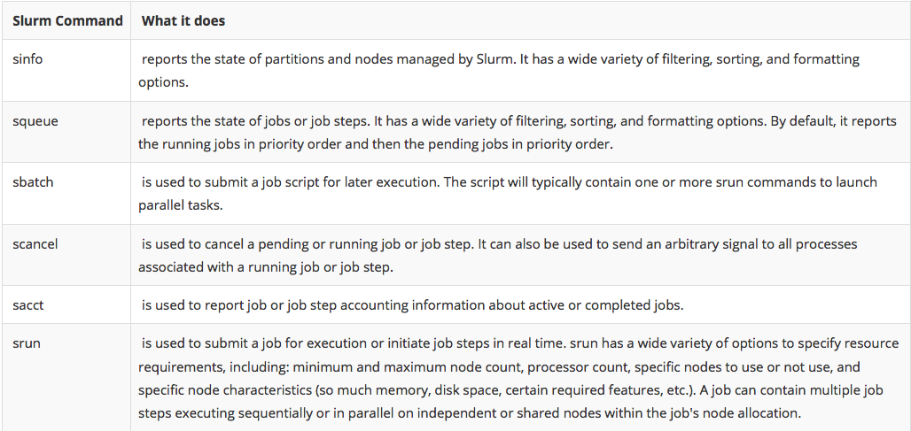
Job Submission with SLURM
https://www.chpc.utah.edu/documentation/software/slurm.php

Slide 9
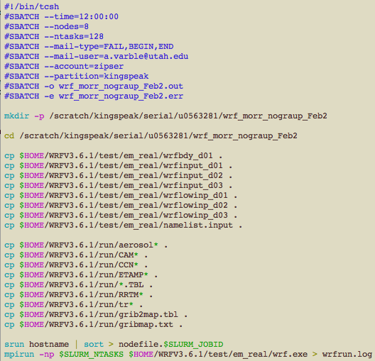
Example SLURM Script
Submission
> sbatch wrf.slurm
Queue Check
> squeue -u (uNID)
Cancel Job
> scancel (jobID)

