Slide 1
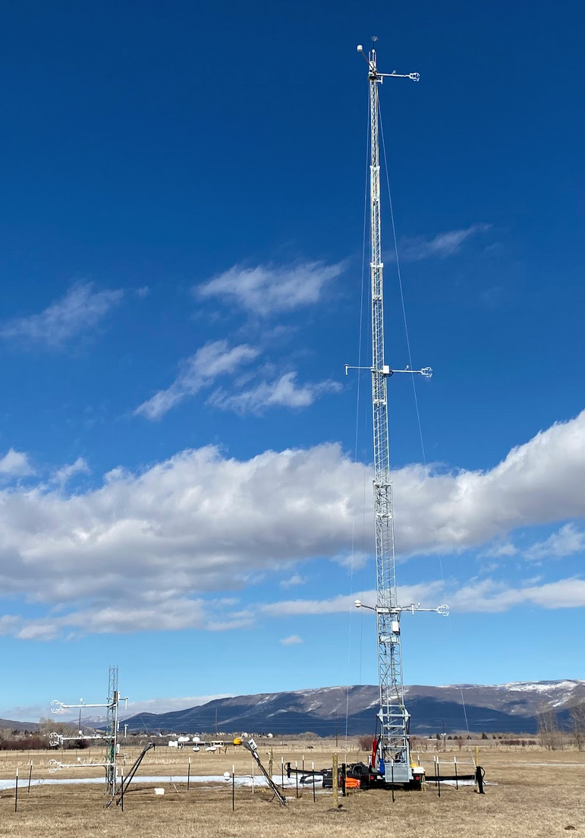
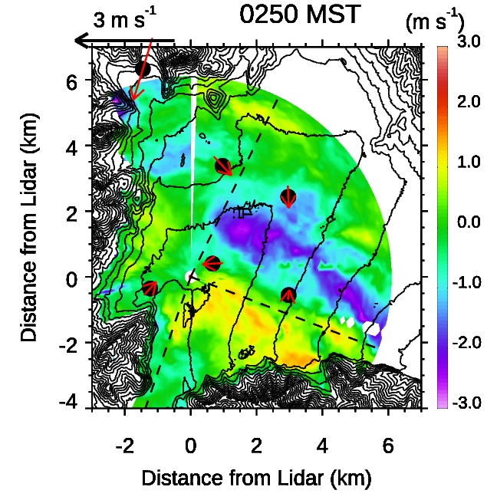
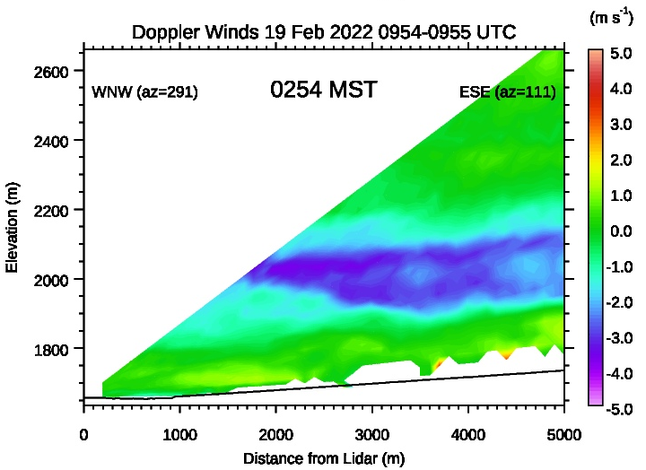
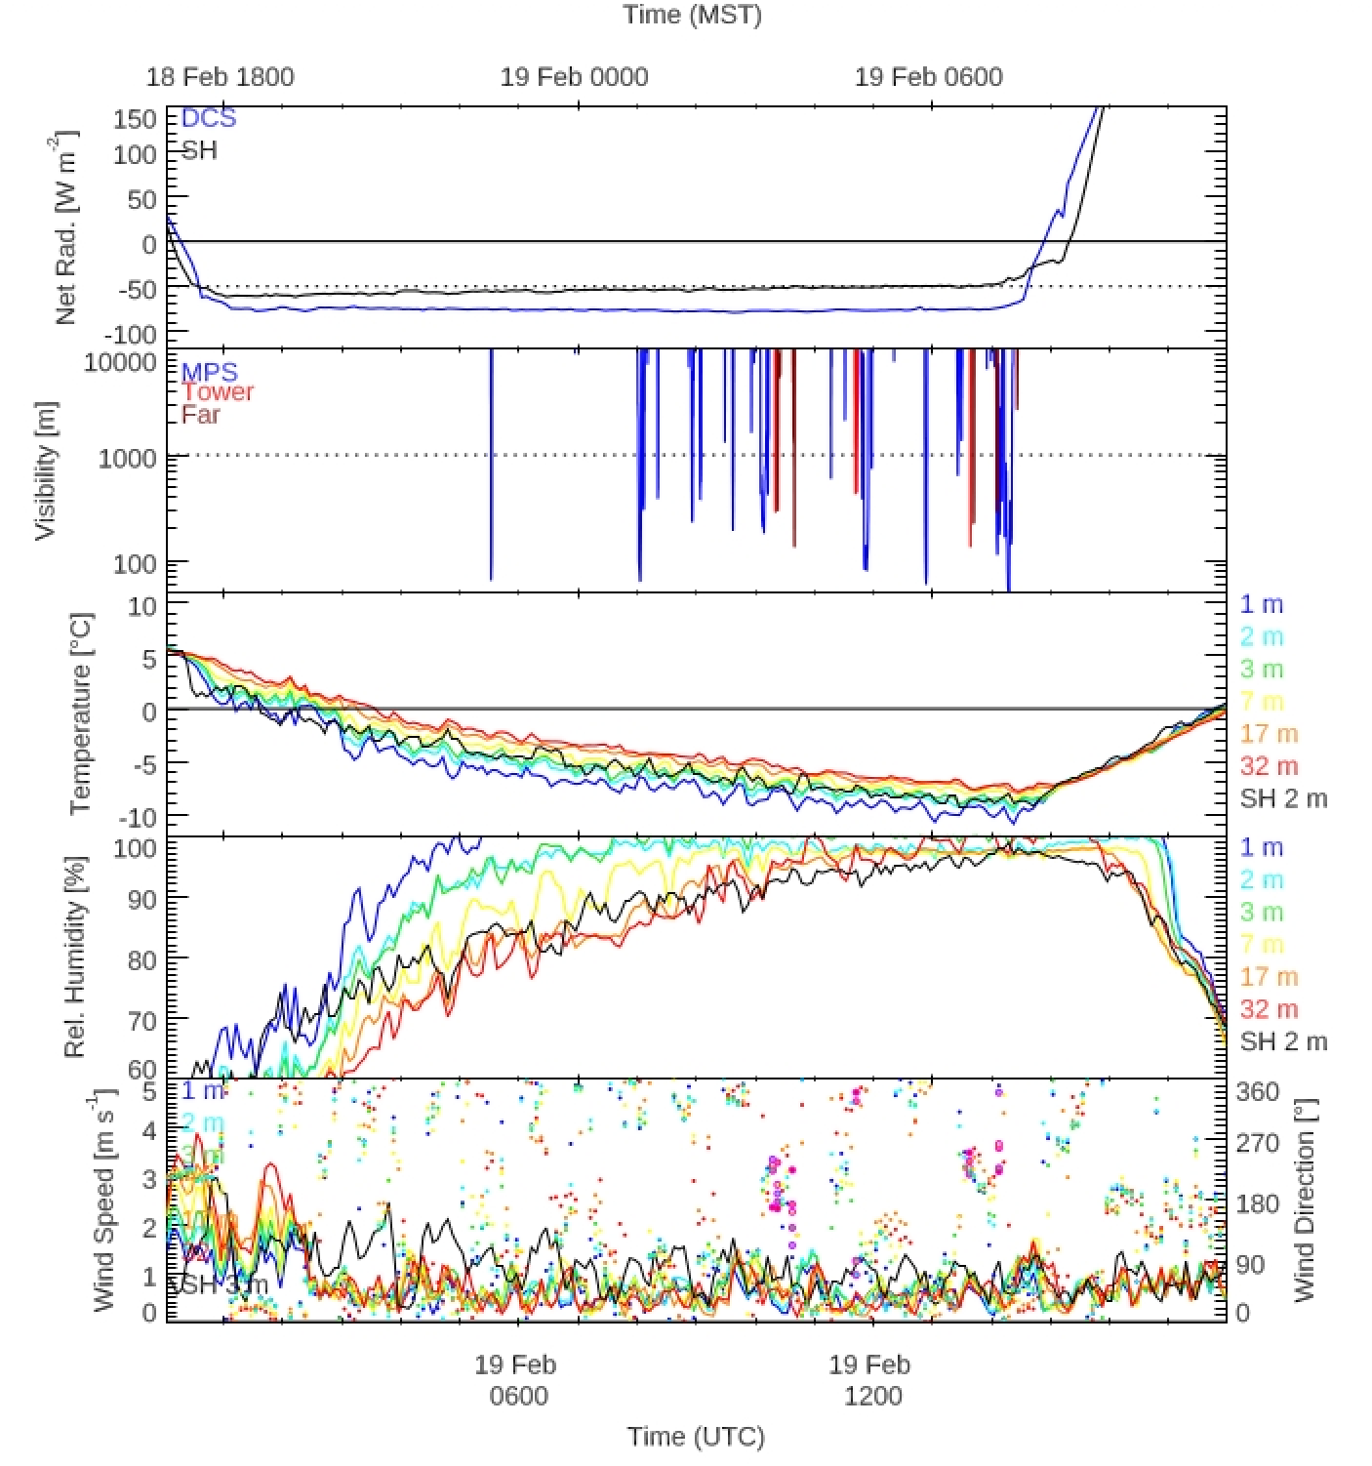
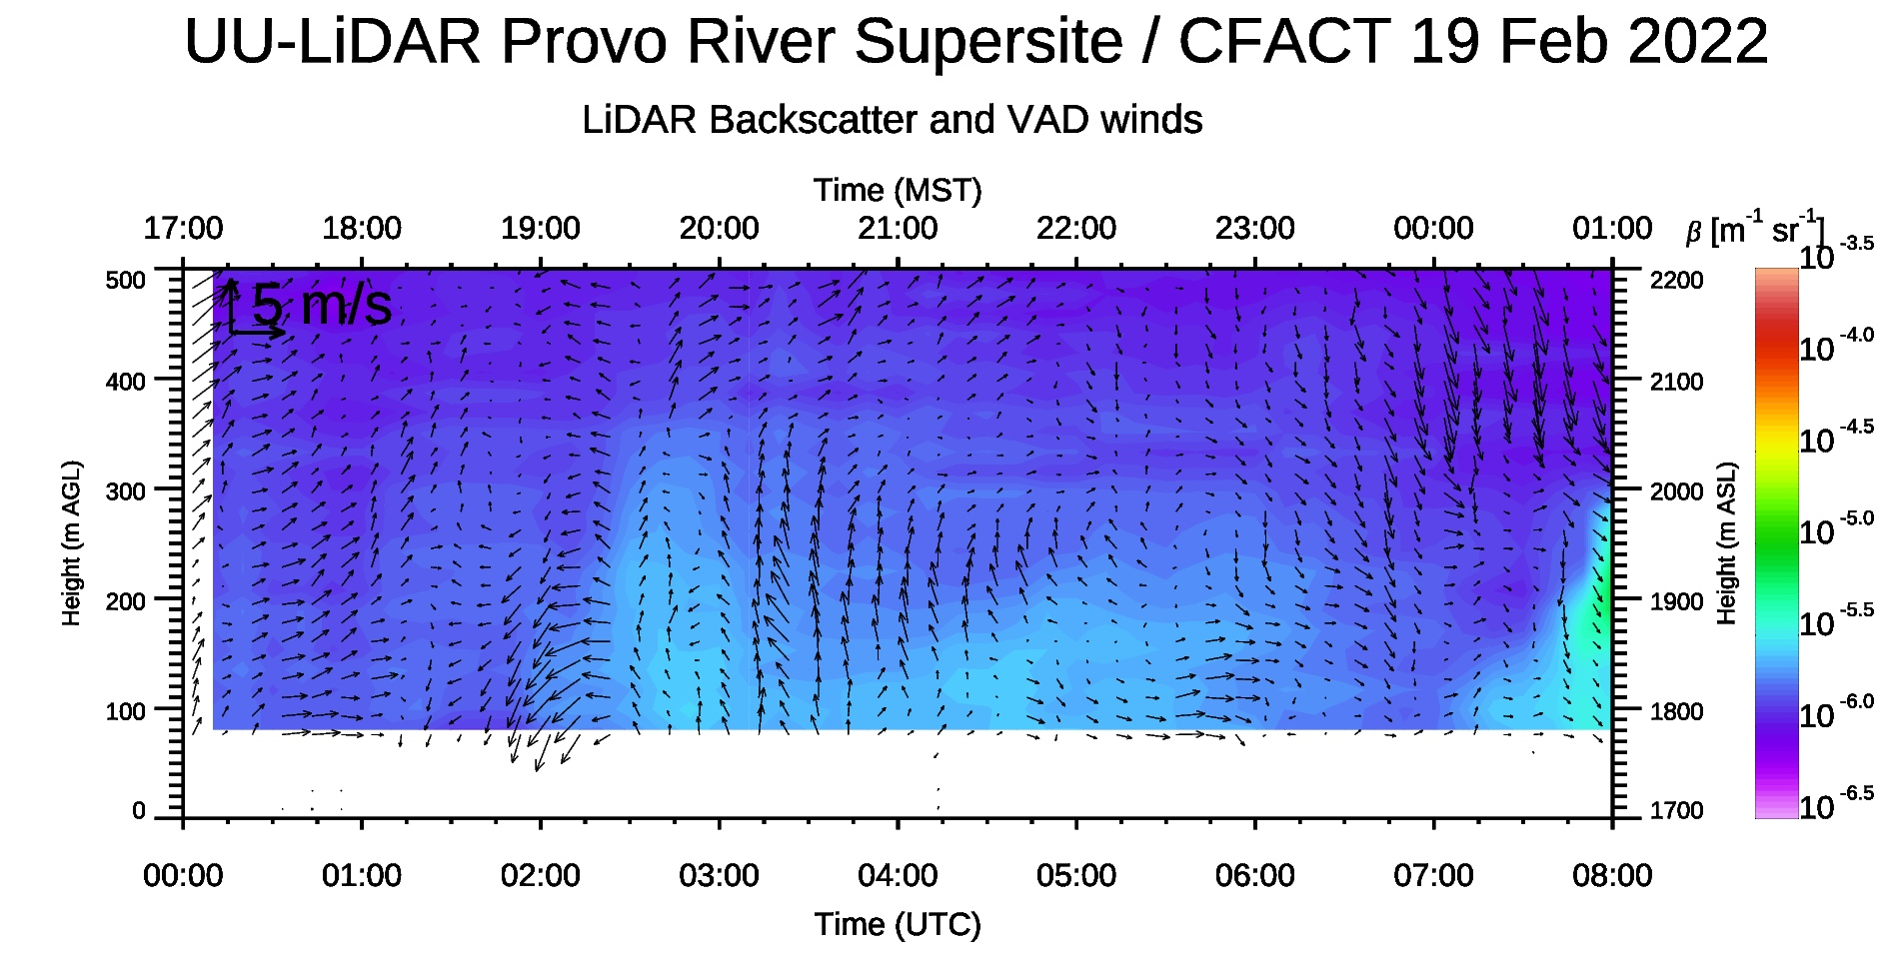
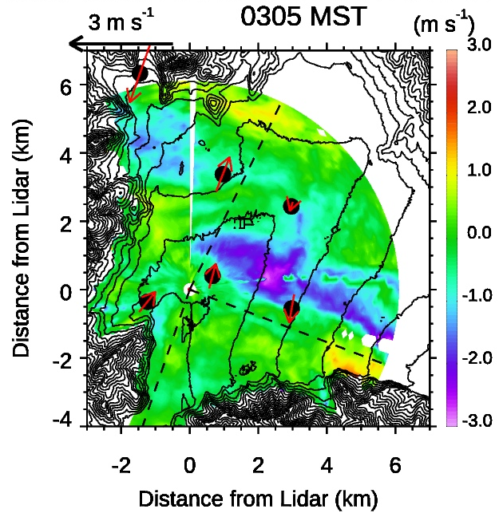
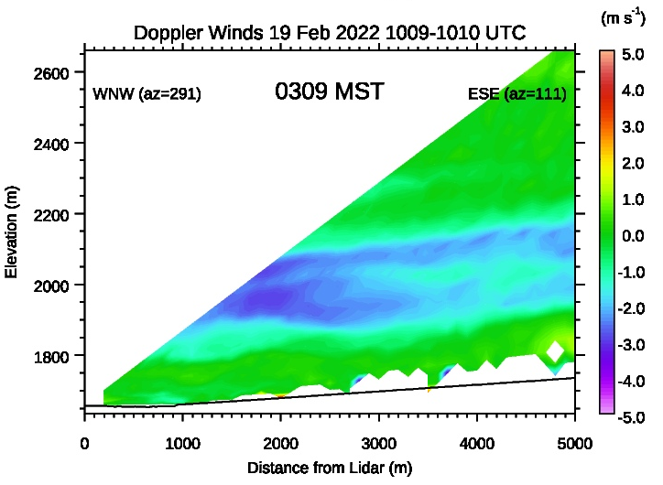
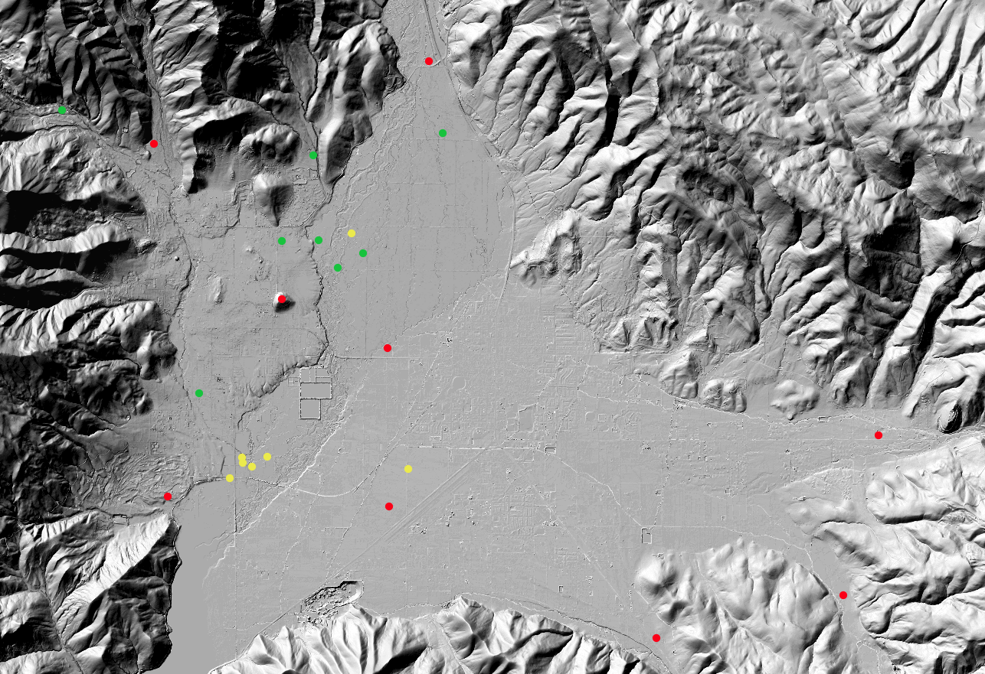
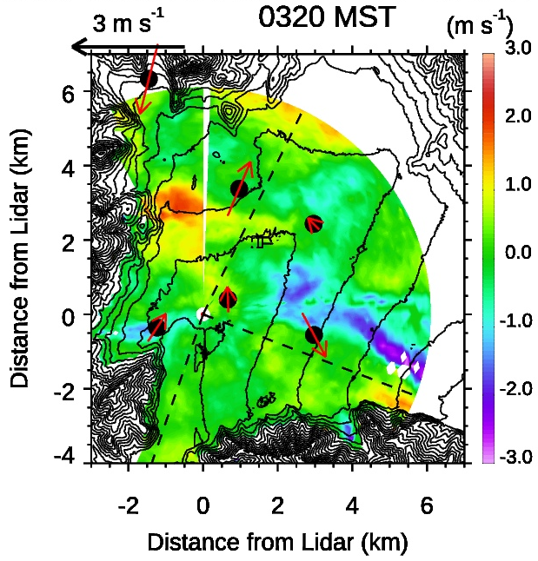
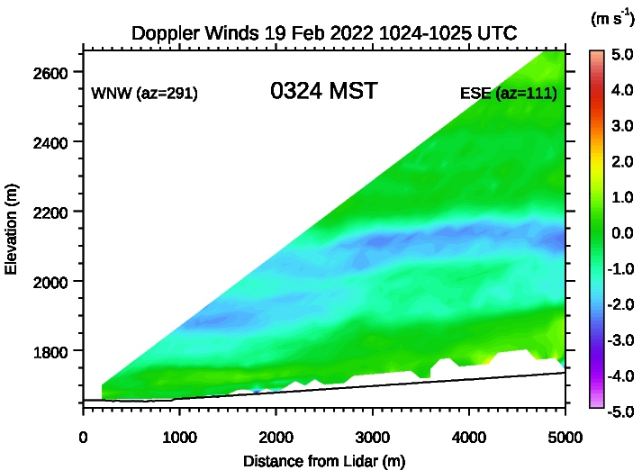
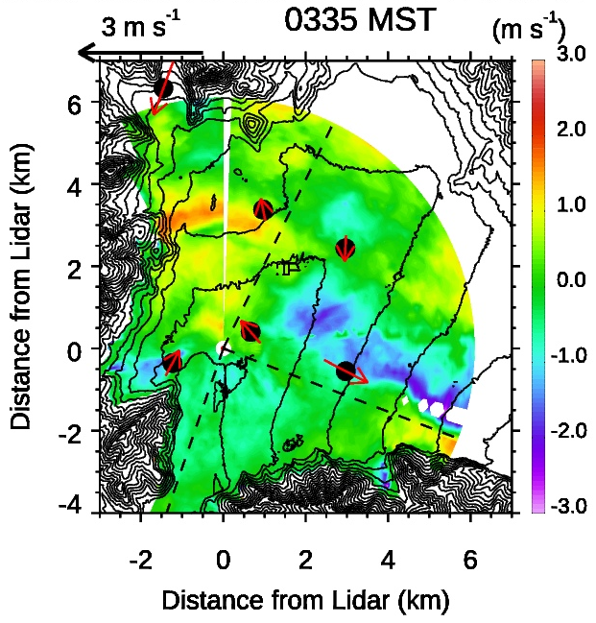
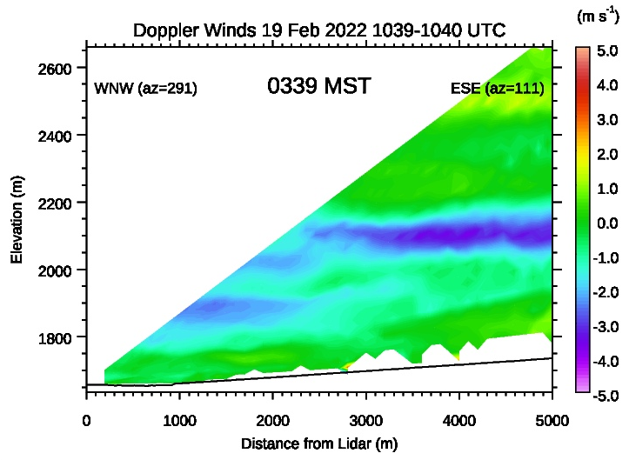
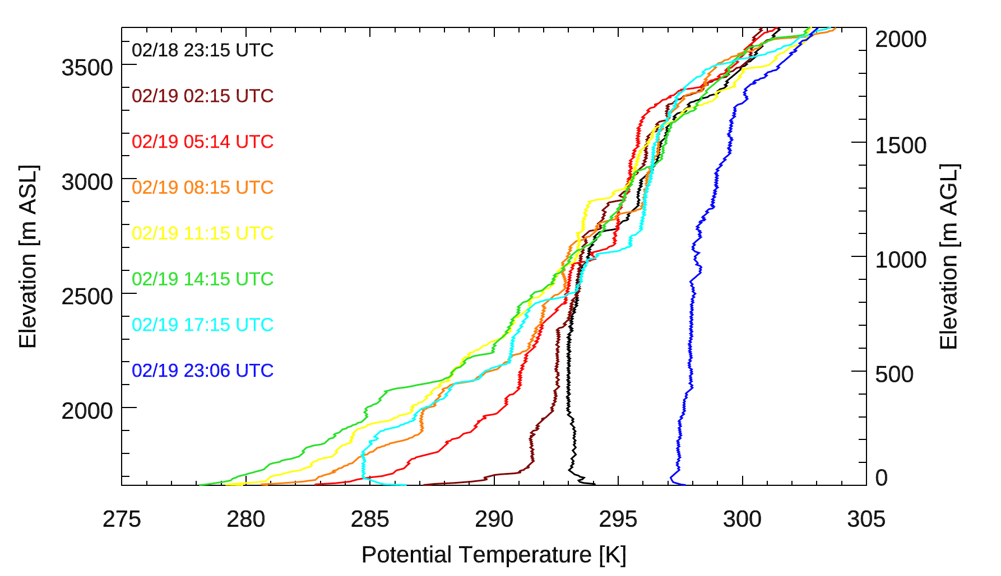
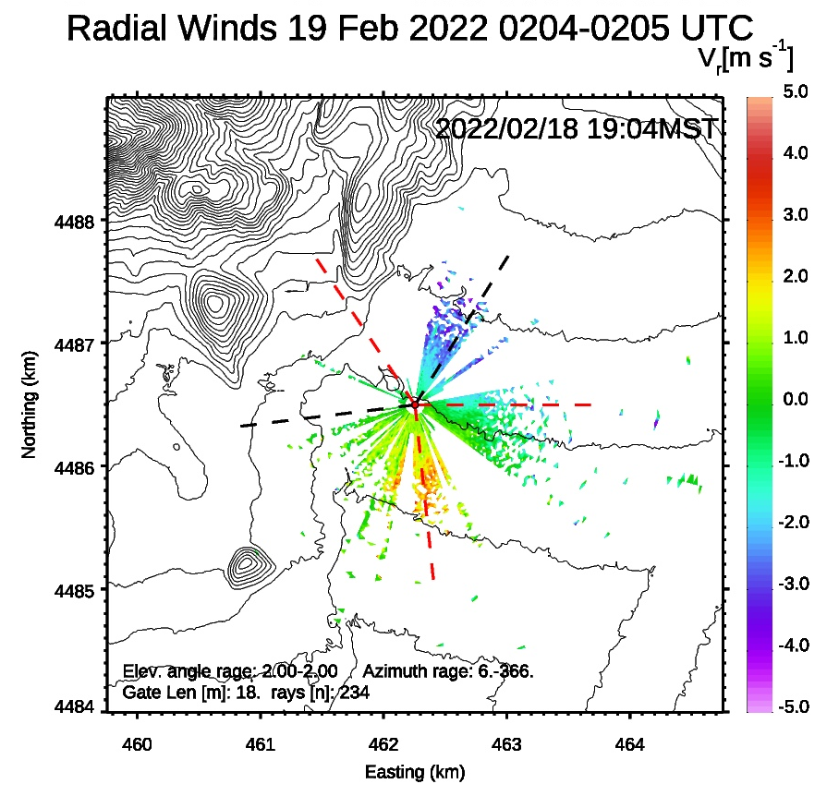
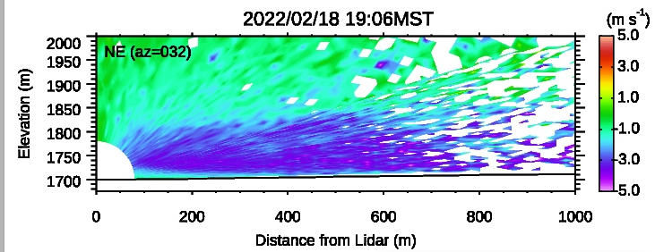
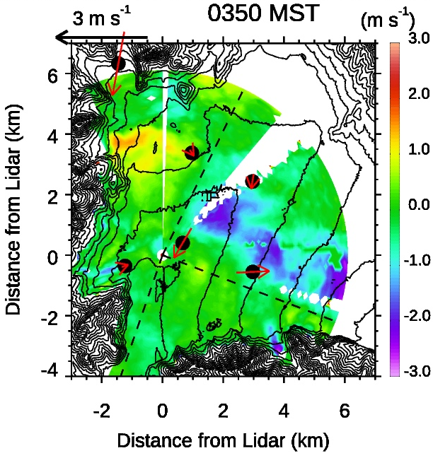
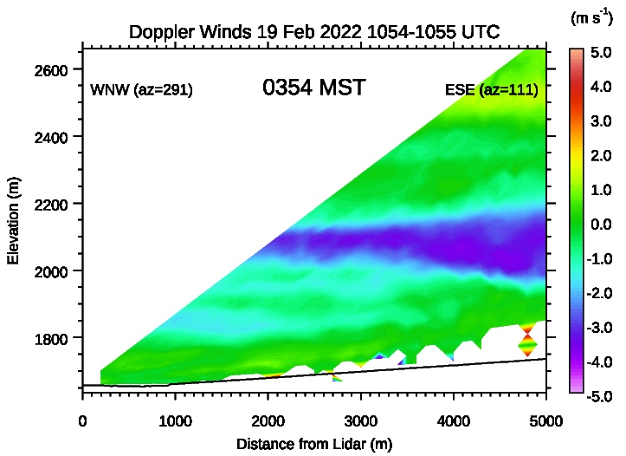
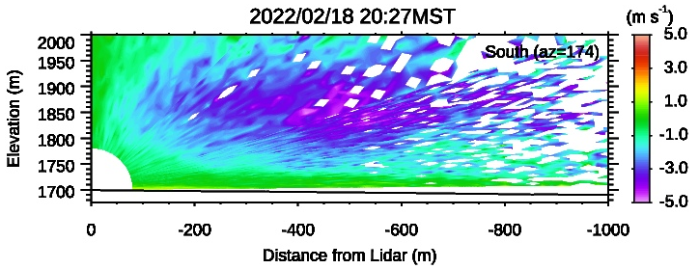
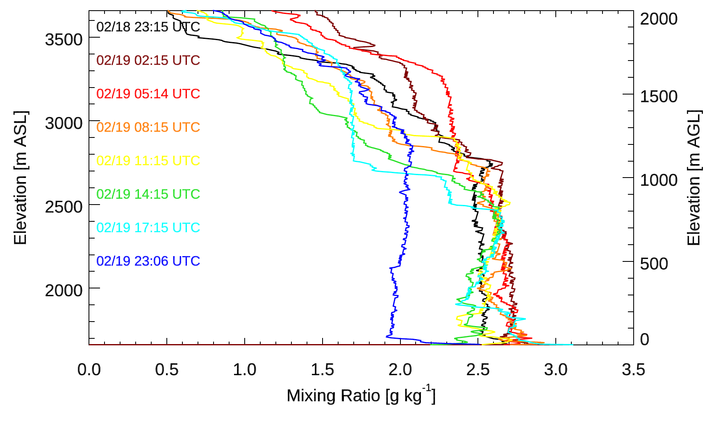
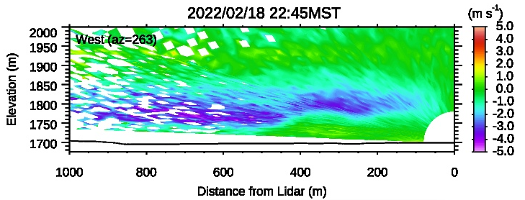
Thermally Driven Flows and Cold Pool Motion Observed During the Cold Fog Amongst Complex Terrain (CFACT) Experiment
21st AMS Conference on Mountain Meteorology
22 - 26 July, 2024 Boise, Idaho
Sebastian W. Hoch, E. R. Pardyjak, A. Perelet, Ismail Gultepe, Zachary Ruble, Gerardo Carrillo-Cardenas, Rebecca Beal, Zhaoxia Pu, Steve Oncley, William Brown
Introduction
Ephemeral Fog at the Deer Creek Supersite
The Cold Fog Amongst Complex Terrain (CFACT) experiment, conducted in early 2022 in Heber Valley, Utah, offers a unique dataset to study the life cycle of ephemeral, i.e. short lived cold-fog events. CFACT was designed to elucidate the complex interactions between multi-scalar meteorological and microphysical processes governing the formation of cold fog in a typical alpine basin.
Heber basin was instrumented with two supersites and nine satellite sites (Figure 1), with meteorological flux and surface energy balance towers, Doppler wind LiDARs, ceilometers, and a wind profiler, as well as microphysical and aerosol platforms. Intensive Observational Periods added a tethersonde and frequent radiosonde ascents.
Ephemeral fog formed on 19 February 2022 at and around the Deer Creek Supersite. Fig. X shows time series of relevant variables measured on the 32-m flux tower and visibilities at three nearby sites that show the intermittence and spatial heterogeneity of the fog occurrence.
UP
 | Site | Elevation (m)
1 | Deer Creek Supersite (DCSS) | 1659
2 | Provo River Supersite (PRSS) | 1699
3 | Midway (MW) | 1679
4 | Memorial Hill (MH) | 1764
5 | Center Creek (CC) | 1865
6 | Solider Hollow (SH) | 1668
7 | South Pivot (SP) | 1697
8 | Pine Canyon (PC) | 1792
9 | Upper Provo (UP) | 1740
10 | Lake Creek (LC) | 1873
11 | Daniel Canyon (DC) | 1809
L8
PC
L6
L7
PRSS
Provo River
Supersite
L2
L3
L4
L5
MH
MW
L1
DC AT
Dear Creek
Supersite
LC
SH
DC S
DC MP
DC FT
NP
DC L
SP
Airport
1 km
Deer Creek Reservoir
DC
CC
Fig. 1: Heber Valley basin and observation sites for CFACT.
Flow collisions at the Provo River Supersite
Based on the MATERHORN-FOG experiment conducted in the area of the supersite, a wind lidar was deployed to look for the expected collisions of flows. In the night form 18-19 February 2022, prior to an ephemeral fog formation, down-valley flows affected the site in the early evening, while slope winds originating from tributary canyons collided with a basin cold pool later in the night.
Lidar observations resolve flow interactions
Tower observations resolve the local mixing conditions triggering fog formation
This presentation aims at evaluating and characterizing the complex flow interactions occurring in the basin during fog-prone conditions using tower observations and Doppler wind LiDAR retrievals from the supersites. The goal of the analysis is to evaluate basin-scale advective processes, turbulent mixing, gravity wave motions, and the role of slope flows interacting with a basin cold pool.
Interactions between the basin-scale cold air pool and the thermally driven flows from tributary canyons lead to sporadic mixing events triggering the ephemeral fog episodes.
Acknowledgments: CFACT is sponsored by the National Science Foundation grant 2049100. We thank all CFACT participants, including EOL ISFS and ISS, and all volunteers – we could not have done it without you!
Contact: sebastian.hoch@utah.edu

