Slide 1
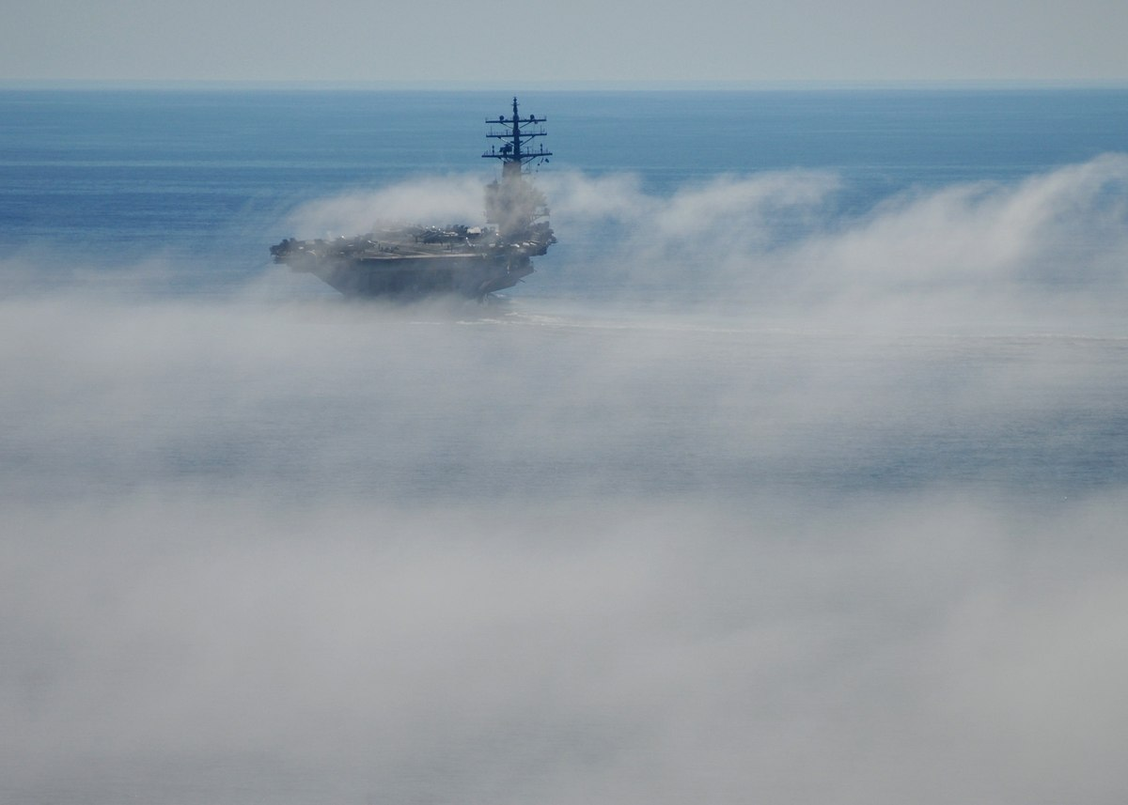
Contributions to
CFOG
Eric Pardyjak and Sebastian Hoch
University of Utah
C-FOG Kickoff Meeting, 21 May 2018, Notre Dame University
© NAVY/Dylan McCord

Slide 2
MOTIVATION:
Halifax video?

Slide 3
MOTIVATION / OVERVIEW / SCIENTIFIC FRAMEWORK
Fundamentals
Life cycle, radiative transfer, turbulence,
Boundary Layer Structure
ADD ARROWS
Thermodynamics
radiative mechanisms, cooling, phase changes
Microphysics
droplet characterization, nucleation
Fog Detection
Fog Forecasting

Slide 4
fundamentals (life cycle, radiative transfer, turbulence, and boundary-layer structure)
microphysics (droplet characterization, nucleation)
thermodynamics (radiative mechanisms, cooling, phase changes)
detection (in-situ and path measurements, profiling and remote sensing), satellite observations (GOES-R, MODIS)
forecasting/numerical modeling (mesoscale and microscale modeling, validations, parameterizations).
topographic features, land use (e.g., vegetation, lakes), sea/land
breezes, and land-sea heterogeneity (Bari et al. 2015; Huang et al. 2015).
Radiation and aerosols usually intensify fog, but at times they sharply reduce fog due to turbulent mixing at the Boundaries
Low forecast skill are the surface heating/cooling and moisture bias in the
boundary layer. Specifically, these biases are more pronounced at the marine-land interface. Detailed fog microphysics and radiation algorithms are needed for better forecasts

Slide 5
Contributions of the University of Utah Team
Processes related to fog development, fog life cycle and fog dissipation, that are in the focus of our (UU) contribution to CFOG:
Turbulence
Radiation
Surface Energy Balance
Observational focus will be at the land-coast-ocean interface – to be tied into ocean-based observations.
Observations are designed to
advance basic understanding
model validation
parameterization development
Boundary Layer Evolution
Spatial and temporal scales covered ?

Slide 6
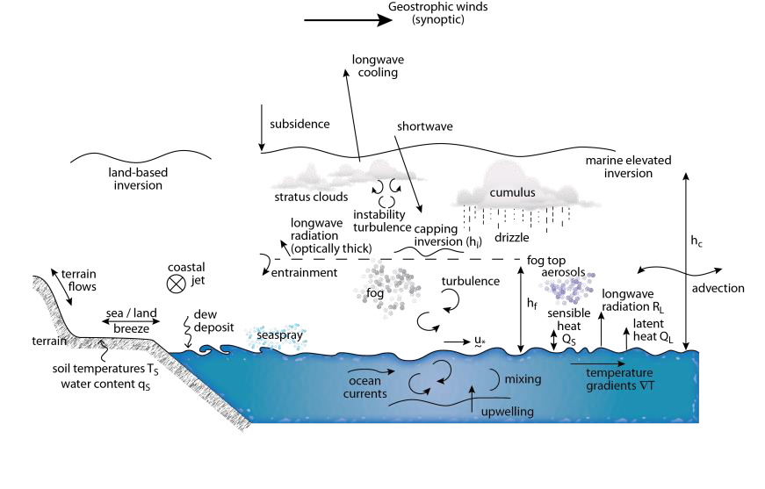
UU Focus

Slide 7
Processes related to fog development, fog life cycle and fog dissipation, that are in the focus of our contribution to CFOG:
Turbulence
Radiation
Surface Energy Balance
Link back to modeling !
“favorable mix of dynamic, microphysical and thermodynamic
Processes”
Incomplete understanding of relevant physical-radiative processes, thermodynamic and dynamic complexity, and space-time scales over which fog processes are distributed.
develop high fidelity sub-grid parameterizations for fog based on deeper understanding of physical, dynamical and thermodynamic processes
(Koračin et al. 2014)
lack of understanding of the interplay of microphysical properties of fog, turbulence, local energetics and land-surface (Bari et al. 2015; Chaouch et al. 2017).

Slide 8
Surface Energy Balance
What is the role of surface energy balance differences in driving boundary layer contrasts affecting the life cycle of coastal fog?
What are the feedback mechanisms between fog and the surface energy balance
Observational Strategy:
1) Coast -to- Inland transect
Observational Tools/ Instrumentation
Radiation balance (LW, SW, upward and downward)
Sensible heat flux (H)
Latent heat flux (L)
Ground hear flux (heat flux plates, soil temperatures)
Soil Moistures, thermal properties
Land / Sea Breeze & Advective flows
Larger scale (synoptic) influences – radiosonde launches
LEMS (2D-Sonics)

Slide 9
Turbulence (in situ and path-integrated)
What is the role of turbulence in the life cycle of coastal fog?
Observational strategy:
Coast to inland transect
Coastal water surface (integrated)
Observational tools / Instrumentation:
Flux towers (covering a model grid cell)
Sonic Anemometer (momentum and sensible heat flux H)
EC150 (latent heat flux L)
Scintillometers (microwave & optical; path- integrated H and L)
Doppler Wind Lidar (sigma_w; flow structure, waves, … close collaboration with other LiDARs anticipated)
Model validation / parameterization testing and development

Slide 10
Radiation (clear air cooling, radiative flux divergence)
What is the role of radiative cooling in the life cycle of coastal fog?
How is the radiative field altered with fog advection?
What are the radiative feedbacks?
Observational strategy:
Coastal tower(s) equipped with multiple levels of pyrgeometers (LW)
Clear air radiative cooling (radiative flux divergence; RFD) will be directly measured.
Observational tools / Instrumentation:
CGR4 pyrgeometers (Kipp&Zonen), carefully calibrated relatively to each other.
Homogeneous environment (land cover) around tower needed
Model validation / parameterization testing and development

Slide 11
Boundary Layer Evolution
What are the feedbacks between Atmospheric Boundary Layer (ABL) evolution and fog along the inland-Coast-Ocean ?
Role of land/sea breeze on fog evolution?
Synoptic influences?
Observational strategy:
Monitor the thermodynamic and dynamic ABL evolution at the coastal interface, as well as aerosol vertical structure via in situ and remote sensing
Observational tools / Instrumentation:
Tethered Balloon (T,RH,u,d, Aerosol/Droplet size distribution (OPC)
Flux towers
UAV
Ceilometers (one on coast, one inland)
Wind profile (LiDAR)
Graw radiosondes
Model validation / parameterization testing and development
Radiative transfer / radiation – microphysical feedbacks

Slide 12
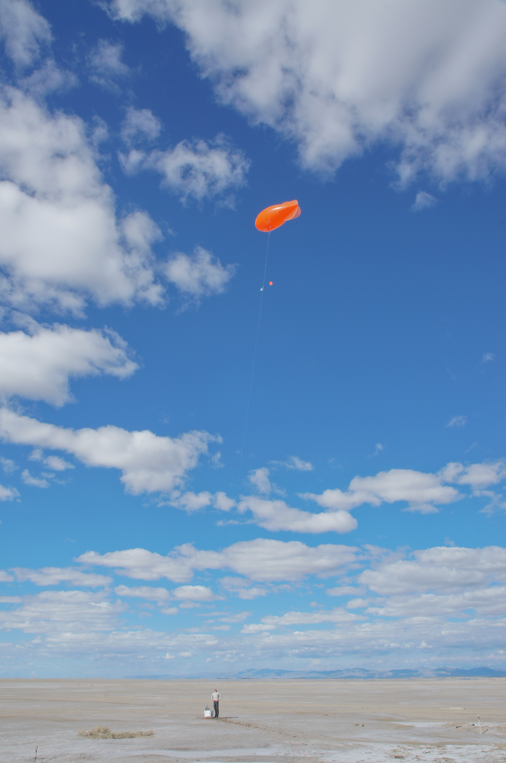
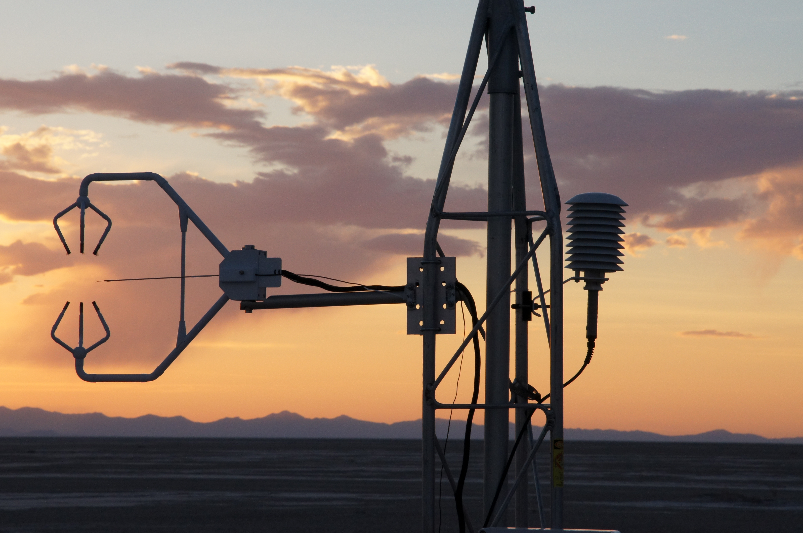
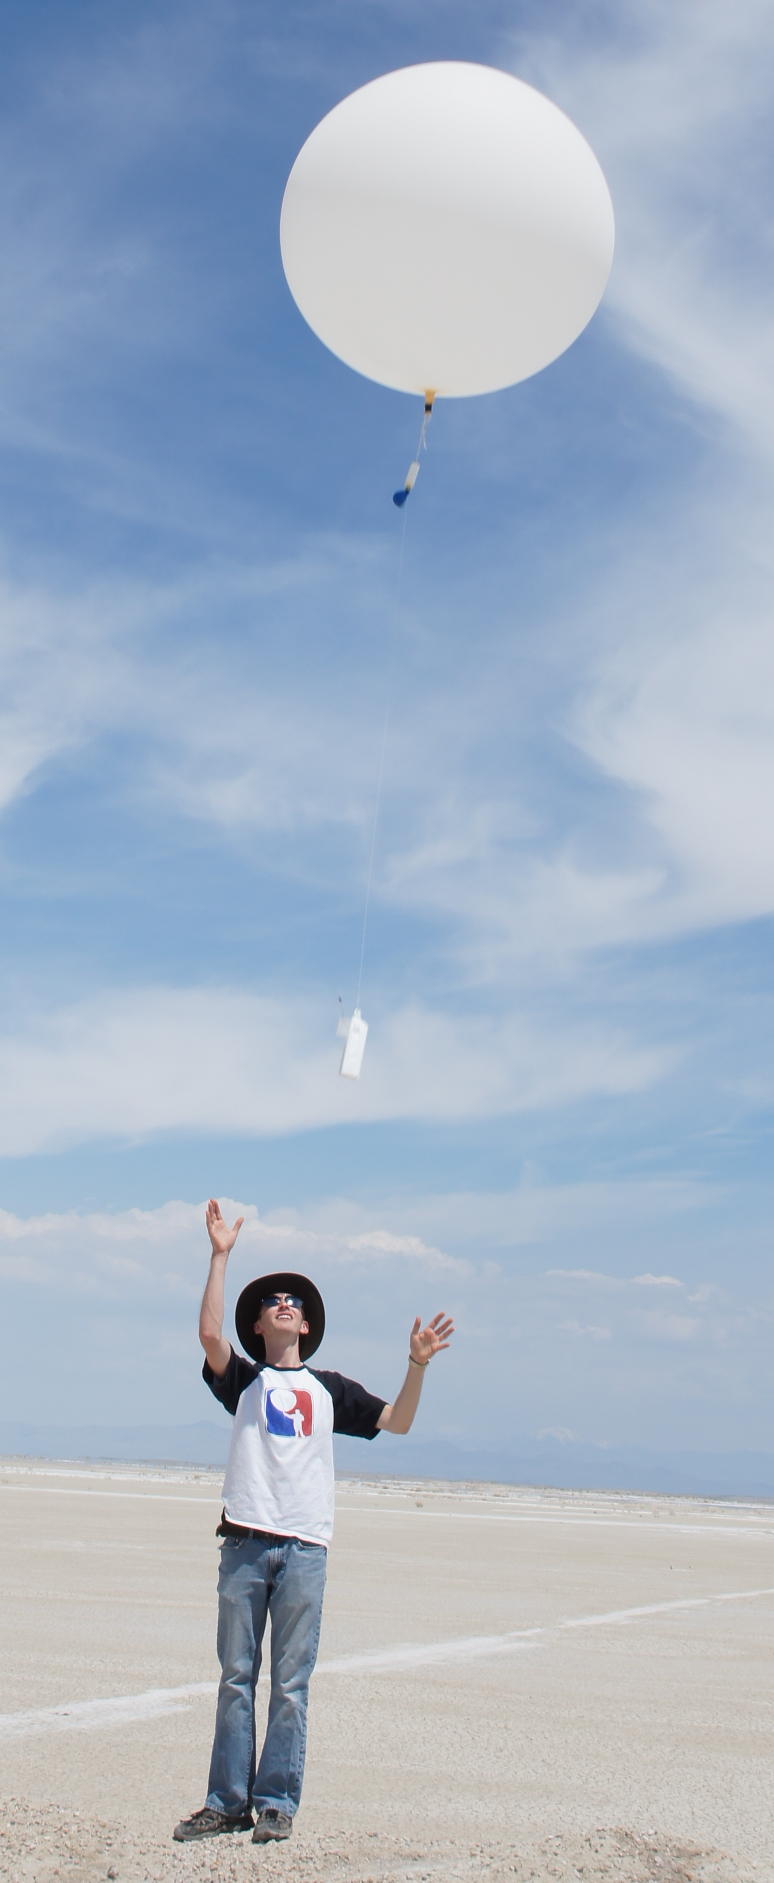
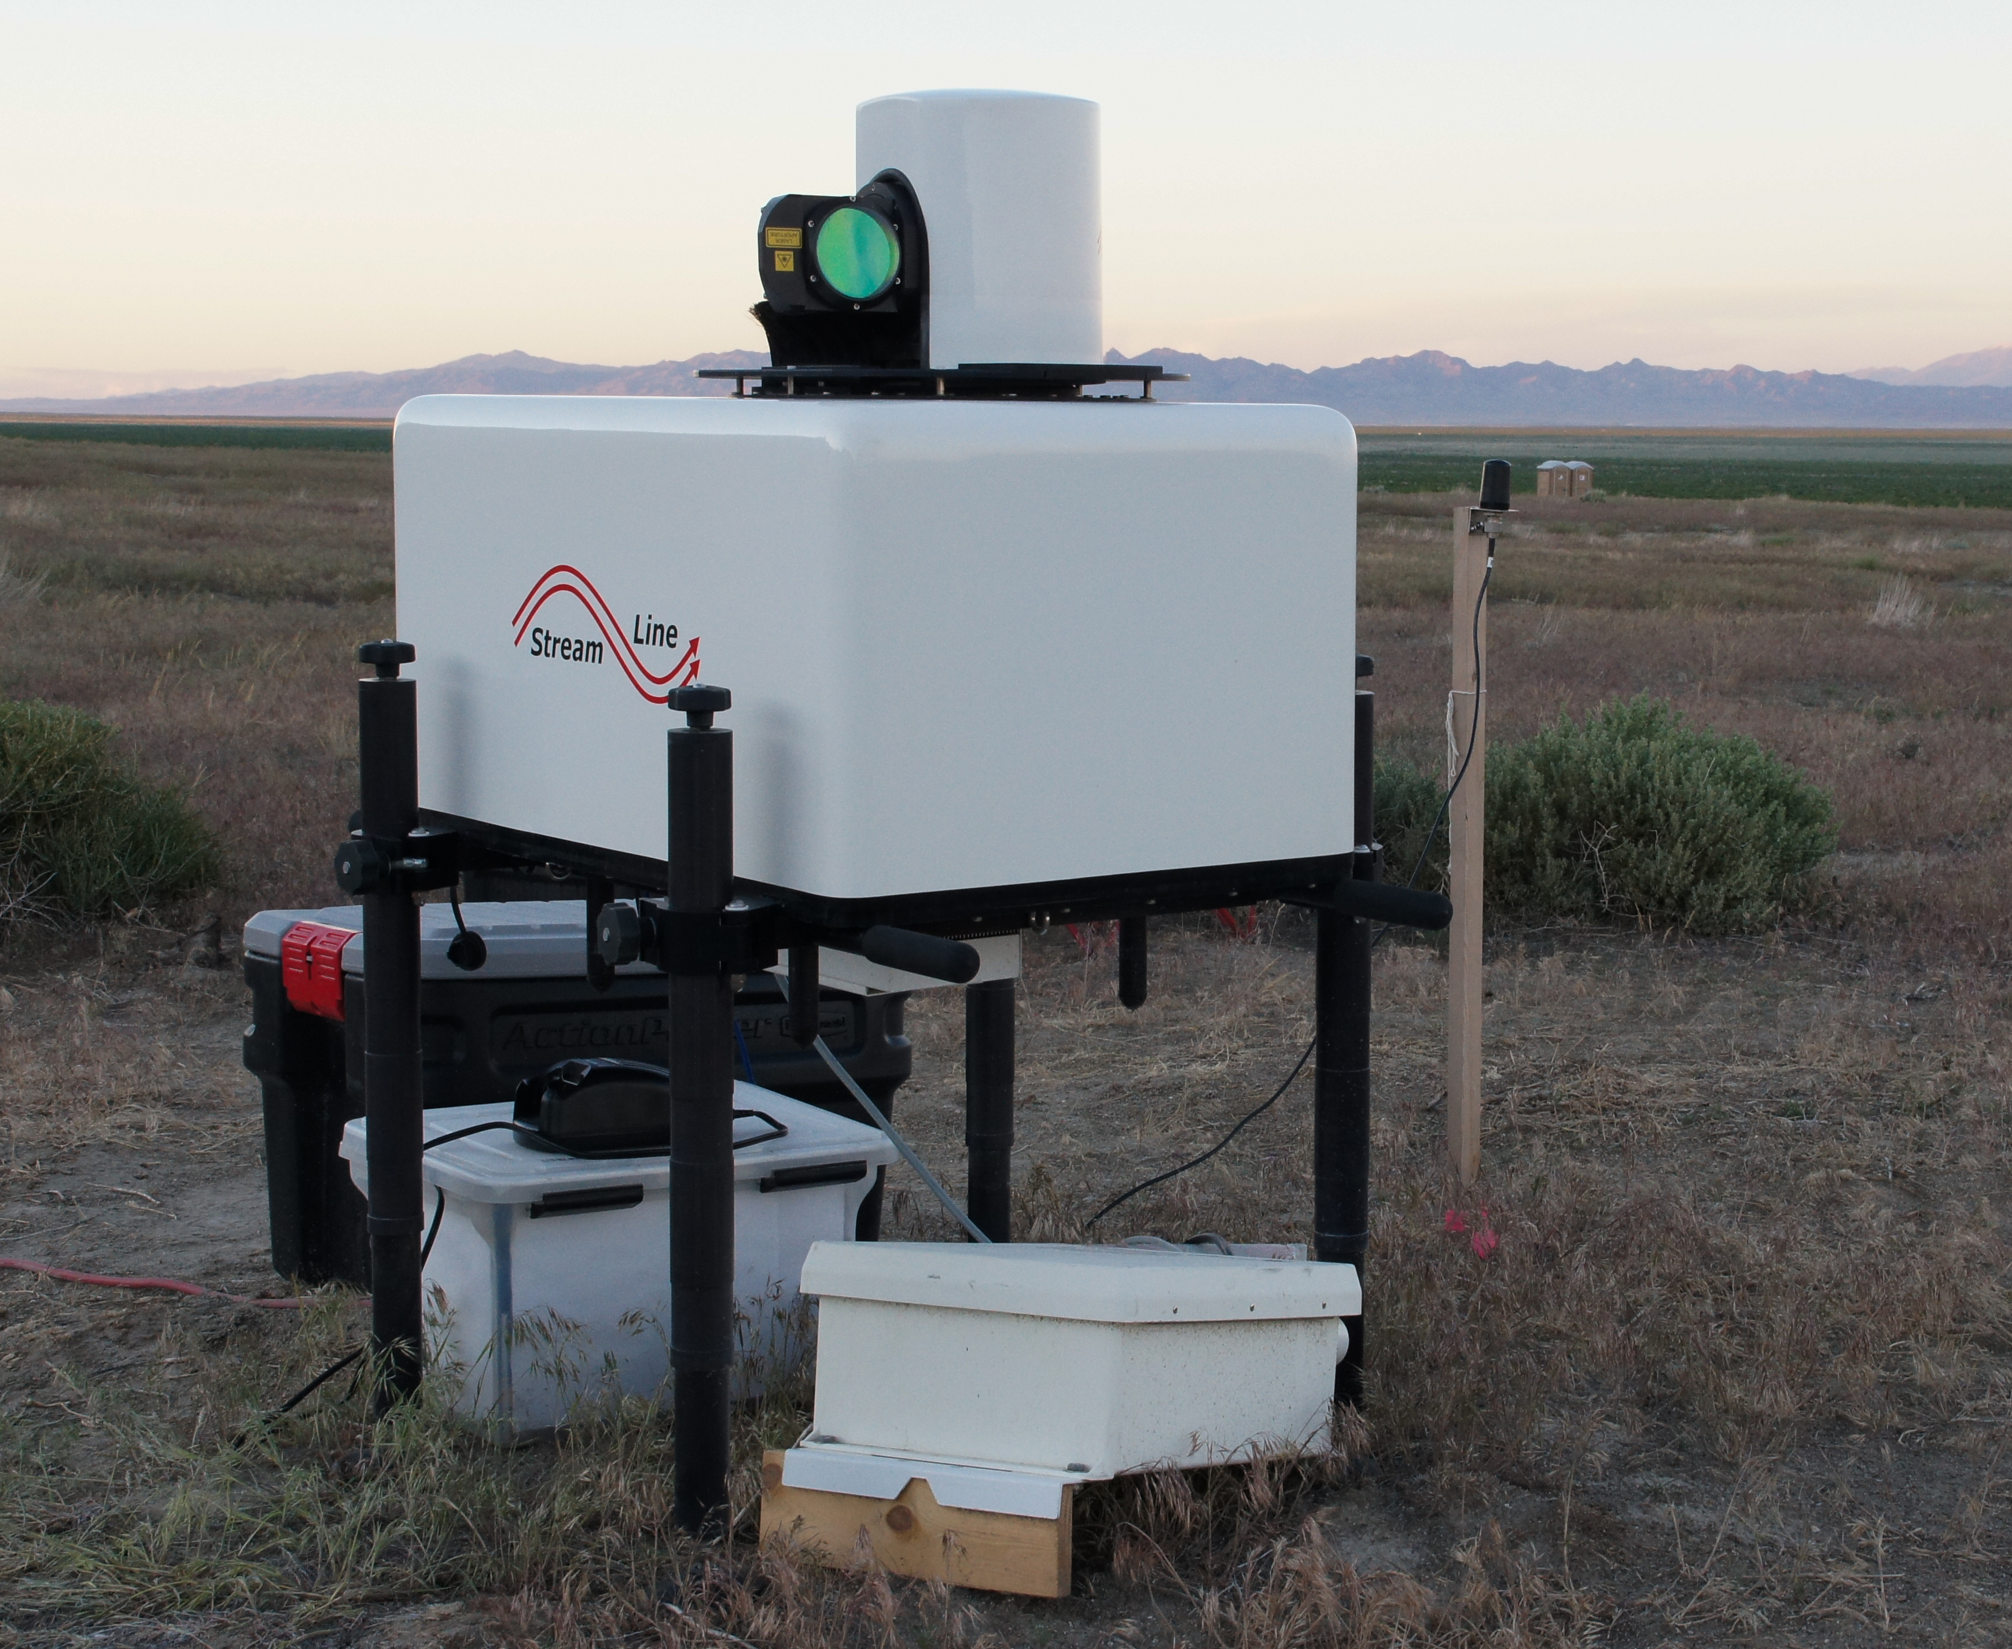
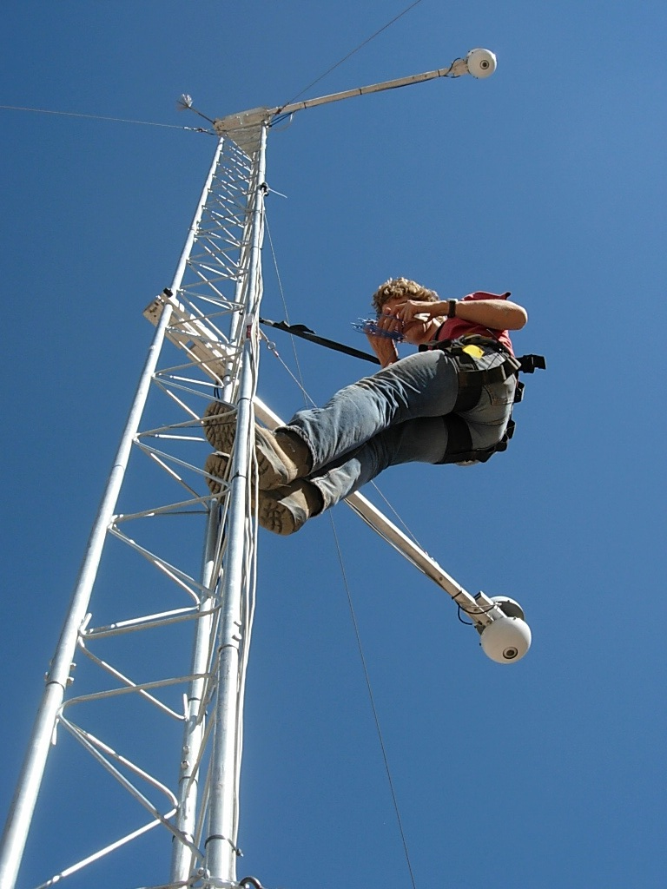
Data Examples

Slide 13
Radiation (clear air cooling, radiative flux divergence)
Careful relative calibration required, homogeneous environment (land cover) around tower needed
Radiative feedback / transition with the development or advection of fog
The radiative feedbacks in the fog life cycle will be investigated via direct observations of the surface radiation budget. We will also make direct observations of clear-air radiative cooling (radiative flux divergence, RFD) at the coastal tower site by measuring longwave in- and
outgoing radiation at two heights above ground using carefully calibrated pyrgeometers (K & Z CGR4). The introduction of fog particles will modify the radiative exchange processes depending on their radiative properties (Hoch et al. 2007, 2016). Co-located observations of fog particle properties (size distribution, phase, etc.) will allow validation of radiative transfer calculations and parameterizations used in NWP models.

Slide 14
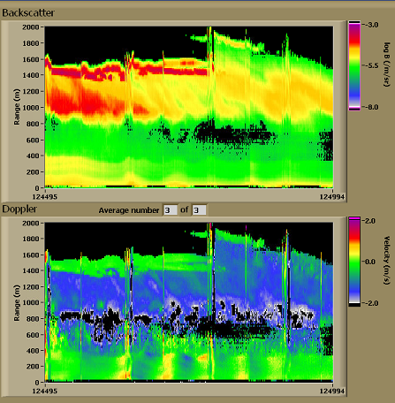
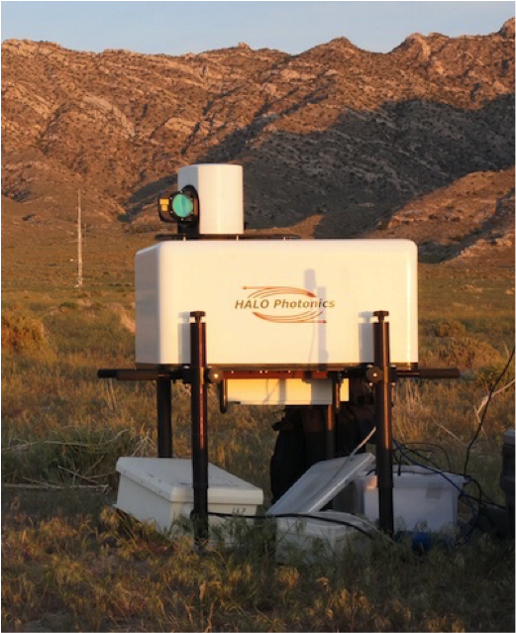
LiDAR observations
measure the spatial gradients
and vertical profiles of meteorological variables. The use of Lidars, however, will be limited during thick fog.
… close collaboration with other LiDARs anticipated
MATERHORN Fog 10 Jan 2015 1800

Slide 15
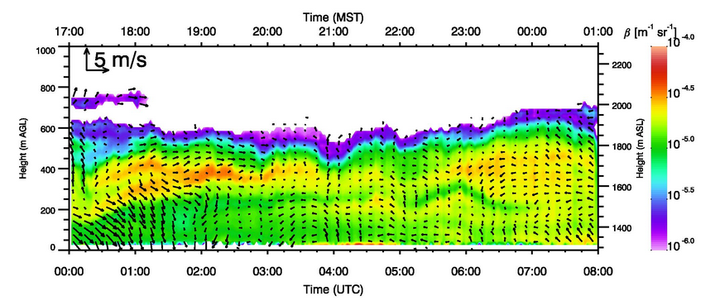
8-9 January 2015
Lake breeze, gravity waves
MATERHORN-Fog, Salt Lake Valley study site

Slide 16
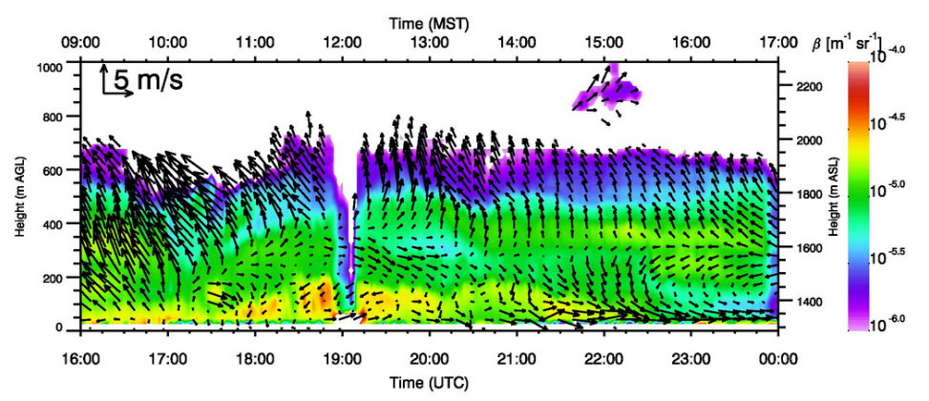
8-9 January 2015
Interactions between thermally driven (lake-land breeze, down-valley) and synoptic circulations
MATERHORN-Fog, Salt Lake Valley study site

Slide 17
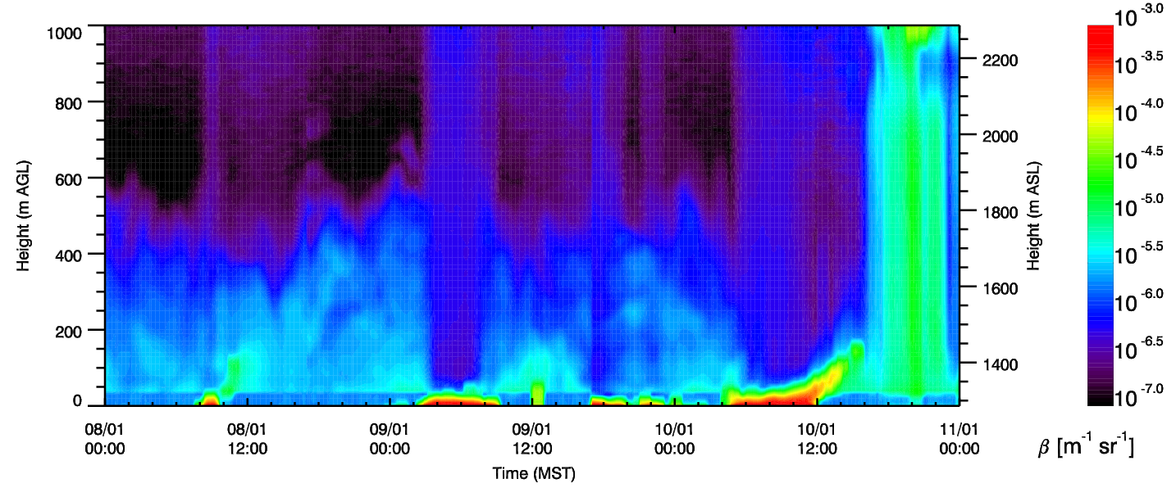
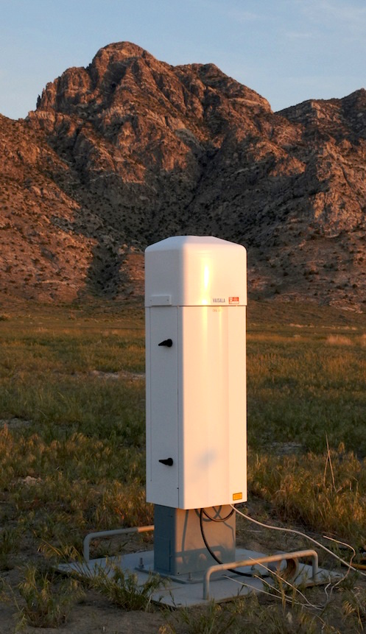
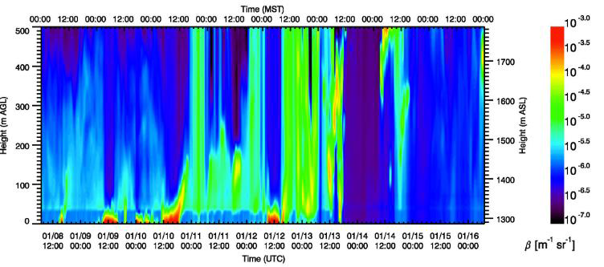
Ceilometer observations
Ceilometer backscatter at SLC site, 8-11 Jan. 2015
Vaisala, CL31
MATERHORN Fog, Salt Lake City site

Slide 18
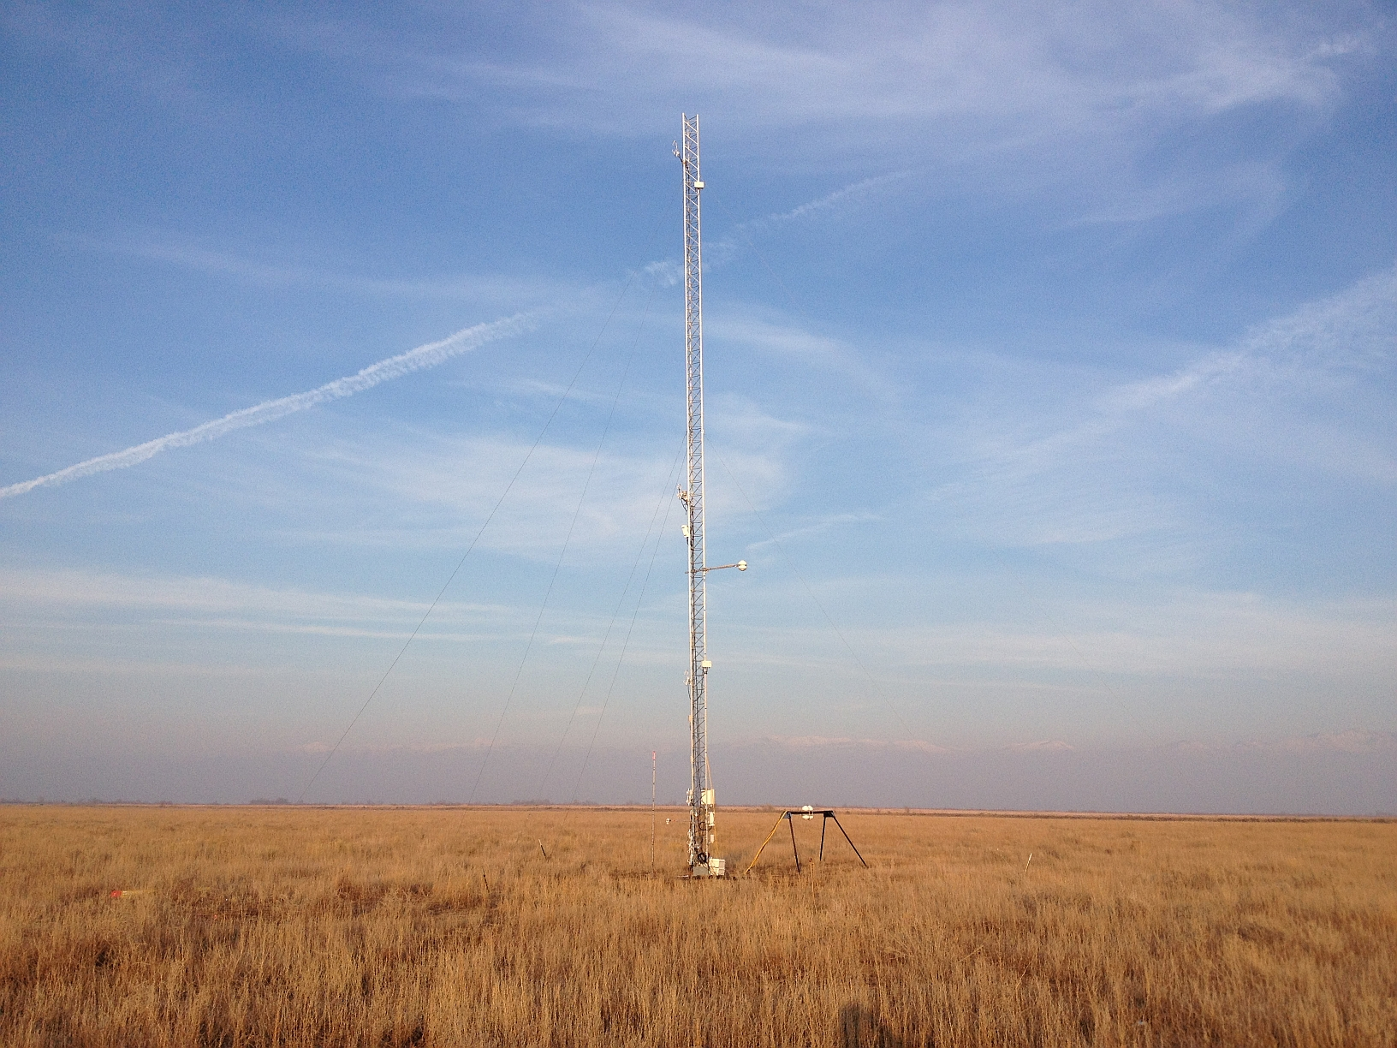
Radiative feedback / fog

Slide 19
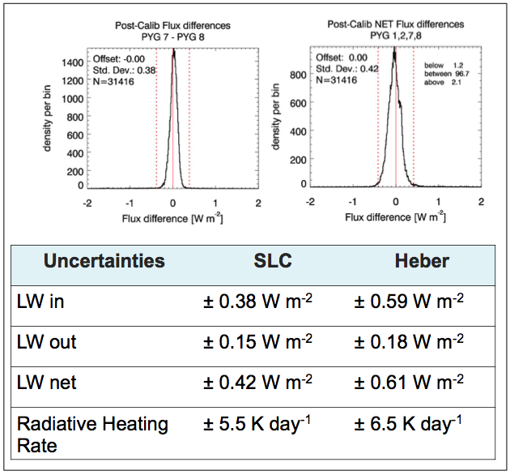

Slide 20
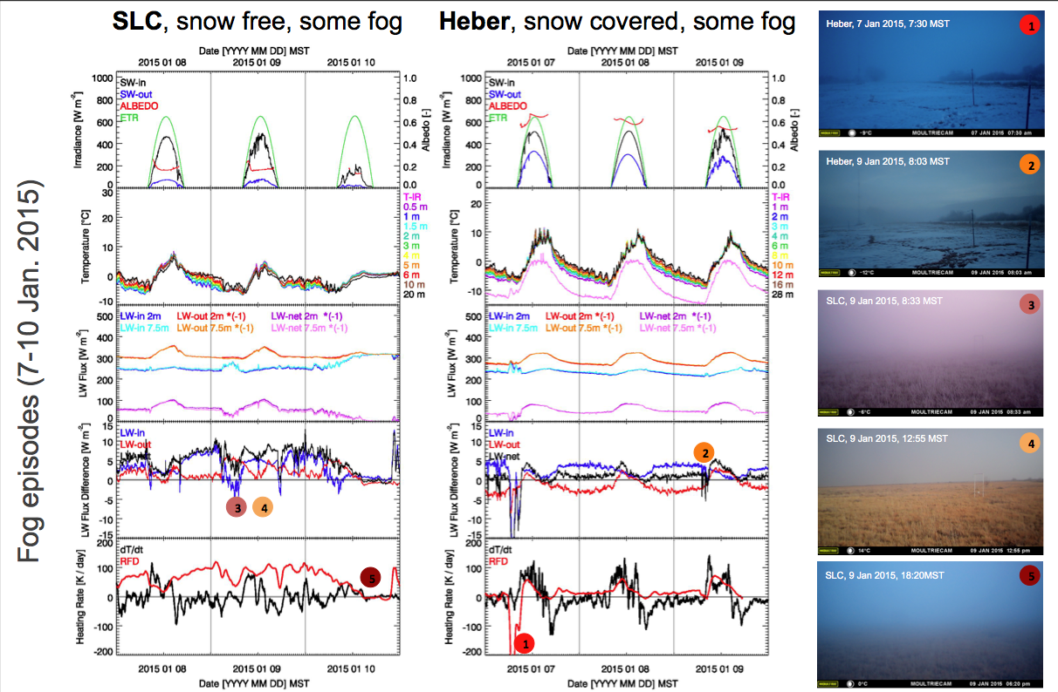

Slide 21
Highlight results from Chao’s fog paper – Heber – that are relevant

Slide 22
List of UU Equipment
UU: Network of Local Energy-budget Measurement Stations, LEMS (12), Vaisala TSB-9 Portable Tethered Meteorological Tower with tethersondes (4) and light-weight optical particle counters (5), BLS9000 optical scintillometer, RPG-MWSC-160 Microwave Scintillometer, Halo Photonics Streamline XR Doppler wind Lidar (1), Vaisala CL31 Ceilometers (2), Graw radiosonde system (1), Campbell Scientific Sonic Anemometers (13), Cambell Scientific EC150-
Open Path Gas Analyzers (3), Kipp and Zonen CNR1 Net radiometer (1), CGR4 pygeometers (6), CMP21 pyranometers (6), Hukseflux HFP01SC self-calibrating soil heat flux plate (6), Hukseflux TP01 soil thermal property probes (3), fine wire thermocouples (~100), FLIR thermal camera, optical cameras (2) .

Slide 23
Acknowledgments
MATERHORN is sponsored by the US Department of Defense, Office of Naval Research.

Slide 26
Ovens Natural Park, optical and microwave scintillometers will be deployed to measure sensible and latent heat fluxes from the sea. The reflector will be located across the bay
at Blue Rocks. A tethered balloon will be deployed with slow measurements of wind speed/direction, humidity, temperature and pressure as well as particle size distribution. An UAV will probe the ABL over land and water at this supersite.

Slide 27
The aircraft carrier Ronald Reagan maneuvers through fog on the Pacific Ocean. (MC3 Dylan McCord/Navy)

