Slide 1
CFOG
Eric Pardyjak and Sebastian Hoch
University of Utah

Slide 2
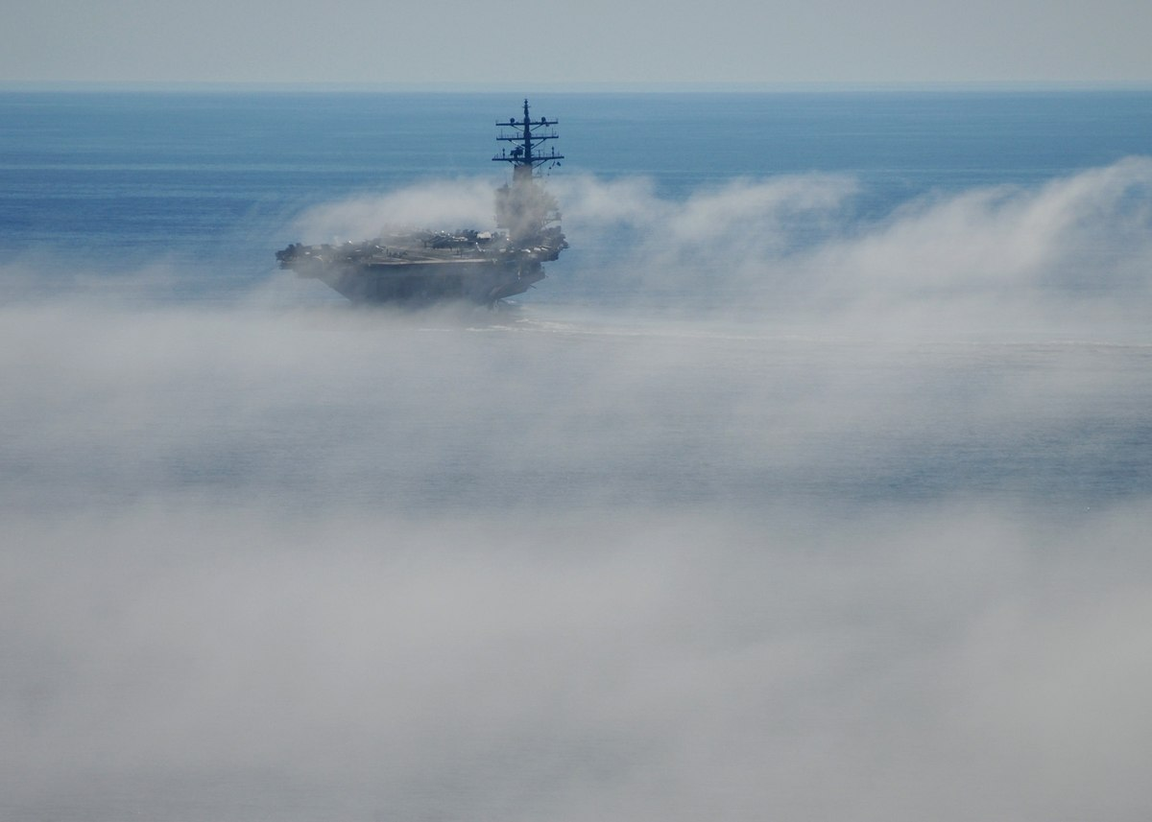
The aircraft carrier Ronald Reagan maneuvers through fog on the Pacific Ocean. (MC3 Dylan McCord/Navy)

Slide 3
Halifax video?

Slide 4
fundamentals (life cycle, radiative transfer, turbulence, and boundary-layer
structure), microphysics (droplet characterization, nucleation), thermodynamics (radiative
mechanisms, cooling, phase changes), detection (in-situ and path measurements, profiling and
remote sensing), satellite observations (GOES-R, MODIS), and forecasting/numerical modeling
(mesoscale and microscale modeling, validations, parameterizations).
topographic features, land use (e.g., vegetation, lakes), sea/land
breezes, and land-sea heterogeneity (Bari et al. 2015; Huang et al. 2015). Radiation and aerosols
usually intensify fog, but at times they sharply reduce fog due to turbulent mixing at the
Boundaries
low skill are the surface heating/cooling and moisture bias in the
boundary layer. Specifically, these biases are more pronounced at the marine-land interface.
Detailed fog microphysics and radiation algorithms are needed for better forecasts

Slide 5
Processes related to fog development, fog life cycle and fog dissipation, that are in the focus of our contribution to CFOG:
Turbulence
Radiation
Surface Energy Balance
Link back to modeling !
“favorable mix of dynamic, microphysical and thermodynamic
Processes”
incomplete
understanding of relevant physical-radiative processes, thermodynamic and dynamic complexity,
and space-time scales over which fog processes are distributed.
develop high fidelity sub-grid parameterizations
for fog based on deeper understanding of physical, dynamical and thermodynamic processes
(Koračin et al. 2014)
lack of understanding of the interplay of microphysical properties of fog, turbulence, local
energetics and land-surface (Bari et al. 2015; Chaouch et al. 2017).

Slide 6
scales

Slide 9
Surface Energy Balance
Coast -to- Inland transect
Radiation balance (LW, SW, upward and downward)
Sensible heat flux (H)
Latent heat flux (L)
Ground hear flux (heat flux plates, soil temperatures)
Soil Moistures, thermal properties.
Drives land breeze
Land / Sea Breeze & advective flows / monitored with LEMS (2D sonics!)
Coupling to Larger scale - Radiosondes

Slide 10
Turbulence (in situ and path-integrated)
Sonic Anemometer (momentum and sensible heat flux H)
EC150 (latent heat flux L)
Scintillometers (path- integrated H and L)
Doppler Wind Lidar (sigma_w; flow structure, waves, … close collaboration with other LiDARs anticipated)

Slide 11
Radiation (clear air cooling, radiative flux divergence)
1 tall or 2 shallow coastal towers equipped with multiple levels of pyrgeometers
Careful relative calibration required, homogeneous environment (land cover) around tower needed
Radiative feedback / transition with the development or advection of fog
The radiative feedbacks in the fog life cycle will be investigated via direct observations of the surface radiation budget. We will also make direct observations of clear-air radiative cooling (radiative flux divergence, RFD) at the coastal tower site by measuring longwave in- and
outgoing radiation at two heights above ground using carefully calibrated pyrgeometers (K & Z CGR4). The introduction of fog particles will modify the radiative exchange processes depending on their radiative properties (Hoch et al. 2007, 2016). Co-located observations of fog particle properties (size distribution, phase, etc.) will allow validation of radiative transfer calculations and parameterizations used in NWP models.

Slide 12
LiDAR
measure the spatial gradients
and vertical profiles of meteorological variables. The use of Lidars, however, will be limited
during thick fog.

Slide 13
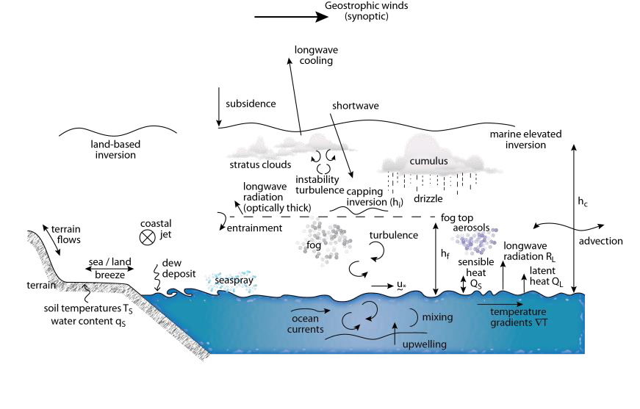

Slide 14
UU: Network of Local Energy-budget Measurement Stations, LEMS (12), Vaisala TSB-9
Portable Tethered Meteorological Tower with tethersondes (4) and light-weight optical particle
counters (5), BLS9000 optical scintillometer, RPG-MWSC-160 Microwave Scintillometer, Halo
Photonics Streamline XR Doppler wind Lidar (1), Caisala CL31 Ceilometers (2), Graw
radiosonde system (1), Campbell Scientific Sonic Anemometers (13), Cambell Scientific EC150-
Open Path Gas Analyzers (3), Kipp and Zonen CNR1 Net radiometer (1), CGR4 pygeometers
(6), CMP21 pyranometers (6), Hukseflux HFP01SC self-calibrating soil heat flux plate (6),
Hukseflux TP01 soil thermal property probes (3), fine wire thermocouples (~100), FLIR thermal
camera, optical cameras (2) .

Slide 15
Ovens Natural Park, optical and microwave scintillometers will be deployed to
measure sensible and latent heat fluxes from the sea. The reflector will be located across the bay
at Blue Rocks. A tethered balloon will be deployed with slow measurements of wind
speed/direction, humidity, temperature and pressure as well as particle size distribution. An UAV
will probe the ABL over land and water at this supersite.

Slide 16
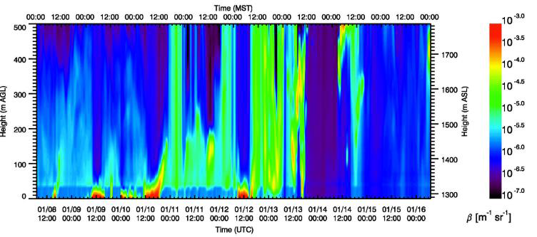
Ceilometers (coast-inland)

