Slide 1
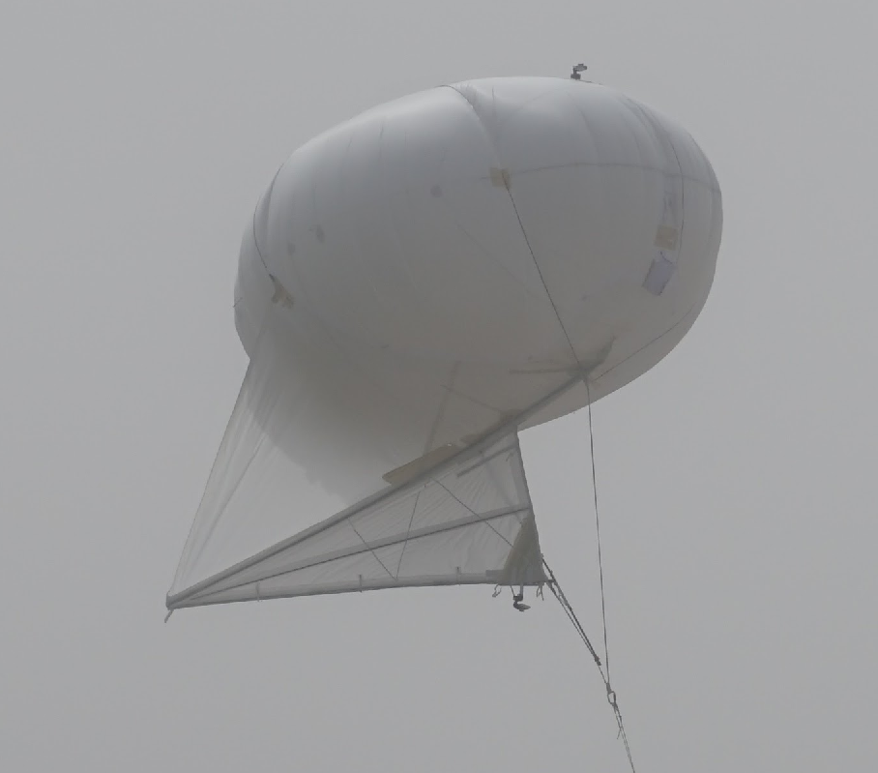
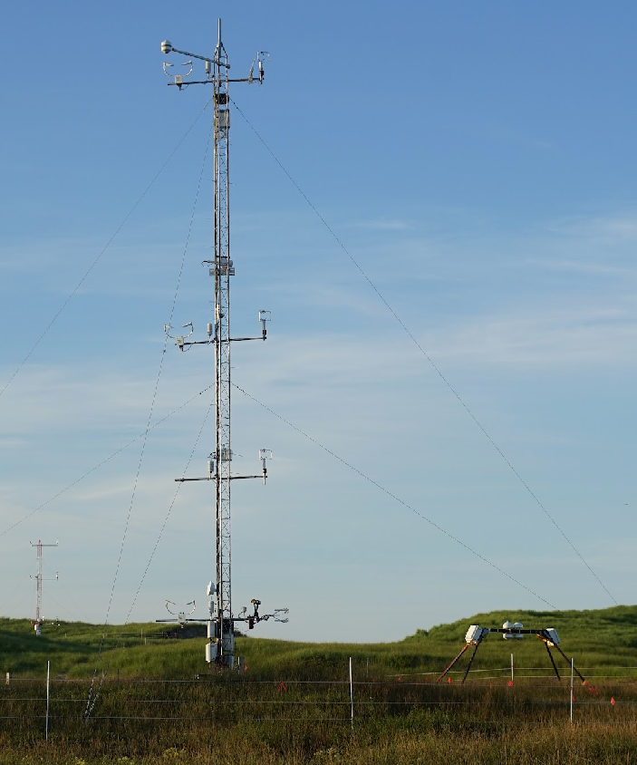
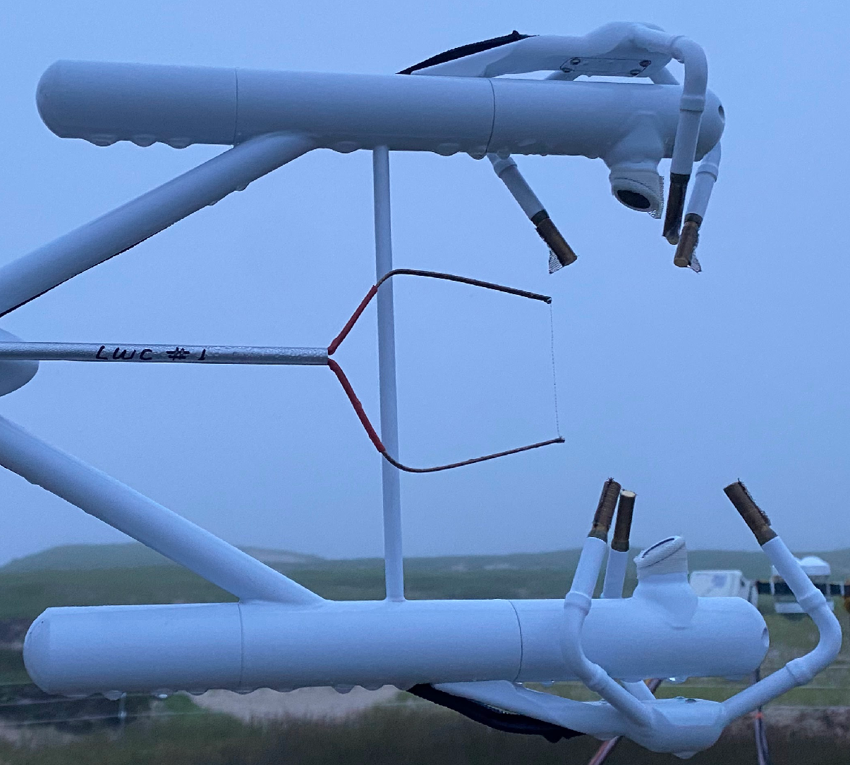
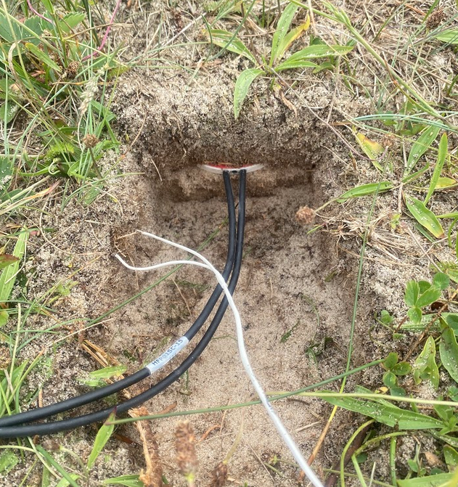
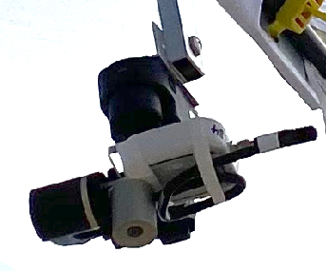
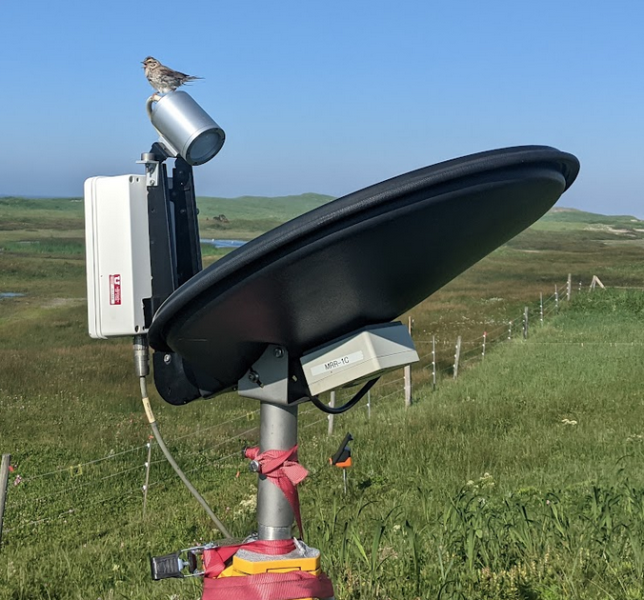
Surface Radiation and Energy Balance on Sable Island
RFD / Radiative cooling in surface layer (2-13 m)
RFD / Radiative cooling - Balloon-Borne observations
LiDAR maintenance / programming / quicklooks
Ceilometer comparisons / quicklooks
LWC probe calibration and deployment
MRR-2

Slide 2
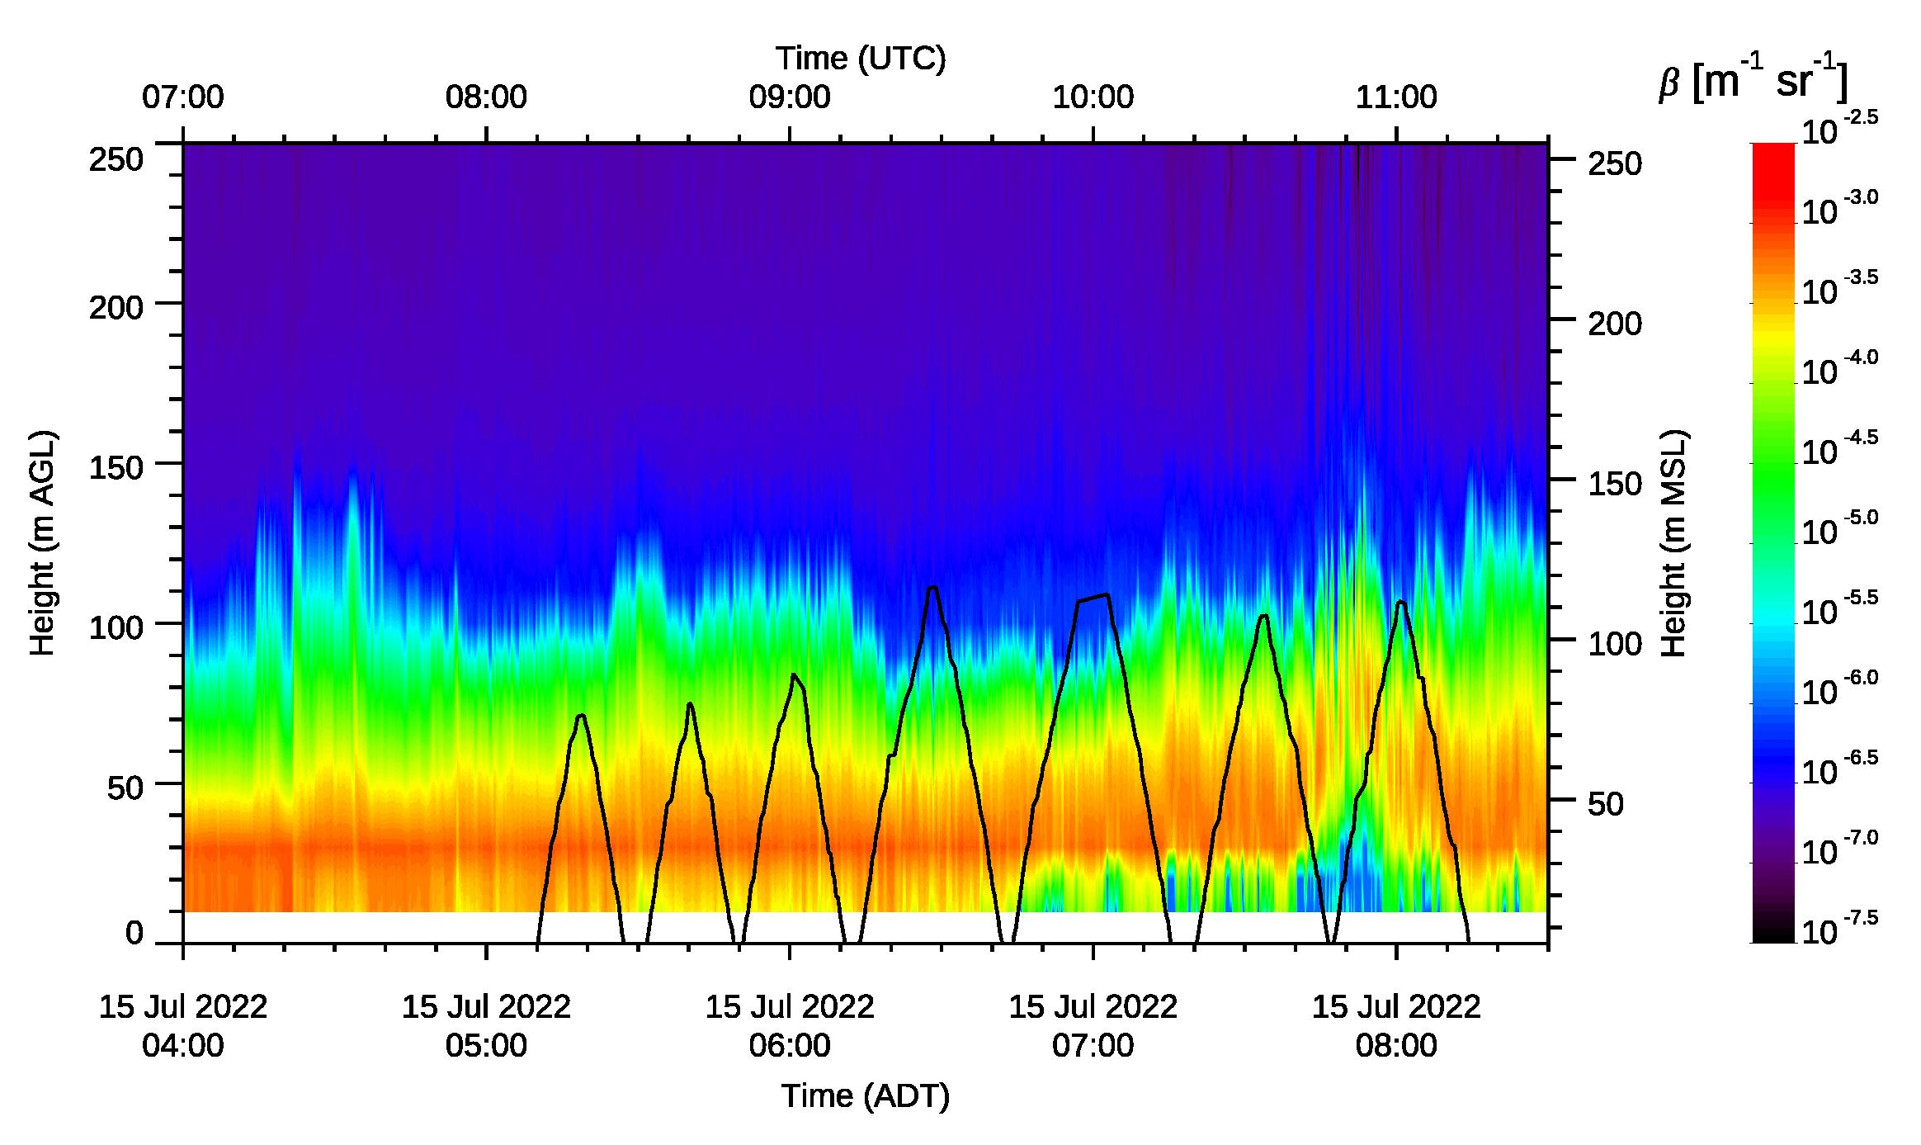
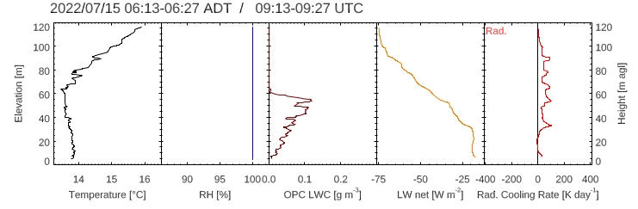
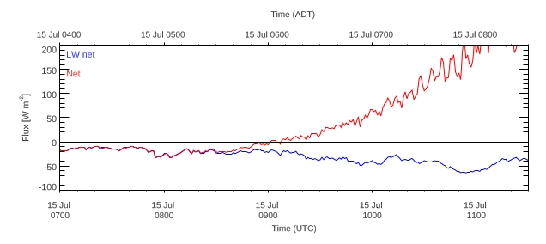
0620 ADT
0620 ADT

