Slide 1


KMA/COMET Olympic Mountain Weather Course
21 September 2016
Sebastian W. Hoch, University of Utah
sebastian.hoch@utah.edu
This morning’s topics:
1. Thermally-Driven Flows - Diurnal Mountain Winds
2. Dynamically-Driven Flows - Terrain-Forced Flows

Slide 2

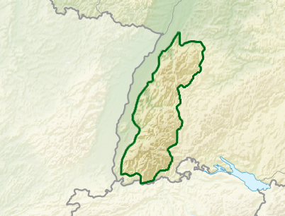


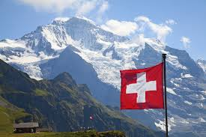
About your instructor …
France
The Black Forest
Germany
Switzerland

Slide 3
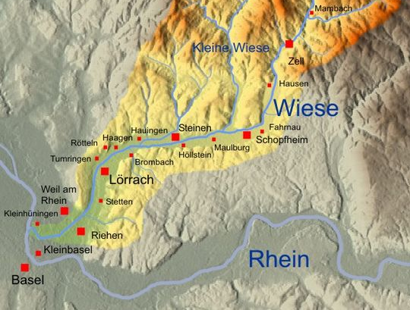
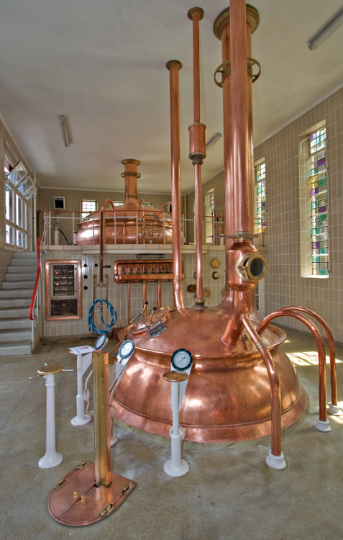

Early triggers of my interests in Mountain Meteorology …
Westerly Flow
Easterly Flow
Local Chocolate Factory
© Luca Galuzzi / www.galuzzi.it
© „Einzugsgebiet und Flusssystem der Wiese“ von benediktleander - Eigene Arbeit auf Grundlage von Maps for Free. Creative Commons
Local Brewery

Slide 4
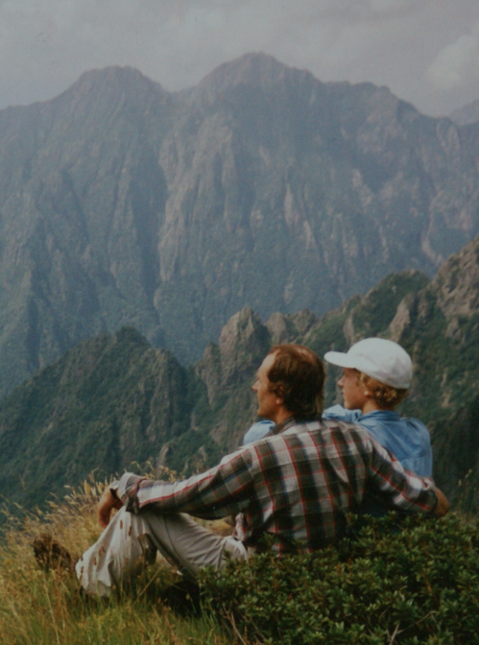
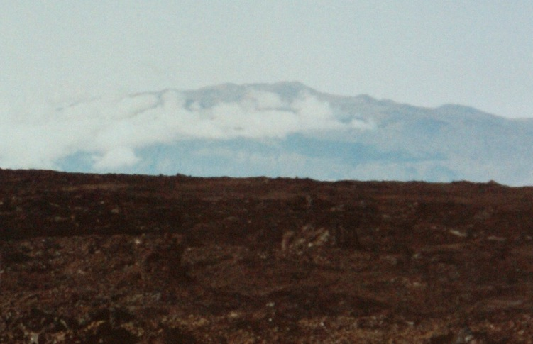
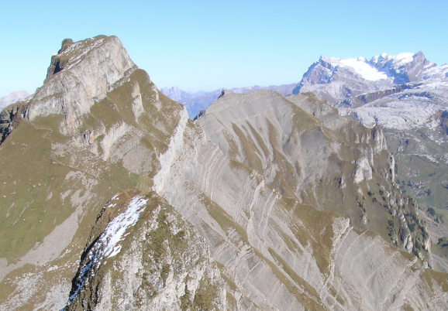
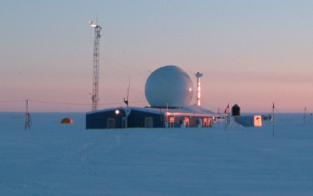
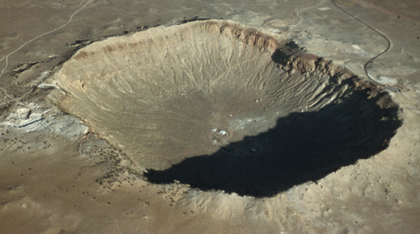
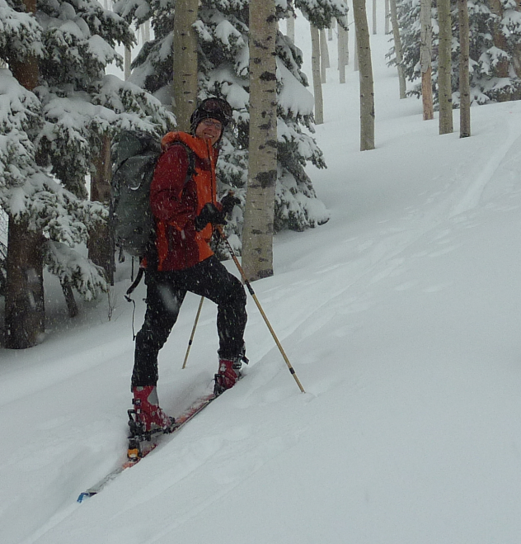
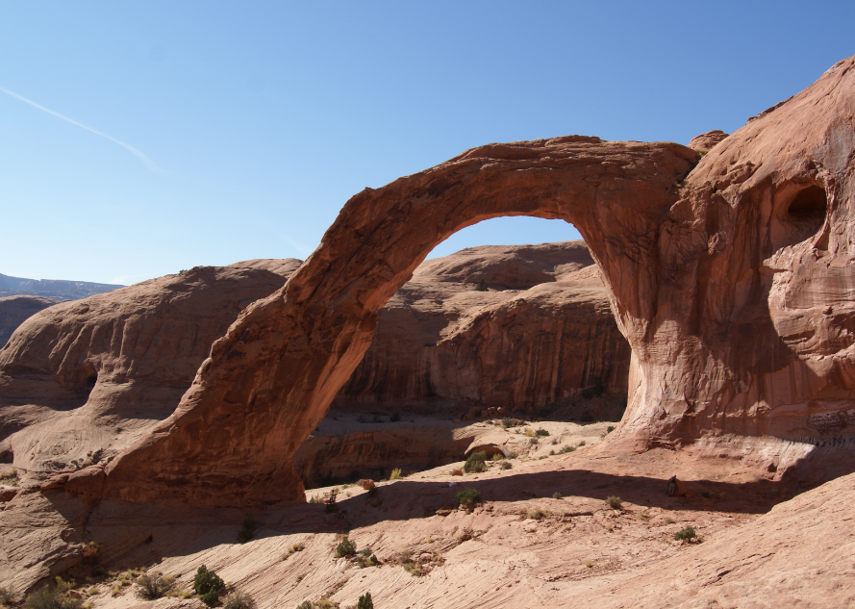
Hiking in the Italian Alps as a teenager
Foreign exchange – Alaska
Month-long field trip to Hawaii
Studies in Earth Sciences at ETH (Swiss Federal Institute of Technology)
PhD work on the Greenland Ice Sheet
Postdoc at the University of Utah with Dave Whiteman
Research Assistant Professor at the University of Utah
Mauna Kea from Mauna Loa
Swiss Alps
Summit Camp, Greenland
Arizona Meteor Crater
Moab, Utah
Skiing Utah

