Slide 1
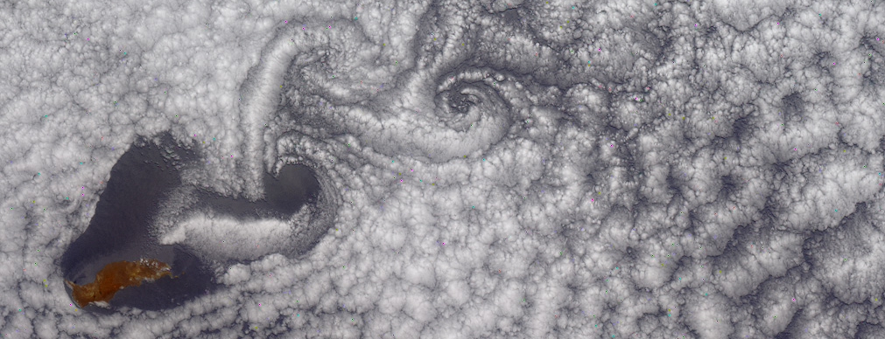
Terrain-Forced Flows
Sebastian W. Hoch
C. David Whiteman

Slide 2

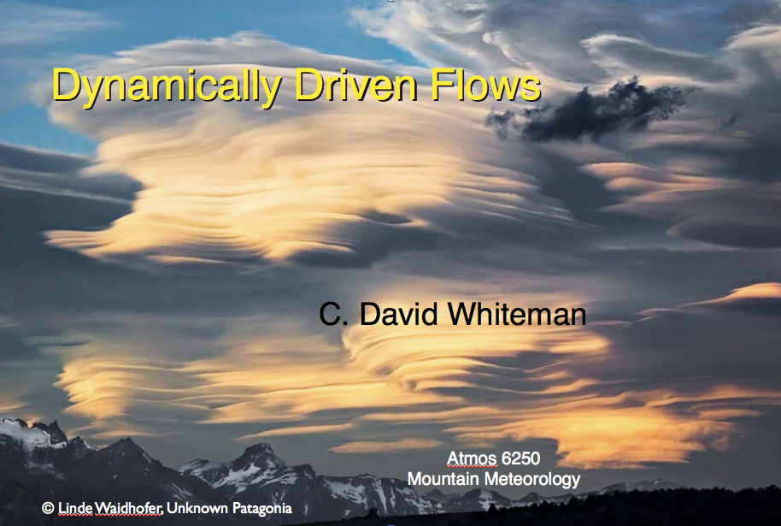
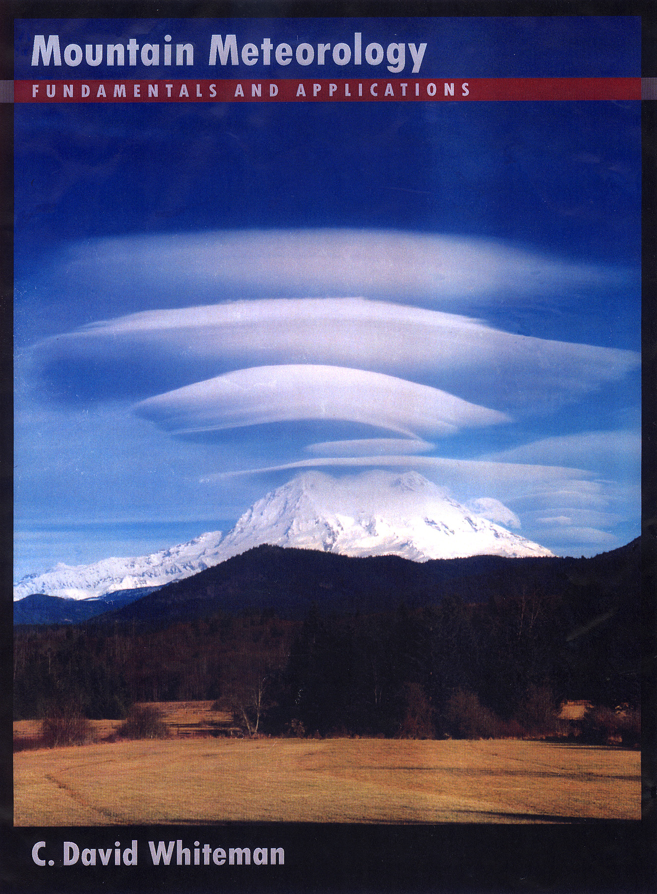
Whiteman; Lecture Atmos. 6250, 2012
C. David Whiteman
Markowski and Richardson (2010):
“Mesoscale Meteorology in Midlatitudes”
Jim Steenburgh, University of Utah
Figures: Whiteman (2000) unless otherwise indicated

Slide 3
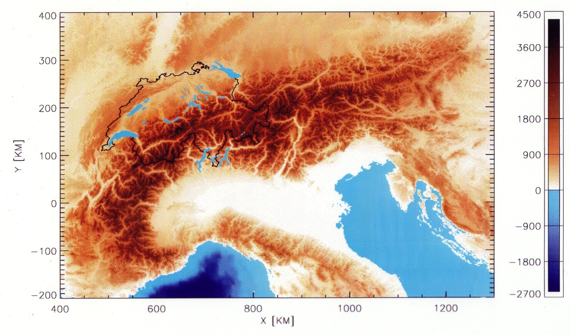
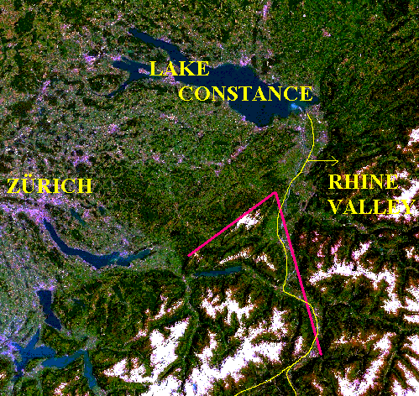

Video from Hoher Kasten
Provided by Reinhold Steinacker

Slide 4
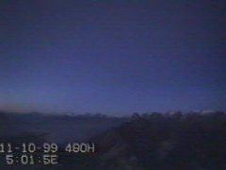

Slide 5
Outline
Introduction
Topography
Blocking/Obstruction of Air Masses
Flow Over Mountains
Flow Around Mountains
Flow Through Passes, Channels and Gaps
Other phenomena

Slide 6
Introduction
Two types of mountain winds
  Diurnal mountain winds (thermally driven circulations): produced by temperature contrasts that form within mountains or between mountains and surrounding plains [this morning]
  Terrain-forced flows: produced when large-scale winds are modified or channeled by underlying complex terrain
Terrain forcing can cause an air flow approaching a barrier to be carried over or around the barrier, to be forced through gaps in the barrier or to be blocked by the barrier.

Slide 7
Three main variables determine the reaction of the approach flow with the terrain barrier:
  Stability of approaching air (unstable or neutral stability air can be easily forced over a barrier. The more stable, the more resistant to lifting. Concept of dividing streamline height.)
  Wind speed (Moderate to strong flows are necessary to produce TFFs. Therefore, most common in areas of cyclogenesis, low pressure, jet streams)
  Topographic characteristics of barrier …

Slide 8
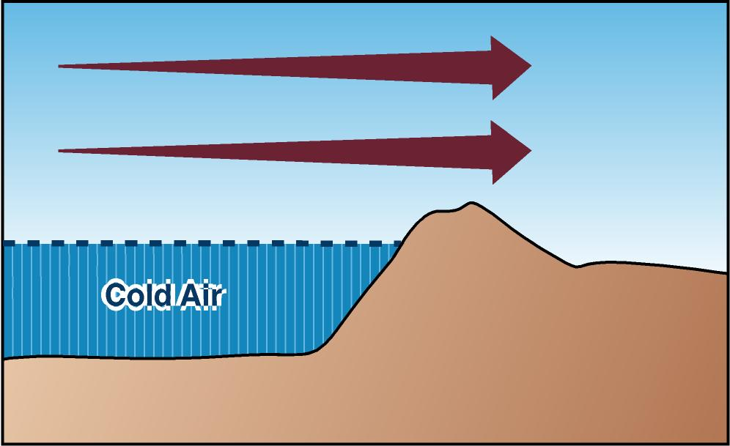
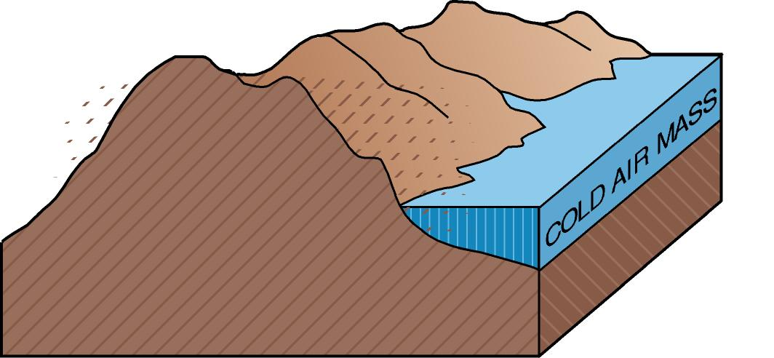
Mountains as flow barriers
Whiteman (2000)
Notes:
Terrain blocking is quite important in the Intermountain Basin (Mayr and McKee, 1995). Blocks can be released over periods as short as 1-3 hours as short wave troughs pass. Cold air masses building up on the plains east of the Rockies can flow through some passes and low ground to enter IB from the NE.

Slide 9
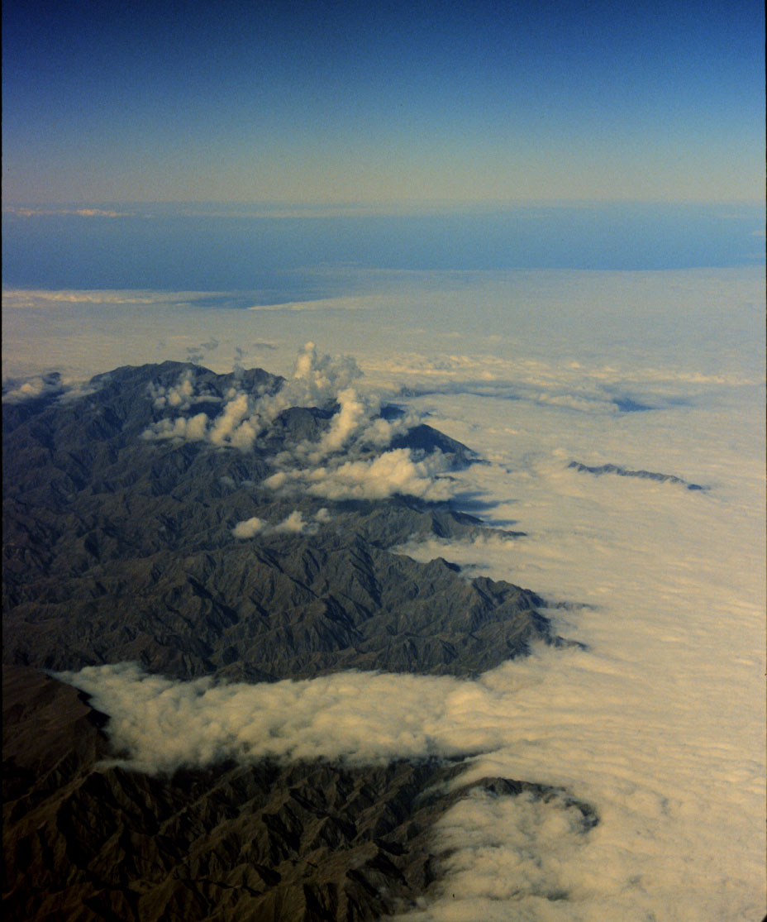
Blocked flow
New Zealand
Whiteman photo

Slide 10
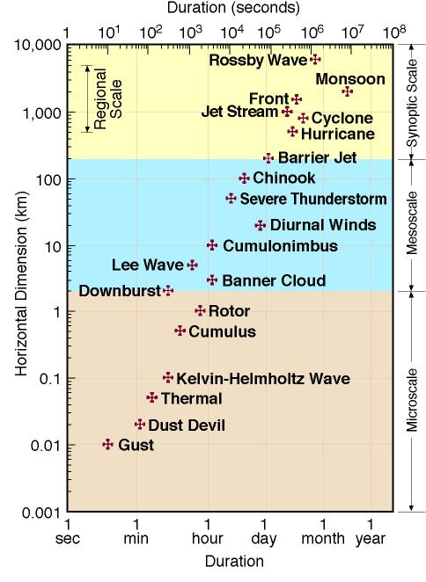
Atmospheric scales of motion
Whiteman (2000)

Slide 11
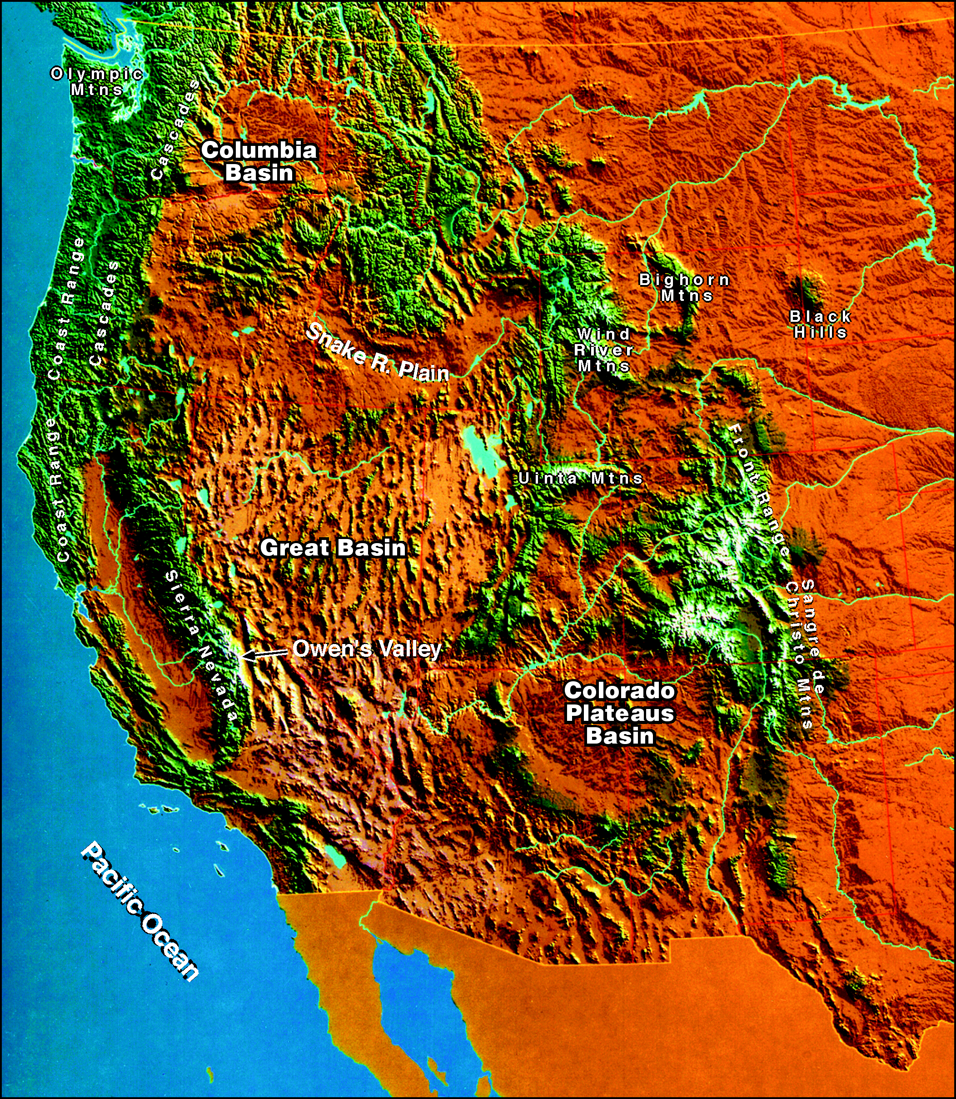
Topography
The Intermountain West
Whiteman (2000)
Notes:
The West’s wind systems are closely related to the types of topography. Ex. Of key features: Snake River Plain, the Wyoming gap, the Intermountain Basin, the Wasatch Range, the Great Salt Lake.

Slide 12
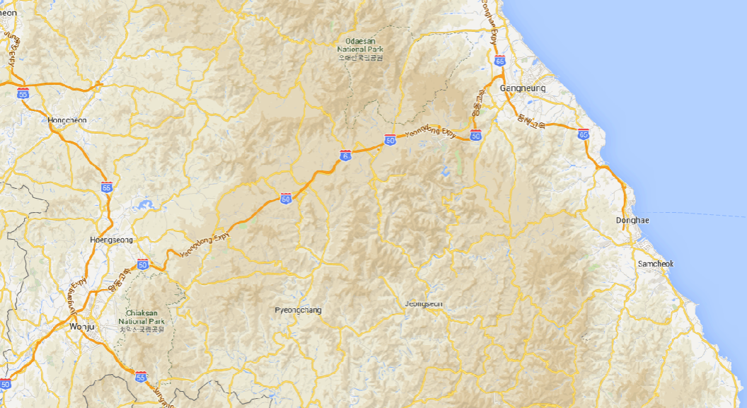
Topography

Slide 13
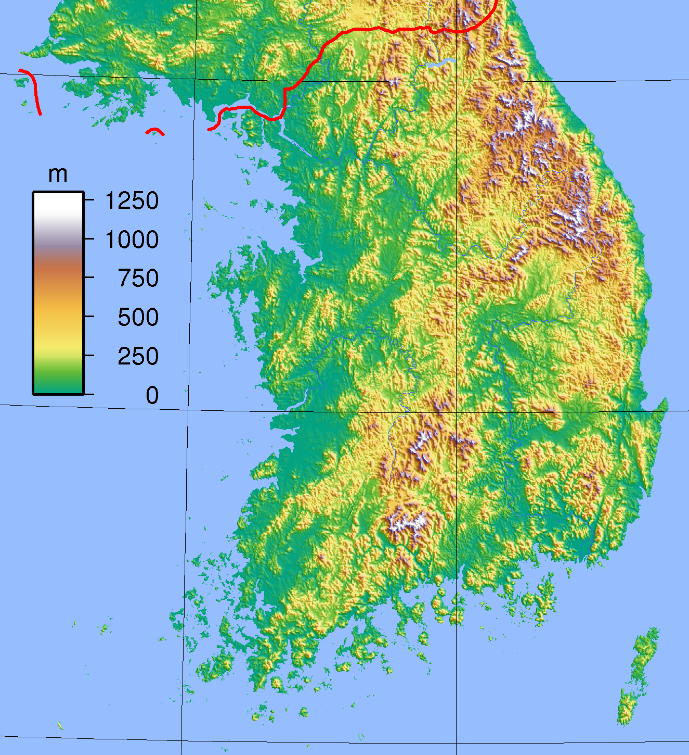
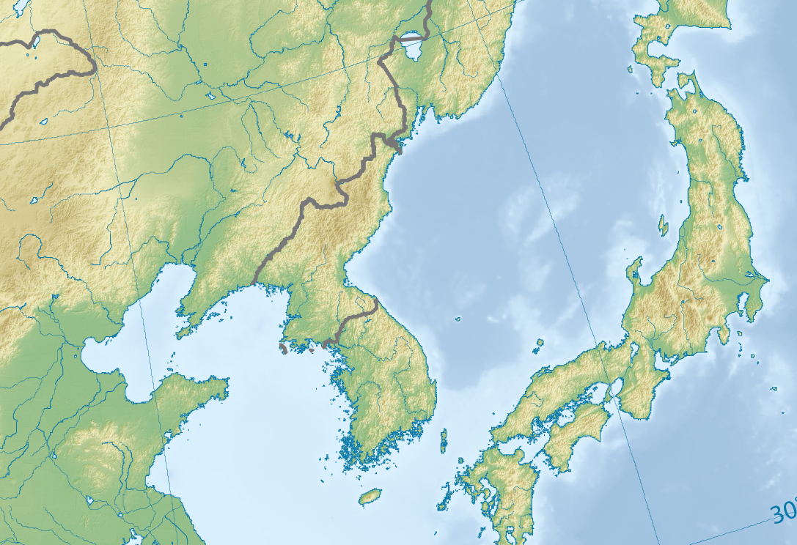
Topography
Own work by Ksiom; Wikimedia Commons
Source: "South Korea Topography” by Sadalmelik - Own work.
Licensed under Creative Commons Attribution

Slide 14
The Basics: Landforms associated with strong and weak surface winds
Expect high winds at sites:
Located in gaps, passes or gorges in areas with strong pressure gradients
Exposed directly to strong prevailing winds (summits, high windward or leeward slopes, high plains, elevated plateaus
Located downwind of smooth fetches
Expect low wind speeds at sites:
Protected from prevailing winds (low elevations in basins or deep valleys oriented perpendicular to prevailing winds)
Located upwind of mountain barriers or in intermountain basins where air masses are blocked by barrier
Located in areas of high surface roughness (forested, hilly terrain)

Slide 15
Wind variations with topographic characteristics, continued …
Wind increases at the crest of a mountain (more so for triangular than for rounded or plateau-like hilltops)
Separation eddies can form over steep cliffs or slopes on either the windward or leeward sides
Speed is affected by orientation of ridgeline relative to approaching wind direction (concave, convex)
Winds can be can be channeled through passes or gaps by small topographic features
Sites low in valleys or basins are often protected from strongest winds, but if winds are very strong above valley, eddies can form in the valleys or basins bringing strong winds to valley floors.
Wind speeds are slowed by high roughness
Concept of ‘effective topography’
In complex terrain, winds respond to landforms (valleys, passes, plateaus, ridges, and basins) and roughness elements (peaks, terrain projections, trees, boulder, etc.)

Slide 16
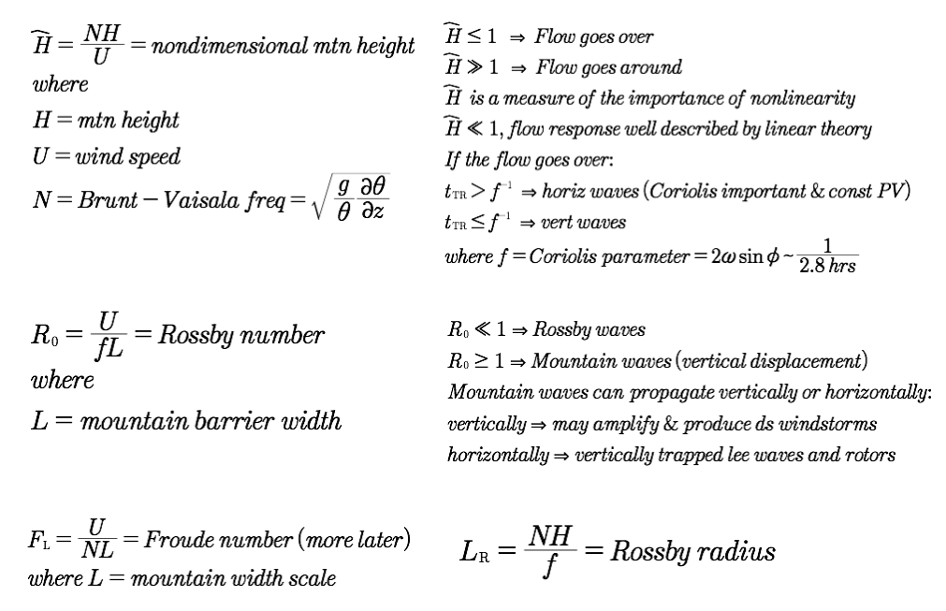
Non-dimensional numbers

Slide 17
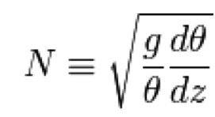
Non-dimensional numbers
ε = h₀N/U : non-dimensional mountain height (aka “inverse Froude number”)
U: cross-mountain wind speed
N: Brunt-Väisälä Frequency
h₀: Mountain Height
ε ≤ 1 : Flow goes over the mountain
ε >>1 : Flow goes around the mountain
ε : describes the importance of nonlinearity
ε << 1, flow well described by linear theory (or constant N and U with height)
If the flow goes over:
t_{TR} > f ⁻¹ : horizontal waves
t_{TR} ≤ f ⁻¹ : vertical waves
Where f =Coriolis parameter = 2ωsinΦ ≈ 1/ 2.8 hr
Smith (1988, 1989)
Reinecke and Durran (2008)
Notes:
E referred to “inverse Froude Number”
E mountain height normalized by a scale for the vertical wavelength of a linear 2D hydro-static mountain wave
ratio of a wave speed to the flow speed;
describes the nonlinearity of the flow since the perturbation U in the linear limit is proportional to NH

Slide 18
Non-dimensional numbers
1) Rossby Number R₀
R_{o} = U/fL
U: cross-barrier wind speed
f: Coriolis parameter
(midlatitudes ~10⁻⁴ s⁻¹)
L: Mountain barrier width
2) Non-dimensional Mountain Height ε
aka “inverse Froude number” (more on Froude number later)
ε = h₀N/U
U: cross-barrier wind speed
N: Brunt-Väisälä Frequency
h₀: Mountain Height
Reinecke and Durran (2008)
ε ≤ 1 : Flow goes over the mountain
ε >>1 : Flow goes around the mountain
ε : describes the importance of nonlinearity
ε << 1, flow well described by linear theory (or constant N and U with height)
If the flow goes over:
t_{TR} > f ⁻¹ : horizontal waves
t_{TR} ≤ f ⁻¹ : vertical waves
Where f =Coriolis parameter = 2ωsinΦ ≈ 1/ 2.8 hr
Smith (1988, 1989)
Notes:
E referred to “inverse Froude Number”
E mountain height normalized by a scale for the vertical wavelength of a linear 2D hydro-static mountain wave
ratio of a wave speed to the flow speed;
describes the nonlinearity of the flow since the perturbation U in the linear limit is proportional to NH

Slide 19
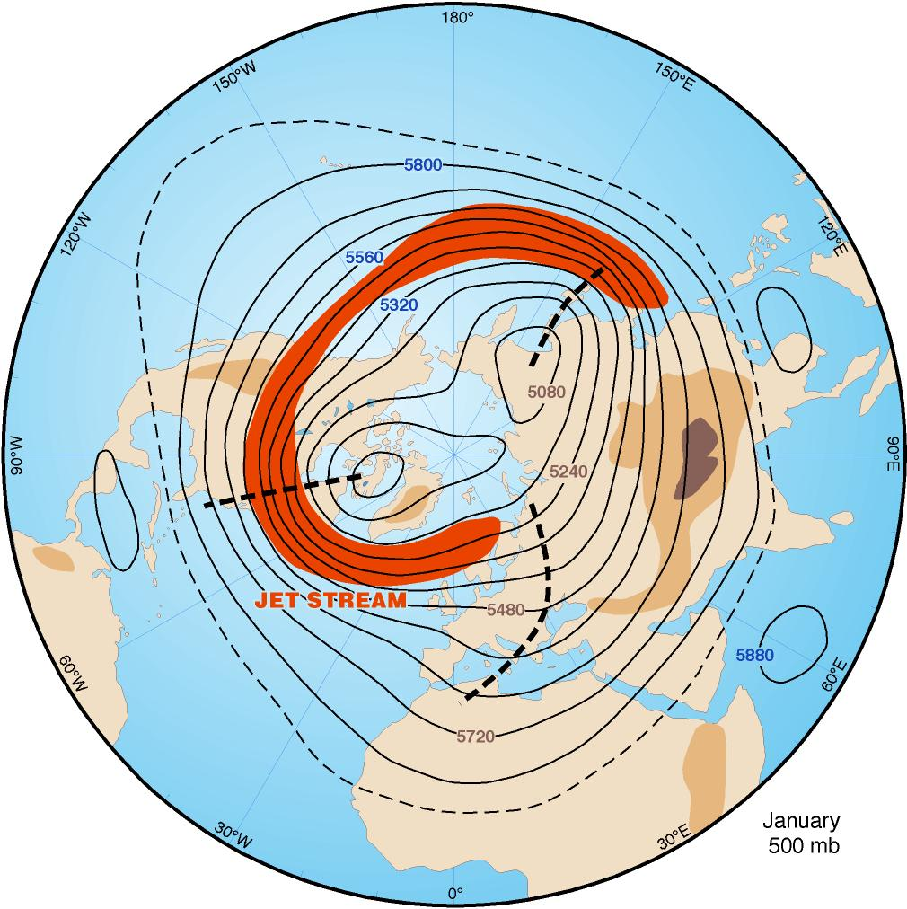
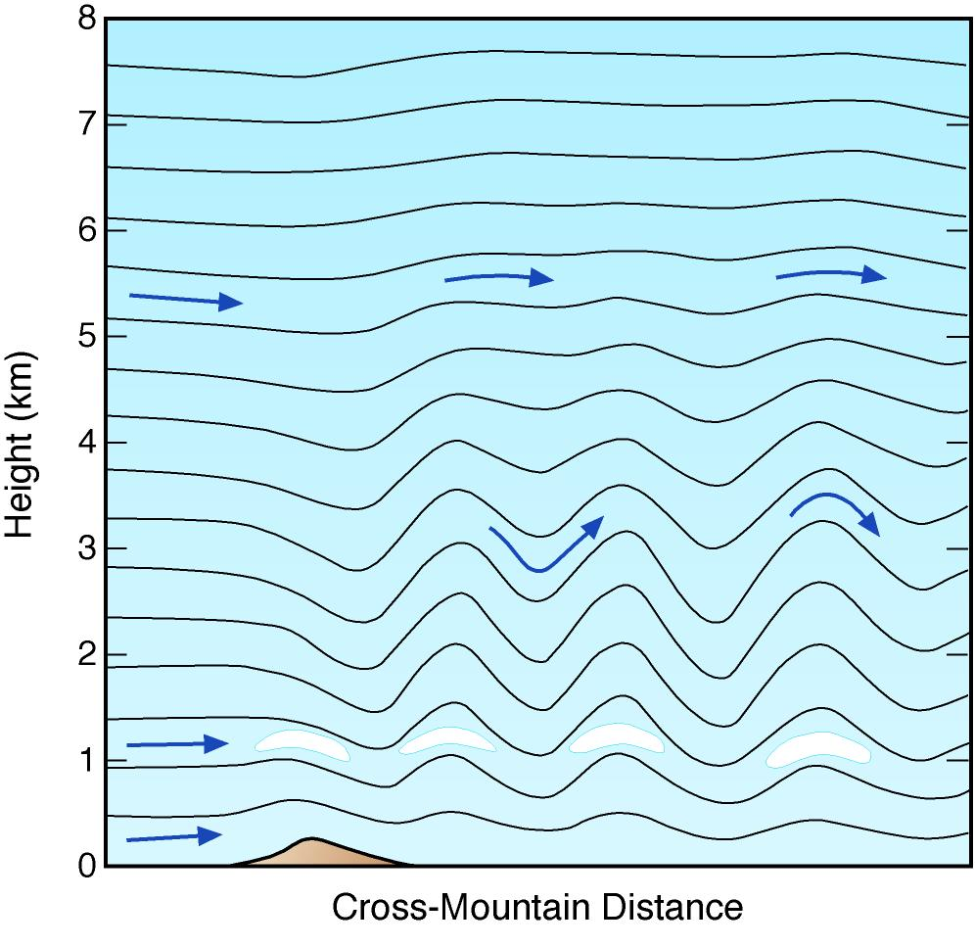
Rossby Number (R_{o}); R_{o} = U/fL
R_{o} << 1
Air takes >> f ⁻¹ to cross barrier
Coriolis force dominates
Parcels displaced horizontally
Rossby waves produced
R_{o} ≥ 1
Coriolis effects negligible
Buoyancy force dominates
Parcels displaced vertically
Mountain waves produced
Images: Whiteman (2000)

Slide 20
Non-Dimensional Mountain Height ε
ε = h₀N/U
“Will the air flow over the barrier?”
ε corresponds to the ratio of the potential energy required to lift air mass over barrier (N²h₀²/2) to the kinetic energy of incoming flow (U²/2)
ε = h₀ N/U = [(N²h₀²/2)/(U²/2)]^{1/2}
ε > 1: Inertia too weak and the flow is blocked
High stability, large mountain; weak cross-barrier flow
ε < 1: Inertia overcomes stability, flow surmounts barrier
Low stability, small mountain, strong cross-barrier flow

Slide 21
Which is most likely to result in a transition from Blocking to flow over the mountain?
Flow speed and stability decreasing
Flow speed and stability increasing
Flow speed increasing and stability decreasing
Flow speed decreasing and stability increasing

Slide 22
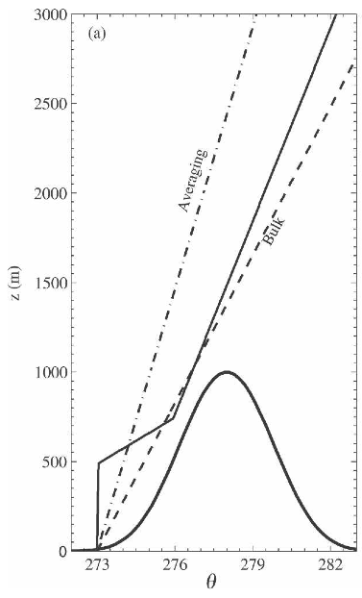
Non-Dimensional Mountain Height ε
Useful concepts, but assume uniform upstream wind, U, and stratification, N
No variations horizontally or vertically
Assume no parcel accelerations from large-scale flow or flow adjustment to orography
Difficult to apply in practice due to non-uniform nature of real world flows and stratification
See: Reinecke and Durran (2008)
Notes:
Brunt–Väisälä frequency is averaged between the ground and some height aloft to yield a constant N. “Averaging Method”
The total change of the potential temperature between the ground and some level aloft is used to define N. “Bulk Method”

Slide 23
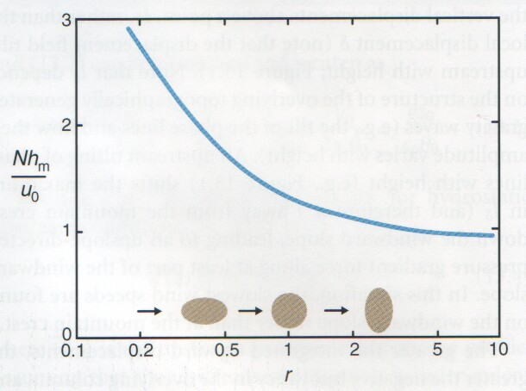
Blocking / Obstruction of Air Masses
These processes affect stable air masses and occur most frequently in winter.
The blocked flow upwind of a barrier is usually shallower than the barrier depth. Air above the blocked flow layer may have no difficulty surmounting the barrier and may respond to the ‘effective topography’ including the blocked air mass.
Onset and cessation of blocking may be abrupt.
Stagnation (blue line) as a function of nondimensional mountain height and mountain aspect ratio r.
blocked
critical value
r = crosswise / streamwise dimensions
Markowski & Richardson (2010) / Smith 1990

Slide 24
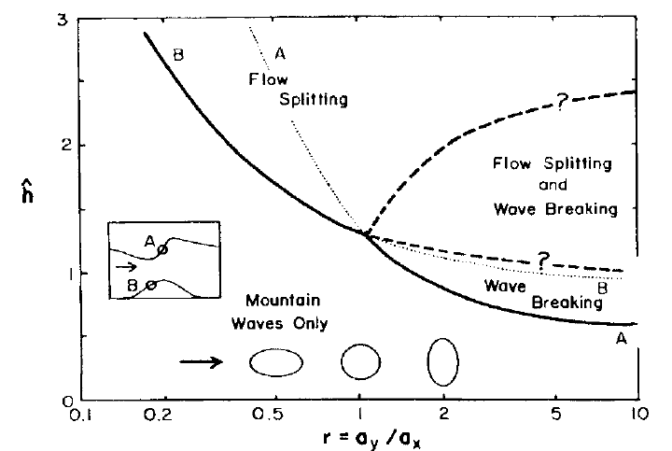
ε
Bauer et al (2000)
wave breaking, lee vortex formation, and windward stagnation

Slide 25
Non-dimensional mountain height ε
“Constant U and Stratification” Linear Theory solutions; Smith (1988, 1989)
… real world approximations needed…
Brunt–Väisälä frequency is averaged between the ground and some height aloft to yield a constant N. “Averaging Method”
The total change of the potential temperature between the ground and some level aloft is used to define N. “Bulk Method”
Results depend on application (flow speed or flow mass diversion)
See: Reinecke and Durran (2008)

Slide 26
Non-dimensional numbers (2)

Slide 27
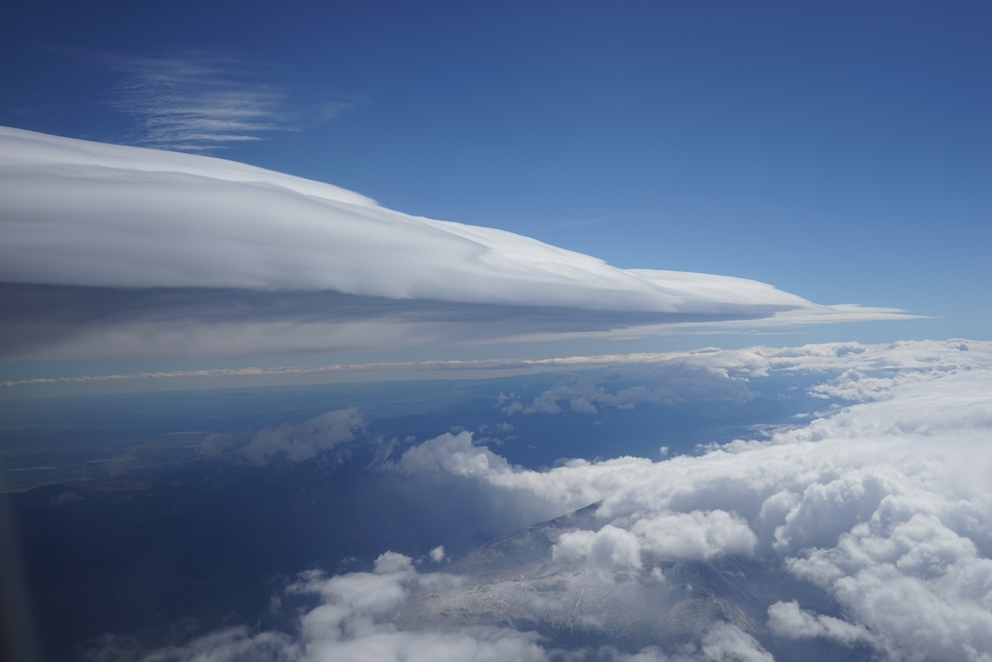
Flow Over Mountains
Approaching flows tends to go over mountains if
Barrier is long,
Cross-barrier wind component is strong, and
Flow is unstable, neutral or only weakly stable. Common in North American mountain ranges.
Flow over a mountain can be ascertained by presence of
Lenticular clouds
Cap clouds
Banner clouds
Rotors
Foehn wall
Chinook arch
Billow clouds
Blowing snow,
Cornice buildup
Blowing dust
Downslope windstorms, etc…
30 September 30, 2014, ~ 2 pm

Slide 28
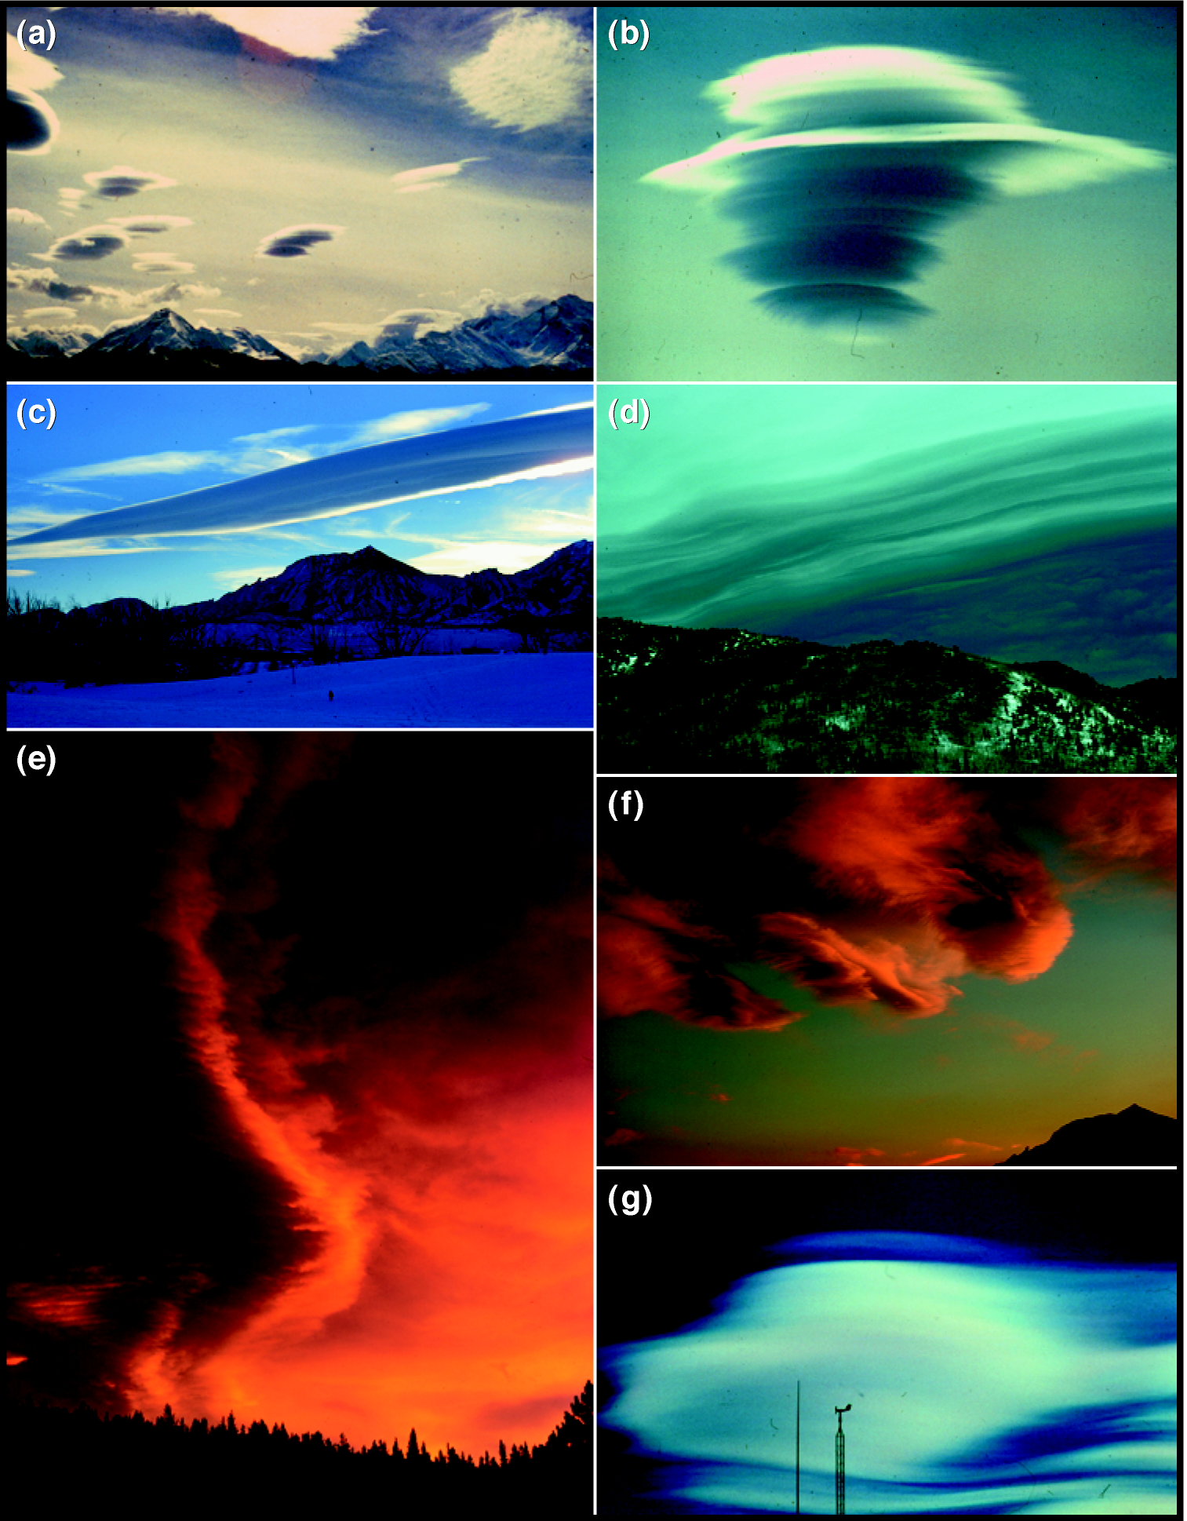
Lenticular and wave clouds
The presence of orographic waves is often indicated by lenticular or wave clouds.
Gravity waves that form over mountains are called mountain waves. They have a tendency to propagate vertically and can be found not only at low levels over hills but throughout the troposphere and even into the stratosphere.
Lee waves, on the other hand, are often confined or trapped in the lee of a barrier by a smooth horizontal flow above. There is a continuum between lee and mountain waves, but mountain waves are generally higher, with longer wavelengths and smaller amplitudes.
a, b, & g:
Brooks Martner photos
Whiteman (2000)

Slide 29
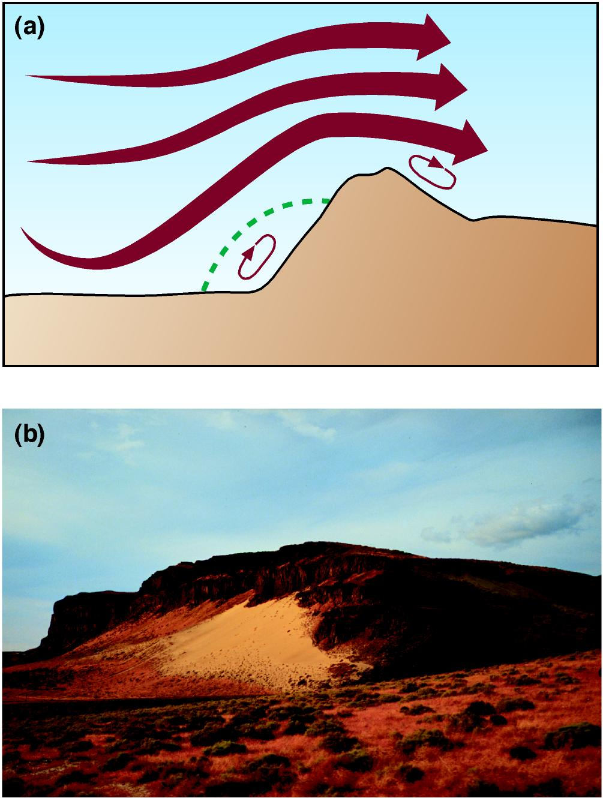
Separation eddies
Whiteman (2000)

Slide 30
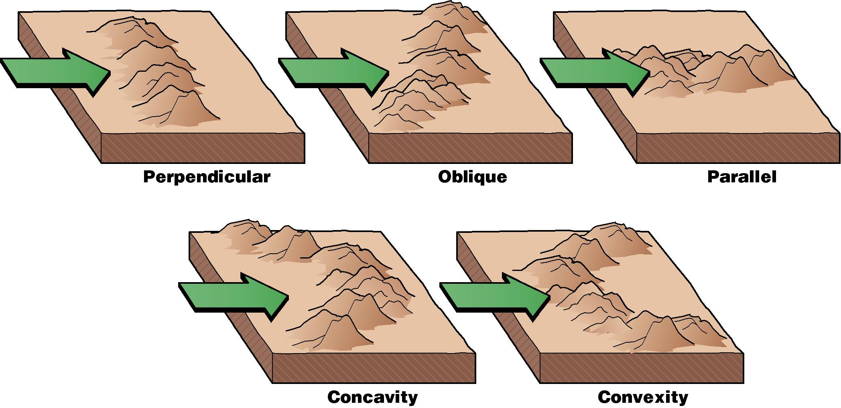
Angle of attack
The best lifting requires strong cross-barrier flow
Whiteman (2000)
Notes:
The effectiveness of the lifting depends on the orientation of the underlying ridges or mountain barriers relative to the approaching air.

Slide 31
Boulder,
Colorado

Slide 33
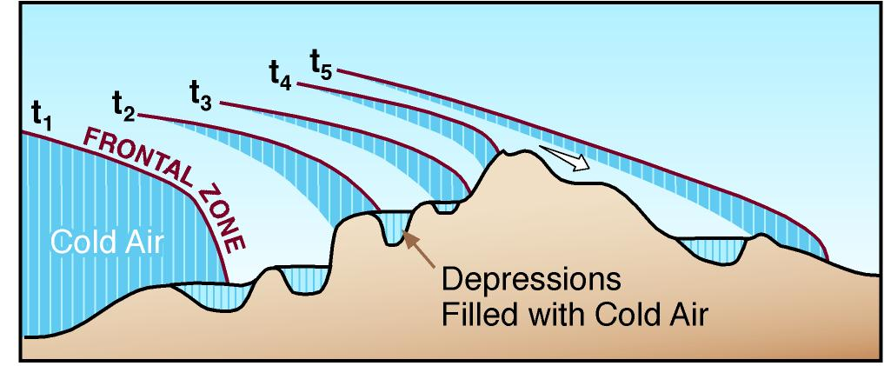
Frontal movement up and over a mountain barrier
Whiteman (2000)

Slide 34
Mean January 500 mb hemispheric map
Mean troughs form down-wind of major mountain barriers
Wallace & Hobbs (1977)

Slide 35
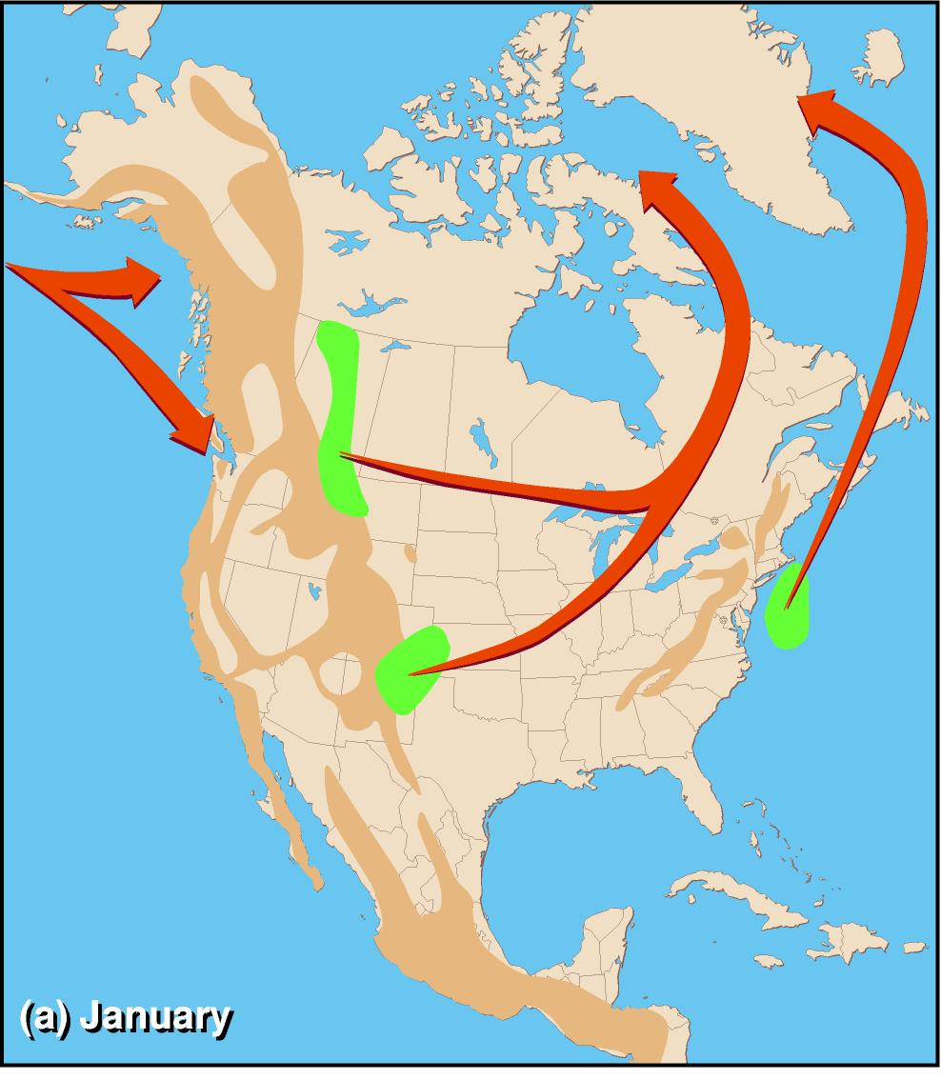
January cyclogenesis areas and paths
Zishka & Smith (1980)

Slide 36
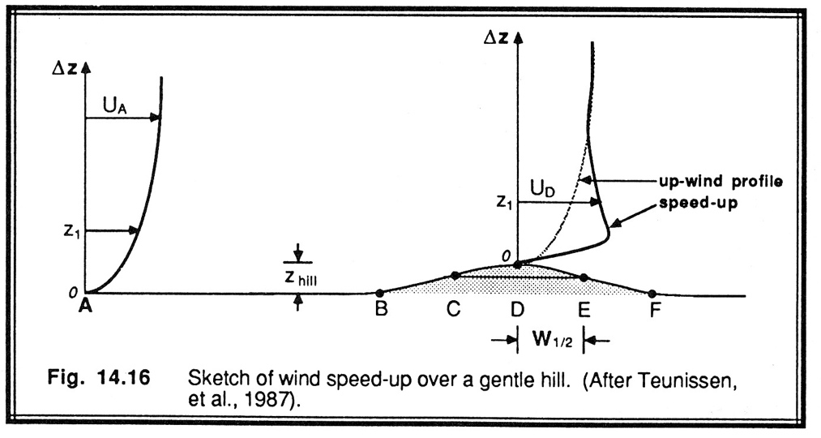
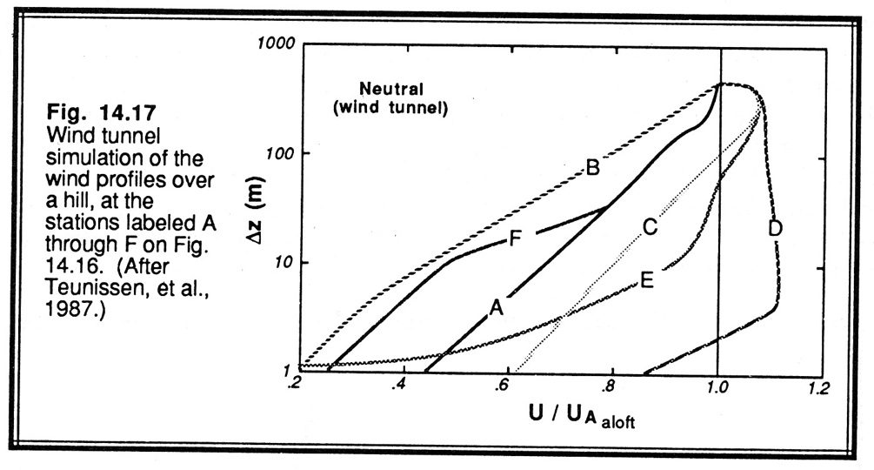

Wind speedup over hills and mountains
Stull (1988)
Roland Stull

Slide 37
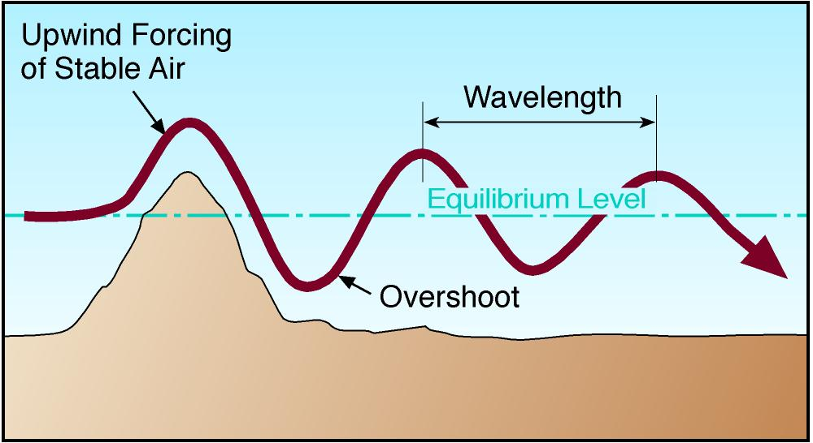
Lee waves
Stull (1995)
Lee waves are gravity waves produced as stable air is lifted over a mountain. The lifted air cools and becomes denser than the air around it. Under gravity’s influence, it sinks again on the lee side to its equilibrium level, overshooting and oscillating about this level.

Slide 38
Amplification and cancellation of lee waves
If the flow crosses more than one ridge crest, the waves generated by the first ridge can be amplified (resonance) or canceled by the second barrier, depending on its height and distance downwind from the first barrier.
Orographic waves form most readily in the lee of steep, high barriers that are perpendicular to the approaching flow.
Bérenger & Gerbier (1956)
Mayr & Gohm (2000)

Slide 39
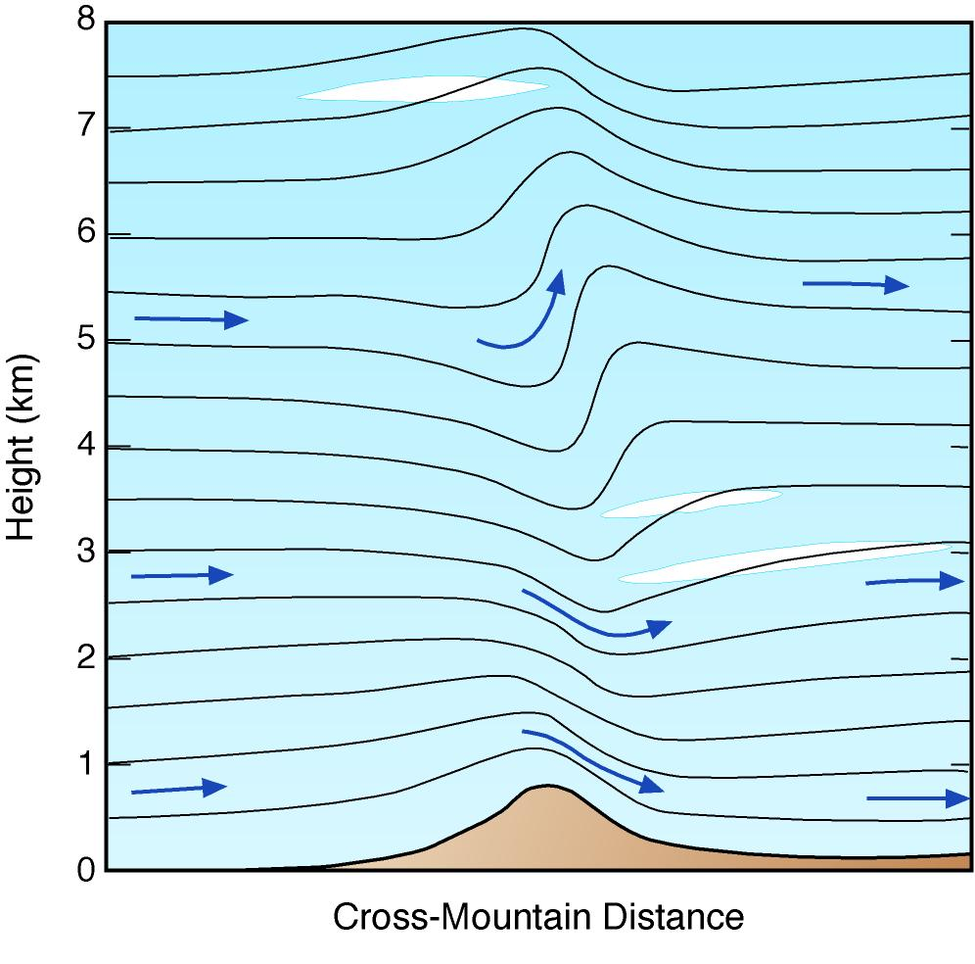
Trapped and vertically propagating lee waves
Carney et al. (1996)

Slide 40
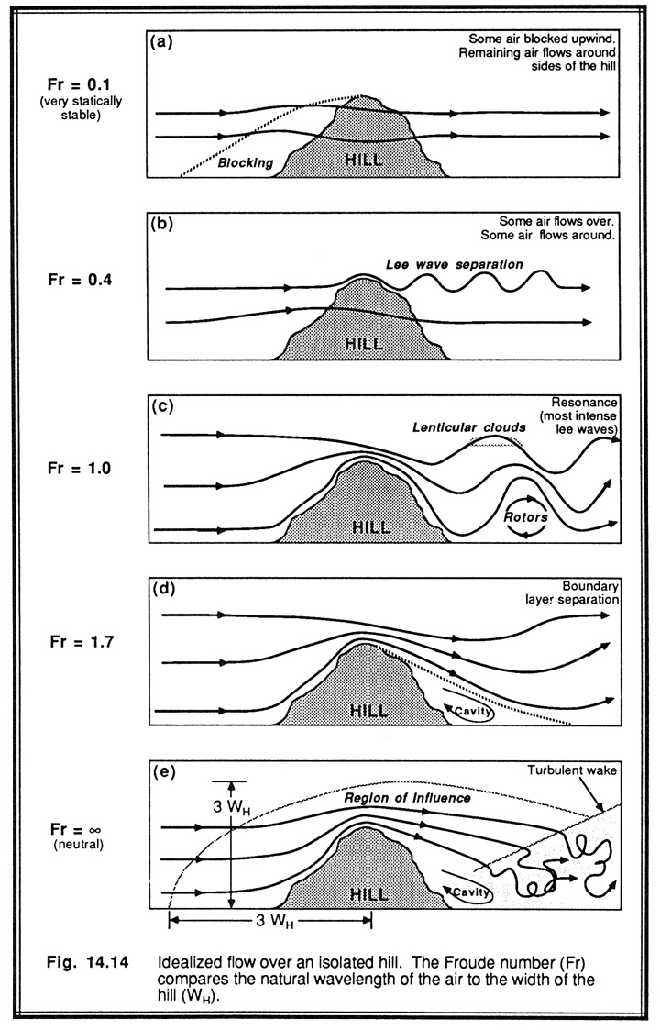
Froude number
Fr = (2πU) /(N 2W)
Natural wavelength of air / effective wavelength of obstacle.
U: mean cross-barrier speed
N: Brunt-Väisälä Frequency
W: Length of obstacle
Stull (1988)

Slide 41
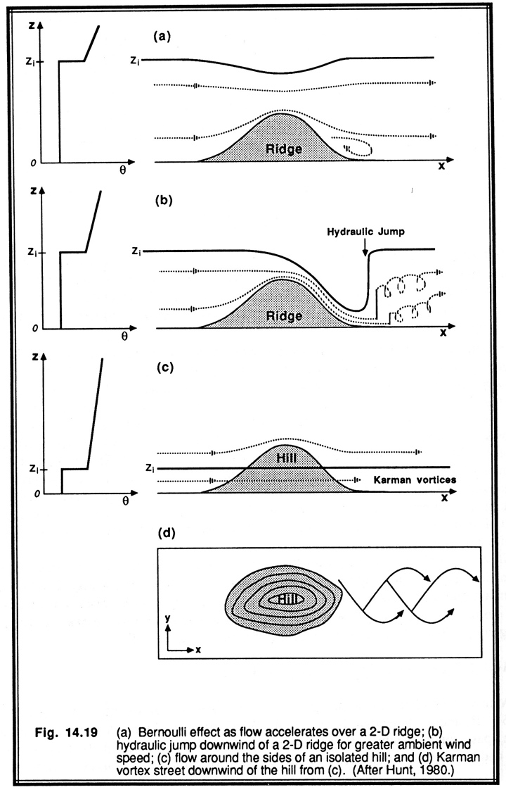
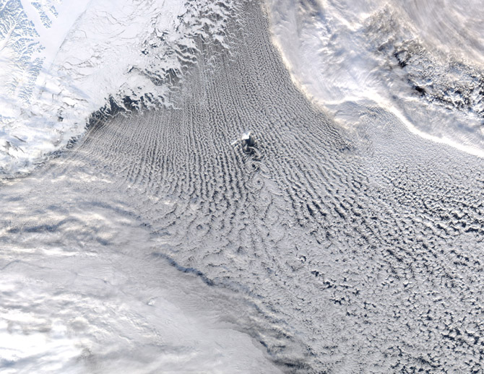

The influence of an elevated inversion in flow over a hill
Jan Mayen Island, Greenland Sea
Stull (1988)

Slide 42
Formation of waves
The basic form of a wave (trapped or vertically propagating) and its wavelength depend on variations of speed and stability of the approach flow. One of 3 flow patterns results depending on the characteristics of the vertical profile of the horizontal wind.
  If winds are weak and nearly invariant with height, shallow waves form downwind of the barrier.
  When winds become stronger and show a moderate increase with height, air overturns on the lee side of the barrier, forming a standing (i.e., non-propagating) lee eddy with its axis parallel to the ridgeline.
  When winds become stronger still and show a greater increase in speed with height, deeper waves form and propagate farther downwind
The wavelengths of orographic waves increase when wind velocities increase or stability decreases.

Slide 43
Downslope windstorms
Large-amplitude mountain waves that undergo a hydraulic transition giving strong, supercritical flow on the lee slope
Three mechanisms:
Classical hydraulic flow.
Amplification of linear vertically propagating gravity waves by waves reflected off the tropopause (or some other layer where the Scorer parameter changes rapidly).
Breaking of a vertically propagating mountain wave creates a self-induced critical layer. If the distance between this critical layer and the mountain is suitably tuned it may trap and reflect upward propagating waves resulting in resonance and strong surface winds.

Slide 44
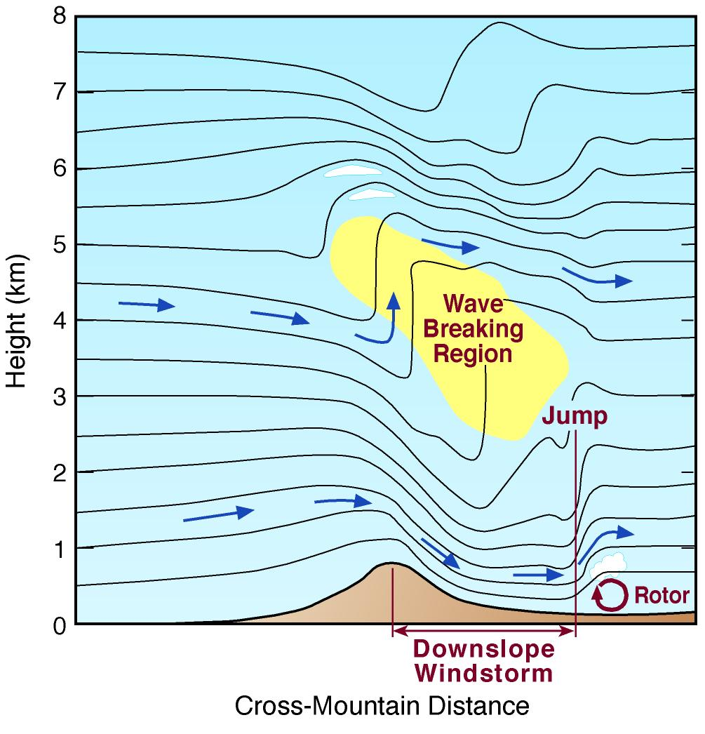
Downslope windstorm
Under certain stability, flow and topography conditions, the entire mountain wave can undergo a sudden transition to a hydraulic flow involving a hydraulic jump and a turbulent rotor. This exposes the lee side of the barrier to sweeping, high speed turbulent winds that can cause forest blowdowns and structural damage.
Whiteman (2000) adapted from Carney et al. (1996)

Slide 45
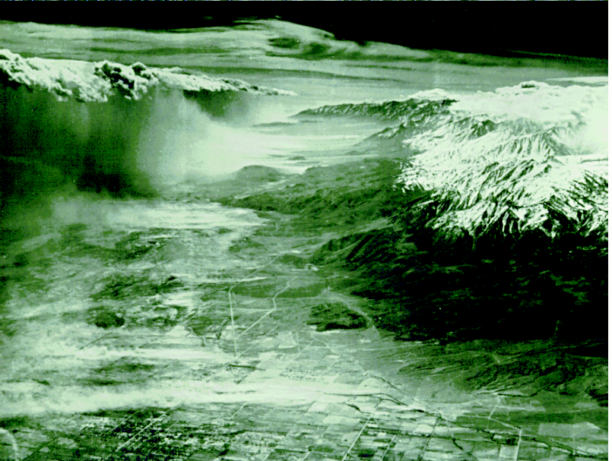
The Sierra Wave
USAF, Robert Symons photo

Slide 46

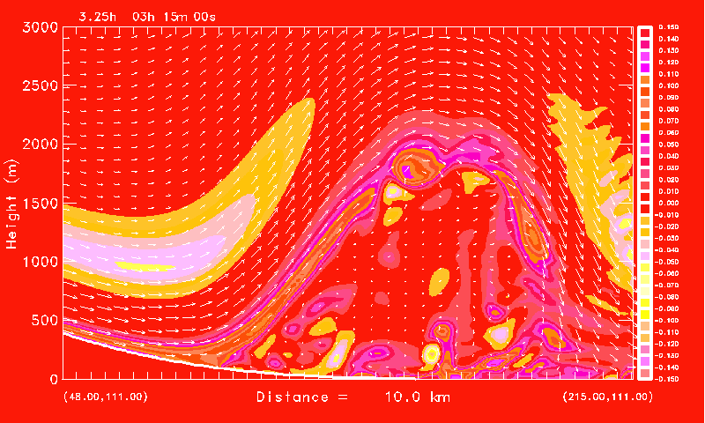
© Jim Doyle
3-D rotor simulation
Horizontal vorticity (s⁻¹)

Slide 47
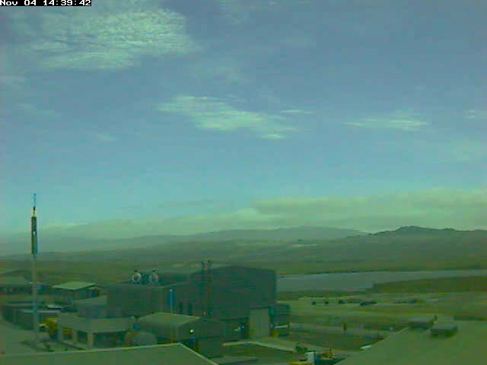

Prof. Stephen
Mobbs, Umiversity of Leeds, UK
Rotor flow movie, Falkland Islands

Slide 48
Chinook winds usually occur on the east side of N American mountain ranges since winds aloft are usually westerly. But, they can occur on the west sides when upper-level winds are from the east (Ex: Santa Ana and Wasatch winds).
Santa Ana winds - late Fall and Winter, cause horrendous wildfires.
Wasatch or canyon winds - are of two types. Some come through gaps in the Wasatch ridgeline, affecting primarily the canyon exits. Others (less common) affect a more or less contiguous zone along the foothills. These are probably produced by strong mountain waves or hydraulic jumps.
Whiteman (2000), adapted from Schroeder & Buck (1970)

Slide 49
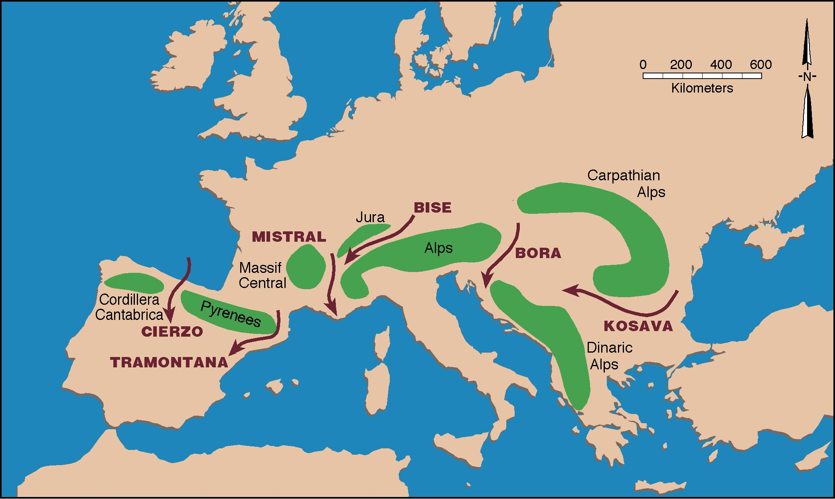


Named Alpine windstorms
Heinz Wanner
Markus Furger
Whiteman (2000), adapted from Wanner & Furger (1990)

Slide 50
Downslope windstorms - Bora, Foehn, Chinook
Are associated with large amplitude lee waves
Form on the lee side of high-relief mountain barriers when a stable air mass is carried across the mountains by strong cross-barrier winds
Strong winds are caused by intense surface pressure gradients (high upwind, low pressure trough downwind). Pressure difference is intensified by lee subsidence which produces warming and lower pressure.
Elevated inversion layers near and just above mountaintop levels appear to play an important role.
Occur primarily in winter
May be associated with wave trapping, or wave breaking regions aloft.
Local topography often plays an important role (Ex: Boulder, CO and Livingston, MT). Steep leeside slopes, canyons, concave ridgeline.
Can bring cold (Bora) or warm (Foehn, Chinook) air to leeward foothills.

Slide 51
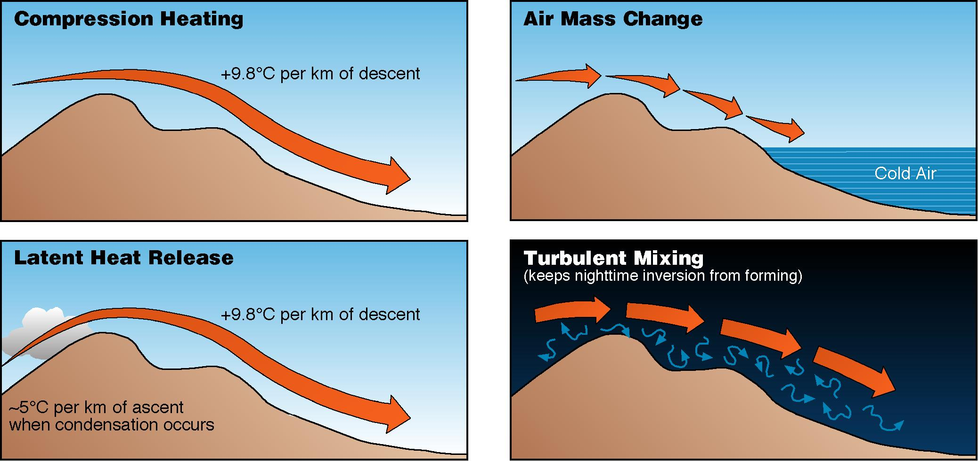
Four Chinook mechanisms
Beran (1967)
Four factors contribute to the warmth and dryness of Chinook winds

Slide 52
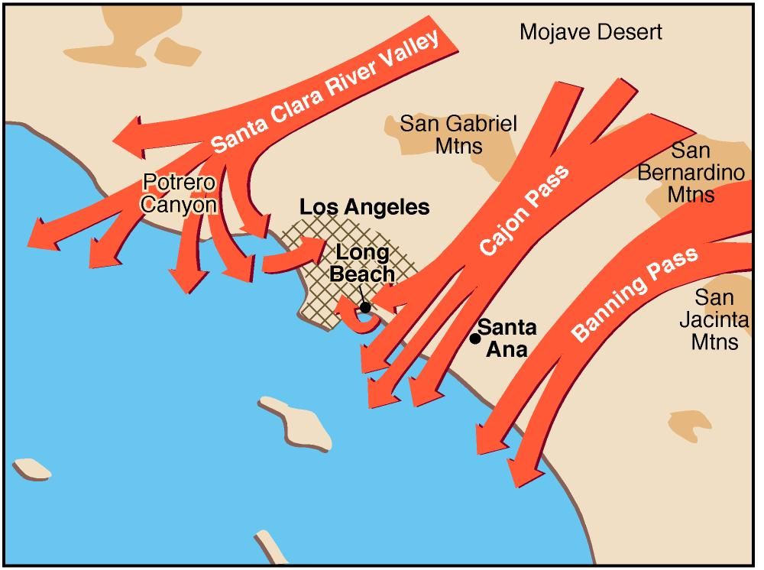
Santa Ana winds
Rosenthal (1972)

Slide 53
Foehn pauses & rapid T changes, Havre, MT
Foehn (Chinook) pause: abrupt cessation of downslope winds.
Alternating strong wind break-ins and foehn pauses can cause temperatures to oscillate wildly.

Slide 54
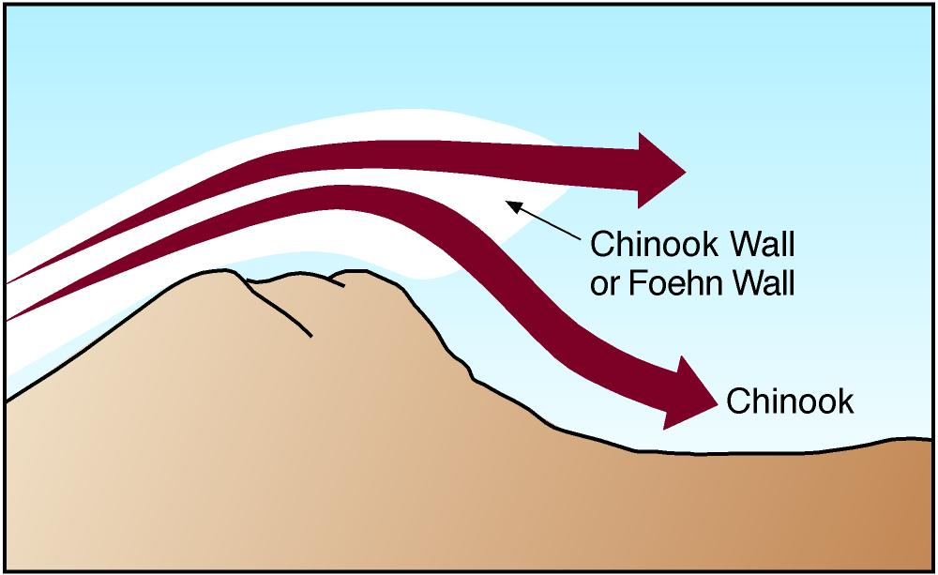
Chinook wall
Whiteman (2000)

Slide 55
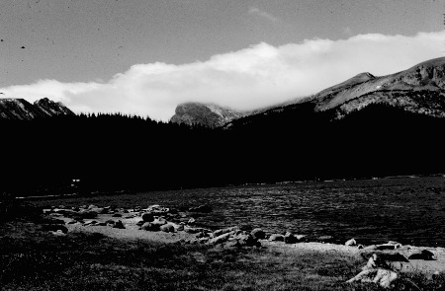
Chinook wall cloud, RMNP, CO
B. Martner photo

Slide 56
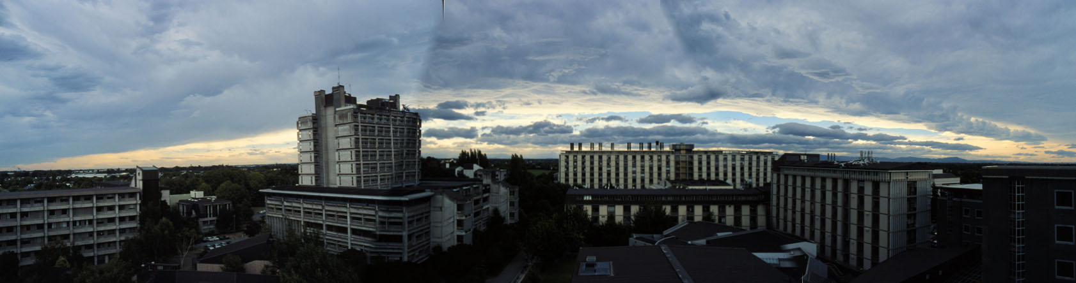
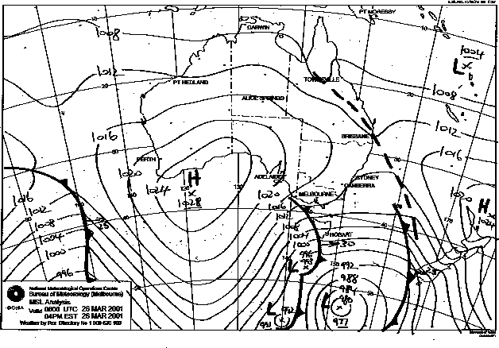

NW arch, Canterbury Plains, Christchurch, NZ
Whiteman photo
Andy Sturman
26 Mar 01, 0800 UTC

Slide 57
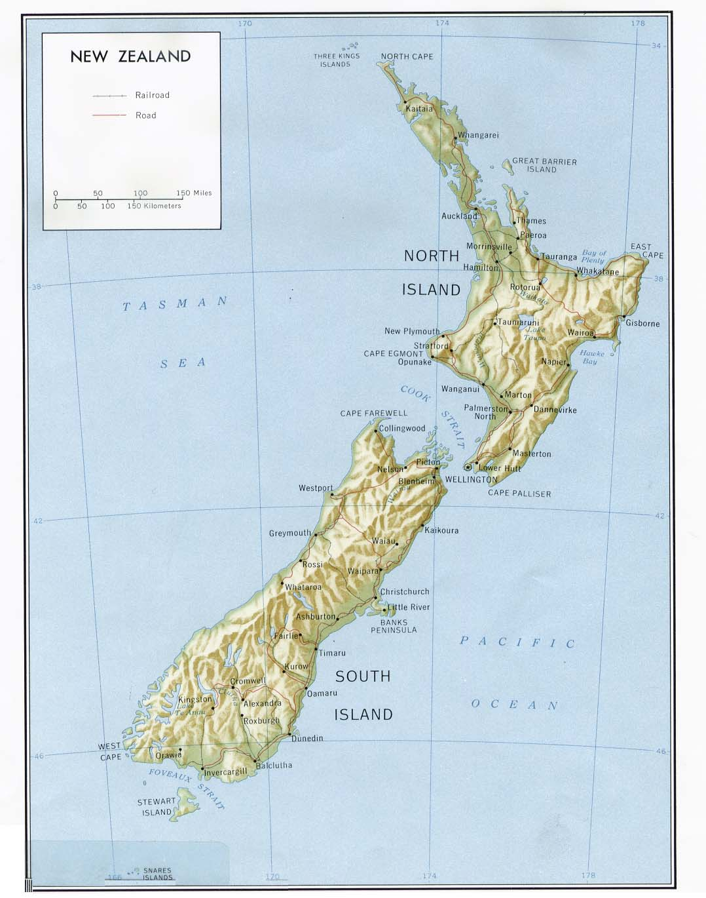
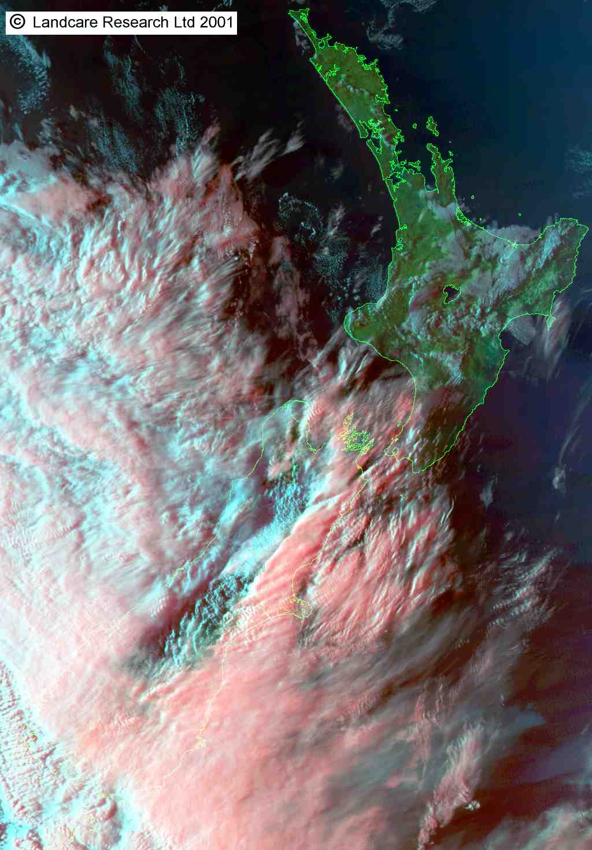
Satellite photo - NW arch - 1700 NZST 16 Mar 2001

Slide 58
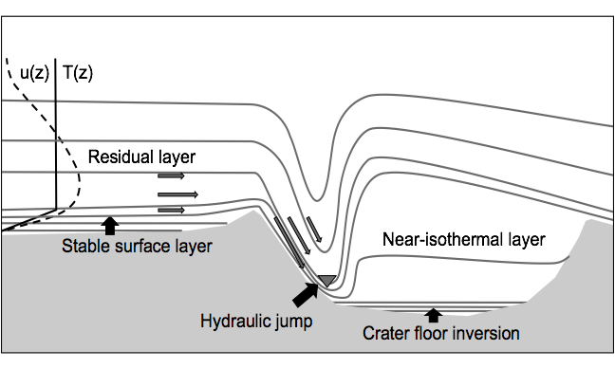
METCRAX-II / Conceptual model
During METCRAX-I in 2006 we found that intermittent downslope-windstorm-type flows developed over the crater’s SW sidewall on clear, undisturbed nights. (See Adler et al. 2012)
METCRAX II, is investigating these flows. Laboratory-like experiment – continuous observations of approach flow and response of crater atmosphere.
Notes:
Conceptual model – untested !
From METCRAX-I: Warm-air intrusions (downslope windstorms) occurred intermittently on clear undisturbed nights.
Several episodes per night, average duration 13 minutes. Meteor Crater is on the “edge” of producing this phenomenon.
Due to a lightning strike no data on approaching flow.
How/why does this occur? Laboratory-like experiment, continuously measuring the approach flow and the response inside the crater.

Slide 59
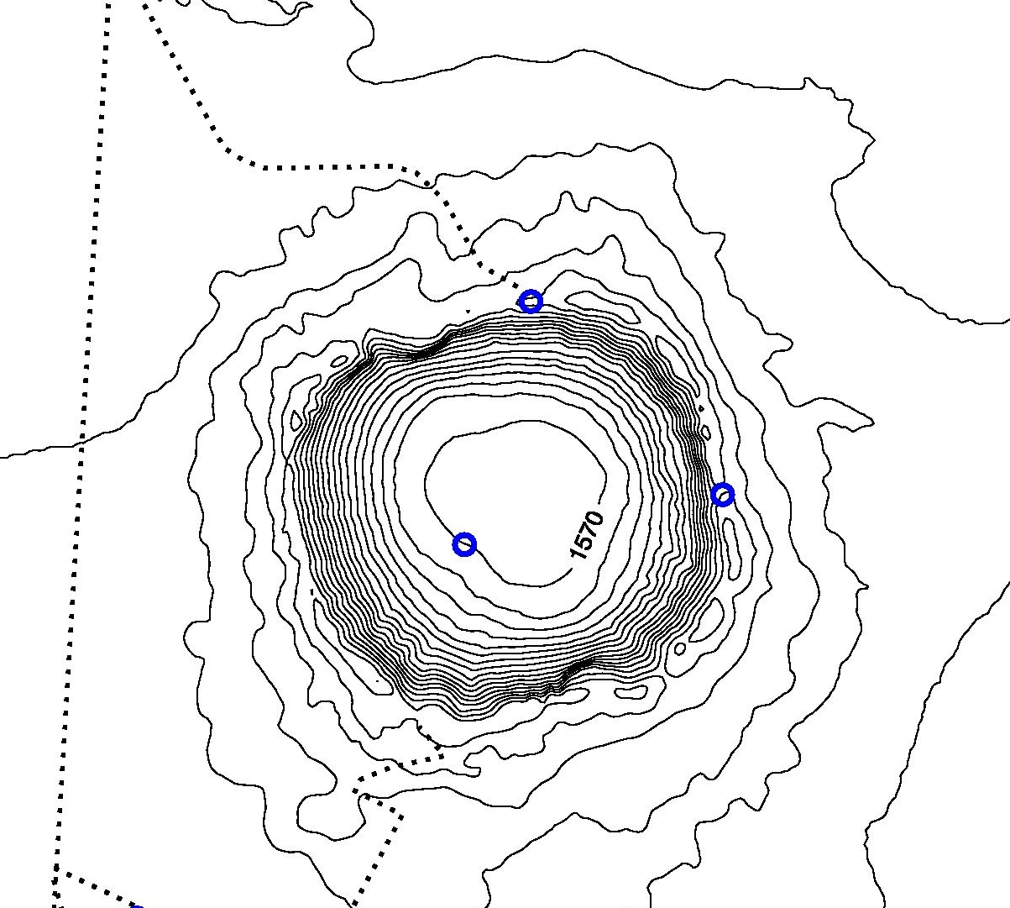
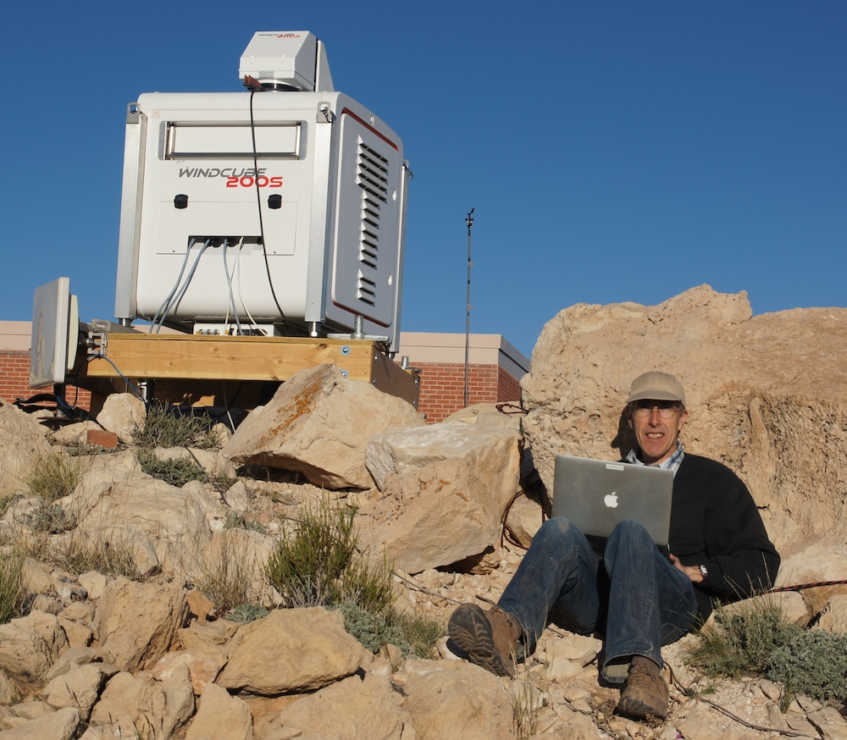

Dual-Doppler Retrieval
IOP-4 (19-20 October 2013)
North Rim
Floor
Rim Tower
Scans within a 2-3 min time window are averaged and used in a dual doppler analysis.

Slide 60

Dual-Doppler Retrieval
IOP-4 (19-20 October 2013)
Scans within a 2-3 min time window are averaged and used in a dual doppler analysis.

Slide 61

Hydraulic Jumps, rotors, …

Slide 62

Flow Separation

Slide 63

Warm-Air Intrusions & Cold-Air Inflows
10°C
10°C

Slide 64
Wakes, eddies, vortices
Wakes, eddies and vortices are common in mountains
Vertical and horizontal dimensions a function of stability
They form behind terrain obstacles when the approach flow has sufficient speed
Eddy: swirling current of air at variance with main current
Wake: eddies shed off an obstacle cascading to smaller and smaller sizes. Characterized by low wind speeds and high turbulence.
Vortex: whirling masses of air in form of column or spiral, usually rotate around vertical or horizontal axis.
Examples: rotors; rotor clouds; drifts behind snow fences, trees and other obstacles; cornices. Winds are slowed to distances of 15 (sometimes 60) times obstacle height.

Slide 65

Kármán vortices in lee of New Zealand volcano
From Erick Brenstrum

Slide 66

Wakes
Large, generally isotropic vertical-axis eddies can be produced by the flow around mountains or through gaps as eddies are shed from the vertical edges of terrain obstructions.
Ex.: The Schultz eddy on the north side of the Caracena Strait in CA’s Sacramento Valley or on either side of Parley’s Canyon (Wasatch Range).
Orgill (1981)
Notes:
A wake is a region of turbulence immediately behind a solid body caused by the flow of air over or around the body. Produces slower wind speeds but enhanced gustiness. Wakes occur on a variety of scales and can make it quite difficult to predict small scale winds such as might occur near ski jumps.

Slide 67
Banner clouds
© Zacharie Grossen

Slide 68

from Volkmar Wirth

Slide 69


Mt. Zugspitze, Germany
Schween et al. (2007)
Volkmar Wirth
University of Mainz, Germany

Slide 70

Cloud eddy in lee of Handies Peak, CO
Whiteman (2000)

Slide 71
Flow Around Mountains
A flow approaching a mountain barrier tends to go around rather than over a barrier if:
Ridgeline is convex on windward side
Mountains are high
Barrier is an isolated peak or a short range
Cross barrier wind component is weak
Flow is very stable
Approaching low-level air mass is very shallow
Because Rockies and Appalachians are long, flow around them is uncommon. But these types of flows are seen in the Aleutians, the Alaska Range, the Olympic Mountains and around isolated volcanoes. They should be expected to occur also around the Uintas and in southern Wyoming.

Slide 72


Wind variations with topographic characteristics
Height and length can determine whether air goes around barrier; to carry air over a high mountain range or around an extended ridge requires strong winds
When stable air splits around an isolated peak, the strongest winds are usually on the edges of the mountain tangent to the flow

Slide 73


Flow splitting
3-hourly frontal positions
Whiteman (2000)
Steinacker (1987)
Note: Convergence zones often form on the back side of isolated barriers (e.g., Puget Sound)
Reinhold Steinacker

Slide 74

Barrier Jets

Slide 75
An elevated wind maximum on the windward side of a mountain barrier blowing parallel to the ridgeline.
Occurs in the extratropics when a stably stratified flow is blocked by a barrier for hours or days. The flow lifted up the barrier is cooled, forming a high pressure along the slope, decelerating and blocking the flow. Geostrophic adjustment occurs between the flow and the high pressure, turning the flow to the left (NH) toward low pressure.
Barrier jets
W side of Cascades and Sierras, on E side of Rockies and Appalachians, and on N side of Brooks Range.

Slide 76
Barrier Jets
Mesoscale, along-barrier winds that develop adjacent to steep terrain in the extratropics
Associated with low-level blocking
Impacts: Cold-air damming, moisture transport, orographic precipitation, hazardous winds

Slide 77
Discussion
As flow approaches a mountain barrier, what factors are likely to lead to along-barrier flow and the formation of a barrier jet?

Slide 78
Basic Dynamics
PG (pressure gradient force )
996 mb
V
1000 mb
COR (Coriolis force)
In the absence of topography and friction, the flow exhibits geostrophic balance.

Slide 79
Basic Dynamics
PG
996 mb
V
Mountain Range
1000 mb
COR
If flow is characterized by a low Froude number (U/NH < 1), the the low-level flow will be blocked and decelerate as it approaches mountains.

Slide 80
Basic Dynamics
PG
PG
996 mb
V
V
Mountain Range
Cor
1000 mb
COR
As the flow decelerates, the Coriolis force weakens, and the flow is deflected toward lower pressure.

Slide 81
Basic Dynamics
PG
PG
996 mb
V
V
Mountain Range
Cor
1000 mb
COR
Flow deceleration results in a piling up of mass and development of a mesoscale pressure ridge near the mountains (mutual adjustment of mass and momentum)

Slide 82
Basic Dynamics
PG
V
996 mb
PG
V
Cor
Mountain Range
1000 mb
Friction
COR
The final near-barrier force balance.

Slide 83
Mature Force Balance
Along-barrier antitriptic
  Pressure gradient balances friction
Cross-barrier geostrophic
V
PG
V
Cor
Mountain Range
Friction

Slide 84
Barrier jets
Classic barrier jets
Hybrid barrier jets
Cold air damming
An elevated wind maximum on the windward side of a mountain barrier blowing parallel to the ridgeline. Occurs in the extratropics when a stably stratified flow is blocked by a barrier for hours or days. The flow lifted up the barrier is cooled, forming a high pressure along the slope, decelerating and blocking the flow. Geostrophic adjustment occurs between the flow and the high pressure, turning the flow to the left (NH) toward low pressure.
In US, barrier jets have been noted on W side of Cascades and Sierras, on E side of Rockies and Appalachians, and on N side of Brooks Range. They probably occur elsewhere in N America.
Rossby radius L_{R}

Slide 85



Barrier jet / cold air dam
Barrier jet
Cold air damming
from Nathaniel Winstead
From Markowski and Richardson (2010)

Slide 86

Barrier Jets from SAR obs
a) classical barrier jet
b) lull season barrier jet
c) hybrid jet (note gap flow)
d) pure gap flow
e) shock barrier jet
f) variable barrier jet
Climatology:
cool season
Mt. Fairweather and Valdez-Cordova
half exceed 20 m/s
typically width < 100 km
max speed is 2-3 x synoptic flow
some detach from coastline (<10 km)
Loescher et al. (2006)
Colle et al. (2006

Slide 87

From Markowski and Richardson (2010)

Slide 88

From Markowski and Richardson (2010)

Slide 89
Flow through Passes,
Channels and Gaps
Gaps - major erosional openings through mountain ranges
Channels - low altitude paths between mountain ranges (usually with the sea as the base of the channel)
Mountain passes - routes over or through mountains
Strong winds in a gap, channel or pass are usually pressure driven - i.e., caused by a strong pressure gradient across the gap, channel or pass.
Regional pressure gradients occur frequently across coastal mountain ranges because of the differing characteristics of marine and continental air. These pressure gradients usually reverse seasonally.

Slide 90

Flow through passes and gaps
Whiteman (2000)
Notes:
Can also occur from E to W.

Slide 91

Waterfall clouds
© Nick Groves
Notes:
Nick Groves is professional photographer in NZ, n_groves@globe.net.nz
Photo of MacKinnon Pass, South Island in May (2003?)

Slide 92

Gap flow
Gap flows are associated with along-gap pressure gradient forces, but also arise from low-level temperature differences between air masses on different sides of the gap.
The fastest winds are not generally within the gap, but at the gap exit.
An inversion is often present below the crest.
Markowski and Richardson (2010)
Strait of Juan de Fuca

Slide 93



Gap flow
Other well-known gap winds:
Caracena Strait, CA
Strait of Juan de Fuca
Fraser Valley, BC
Stikine Valley (near Wrangell)
Taku Straits (near juneau)
Copper River Valley (near Cordova)
Turnagain Arm (Anchorage)
Gibraltor Strait
Brenner Pass, Austria
Alex Gohm
Georg Mayr
Ex.: The Columbia Gorge:
Pacific High, heat low in Columbia Basin
Excellent windsurfing as wind blows counter to the river current with high speeds.

Slide 94


Gap flow
Gap flows observed by synthetic aperture radar (SAR) in the Dixon Entrance between Grand Island, BC, and Prince of Wales Is, AK. (From Nathaniel Winstead)
from Nathaniel Winstead
Markowski and Richardson (2010)

Slide 95



Gap flow
Westerly winds encountering a gap, with
Fr_{m} = (a) 4.0, (b) 0.7, (c) 0.4, and (d) 0.2.
Shown are horizontal streamlines and normalized perturbation velocity [(u-U)/U, colors], where u is the zonal windspeed and U is the zonal windspeed far upstream.
from Gaberšek & Durran (2004)
Saša Gaberšek
Dale Durran
Markowski and Richardson (2010)
Fr_{m} = U/NH

Slide 96
Shown are normalized pressure perturbations (lines) and normalized perturbation velocity (colors)
Fr_{m}= 4.0
Fr_{m}= 0.7
Fr_{m}= 0.4
Fr_{m}= 0.2
Markowski and Richardson (2010)
from Gaberšek & Durran (2004)

Slide 97


Other Phenomena
Pressure driven channeling versus forced channeling
Pressure driven channeling
Forced Channeling

Slide 98

Pressure driven channeling
Whiteman (2000)
Notes:
In PDC, the winds blow along the valley axis from the high pressure to the low pressure end of the valley. Because wind direction aloft and pressure gradient force are 90° different, the wind in the valley differs by 90° from that produced by forced channeling. See Whiteman and Doran (1993).

Slide 99

Channeling
Forced Channeling
Pressure Driven Channeling

Slide 100


Valley exit jet
adapted from Pamperin &
Stilke (1985)
Notes:
Winds at the exit of a valley can be quite strong, but shallow, as potential energy is converted to kinetic energy.
What is the best topography for forming valley exit jets?

Slide 101

Weber Canyon, UT

Slide 102


Slide 103
Venturi Effect
Whiteman (2000)
Venturi effect causes a jet to form as winds pass through a terrain constriction and strengthen.

Slide 104

Cloud waterfall
Whiteman (2000)
Notes:
Waterfall Cloud, Mackinnon Pass (1154 m), Southern Alps of New Zealand. Flow from Clinton River Valley into Arthur River valley. Gap winds, e.g., Columbia Gorge. Copyrighted photo by C. D. Whiteman.

Slide 105

Waterfall cloud, NZ Alps near Mt. Cook
Whiteman photo

Slide 106

Forced channeling
Whiteman (2000)
Notes:
General view of terrain channeling. Winds aloft parallel to isobars or isoheights. Along-valley component of upper wind channeling along valley axis. Often, however, the channeling is actually pressure gradient channeling (next slide).

Slide 107


Slide 108

Kelvin-Helmholz waves
© R. D. Richard Adams
Notes:
Taken at the 200 Area fire station in 2003.

Slide 109

© Rick Dunn 1995
www.RJDphoto.com
Notes:
Rick Dunn Photography, Loveland. Bear River Mountains? NE of Yellowstone Park.

Slide 110

© Marcia Politovich
Notes:
Boulder, Colorado on 9 February 2004. Greg Thompson mentioned it to me and Brooks Martner sent it.

Slide 111

The End
© Linde Waidhofer from Unknown Patagonia
used with permission, e-book can be downloaded for free

