Slide 1
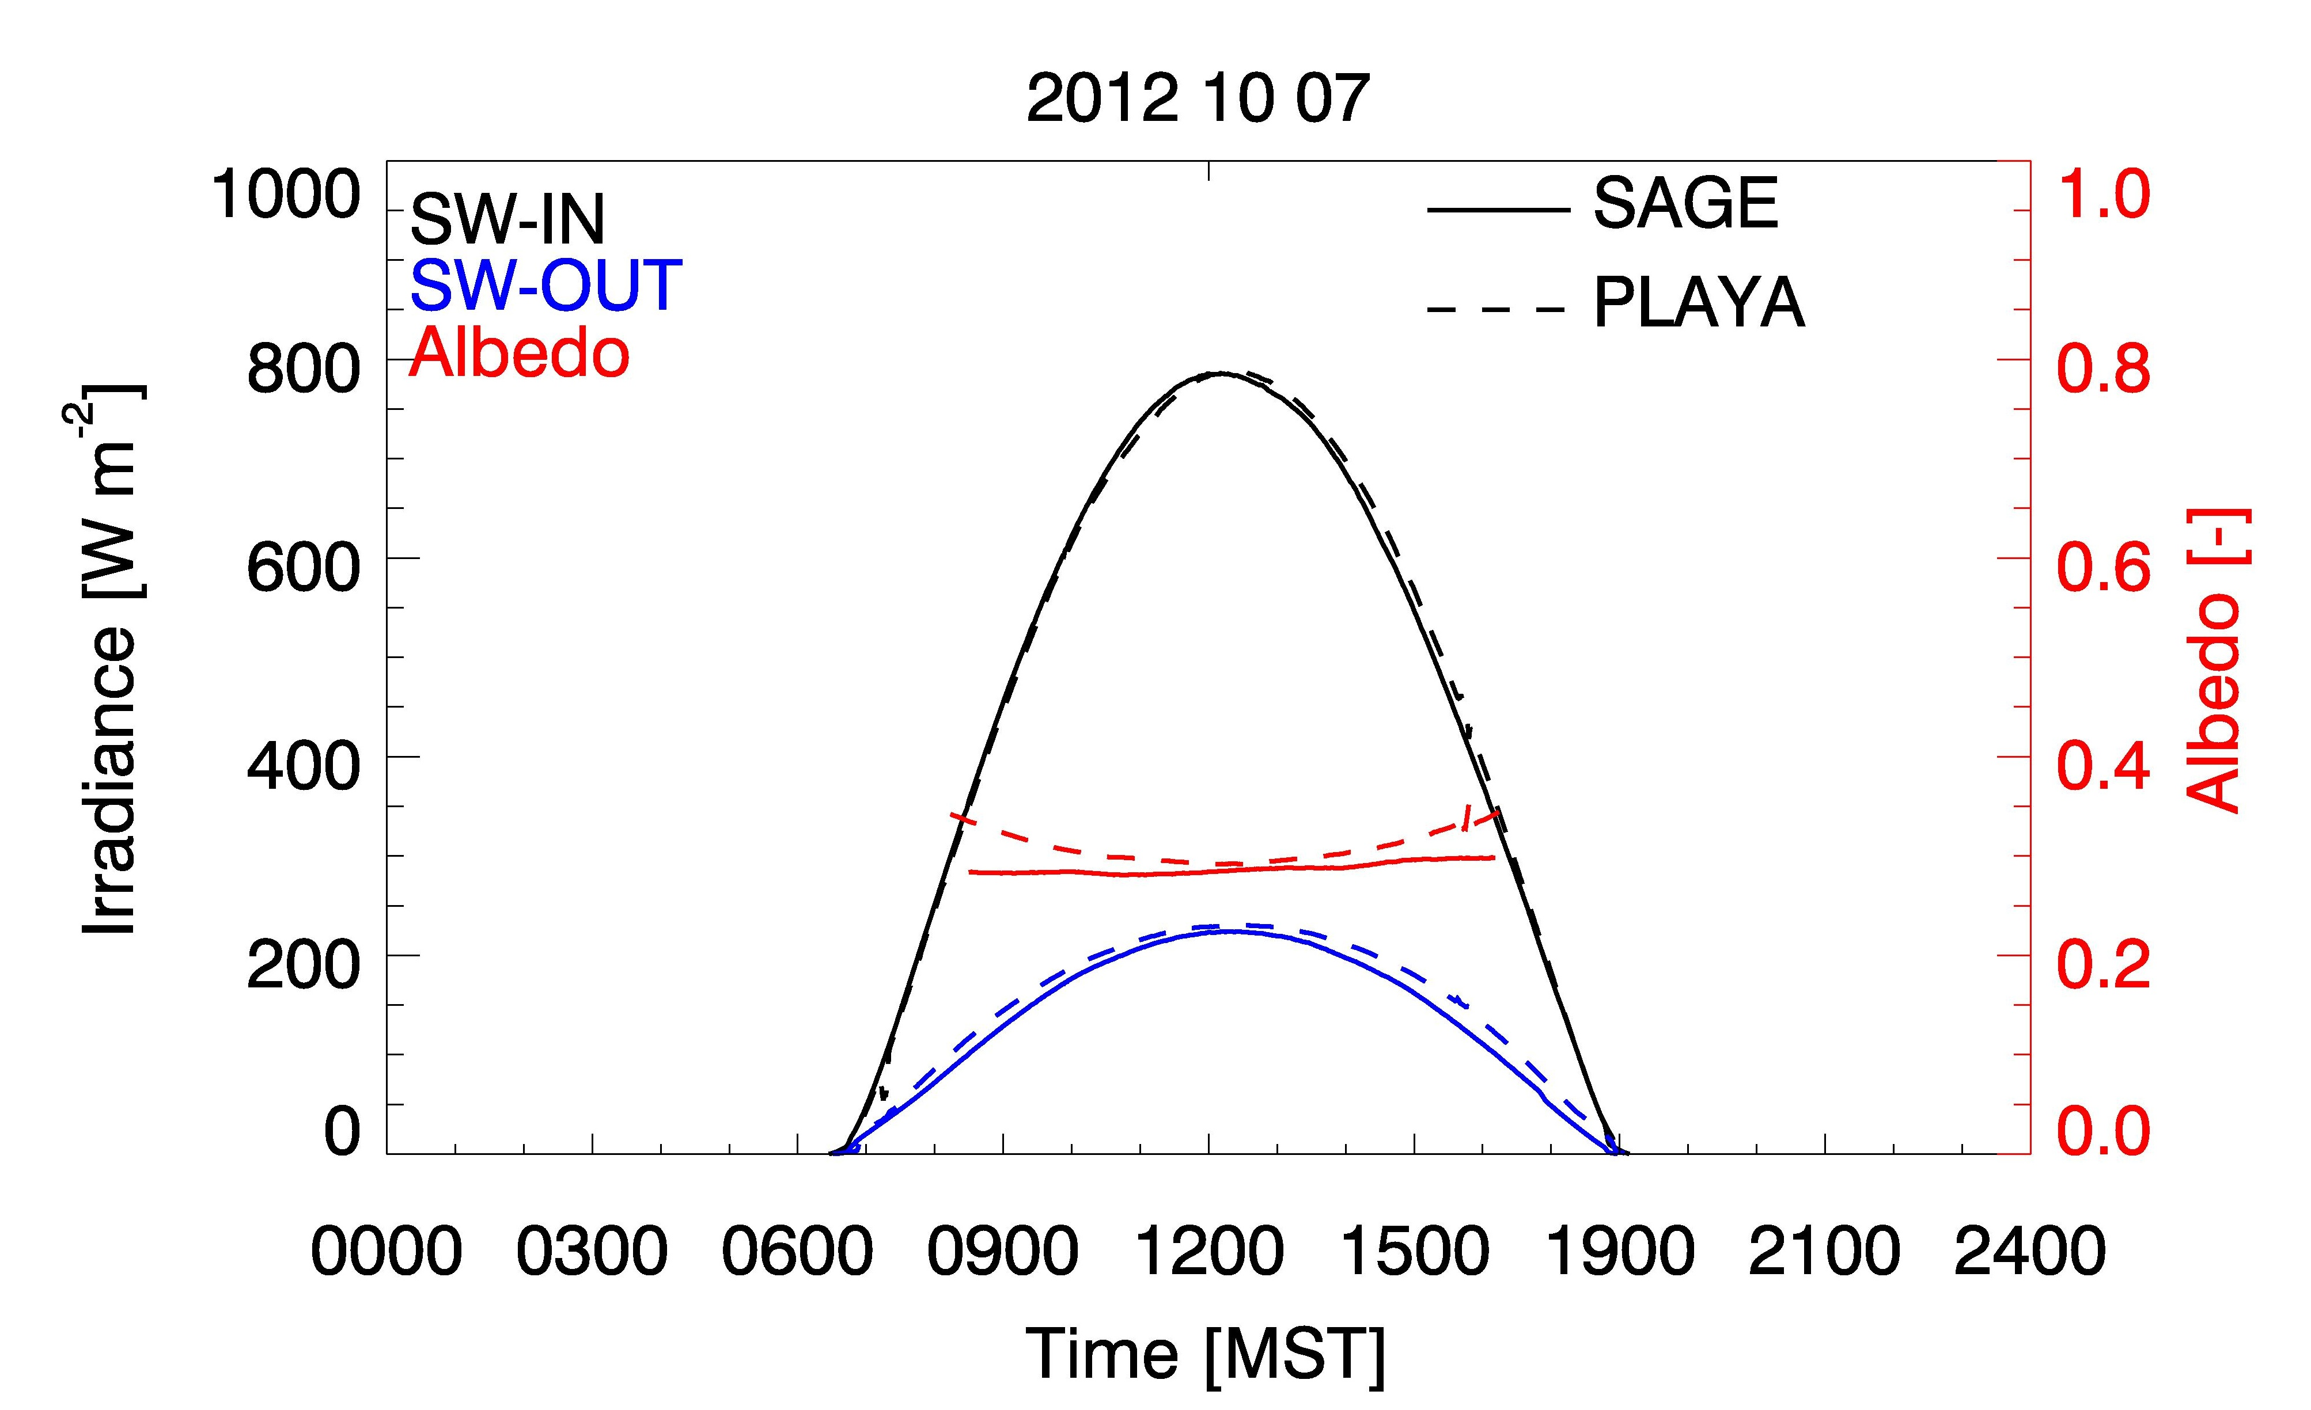
Radiation Balance Observation – Sagebrush vs. Playa
Relatively small albedo differences!
Large diurnal variation of albedo at Playa

Slide 2
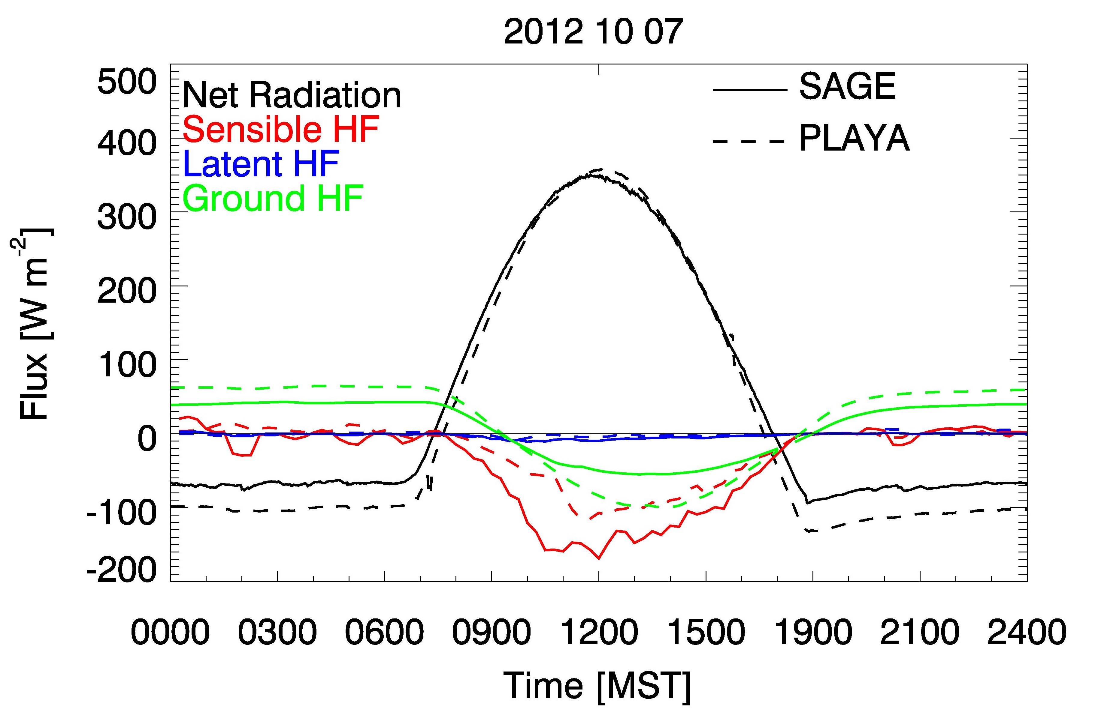
Energy Balance Observation – Sagebrush vs. Playa
Net Radiation differences dominated by Longwave Net Radiation
Nighttime: Larger Net Longwave loss at Playa balanced by Ground Heat Flux
Daytime: Larger energy uptake in soil at Playa reduces Sensible Heat Flux.

