Slide 1
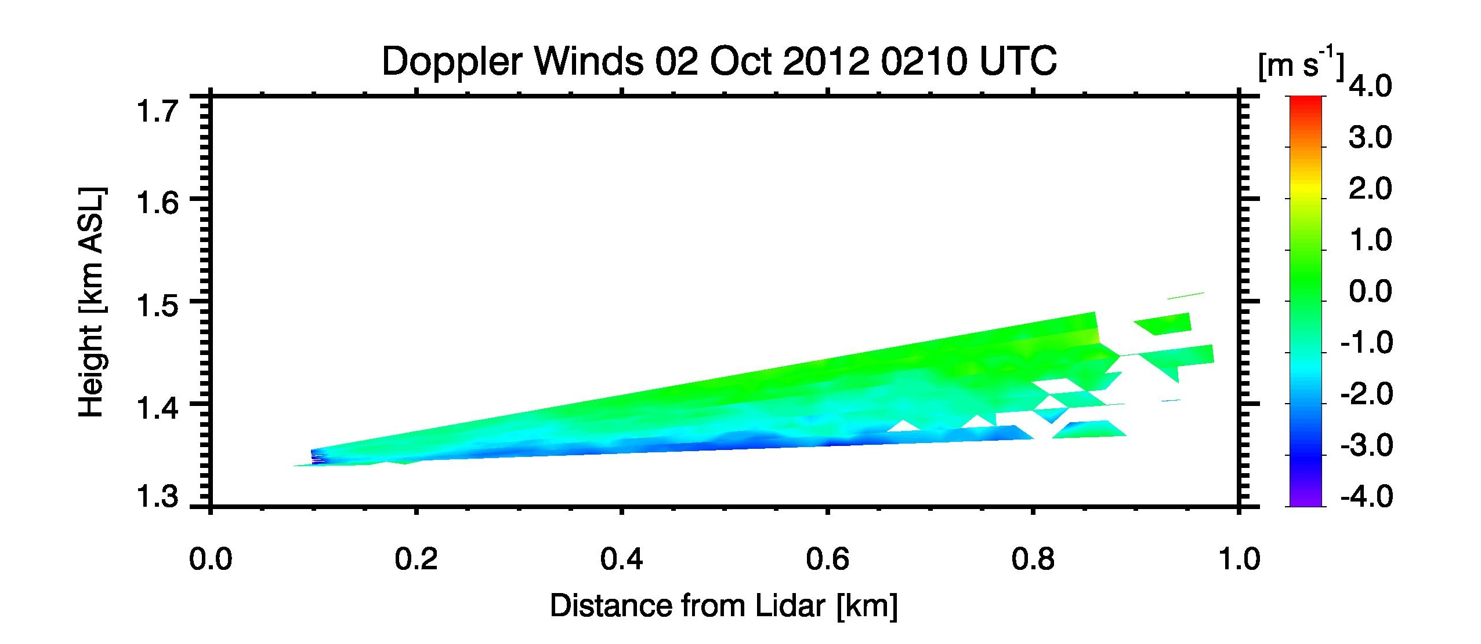
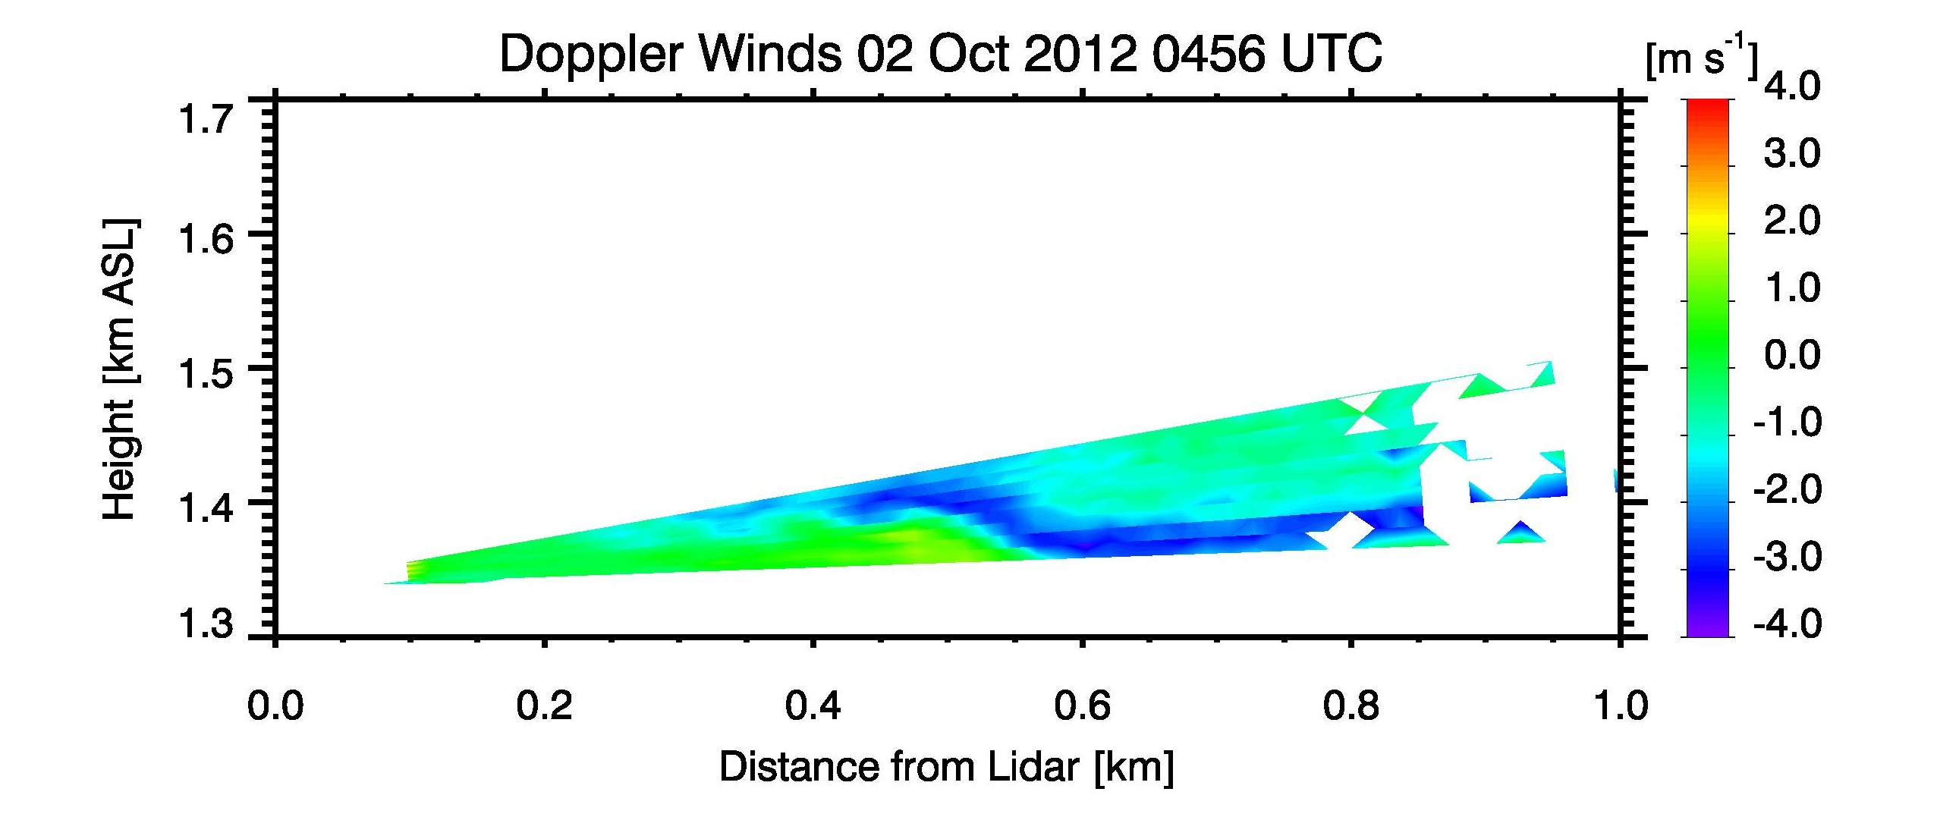
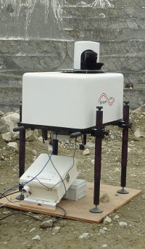
LiDAR observation – East Slope Of Granite Peak
Flow away from /
towards LiDAR
a) Shallow
Down-slope
drainage flow
b) Complex flow interactions / Mixing

