Slide 1

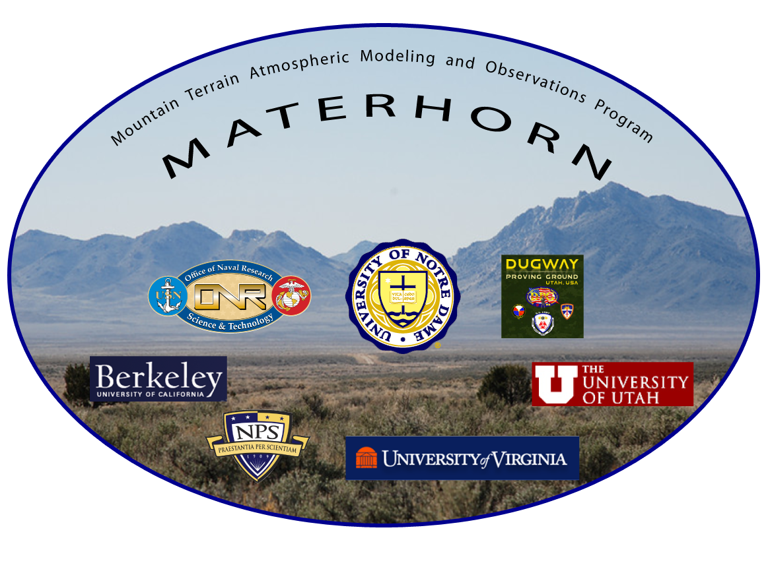


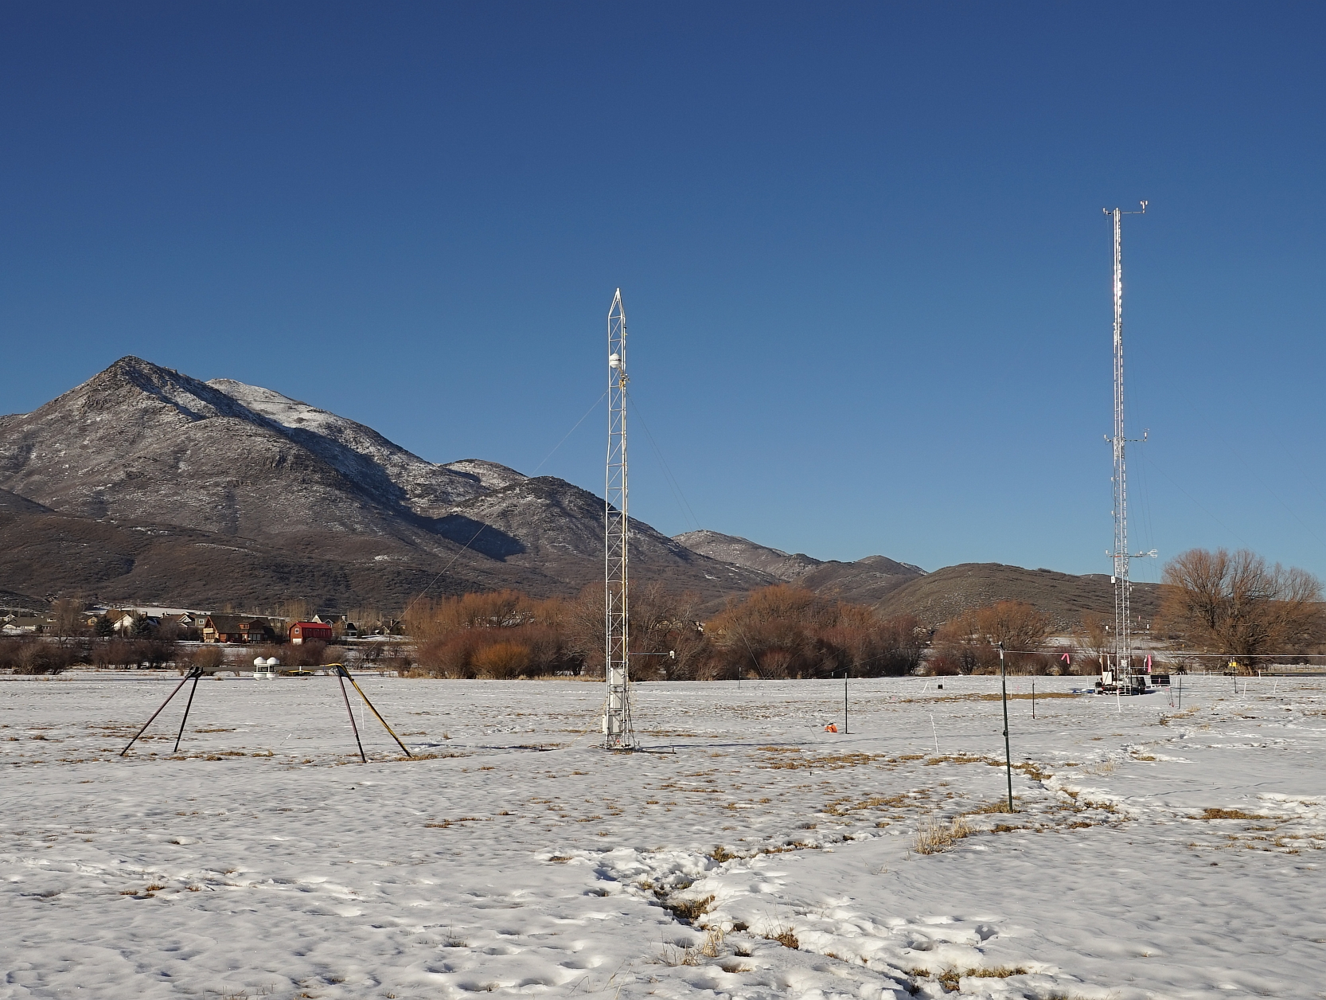
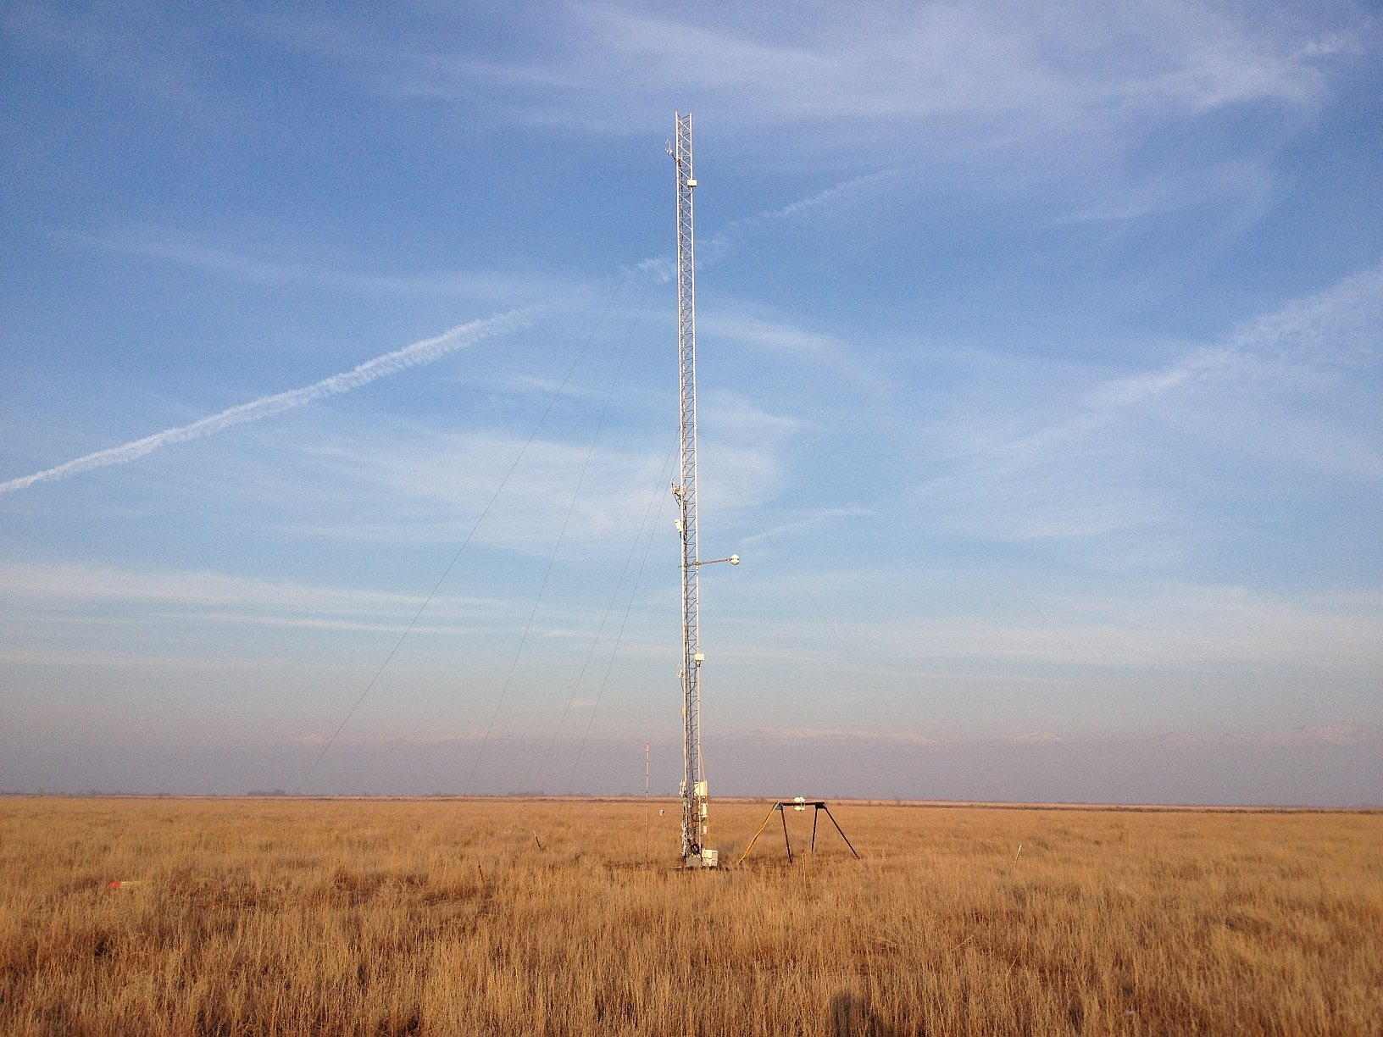
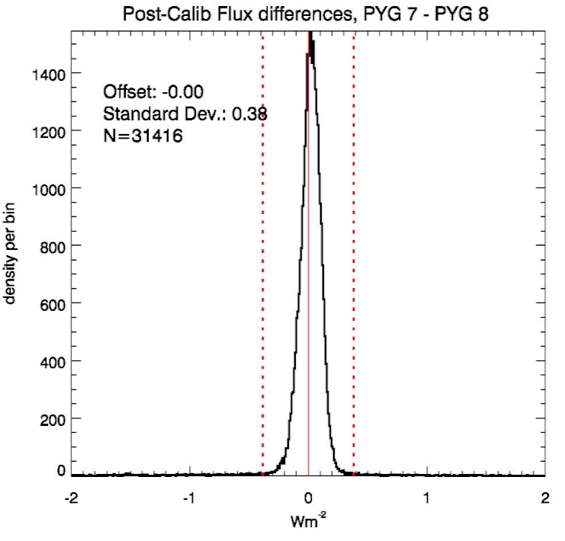
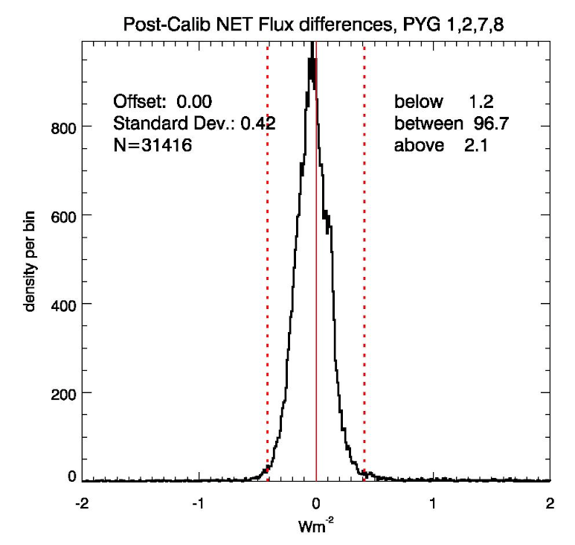
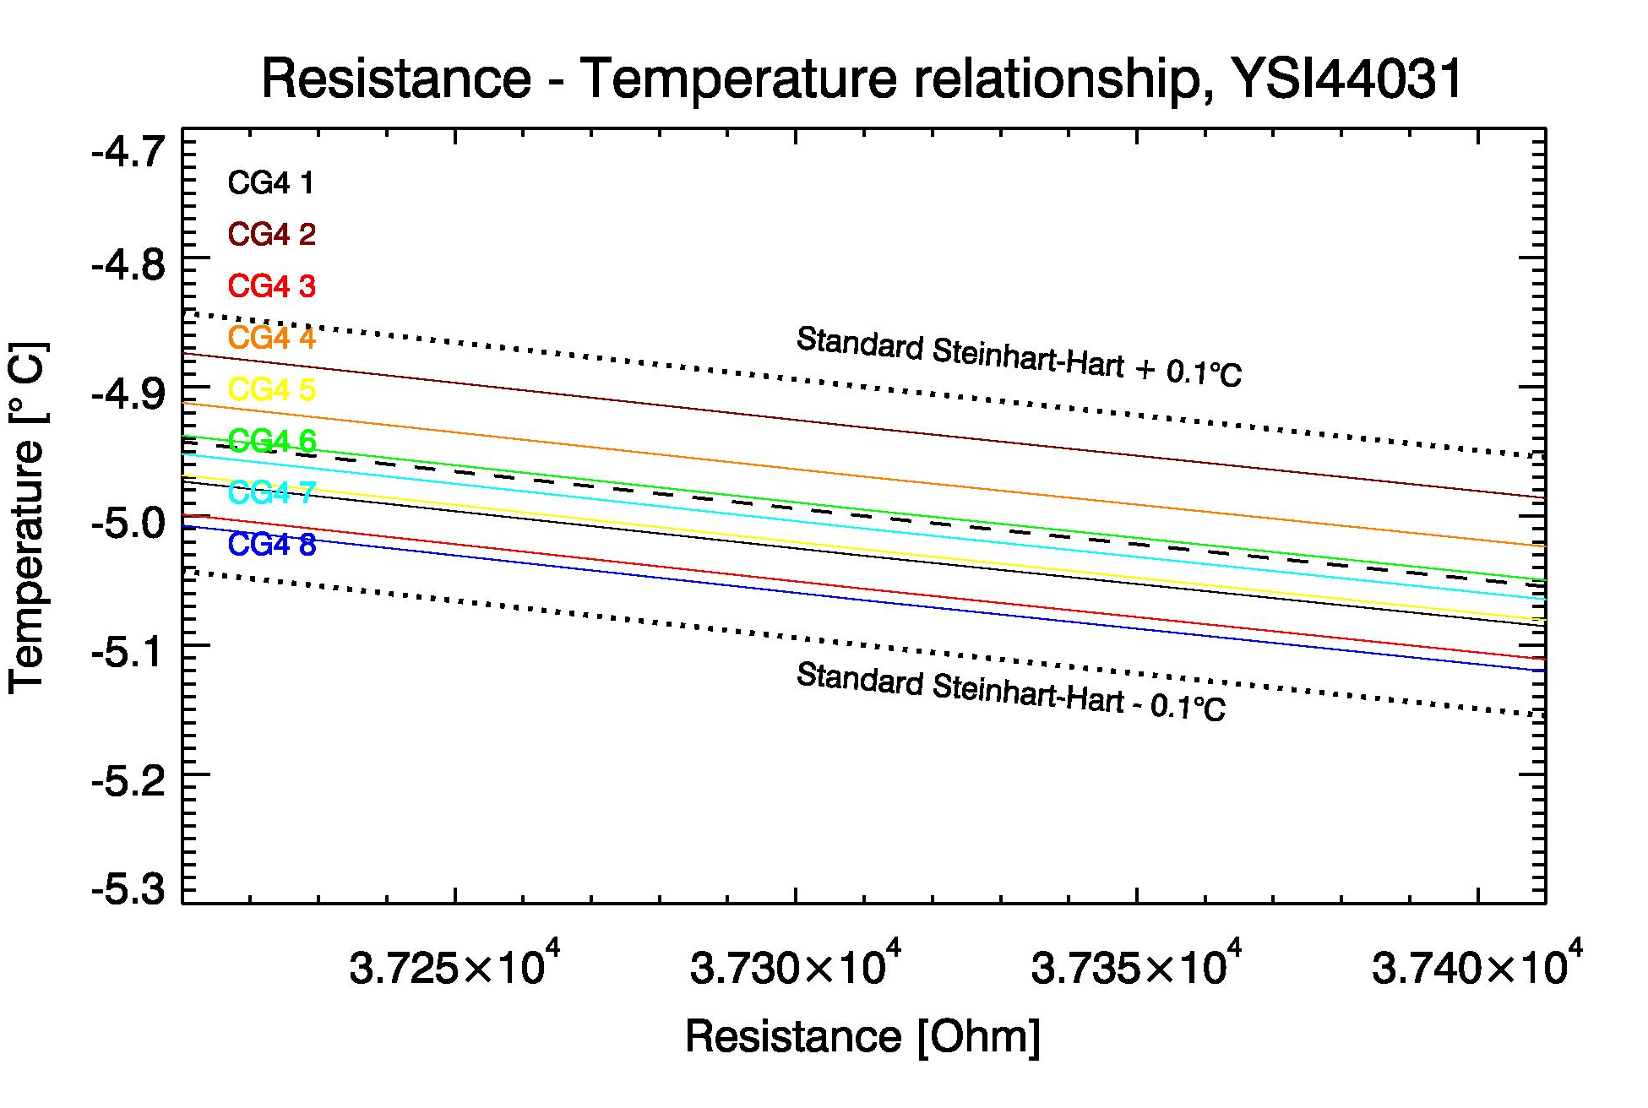
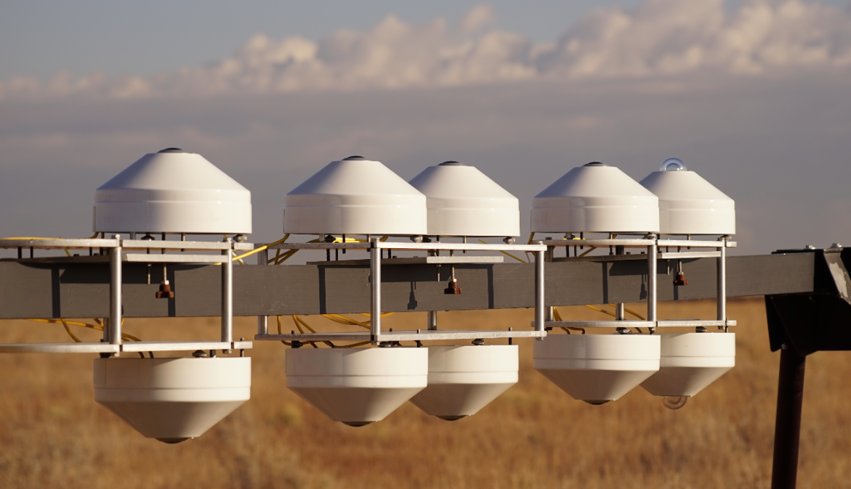
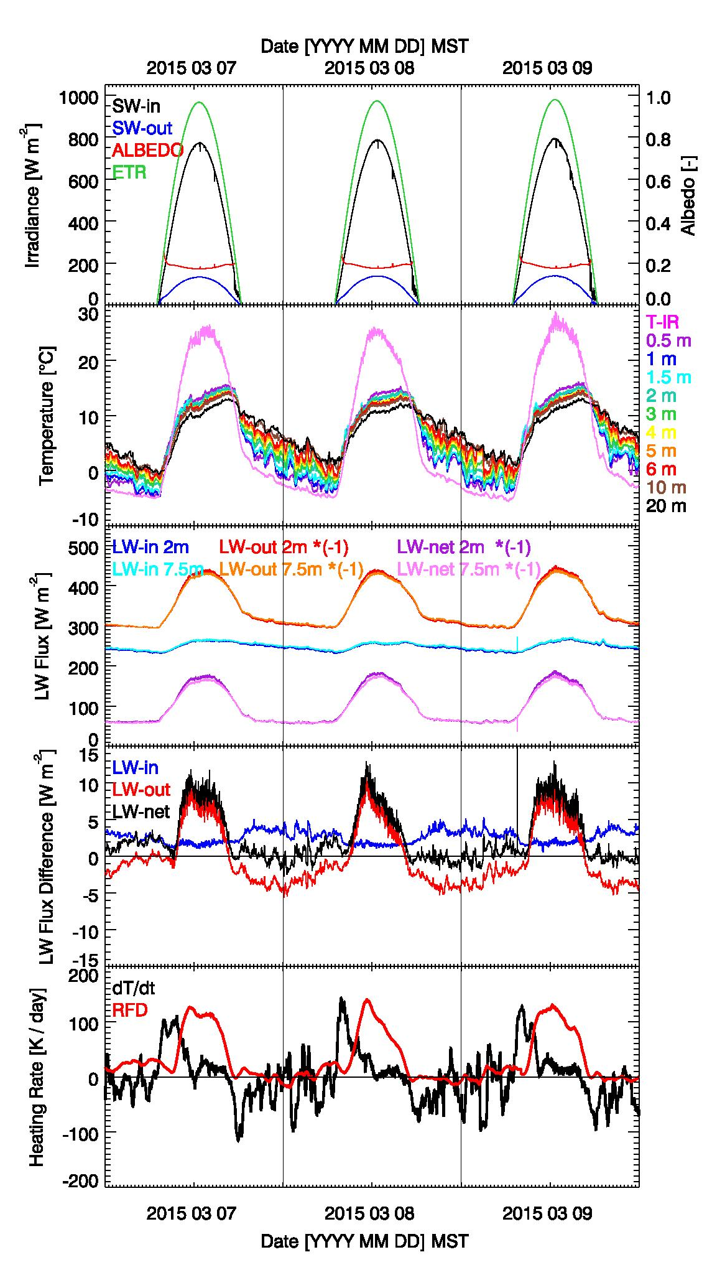
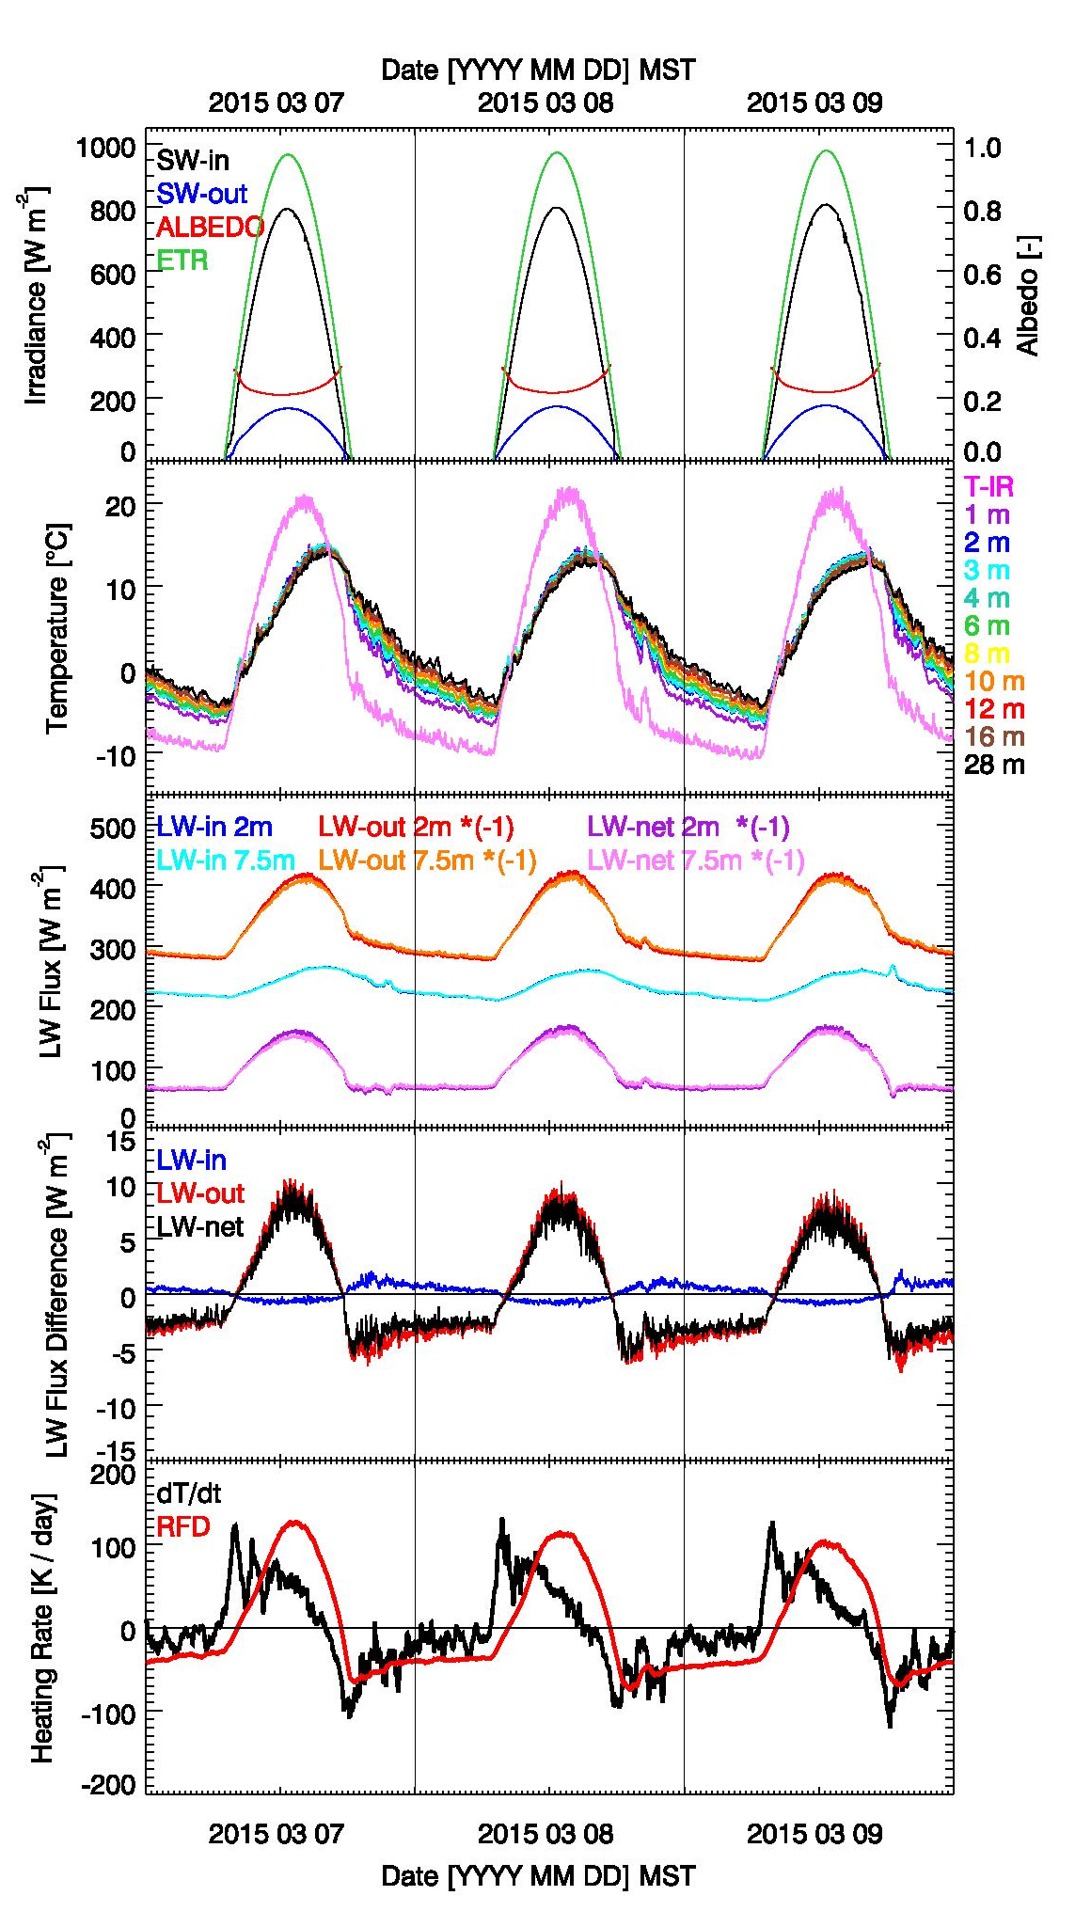
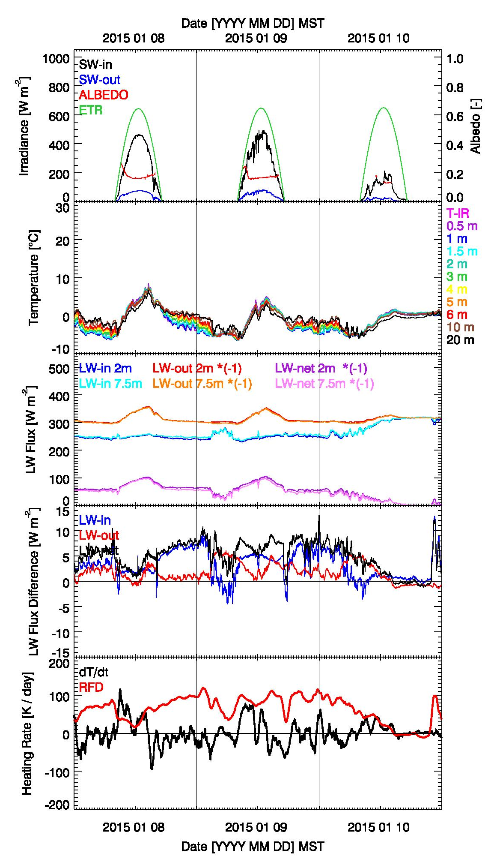
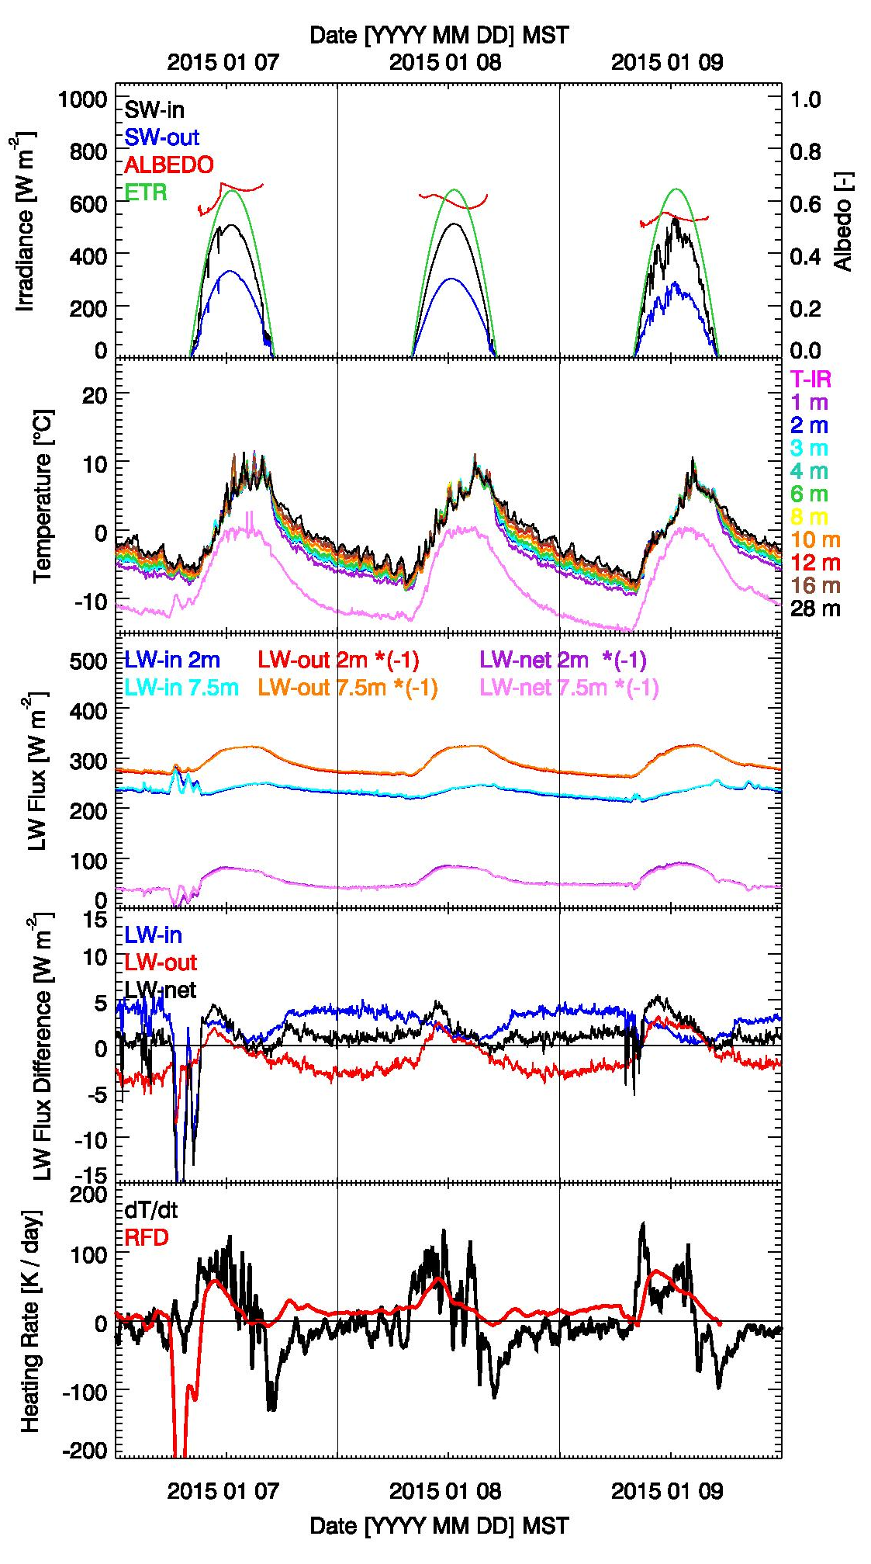
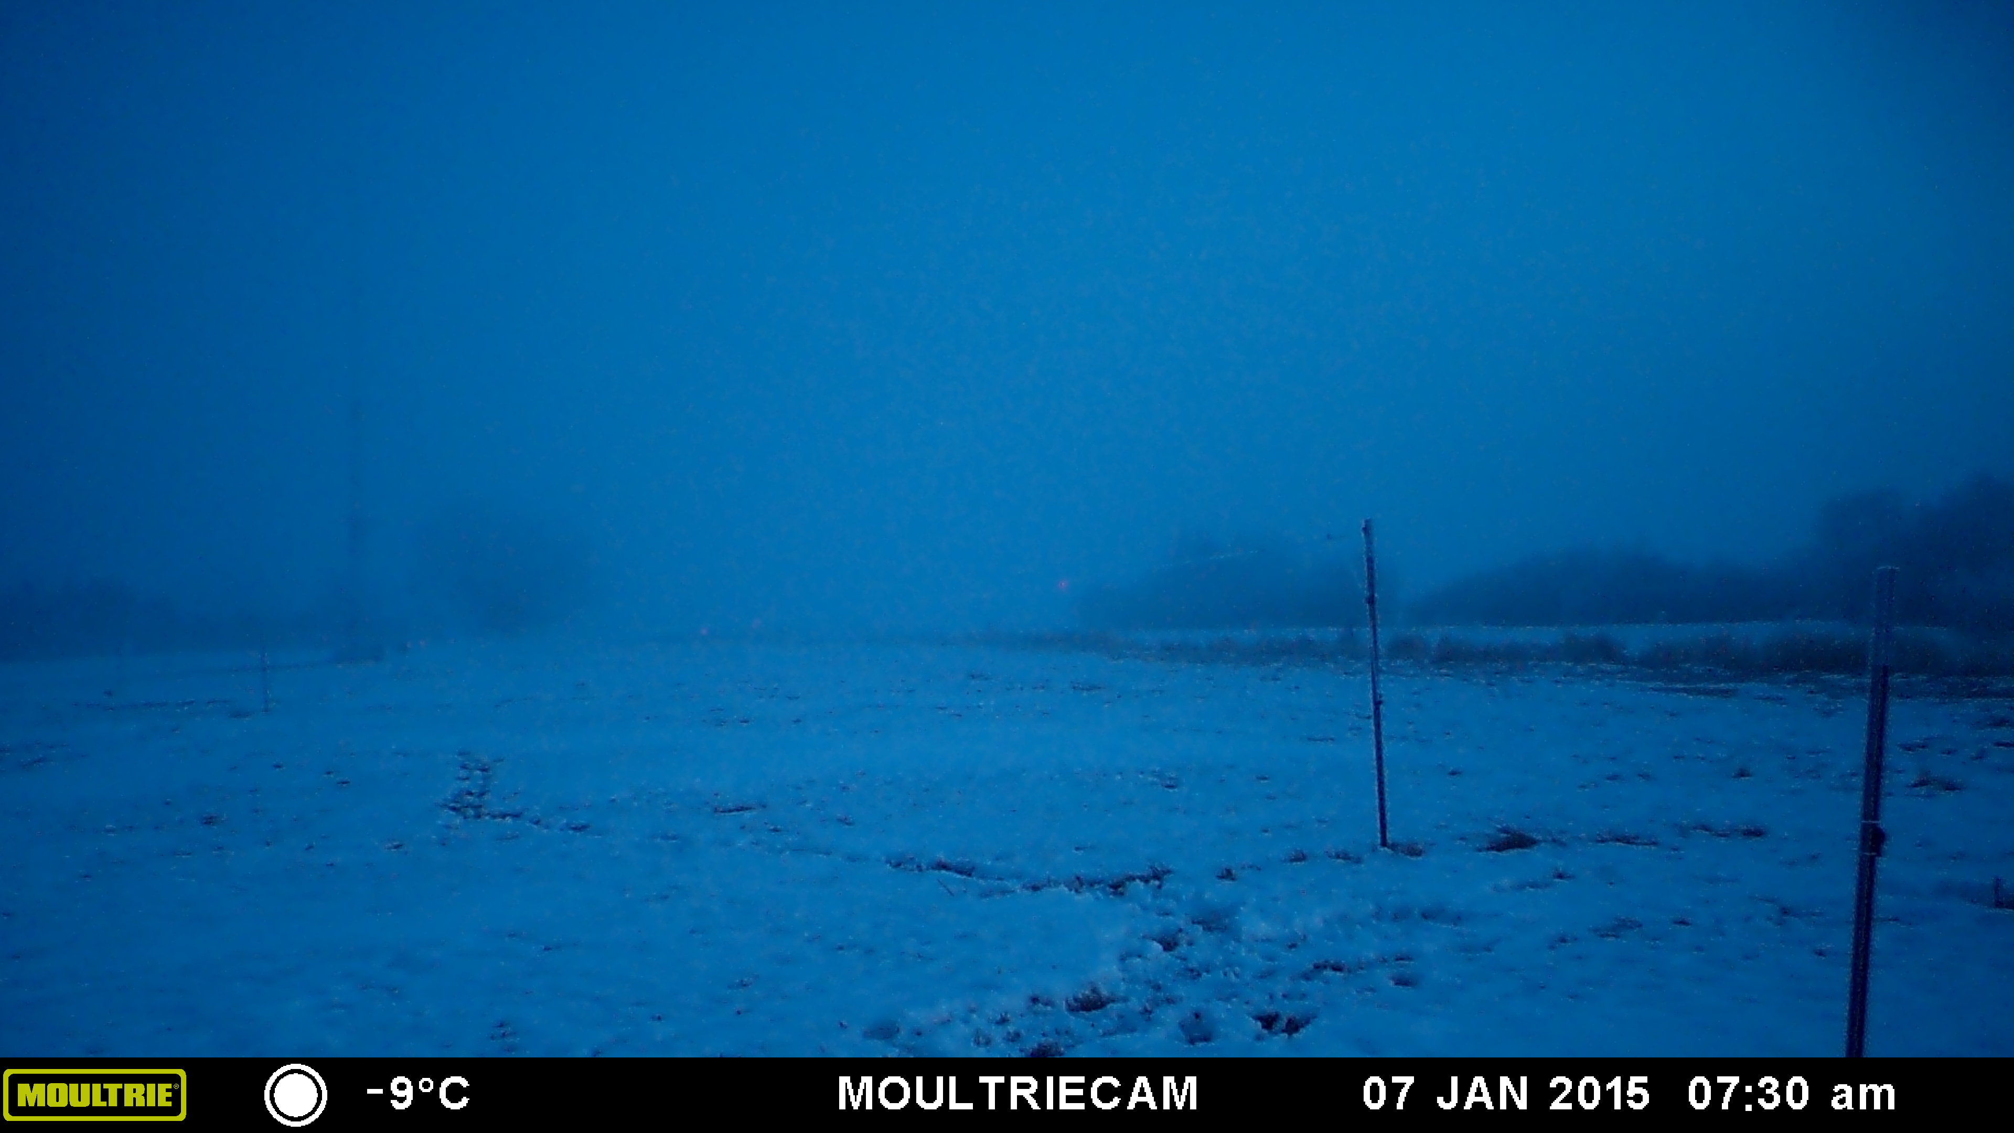
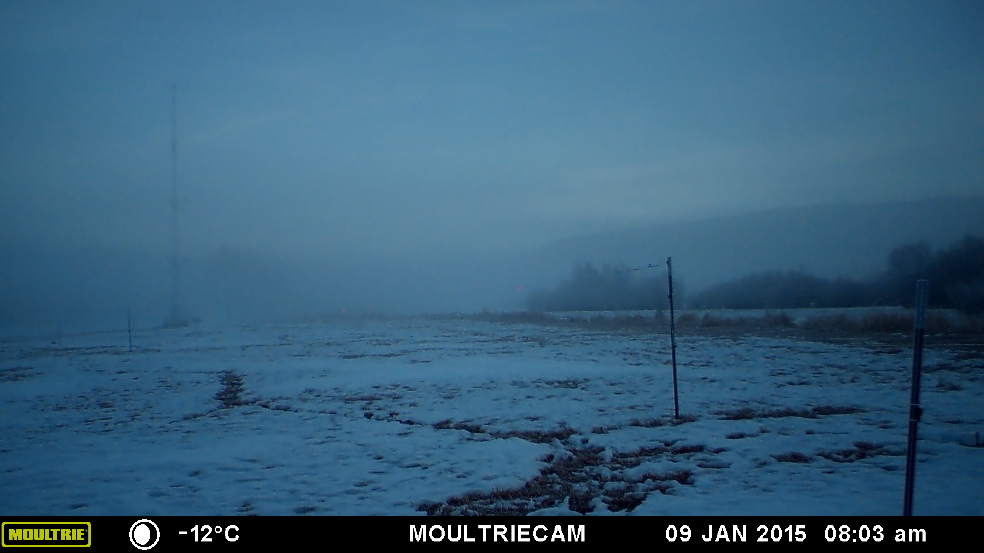
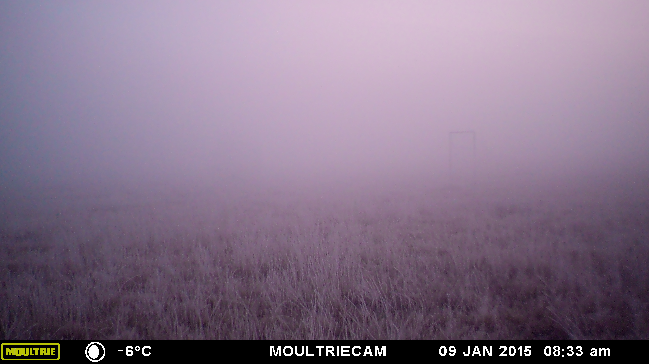
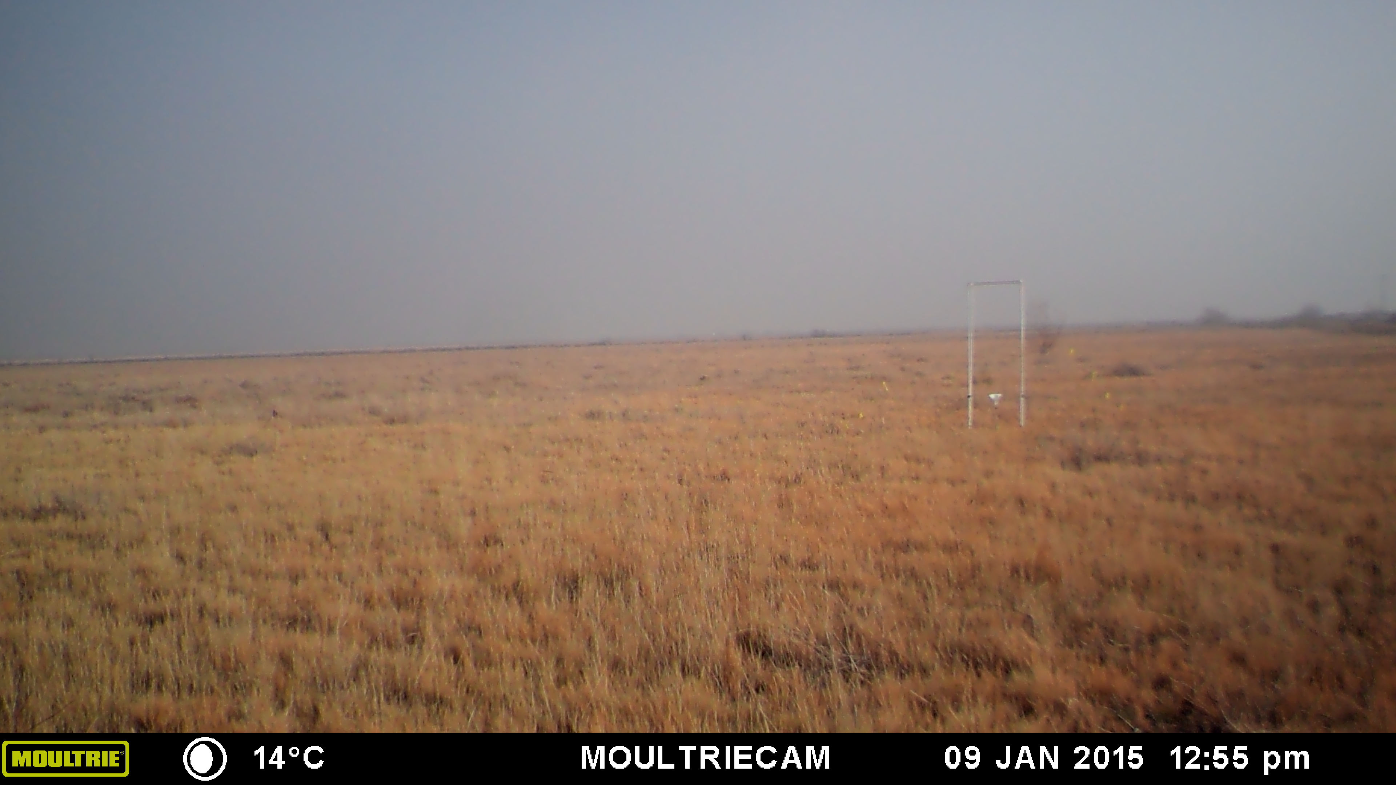
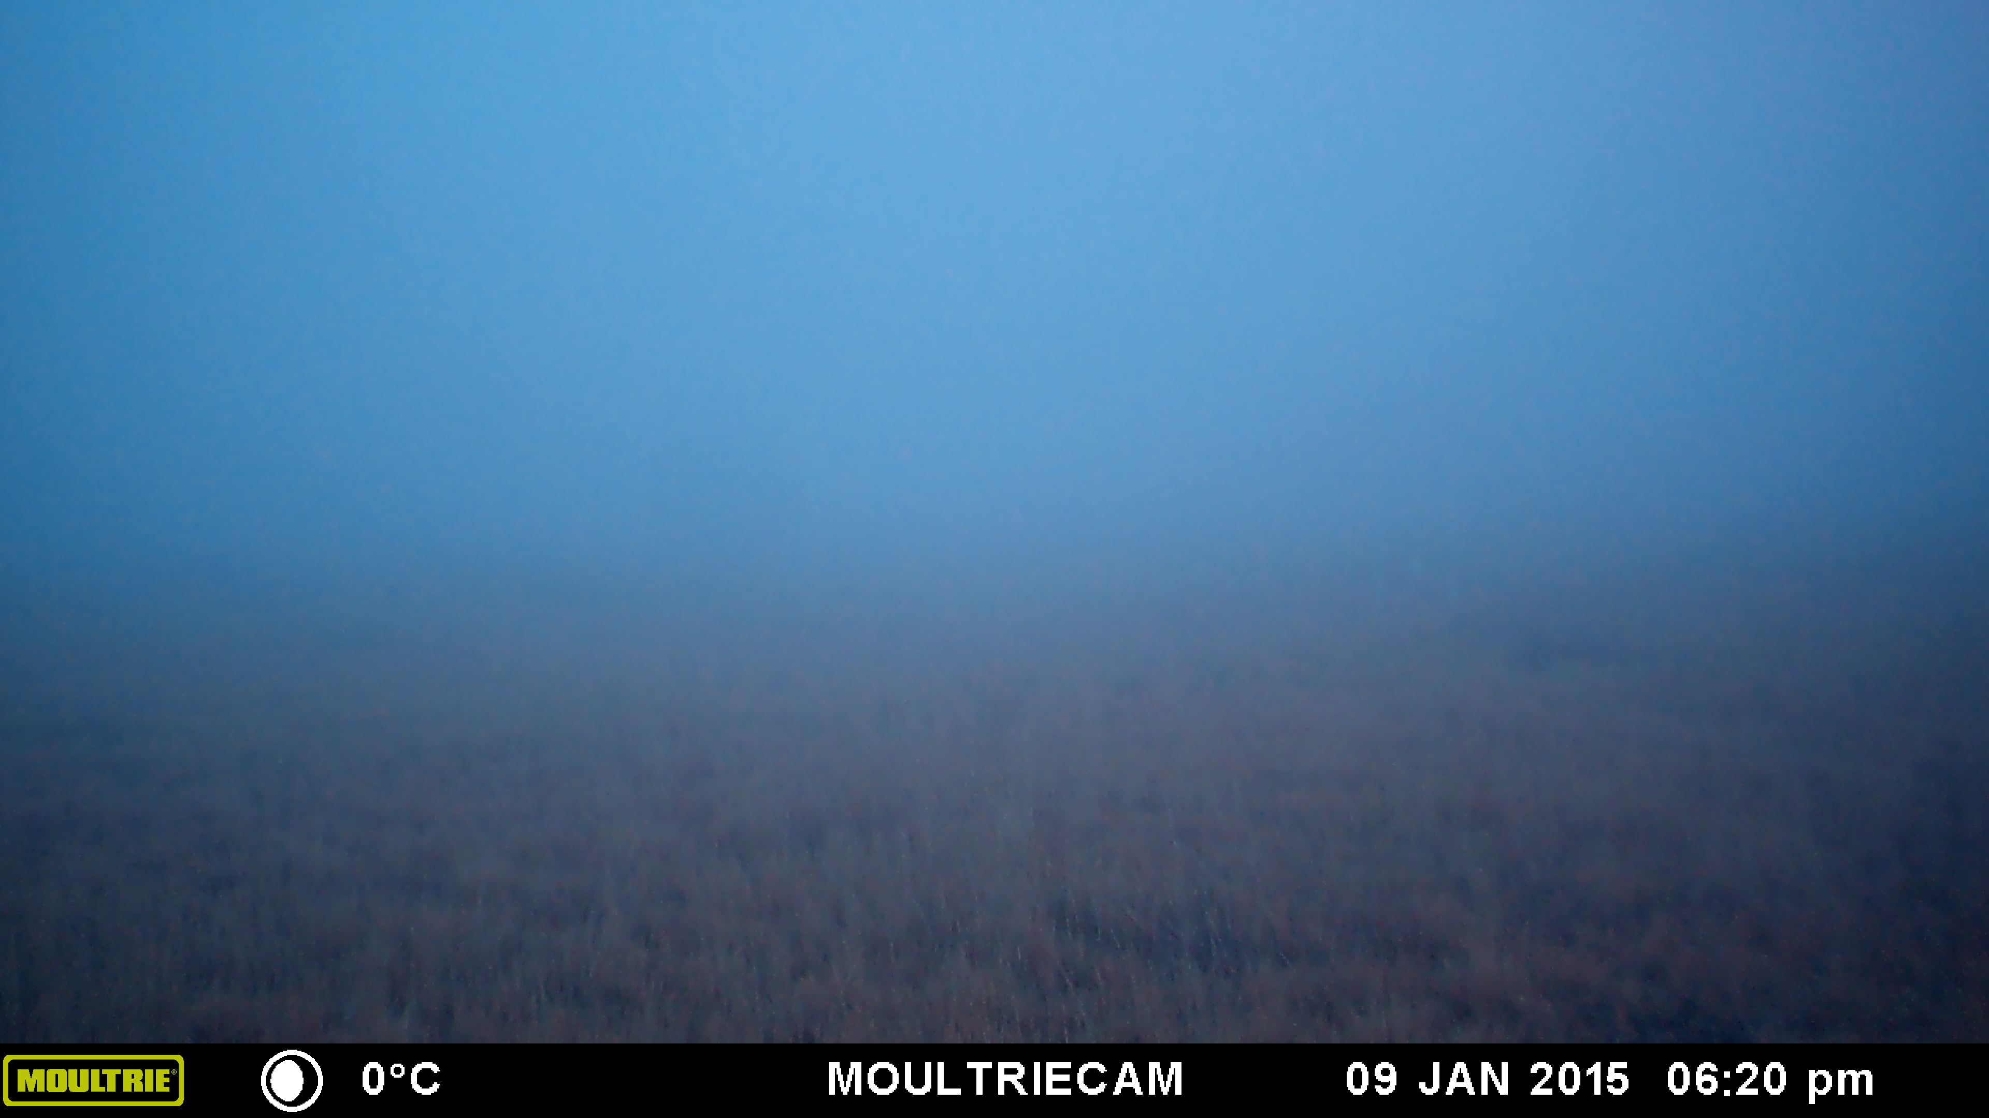
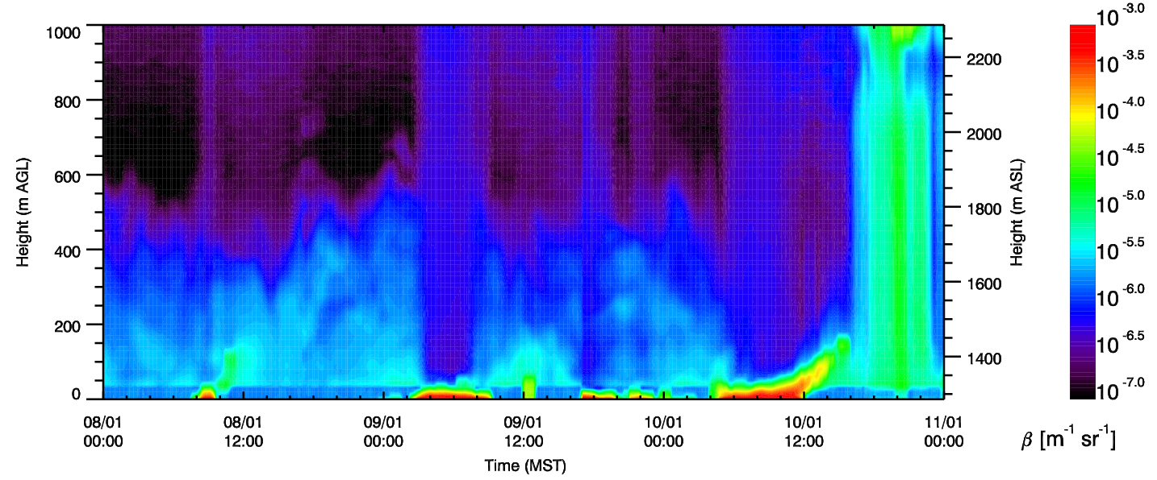
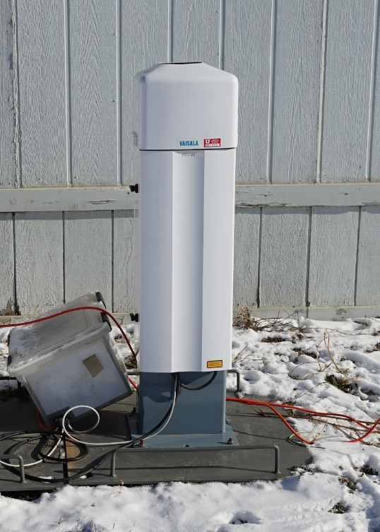
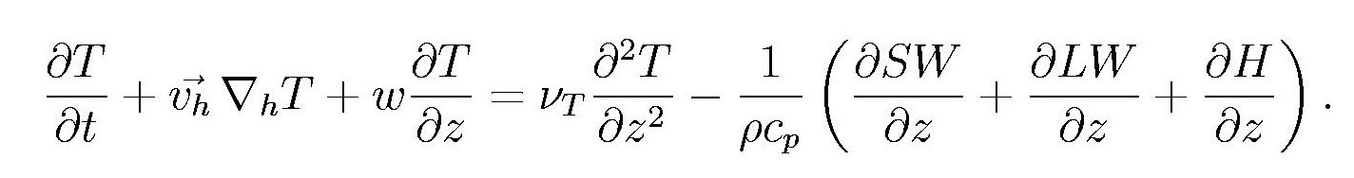
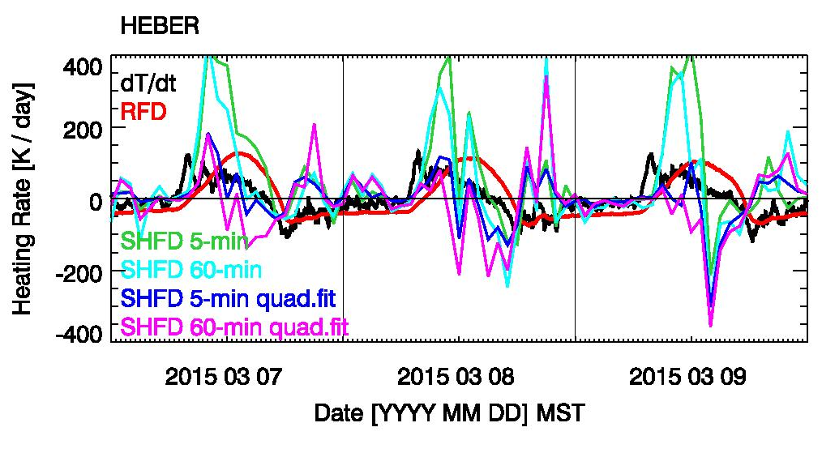
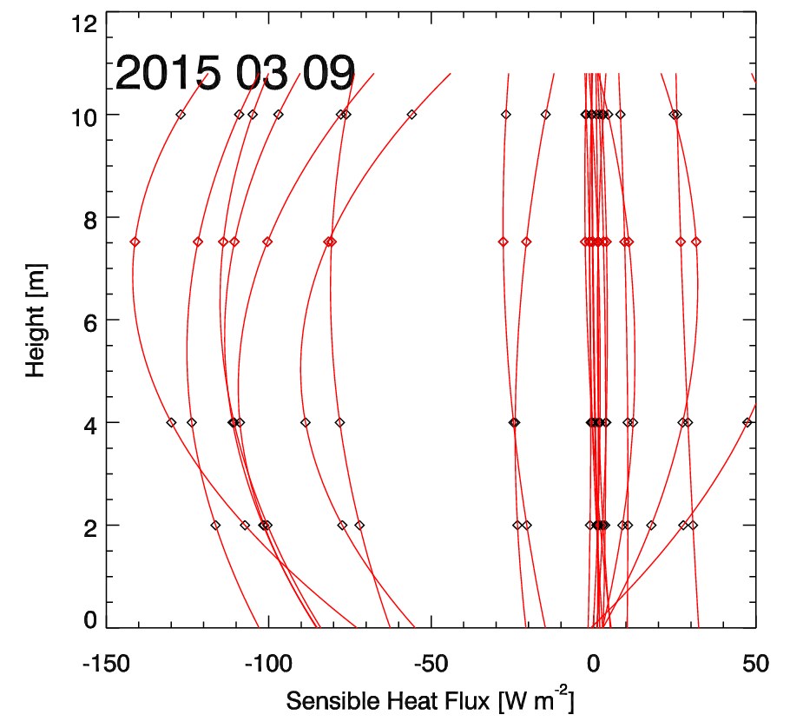

Observations of radiative cooling and heating
under clear sky and fog conditions
P1.32
International Conference
on Alpine Meteorology
31 Aug. – 4 Sep. 2015
Sebastian W. Hoch and Eric R. Pardyjak
University of Utah
Introduction
The radiative heat exchange in the lowest atmospheric layers leads to “clear-air” radiative heating and cooling. During the third field campaign of the Mountain Terrain Atmospheric Modeling and Observations Program (MATERHORN), the contribution of the longwave radiative heating rate to the overall temperature tendency was directly measured in the near-surface layer between 2 and ~8 m above ground. Measurements were conducted at two sites: in the high alpine Heber Valley (1697 m MSL) and in the broad Salt Lake City (SLC) Basin (1289 m MSL).
Relative Calibration
Kipp and Zonen CGR4 pyrgeometers were carefully calibrated at the SLC field site prior to deployment on meteorological masts. The relative calibration involves a regression allowing the calibration coefficient of the instruments and the thermistor coefficients to vary within their uncertainty ranges. It yielded an agreement of individual sensor pairs to between ±0.15 W m⁻² and ±0.59 W m⁻². The uncertainties in the radiative heating rates determined for the bulk layer between the two measurement levels were below 7 K day⁻¹ or 0.3 K hr⁻¹.
Heber Valley, Jan. 8, 2015
Salt Lake City Basin, Jan. 8, 2015
Uncertainties | SLC | Heber
LW in | ± 0.38 W m⁻² | ± 0.59 W m⁻²
LW out | ± 0.15 W m⁻² | ± 0.18 W m⁻²
LW net | ± 0.42 W m⁻² | ± 0.61 W m⁻²
Radiative Heating Rate | ± 5.5 K day⁻¹ | ± 6.5 K day⁻¹
Data examples
Time series of short- and longwave radiative fluxes, temperatures and inferred radiative heating rates are shown for a selected 3-day period of clear skies in March, and for 3-day periods in early January when fog formed at both the Salt Lake Basin and Heber Valley sites.
SLC, clear sky, snow free
Heber, clear sky, snow free
SLC, snow free, some fog
Heber, snow covered, some fog
Heber, 7 Jan 2015, 7:30 MST
1
Heber, 9 Jan 2015, 8:03 MST
2
SLC, 9 Jan 2015, 8:33 MST
3
Clear Sky Conditions (7-9 March 2015)
Fog episodes (7-10 Jan. 2015)
2
SLC, 9 Jan 2015, 12:55 MST
4
3
4
5
SLC, 9 Jan 2015, 18:20MST
5
1
Initial Results
Ceilometer backscatter at SLC site, 8-11 Jan. 2015
Significant differences in the incoming, outgoing, and net longwave radiative fluxes between 2 and ~8 m AGL can be resolved after a careful relative calibration of research-grade pyrgeometers.
A daytime convergence of the net longwave flux typically leads to a daytime radiative heating rate of up to ~100 K day⁻¹ (~4 K hr⁻¹). This magnitude corresponds to the temperature tendency observed in the morning hours. This illustrates the importance of clear-air longwave radiative heat exchange in the surface layer.
The time lag between maximum observed heating and radiative heating indicates the important role of other processes.
At night, under clear skies, the divergence of the outgoing flux is compensated by a convergence of the incoming flux. Zero to weak cooling results.
Under clear-sky conditions, the divergence/convergence of the outgoing longwave flux component dominates net radiative cooling/heating.
When fog droplets are introduced in the surface layer, radiative energy exchange changes dramatically. Initially, shallow fog leads to enhanced radiative cooling (Heber, 7 Jan.); persistent deep, but thin fog/haze in cold air pools leads to a radiative warming dominated by the convergence of the incoming flux (SLC, Jan 8 ~20:00 MST, Jan 9 ~13:00 MST); very deep thick fog results in a zero radiative heating/cooling (SLC, 9 Jan ~18:30 MST).
Heat budget calculations
Future work will involve estimating the other terms in the heat budget:
Especially the derivation of sensible heat flux divergence (SHFD) is of interest. Key questions relative to SHFD derivation include averaging times for flux calculations, interpolation of fluxes to different levels, etc.
Radiative Transfer Modeling
Spectrally-resolved radiative transfer modeling using observed temperature and humidity profiles and measured aerosol concentrations and size distributions will be necessary to fully understand the radiative energy exchange.
Acknowledgments: MATERHORN is sponsored by the US Department of Defense, Office of Naval Research. We thank all MATERHORN-FOG participants and student volunteers.
Contact: sebastian.hoch@utah.edu

