Slide 1
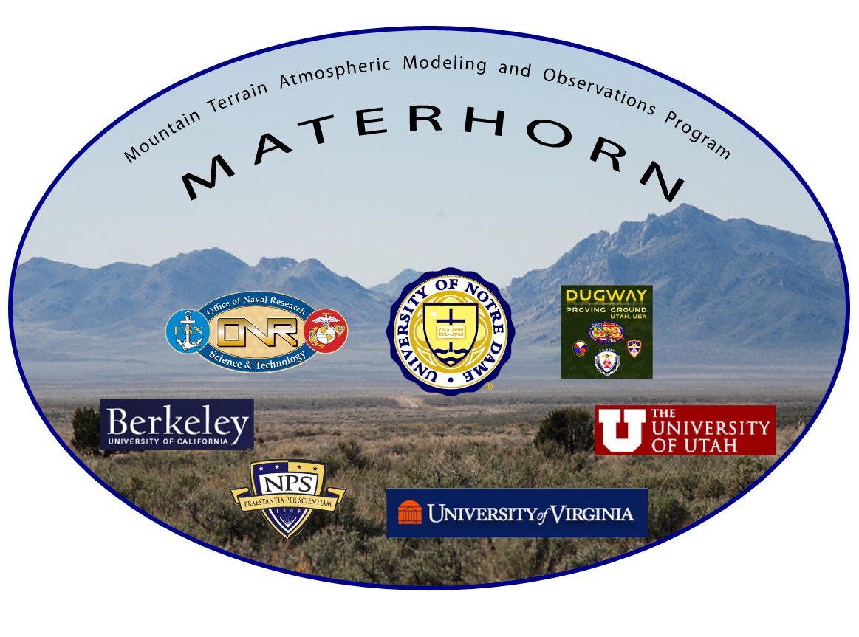
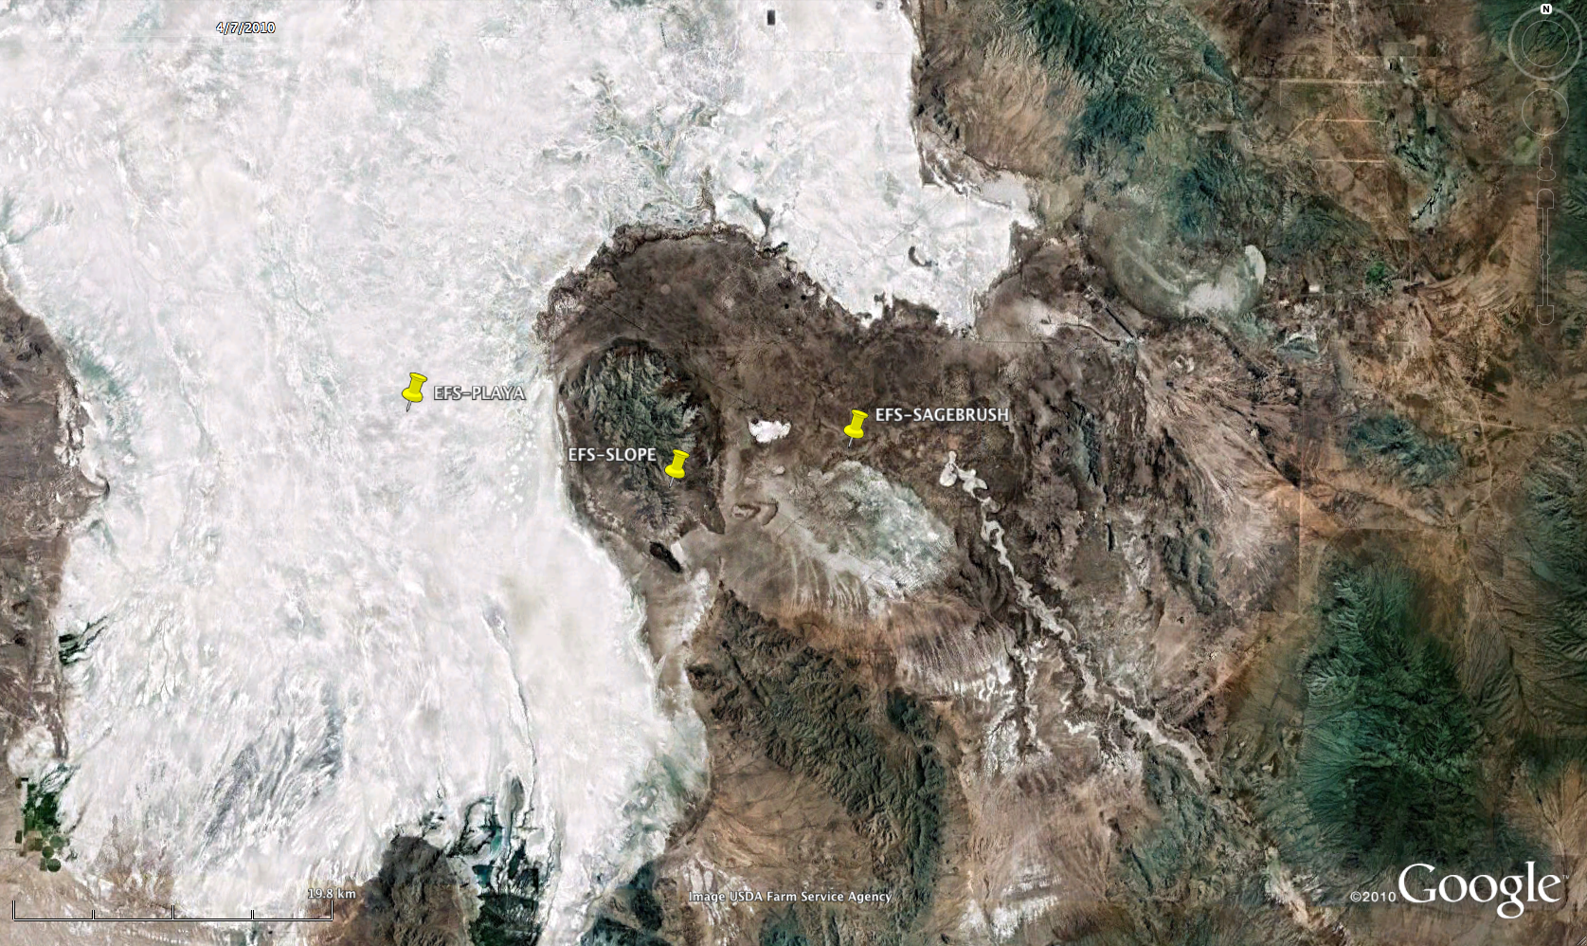
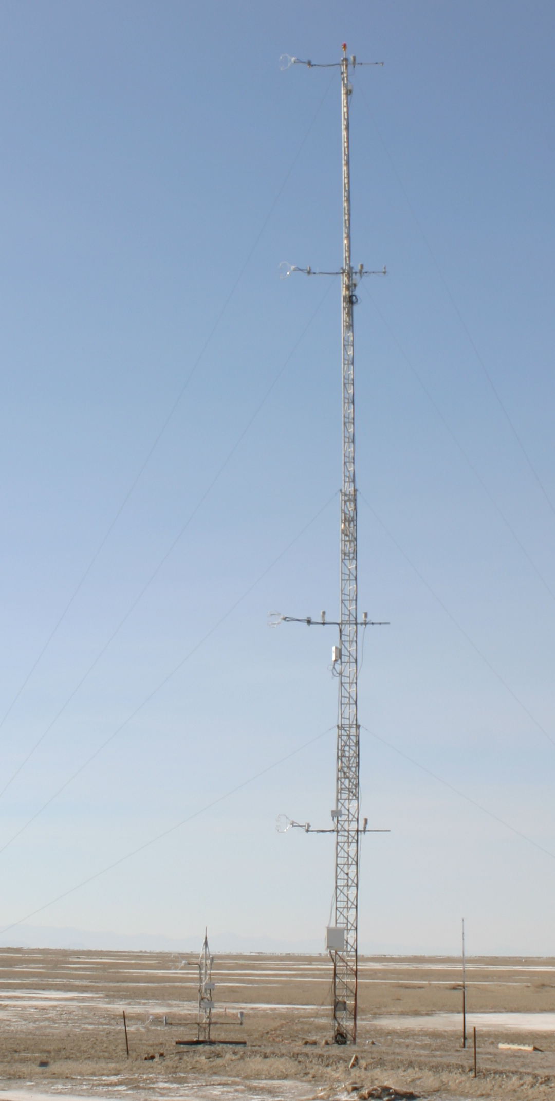
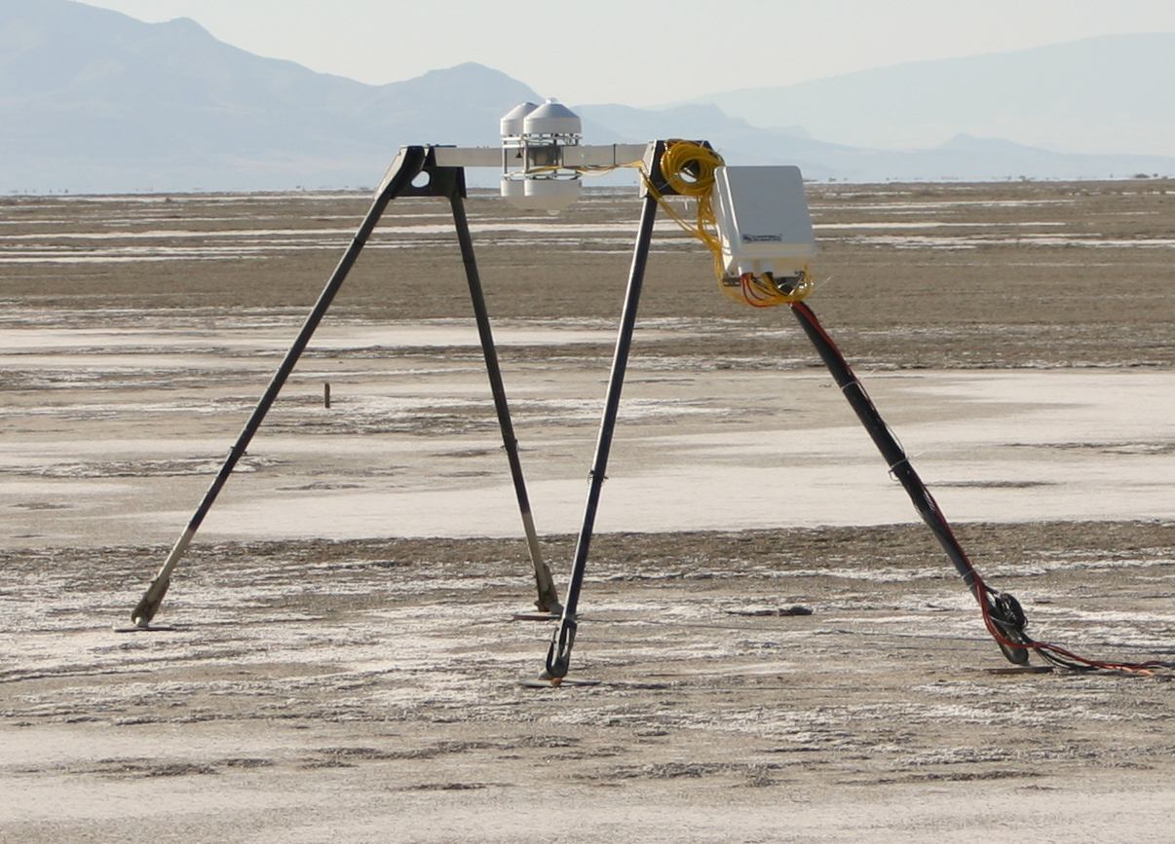
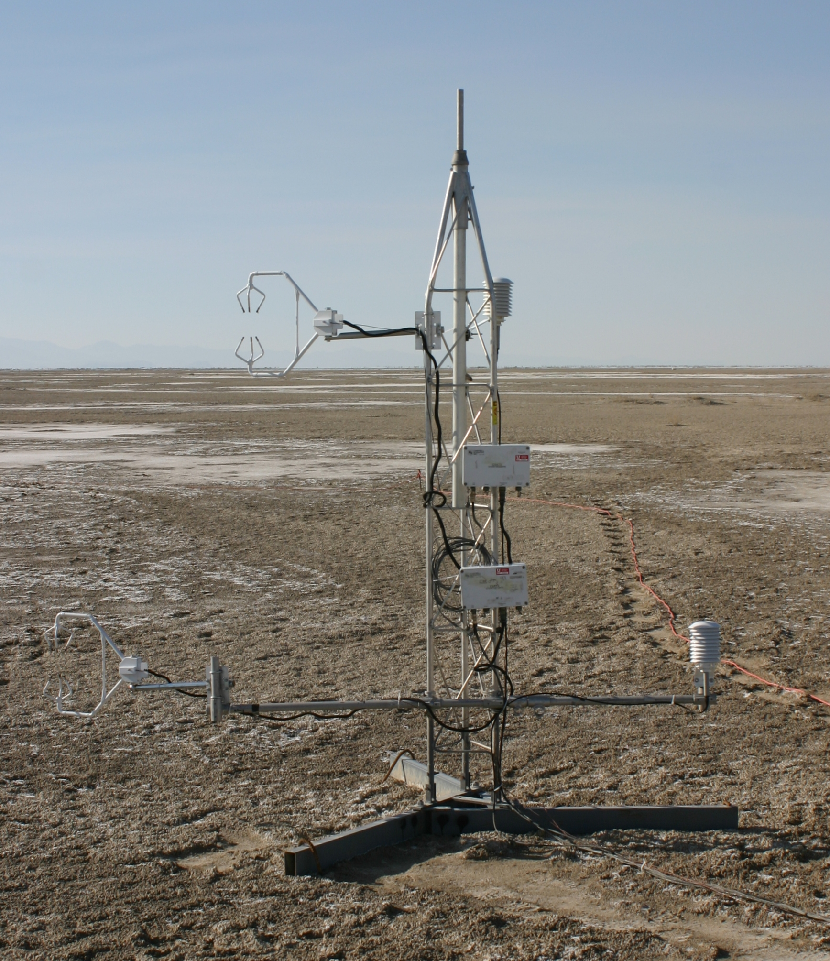
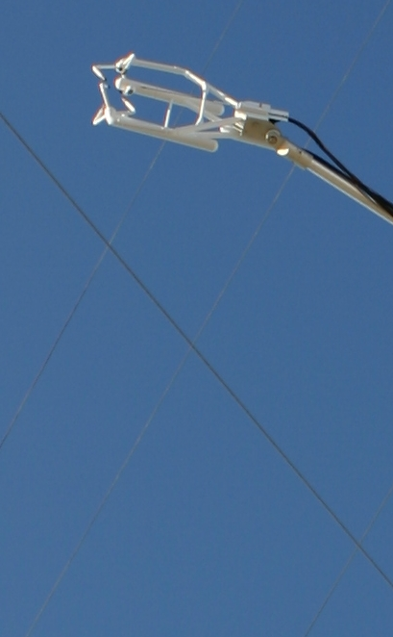
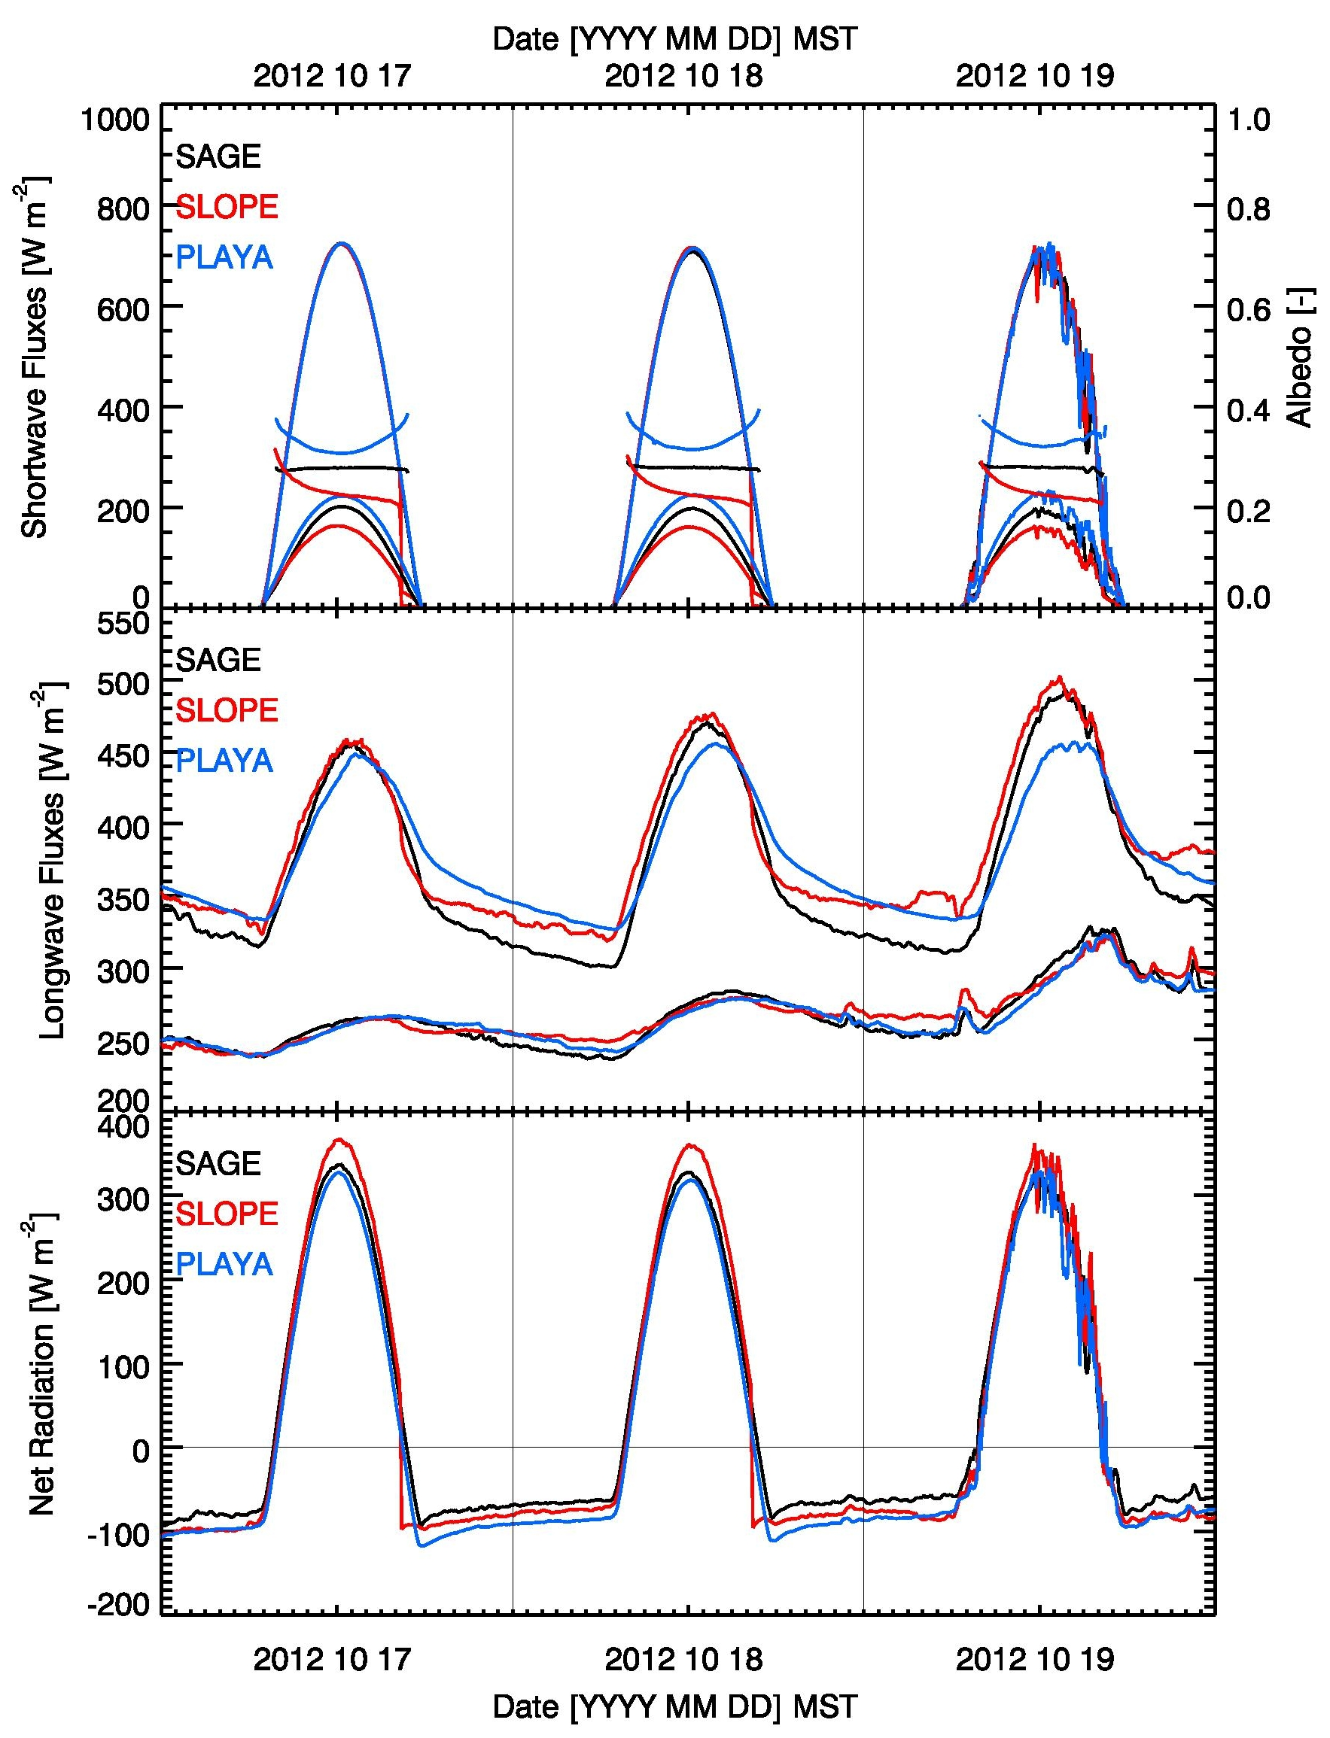
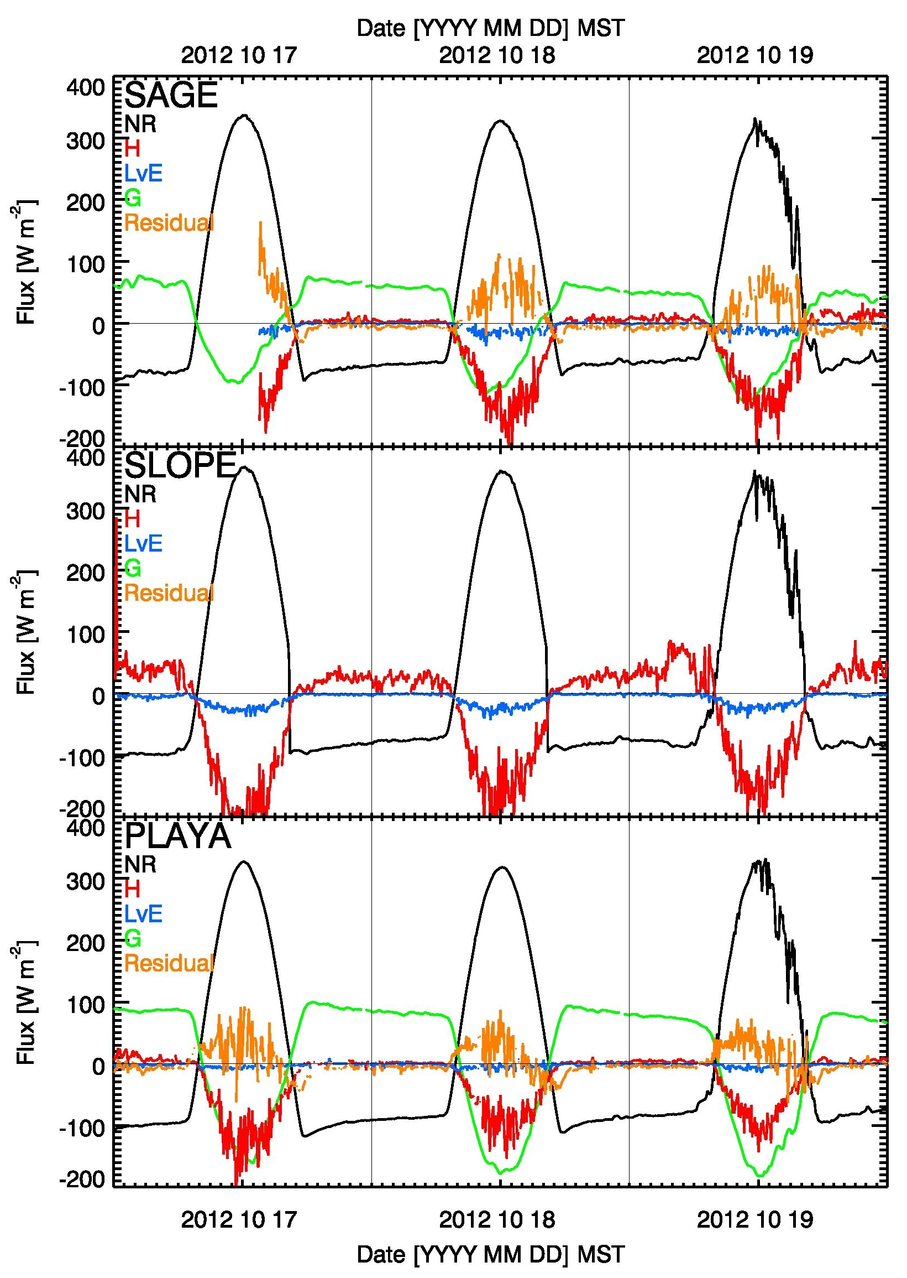
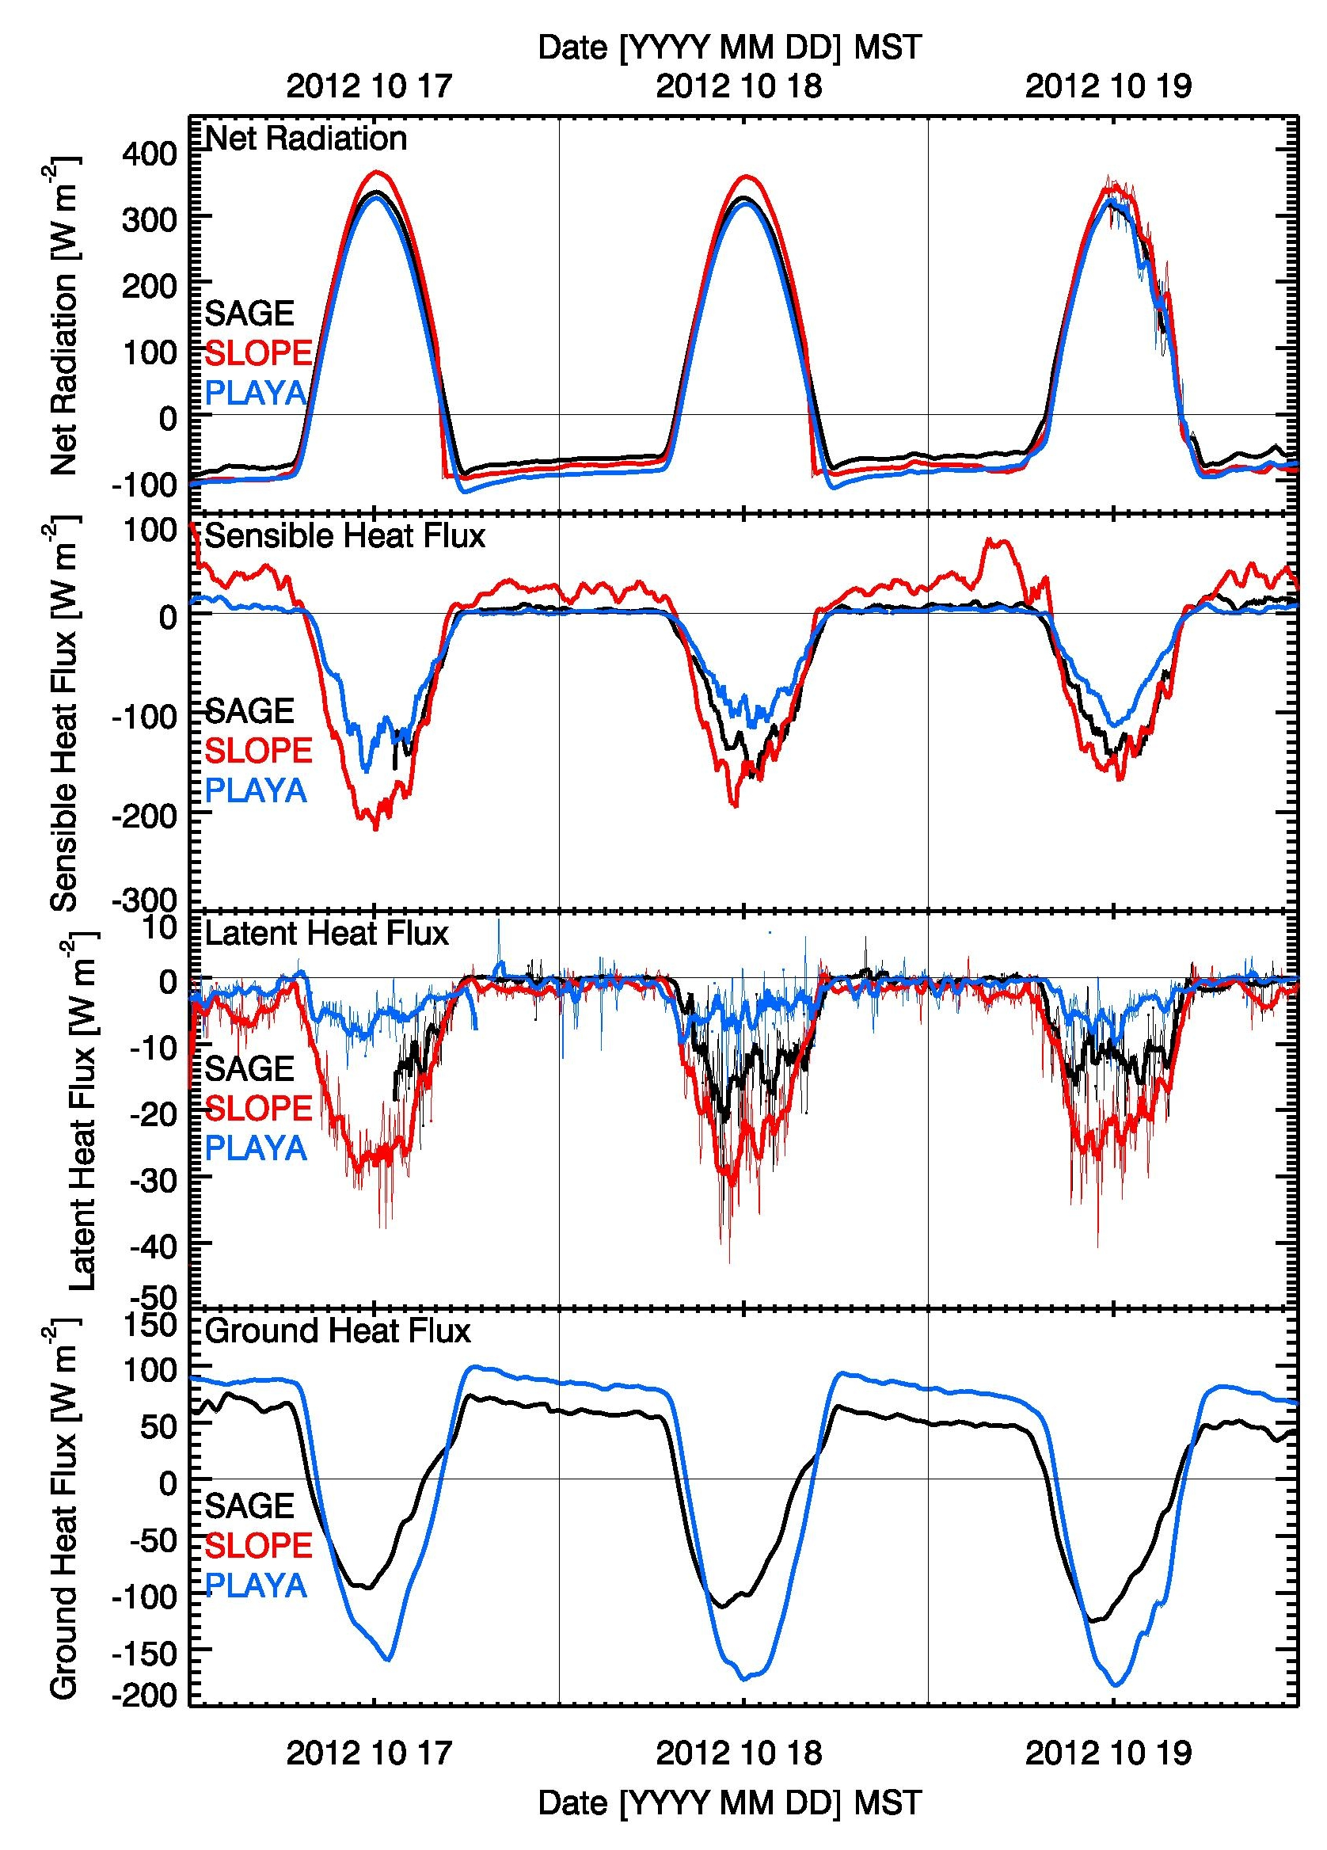
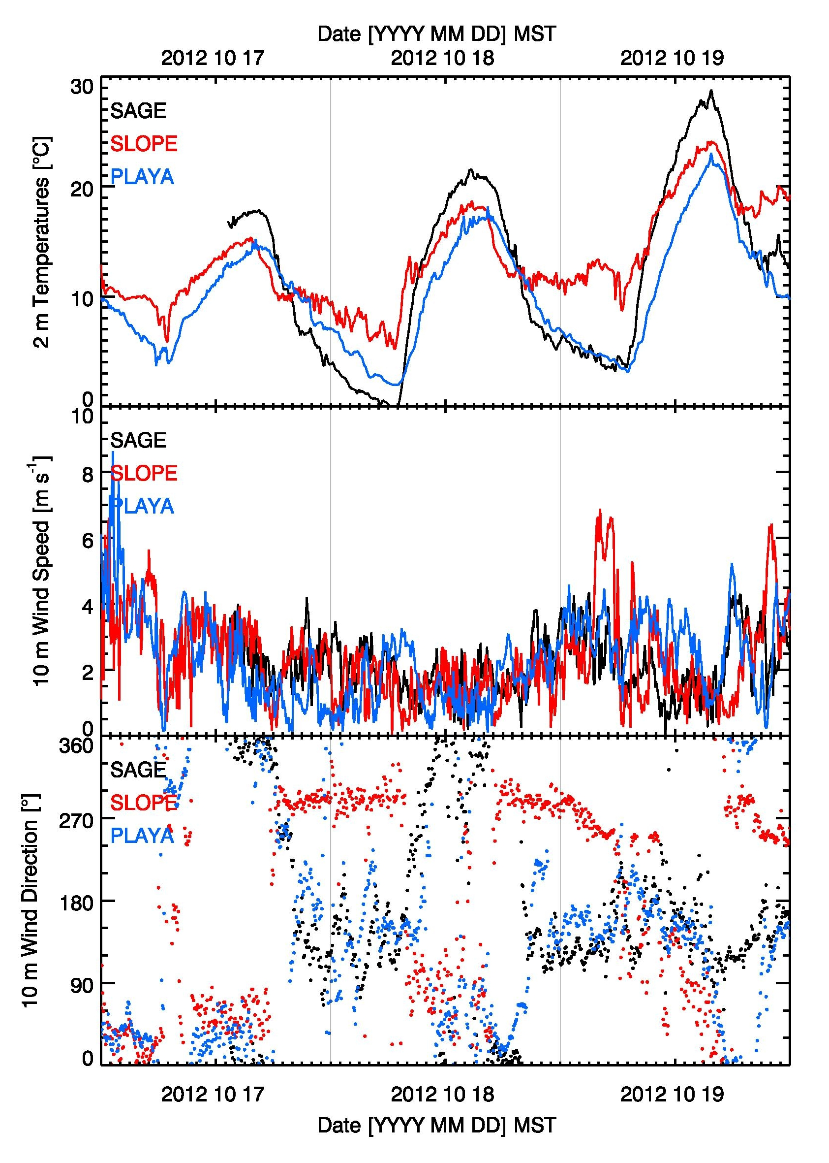
Surface Energy Balance Observations during
MATERHORN
ICAM 2013
International Conference
on Alpine Meteorology
Kranjska Gora, Slovenia,
3 - 7 June 2013
Sebastian W. Hoch⁽¹⁾, Derek Jensen⁽¹⁾, Eric R. Pardyjak⁽¹⁾,
C. David Whiteman⁽¹⁾, Harindra J. Fernando⁽²⁾
⁽¹⁾University of Utah, ⁽²⁾University of Notre Dame
(1) INTRODUCTION
The partitioning of the available energy at the Earth’s surface varies widely by geographic location, land surface type, exposure, soil properties, and available moisture. The surface energy balance ultimately controls boundary layer development and evolution. Spatial energy balance differences lead to the formation of thermally driven circulations, such as sea-, lake- and playa breezes, slope- and valley wind circulations.
One objective of the experimental part of MATERHORN (Mountain Terrain Modeling and Observation Program) was to determine the local surface energy balance differences that would drive the circulation patterns under synoptically quiescent conditions. Three representative sites at Dugway Proving Ground were selected: one site (EFS-Sagebrush) is located in a large sparsely vegetated arid basin, a second (EFS-Playa) on a playa (dry alkali flats which fill with water seasonally to form shallow lakes), and a third (EFS-Slope) on the sparsely vegetated slope of an alluvial fan at the east foot of Granite Peak.
Fig.1: Google Earth™ imagary of Dugway Proving Ground, UT.
All components of the surface energy balance (net radiation NR, sensible heat flux H, latent heat flux L and ground heat flux G) were directly measured at the three sites using some of the best available instrumentation. Besides the measurements of the individual short- and longwave components of the radiation balance and eddy-covariance measurements of the turbulent fluxes, our special focus was directed at the soil heat flux. Pairs of self-calibrating heat flux plates were used at all sites, and the heat storage term above the flux plates was calculated from soil temperature measurements at three levels along with direct observations of the soil's volumetric heat capacity.
Fig. 2: Energy Balance observations at EFS-Playa
(2) SURFACE RADIATION AND ENERGY BALANCE DATA
Fig. 3: Terms of the radiation balance for the three sites.
Fig. 4: Terms of the surface energy balance at the Sagebrush, Slope and Playa sites.
Fig. 5: The individual terms of the energy balance for the three sites.
Fig. 6: Temperature, wind speed and direction at the three sites.
(3) RESULTS
Radiation Balance:
Albedo differences among the sites are the main cause of variations in shortwave energy input. The low albedo at the Slope site leads to the largest values of net radiation (NR) received. Albedo differences between Playa and Sagebrush during the day are compensated by net longwave differences. Daytime net radiation is thus equal for both sites, and net radiation differences between Playa and Sagebrush are greatest at night. Specular reflectance plays a role at Playa and leads to a pronounced diurnal cycle of albedo.
Ground Heat Flux:
The ground heat flux plays an important role in the surface energy budget, especially at Playa. During the night, the ground heat flux balances the net longwave loss at Playa and Sagebrush.
Sagebrush vs Playa / Turbulent Fluxes:
Daytime radiative energy input is similar at Playa and Sagebrush but gets partitioned differently. Playa soil takes up more heat than is released by the sensible heat flux (H), whereas the partitioning is more evenly split at Sagebrush. Latent heat fluxes (L) are very small.
During the night when H and L are near zero, the larger ground heat flux at Playa (as compared to Sagebrush) is compensated by the larger LW loss. Daytime H and L are smaller at Playa where the heat uptake into the soil is very large.
Residual:
The energy balance is closed at night, and the residual term is surprisingly small during daytime.
Drainage Flows / Valley circulation:
During synoptically quiescent periods the thermally driven circulations (playa breeze, valley flows and slope flows) dominate at all three locations.
Acknowledgments: MATERHORN is sponsored by the US Department of Defense, Office of Naval Research.
We thank Dr. Steve Oncley and Tom Horst (NCAR) for equipment loans and advice.
contact: sebastian.hoch@utah.edu

