Slide 1
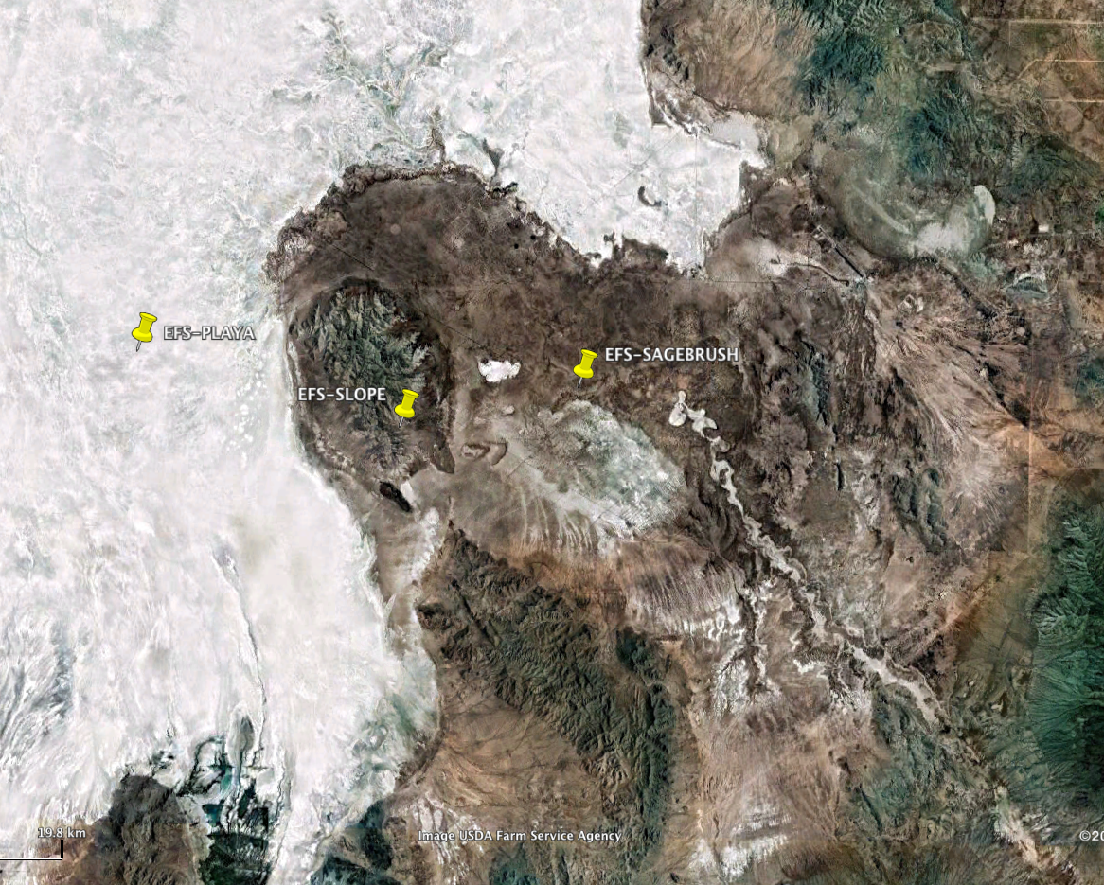
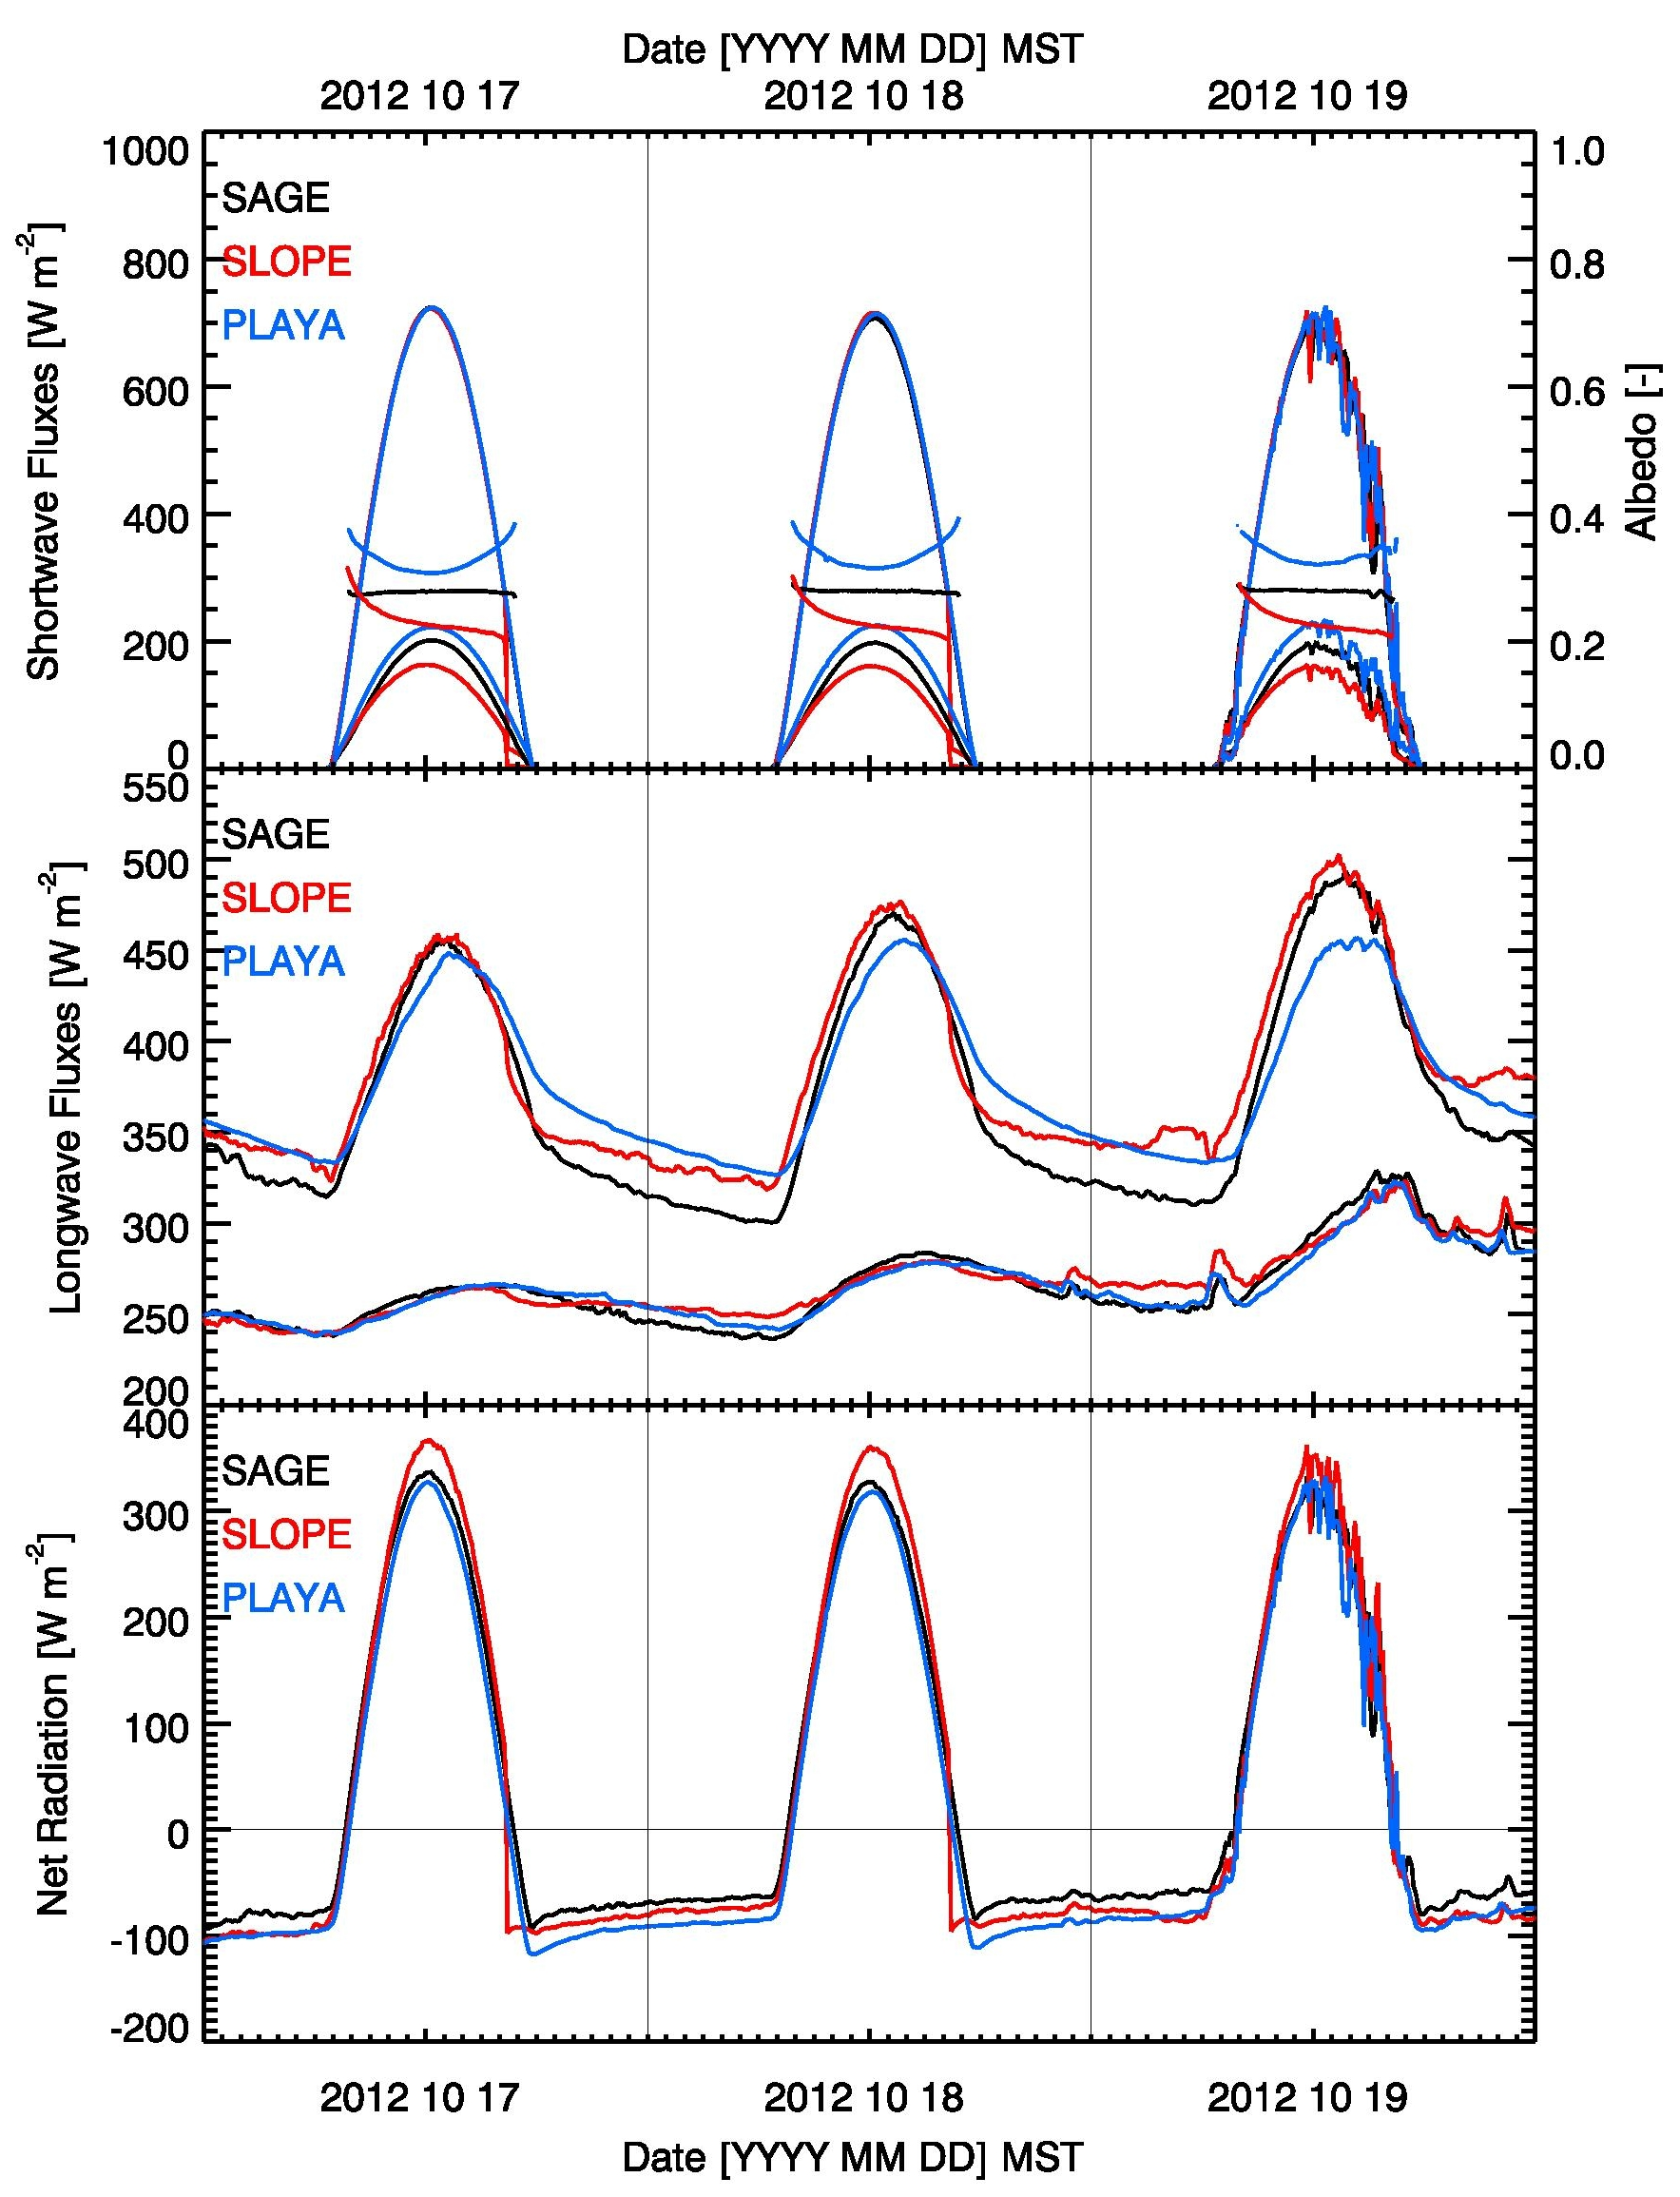
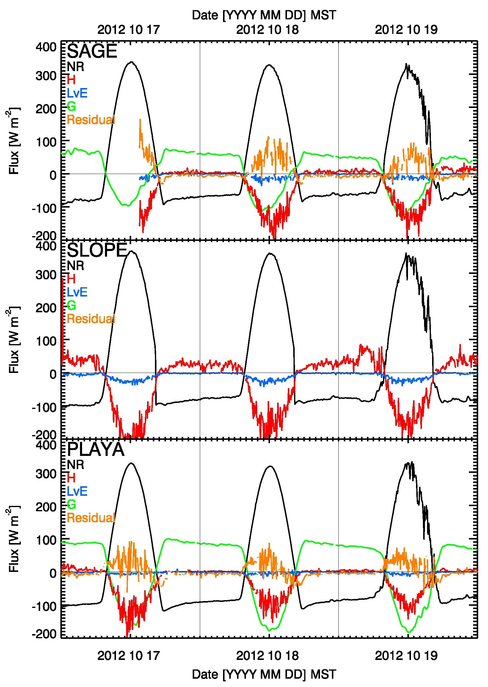
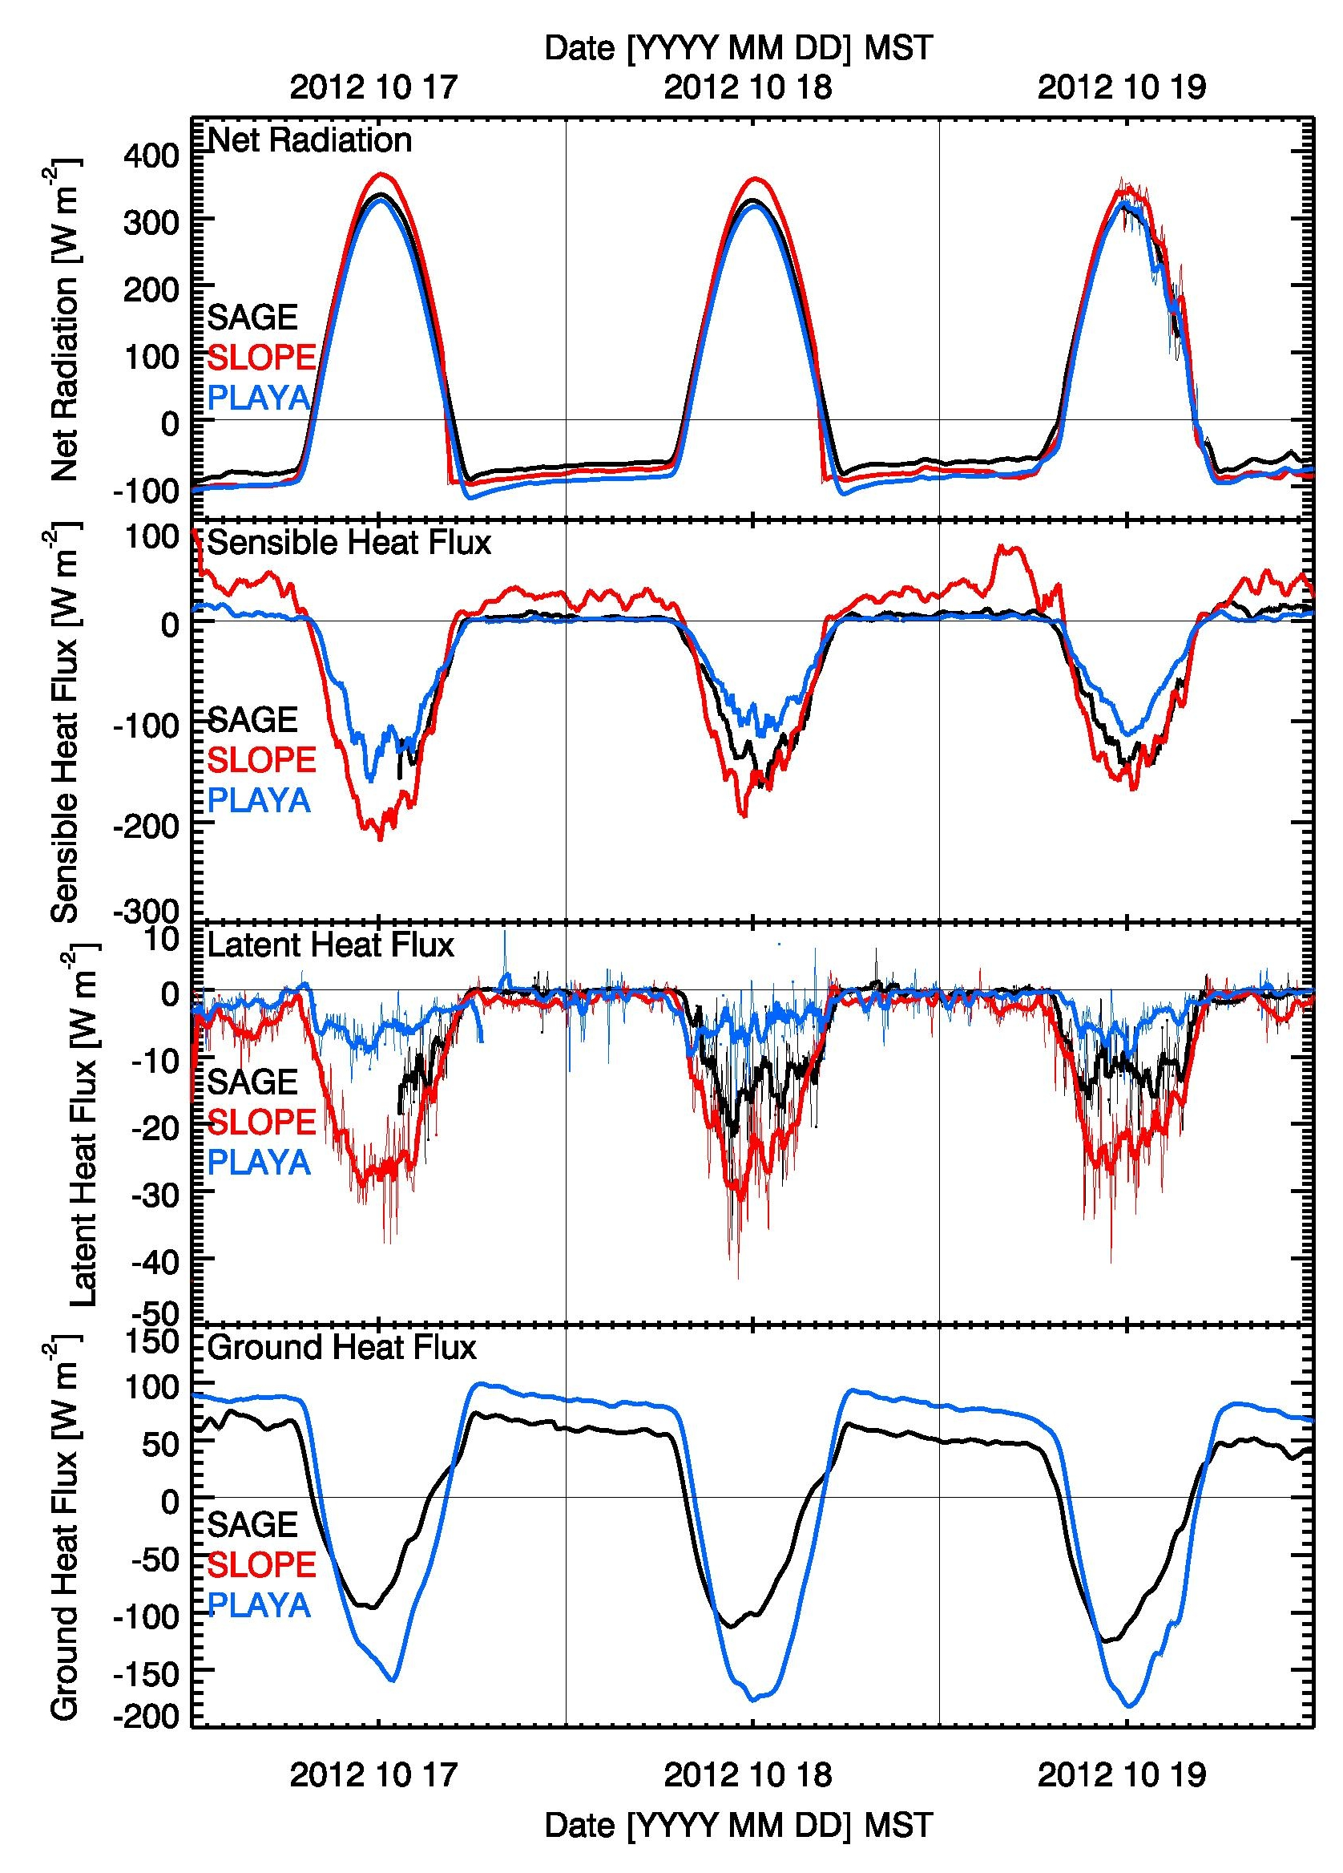
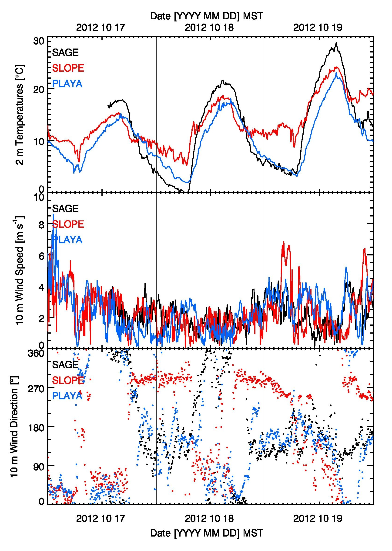
Energy Balance Observations at Extended Flux Sites (EFS) during MATERHORN
Differences in the energy balance among vegetated and playa surfaces are responsible for large spatial air temperature differences and thermally driven flows.
Key difference is the role of the ground heat flux while albedo and daytime net radiation differences play a smaller role. Ground heat fluxes for playa surfaces are much larger than for vegetated areas, leading to smaller daytime sensible heat fluxes. Latent heat fluxes are small.
Google Earth image
Locations of MATERHORN Extended Flux Sites (EFS).
The energy balance is closed at night, when longwave net radiation is balanced by the ground heat flux. Daytime residuals are relatively small.
Terms of the radiation balance for the three EFS sites on selected days.
Terms of the surface energy balance at the three EFS sites on selected days.
The individual terms of the energy balance for the three sites.
Temperature, wind speed and direction at the three sites.

