Slide 1
Observed Surface Conditions vs. WRF
Complex but coherent cold-frontal interactions with topography are observed (see following slide), but poorly resolved or non-existent in WRF (not shown).
Complex but coherent nocturnal terrain-driven flows are observed interacting over the valley floor at DPG but are non-existent in high-res WRF runs.
Diagnosis of the mechanisms for observed phenomena and for WRF failures are ongoing.

Slide 2
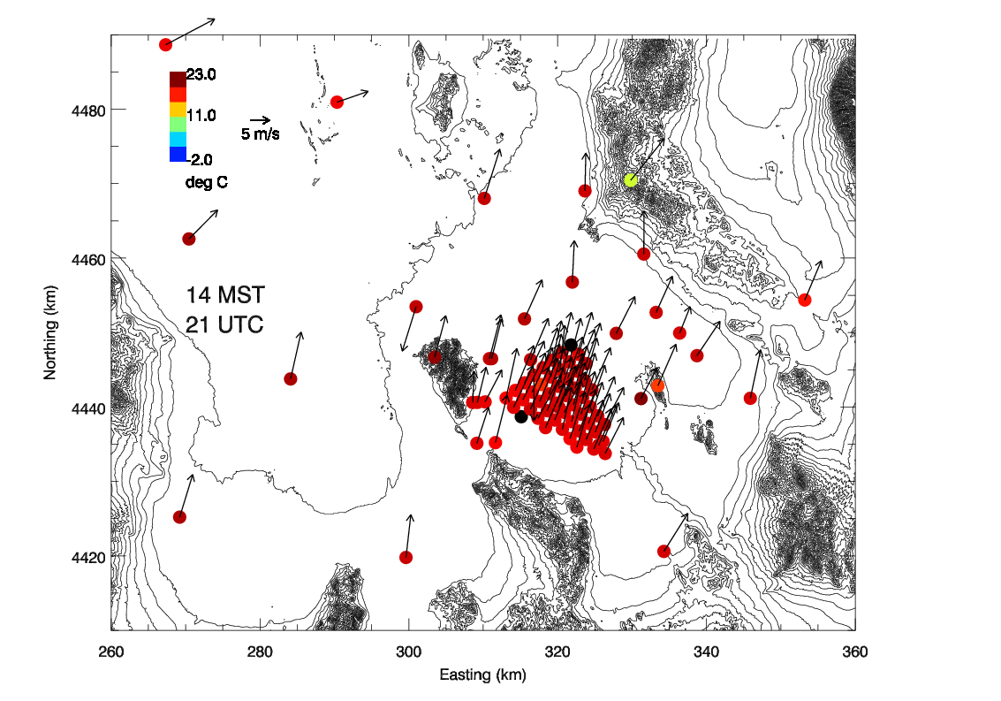
Notes:
This movie is a 24-hour period from 10/23/2012 00Z to 10/24/2012 00Z. This was not an IOP day. One can see a weak dry cold front pass over the main grid at around 03Z. Behind Granite Mountain there is an eddy as the front passes, and the evolution of the front as it crosses the basin is complicated. Sloshing and mixing out of the cold air layer in the lee of terrain both occur. Also, during the latter half of the loop there is confluent northerly flow across the minisams grid in the lee of the Cedar Mountains.

