Slide 1

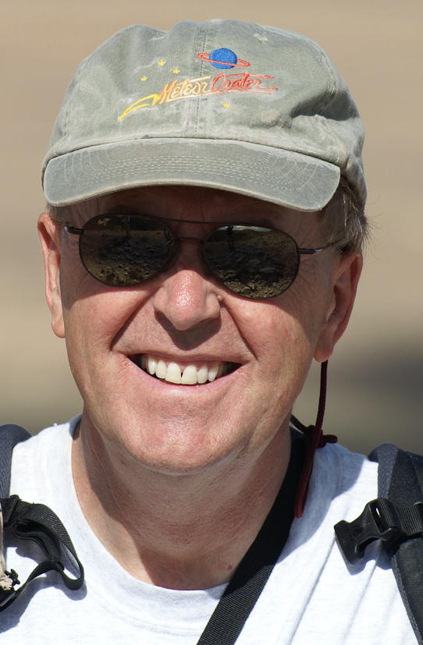
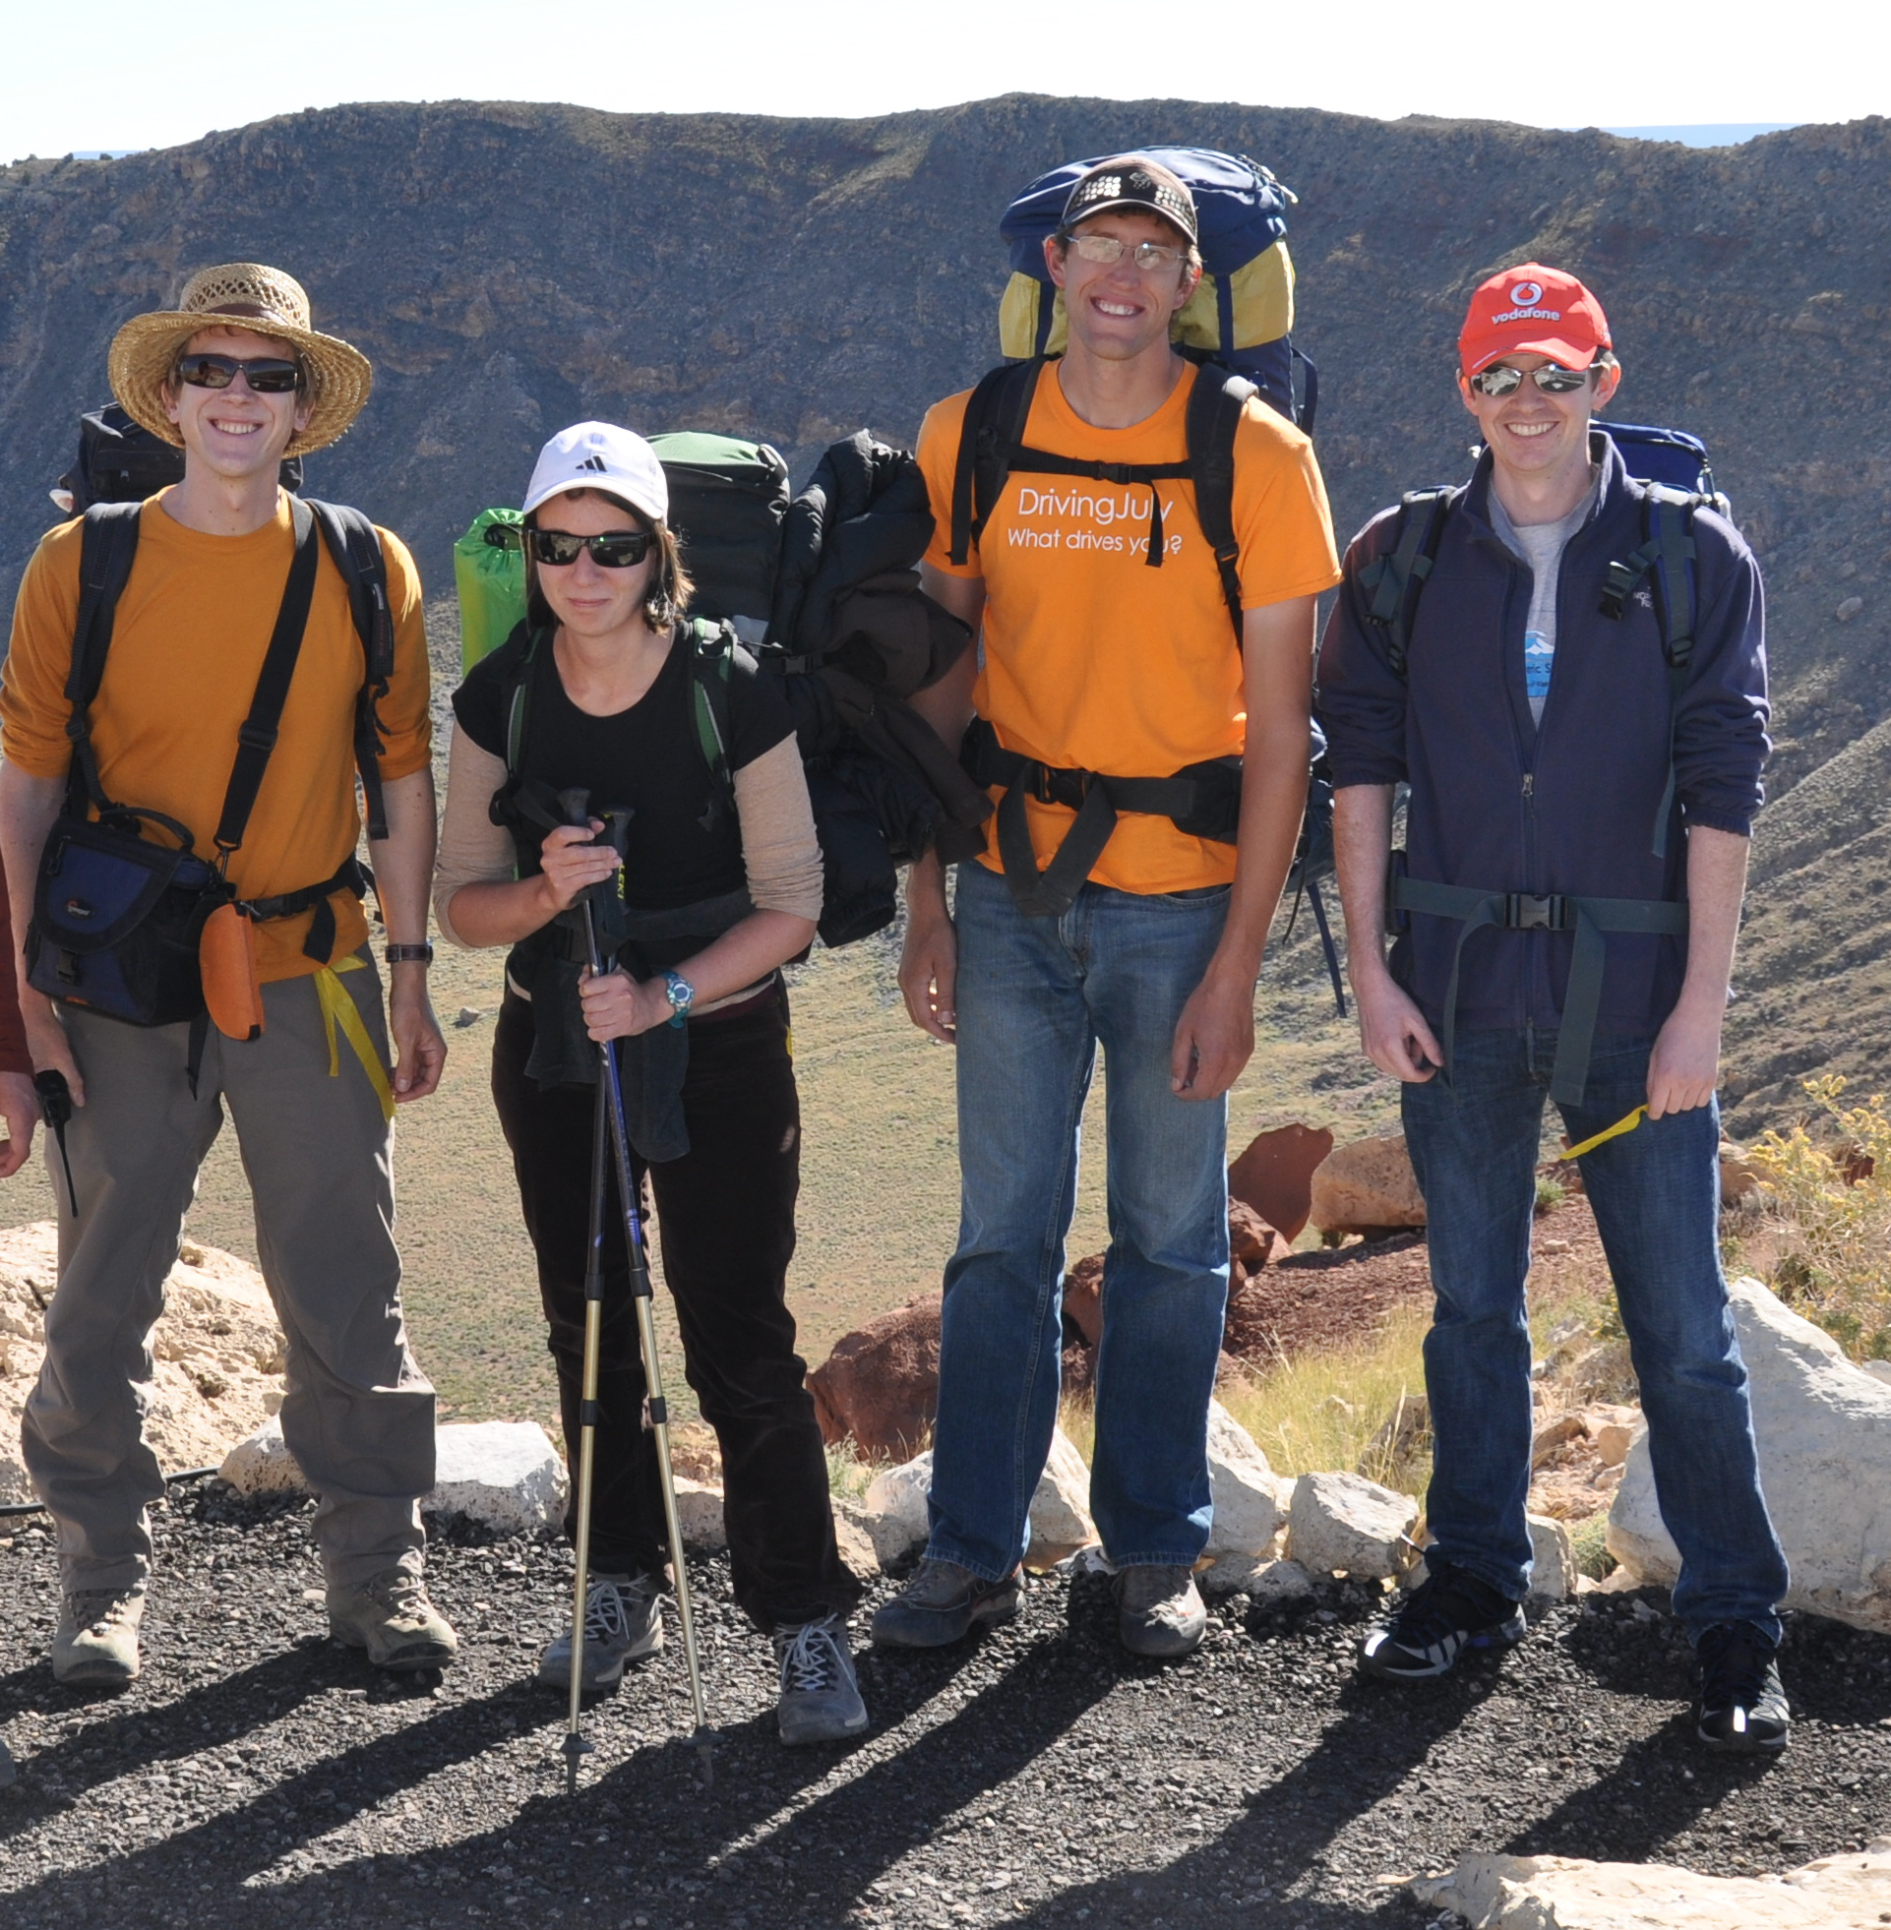
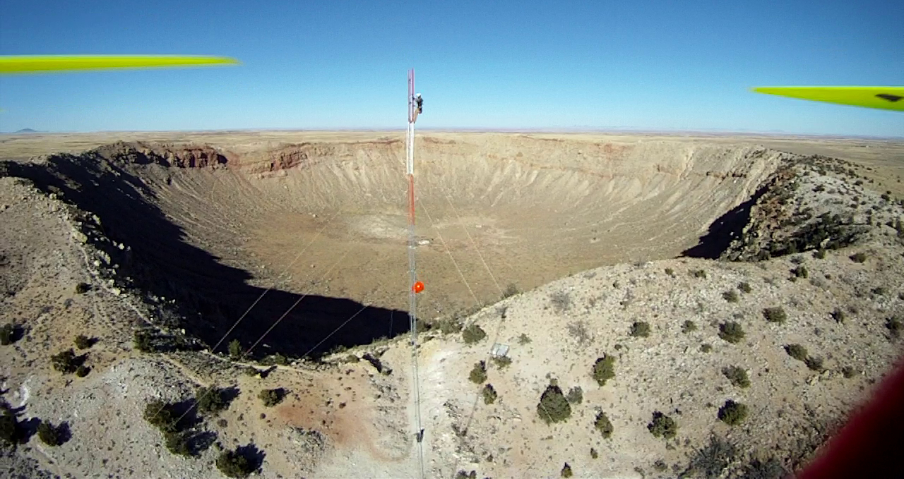
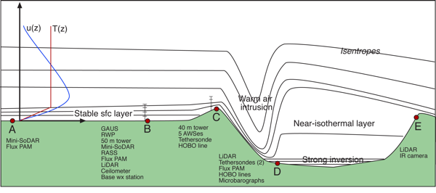
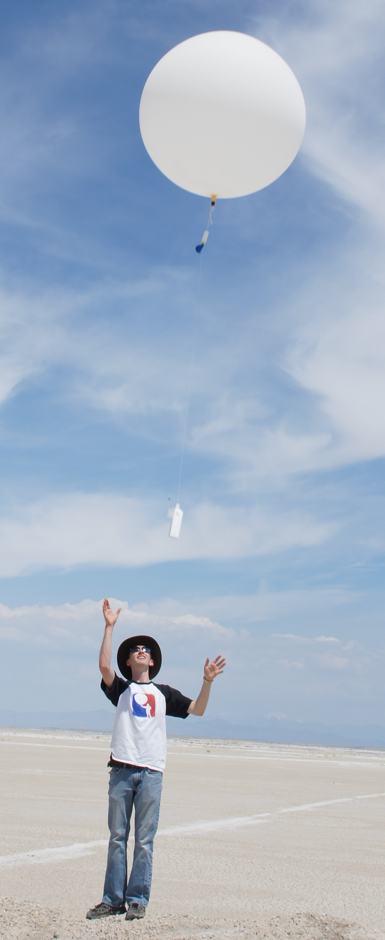
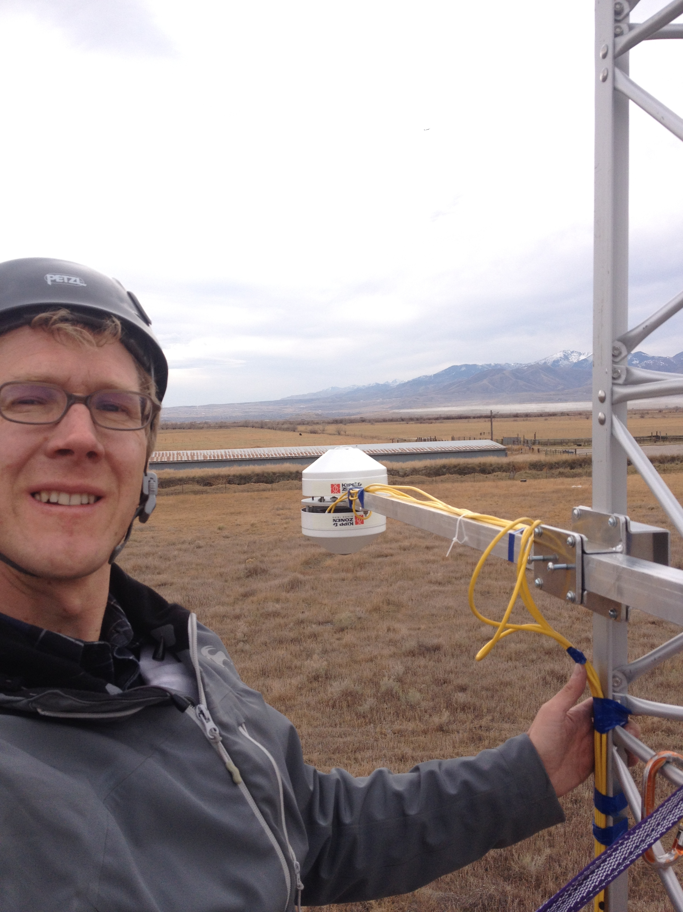
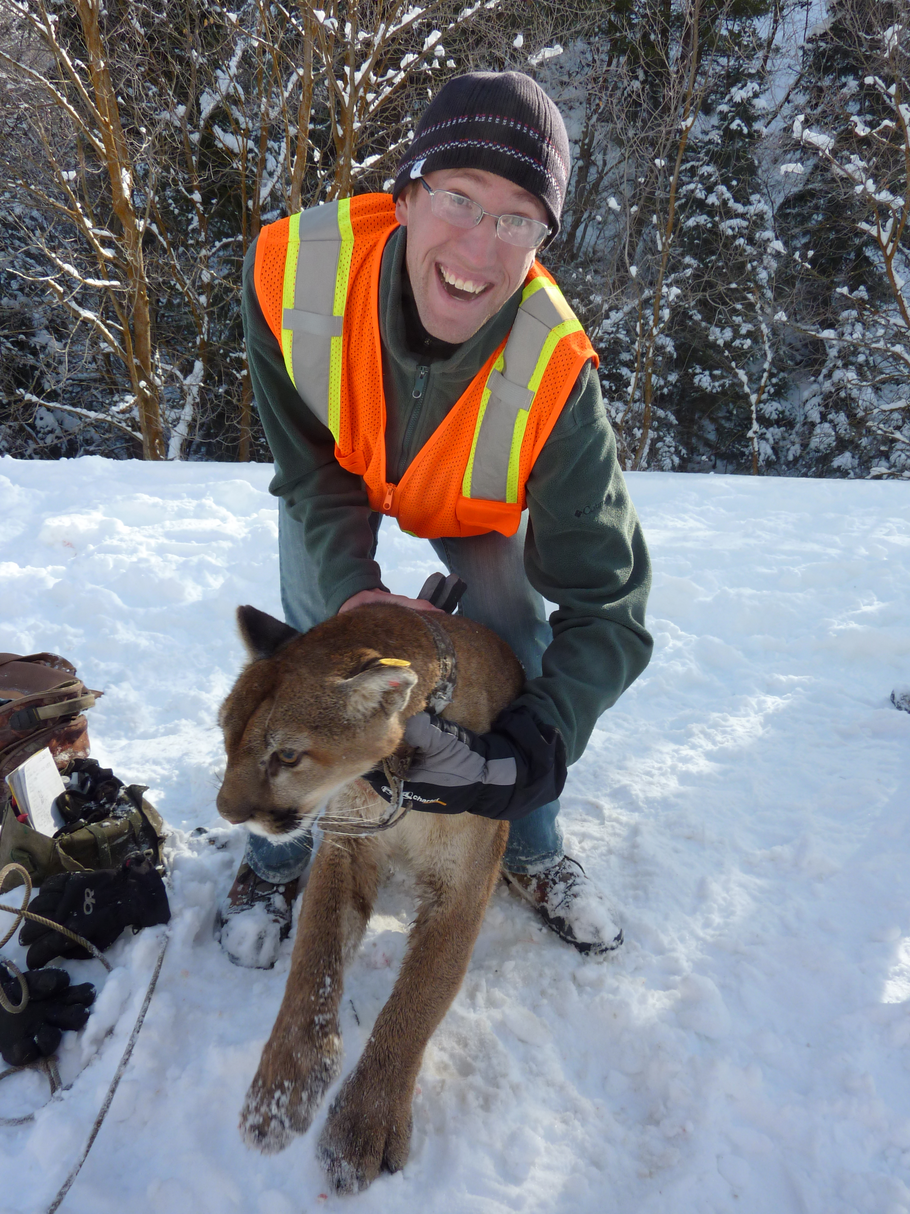
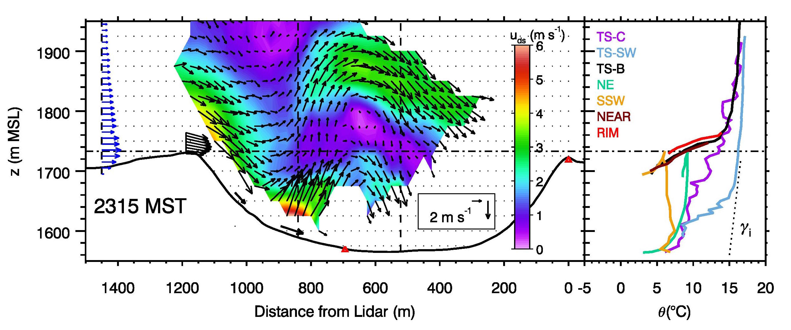
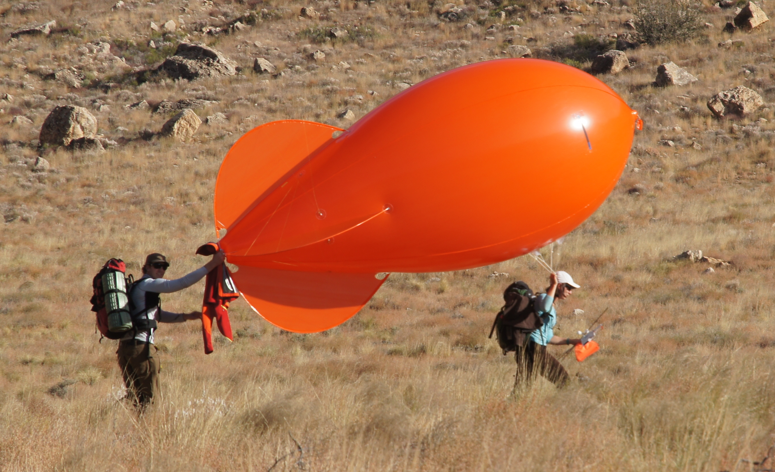
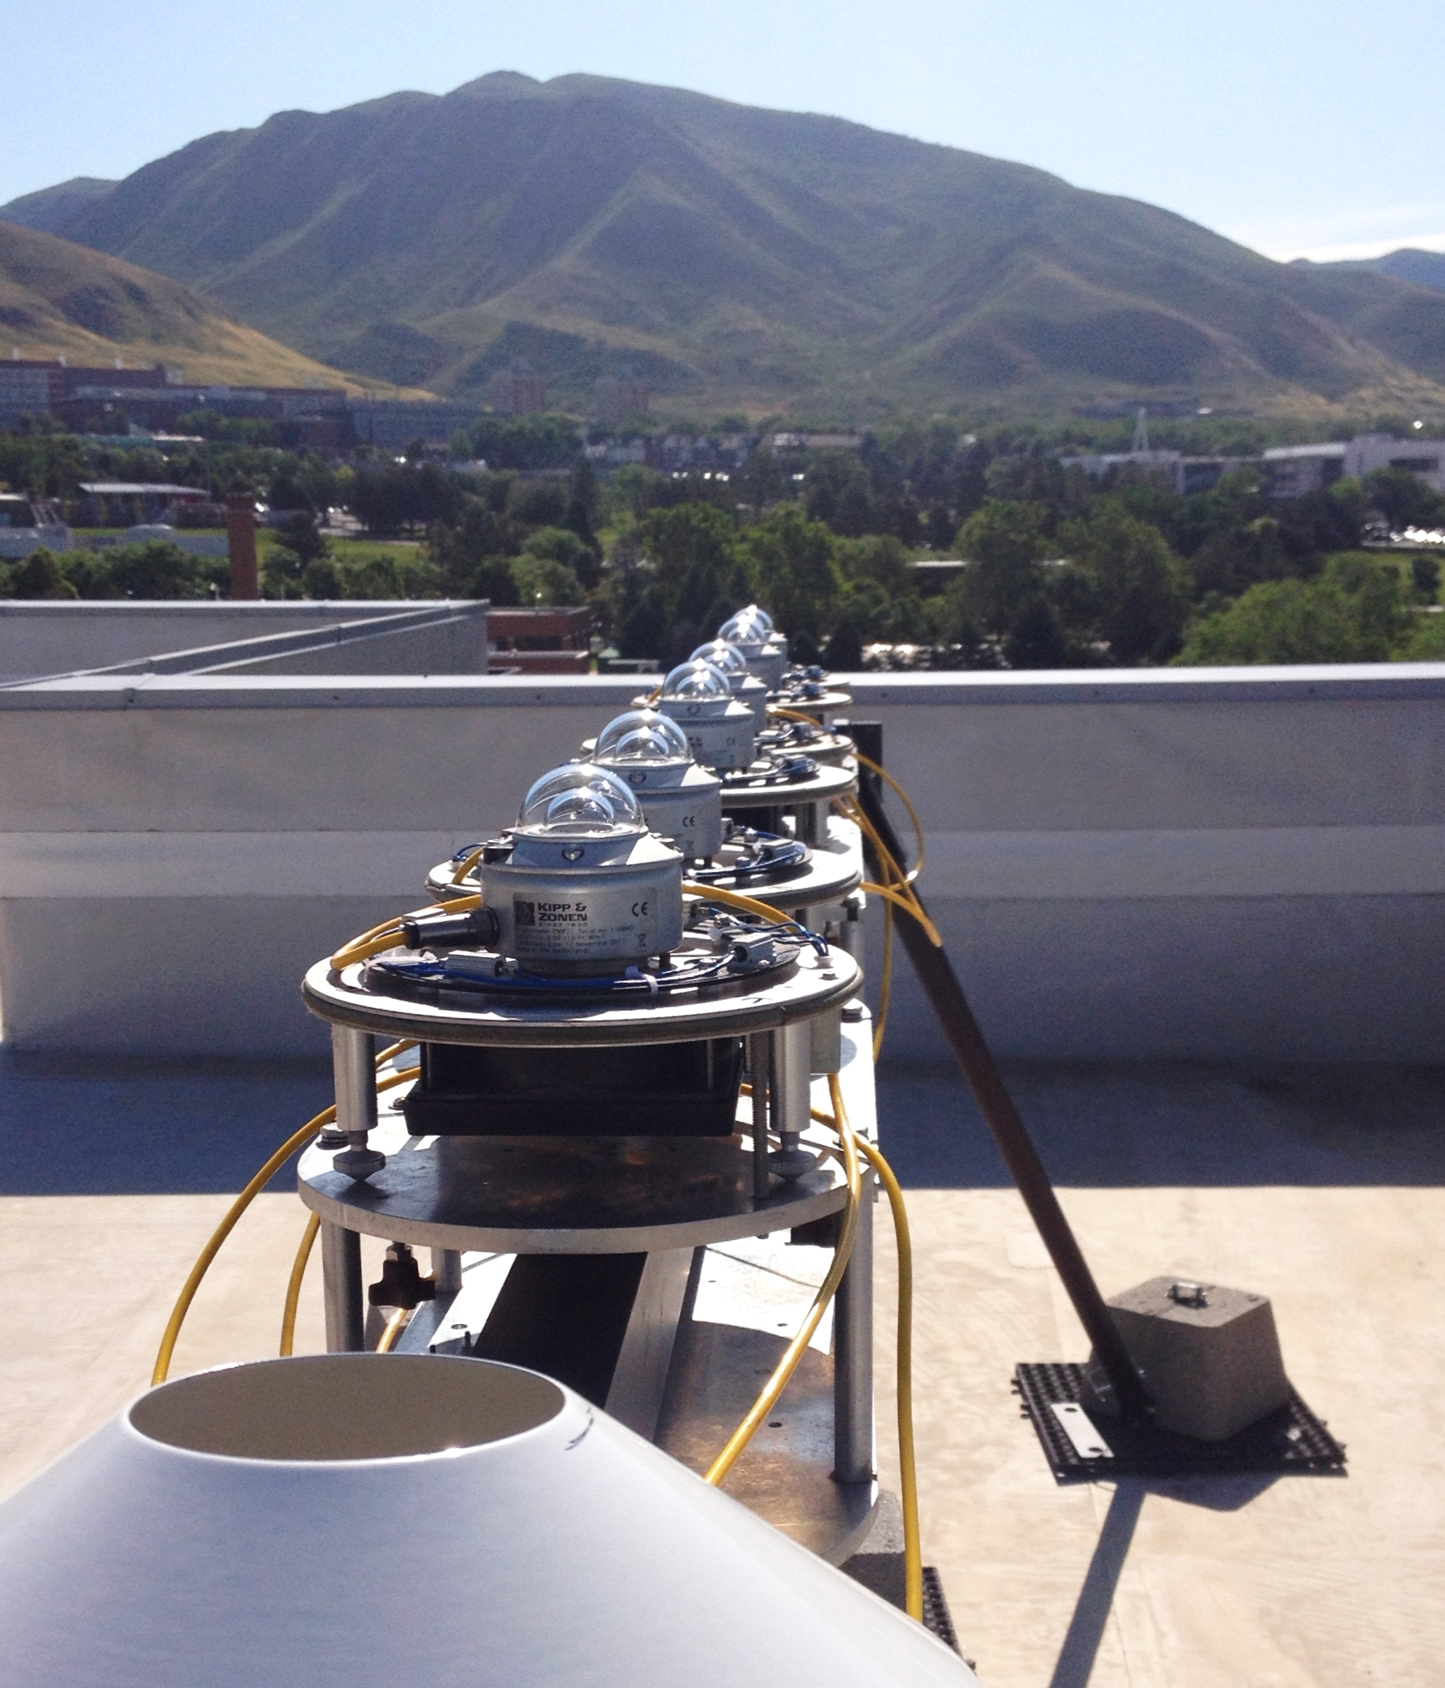
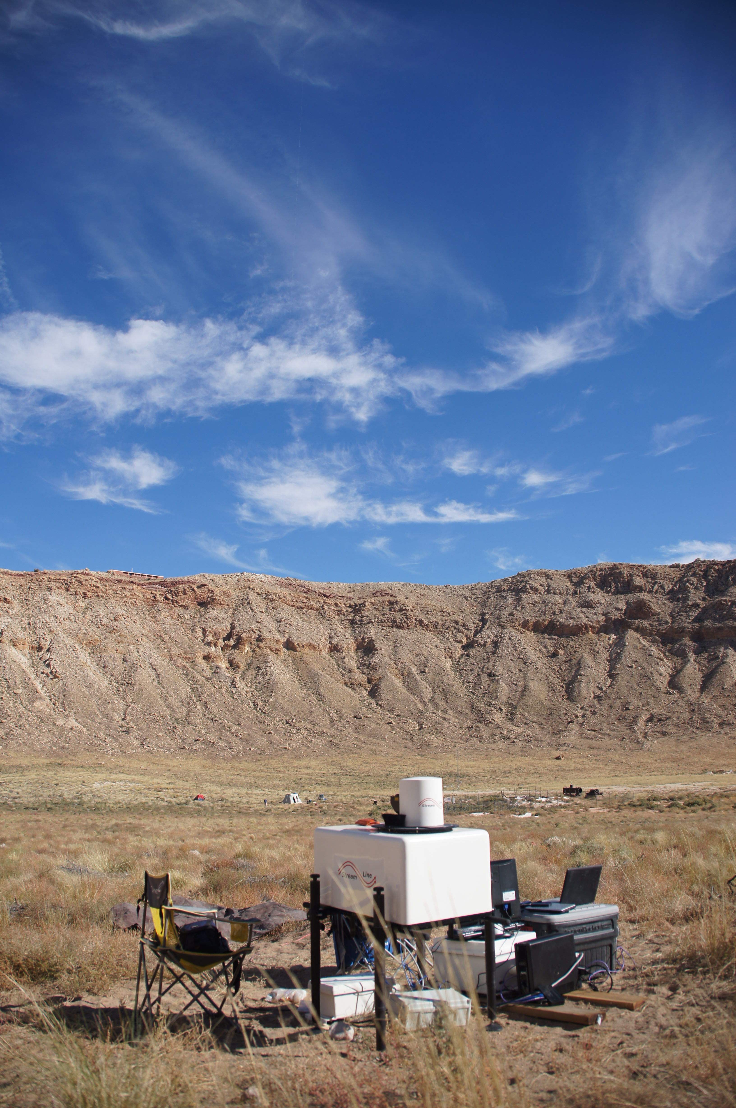
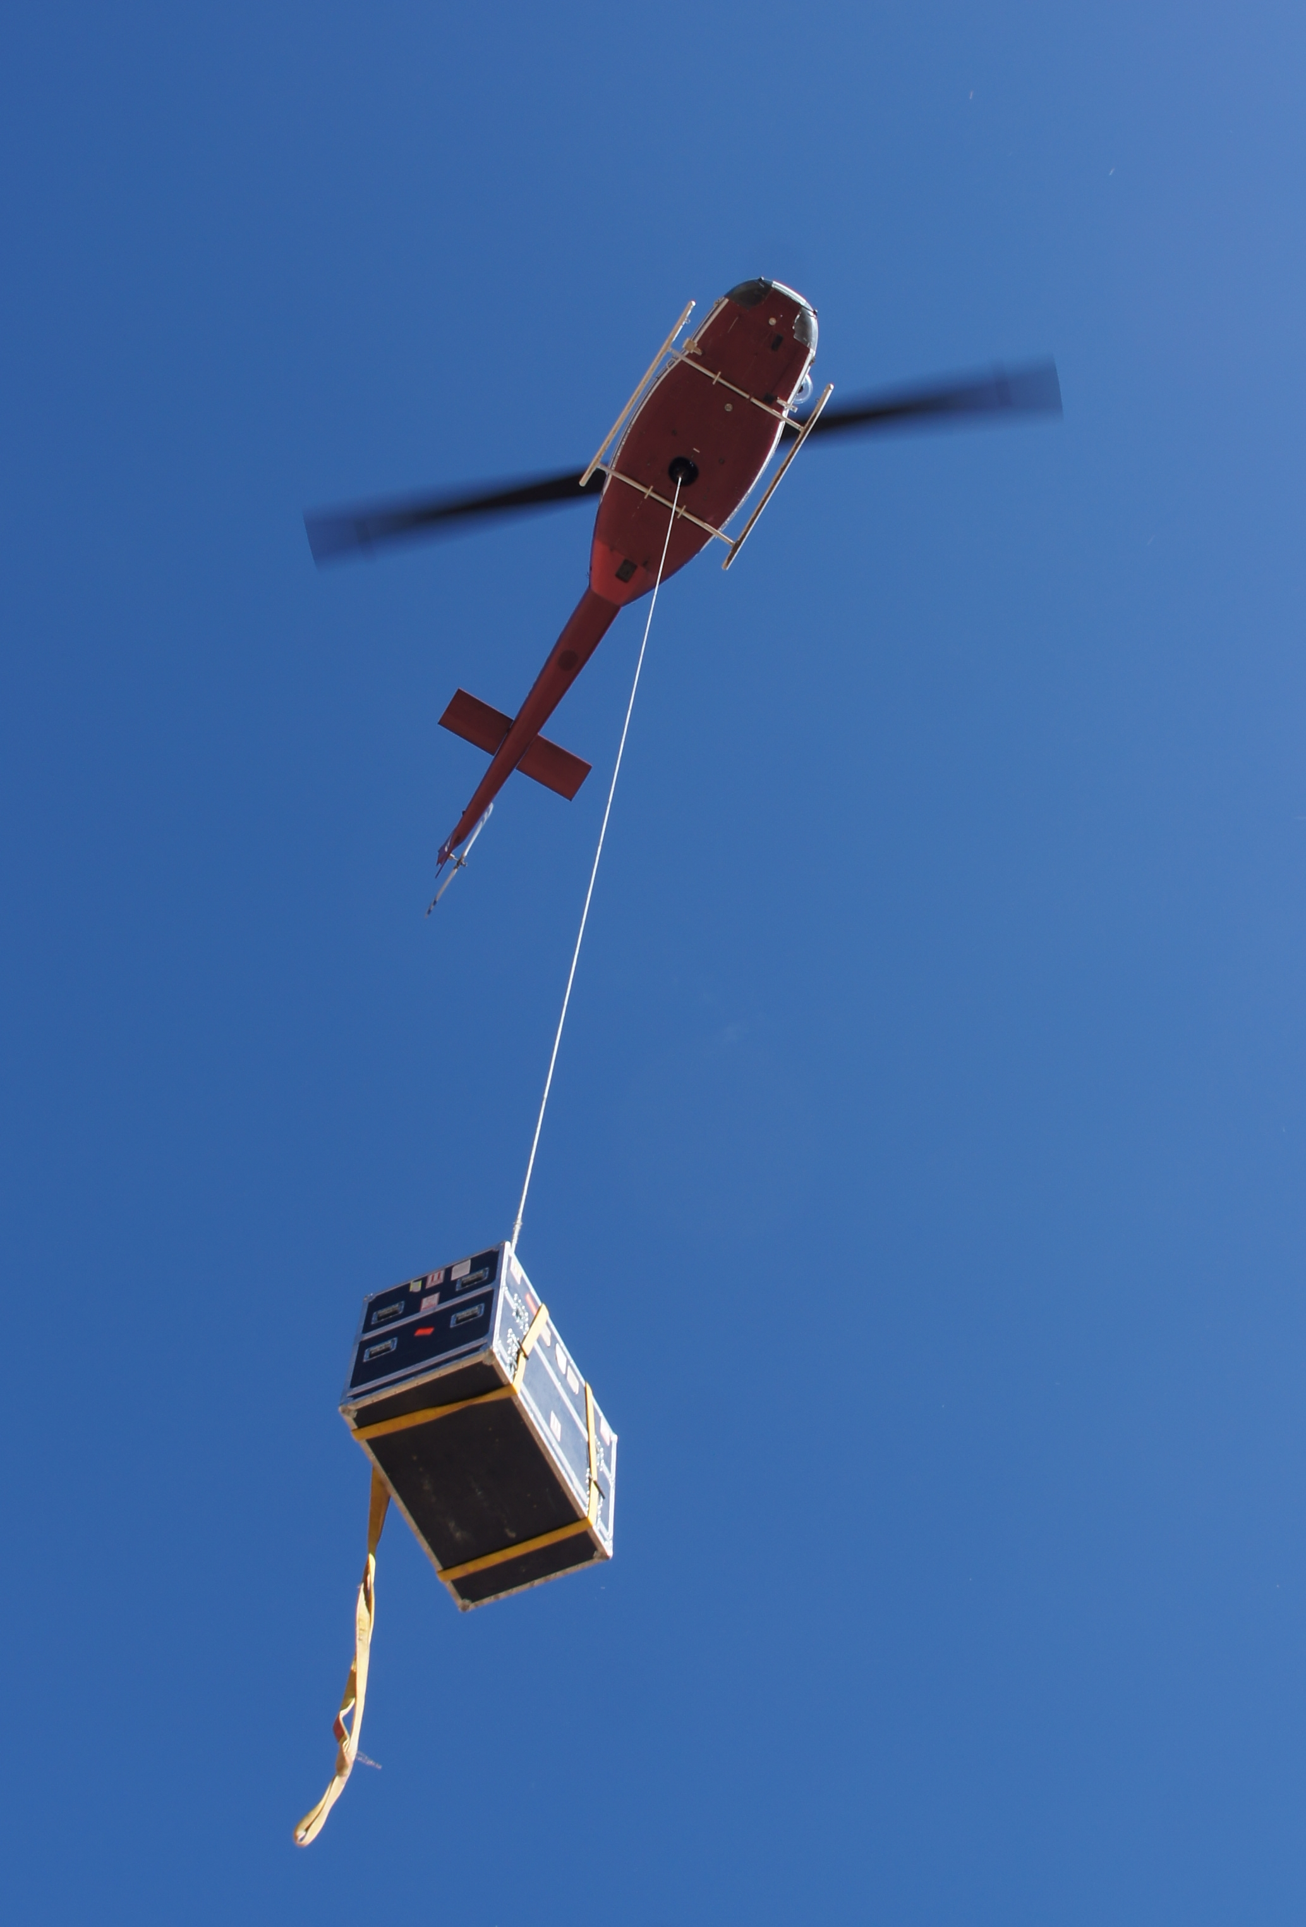
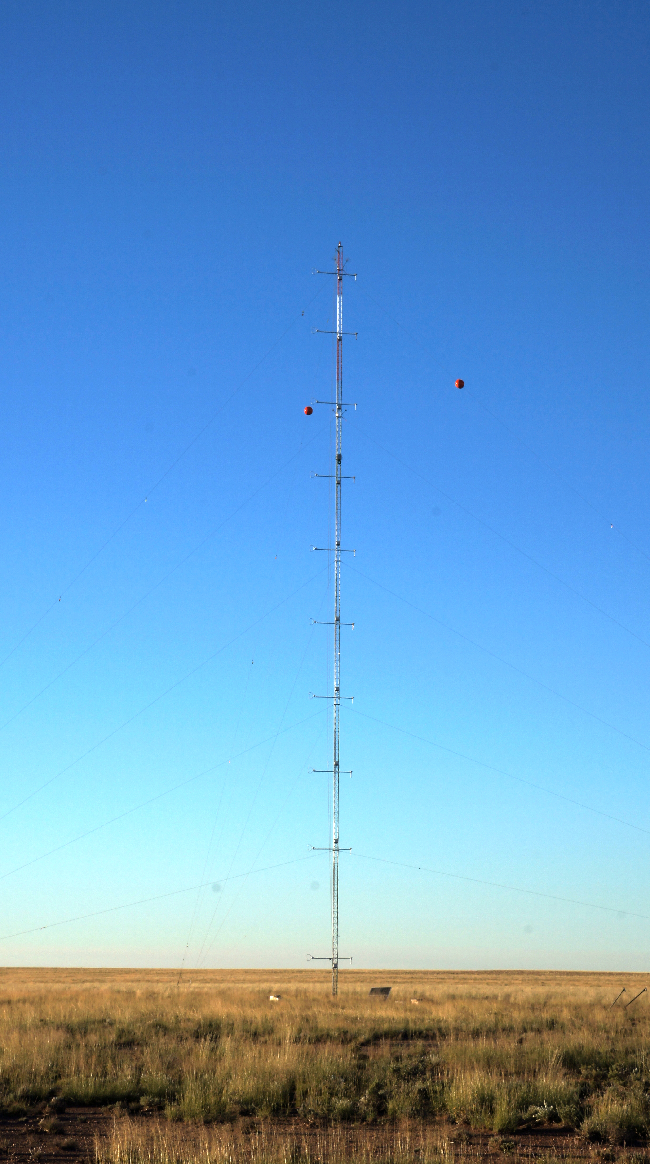
Whiteman & Hoch Group
Research Areas
We conduct research in Mountain Meteorology, using both observations and models. Our research interests cover:
Thermally Driven Flows
Boundary Layer Processes
Surface Energy and Radiation Balance
Cold-Air Pools & Air Quality
Research Instrumentation
METCRAX-II: Study of downslope-windstorm type flows along the inner sidewall of Arizona’s Meteor Crater.
Dave Whiteman, Sebastian Hoch, Manuela Lehner, Matt Jeglum, Matt Hills.
Other past and present projects:
Utah Wintertime Fine Particulate Study
Salt Lake Valley Wintertime PM2.5 Pollution Study
MATERHORN (Mountain Terrain Atmospheric Modeling and Observation Program)
Bingham Canyon Mine Study
PCAPS (Persistent Cold-Air Pool Study)
METCRAX-2006 (1st Meteor Crater Experiment)
T-REX (Terrain Induced Rotor Experiment)
International Collaborations
We are collaborating closely with researches from Europe (Austria, Germany, Switzerland, Italy, Great Britain, Spain) and have been involved in filed experiments abroad (Grünloch Experiment, Dischma-Tal Experiment)

