Slide 1
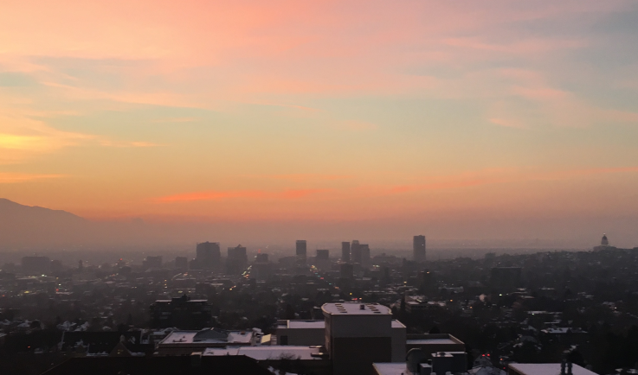




Mixing and Air-Mass Exchange Processes within Salt Lake Valley Persistent Cold-Air Pools and their Effect on Particulate Pollution Concentrations
Sebastian W. Hoch, Erik T. Crosman, Munkhbayar Baasandorj
AMS 18th Conference on Mountain Meteorology, Santa Fe, NM, 25-29 June 2018

Slide 2
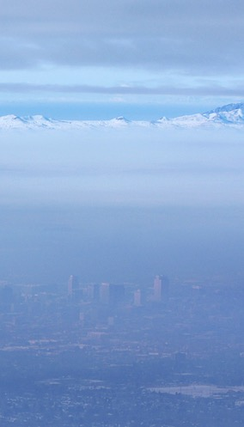
Motivation
The Salt Lake City basin is one of the three populated Utah valleys marked as non-attainment areas for PM_{2.5} pollution (UDEQ 2015).
Adverse health effects of PM_{2.5} are well documented, both for short term and long term exposure (adverse birth outcome, asthma, heart disease, heart attacks, chronic obstructive pulmonary disease; Beard et al. 2012; Pope et al. 2006, WHO 2016).
Chemical composition of PM_{2.5} pollution in Utah valleys shows high mass contribution of Ammonium Nitrate (NH₄NO₃; 70-80%), a ”secondary pollutant” forming from gaseous ammonia (NH₃) and nitric acid (HNO₃) (Kelly et al. 2013; Kuprov et al. 2014).
SLC, UT. 14 Jan 2011

Slide 3
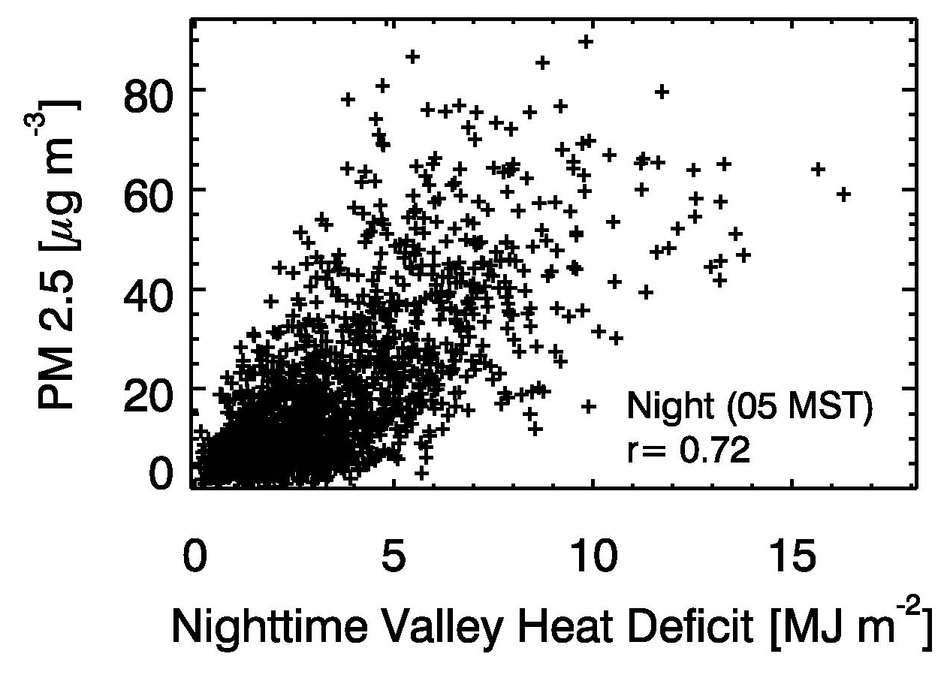
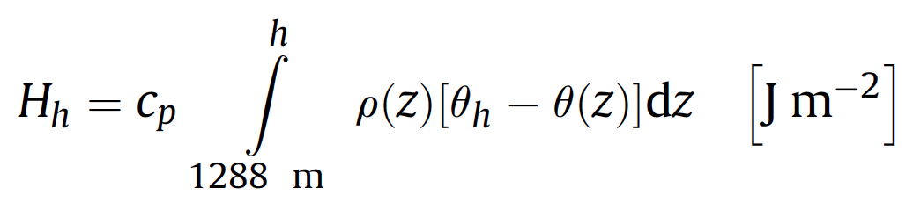

Motivation
Wintertime pollution episodes are closely linked to persistent cold-air pools (PCAPs) (Whiteman et al. 2014, Green et al. 2015). The Valley Heat Deficit concept is very useful.
The life cycle of PCAPs and their dependence on meteorological processes has previously been investigated (PCAPS, COLPEX,…).
The reactive pathways for NH₄NO₃ formation and their dependence on meteorological processes are not well known. Role of oxidants (O₃)?
Very little is known about the spatial and temporal variation (timescales < 24 hours) of PM_{2.5} concentrations and precursor gases within a PCAP.
OTHERS ???
Whiteman et al. 2014, Atmos. Env.
Research Question:
What are the meteorological processes that lead to spatial and diurnal variations in particulate pollution concentrations?

Slide 4
Hypotheses / Approach / Observations
Persistent Cold-Air Pools (PCAPs) are characterized by limited mixing – nevertheless some mixing processes can occur.
These are:
Thermally-driven slope and valley circulations on basin sidewalls and through tributary canyons (sidewall ventilation, injections of “cleaner” air).
Thermally-driven and synoptically forced air-mass exchanges with the Great Salt Lake.
Inter-Basin exchange with the Utah Valley (thermally-driven and synoptically forced).
The development of a Convective Boundary Layer (CBL) at the base of the cold pool leading to vertical mixing during daytime.
Data was collected during the Utah Wintertime Fine Particulate Study (UWFPS) in January 2017 and the DAQ pilot study during the 2015-2016 winter.

Slide 5
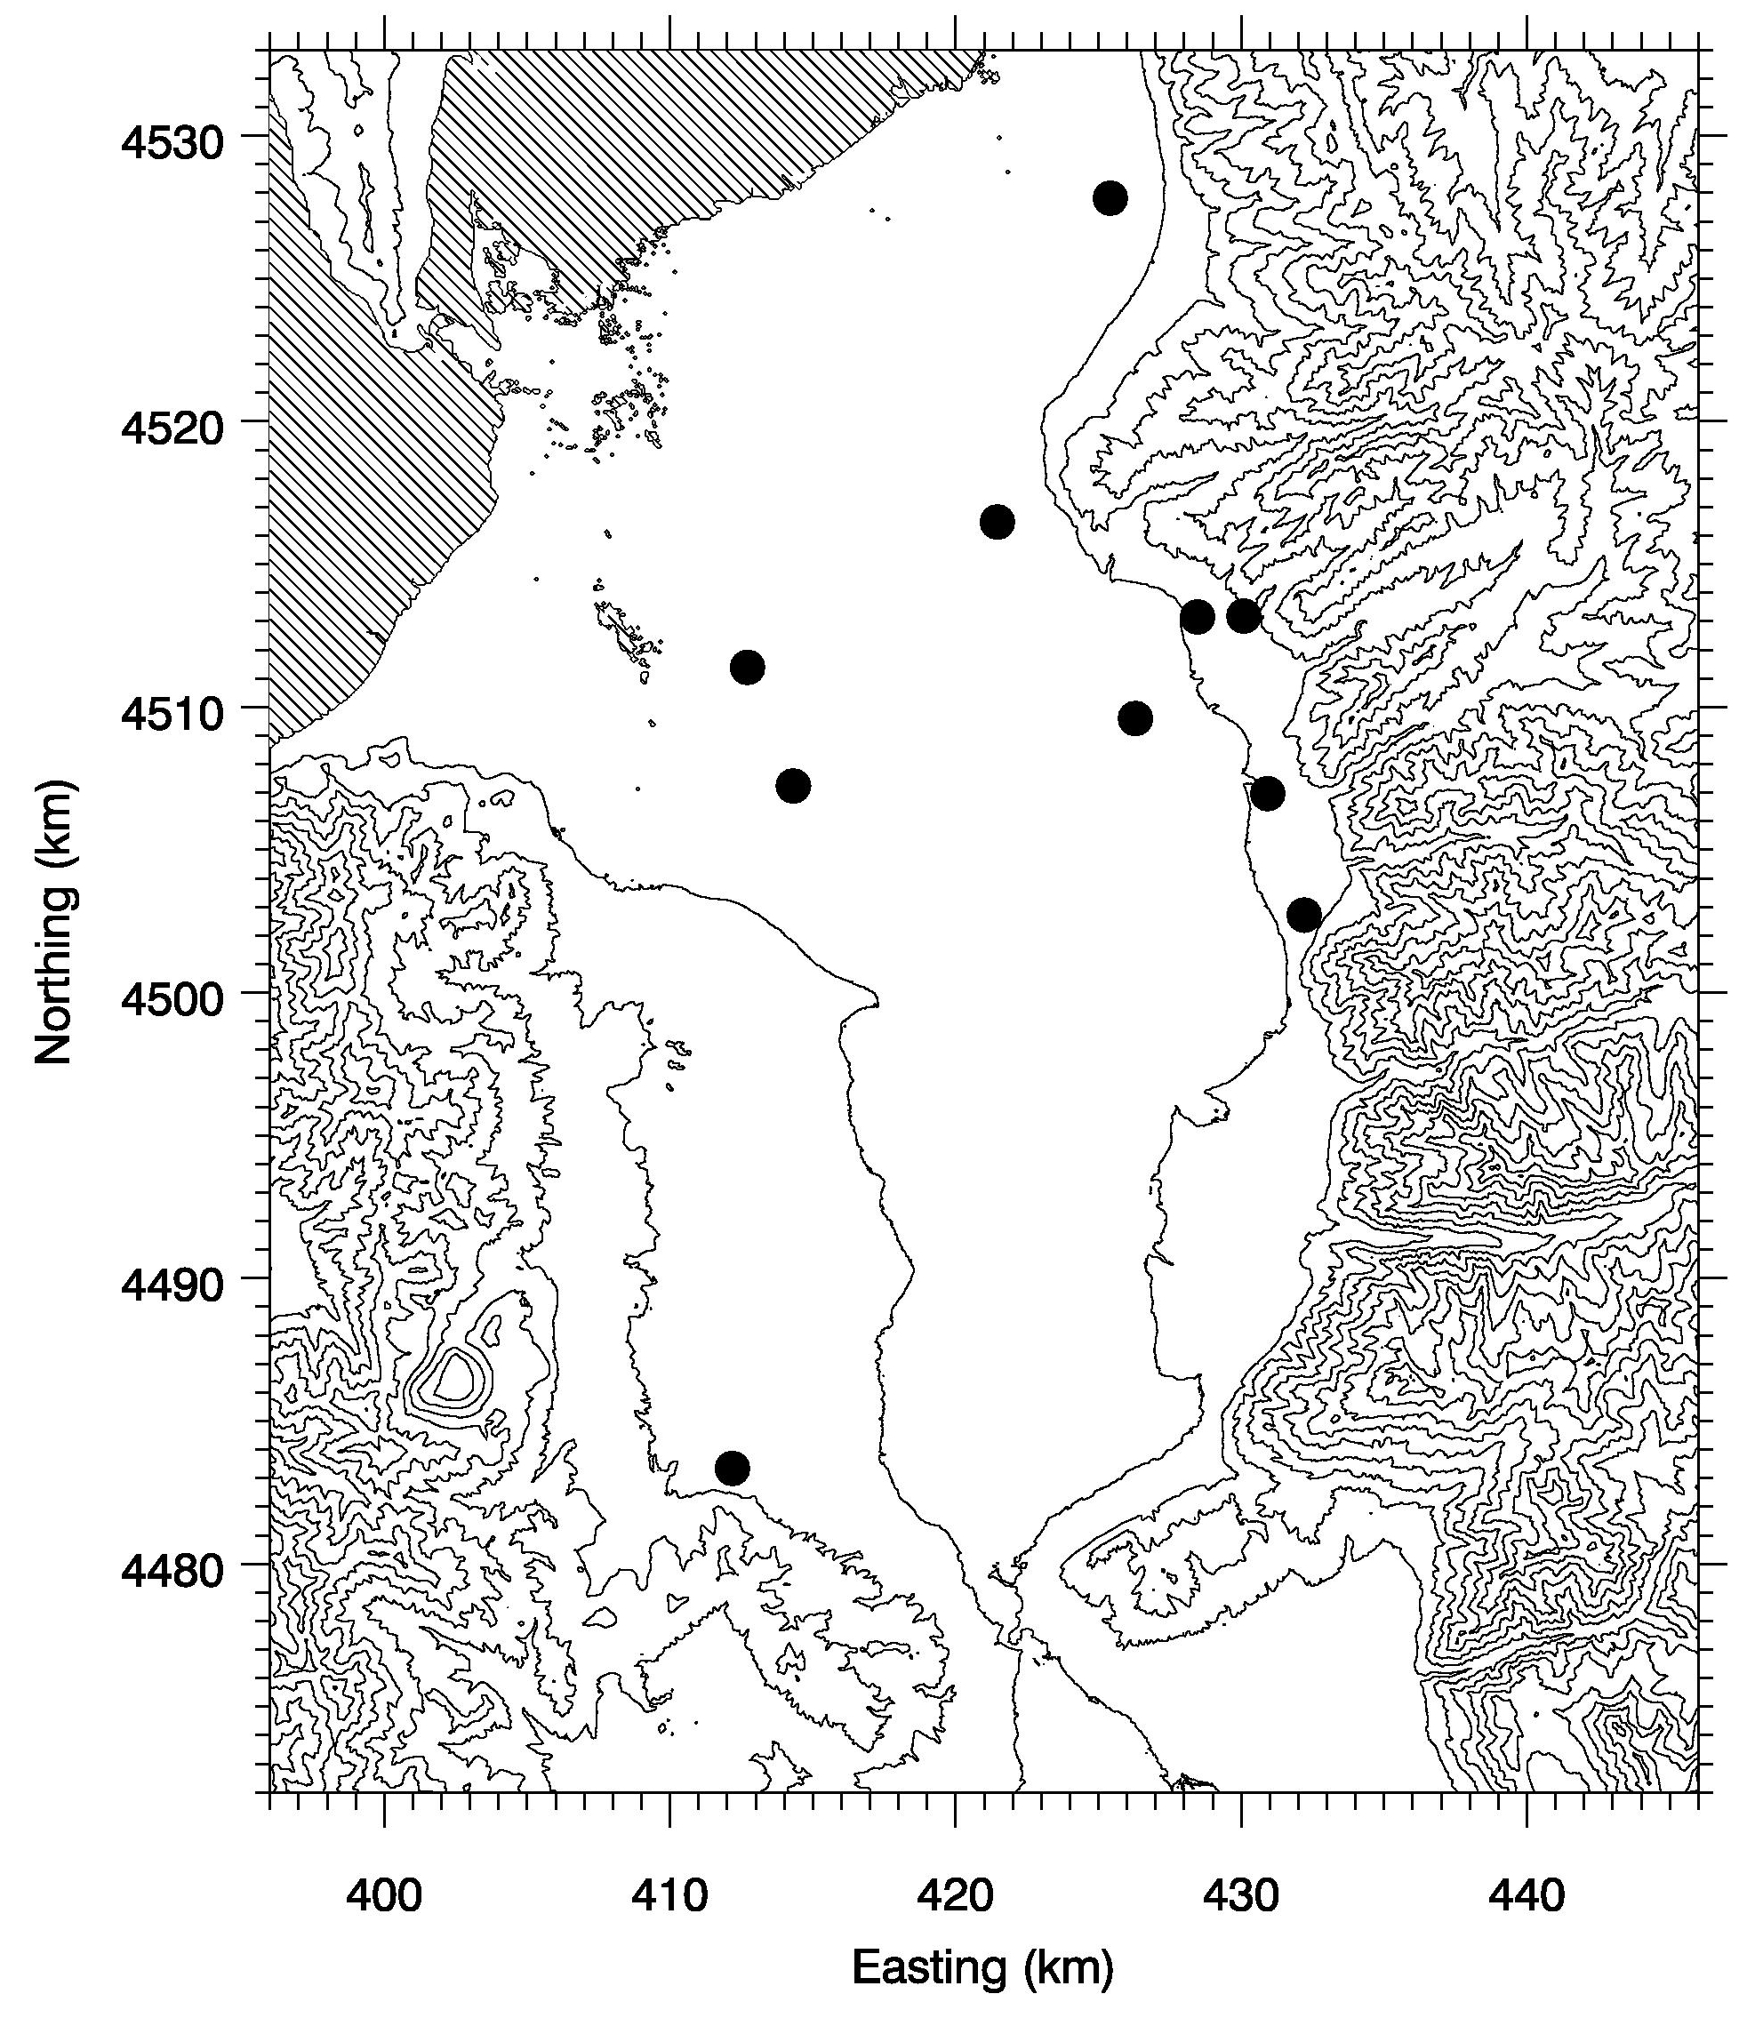
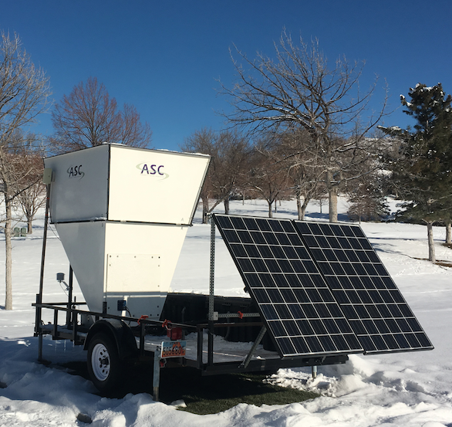
Valley Circulations
Red Butte Canyon
Area: 22 km²
Mouth at: 1525 m MSL
Parleys Canyon
Area:135 km²
Mount at: 1460 m MSL
Salt
Lake
Valley
Oquirrh Mtns
Wasatch Mtns
Traverse Mtns

Slide 6
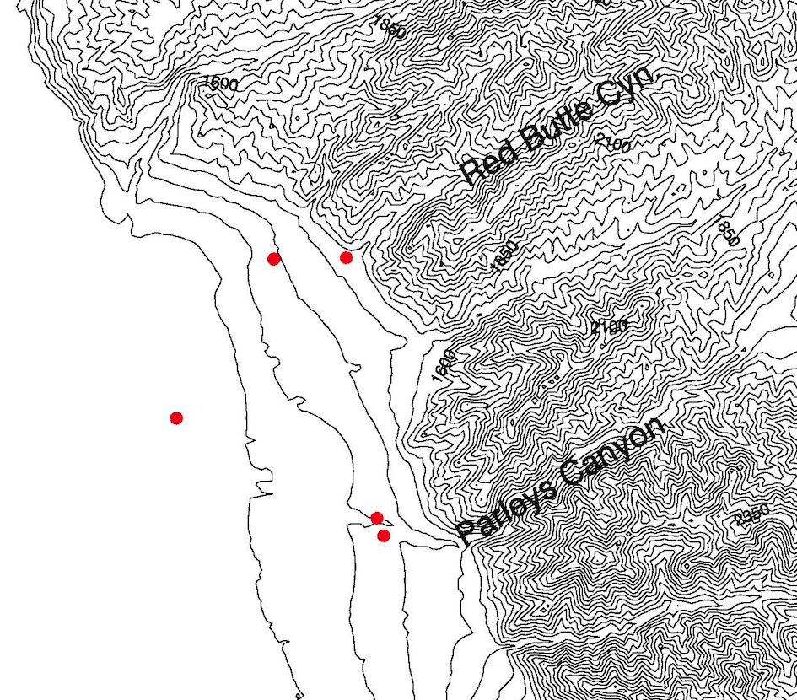
Valley Circulation
UU
Red
Butte
(RB)
Hawthorne
(HW)
Parleys
(PAR)

Slide 7
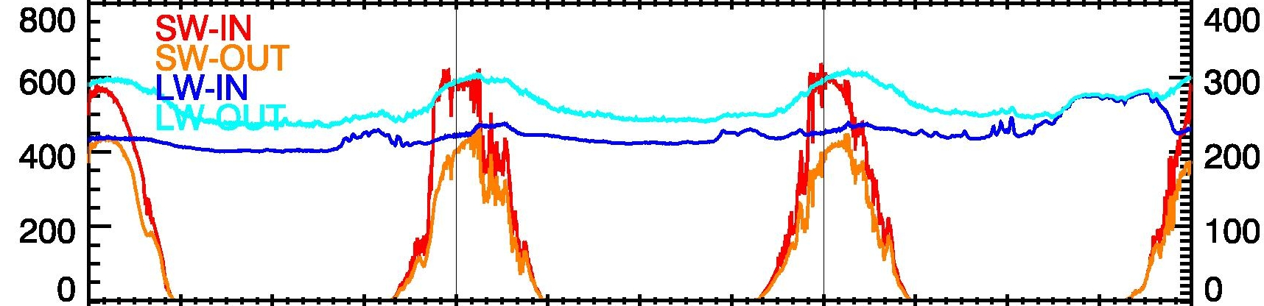
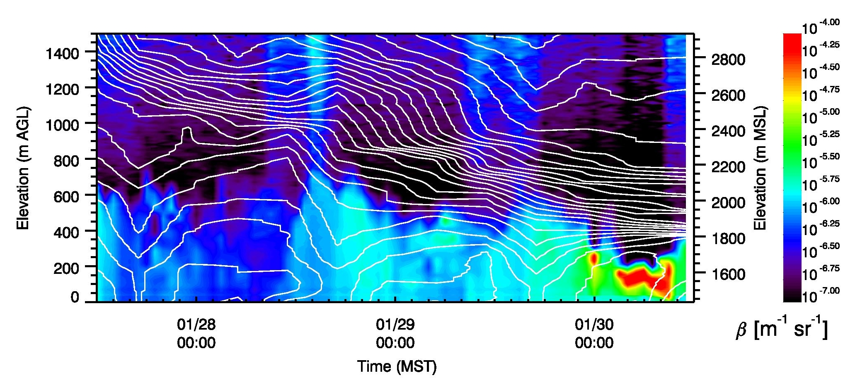
Valley Circulations – 27.-30. January 2017
Radiation Balance
SW Flux [W m⁻²]
LW Flux [W m⁻²]
Ceilometer
Parleys Exit SoDAR

Slide 8
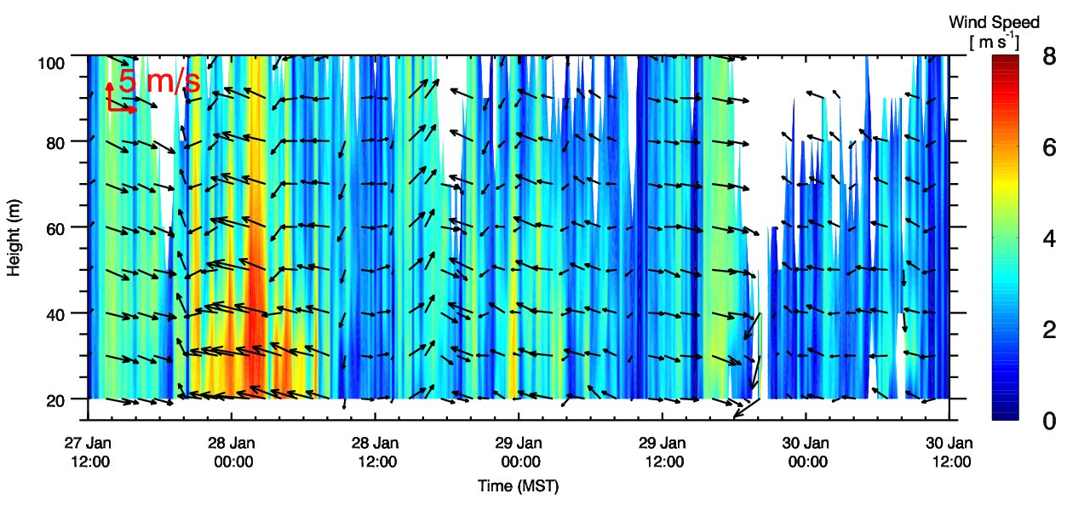
Valley Circulations – 27.-30. January 2017
Radiation Balance
Ceilometer
SW Flux [W m⁻²]
LW Flux [W m⁻²]
Parleys Exit SoDAR

Slide 9
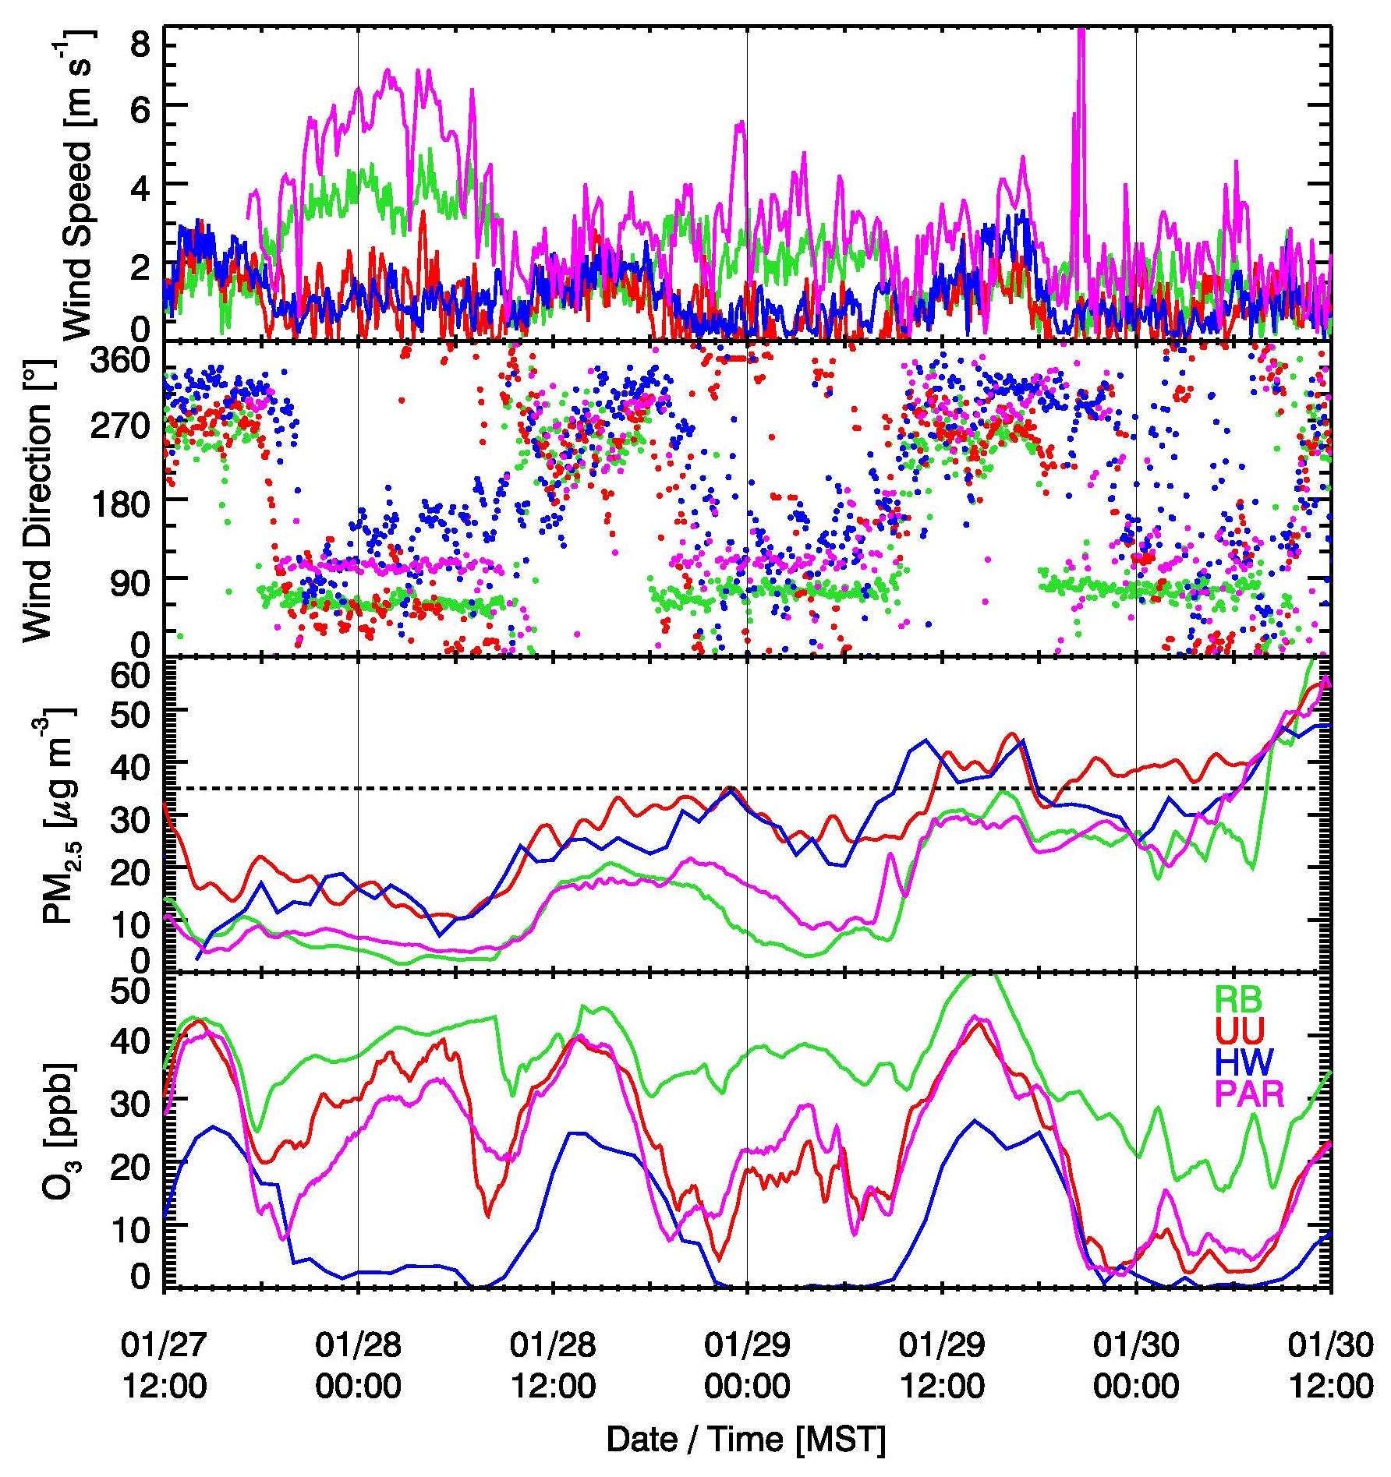
Valley Circulations – 27.-30. January 2017
strong
reduced
“none”
Parleys (PAR)
Red Butte (RB)
Night-time flows are strongest under clear conditions
Down-canyon (PAR,RB) flows at night
Down-slope (UU) flows at night
As PCAP strengthens, [PM_{2.5}] increase. Down-canyon flows locally reduce , [PM_{2.5}]
As PCAP strengthens, [O₃] is titrated at night. Down-canyon flows locally increase [O₃].

Slide 10
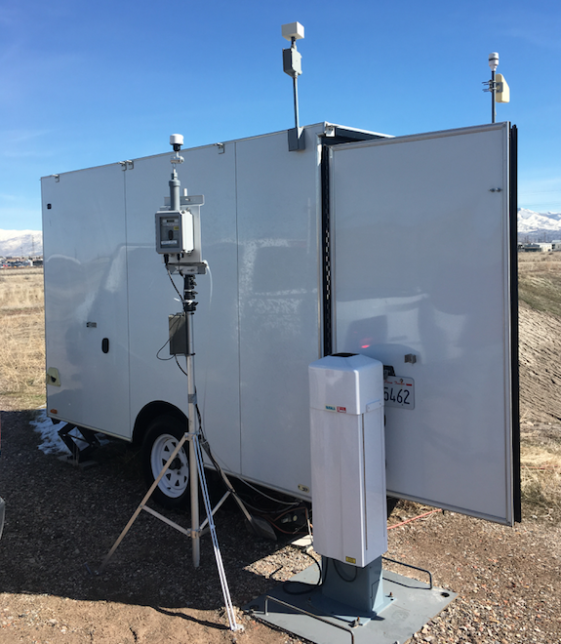
Lake Exchange
Lake “Exchange”
Great
Salt
Lake
Clean Lake Breeze
30 January
Dirty Lake
“Recharge”
3 February 2017
Landfill
Site
Salt
Lake
Valley
Oquirrh Mtns
Wasatch Mtns
Traverse Mtns
Notes:
Early vs later in the PCAP

Slide 11
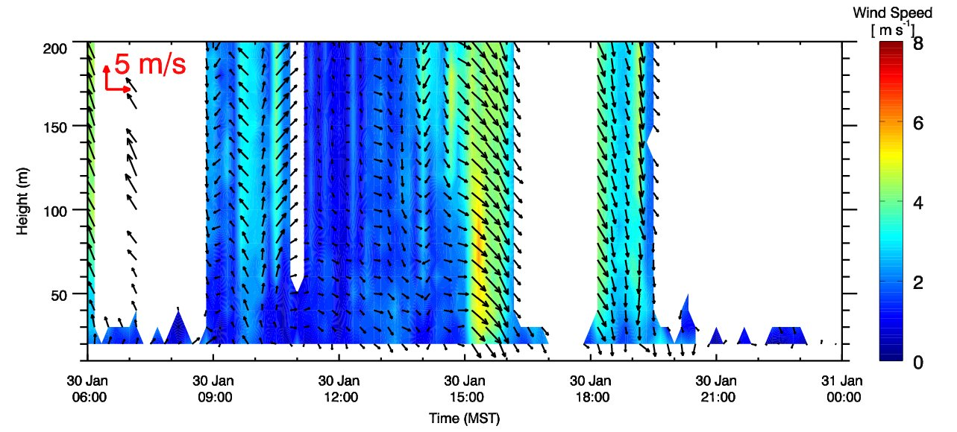
Lake Exchange
Clean Lake Breeze
30 January
Lake Breeze
no data
no data
no data
SoDAR at Landfill Site

Slide 12
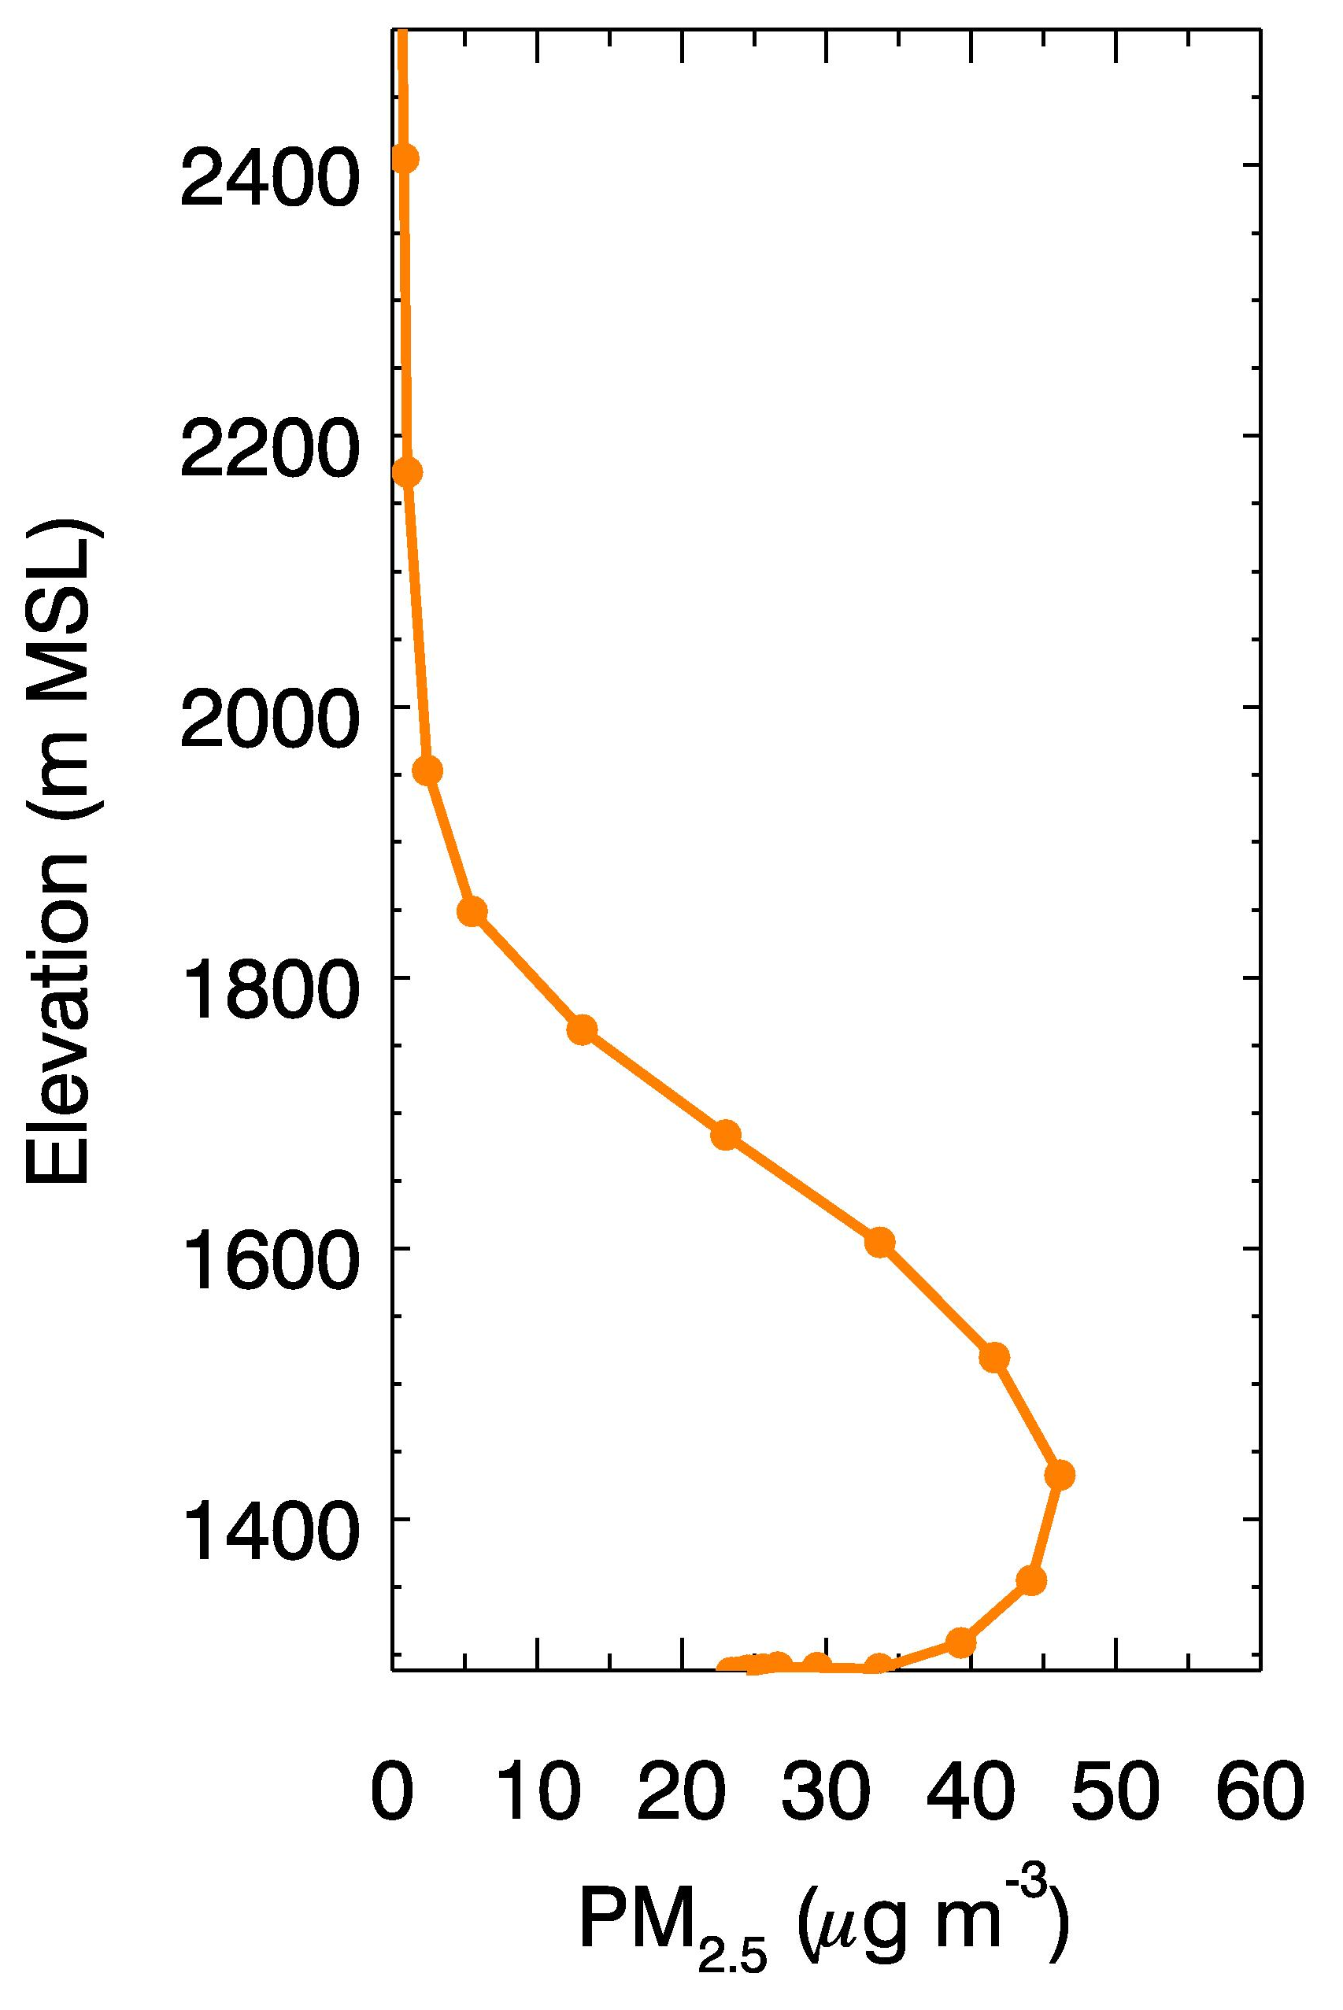
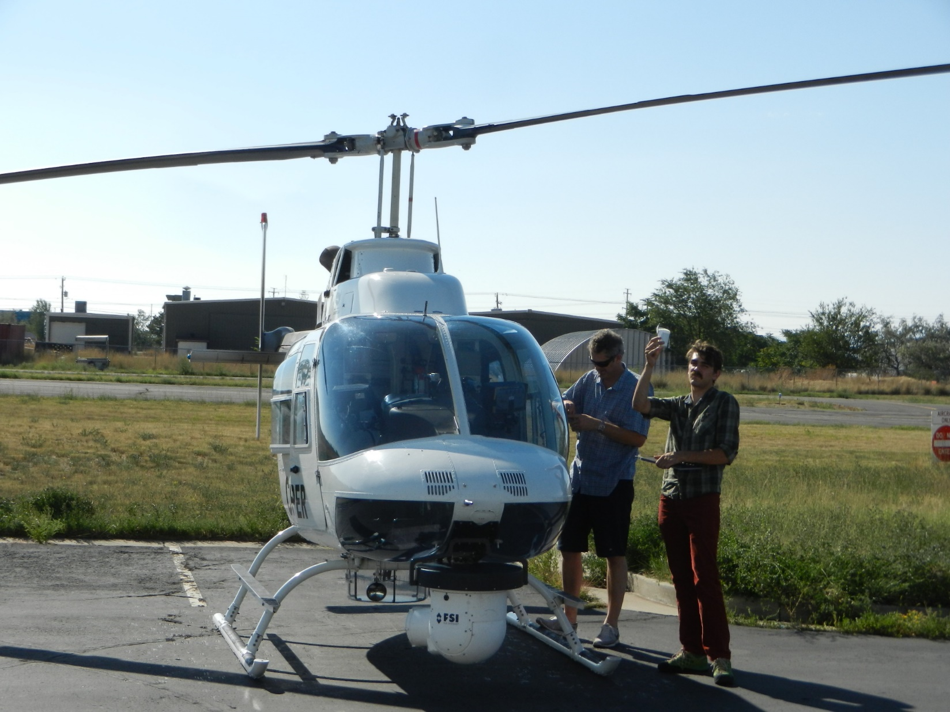


Lake Exchange
“Clean Breeze” 30 January 2017
(a) Isochrones of lake breeze frontal location
Chopper
1700 MST
Colder and cleaner air is advected from the lake, undercutting the very polluted air.
(b) Spatial distribution of PM_{2.5} at 1700 MST
(c) Spatial distribution of O₃ at 1700 MST
Notes:
High ozone

Slide 13
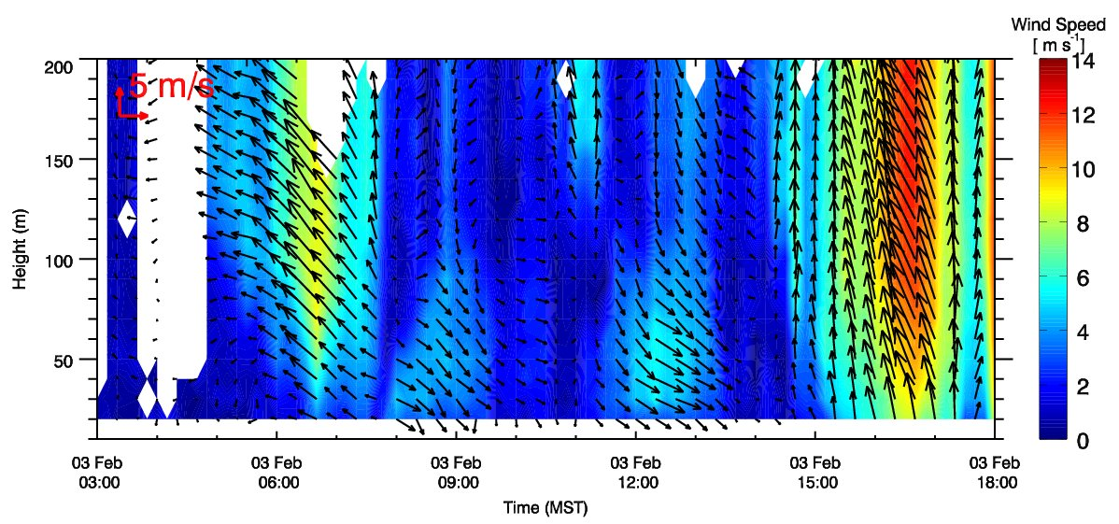
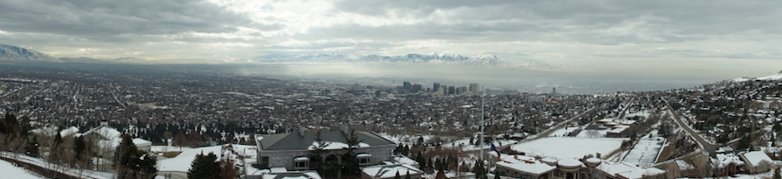
Lake Exchange
Dirty Lake “Recharge”
3 February 2017
Pre-Frontal
Southerlies
Frontal
Passage
no data
“Lake Recharge”
13:10 MST

Slide 14
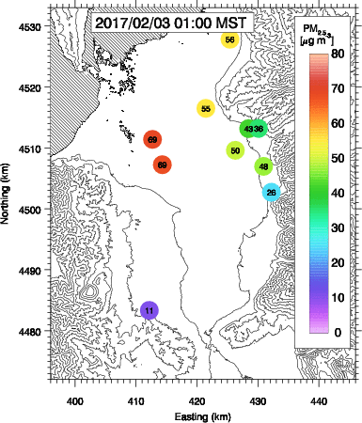

Lake Exchange
“Dirty Breeze / Lake Recharge” 3 February 2017
Polluted Cold
Pool
“Southerly Mix-out Event”
(Lareau et al. 2013, Lareau and Horel 2015)

Slide 15
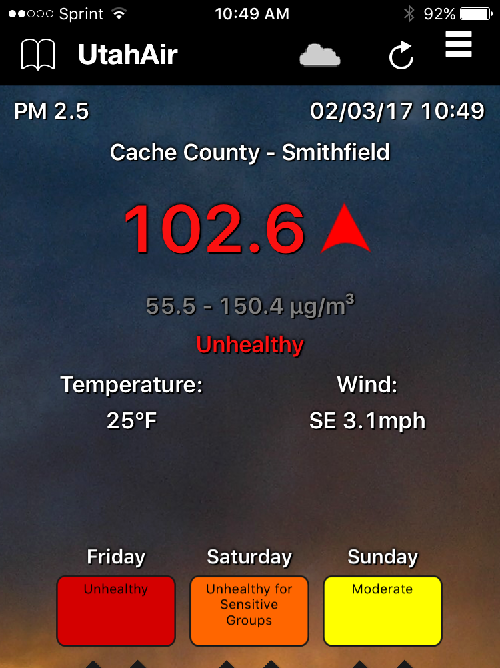
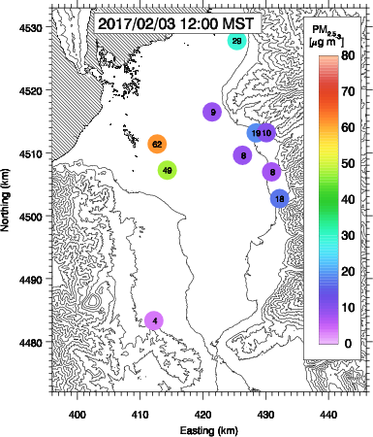
Conclusions
Wintertime Persistent Cold-Air Pools (PCAPs) are characterized by limited mixing and a build-up of particulate pollution occurs in the Salt Lake Valley and other populated basins.
Nevertheless, valley circulations through tributary valleys and thermally-driven and synoptically-forced air mass exchanges with the Great Salt Lake lead to mixing and changes in concentrations of PM_{2.5} and O₃.
These processes can lead to large gradients in pollutant concentrations challenging the decision making processes based on single regulatory monitoring sites.
Injections of O₃ into PCAPs through canyon flows may play a crucial role for chemical reactions leading to ammonium nitrate formation.

Slide 16
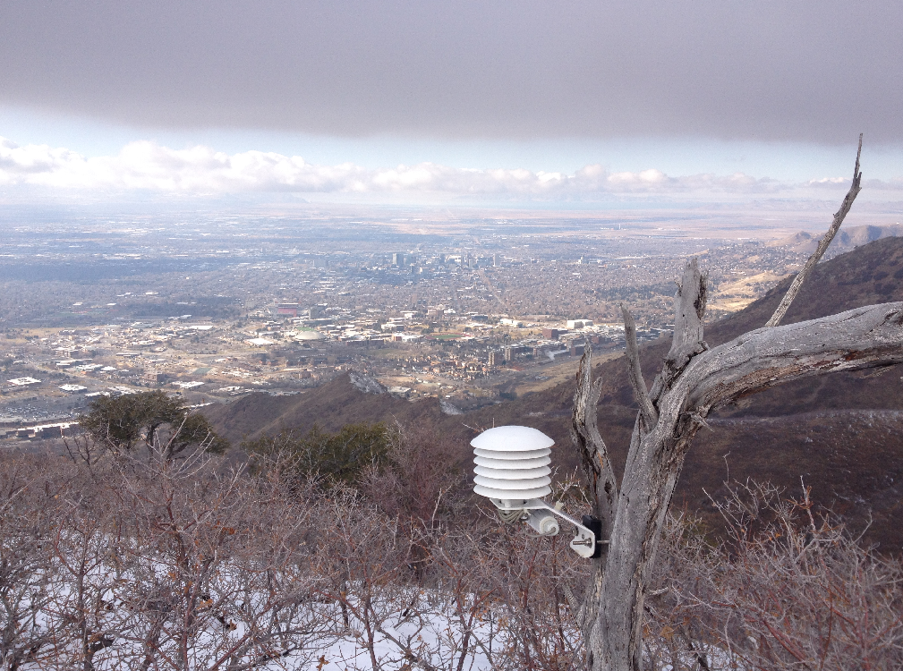
Acknowledgements
Funding from NSF, Grant 1723337
Support from Utah Department of Environmental Quality (UDEQ)
All members of the the NOAA-funded UWFPS.
John Horel, John Lin, Dave Whiteman, Alex Jacques, Luke Leclaire-Marzolf
Volunteers housing equipment throughout the Salt Lake Valley!

