Slide 1
Diurnal changes in turbulent Statistics
EFD Final Project
Terrence Hess
Daniel Alexander
Mohammad Khan
Neil Lareau

Slide 2
Project Objectives
Characterize the diurnal evolution of turbulent statistics for two dissimilar 24 hour periods
  First dominated by approaching trough and strong winds and frontal passage
  Second period contains a more archetypal evolution with weak synoptic forcing
Document the spectral distribution of the changes in sensible heat flux
  Evening transition period
  47 hours of data

Slide 3
Outline
Synoptic overview of weather conditions
General Turbulent Statistics
  Day 1
  Day 2
Spectral analysis of evening transition period
Spectral analysis of the second analysis period
Conclusion

Slide 4
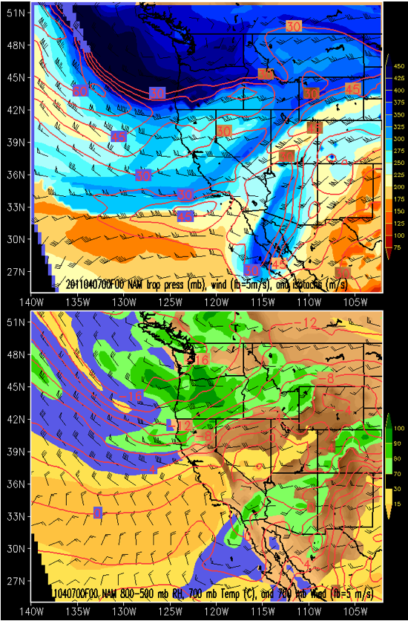
Synoptic Setting (5 Pm April 6)

Slide 5
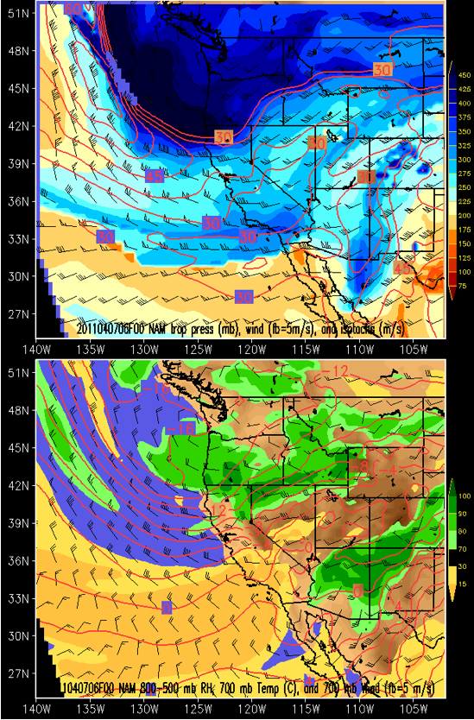
Synoptic Setting (11 PM April 6)

Slide 6
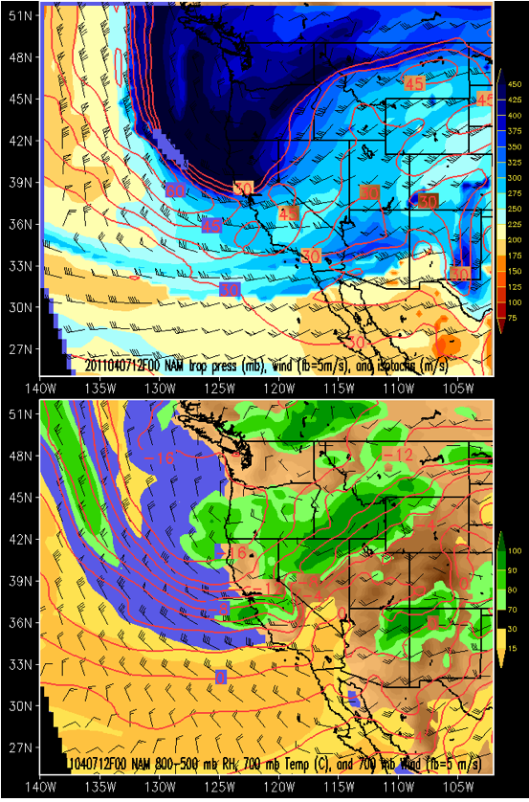
Synoptic Setting (5 AM April 7)

Slide 7
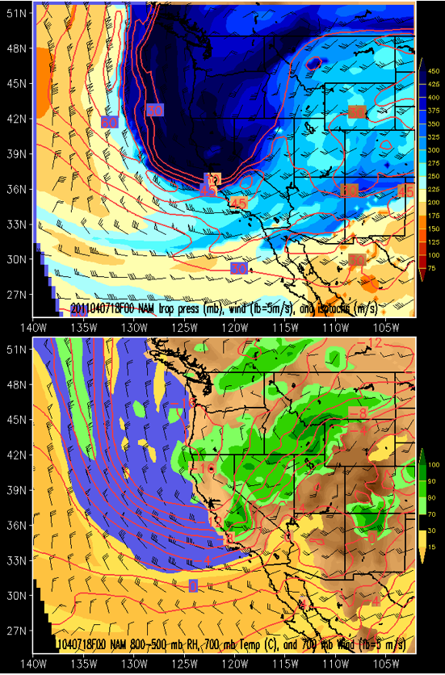
Synoptic Setting (11 AM April 7)

Slide 8
Wind Direction for Meteorology
Wind direction defines the direction FROM WHICH the wind originates
thetadir=atand(u./v);
thetadir(v>=0)=thetadir(v>=0)+180;
thetadir(u>=0 & v<0)=thetadir(u>=0 & v<0)+360;

Slide 9
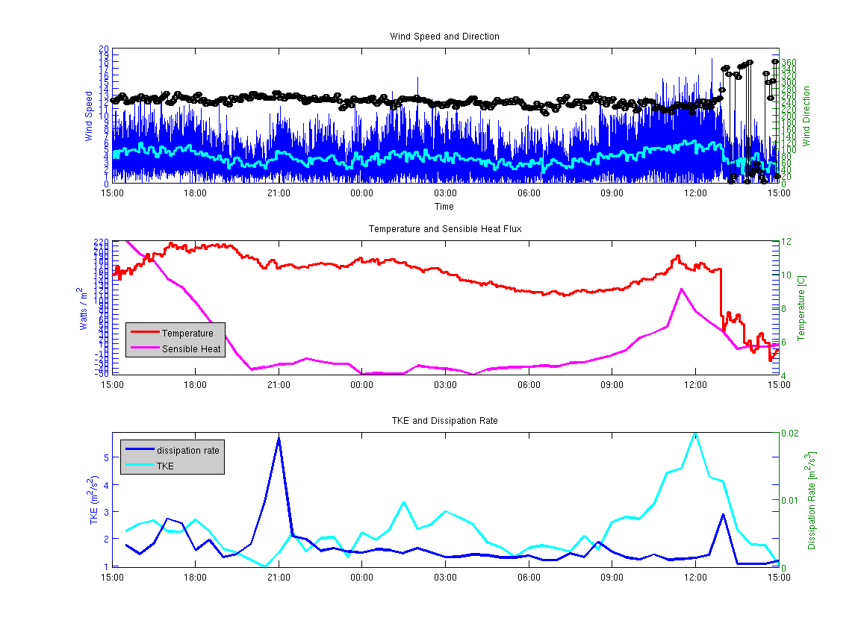
Mean and Turbulent Statistics (Apr. 6-7)

Slide 10
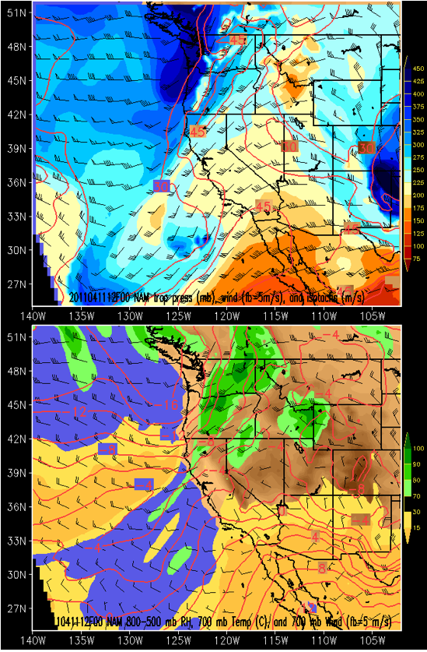
Synoptic Setting (April 11)

Slide 11
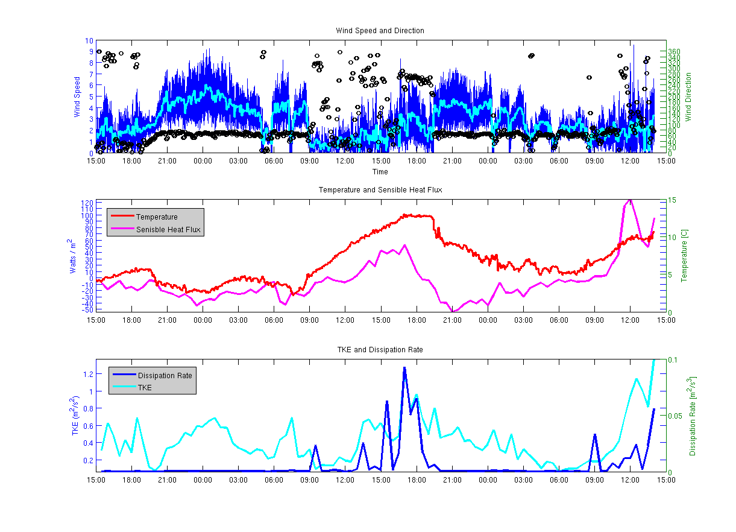
Mean and Turbulent Statistics (Apr. 10-12)

Slide 12
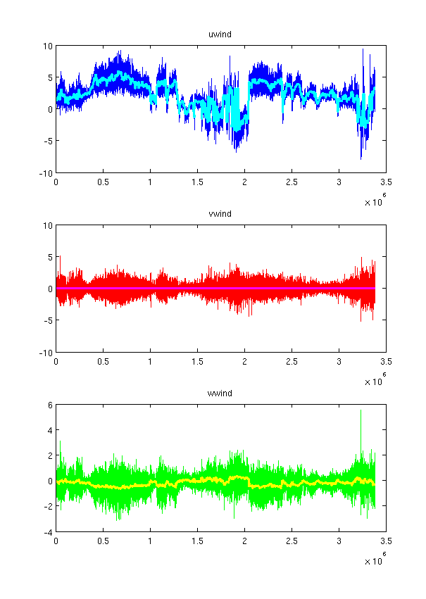
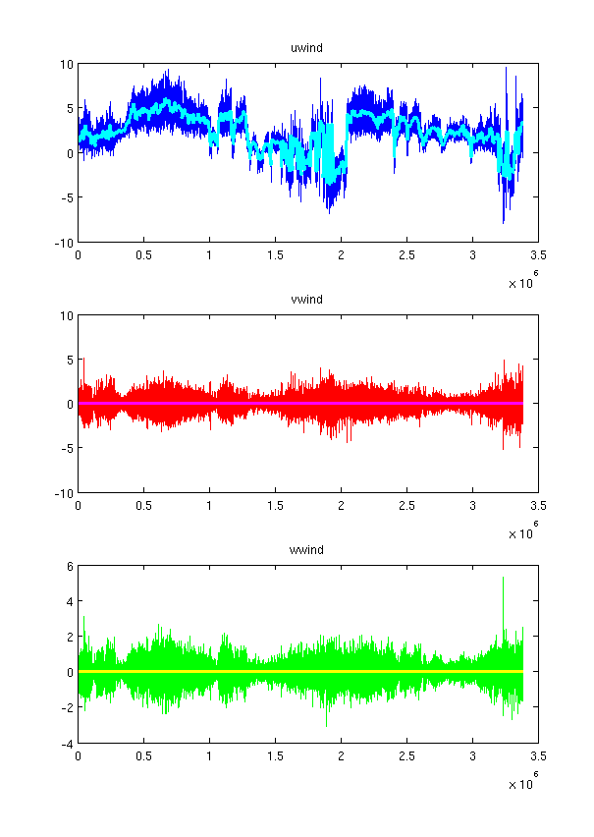
Rotation of the Wind Components (5 Min Means)
First Rotation
Second Rotation

Slide 13
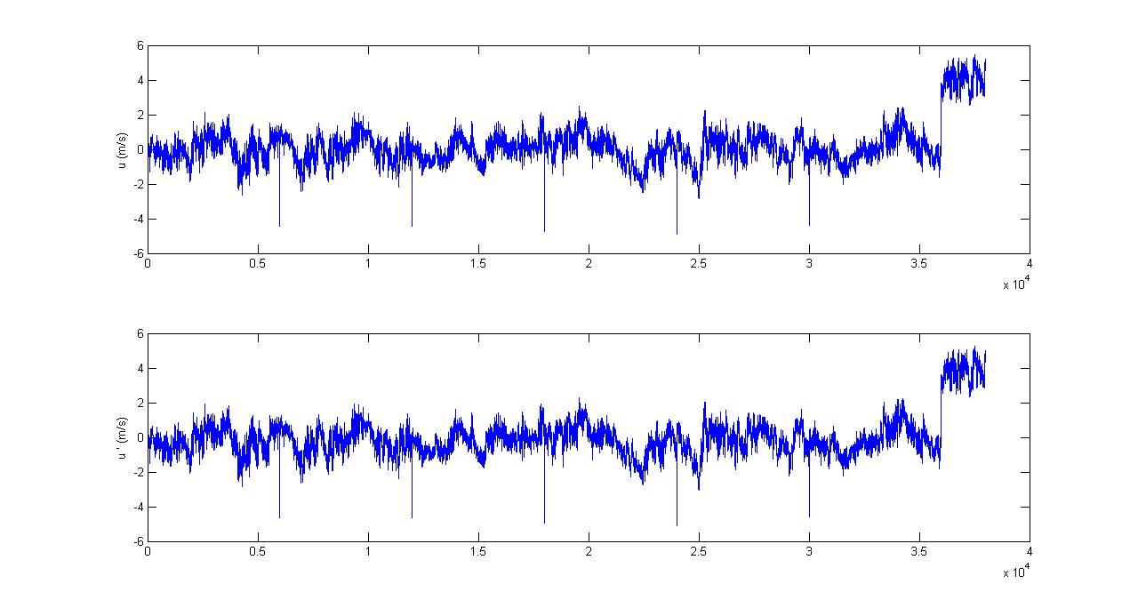
Spectra are analyzed on the perturbations about the 30 minute means (of the 5 minute means)

Slide 14
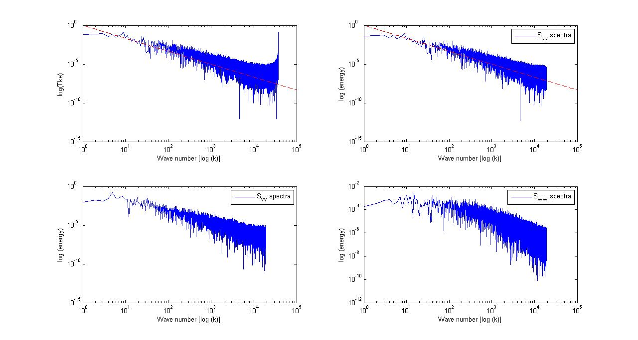
TKE and its components
Inertial Sub-layer (-5/3)

Slide 15
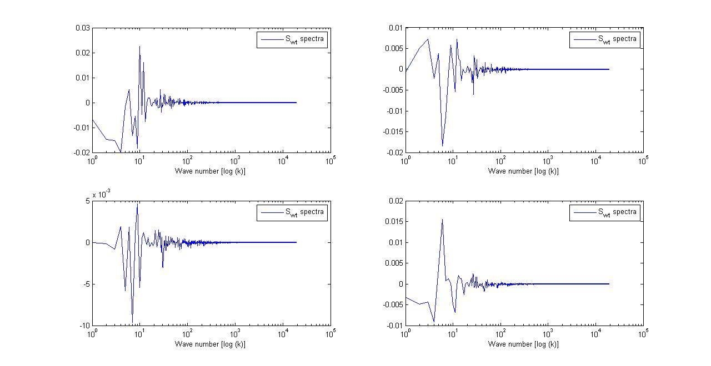
Copectra of W’T’ During Evening Transition (~8PM)
Before Transition
During Transition
After Transition

Slide 16
Mean and Turbulent Statistics (Apr. 10-12)

Slide 17
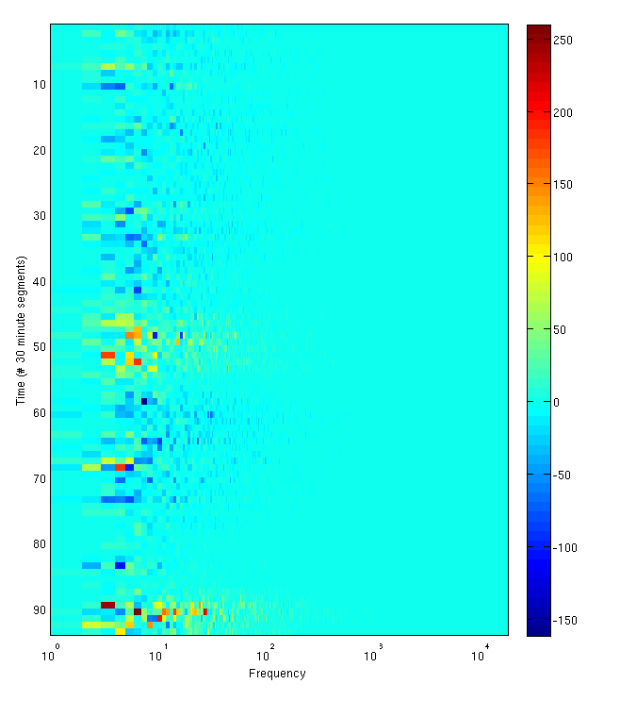
W’T’ Spectral Hovmoller Diagram
Time Increasing
Morning
Evening

Slide 18
Conclusions
Turbulent statistics show different characteristics during the two analysis periods
The first case is dominated by synoptic scale strong winds and attendant shear driven turbulence.
The second case shows stronger local and diurnal characteristics
  Upslope vs. Downslope Flows
More detailed analysis of the spectral evolution of heat flux during the transition periods would be of interest

