Slide 1
Storm Tracks over Western North America
A method for precipitation attribution?

Slide 2
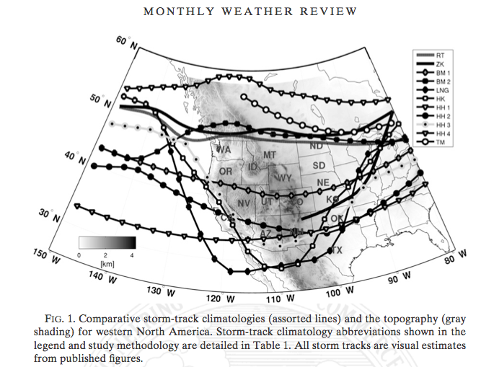

Slide 3
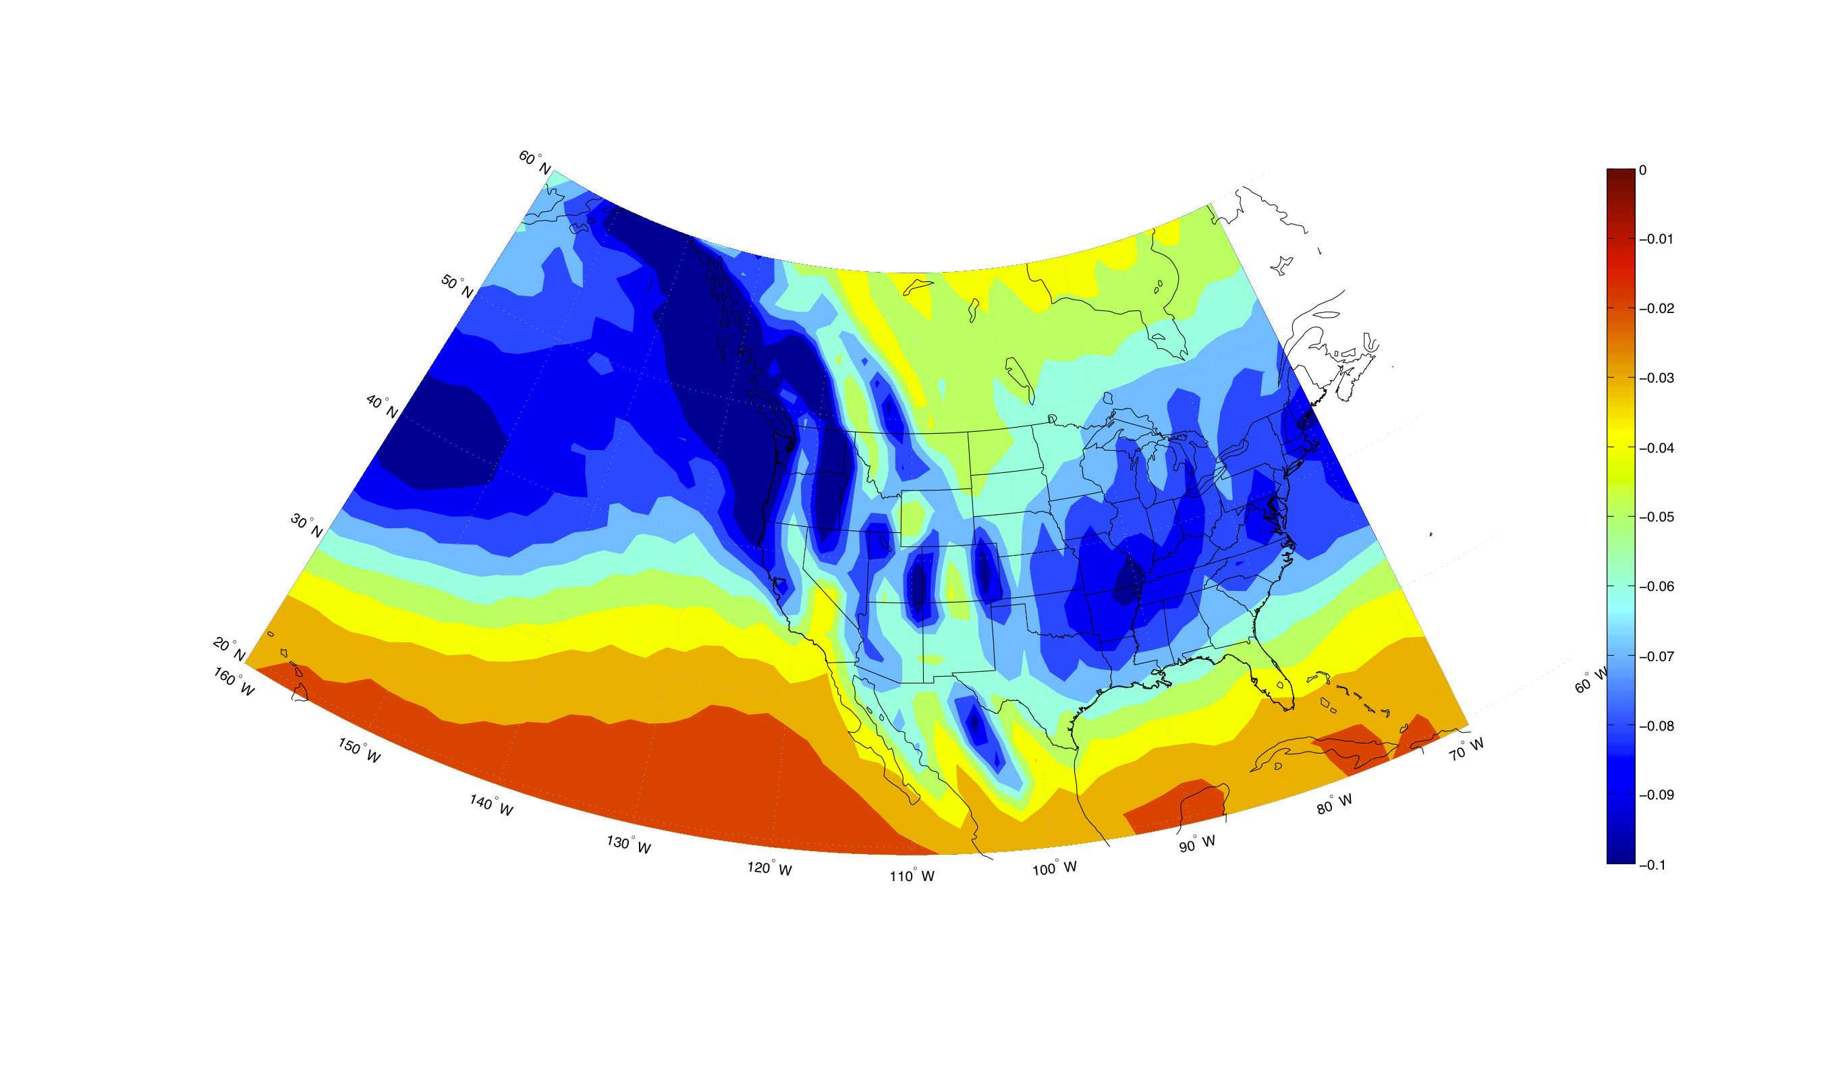
Model Ascent: What is What?
OROGRAPHIC ASCENT? DIABATIC FORCING? SYNOPTIC-SCALE FORCING?

Slide 4
Method
Diagnose the “dry dynamic” synoptic-scale ascent from ERA-interim data
Q-vector approach
Determine the maximum ascent within the vertical column
“Accumulate” that ascent over time periods of interest
Life cycle of an individual storm
Climatological distribution of storms (Oct-Apr)

Slide 5
For a single storm

Slide 7
In Motion:

Slide 8
WUS: 21 Year Climatology (Oct-Apr)

Slide 9
WUS: Seasonal Cycle

Slide 10
WUS: Storm Morphology (composites)

Slide 11
Applied to the Northern Hemisphere

Slide 12
A Cross Section (41 N)

Slide 13
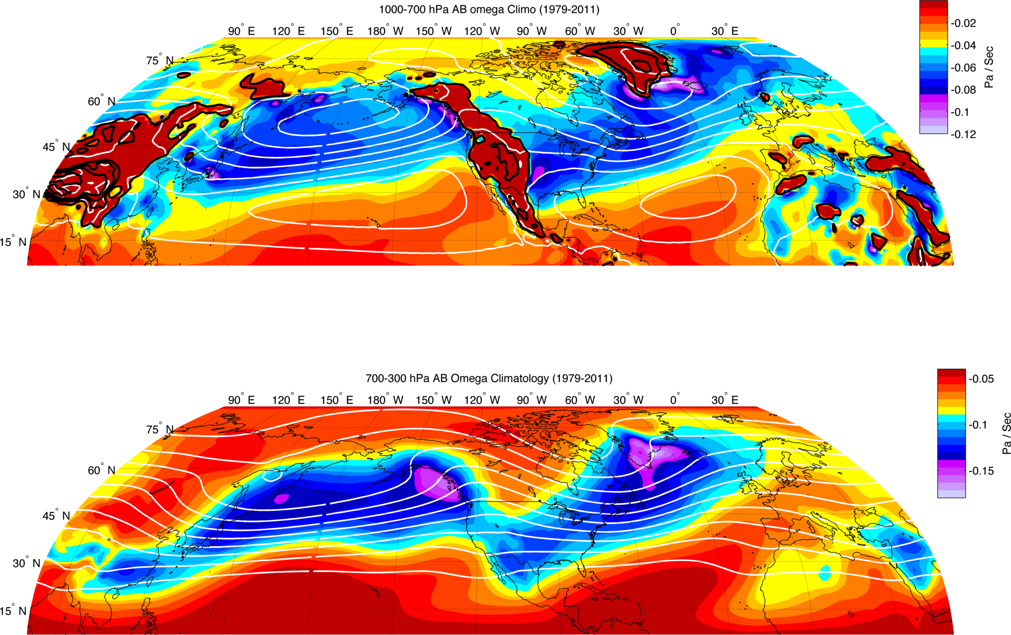

Slide 14
Precipitation vs. Ascent

Slide 15
Atmospheric Rivers and Large Scale Moisture Transport

Slide 16
How can we use this to better understand the Western US Hydorclimate?
Synoptic Ascent
Large Scale Moisture Vapor Transport
Mesoscale Orographics
The nexus of some or all of these?

Slide 17
