Slide 1
Precipitation and Storm Tracks

Slide 2
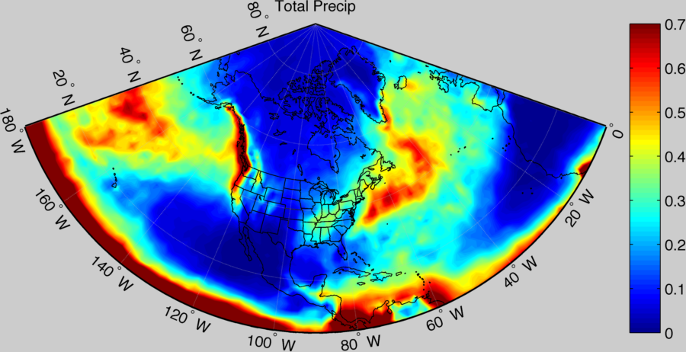
ERA-Interim Precip Winter 2010-2011
Notes:
Goal here is to show the ERA-interim precip data starting with total precip, then Large scale precip, and finally convective precipitation.

Slide 3
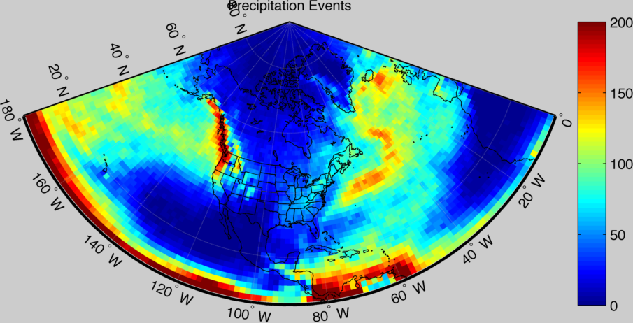
Precip Events (>1 mm/12 hrs)

Slide 4
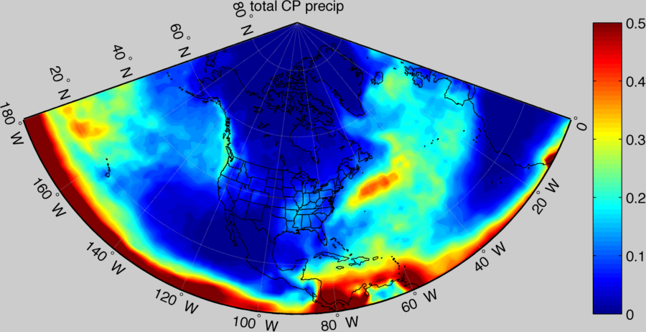
ERA-Convective Precip

Slide 5
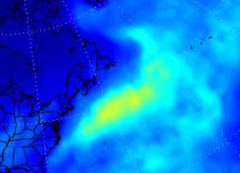
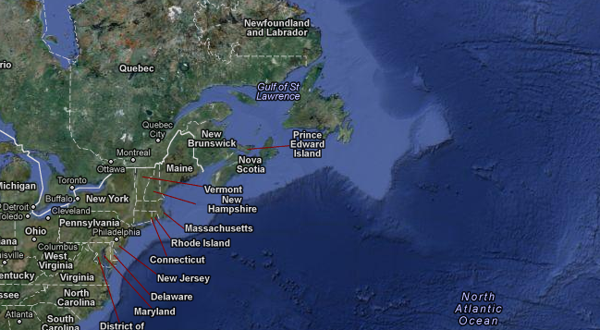
Continental Shelf/Gulf Stream/Conv Precip

Slide 6
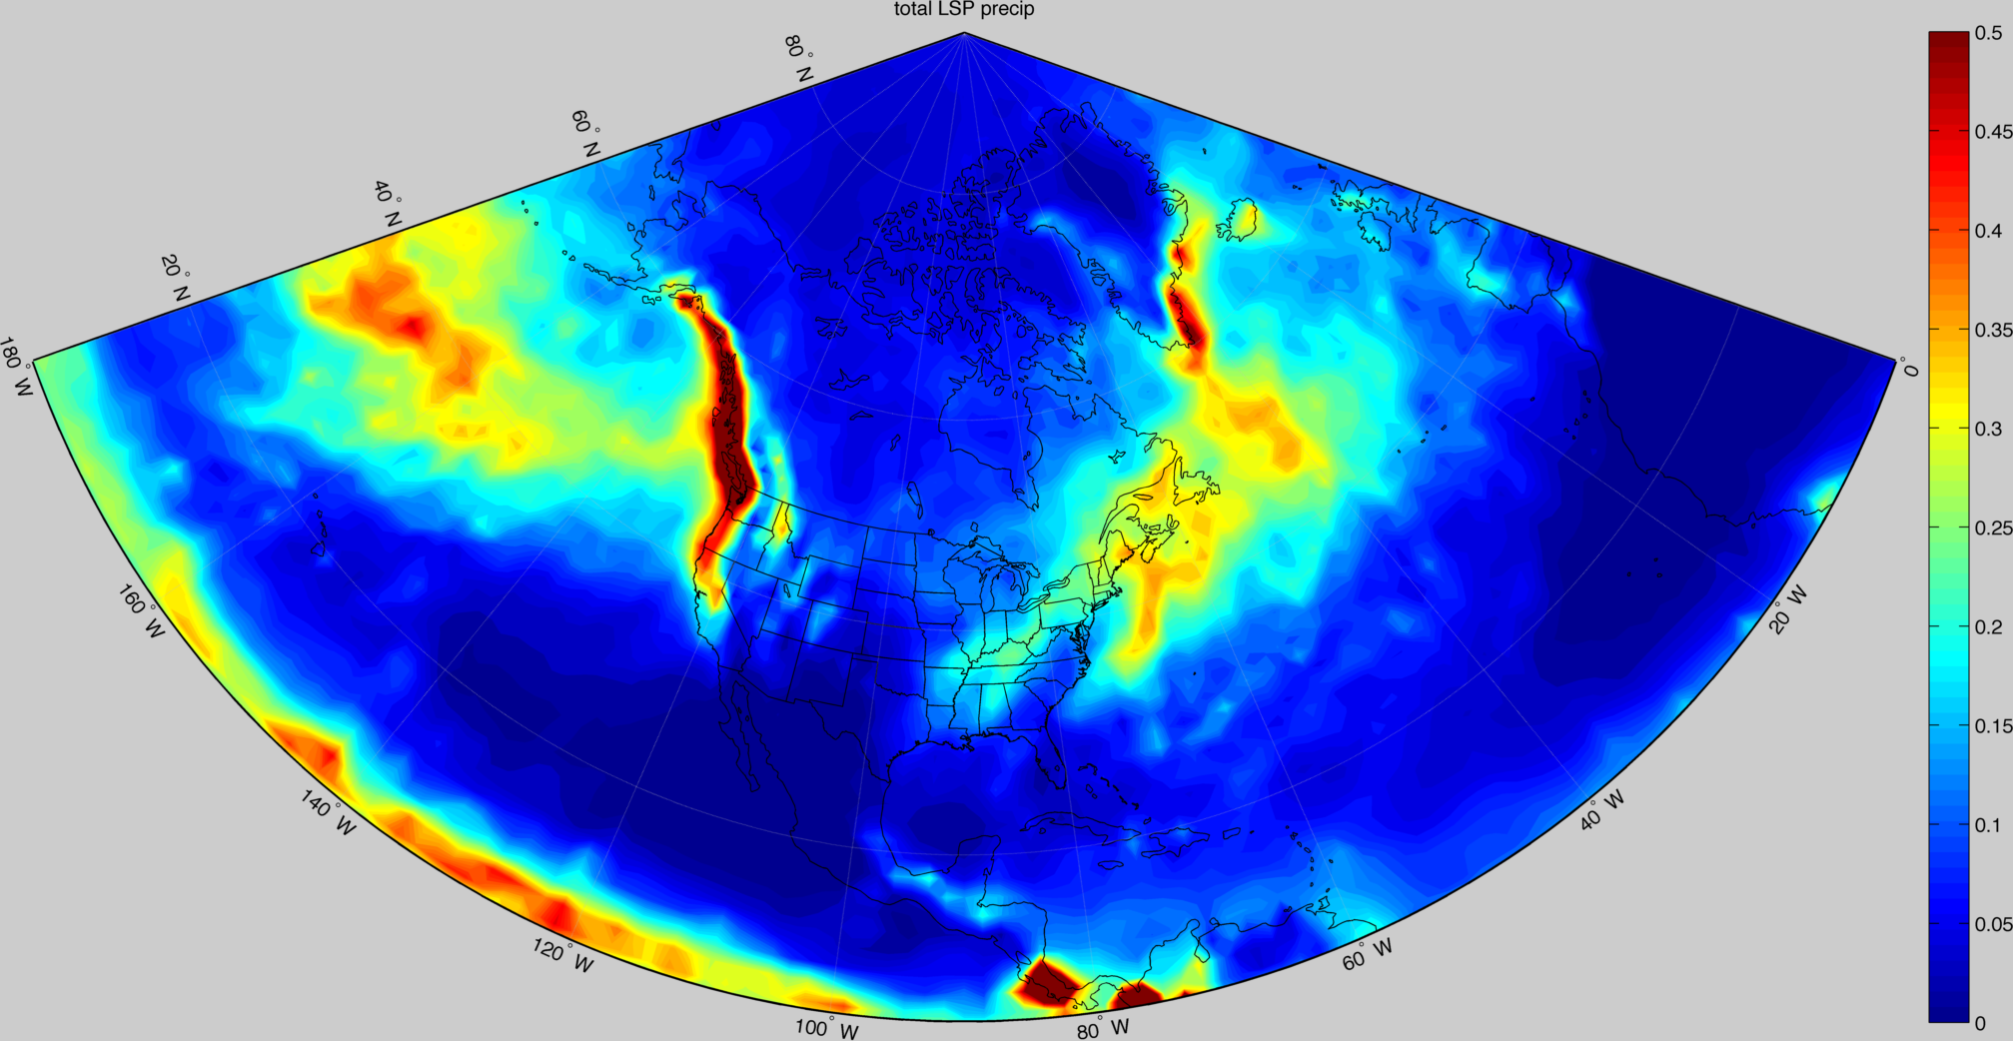
ERA-Large Scale Precip

Slide 7
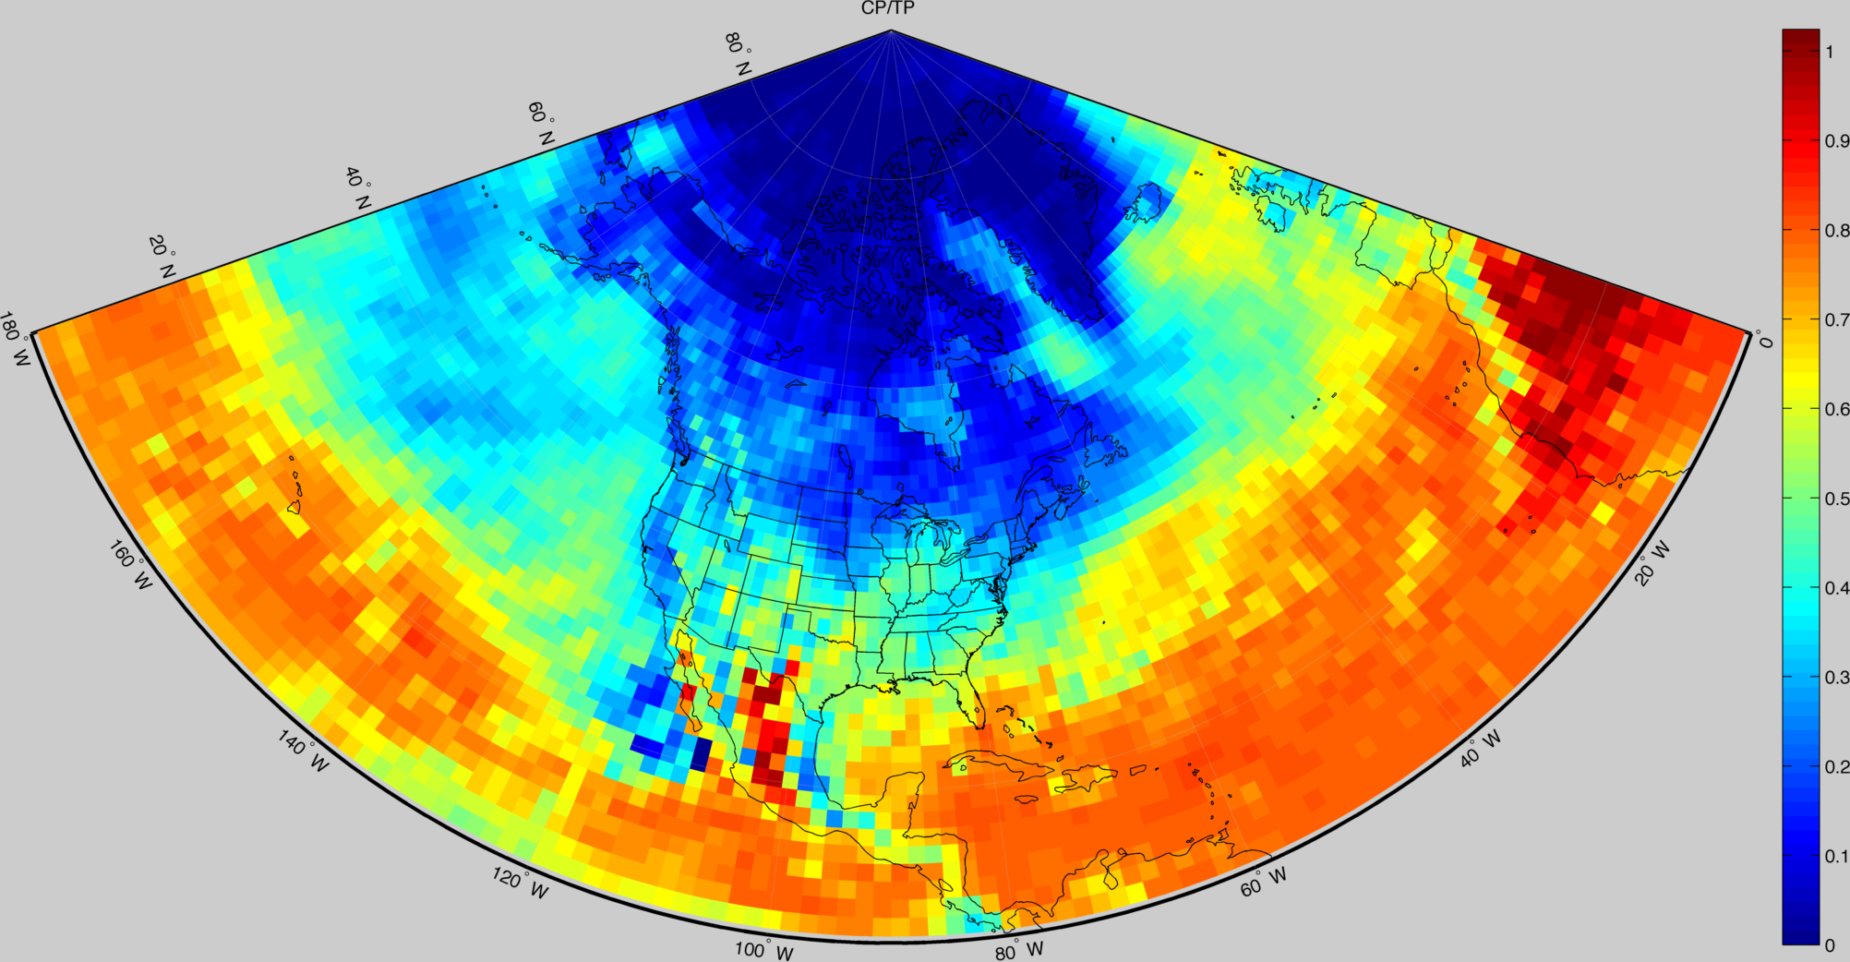
Convective to Total Precip Fraction

Slide 8
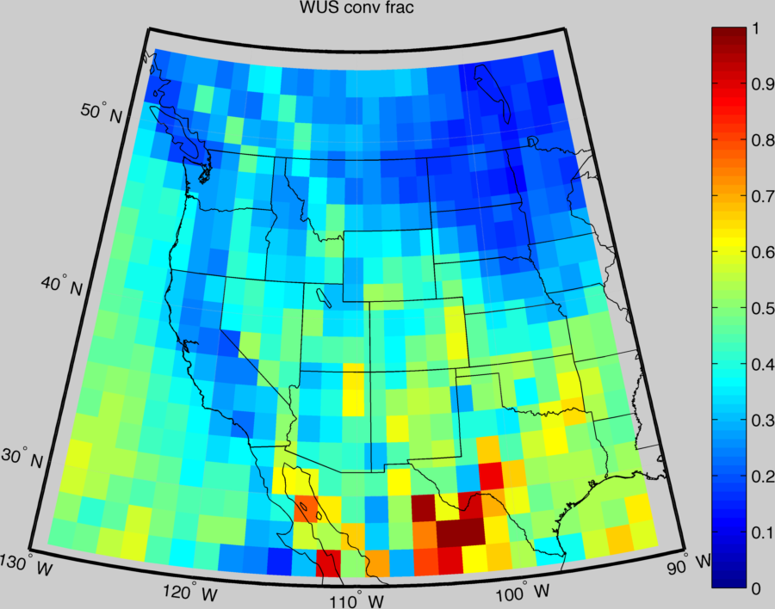
Convective Fraction WUS

Slide 9
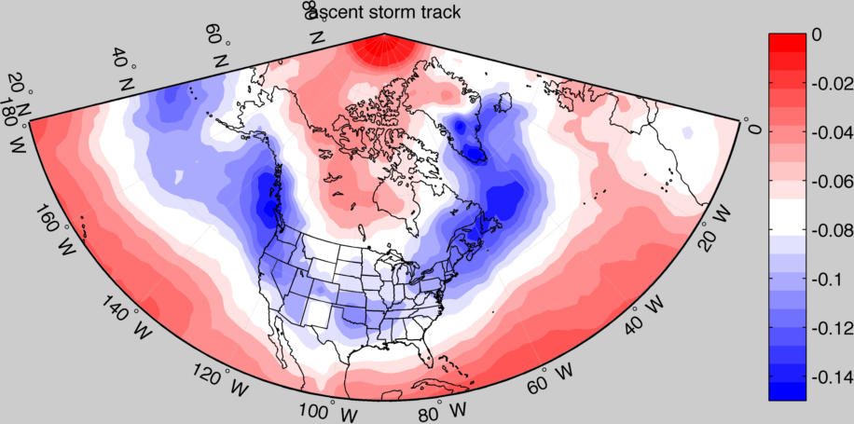
Ascent Storm Track

Slide 10
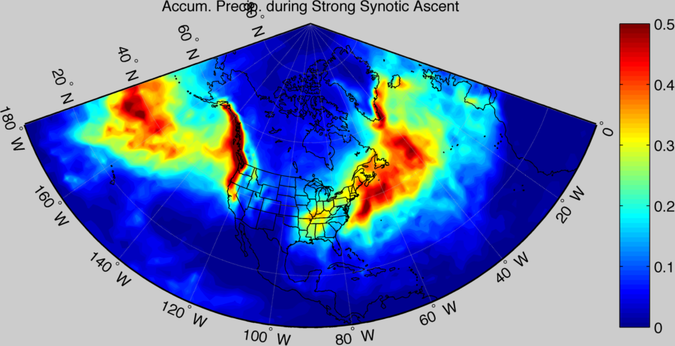
Precipitation During Ascent “Events”

Slide 11
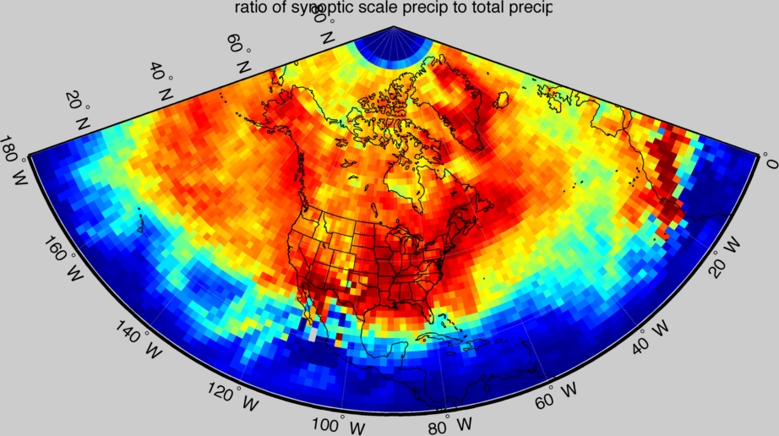

Ratio of Ascent Event to Total Precip

Slide 12
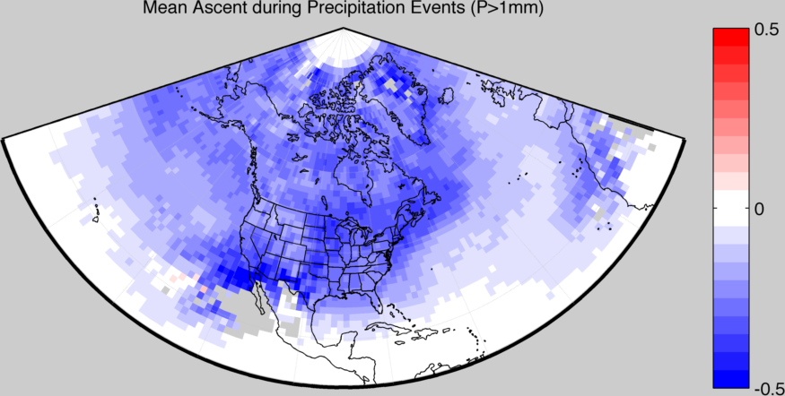
Ascent During Precipitation Events

Slide 13
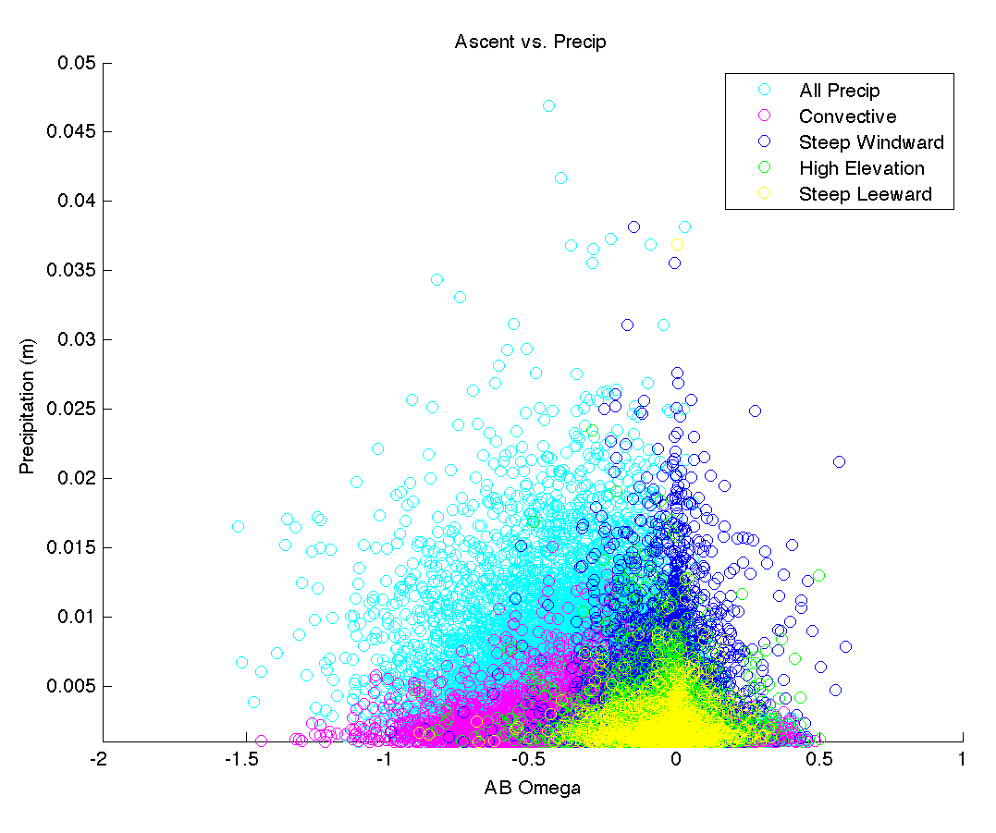

Slide 14
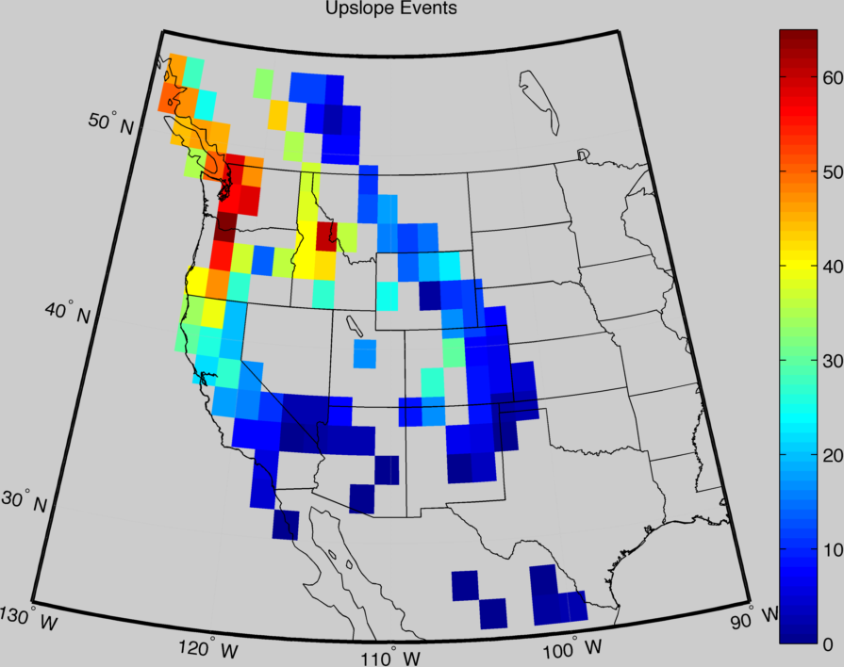
Upslope Event Count

Slide 15
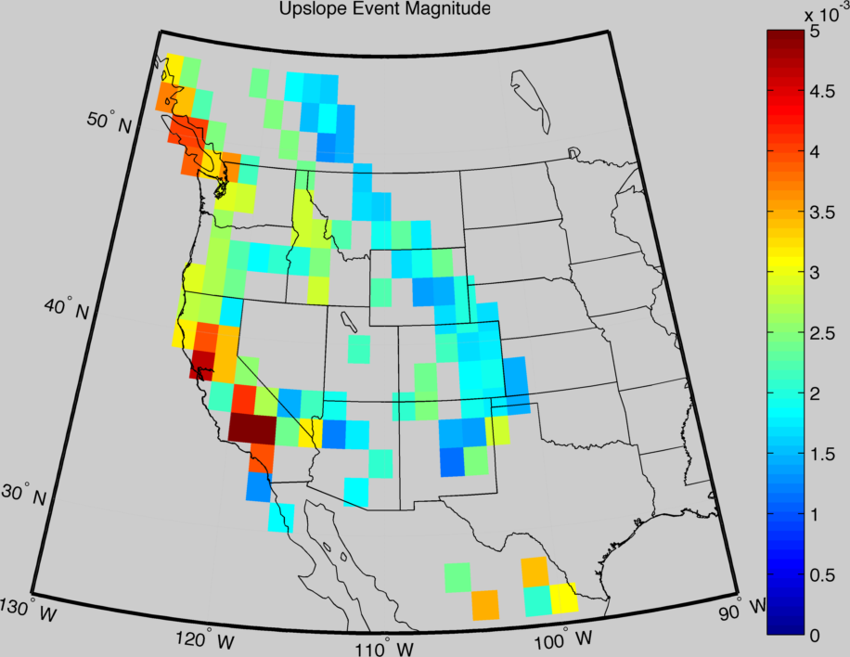
Upslope Event Mag.

Slide 16
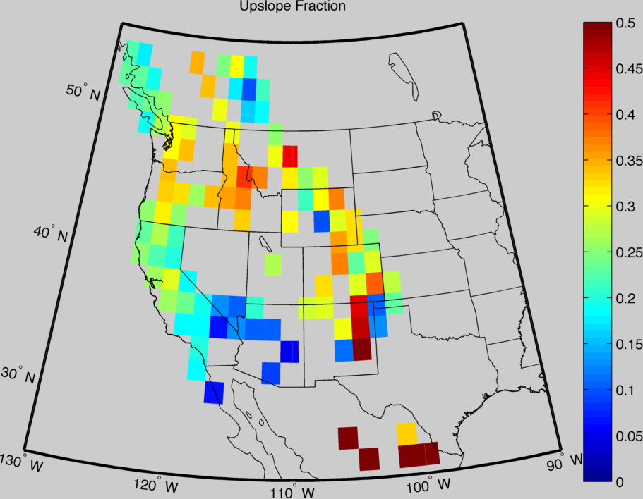
Upslope Fraction of total Precip

