Slide 1
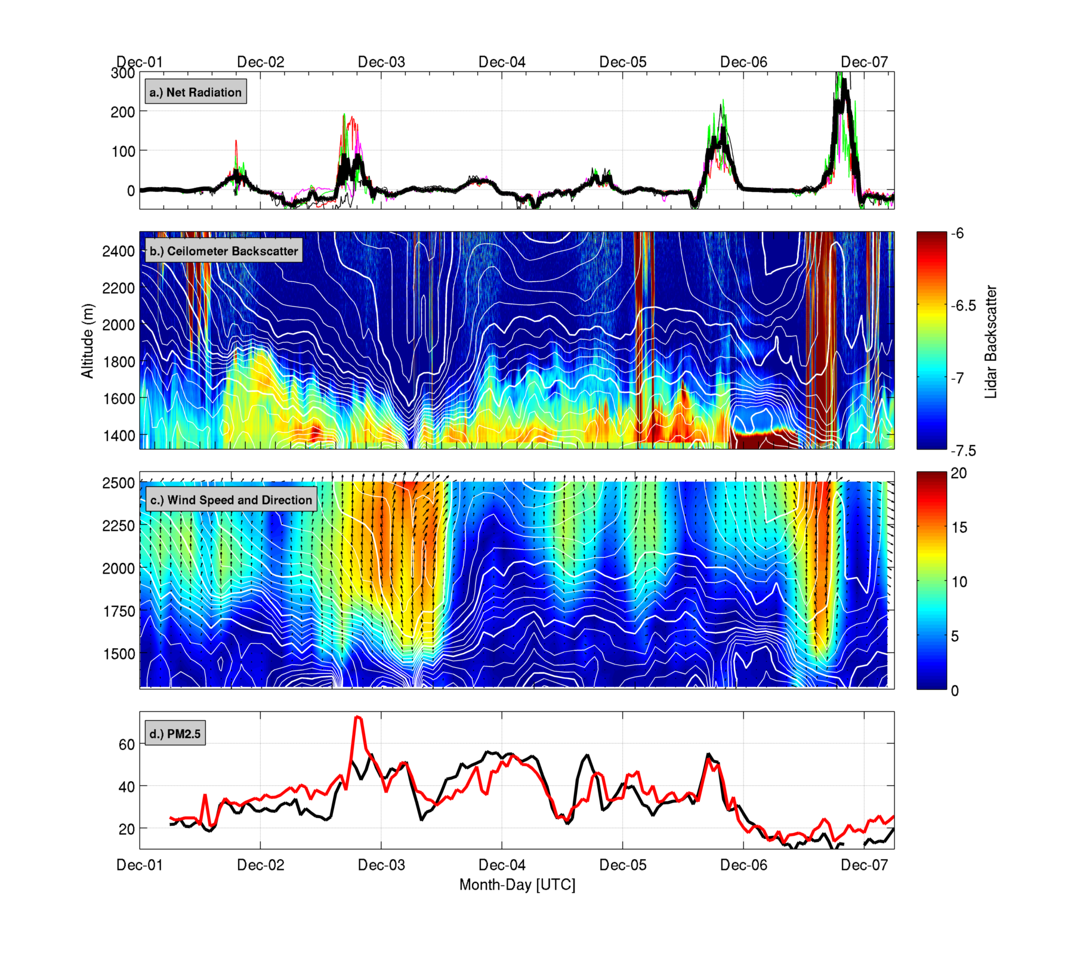

Slide 2
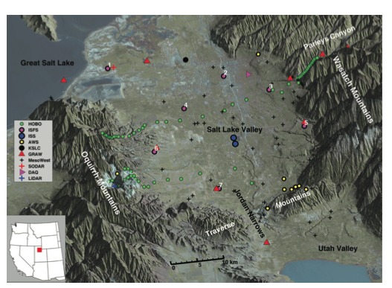

Slide 3
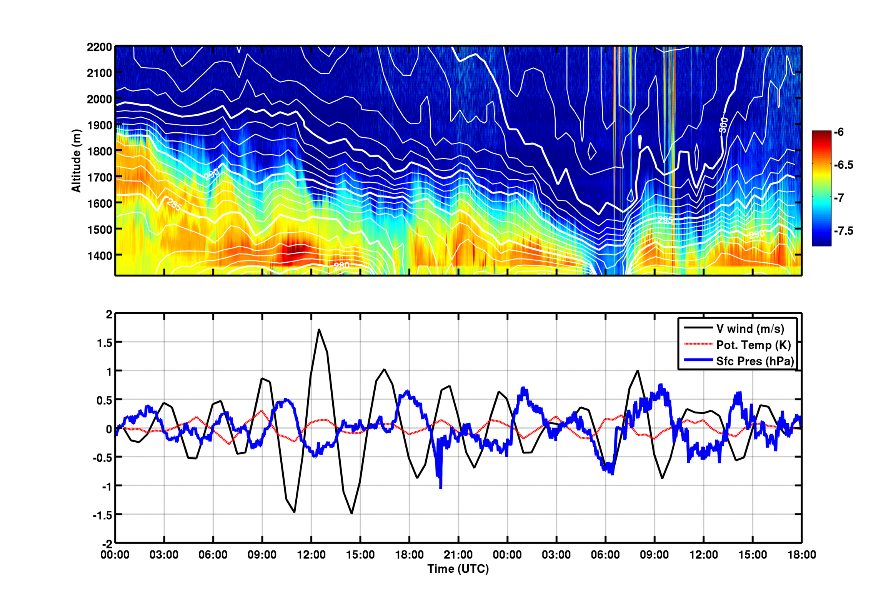

Slide 4
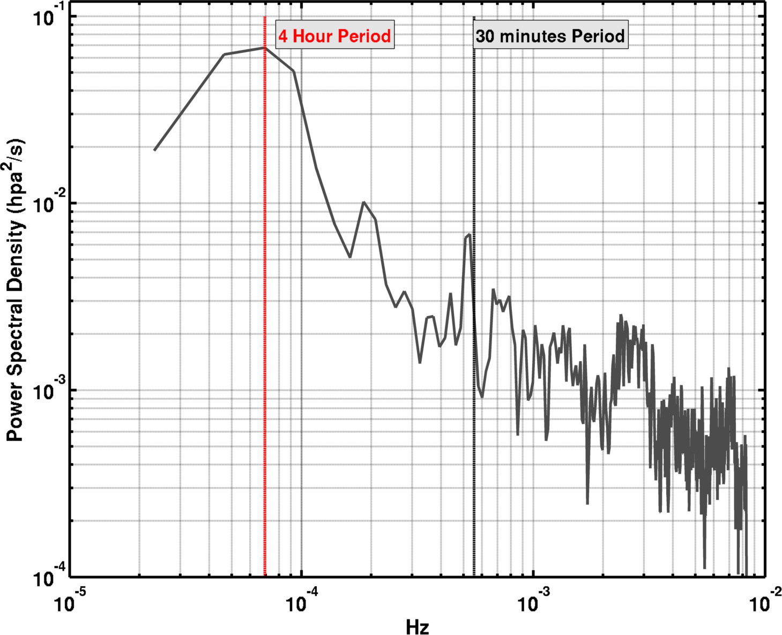

Slide 5
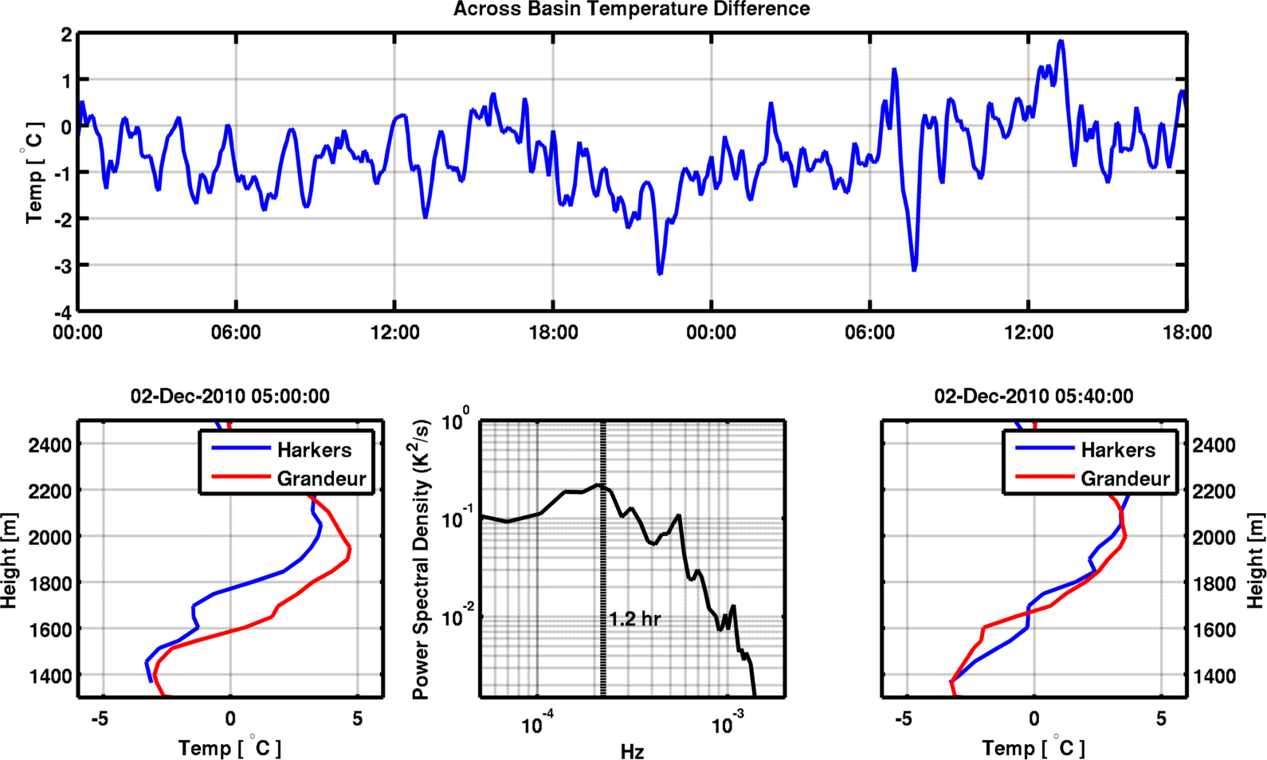

Slide 6
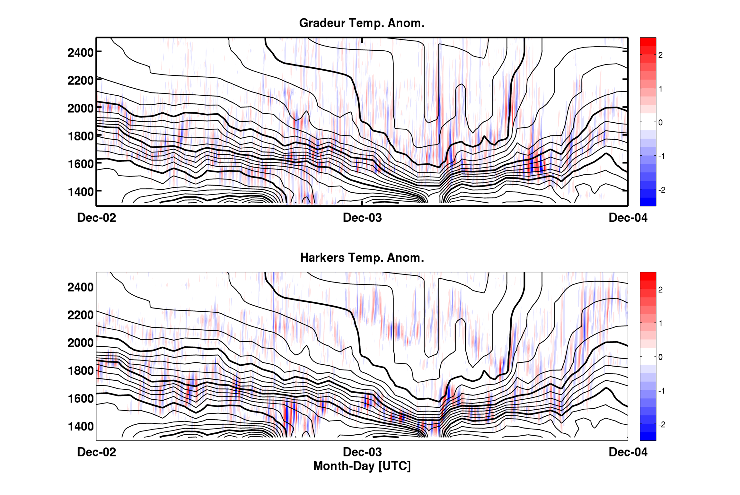

Slide 7
Turbulent Erosion: Kelvin-Helmholtz Instability
100 m
~ 3 min => ~1800 m (assuming v= 10 m/s)
Turbulent mixing occurs within the CAP!!! Not necessarily just along the top edge. Note: We do not know what is going on at the top edge due to the lack of aerosol.
Notes:
Top panel shows a sequence of KH waves that move past ISS. The waves are growing in amplitude in the sequenece and break down to smaller waves after 04:05.
The largest amplitudes are about 100 m, and the wave frequence is about once every 3 mins, giving a very rough spatial scale of >1500m
The waves extrude high aerosol air into the cleaner air aloft
Later, using a sounding, we can see that the waves occur WITHIN the two layered CAP structure where Ri<Ric, not necessarily acting as top down erosion, but instead internal erosion. This complicates the highly idealized scenarios of Petkovsek and Zhong.

