Slide 1
Turbulent Erosion of Cold-Air Pools
Observations and Preliminary Modeling

Slide 2
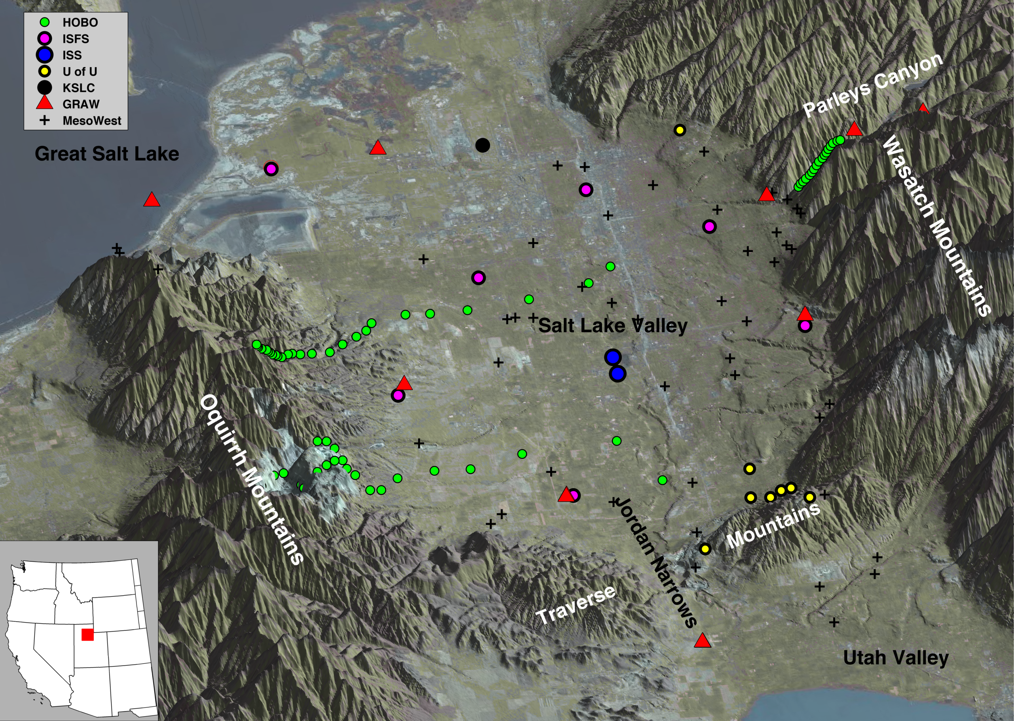

Slide 4
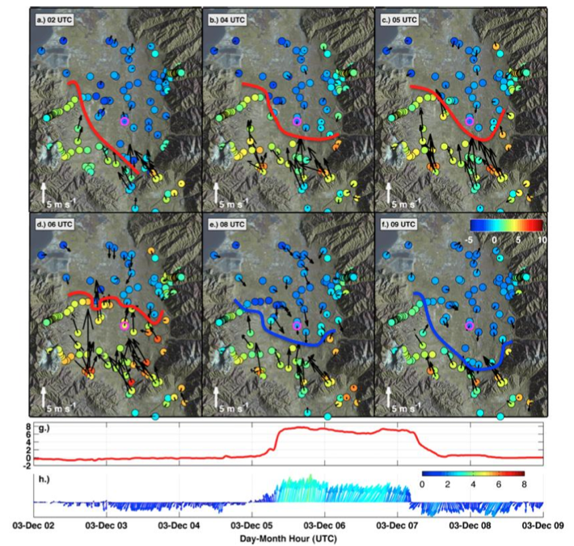

Slide 5
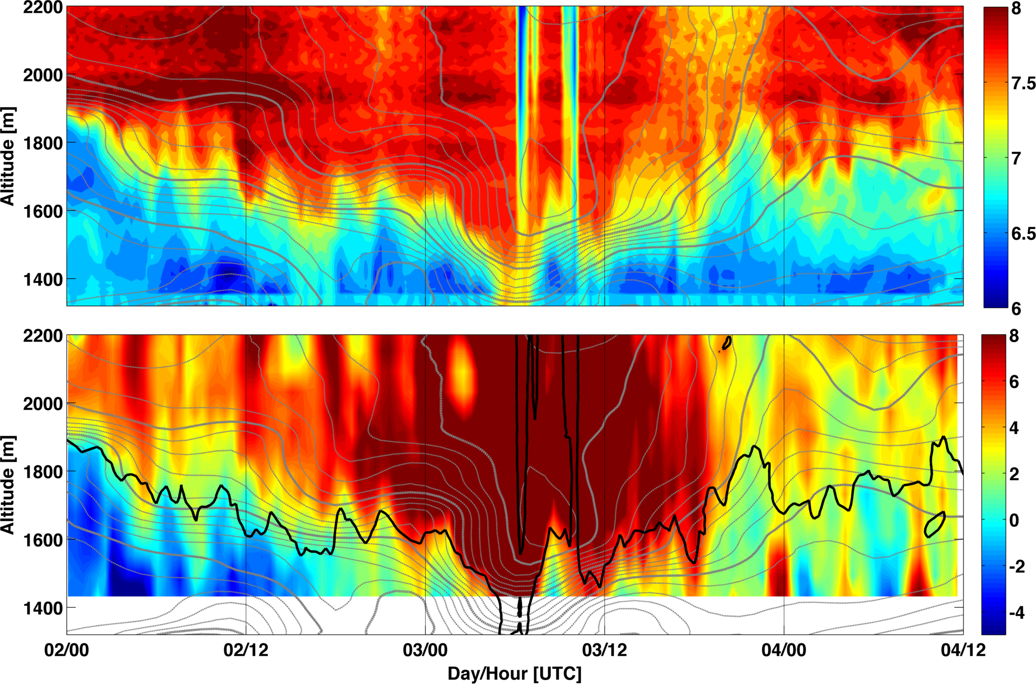
Laser Ceilometer
RASS- T_{v}

Slide 6
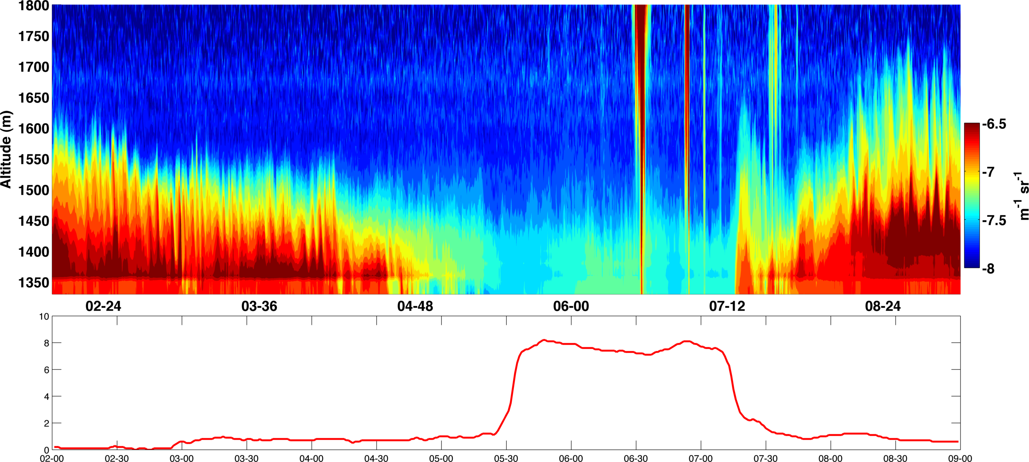

Slide 7
VERY IDEALIZED WRF SIMULATION (500 m)

Slide 8
LES simulation (~100m)

Slide 9
VERY IDEALIZED WRF SIMULATION
2 Hills

