Slide 1
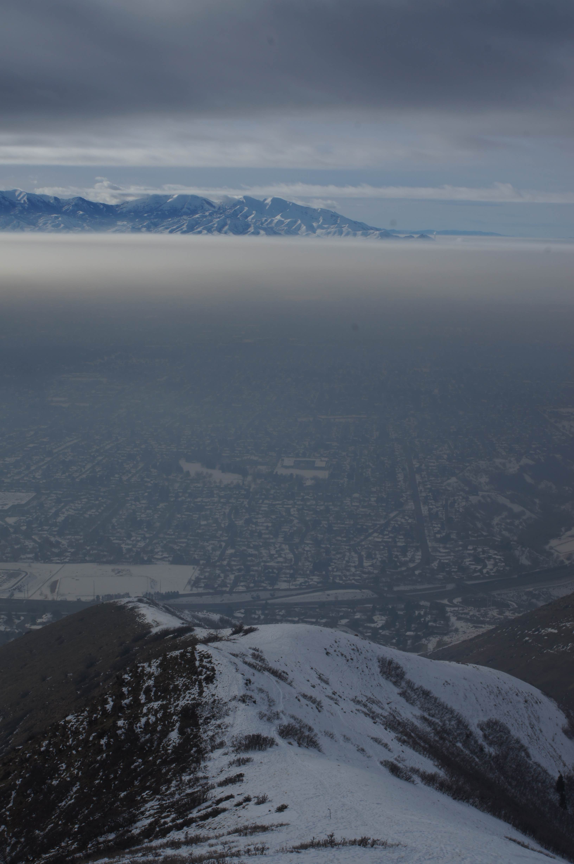
PCAPS
Persistent Cold-Air Pool Study
Neil Lareau, Univ. of Utah, Feb 15 2012

Slide 2

What is a Persistent Cold Air Pool?
A cold-air pool (CAP) is defined as a topographic depression filled with cold air-> PRETTY GENERIC!
CAPs occur when atmospheric processes favor cooling of the air near the surface, warming of the air aloft, or both
Stable stratification prevents the air within the basin from mixing with the atmosphere aloft
Surrounding topography prevents lateral displacement and favors air stagnation
PERSISTENT CAPs are CAPs which survive through more than one diurnal cycle.
  Occasionally remain intact for days or even weeks

Slide 3
CAPs vs. PCAPs
CAPs
PCAPs
Diurnal
Dominated by radiative heating and cooling
Surface based
Grow in depth during the night
  Sometimes grow to fill a basin
Typically destroyed by the growth of the CBL
Multi-day
Multi-scale
  Synoptic Scale vertical motion
  Radiative cooling, cloud micophysics
  Meso-scale circulations
  Many more!!
Grow from top down, bottom up, or both
Often have clouds/fog/freezing/frozen precipitation
Societal impacts
  Air/ground transportation
  Air Quality
Difficult to forecast

Slide 4
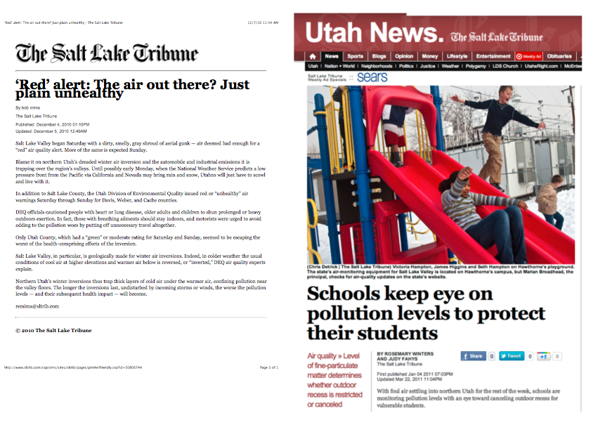

Slide 5
The Persistent Cold-Air Pool Study
RESEARCH OBJECTIVES:
  To identify and observe the meteorological processes that lead to the formation, maintenance, and breakup of persistent CAPs
  To determine the consequences of these processes on air pollution transport and diffusion in urban basins
  To assess how meteorological models can be improved to provide more accurate simulations of long-lived CAPs

Slide 6
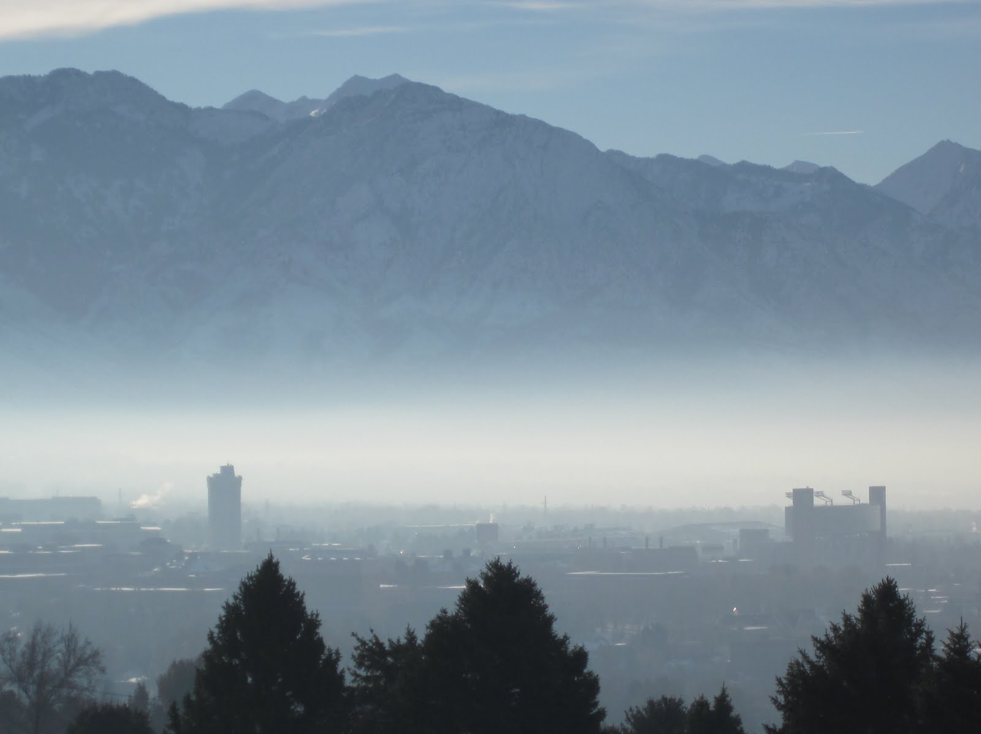
The Persistent Cold-Air Pool Study
Location: Salt Lake City, UT
Dates: Dec-Feb 2010-2011
Participants:
  Univ. of Utah Faculty and Students
  NCAR EOL Researchers and Staff
  SFSU, SJSU
  Univ. of Michigan
FUNDING: National Science Foundation

Slide 7
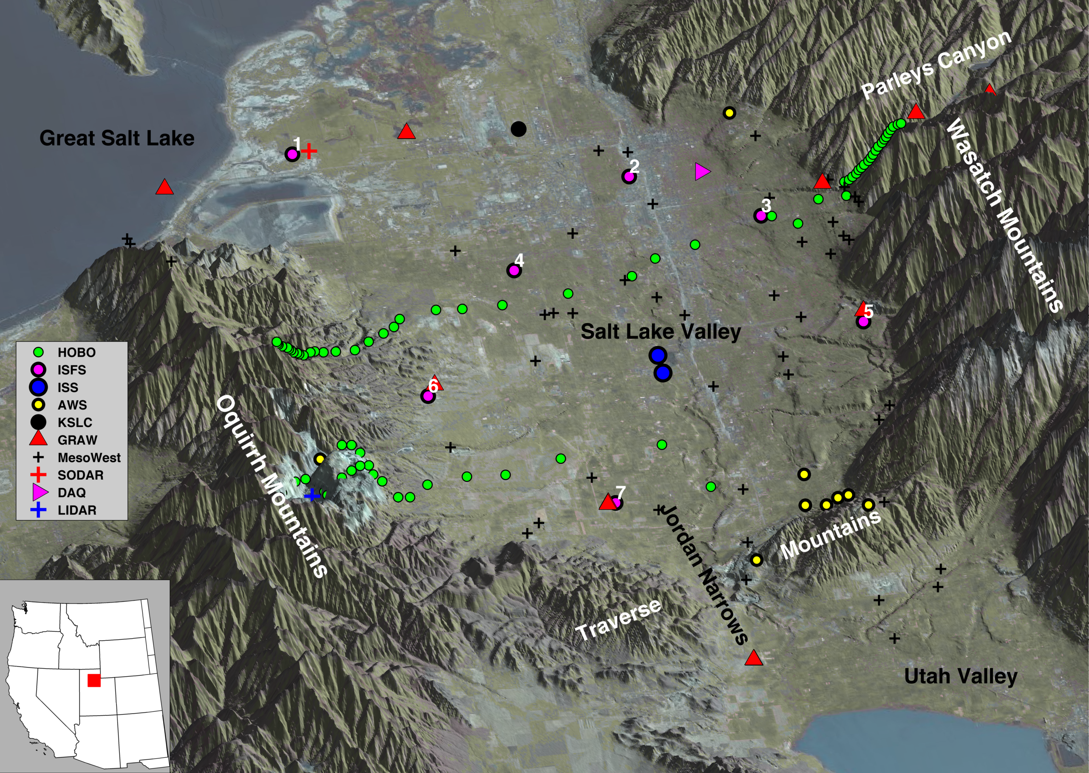
LOCATION AND INSTRUMENTATION

Slide 8
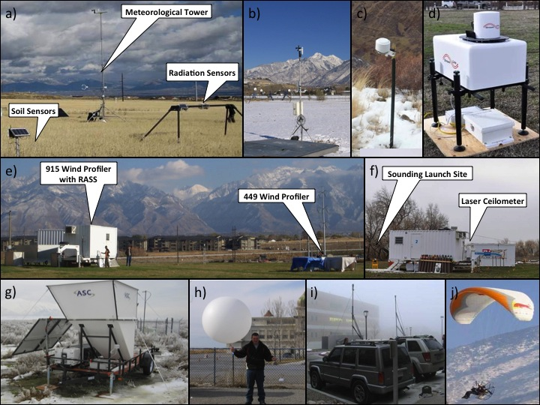

Slide 9
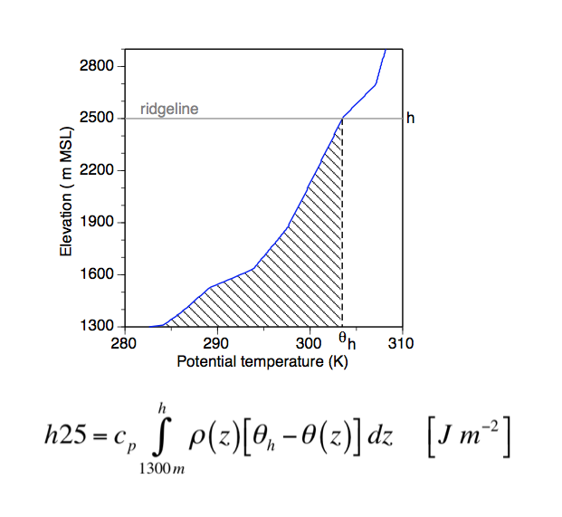
MEASURING COLD POOL STRENGTH
Whiteman et al. 2012

Slide 10
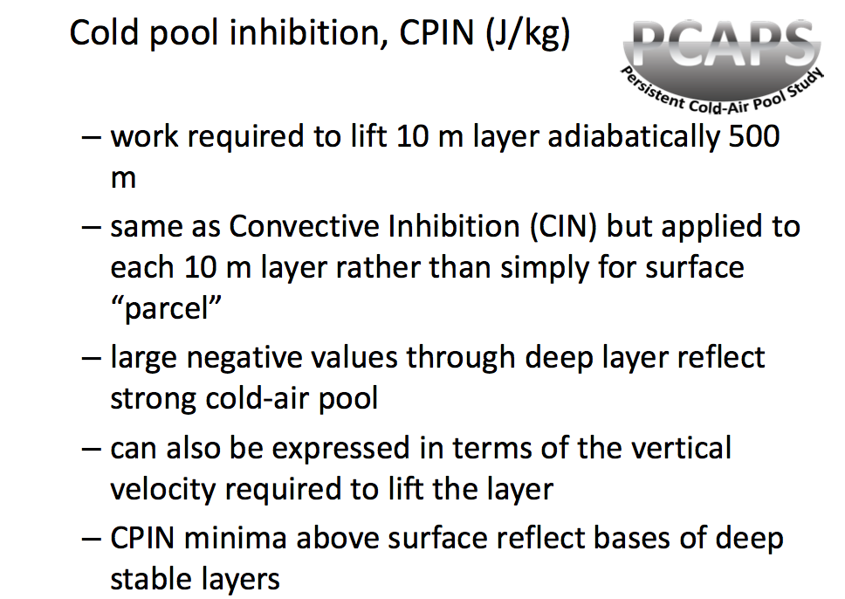
Courtesy John Horel and Chris Anders

Slide 11
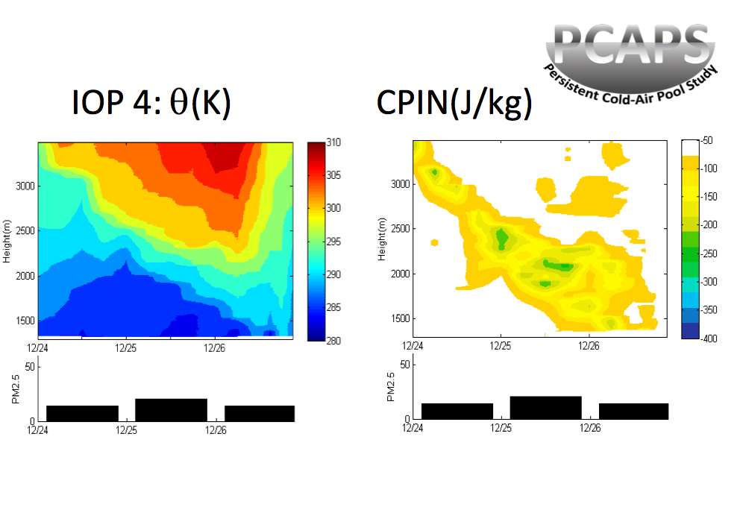
MEASURING COLD POOL STRENGTH
Courtesy John Horel and Chris Anders

Slide 12
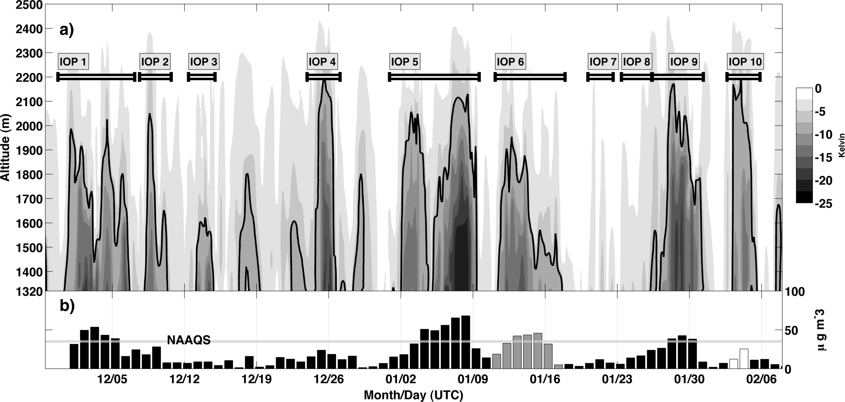
PCAPS OVERVIEW: IOPs, Potential Temp. Deficit, and PM2.5
Lareau et al. 2012

Slide 13
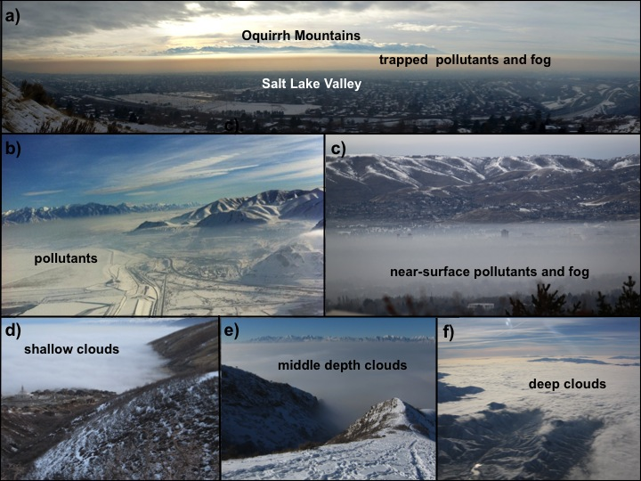

Slide 14
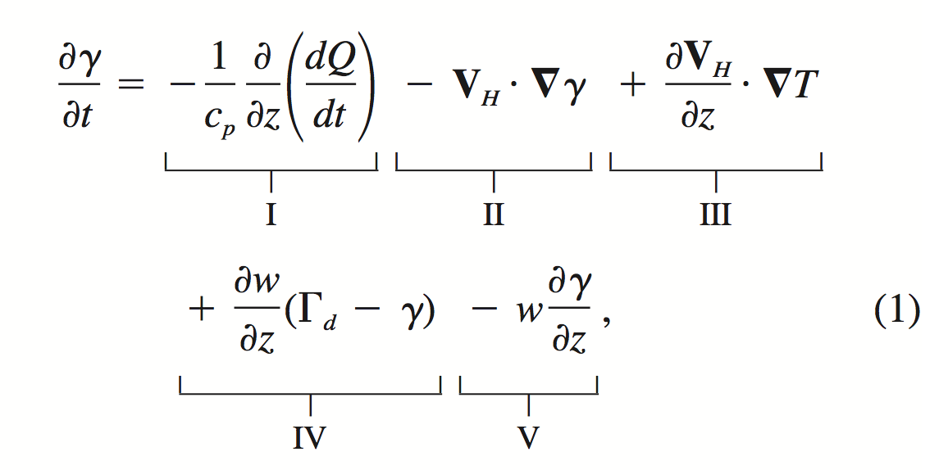
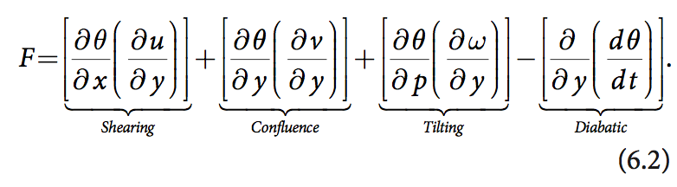
Processes Effecting Vertical Profile
Vertical Differential Heating
Advection of air of different stability
Differential Temperature Advection (tilting)
Vertical Confluence
Vertical Advection of the Lapse rate
TURBULENT TERMS?
Whiteman et al. 2001

Slide 15
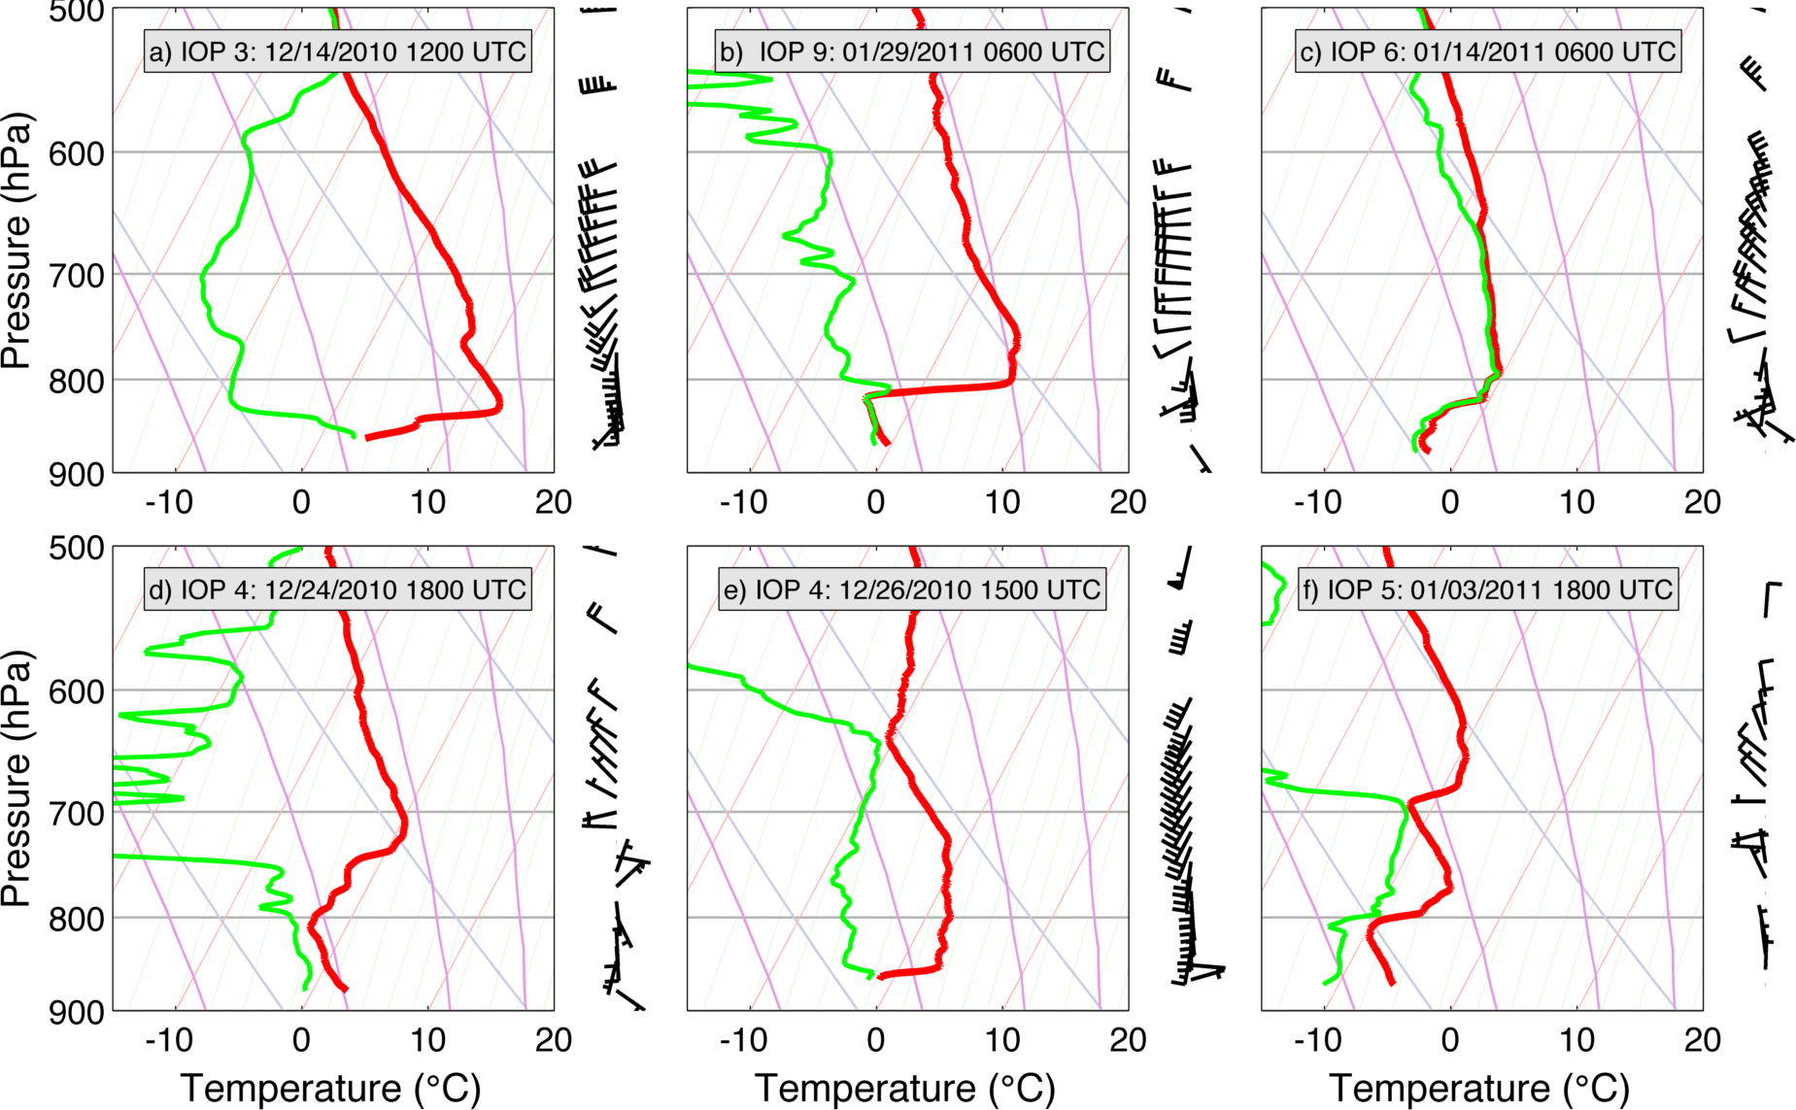

Slide 16
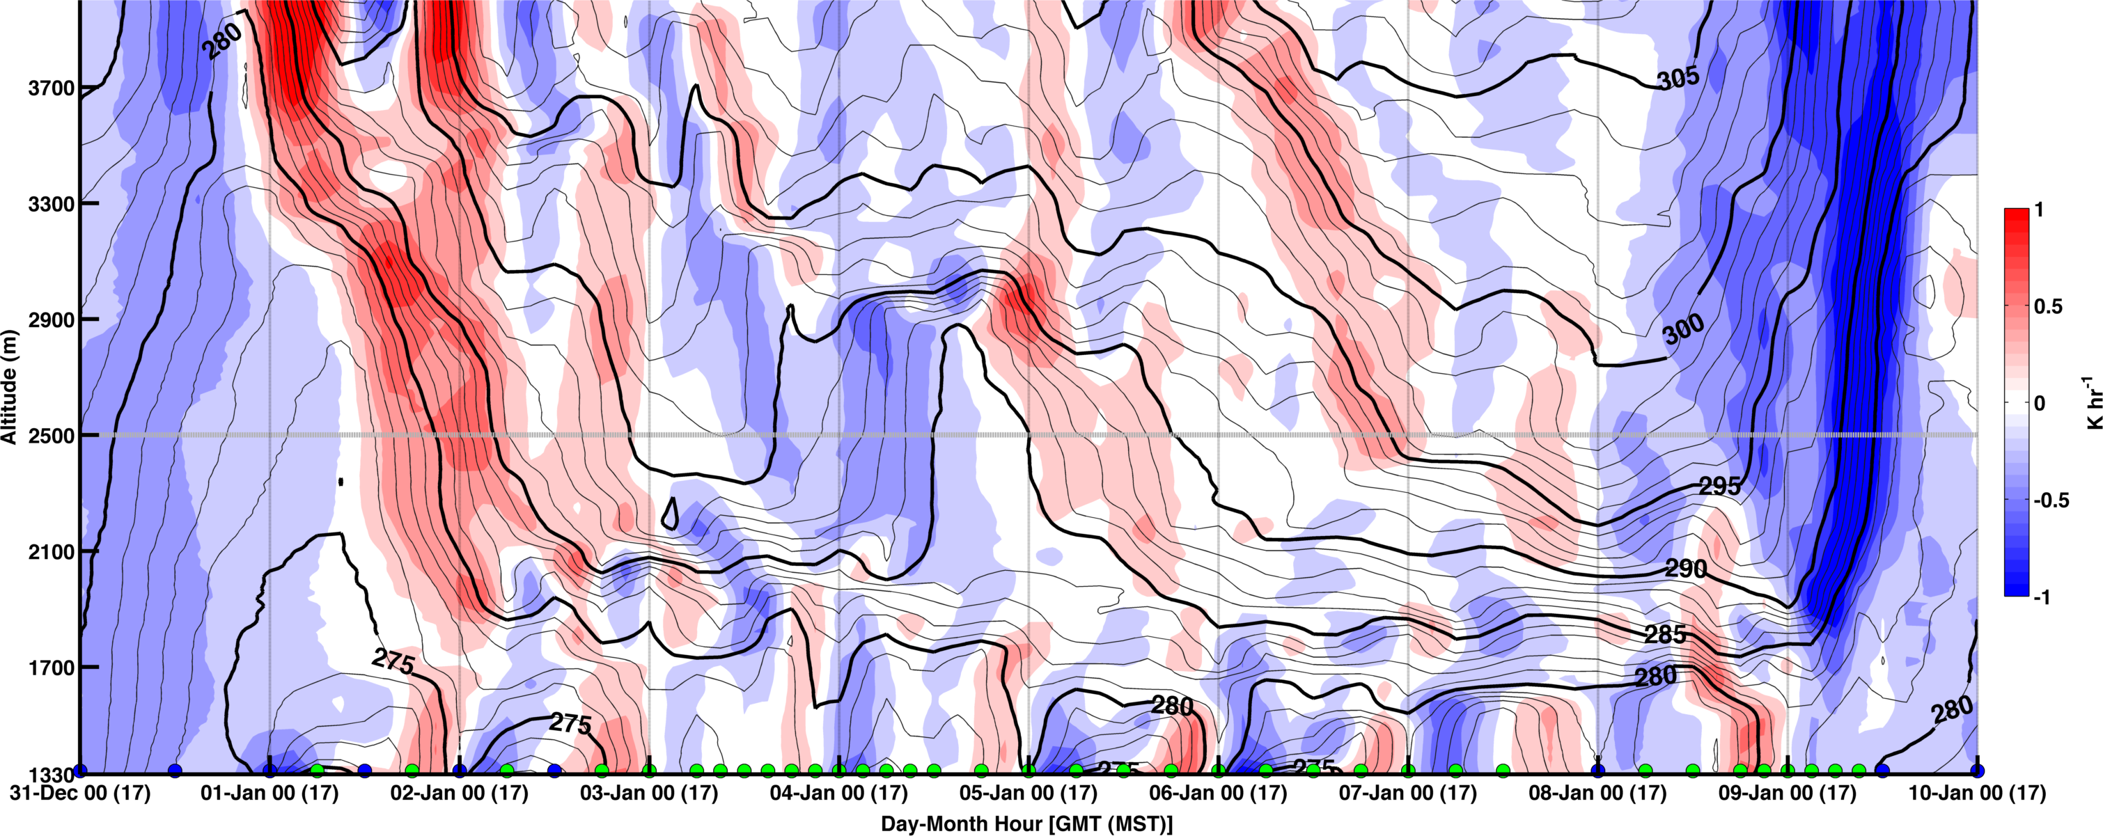
IOP 5: A long lived and complex CAP
Initiated during rapid subsidence warming, destroyed during arctic front
Synoptic-scale modulation: Subsidence, Short waves aloft, WAA/CAA
Diurnal variations: Nocturnal Inversions, CBL
Some unknowns – Semi-diurnal pulsing

Slide 17
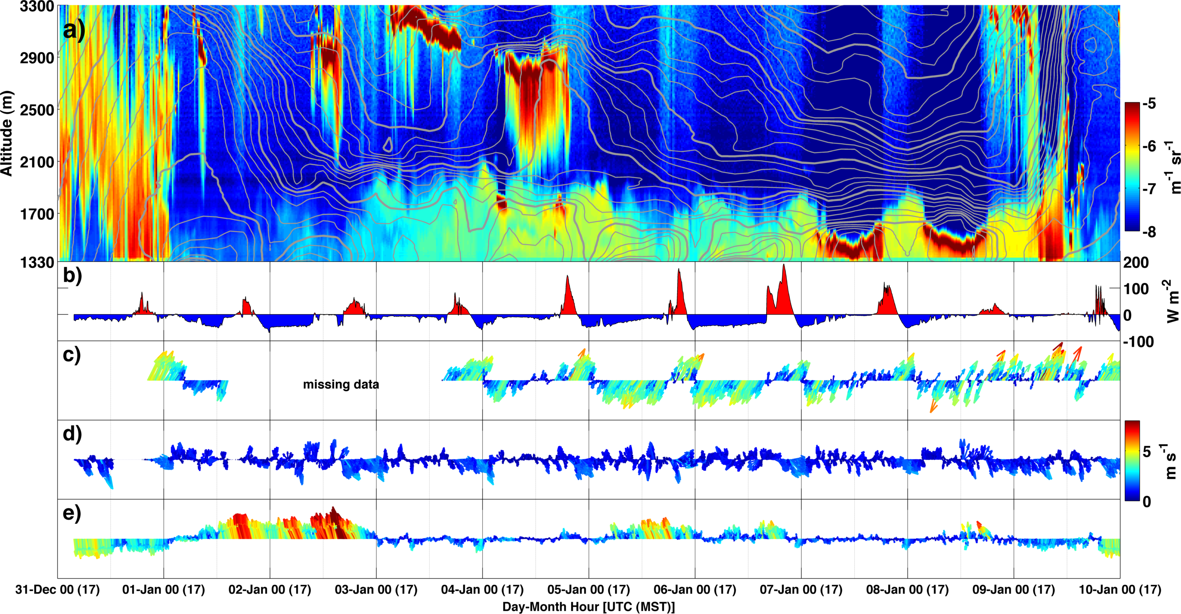
Boundary Layer Evolution
Laser Ceilometer
Parley’s Canyon
Valley Bottom
Jordan Narrows

Slide 18
IOP 5 Summary
Long lived CAP
Strong synoptic modulation
Pronounced diurnal variations
Clouds and Fog
Fairly typical of CAP evolution for SLC

Slide 19
PCAPS: IMPACT OF THE GREAT SALT LAKE

Slide 20
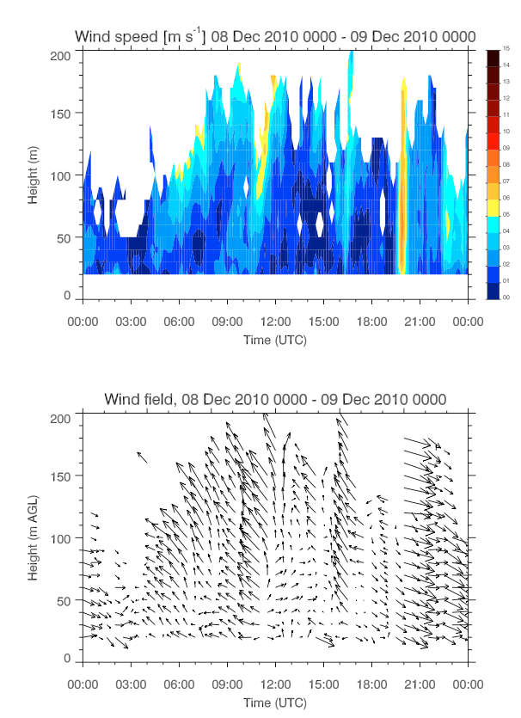
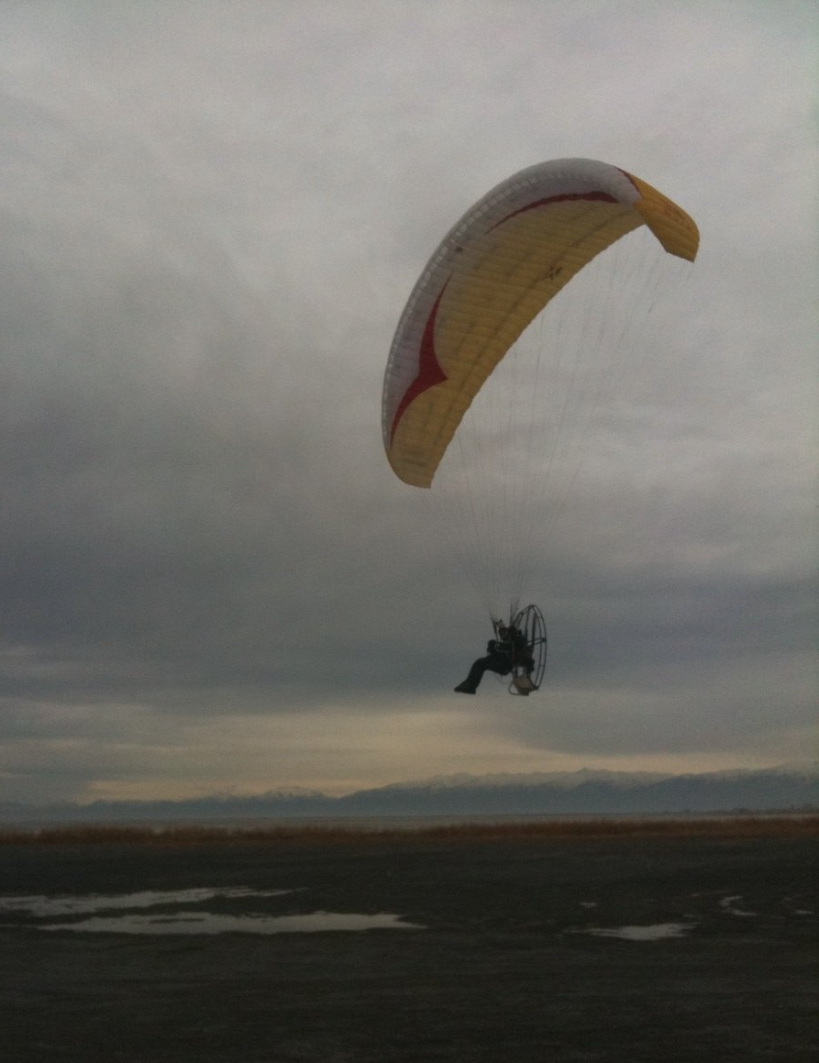

Slide 21
PCAPS: Air pollution

Slide 22
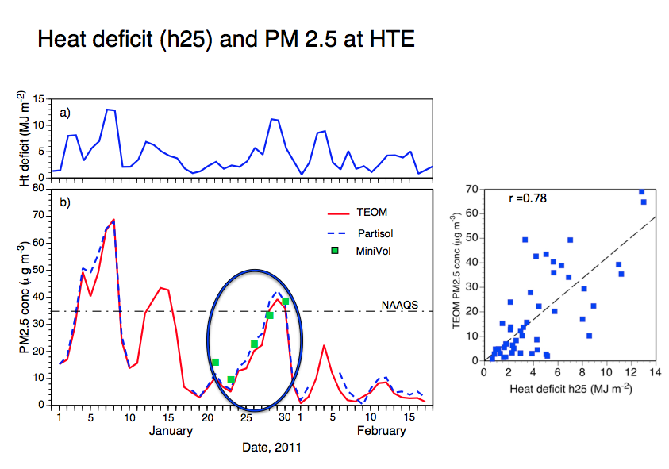
Silcox et al. 2011

Slide 23
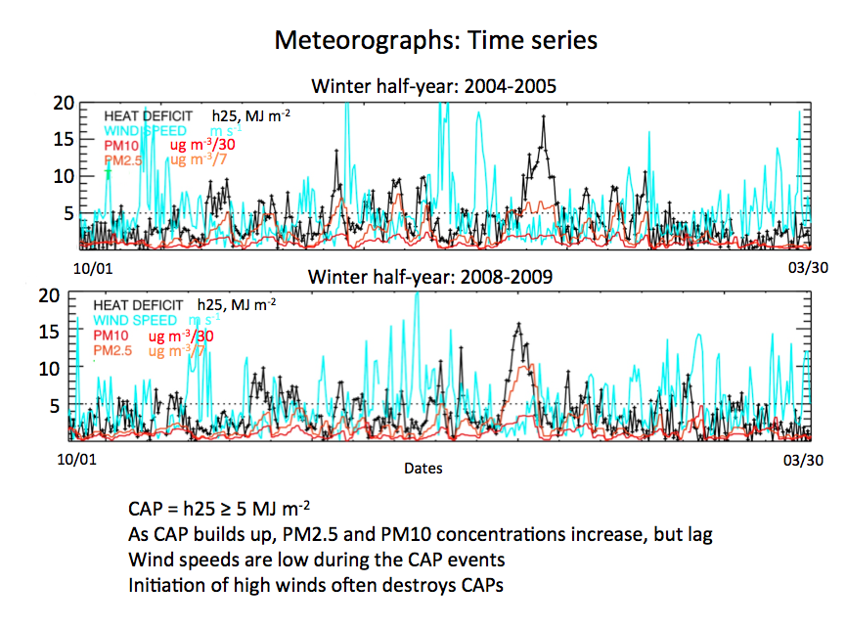
Whiteman et al. 2012

Slide 24
PCAPS: “Mix-out” during strong southerly winds

Slide 25
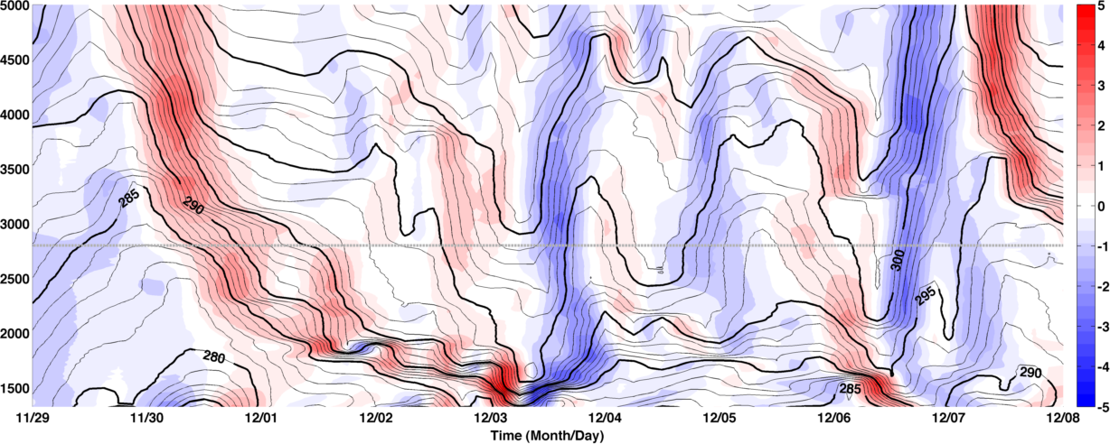
IOP 1: Thermodynamic Overview

Slide 26
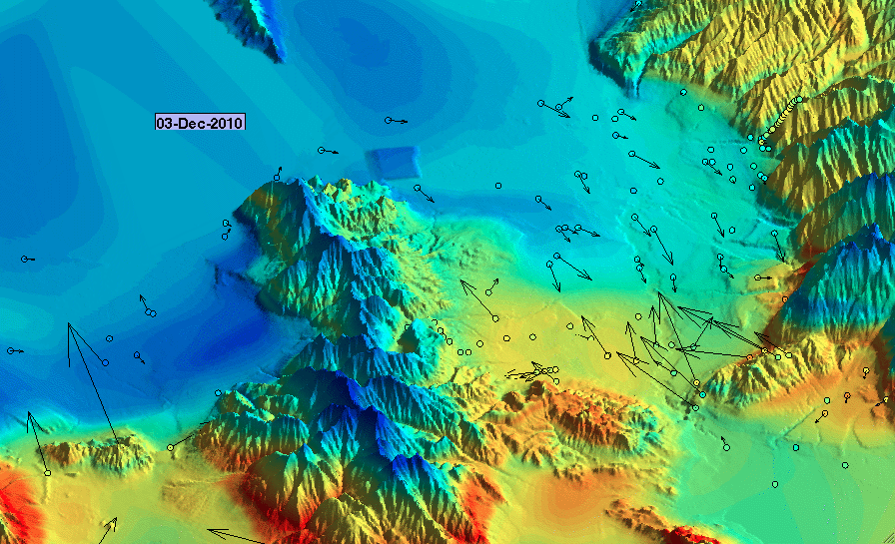


Slide 27
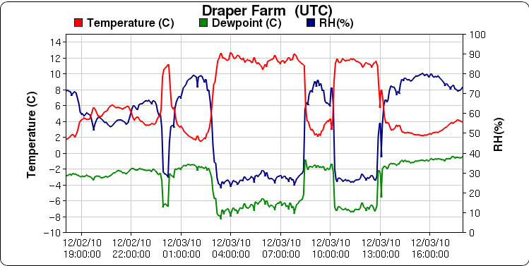
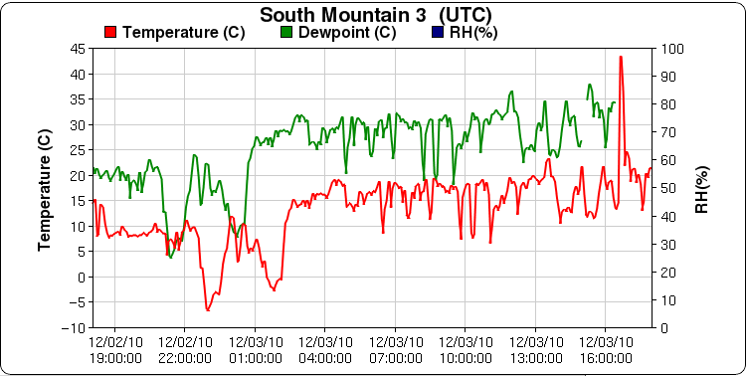
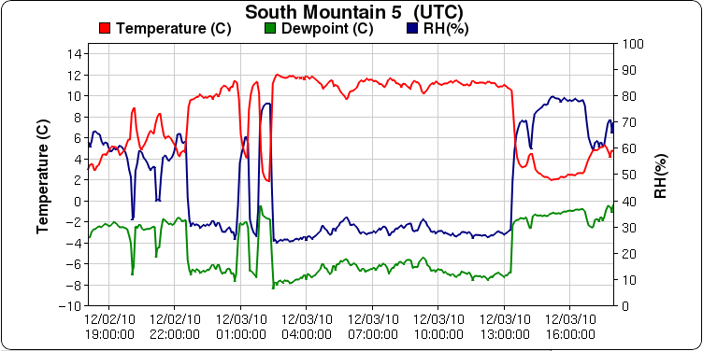
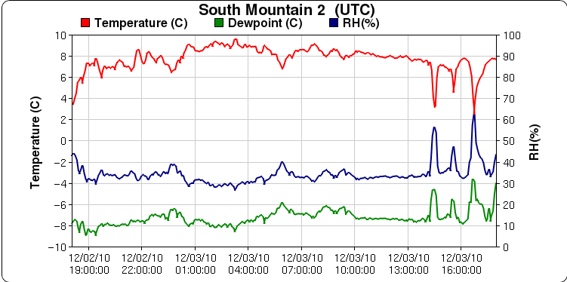
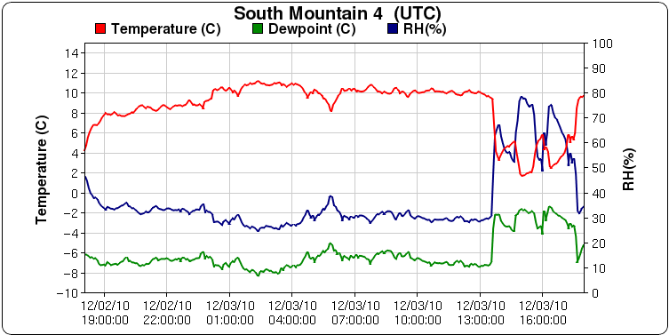
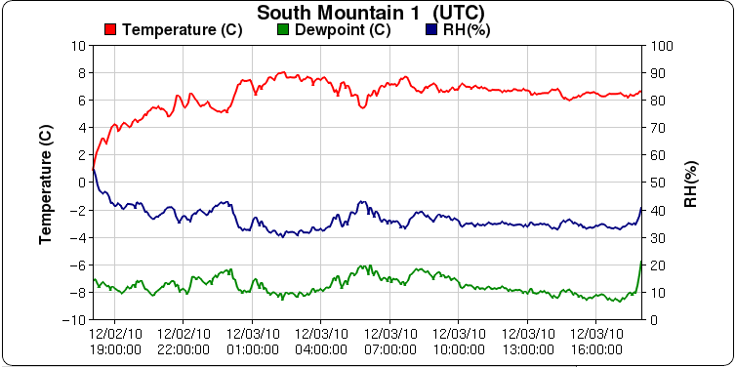

Slide 28
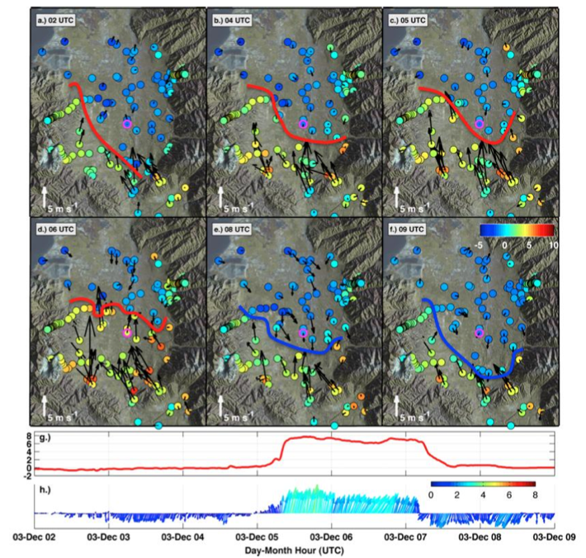

Slide 29
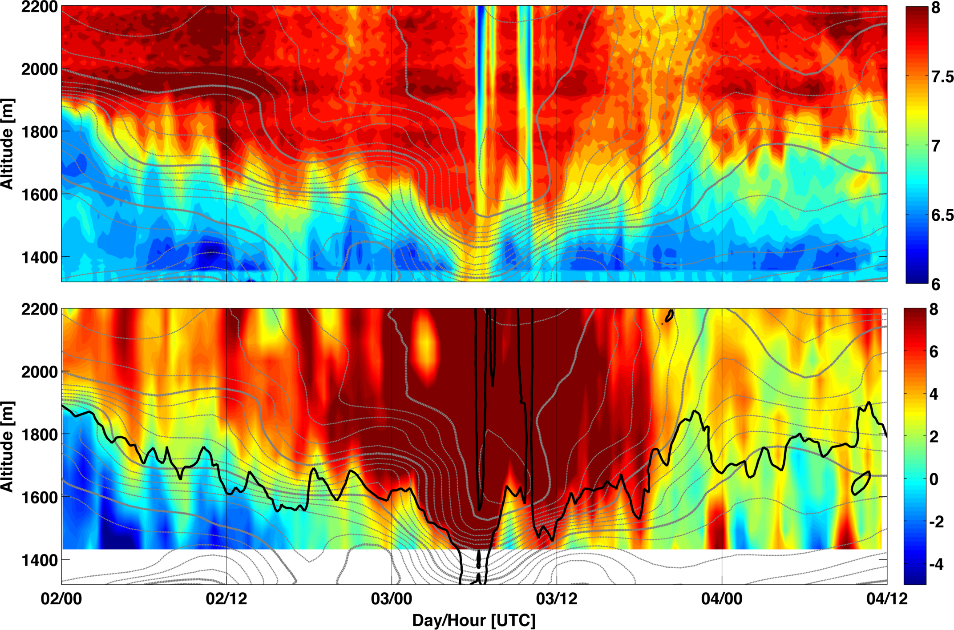
Laser Ceilometer
RASS- T_{v}

Slide 30
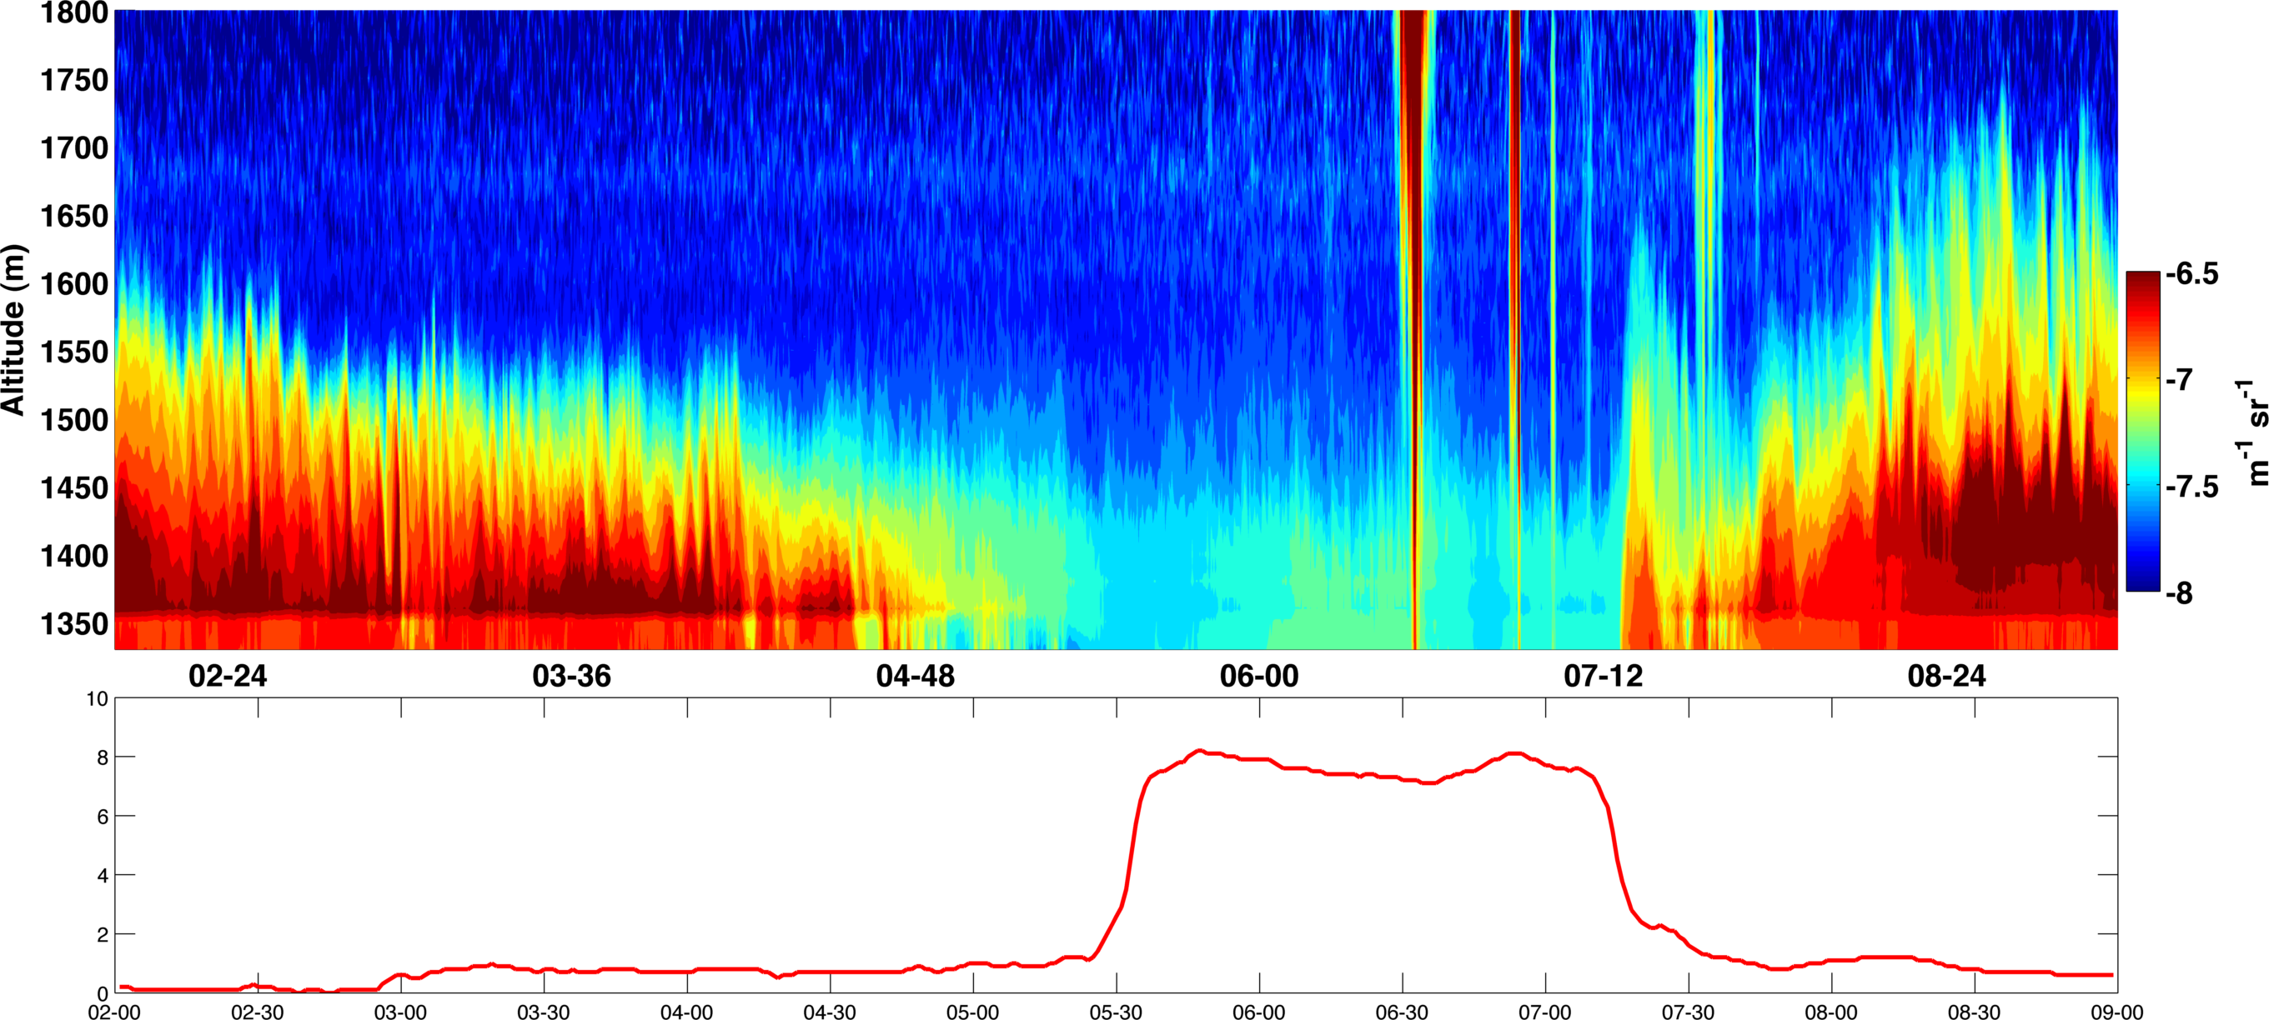

Slide 31
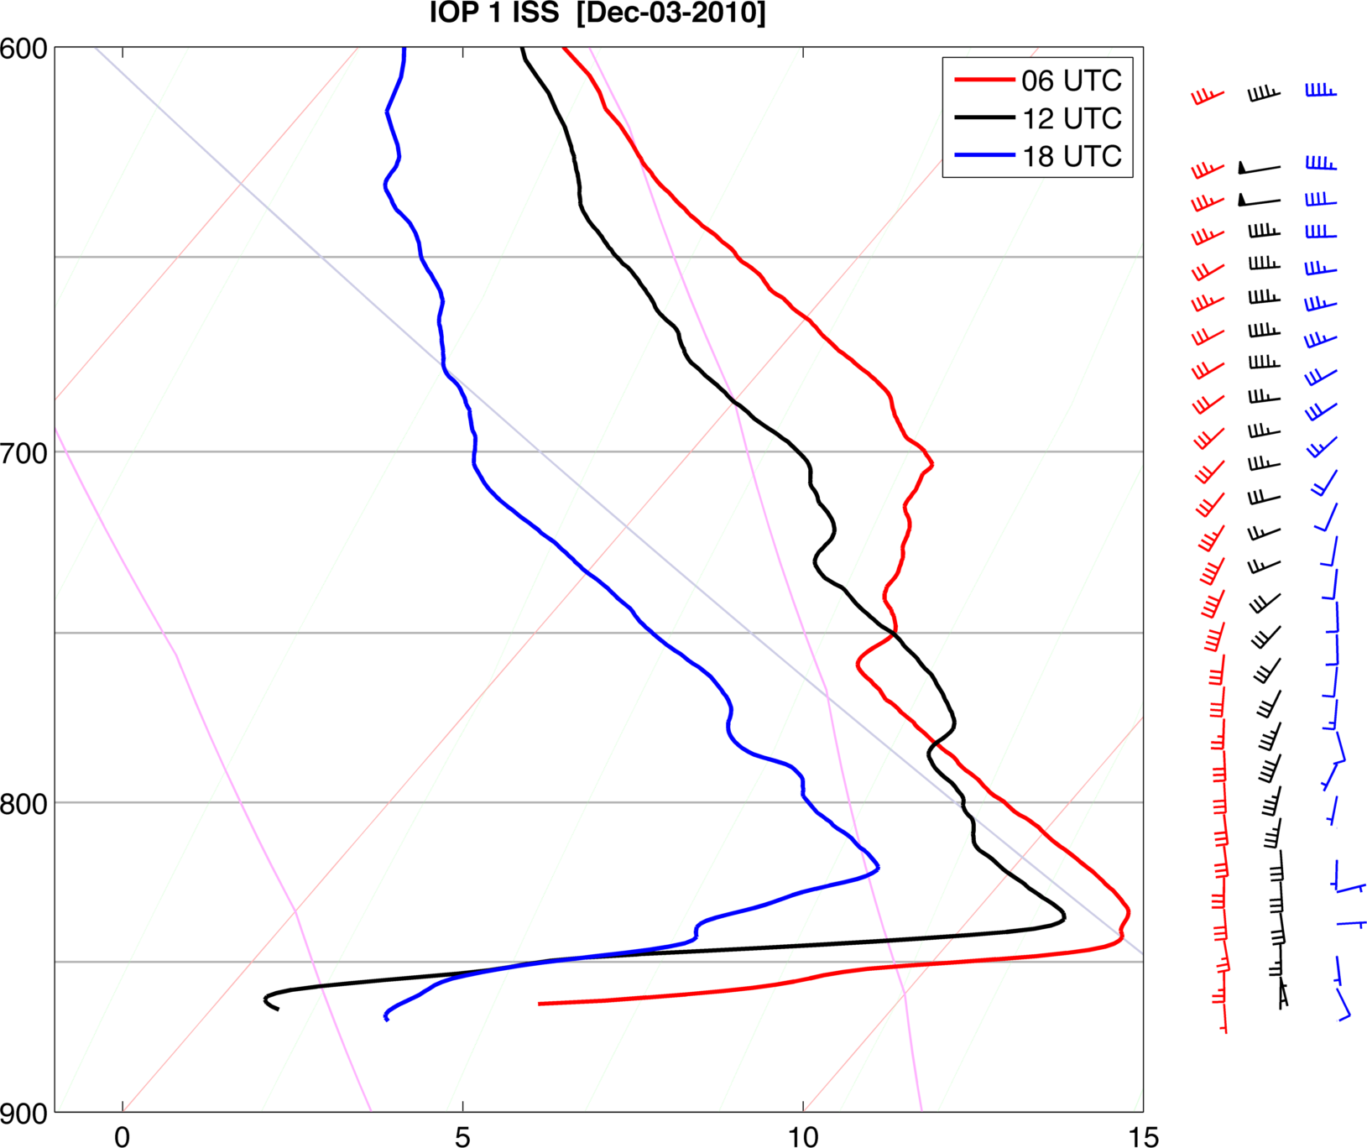

Slide 32
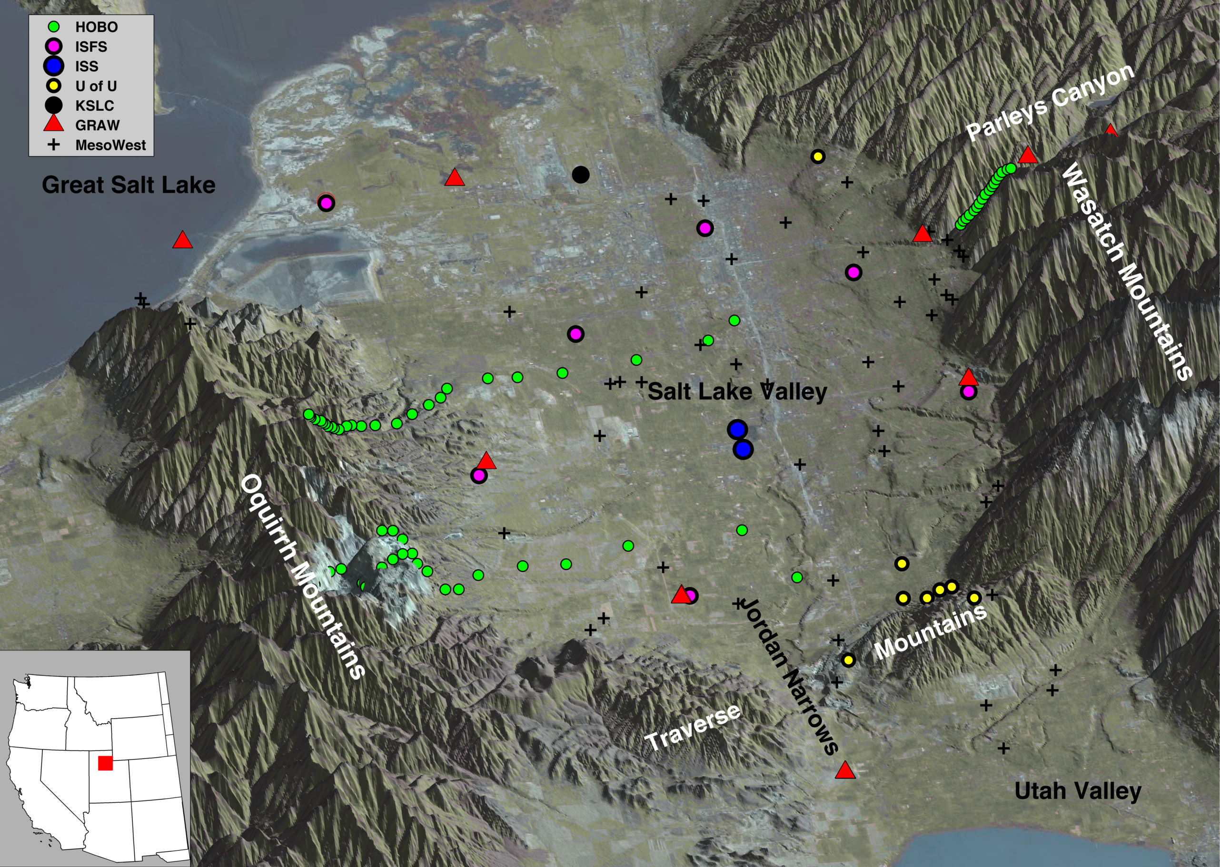

Slide 33
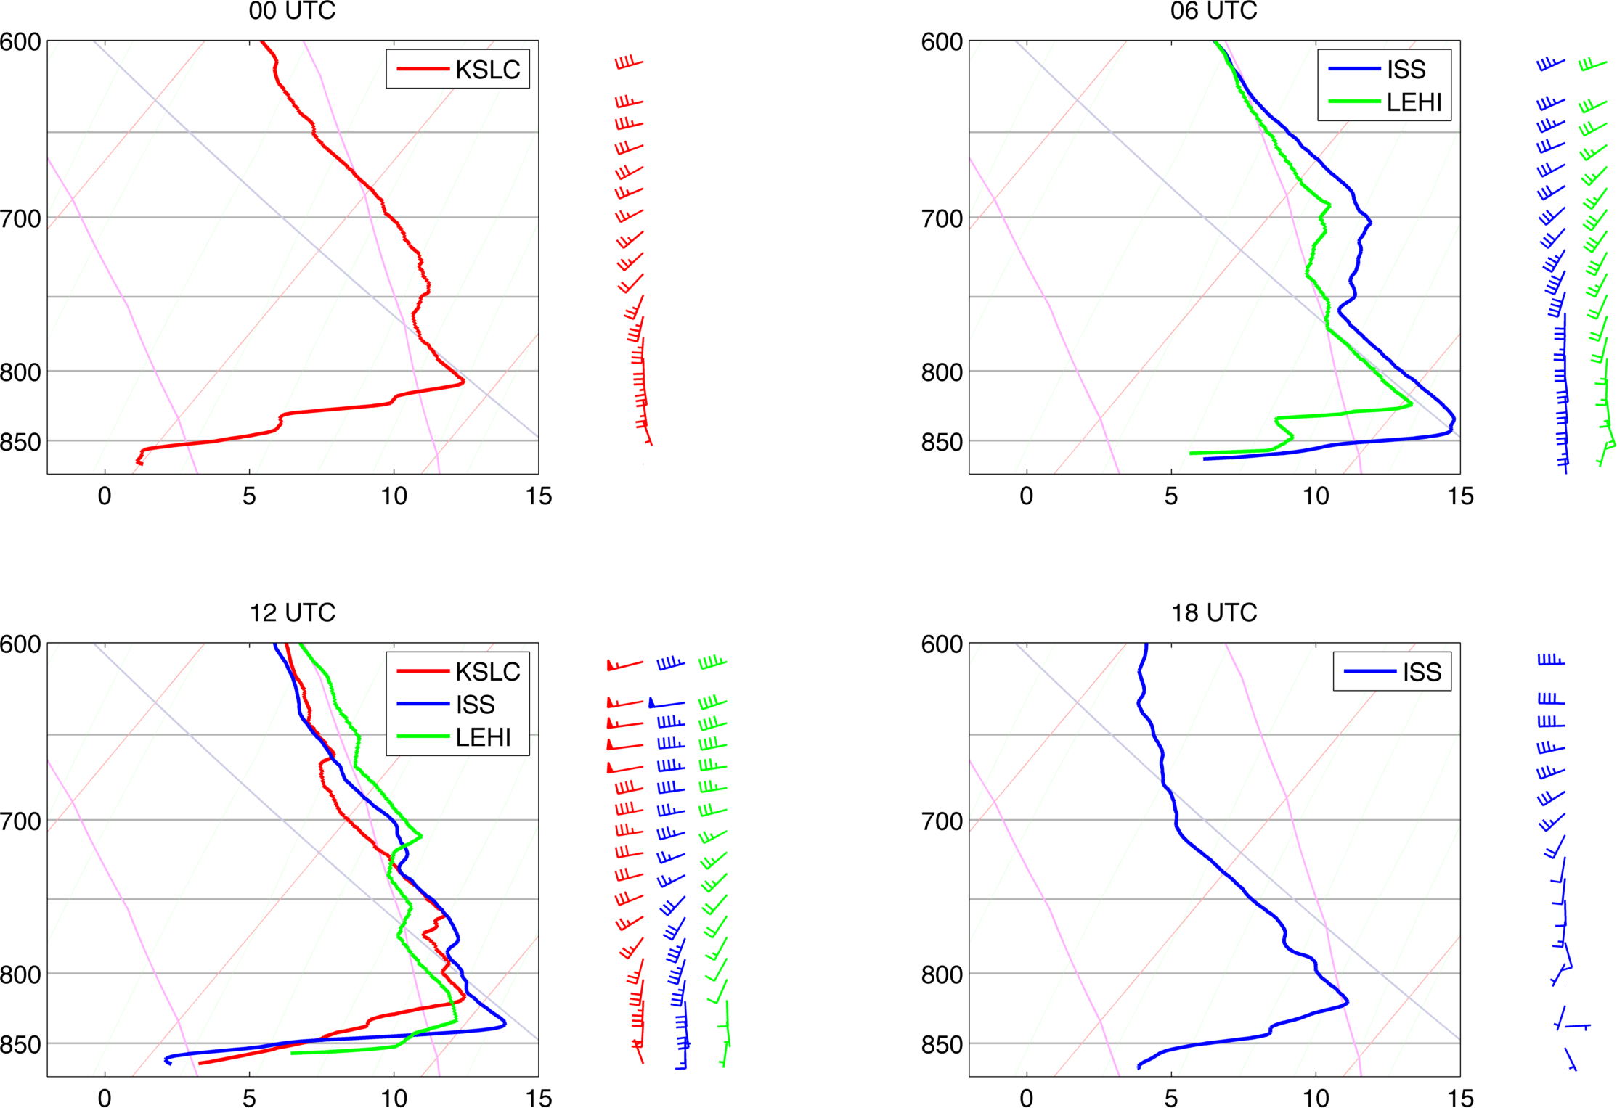
Sloping CAP Surface? Turbulent erosion?

Slide 34
IOP 1 Summary
Strong opposing flow across a sharp temperature contrast.
  Boundary moves north as a warm front, sloshes, and moves south as a cold front
No diabatic heating to remove CAP
Strong winds and warmer temperature lower towards surface over time
CAP flushed to the north, clearer dryer air takes its place temporarily.
Oscillations in aerosol depth correspond with oscillations in temperature… what are these?

Slide 35
HYPOTHESIS: Hydraulic flow/mountain wave over the traverse range displaces/erodes the CAP locally. The exposed edge of the cold air pool then advances as a warm front through the valley. The air within the cold air pool tries to advance against the flow as a density current.

Slide 36
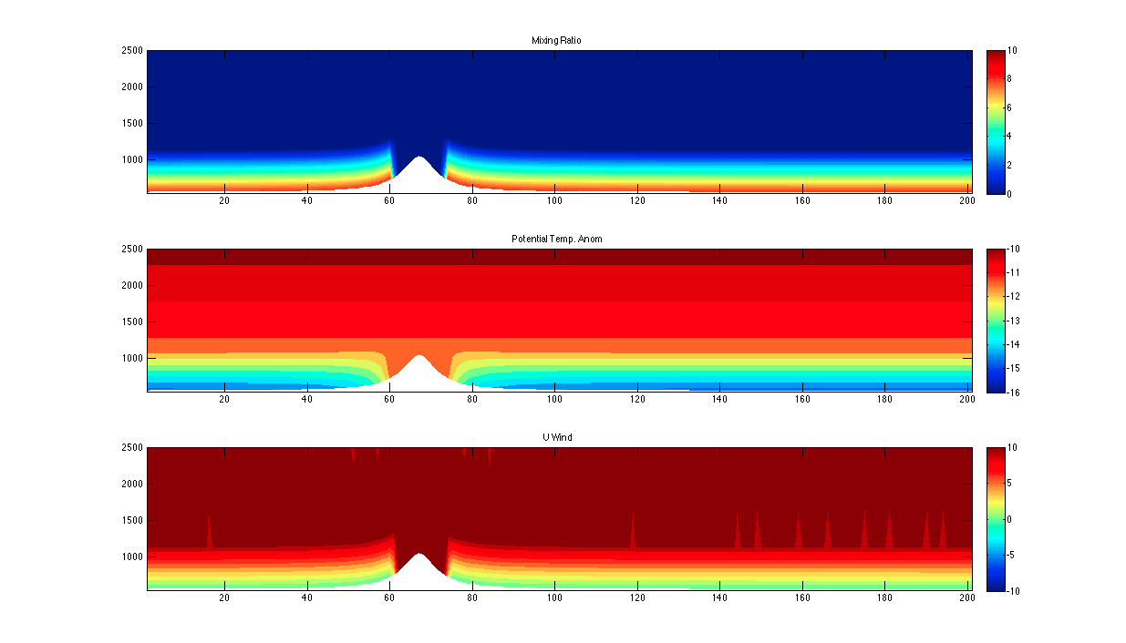

VERY IDEALIZED WRF SIMULATION

Slide 37
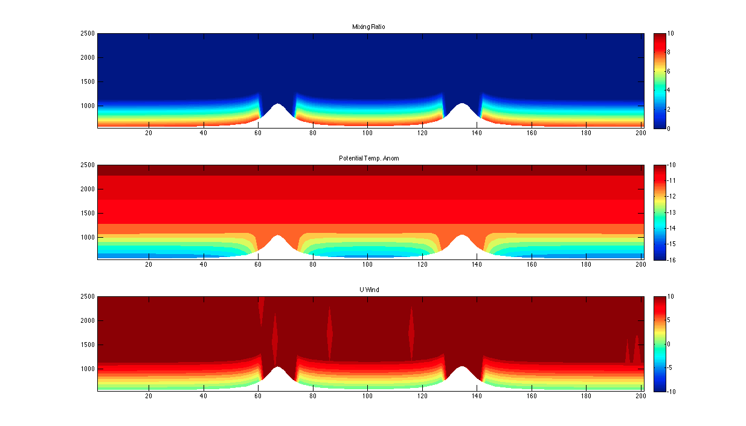

VERY IDEALIZED WRF SIMULATION
2 Hills

Slide 38
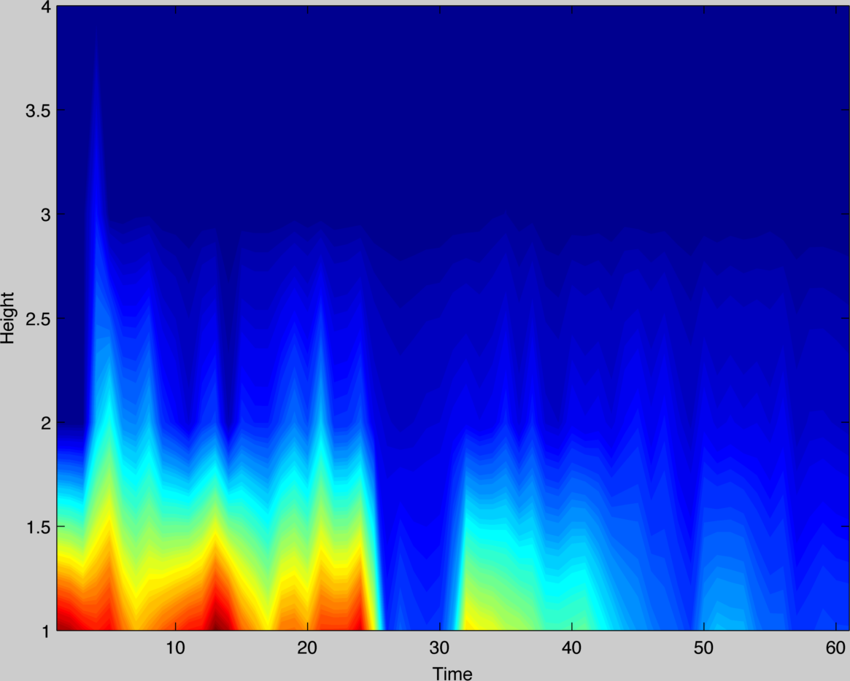
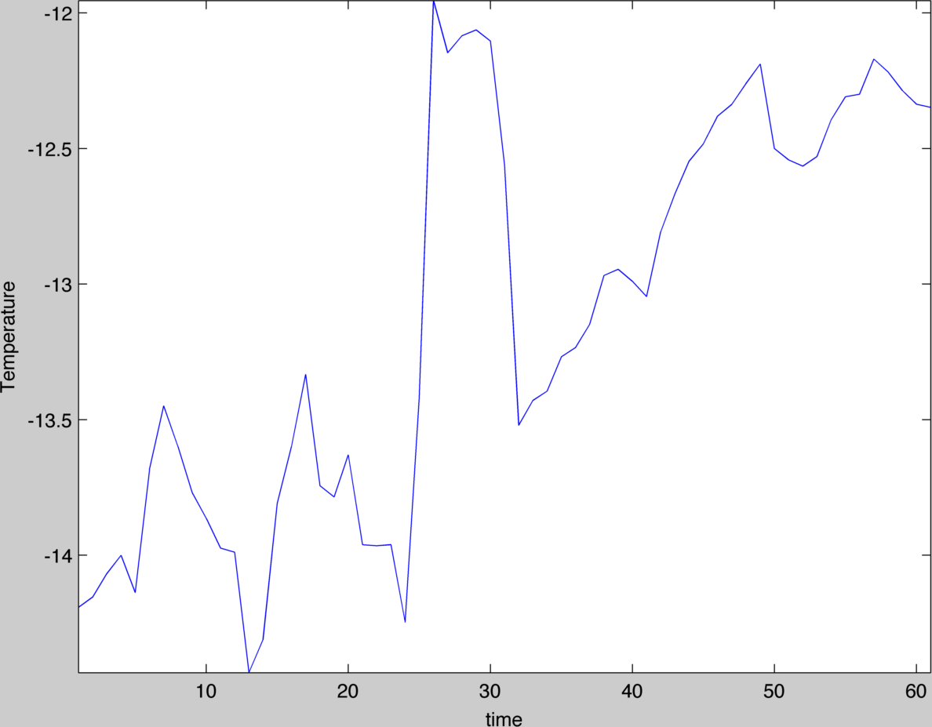

Slide 39
MIX-OUT SUMMARY
Strong south winds due to approaching short wave trough
Winds penetrate to valley floor along the traverse range first
Strong winds and warmer temperatures advance north through valley center
Sloshing
With passage of CFA region P-gradient reverses, valley fills with cold air again

Slide 40
WHAT IS NEXT?
Careful analysis of the observation, Large Eddy Simulations => What factors/parameters control whether or not the CAP will erode?
  Can we come up with some physical basis for determining whether a wind driven mix-out will or will not occur?

Slide 41
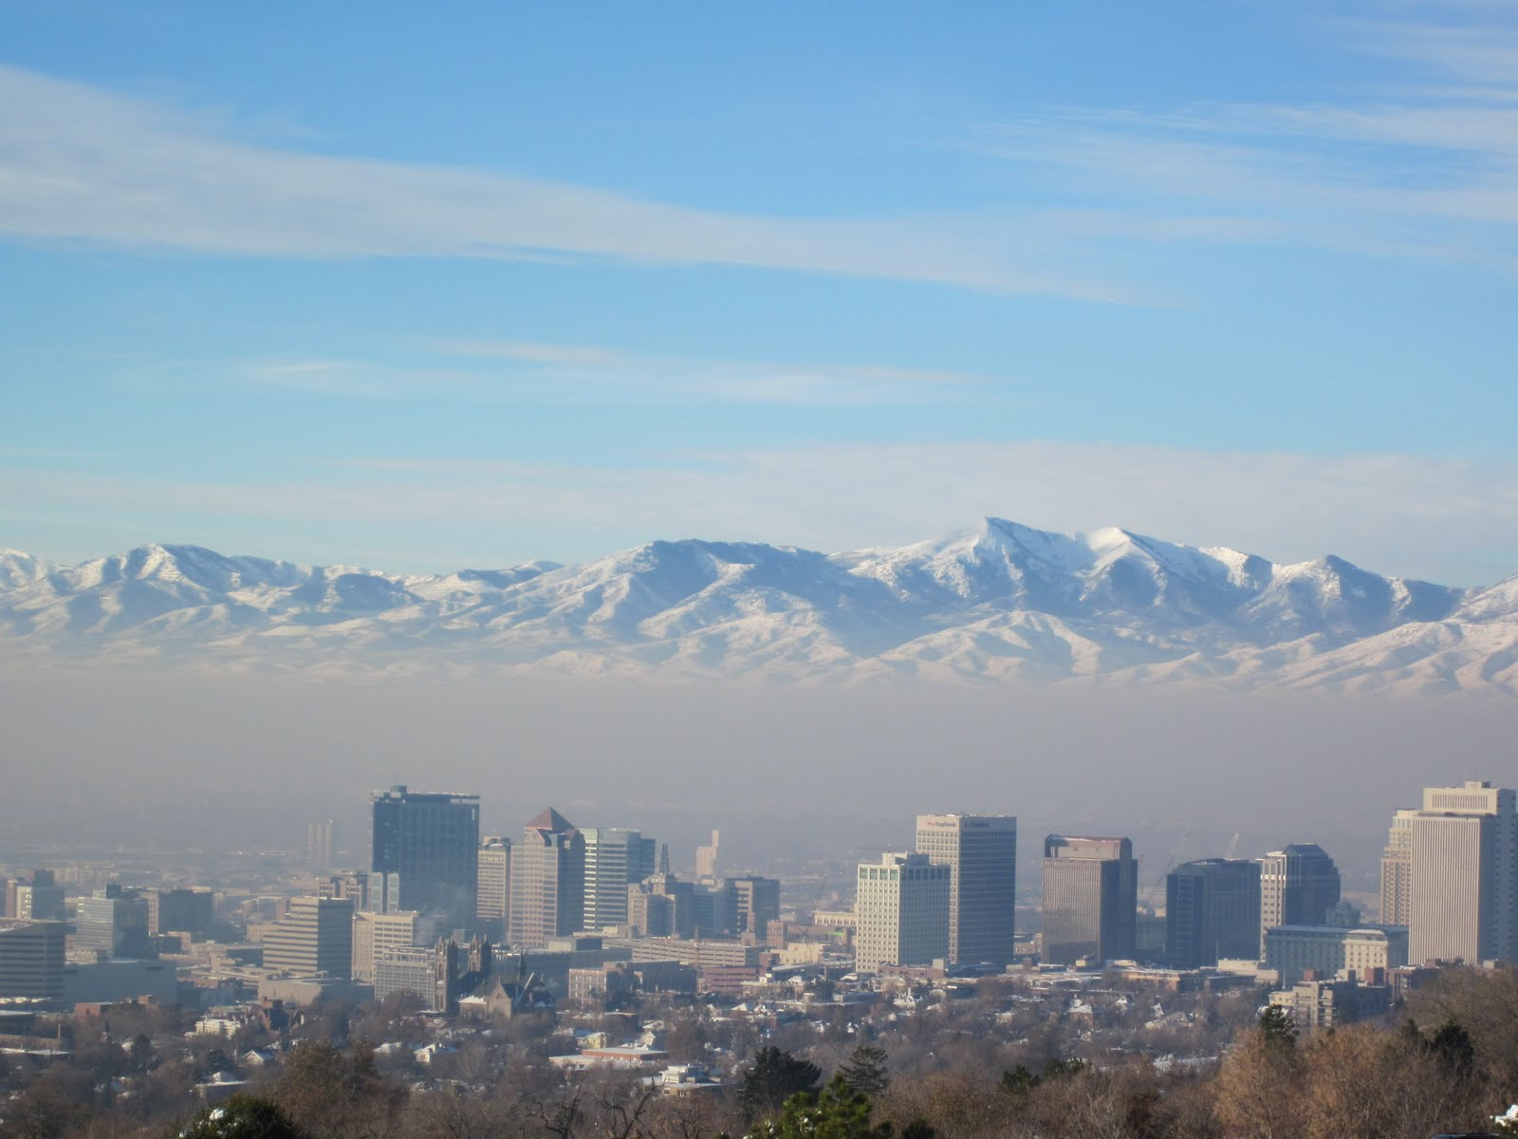
Acknowledgements: John D. Horel, C. David Whiteman, Erik E. Crosman, Joe Young, William Brown, Tom Horst, many more….
QUESTIONS?

Slide 42
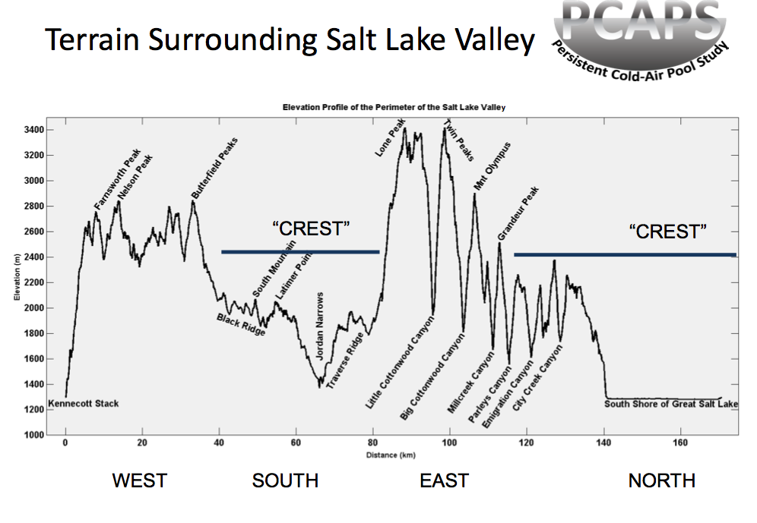

Slide 43
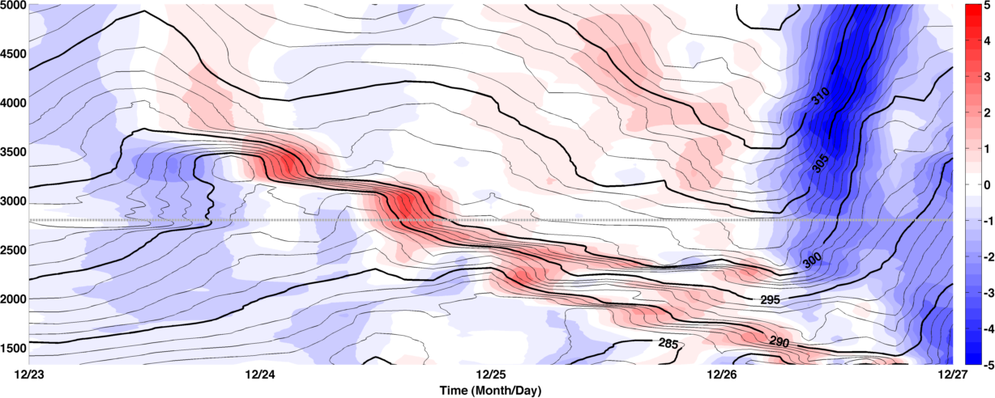
IOP 4: 24-26 December

Slide 44
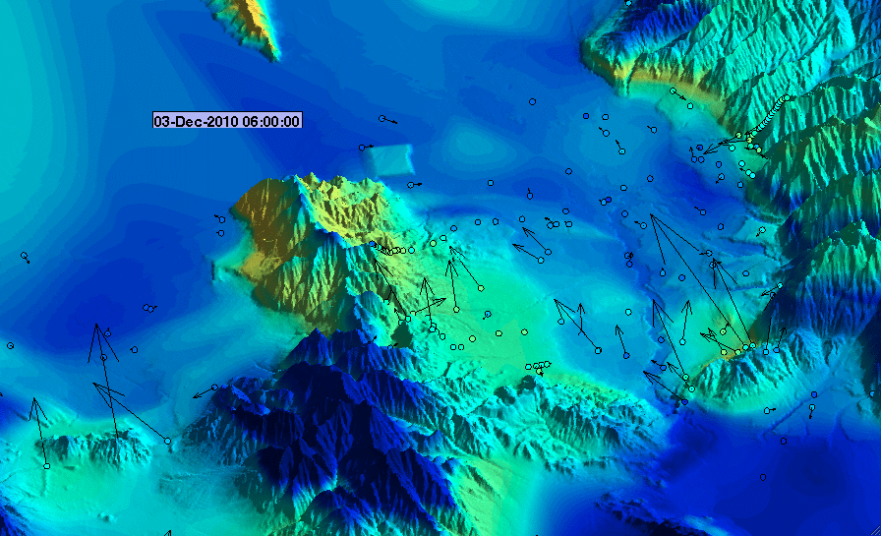

IOP 4 Mix-out

Slide 45
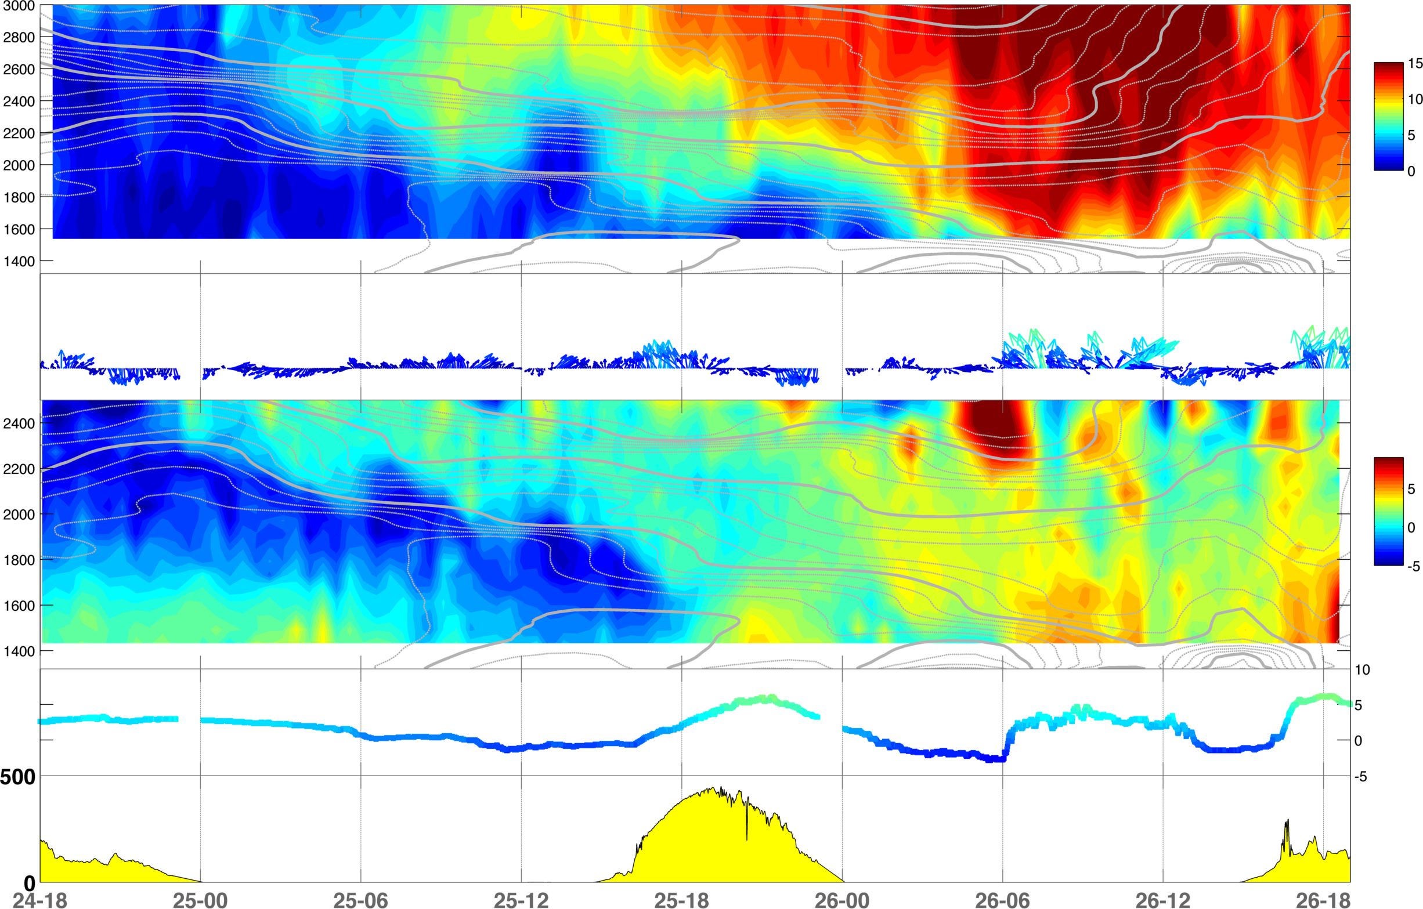
RWP – Wind Mag.
Surface wind vectors
RASS
Temp
Solar

Slide 46
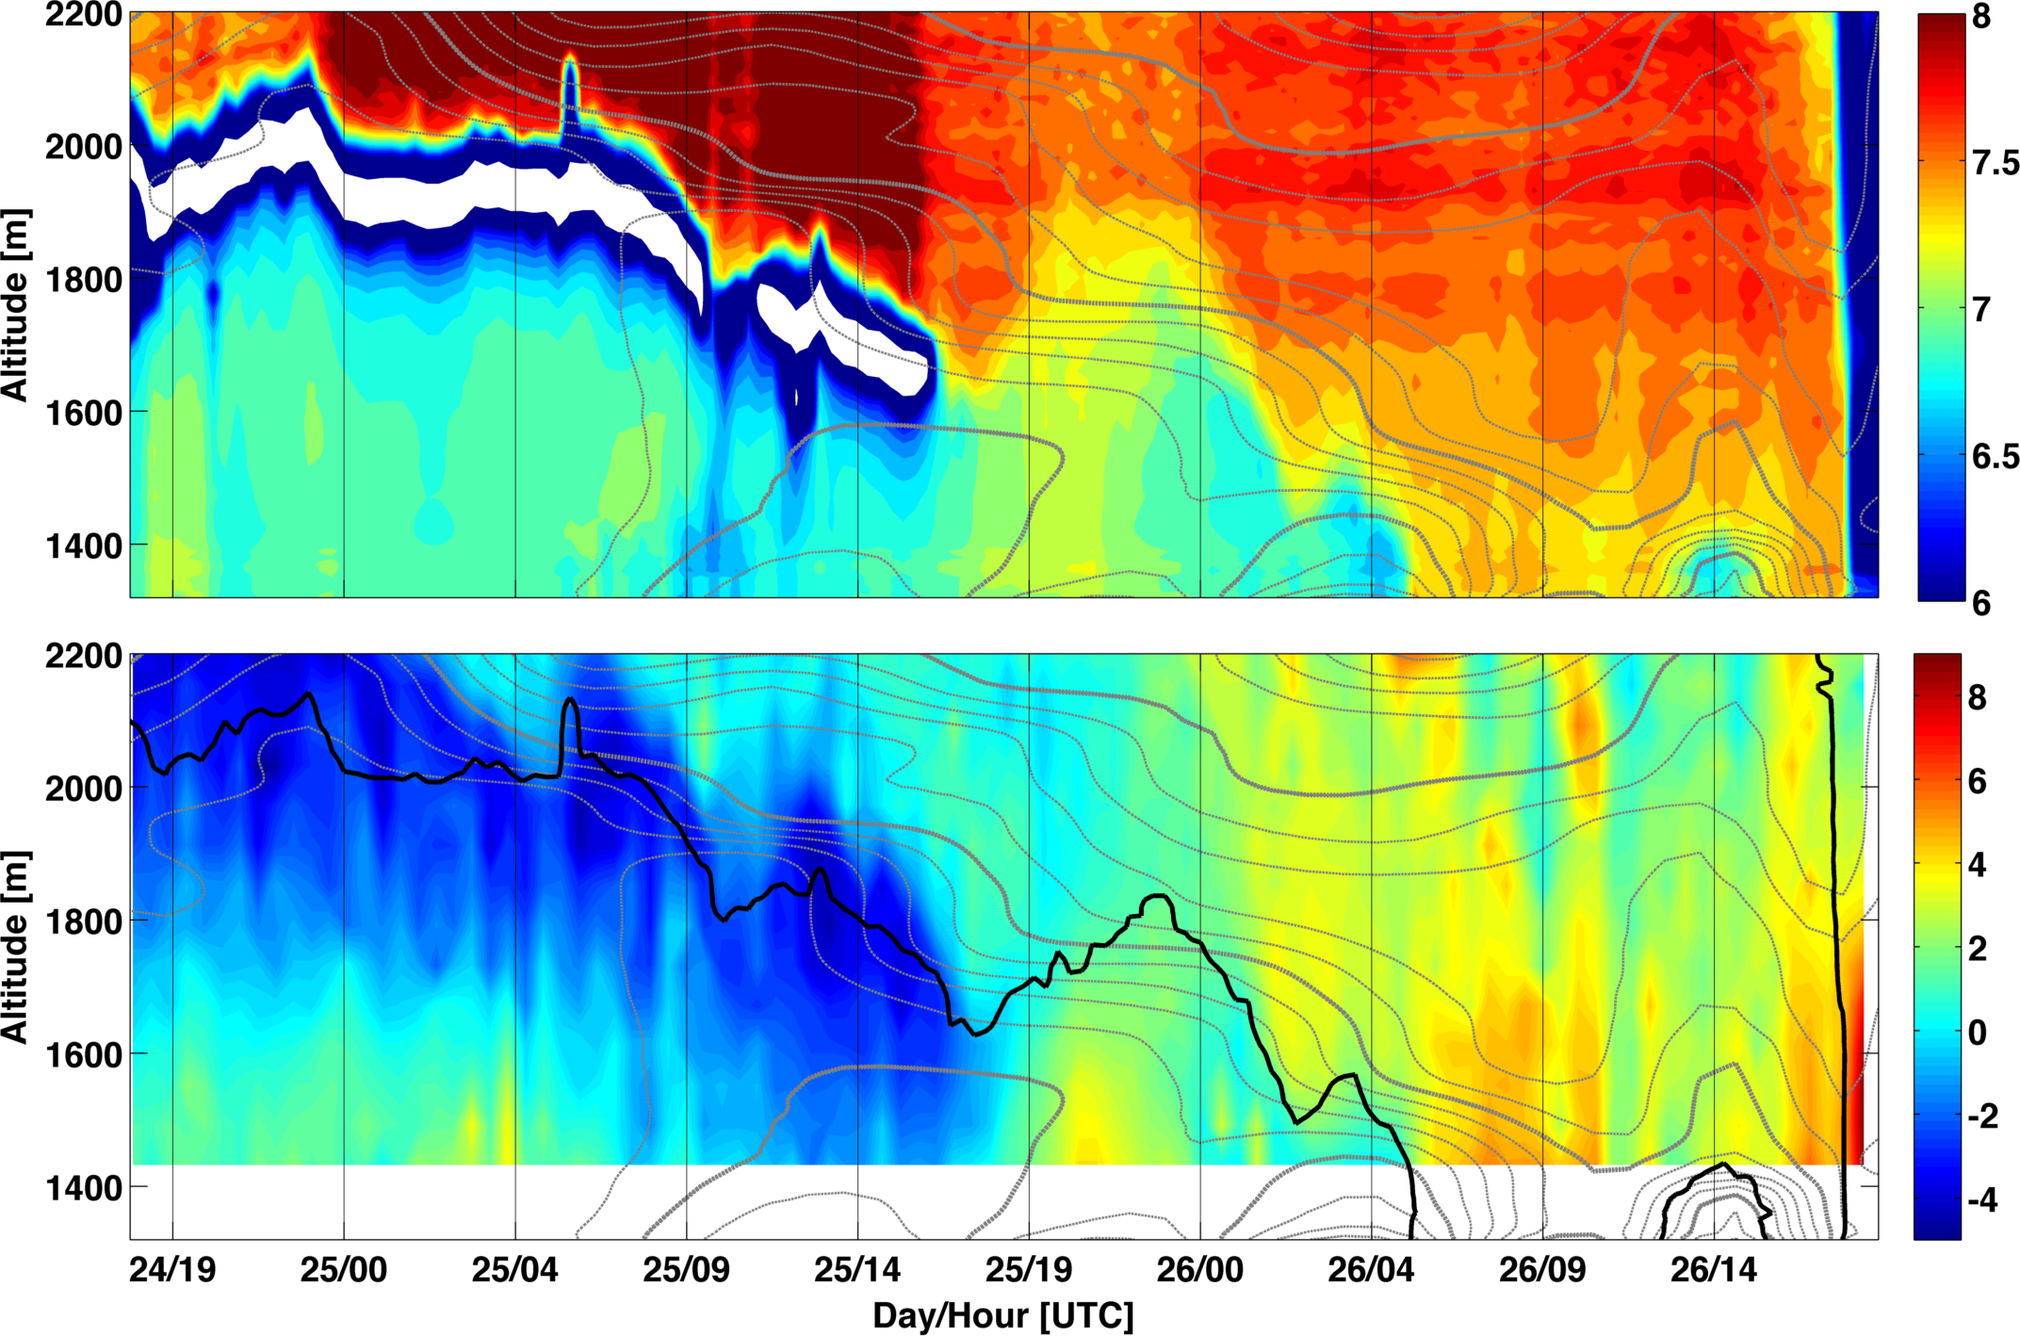
Ceilometer
RASS

Slide 47
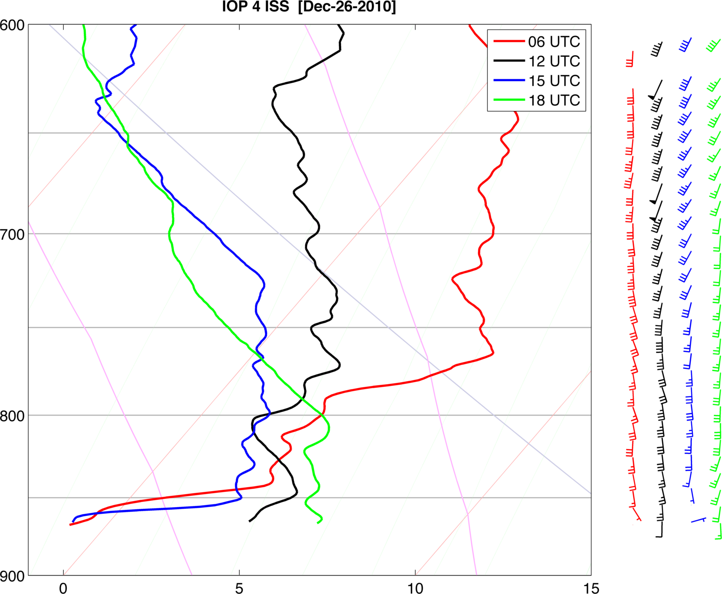

Slide 48
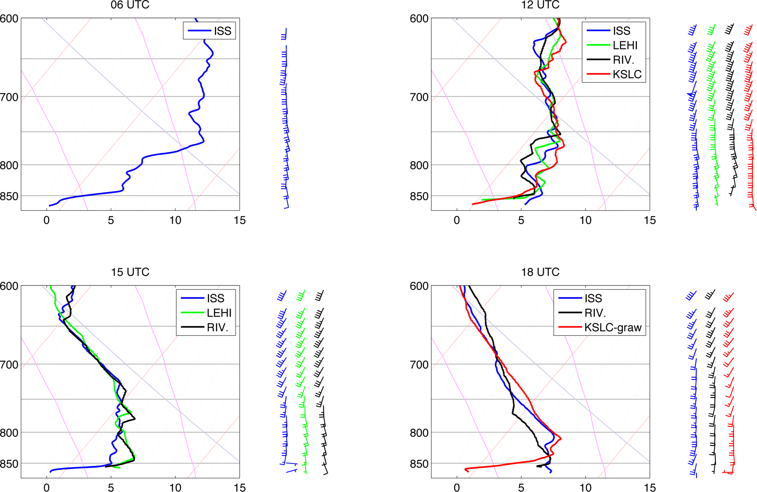

Slide 49
IOP2 Summary
Initial mix-out at ISS occurs at night during period of strong winds
CAP returns as a very shallow layer of cold-air
CAP is then removed from ISS again by both strong winds and diabatic heating
Do the profiles show the results of turbulent mixing?

