Slide 1
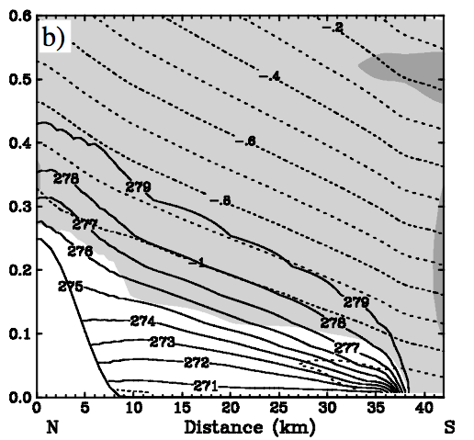
Structure of CAPs
Delta x
P+(dp/dx)(delta x)
T, (dt/dz)warm
P, T, (dt/dz)cold
Delta z
Assumes (dp/dx)= 0 at the surface

Slide 2
CAP STRUCTURE: Discontinuity in the lapse rate
We want to get an expression that gives us the depth of the CAP as a function of distance away from its leading edge
I take this to mean something like:
If we let delta z = h, then
h(x)= h₀ + (dh/dx)(delta x) + (d²h/dx²)(delta x)²
But I’m not really sure how to proceed to get the above expressions? I’m failing at the algebra…

Slide 3
PCAPS DATA SET
Making the most out of our Observations (a.k.a. Neil makes colorful figures too expensive to publish)

Slide 4
BASIC IDEA
Develop a high temporal resolution time height thermodynamic data set during PCAPS
Blend together data from multiple observational platforms
Soundings
RASS
Radar Wind Profilers
Surface meteorological measurements

Slide 5
A FEW KEY POINTS
Surface data helps to constrain interpolation to higher temporal resolution
Basic physical reasoning can be applied to adjust data (e.g. imposing adiabatic layers).
Weighted averages of Remote Sensing data and Sounding data help to create a blended data set
NWS soundings add some value, but complicate the analysis. So just use the data aloft (kind of like a good background)

Slide 6
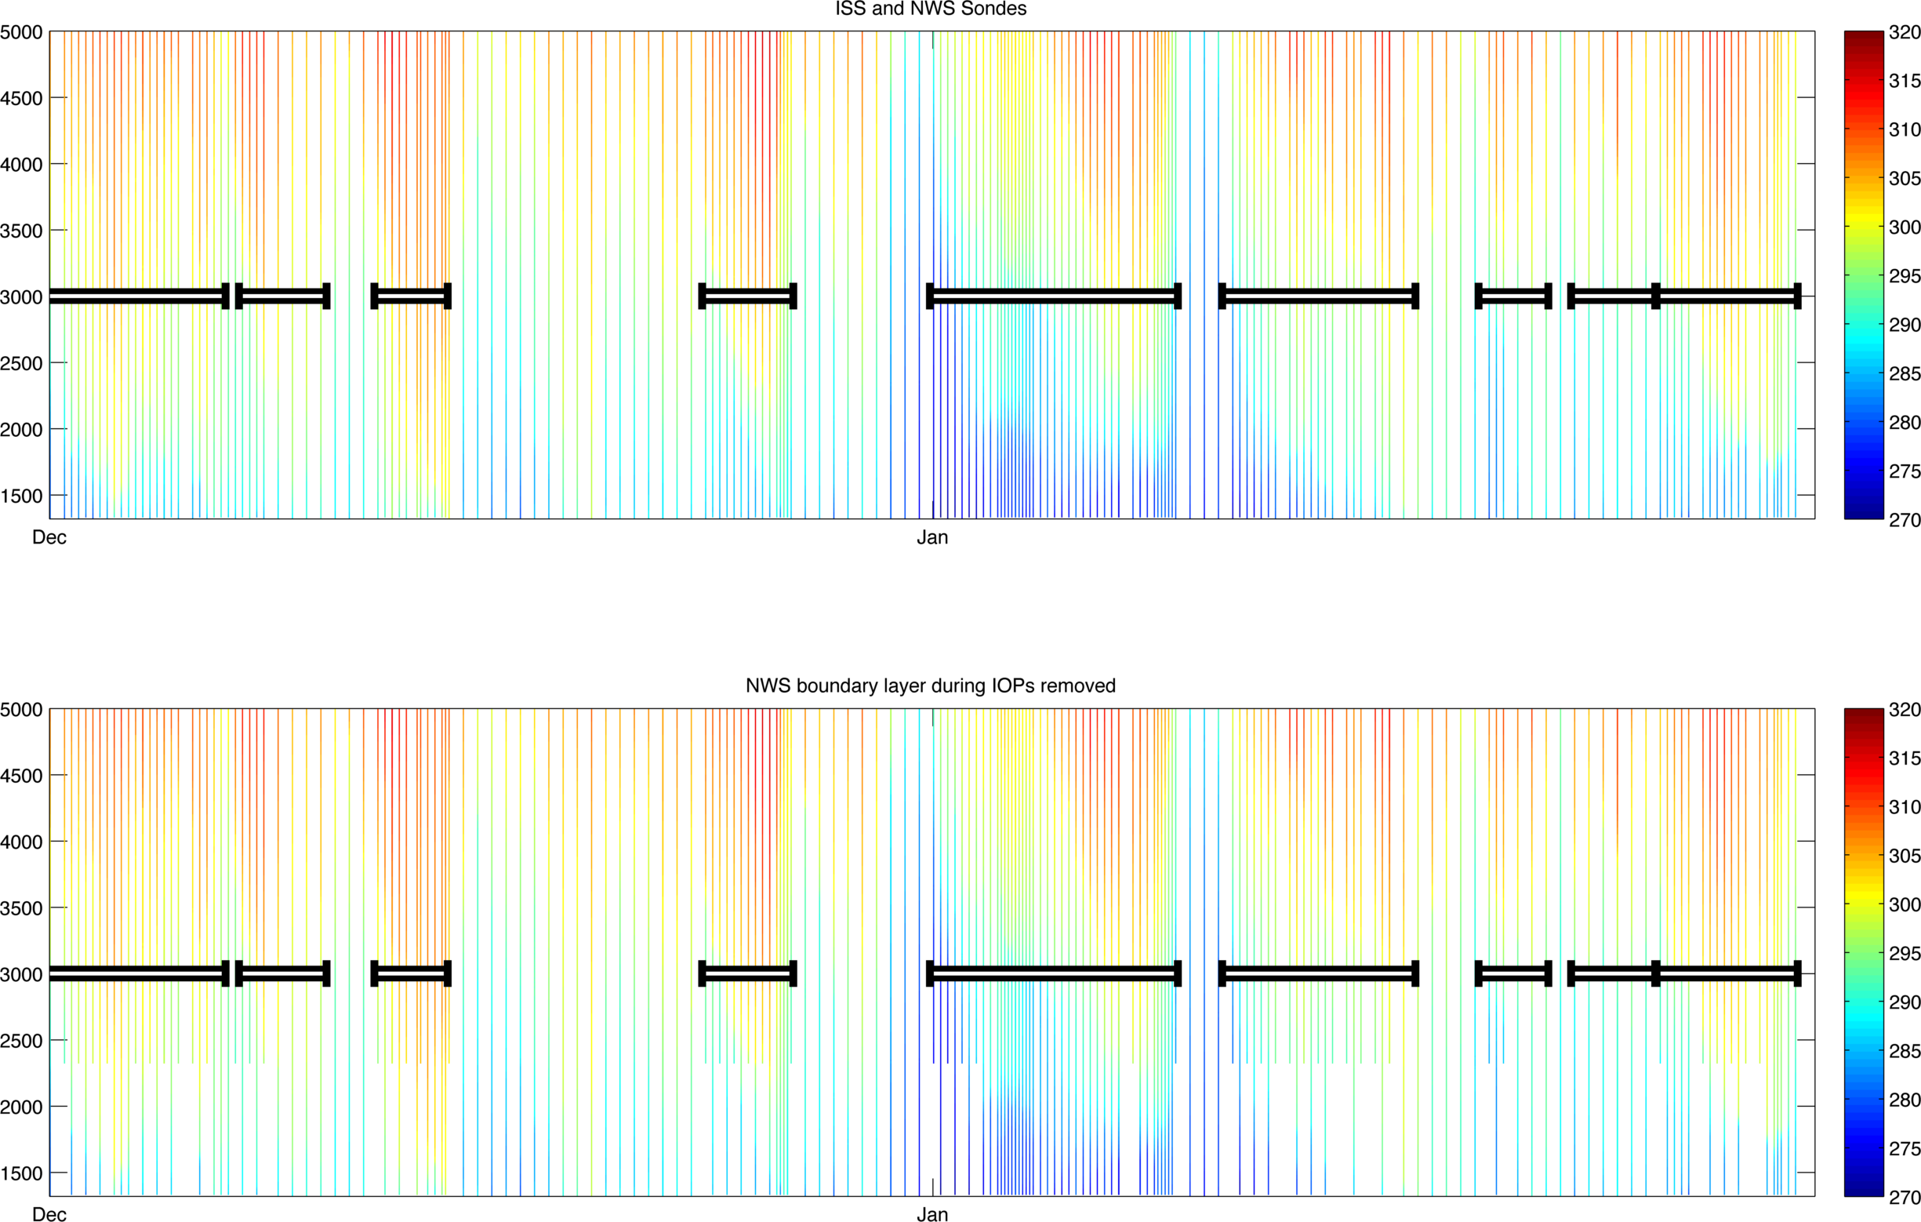
LOAD ALL SOUNDINGS, THEN TRIM THE PBL DATA OUT OF NWS SONDES DURING IOPS

Slide 7
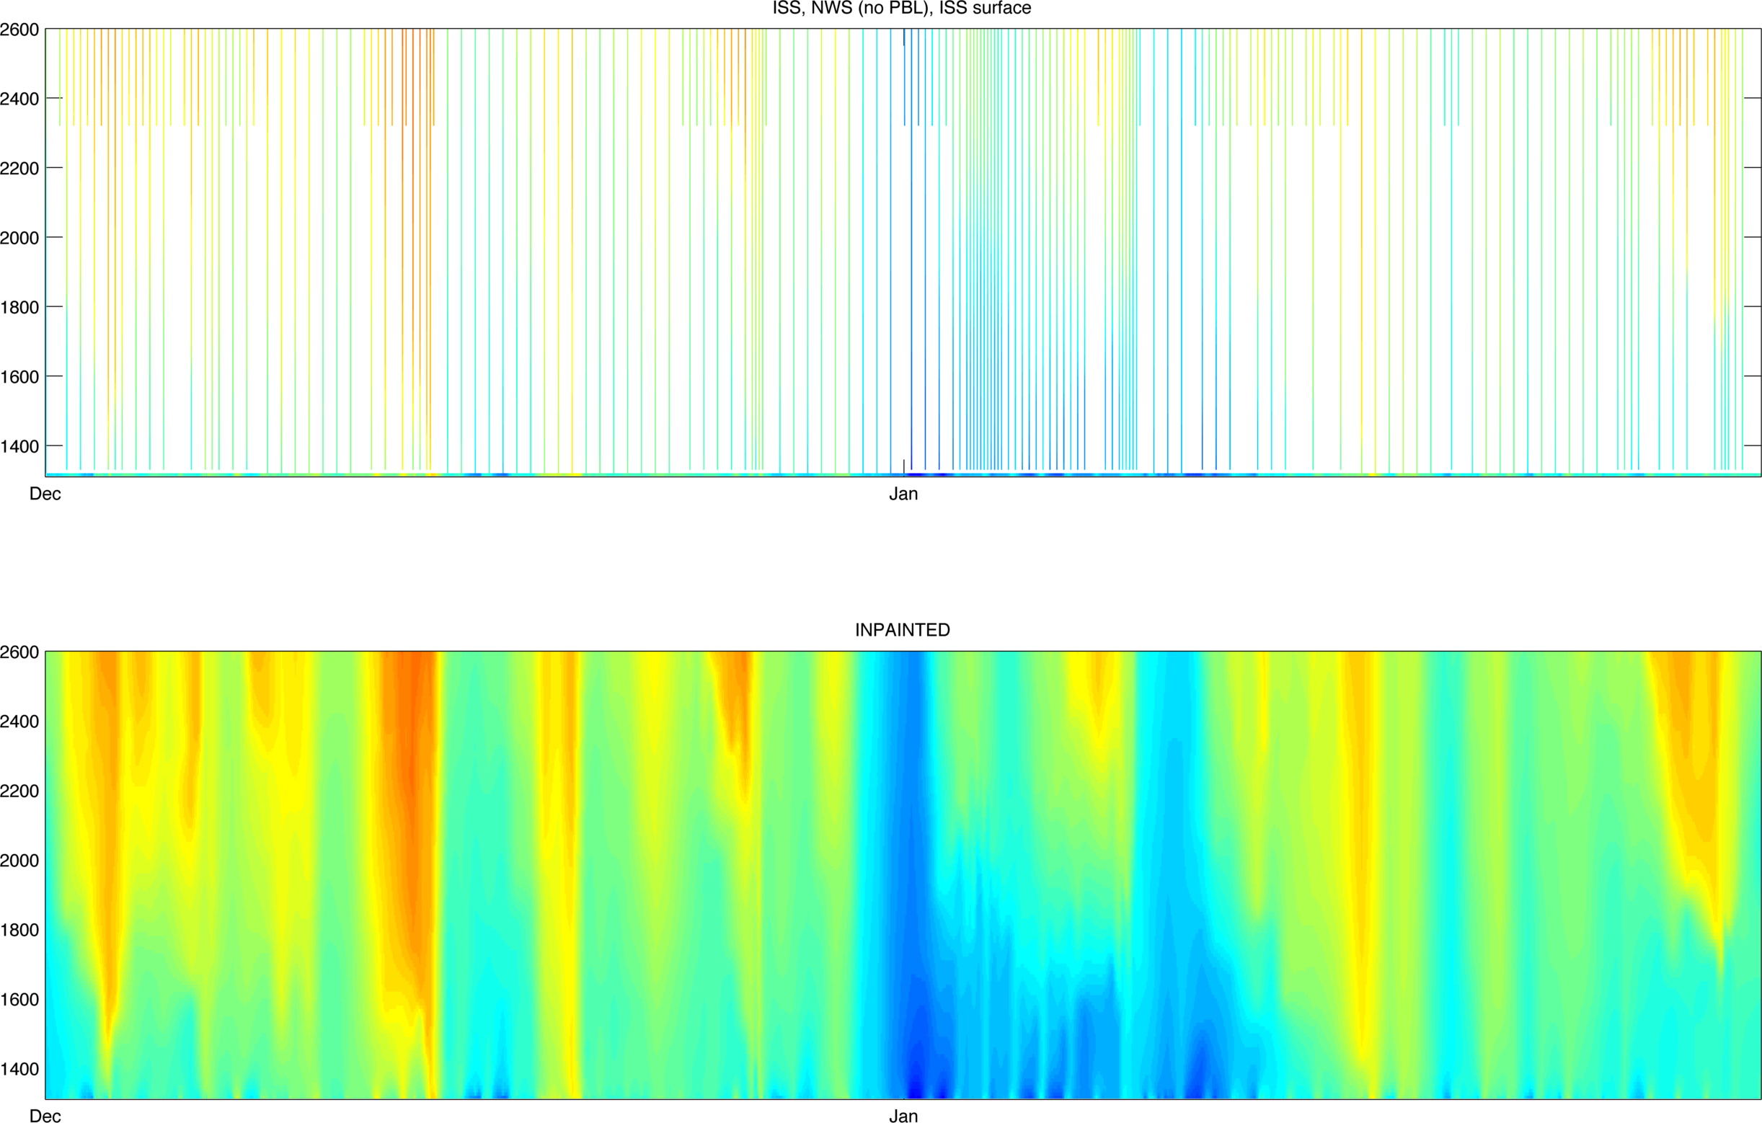
CONSTRAIN THE SOUNDING WITH HOURLY SURFACE DATA, THEN INTERPOLATE TO HOURLY GRID
ISS SURFACE DATA

Slide 8
REMOVE SUPER ADIABATS

Slide 9
Example: IOP5
Adiabatic Mixed Layers

Slide 10
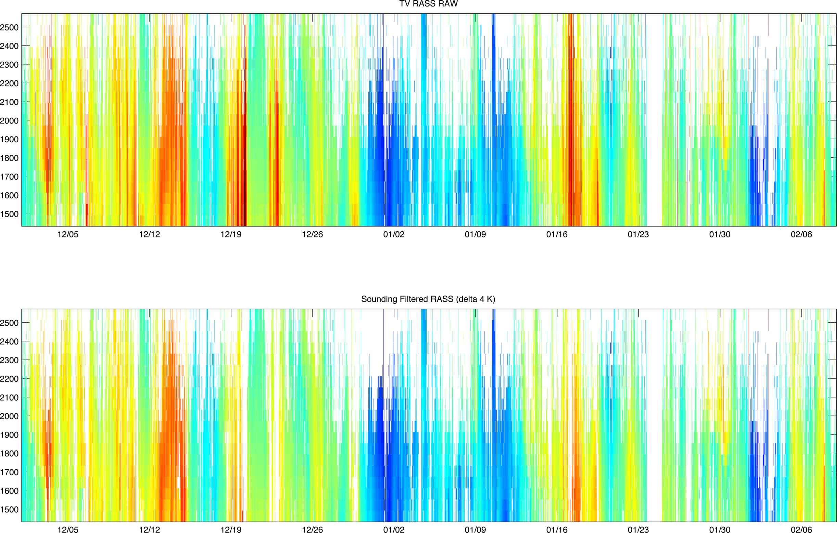
PULL IN RASS DATA, INTERP SOUNDINGS TO RASS TEMPORAL/SPATIAL GRID, FILTER “BAD” RASS DATA (abs (Tsonde-Trass)>4 K)= NAN;

Slide 11
Filter RASS at 3 STDs (Minimal Impact)

Slide 12
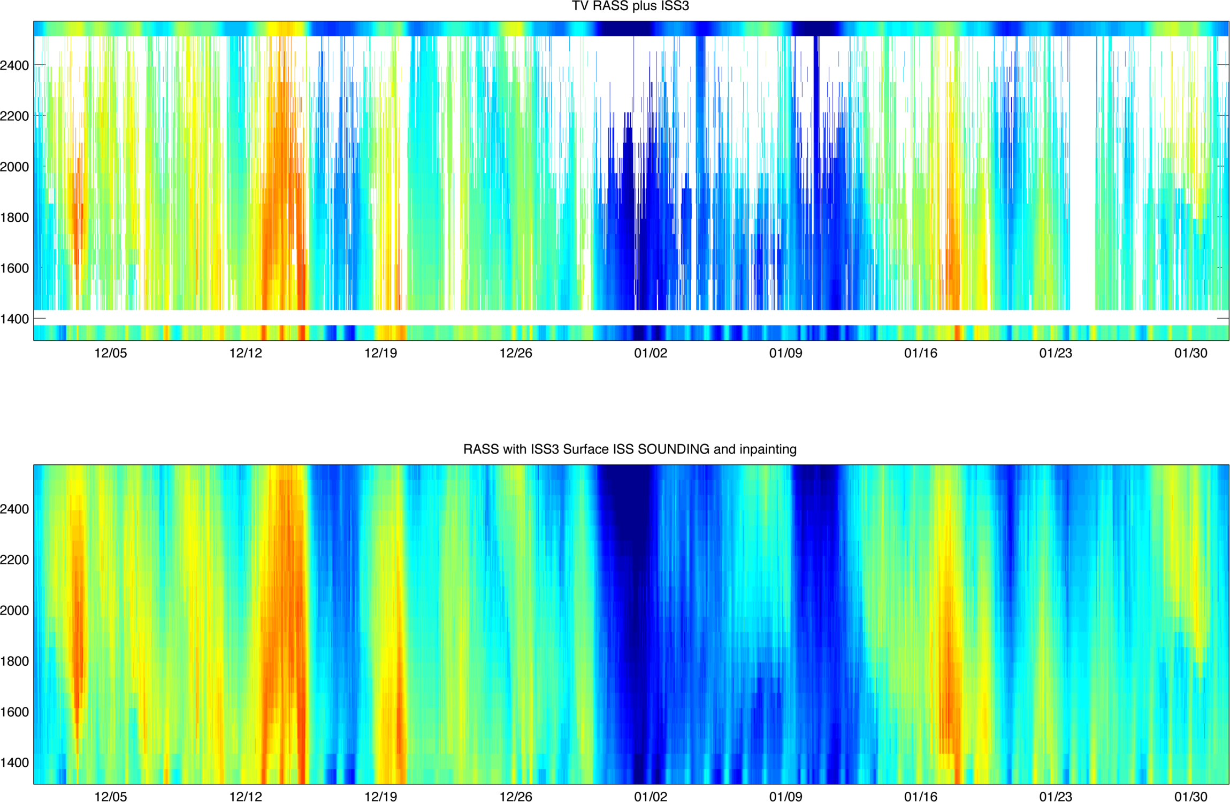
ADD ISS3 SURFACE TEMPERATURE TO RASS GRID (artificial range gate), ADD SOUNDING DATA IN AT UPPER BOUNDARY, INTERPOLATE ACROSS GAPS.

Slide 13
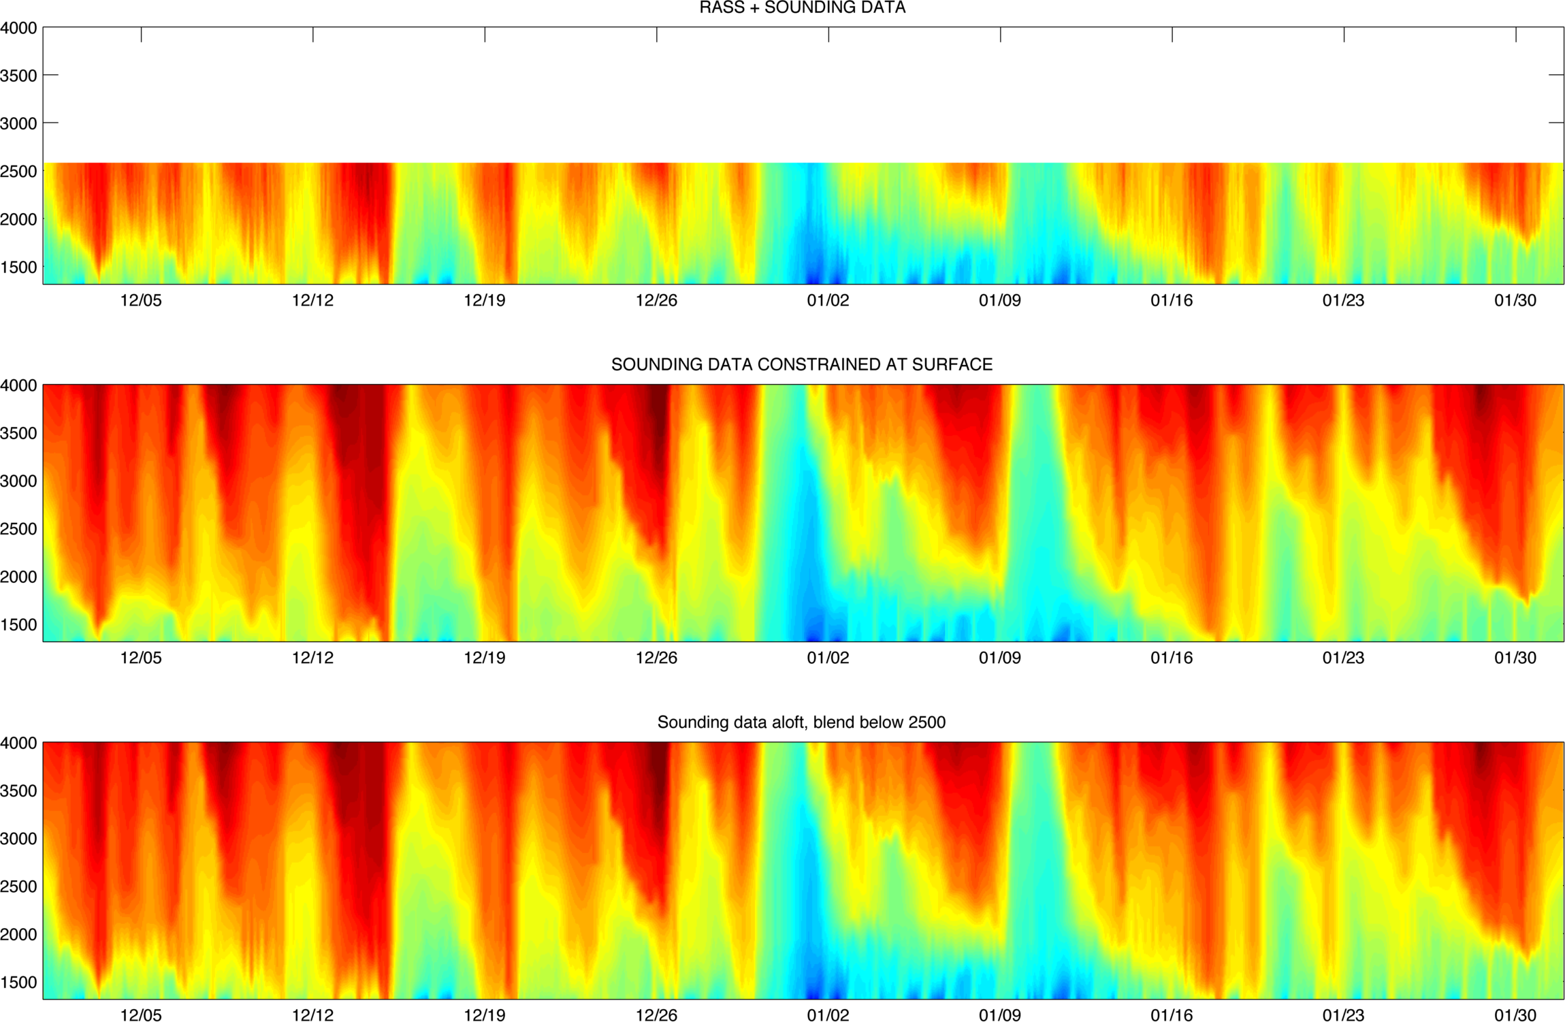
BLEND IT ALL BACK TOGETHER: ADD RASS PBL ADJUSTED DATA BACK INTO SOUNDING DATA (NOTE THAT THE CHANGE IS SUPRISINGLY SMALL!!!!)

Slide 14
EXAMPLES: PCAPS IOPS
Ceilometer, Wind, and Temperature Data

Slide 15
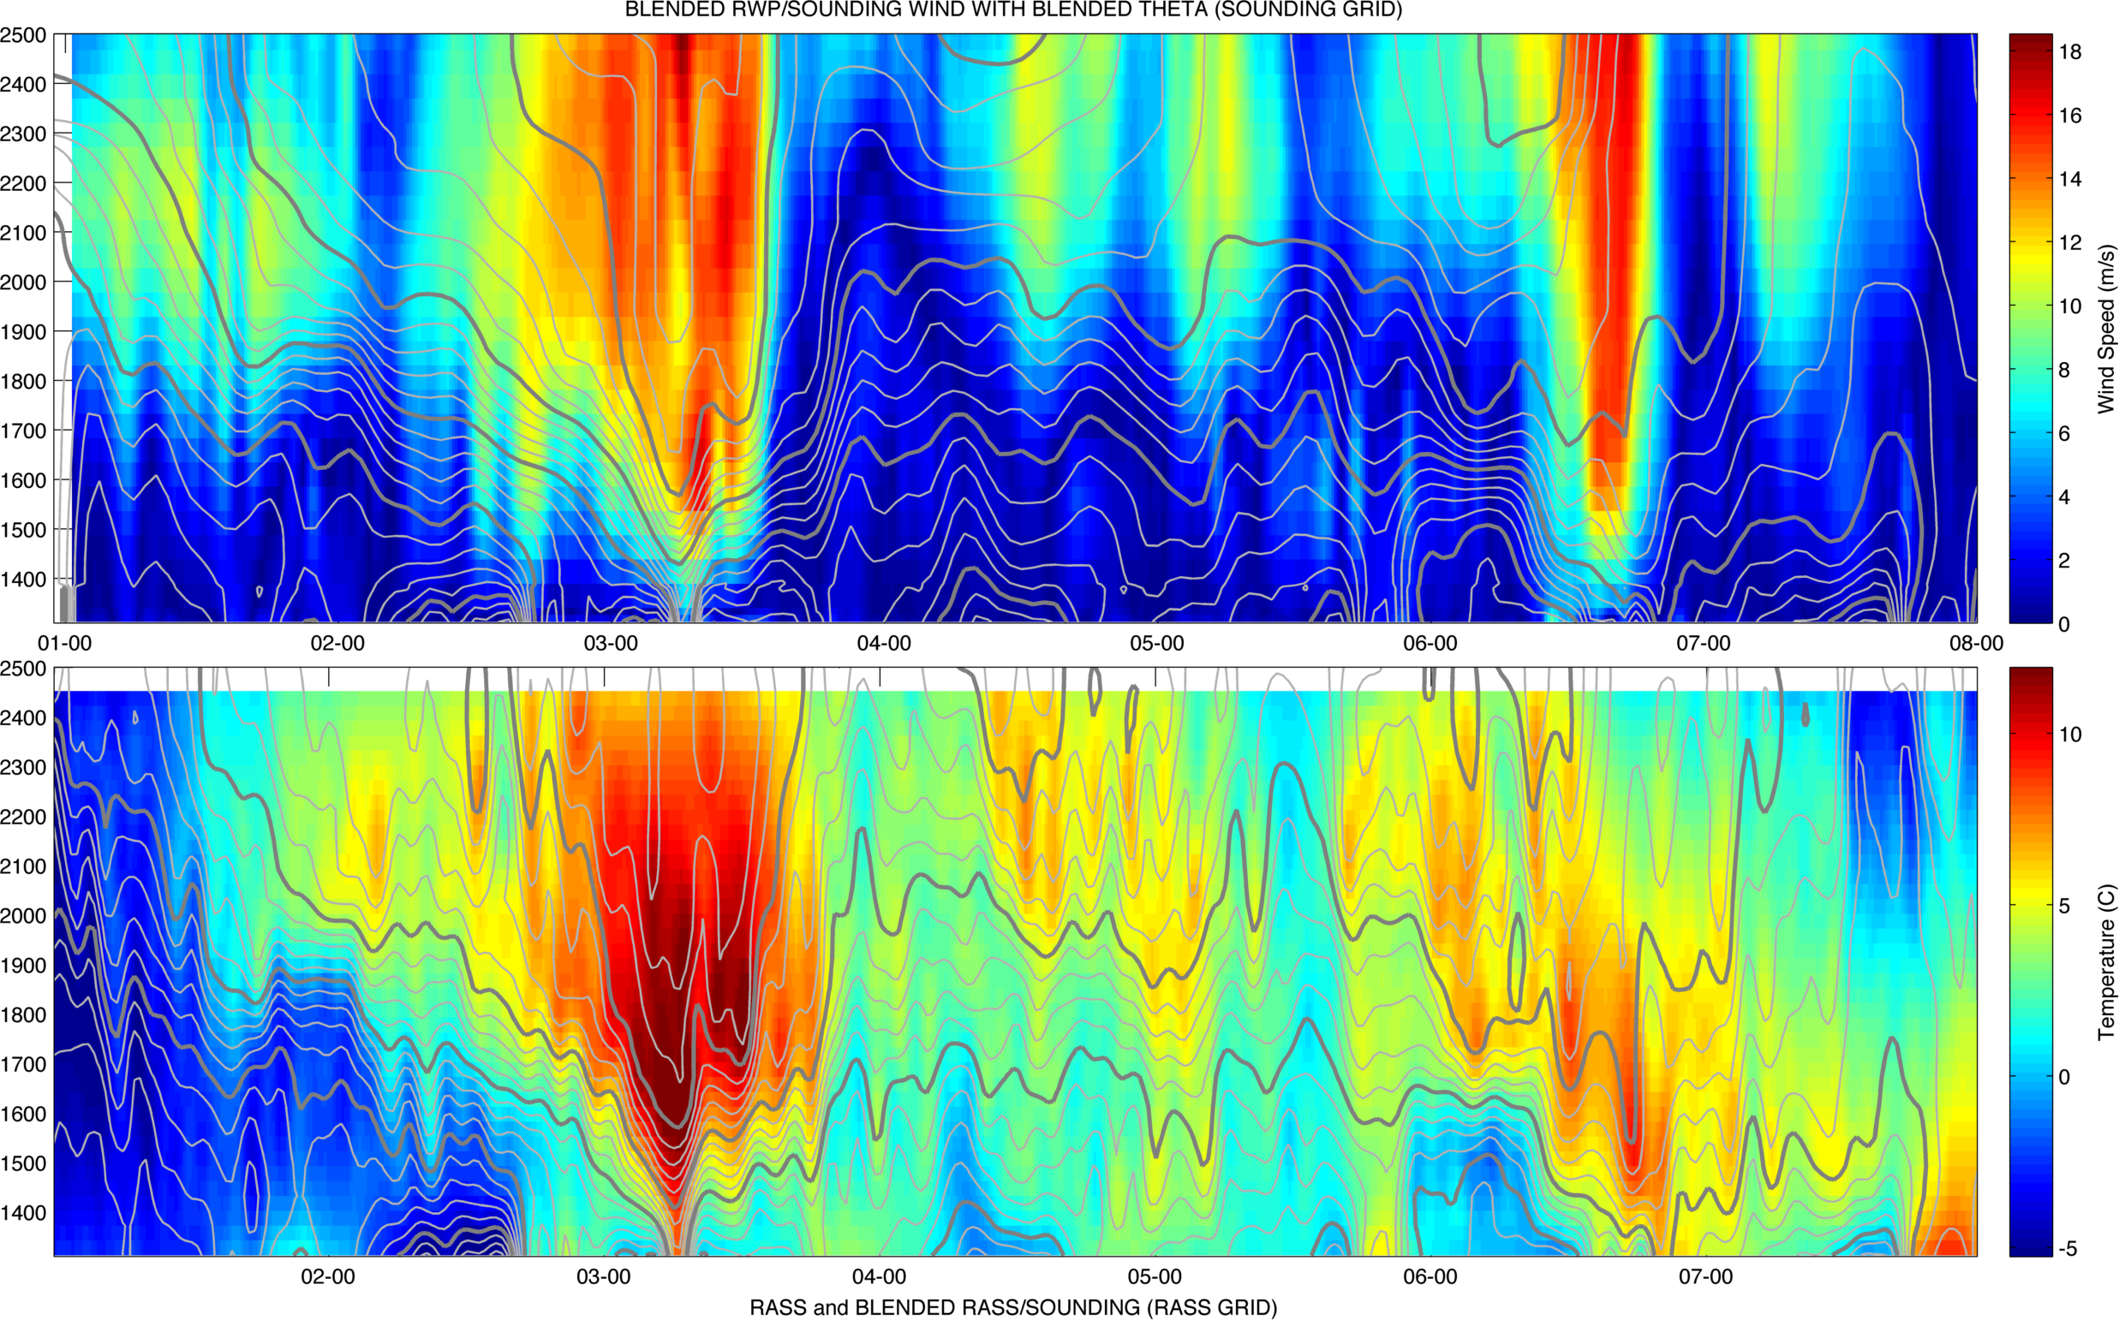
IOP 1
WIND SPEED
RASS TEMPERATURE

Slide 16
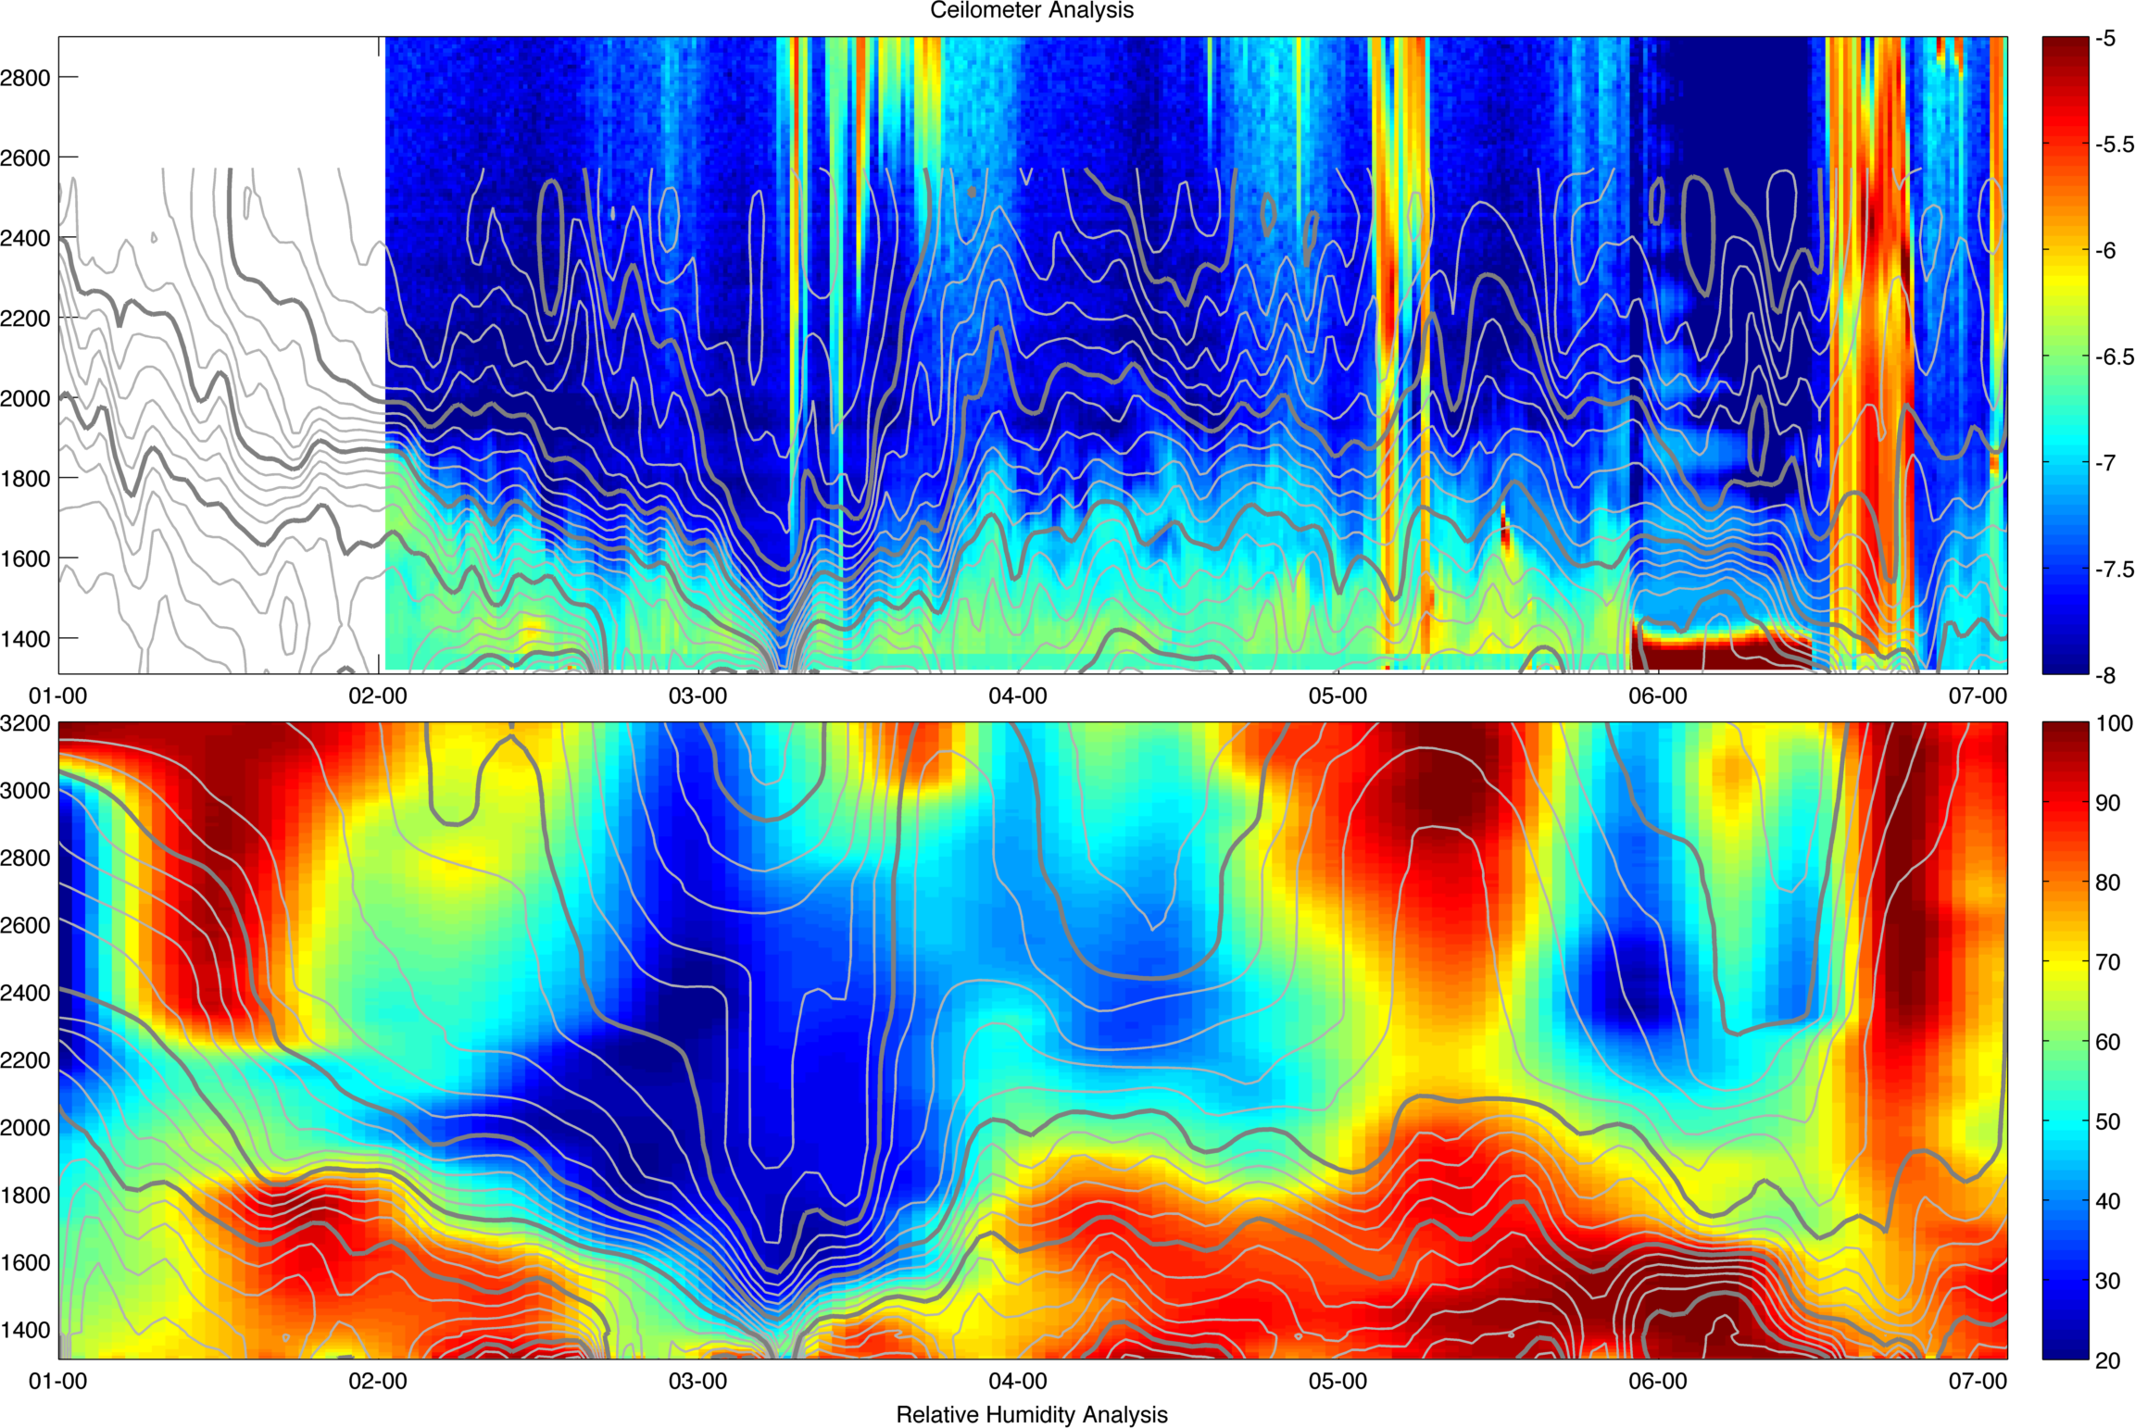
IOP 1
CEILOMETER
Relative Humidity

Slide 17
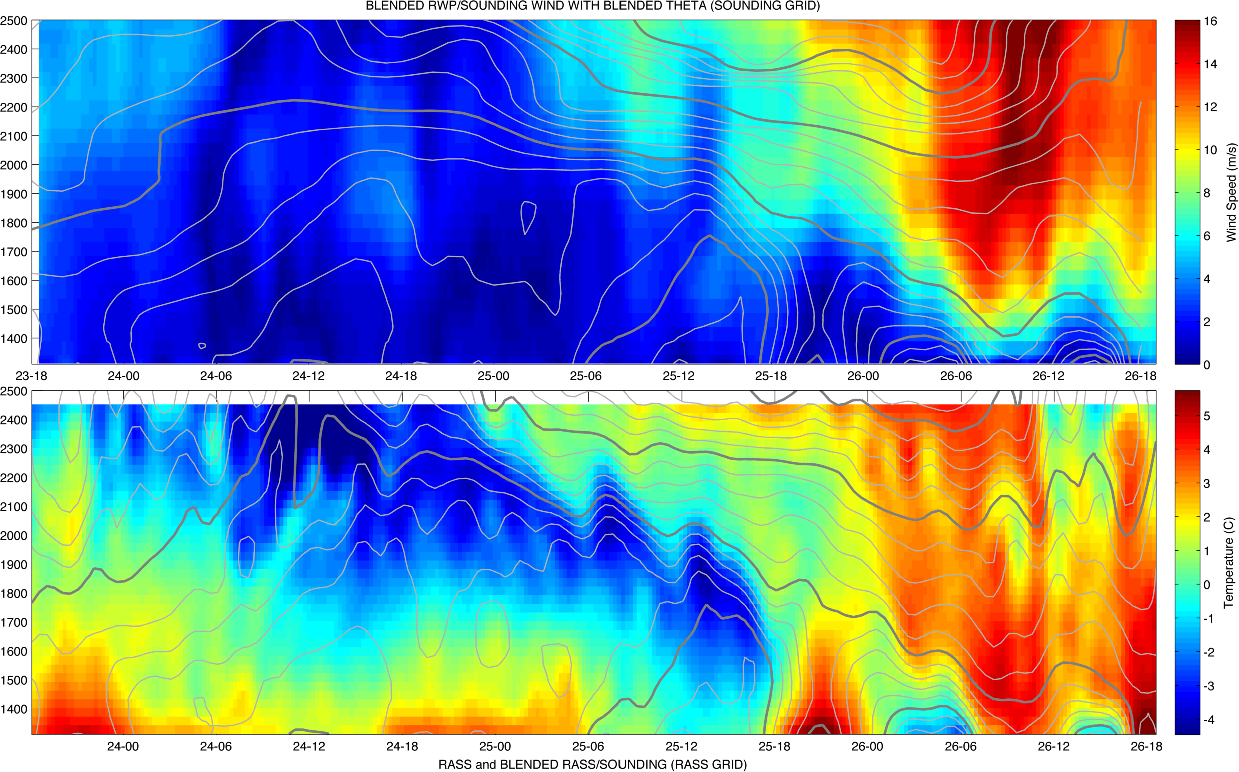
IOP 4
WIND SPEED
RASS TEMPERATURE

Slide 18
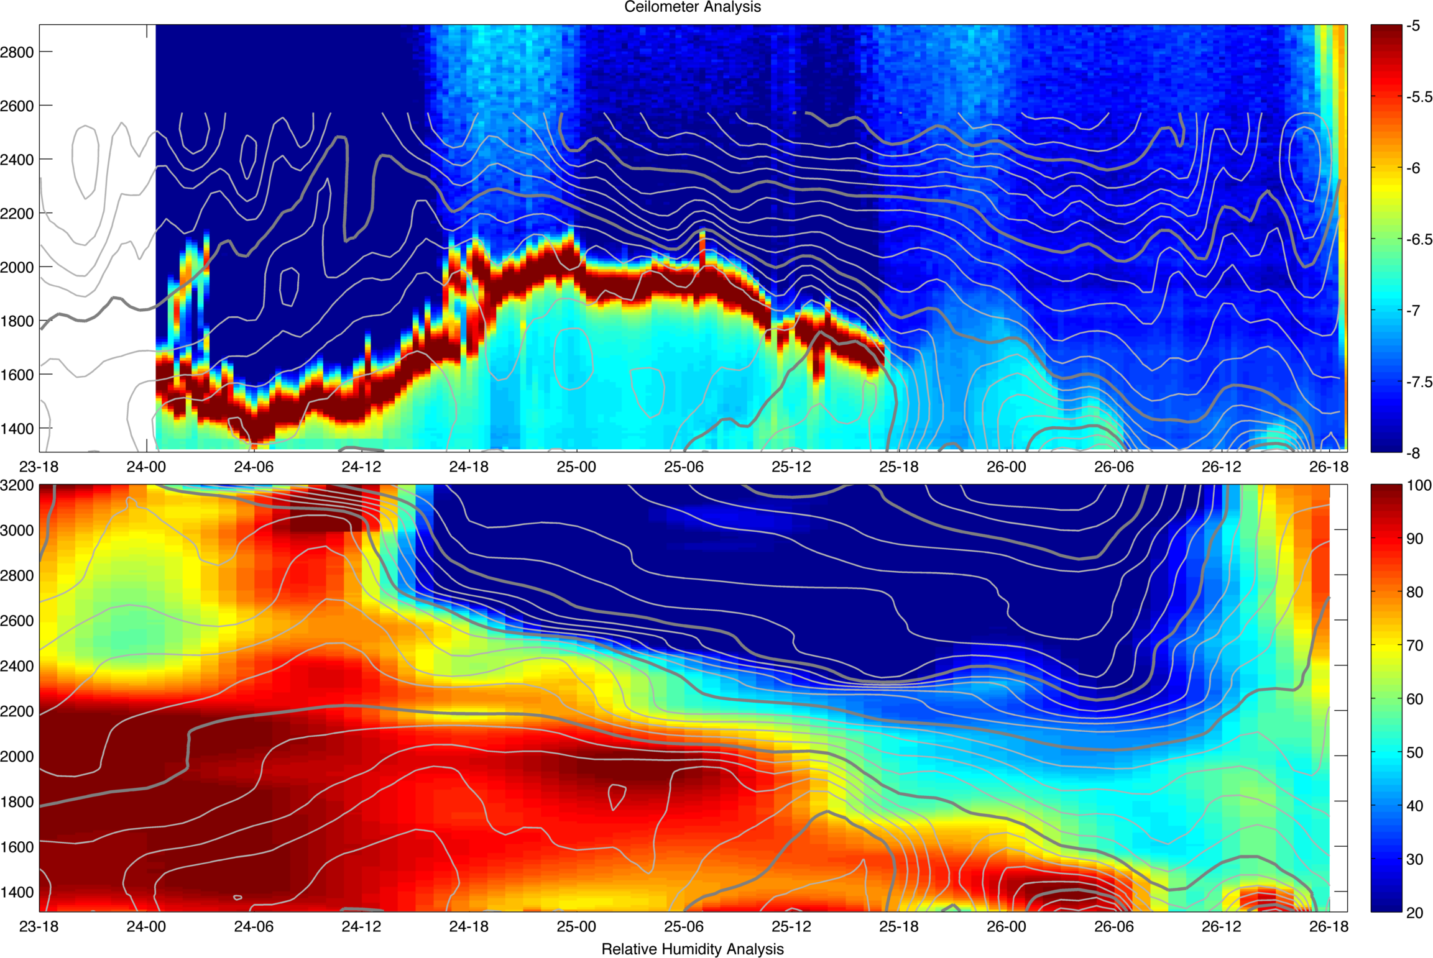
IOP 4
CEILOMETER
Relative Humidity

Slide 19
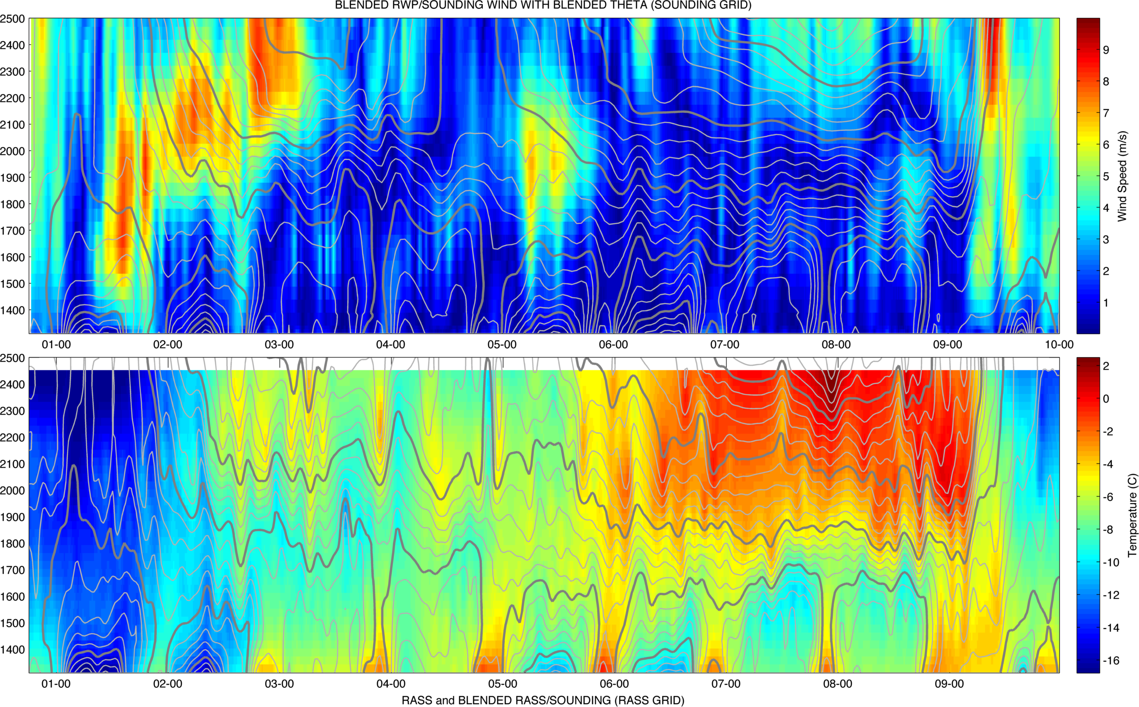
IOP 5
WIND SPEED
RASS TEMPERATURE

Slide 20
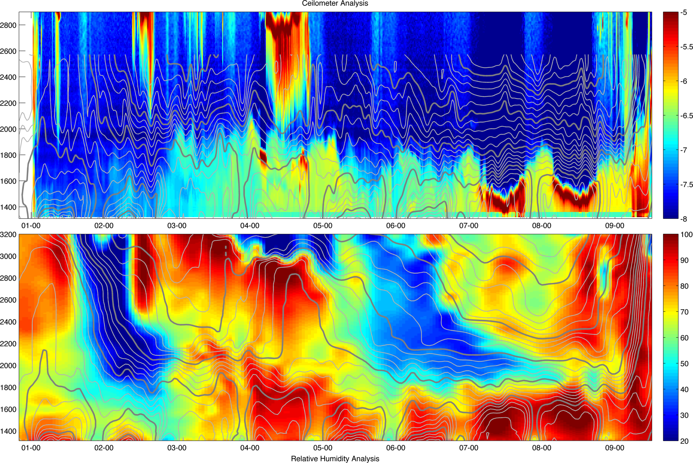
IOP 5
CEILOMETER
Relative Humidity

Slide 21
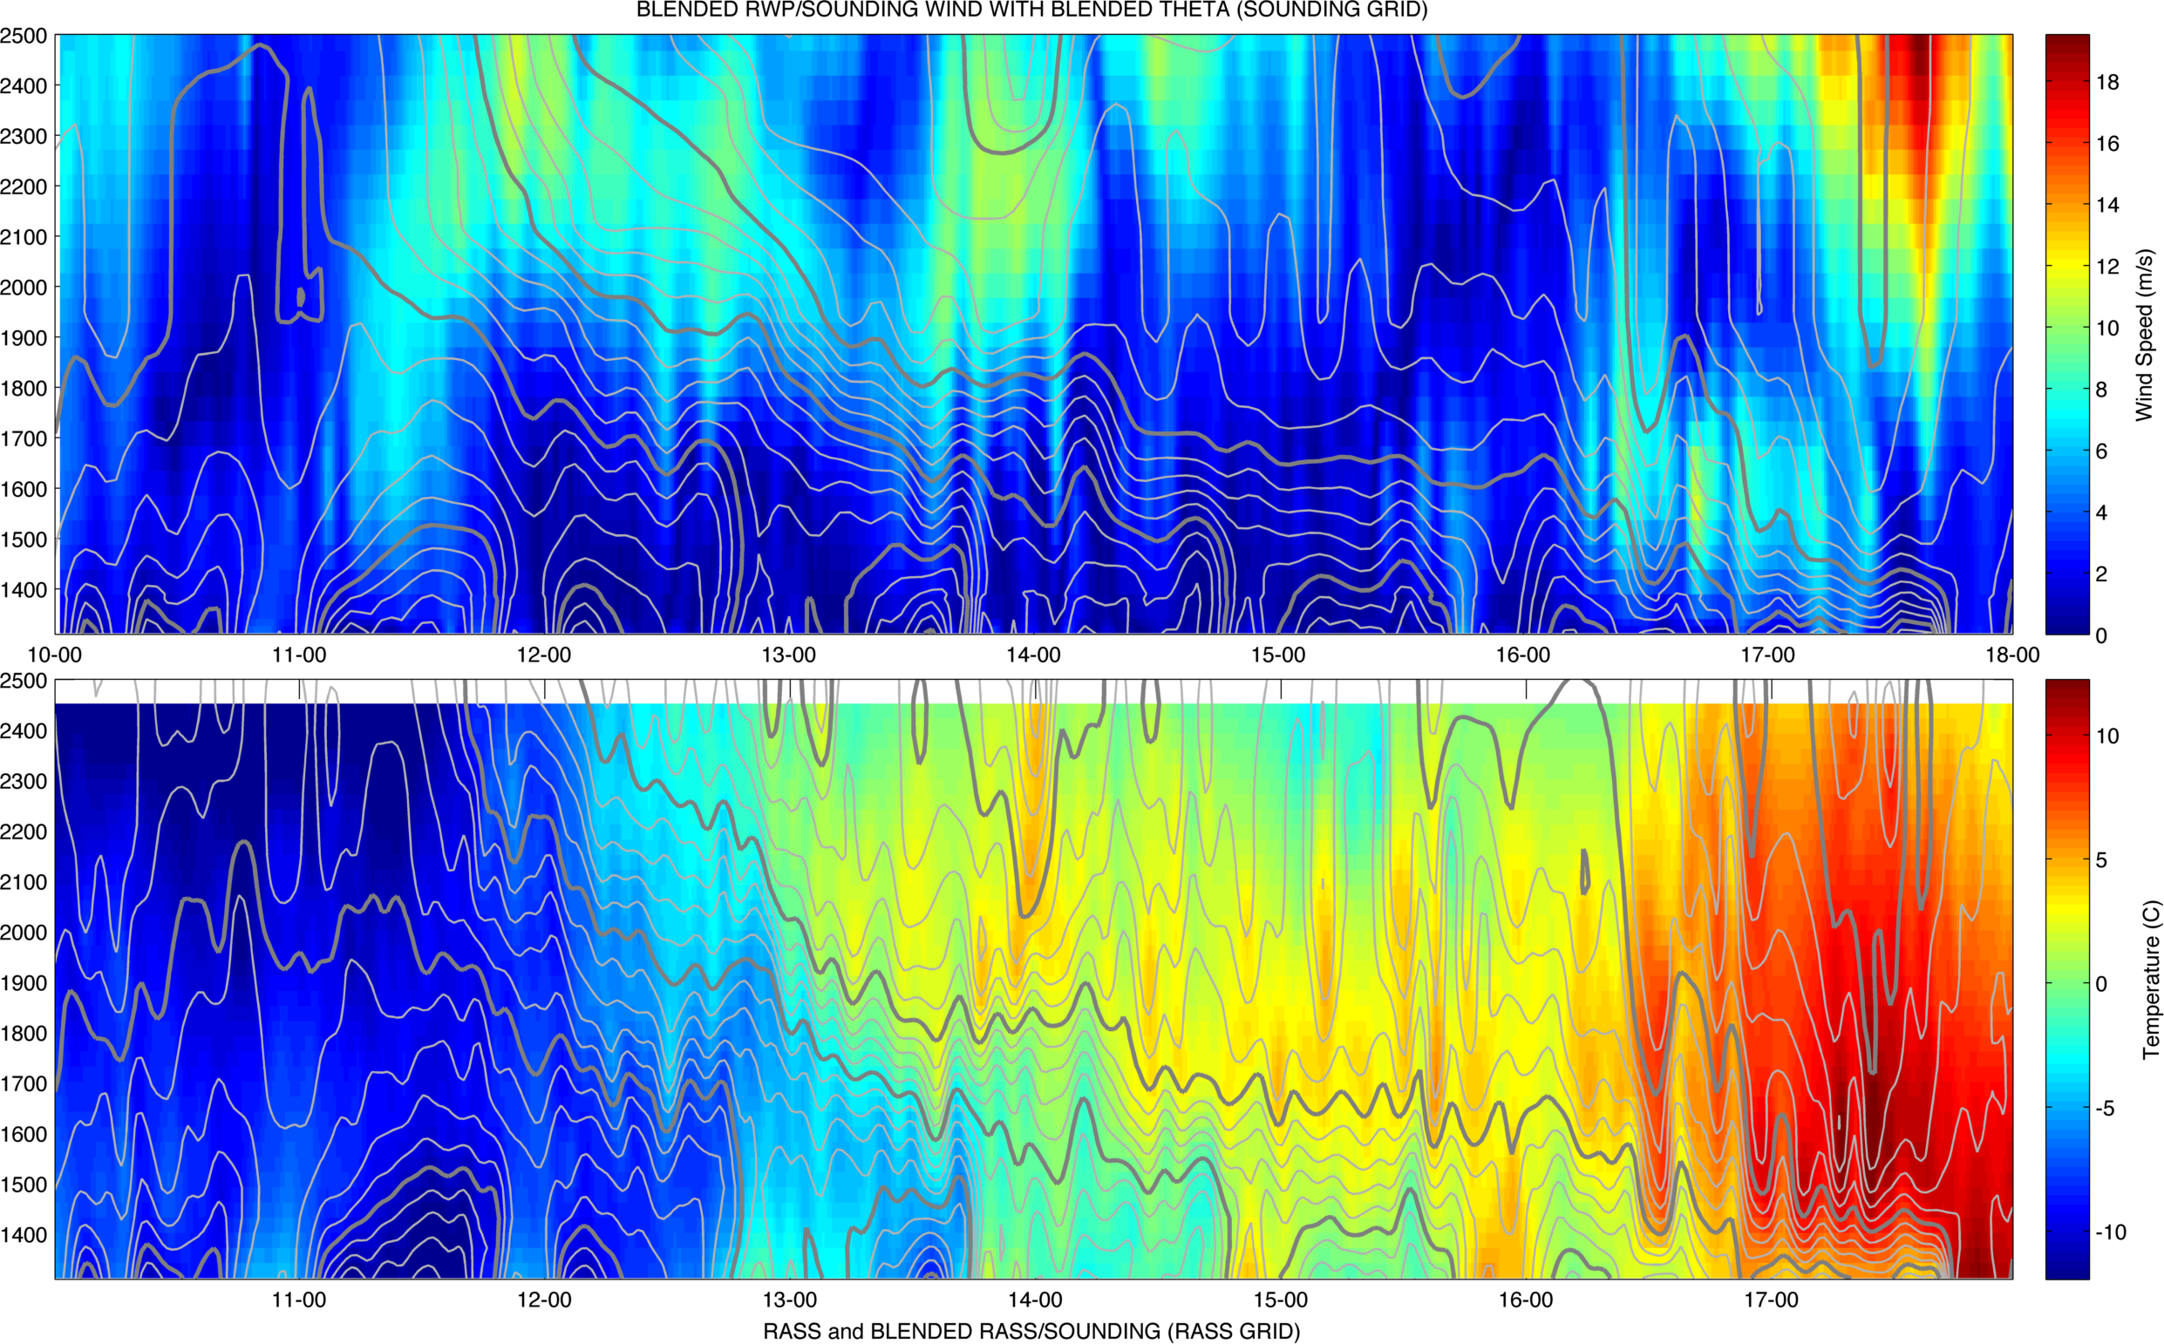
IOP 6
WIND SPEED
RASS TEMPERATURE

Slide 22
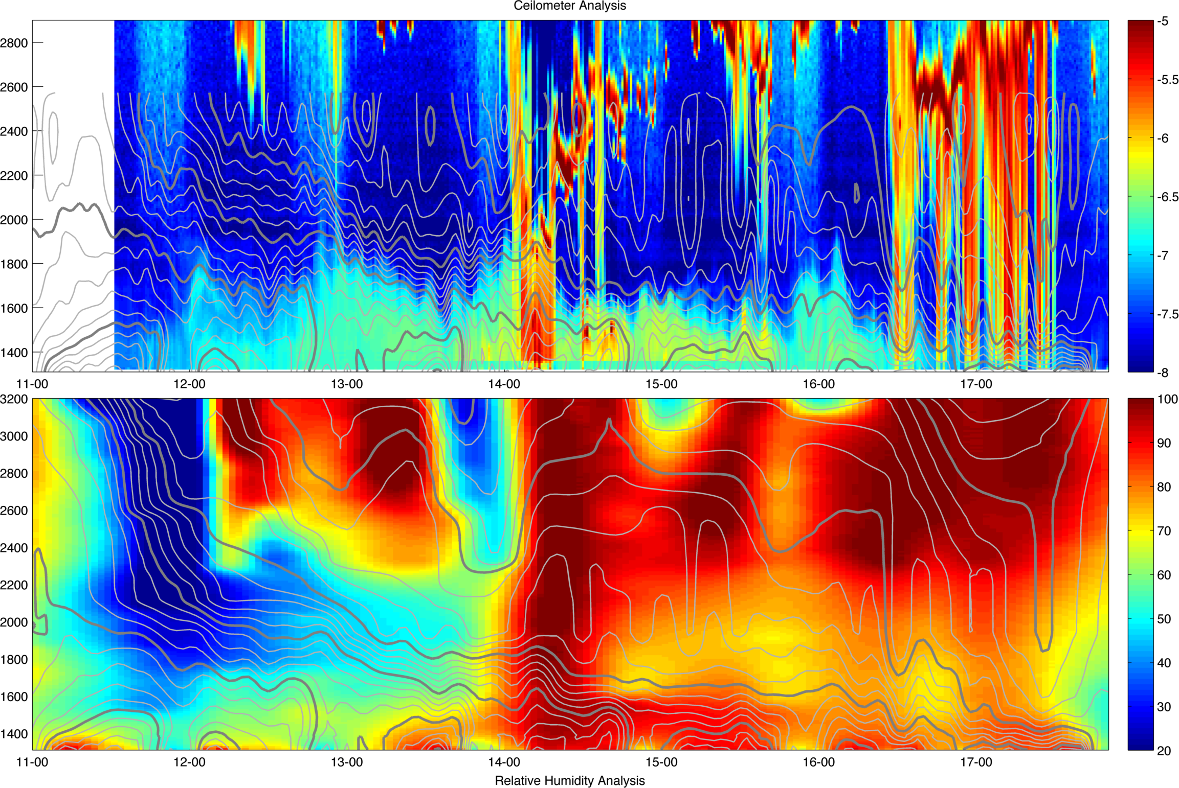
IOP 6
CEILOMETER
CEILOMETER
Relative Humidity

Slide 23
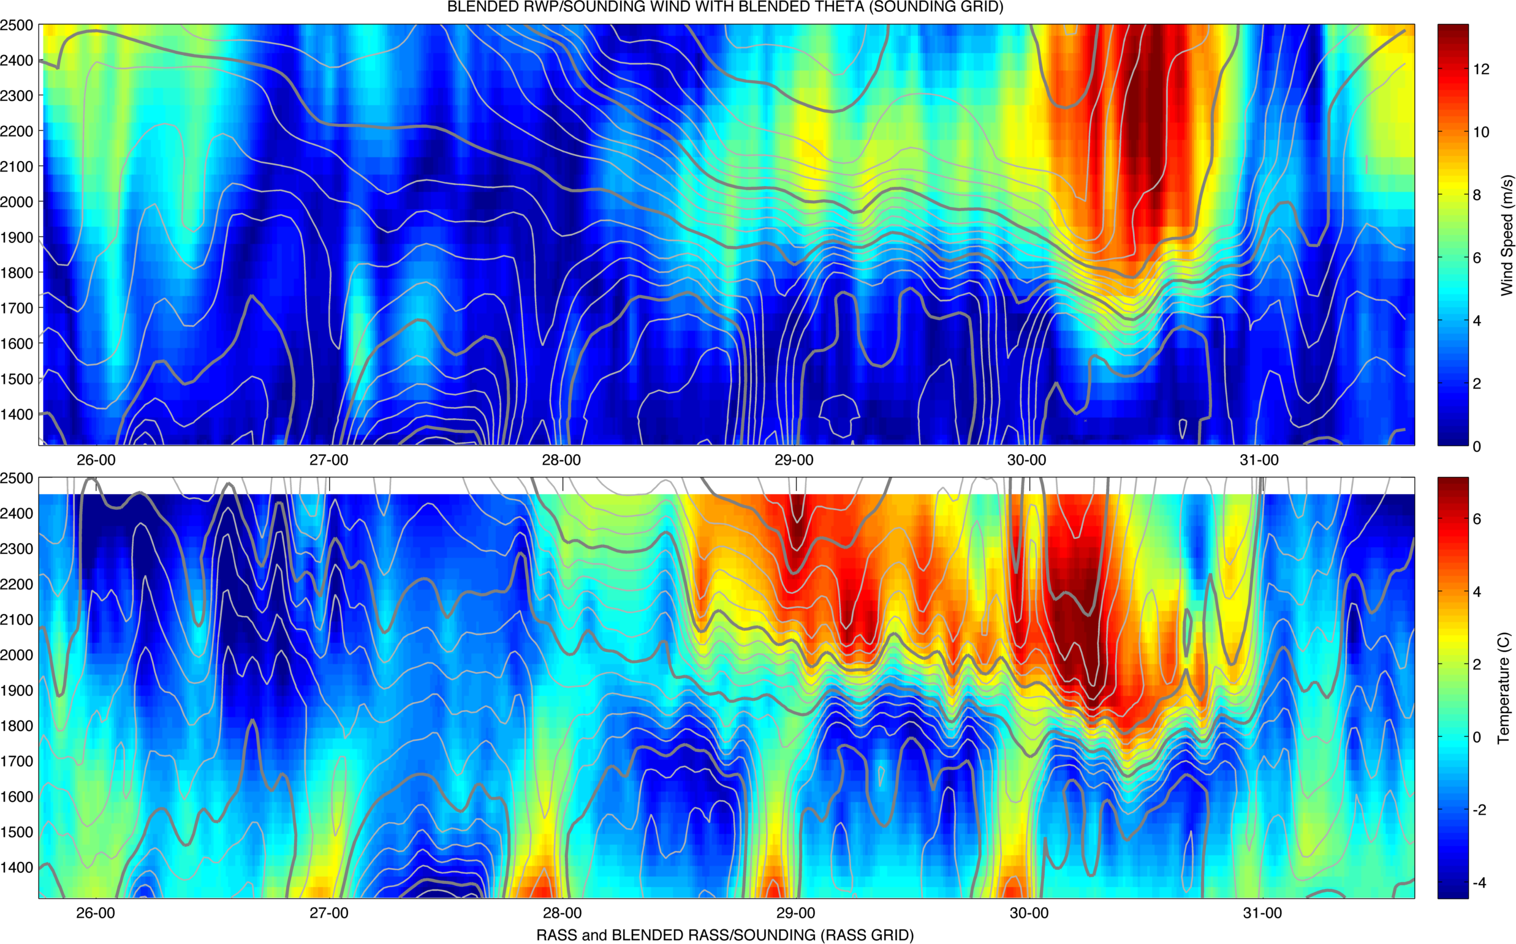
IOP 9
WIND SPEED
RASS TEMPERATURE

Slide 24
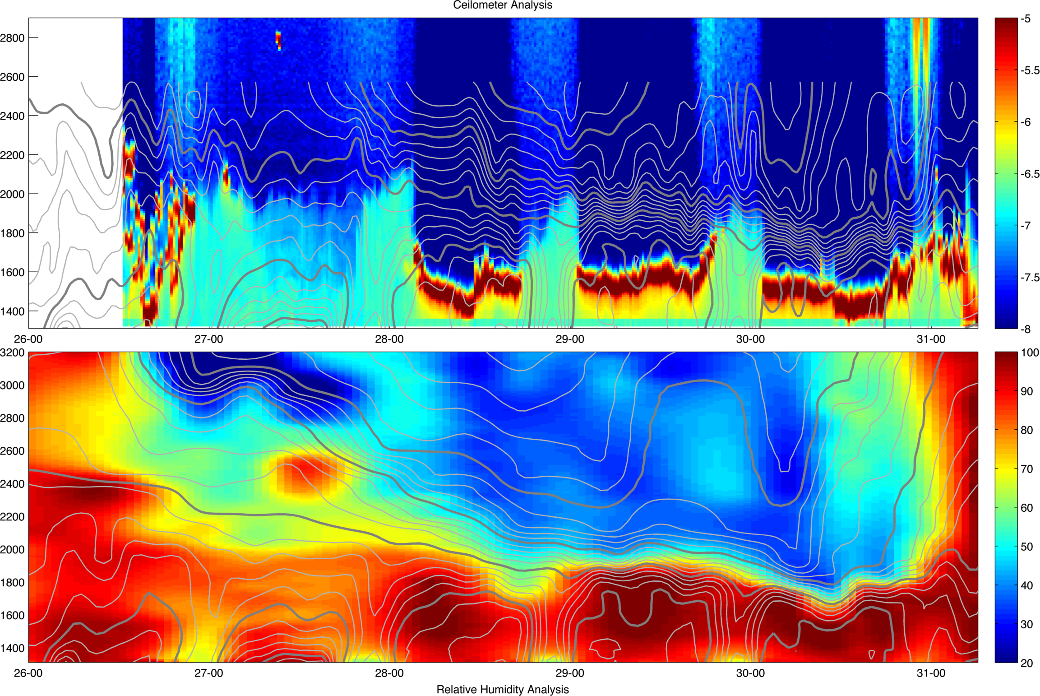
IOP 9
CEILOMETER
CEILOMETER
Relative Humidity

Slide 25
Higher order variables

Slide 26
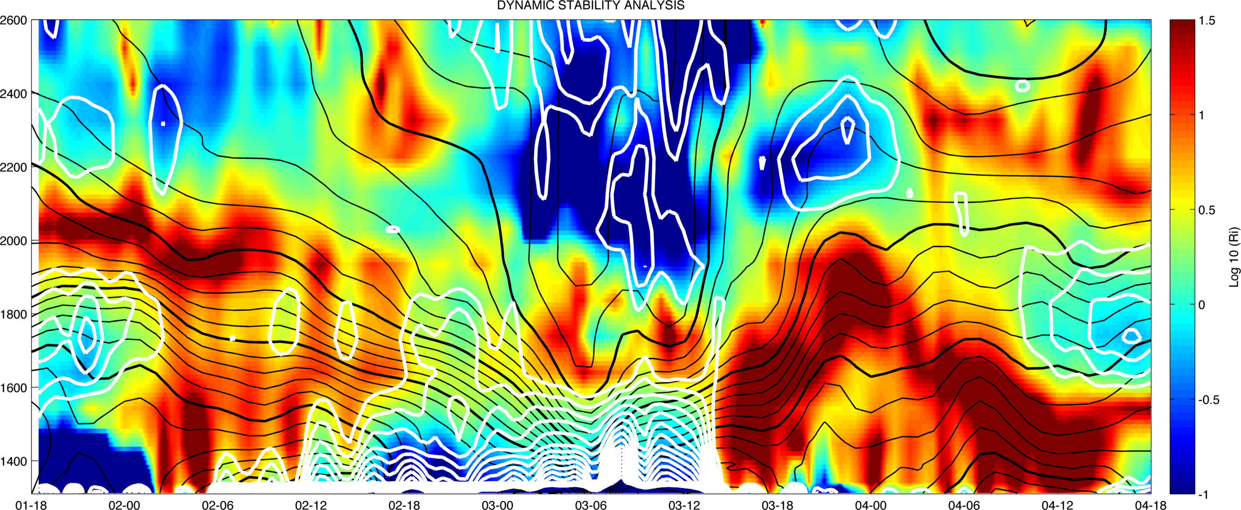
IOP 1: Richardson number and shear

Slide 27
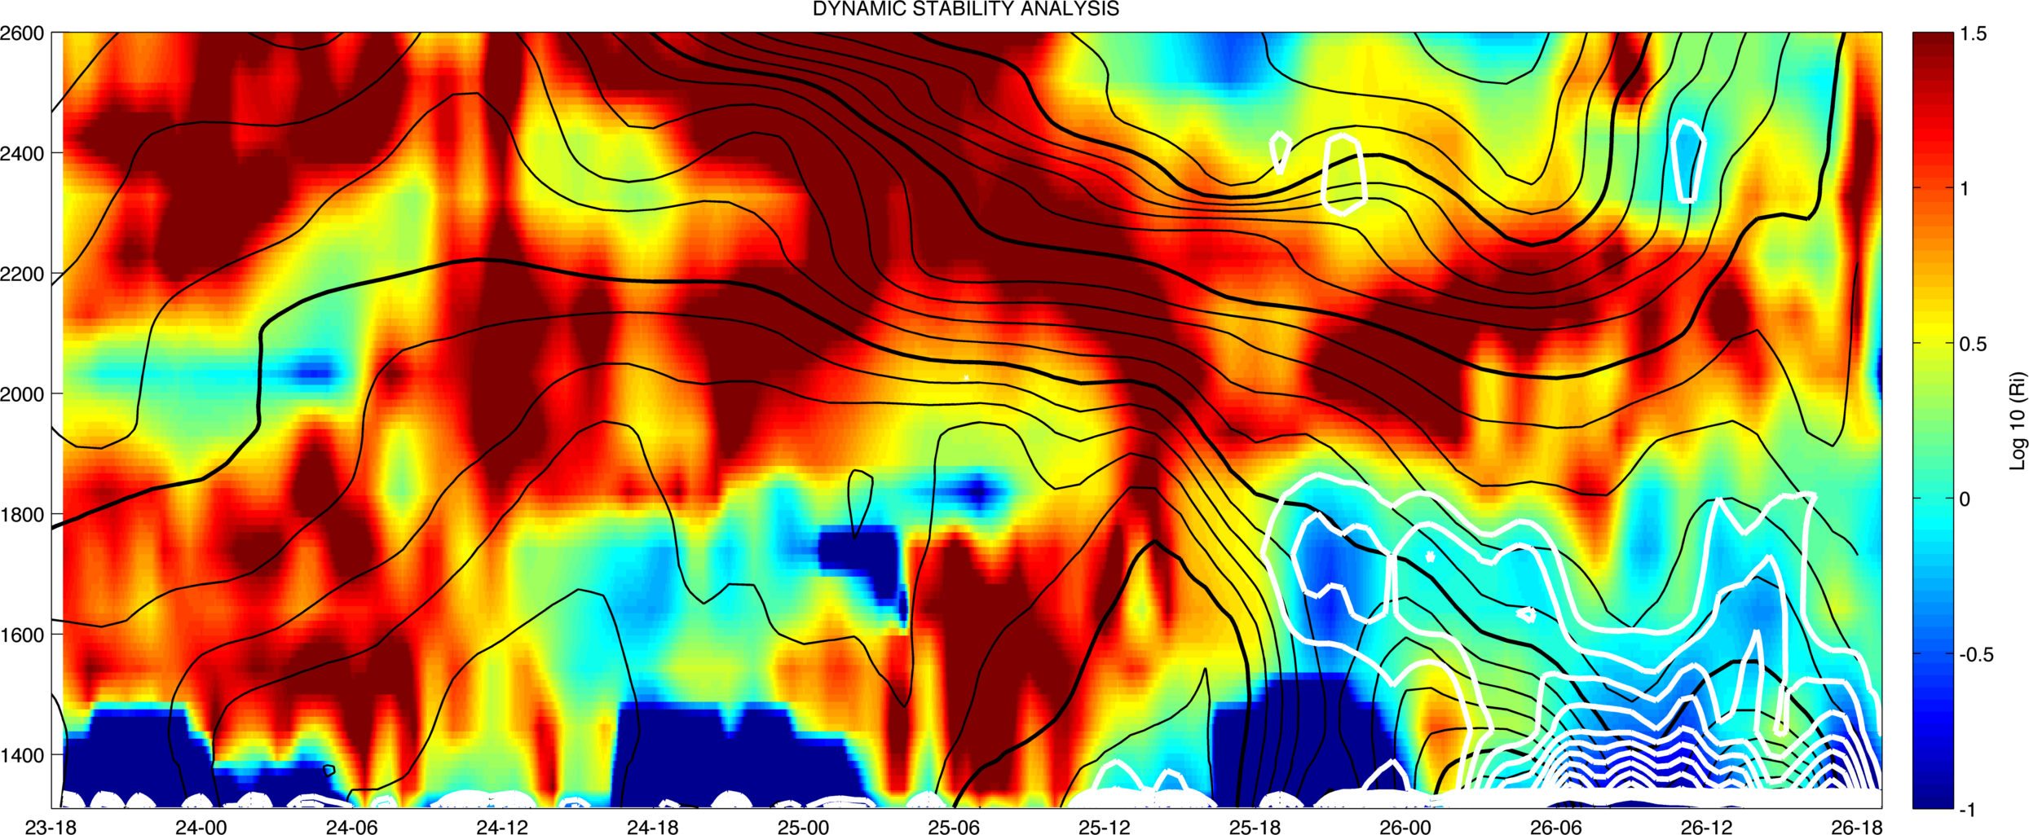
IOP 4: Richardson number and shear

Slide 28
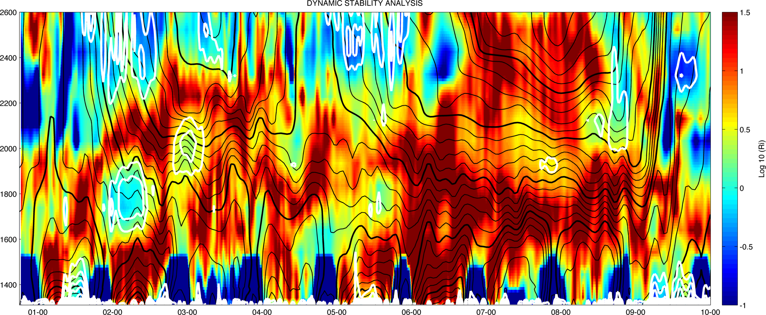
IOP 5: Richardson number and shear

Slide 29
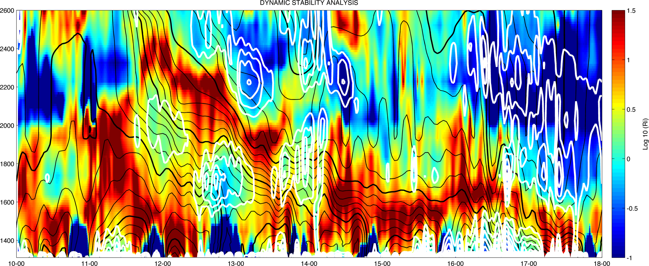
IOP 6: Richardson number and shear

Slide 30
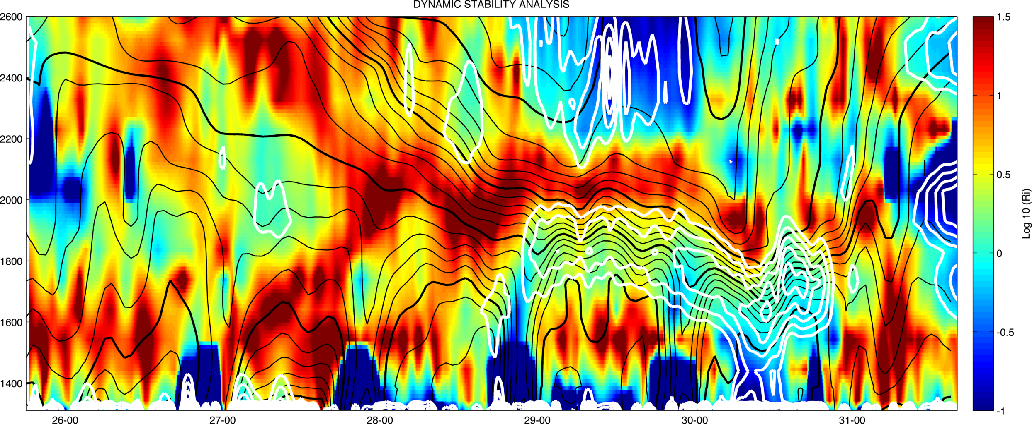
IOP 9: Richardson number and shear

Slide 31
Dt/DZ vs Aerosol mixing depth

Slide 32
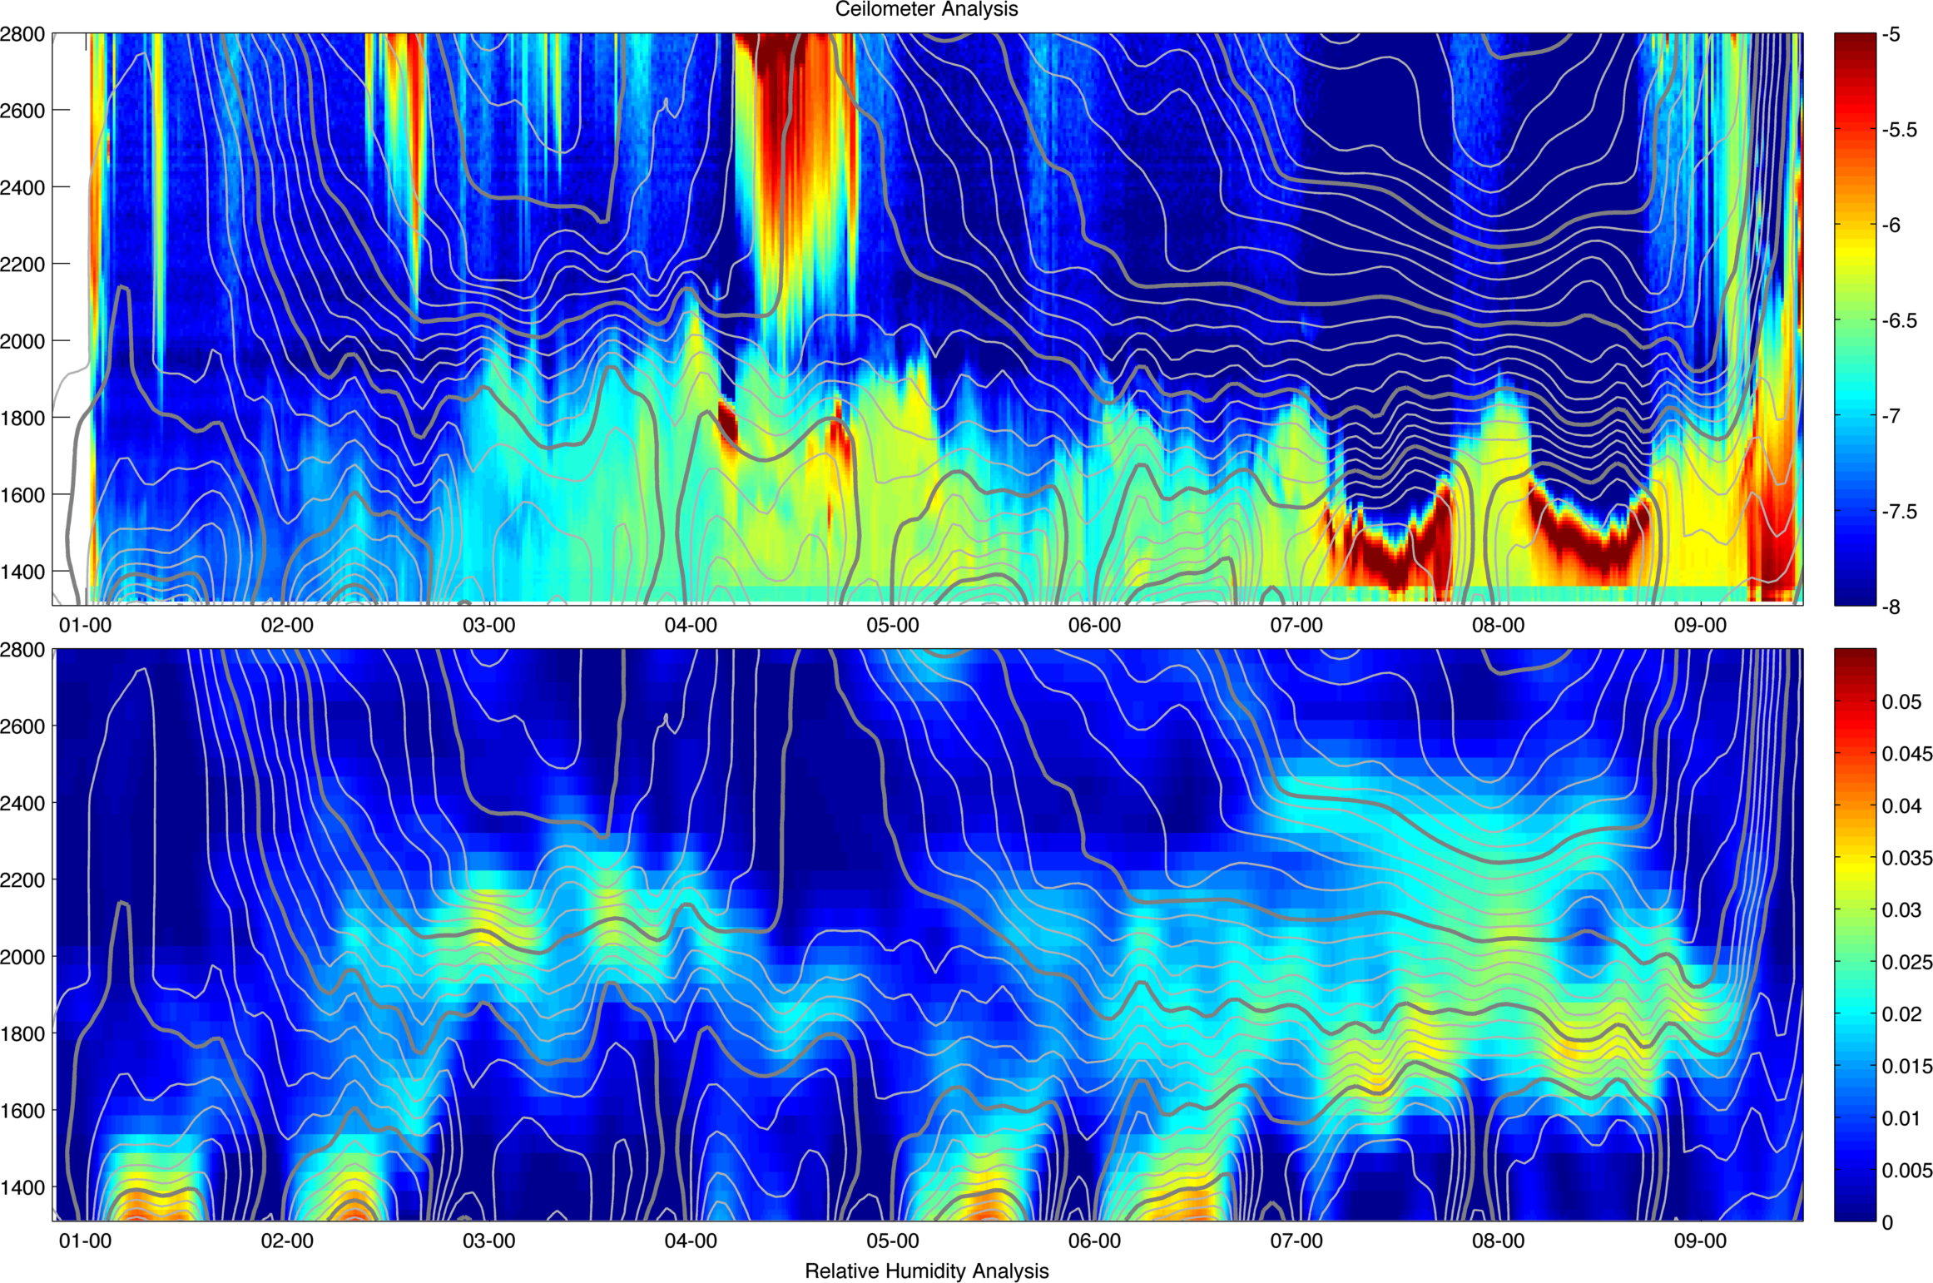

Slide 33
