Slide 1
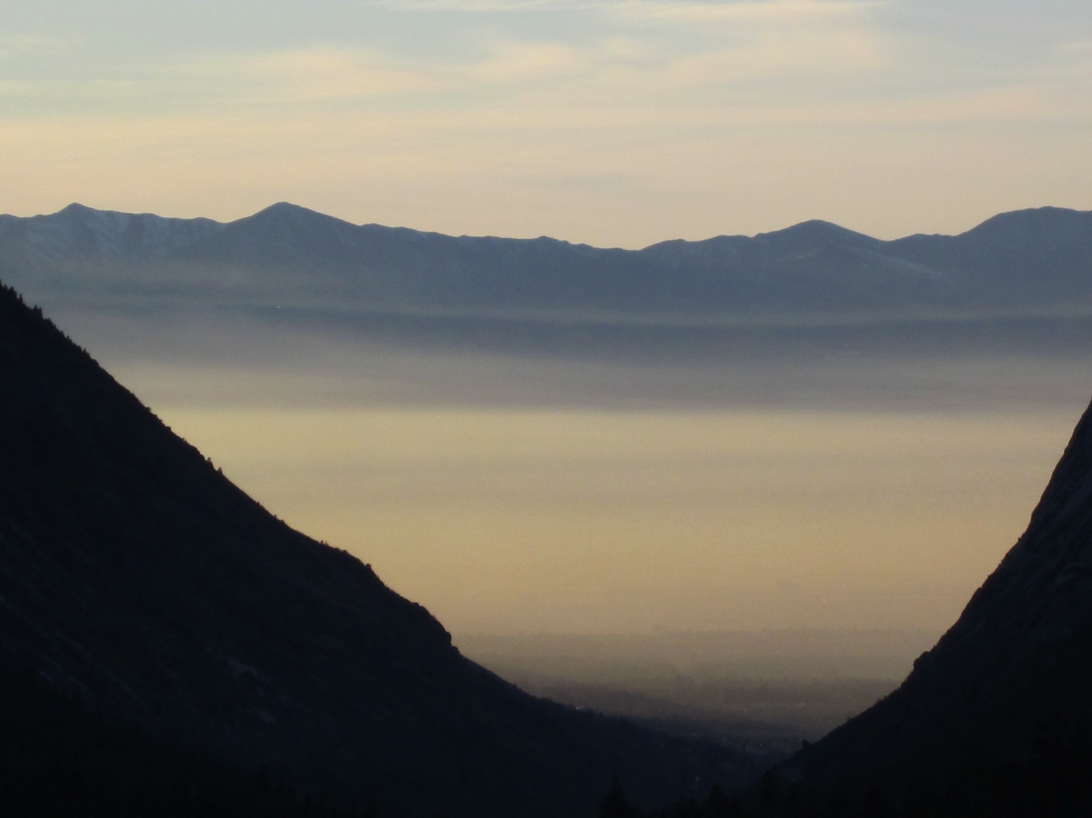
Ph.D. Proposal Defense
Neil Lareau
28 November 2012

Slide 2
Committee Members
Chair: John Horel – U of U Atmos.
C. David Whiteman – U of U Atmos.
Ronald Smith – Yale – Geology/Geophysics
Courtenay Strong – U of U Atmos.
Eric Pardyjak – U of U Mech. Eng.

Slide 3
Personal Background: Interests and Goals
Research interests: Dynamics of the atmosphere across a range of scales
  Mid-latitude dynamics (MS thesis)
    Storm tracks
  CAP dynamics (PhD thesis)
    CAP break-up
  Mountain Meteorology
Career Goals:
  Teaching
  Research
POST-DOC/FACULTY POSITION

Slide 4
Personal Background: Timeline
BFA: Oil Painting Carnegie Mellon University
Weather Observer: Mount Washington Observatory
Applied to Grad Schools ( no go )
MWR Storm Track Paper
TA Instrumentation Class
Cyclone Workshop
High Pass Qualifying Exam (May)
NCAR ASP summer colloquia (June)
PCAPS Project Design
PCAPS operations (Dec 2010-Feb 2011)
Undergrad MET Classes at U of U
MesoWest
Apply to Grad School
Synoptic Met. II instructor
Long Ago
2007
2008
2009
2010
2011
2012
2013
Begin Grad School Aug 2008
Storm Track Research
Defend Master’s Thesis (August )
Present Work at Mountain Met Conference
DOMEX field work (Martinique)
Boundary Layer
Mountain Met
PCAPS BAMS PAPER

Slide 5
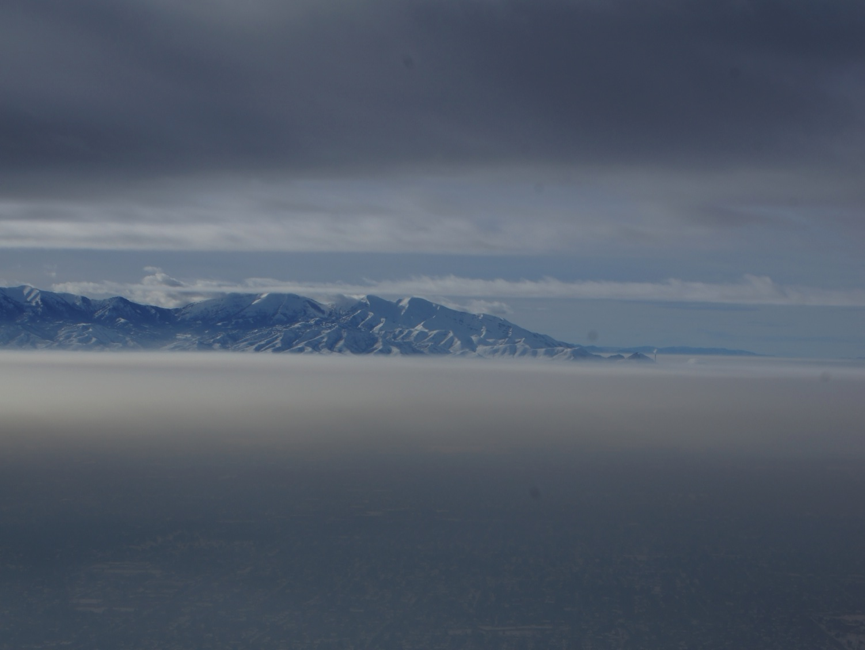
Dynamical Mechanisms of Persistent Cold-Air Pool Removal
Thesis Proposal
Notes:
What we are really here to discuss is the Dynamical Mechamisms of persistent CAP removal

Slide 6
Definitions:
CAP: topographic depression filled with cold-air.
  Forms by cooling of the air near the surface, warming aloft, or often both
  Stable stratification prevents vertical mixing
  Topography prevents lateral displacement, leads to stagnation.
Diurnal CAP: CAP forming at night and decaying during the daytime growth of CBL (and basin scale circulations).
Persistent CAP: CAP surviving through multiple diurnal cycles
  Often accompanied by air pollution and fog
Lareau et al. 2013
Notes:
First lets start out with some definitions to make sure we are all on the same page.
This talk and this research focuses on PCAPS

Slide 7
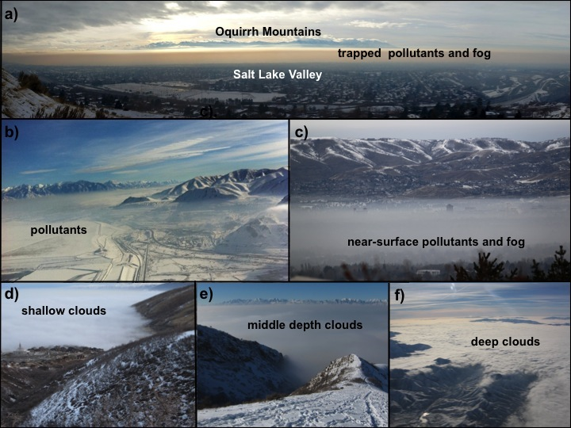
Notes:
Here are some examples of PCAPS observed in the Salt Lake Valley during the winter of 2010/2012
Note that they are often deep, though occasionally very shallow, and of broad expanse

Slide 8
Problem Statement
The degree of interaction between persistent CAPs with passing weather systems is poorly resolved.
The timing or extent of CAP break-up is particularly difficult to predict and poorly understood.
  What processes will matter… turbulence, CAA, CBL growth, all of the above?
Why this matters:
  Air quality forecasts
  Sensible weather

Slide 9
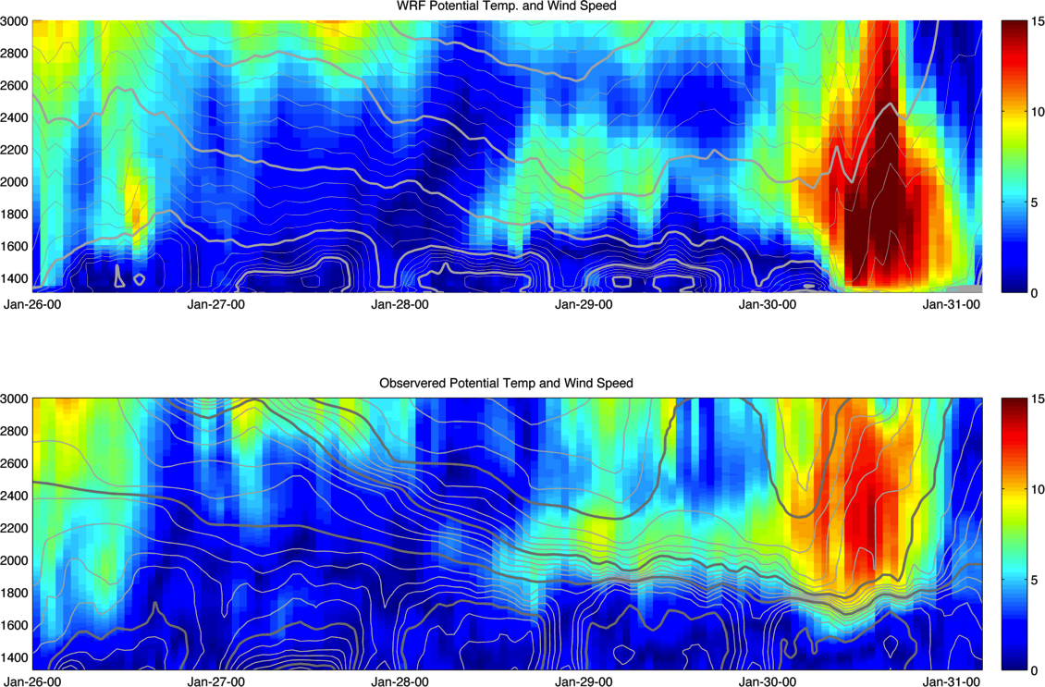
Problem Example
WRF SIMULATION
CAP too shallow
Premature dynamically driven mix-out
Observations
Dense fog and unhealthy air quality persist!
Notes:
Here is an example of just this problem. Even using WRF at relatively high resolution compared to operational models, there are systematic errors in CAP depth and an erroneous mix out event that did not occur. The too shallow cap allows strong winds aloft to break to the surface, removing the CAP and ventilating the valley. In reality the CAP persists through that period, prolonging dangerous air quality and in this case dense fog/stratocumulus.

Slide 10
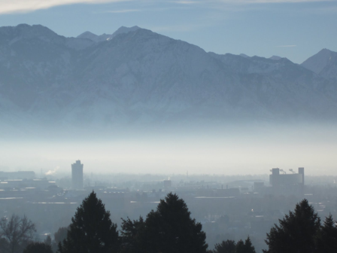
Research Goals
Contribute to our scientific understanding of the dynamical mechanisms affecting the removal of CAPs from valleys and basins.
Mechanisms:
  Mountain Wave/CAP interaction
  Turbulent CAP erosion
  CAP displacement/tilting
  Density current dynamics
Tools:
  Observations from a field campaign
  Large Eddy Simulations
Notes:
To address these problems we propose research as follows:

Slide 11
Persistent CAP Lifecycle
  Typically occur during the quiescent interlude between storms.
  Initiated during warming aloft by advection and/or subsidence
  Strengthened by surface cooling (or emplacement of cold air).
  Multi-layered and deeper than diurnal CAPs
  Survive through weak disturbances aloft (partial mix-outs)
  Fog/clouds may form and feedback on CAP strength and duration
  May last up to two weeks
  Break up due to many processes, typically associated with approaching trough:
    Most often CAA destabilizes the CAP, ventilates valley.
    Sometimes CBL growth acts along with some other destabilizing mechanism
    Displacement and erosion processes (dynamic)
Notes:
To begin, lets have a look at the life cycle of persisent CAPs, particularly those in the intermountain west.

Slide 12
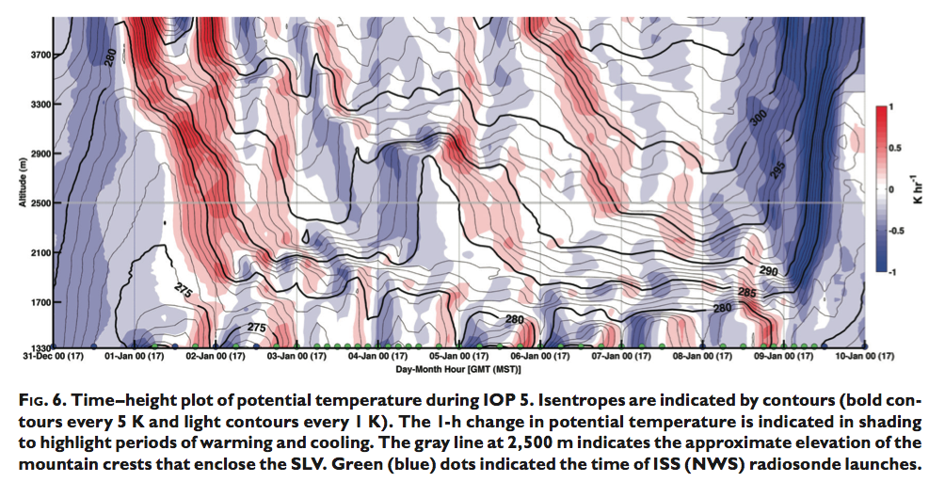
Life Cycle Example
Lareau et al. 2013

Slide 13
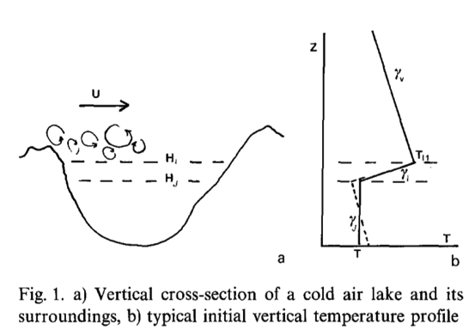
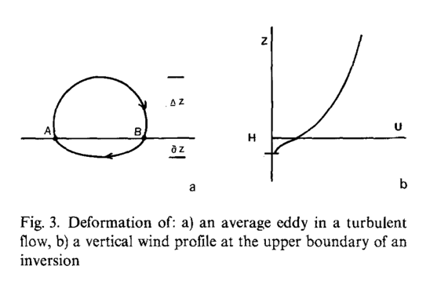
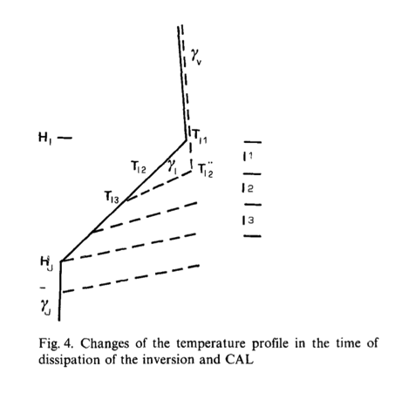
TOP DOWN TURBULENT EROSION
Key Concepts:
-Turbulence aloft encroaches on top of CAP
-CAP air is mixed into the adiabatic layer aloft
-Local inversion strength is enhanced
-Turbulence is damped by increased buoyant consumption
-Continuously accelerating winds are required to maintain erosion
Problem: What is the depth of the layer that is removed?
Petkovšek 1992
Notes:
Focusing in on the dynamic processes, the topic that has received the most attention, though not necessarily enough attention is TURBULENT CAP EROSION
Petkovsek was the first to propose an analytic approach at this problem.

Slide 14
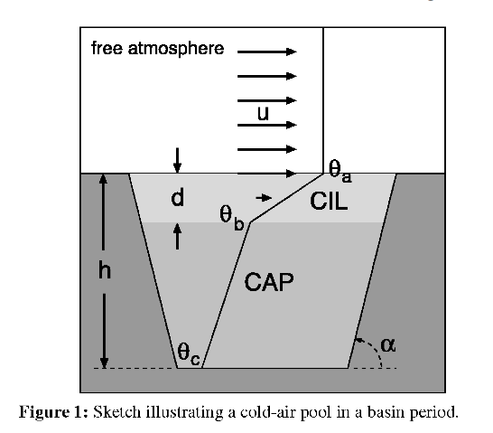
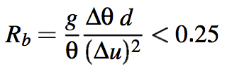

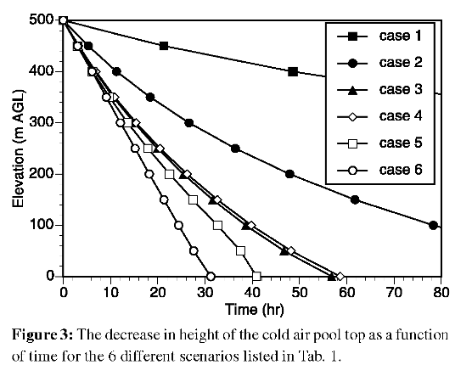
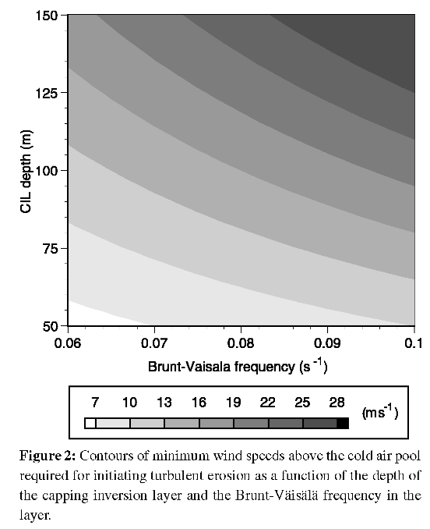
TIME SCALE FOR TURBULENT EROSION
Conclusion: For typical CAP scales, turbulent erosion is unlikely to be the sole source of breakup
Zhong et al. 2003
Notes:
Zhong et al revist this issue using a very similar approach to derive time scales for CAP break up over a range of representative conditions.
Importantly they note the decay of the erosion rate, consistent with Petkovsek, but ultimately conclude that the time scales associated with turbulent break up are too long for it to be the key mechanism.

Slide 15
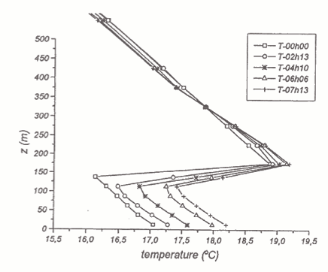
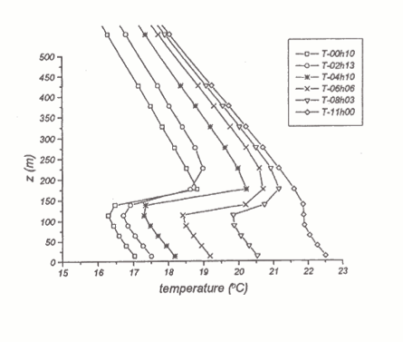
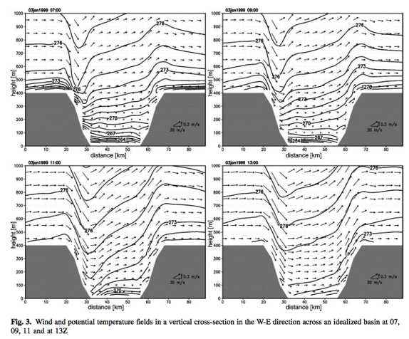
Numerical Simulations of Turbulent Erosion
Vrhovec and Hrabar 1996
Rakovec et al. 2002
Conclusion: Accelerating winds can act to dissipate a CAP, weak steady winds do not

Slide 16
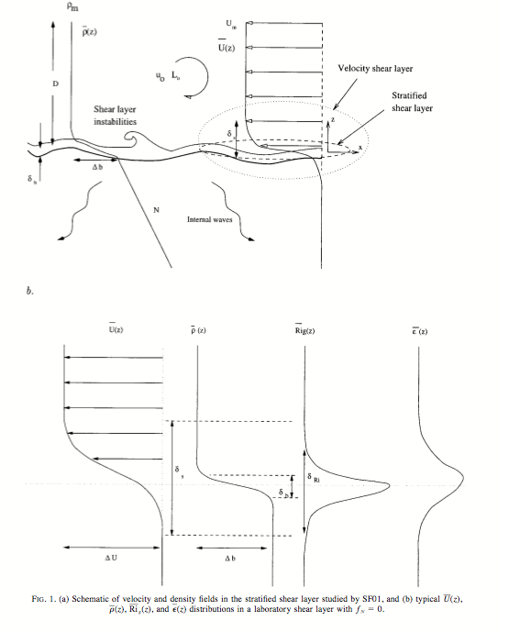
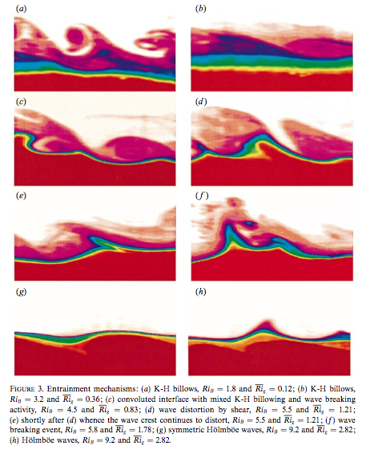
Laboratory Investigations
Strang and Fernando (2001a,b)

Slide 17
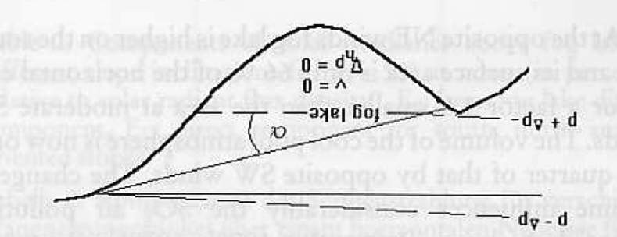
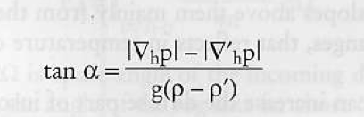
CAP Tilting
Conclusion: CAP will develop a tilt to compensate for a regional pressure gradient.
Petkovšek and Vrhovec 1994
Notes:
Note this effect is similar to the component of a storm surge attributable to reduced pressure

Slide 18
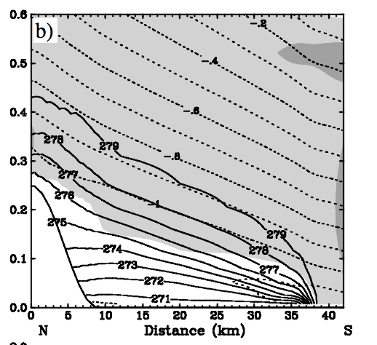
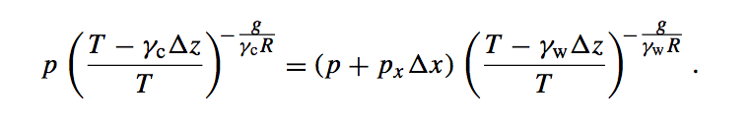
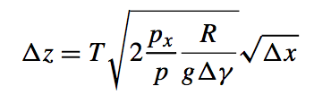
CAP Tilting
Key Points:
CAPs break-up by “spilling over” due to tilting.
Shape is “square root”
Develops a frontal interface
Momentum transfer to front/CAP enhance the tilt.
Fastest break up is during partially blocked ageostrophic flow upstream of a barrier
Zängl 2003
Notes:
Zangl refines the margules formula approach using gradients, rather than temperature itself. Integrates the hydrostatic equations within and without the CAP and derives and expression for CAP depth versus distance from the leading edge.

Slide 19
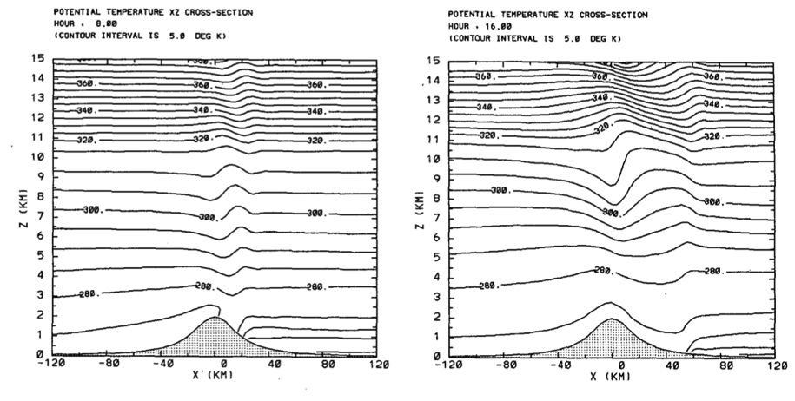
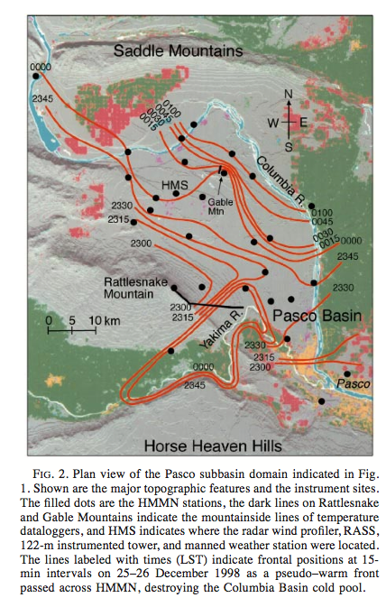
CAP Displacement: Mtn Waves/Warm Fronts
Lee et al. 1989
Also known to occur in the Alpine Föhn (e.g. Flamant et al. (2006)
Whiteman et al. 2001
Notes:
Lee et al 1989 run numerical simulations to investigate the flushing of a lee side inversion by mount waves.

Slide 20
Literature Summary
Turbulent erosion, CAP tilting, and mountain waves are the primary dynamical mechanisms for CAP erosion
More work is required to:
  Test theory against observations
  Expand on theory using high resolution simulations

Slide 21
Data and observations

Slide 22
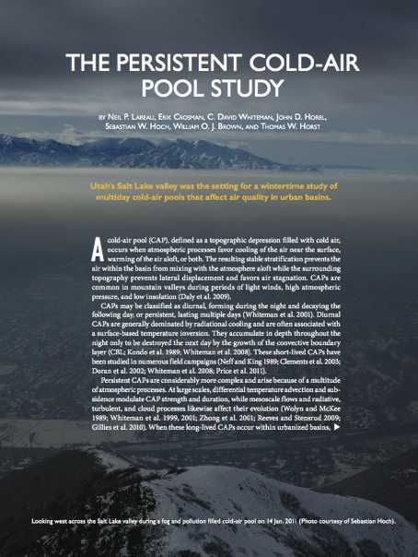

The Persistent Cold-Air Pool Study
Research Objectives
Identify and observe the meteorological processes affecting the life-cycle persistent CAPs
  PCAPS are CAPs that last for more than one diurnal cycle (often many more)
Determine the consequences of these processes on air pollution transport and diffusion in urban basins
Assess how models can be improved to provide more accurate simulations of long-lived CAPs
Lareau et al. 2013 (BAMS)

Slide 23
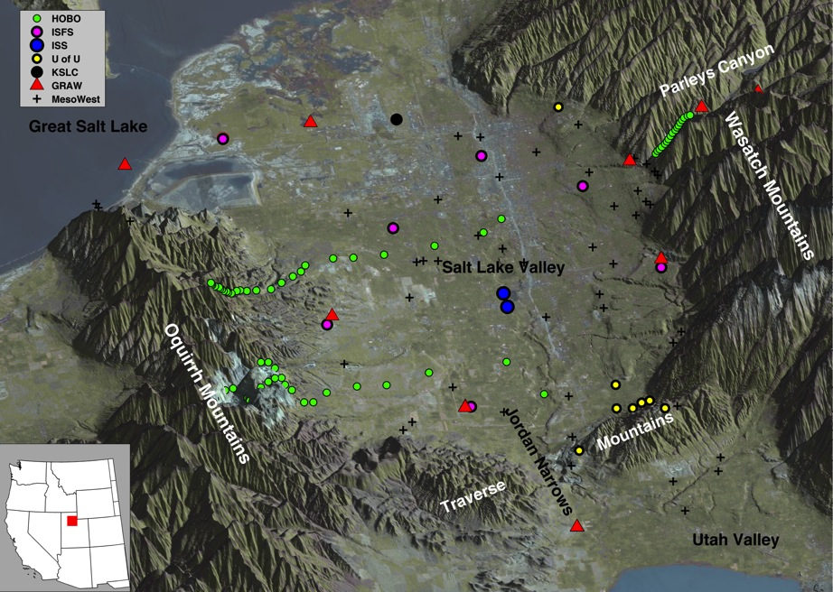
PCAPS: Salt Lake Valley
1 December 2010-7 February 2011
Lareau et al. 2013 (BAMS)
Notes:
We had a chance to test some of these theories during PCAPS

Slide 24
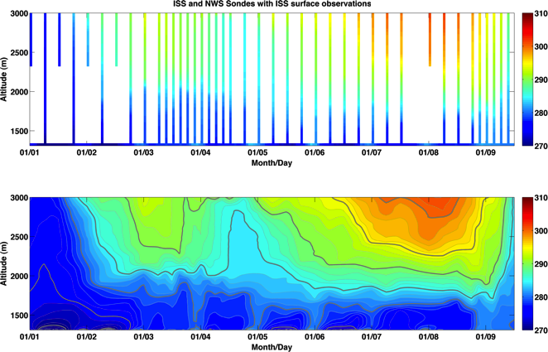
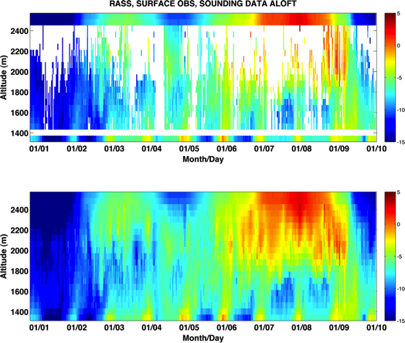
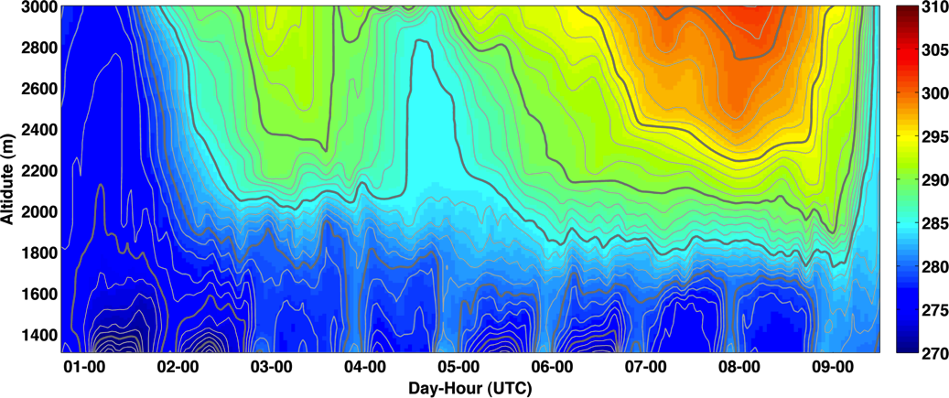
Post Processed Data
Soundings
RASS
BLENDED DATA SET

Slide 25
PCAPS IOP-1 Partial Mix-out Case study
Progress to date:

Slide 26
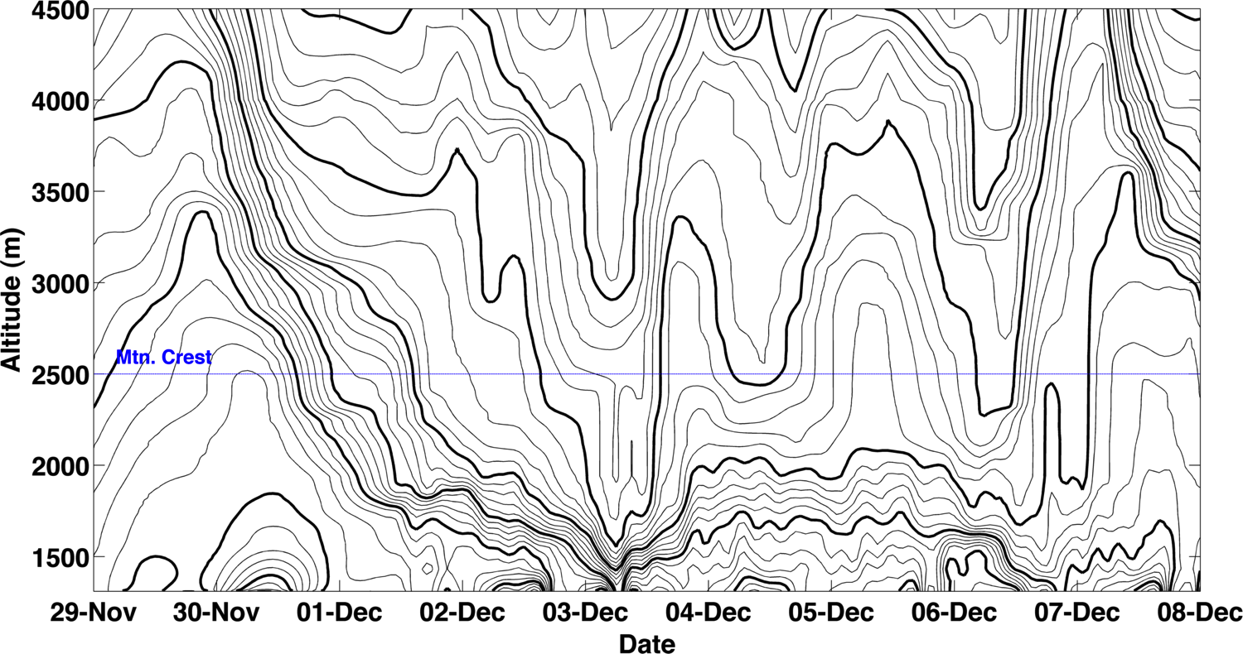
IOP-1: Nov 30th – Dec 7th, 2010
Potential Temperature Time Height
Period of Interest for this talk
(Increasing Time)

Slide 27
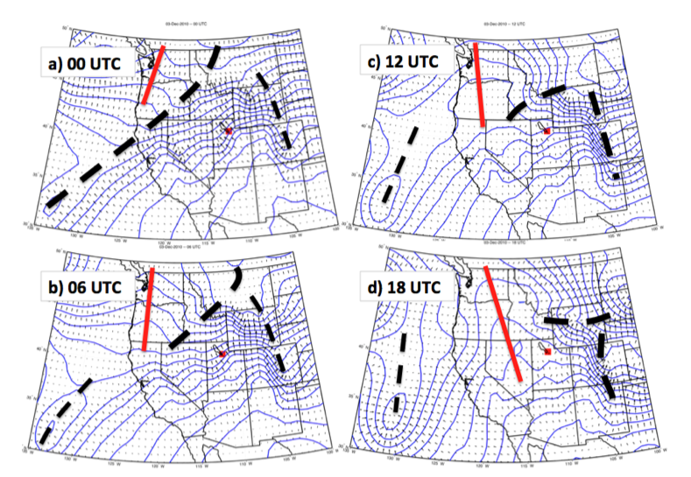

Slide 28
Spatial evolution
Barnes objective analysis using surface observations and sounding data as a background

Slide 29
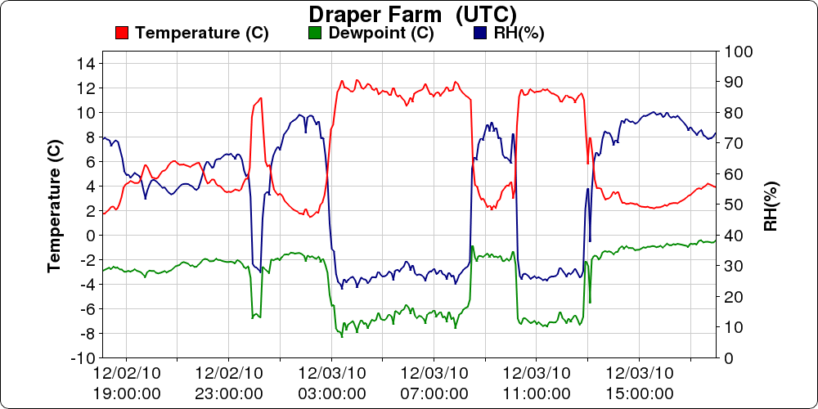
TIME UTC

Slide 30
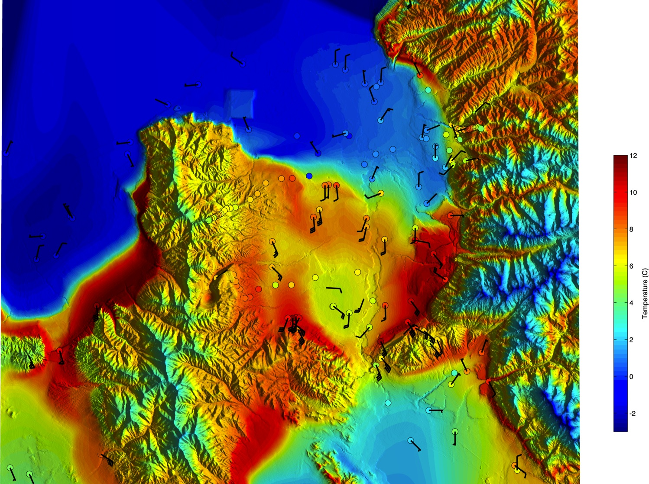
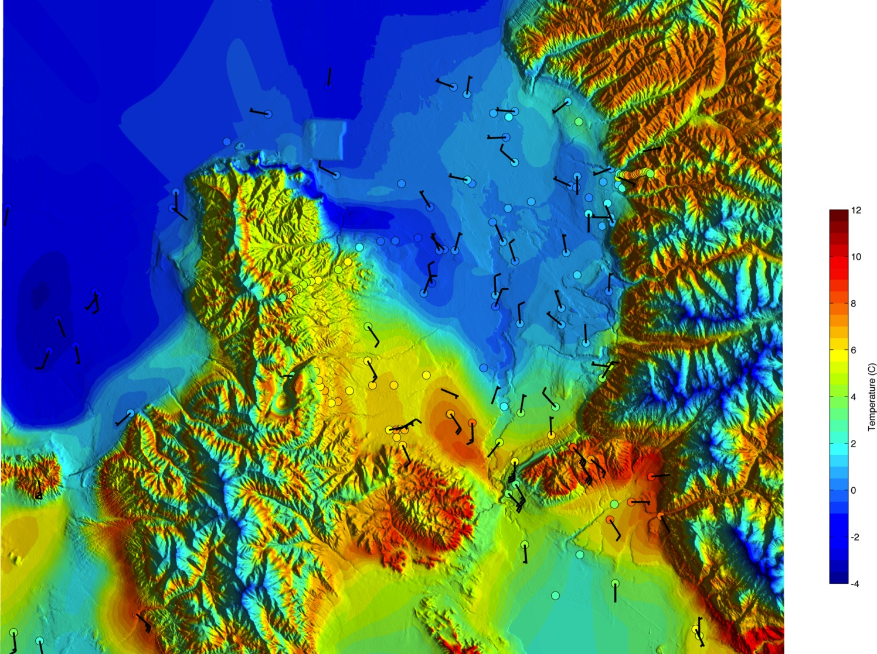
3-Dec 01 UTC (18 MST)

Slide 31
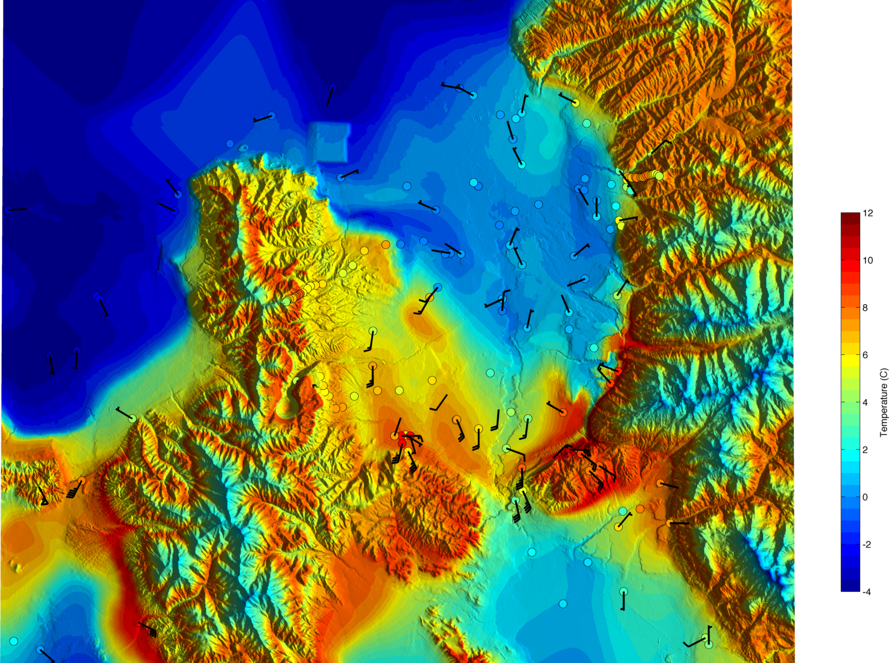
3-Dec 03 UTC (20 MST)

Slide 32
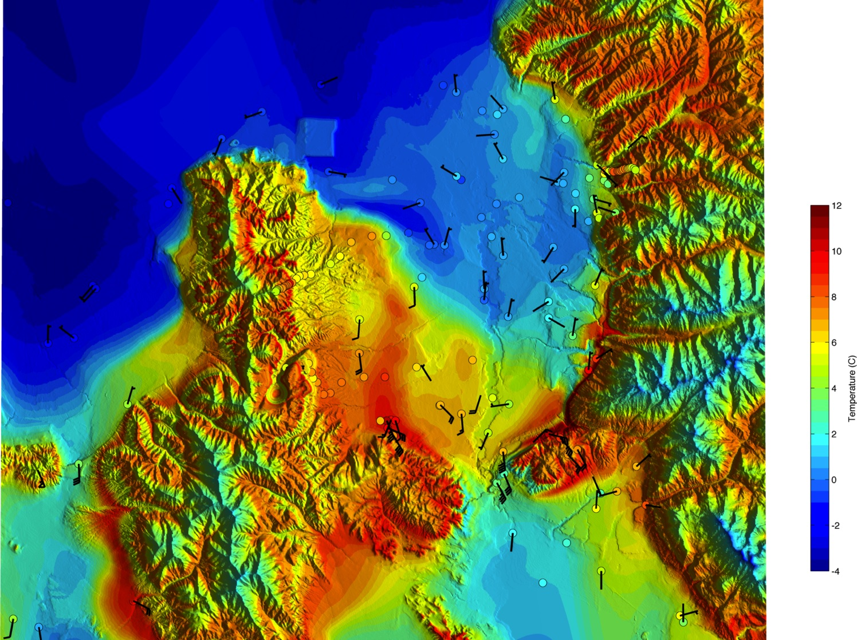
3-Dec 04 UTC (21 MST)

Slide 33
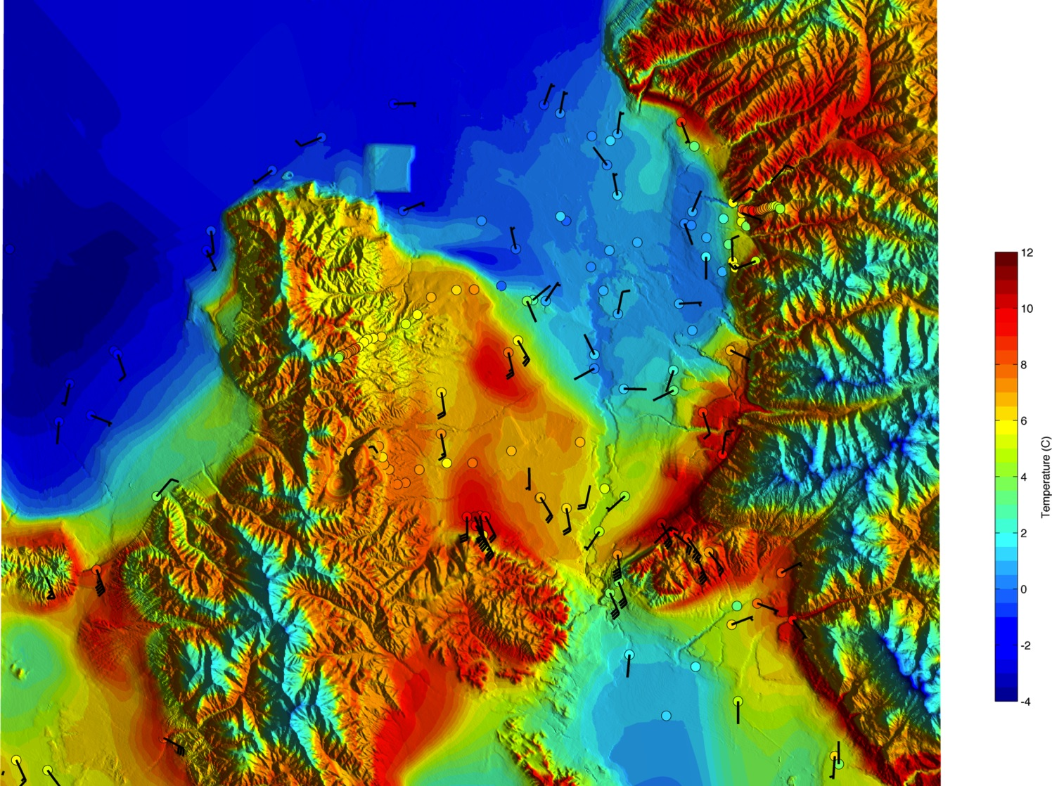
3-Dec 05 UTC (22 MST)

Slide 34
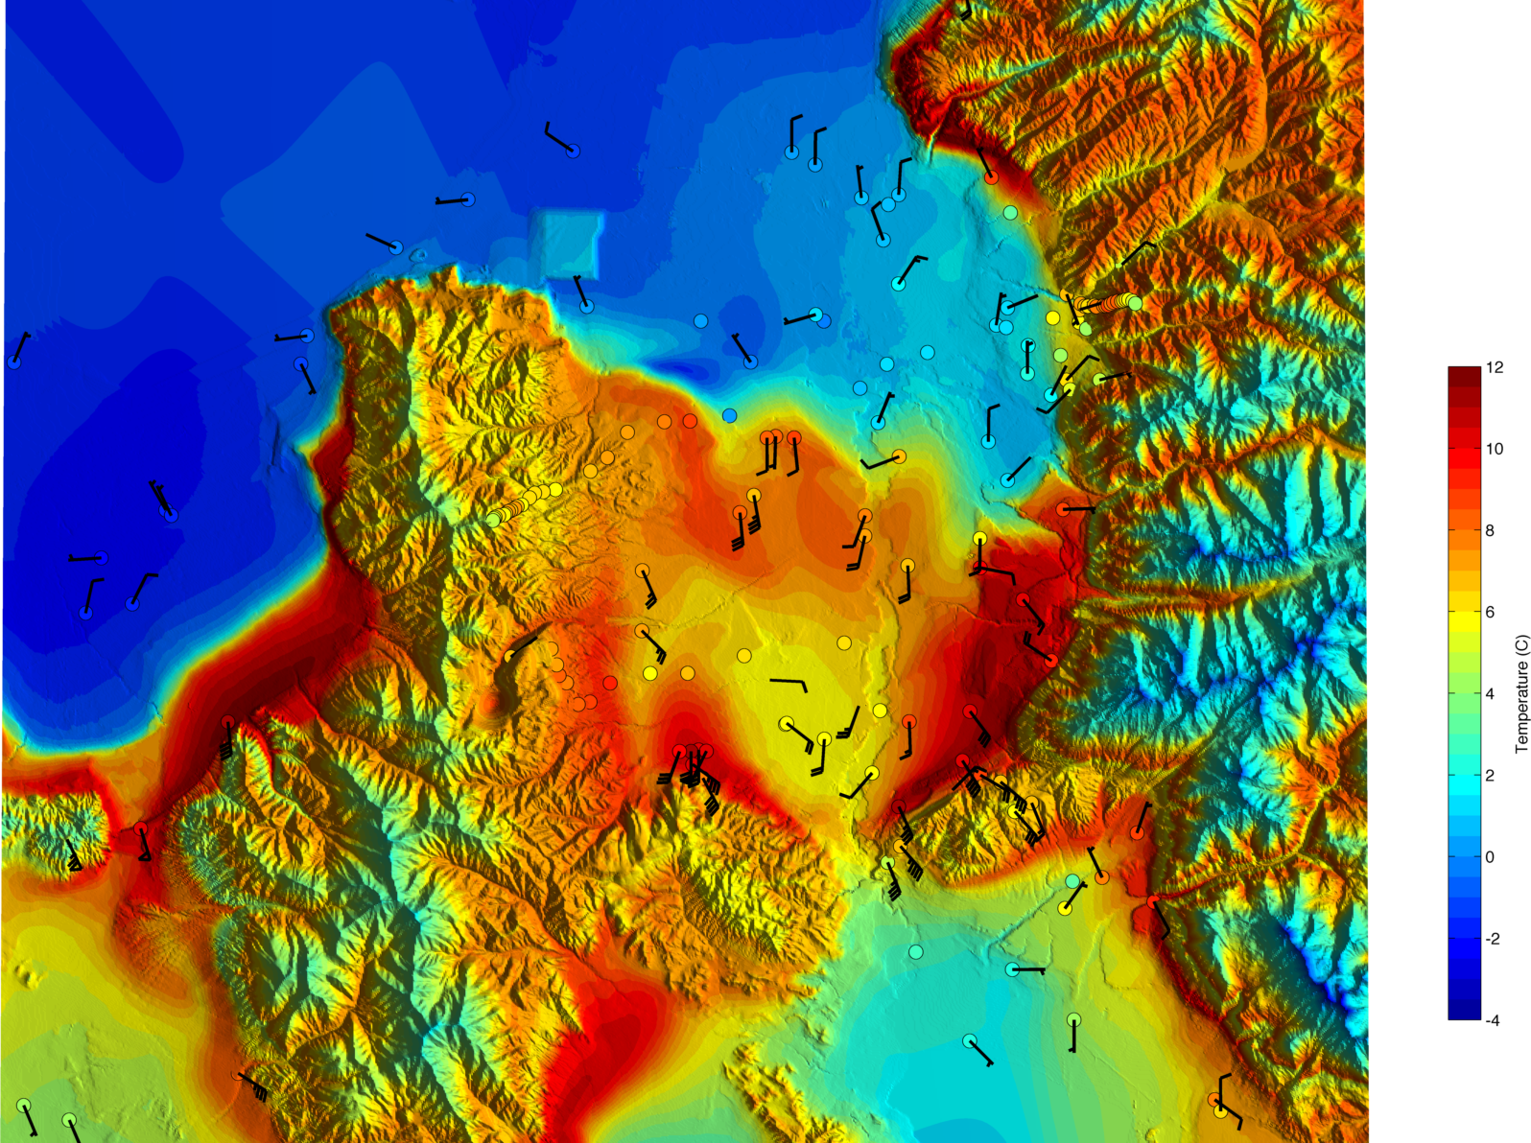
3-Dec 06 UTC (23 MST)

Slide 35
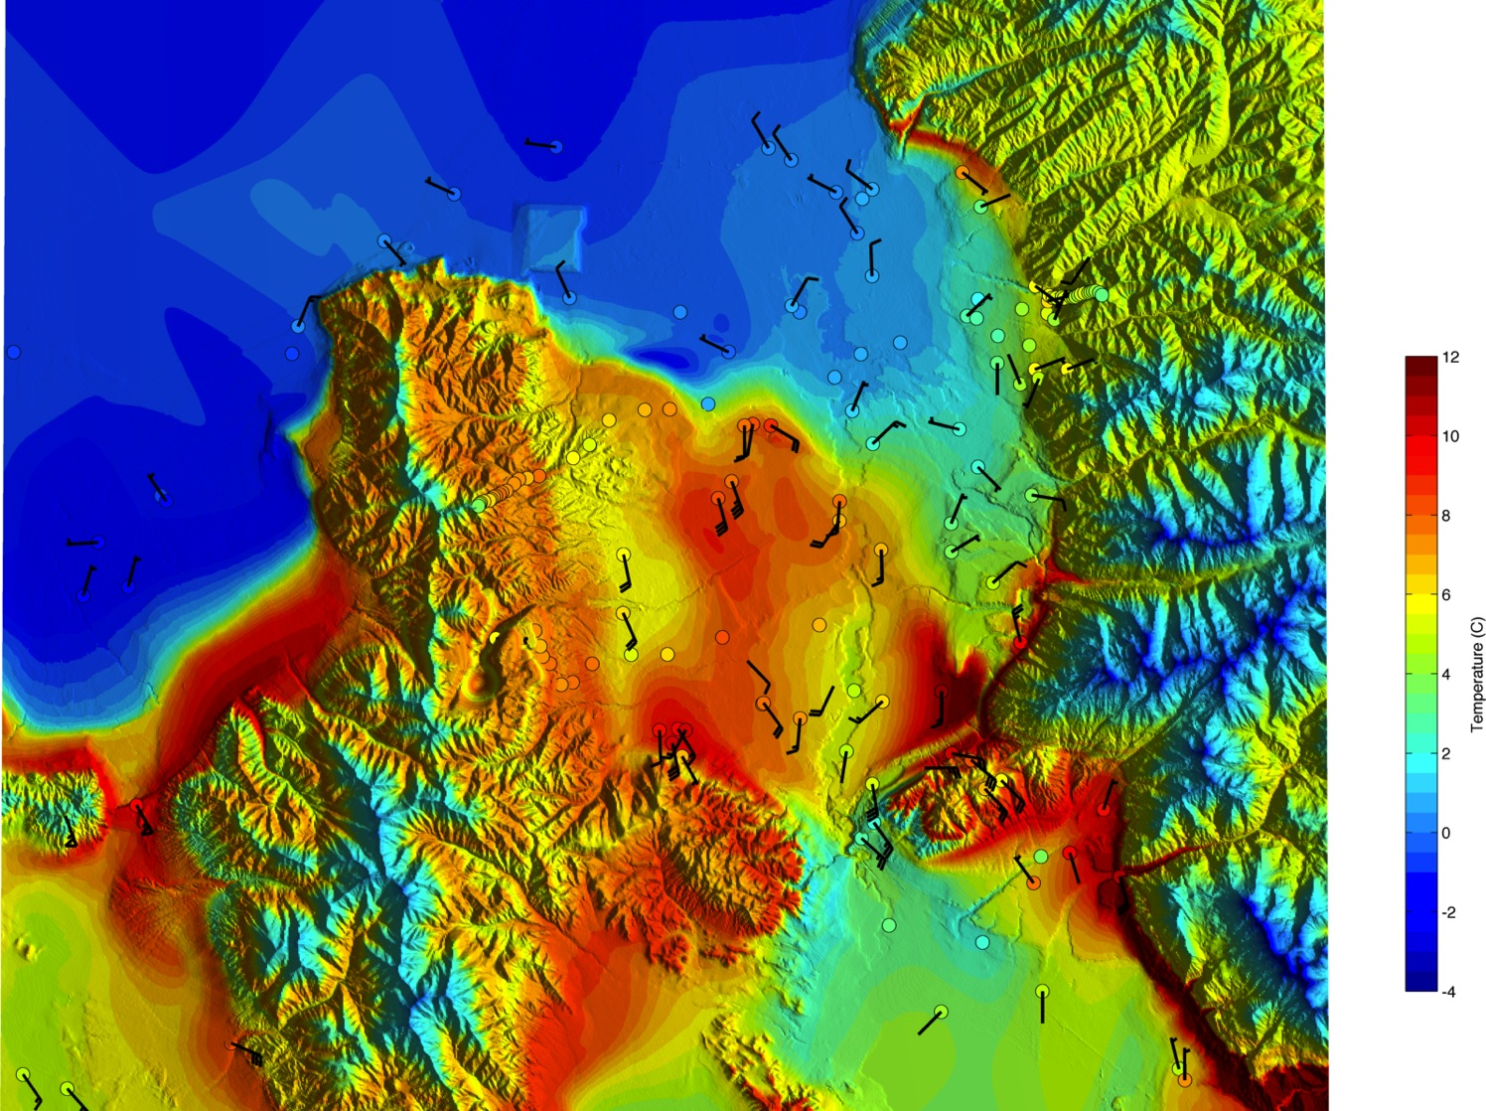
3-Dec 07 UTC (00 MST)

Slide 36
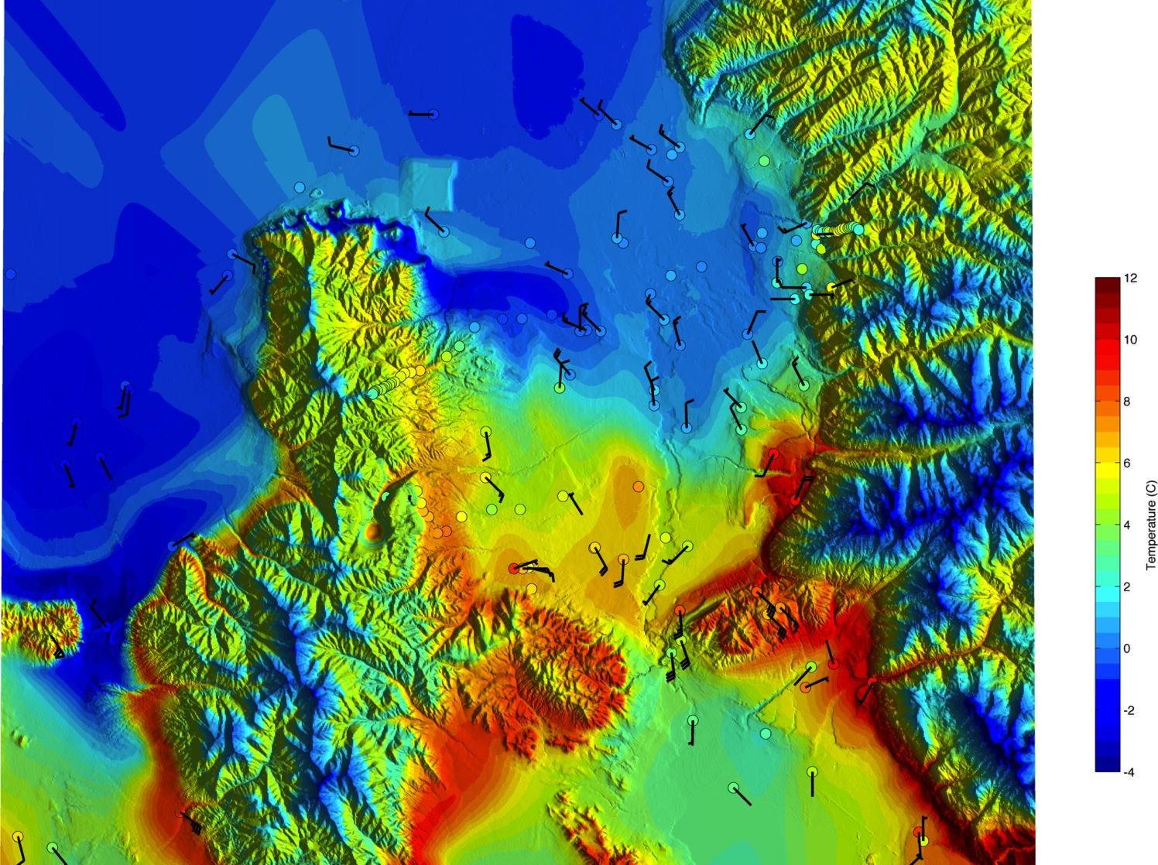
3-Dec 08 UTC (01 MST)

Slide 37
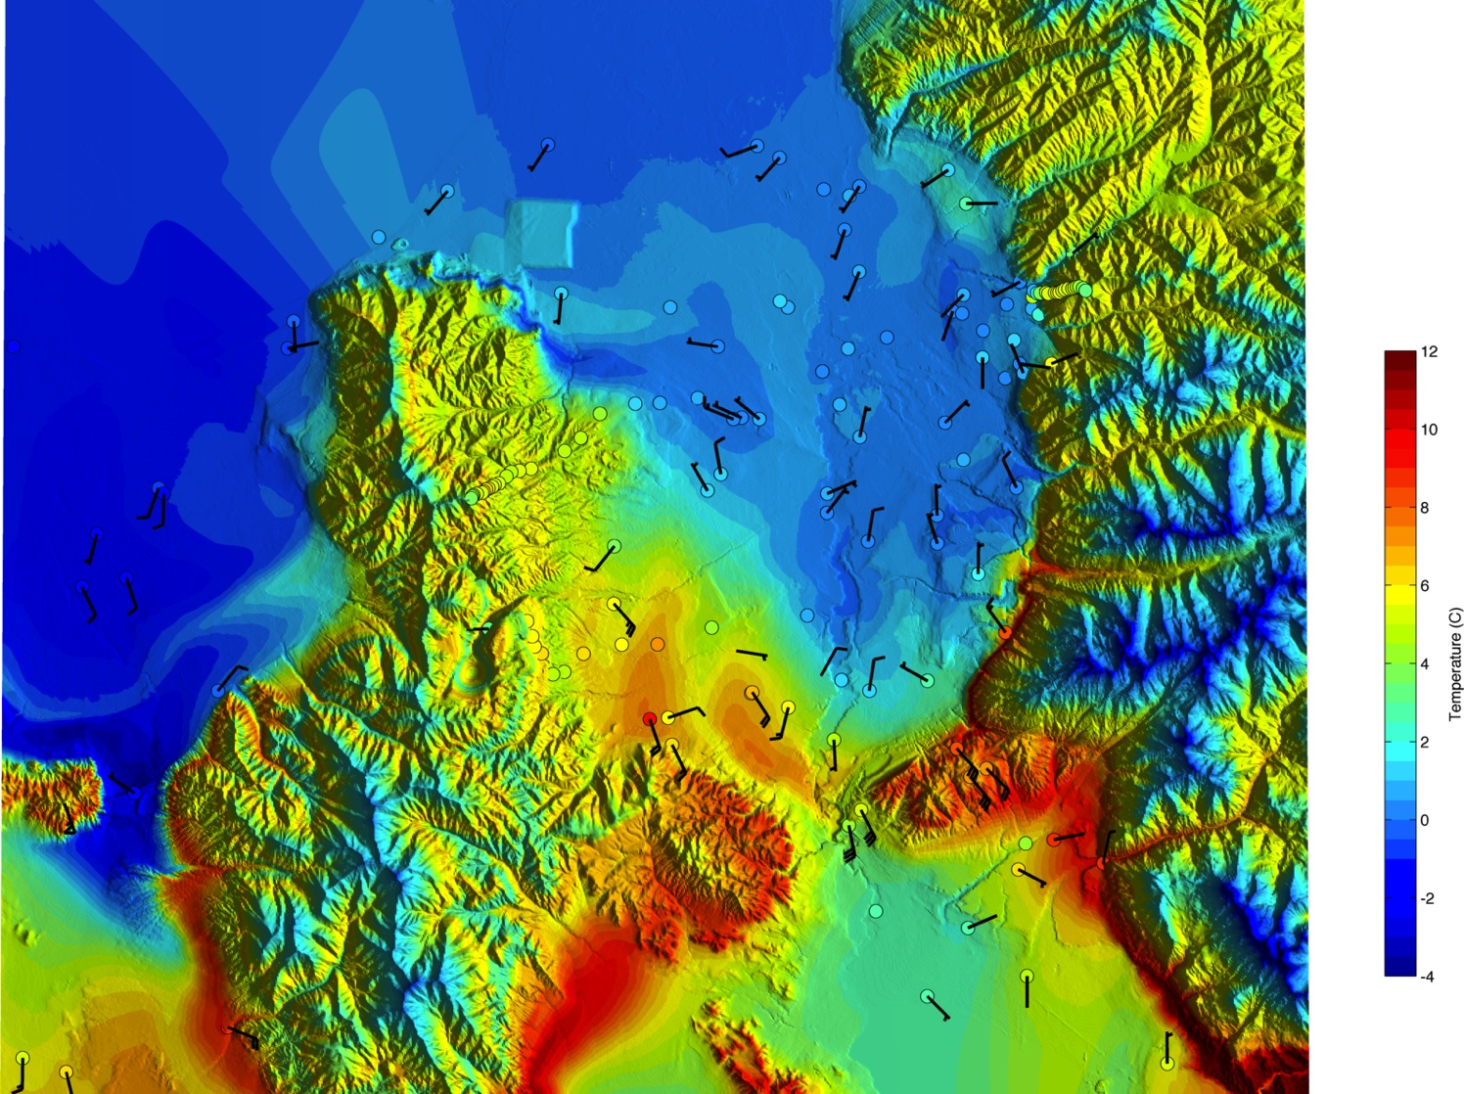
3-Dec 09 UTC (02 MST)

Slide 38
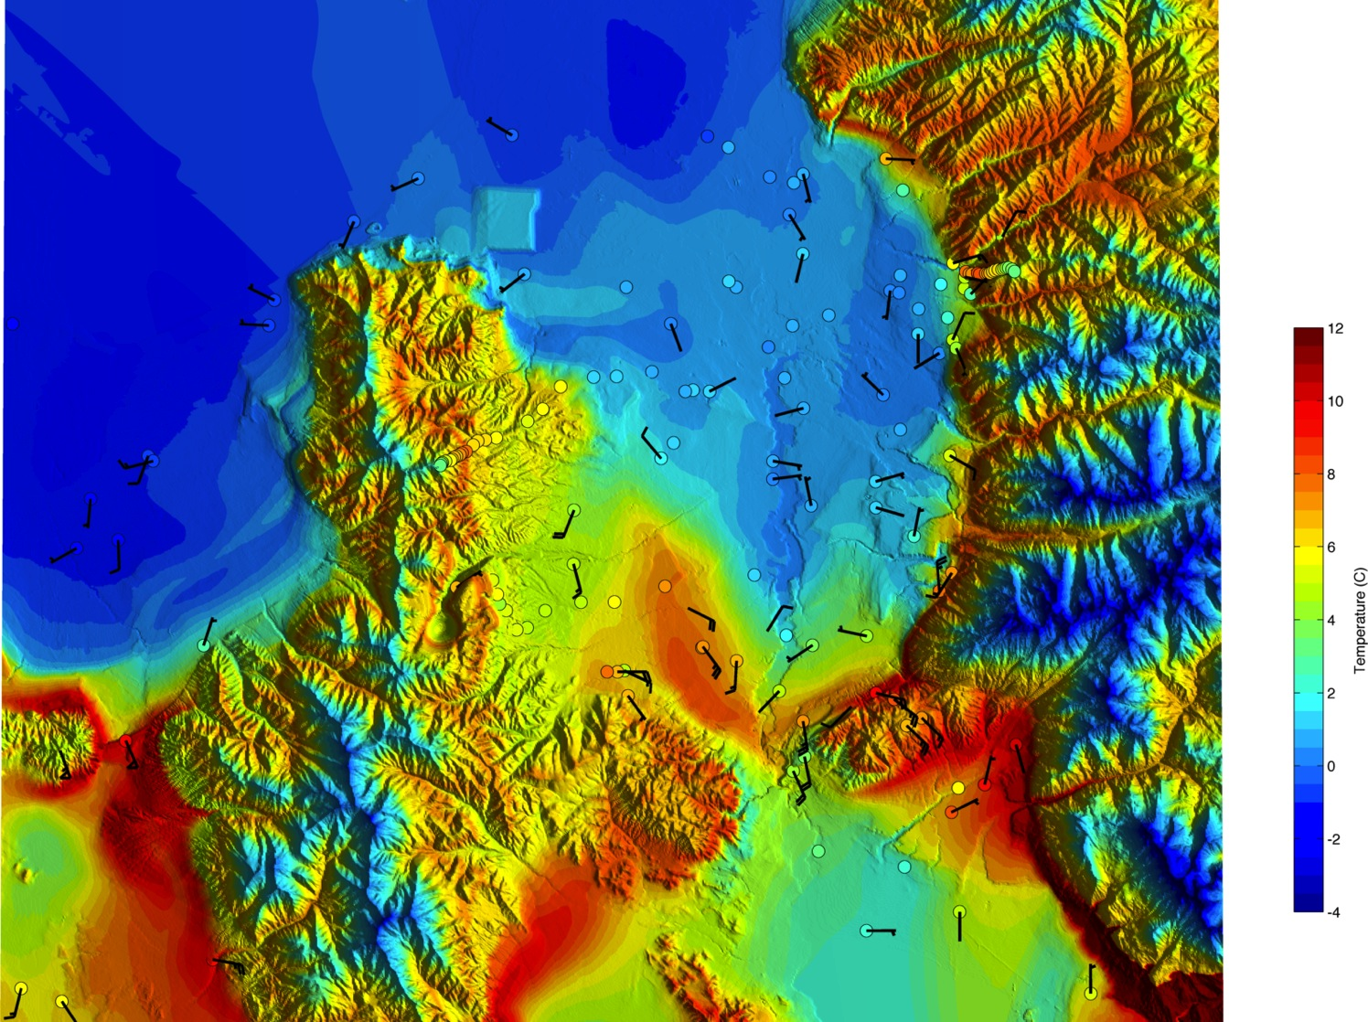
3-Dec 10 UTC (03 MST)

Slide 39
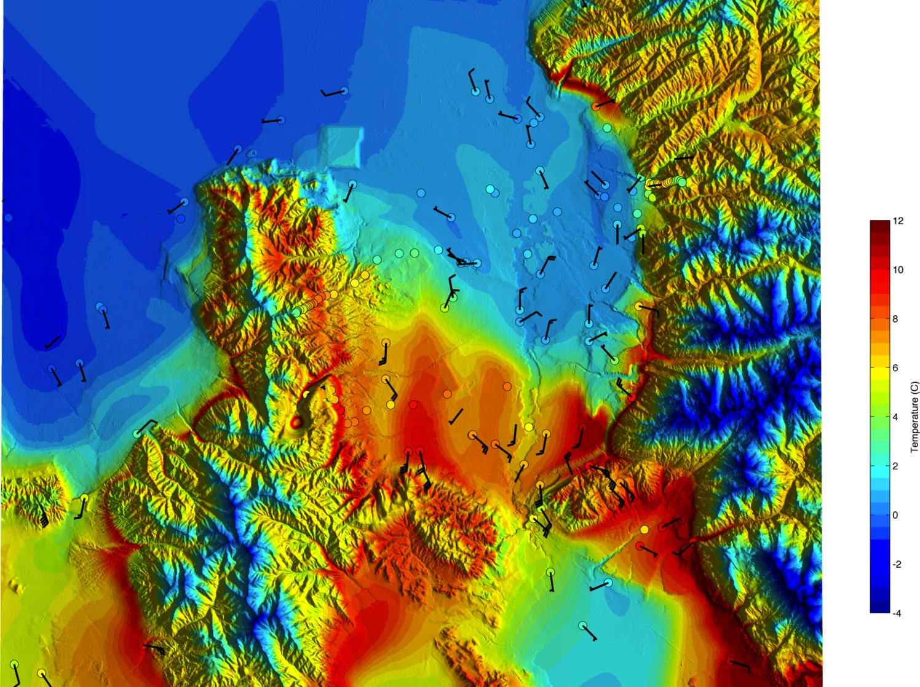
3-Dec 12 UTC (05 MST)

Slide 40
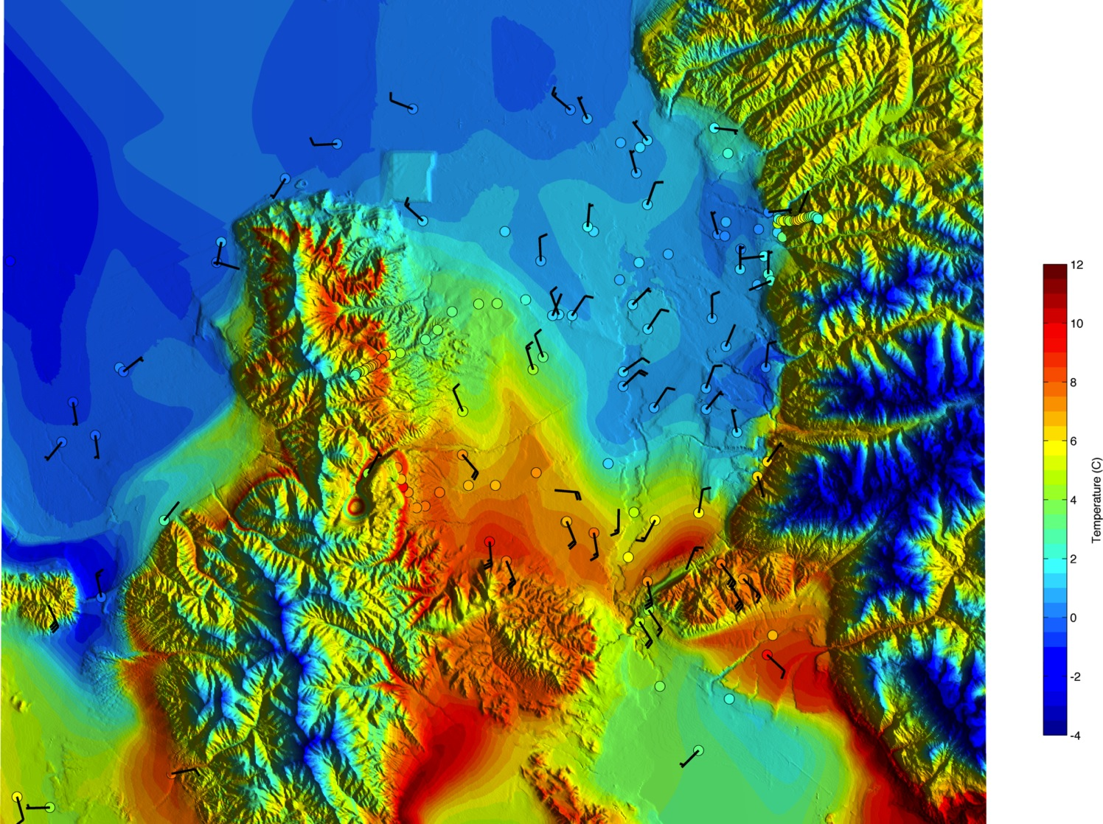
3-Dec 13 UTC (06 MST)

Slide 41
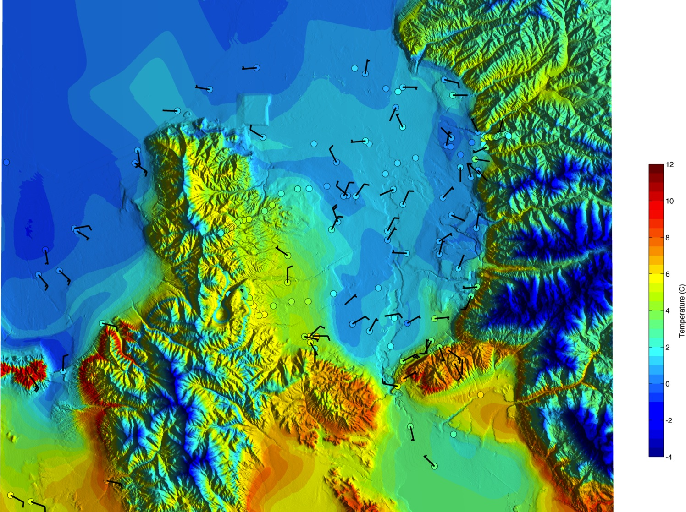
3-Dec 14 UTC (07 MST)

Slide 42
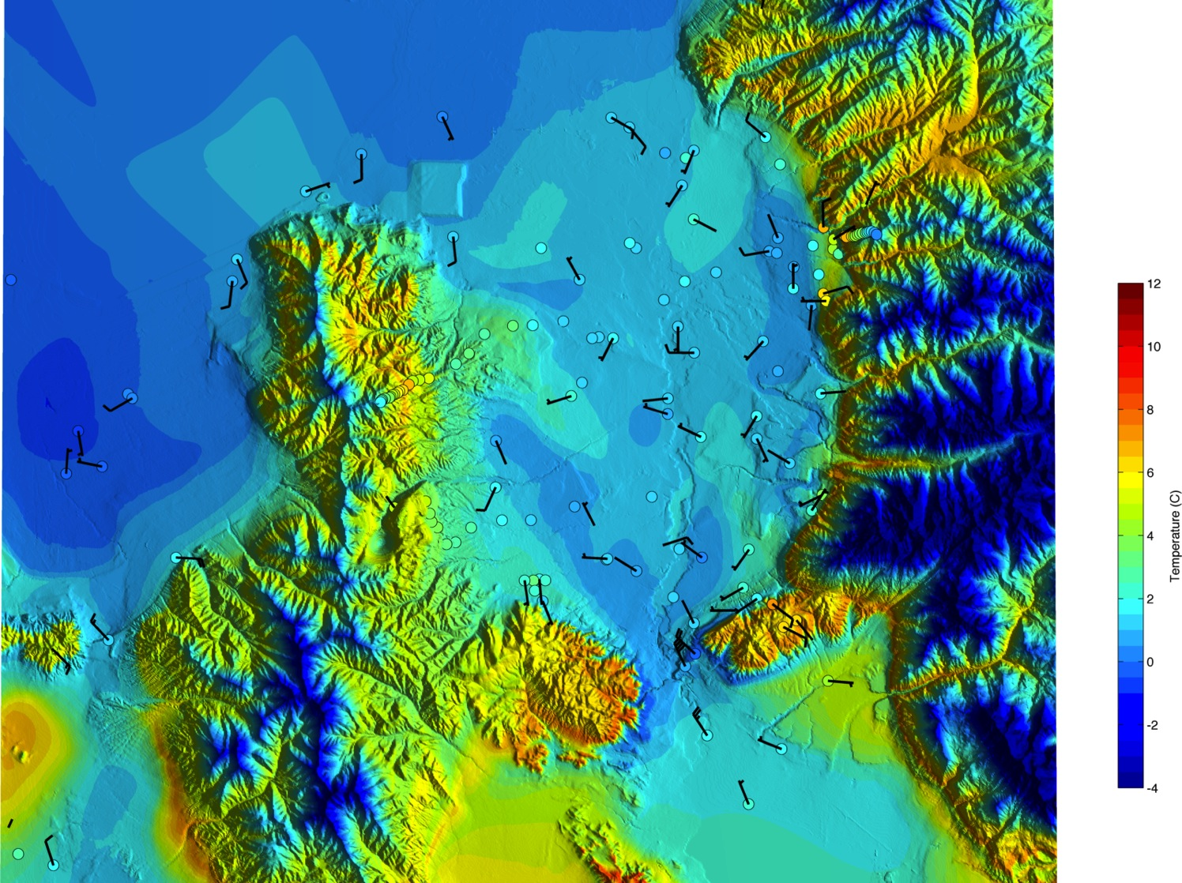
3-Dec 15 UTC (08 MST)

Slide 43
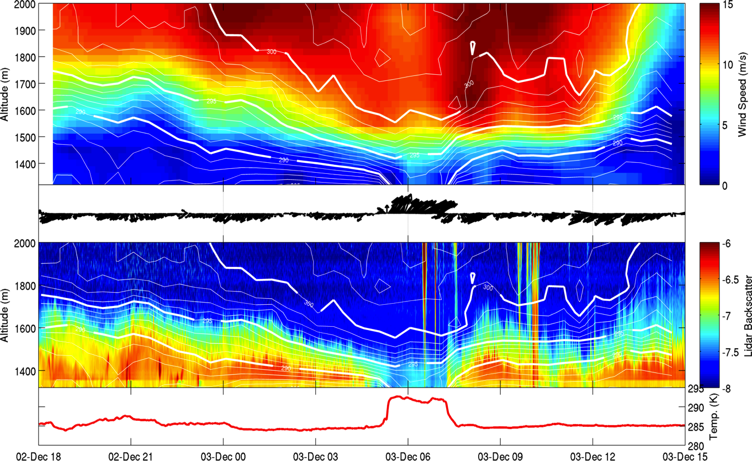
Vertical evolution
Notes:
To gain further insight in to the partial-mix out we look at the vertical profiles at NCAR-ISS
Top panel is potential temperature time height (contours) with wind speed shaded (note that wind direction in this case is predominantly from the south aloft)
Middle pannel shows winds at the surface
Ceilometer data shows that aerosol concentration follow the over all temperatuer evolution, though strong stability extends above the aerosol layers
The frontal period is marked by a sharp rise in temperature and decrease in aerosol concentration

Slide 44
Frontal Structure
Density current dynamics

Slide 45
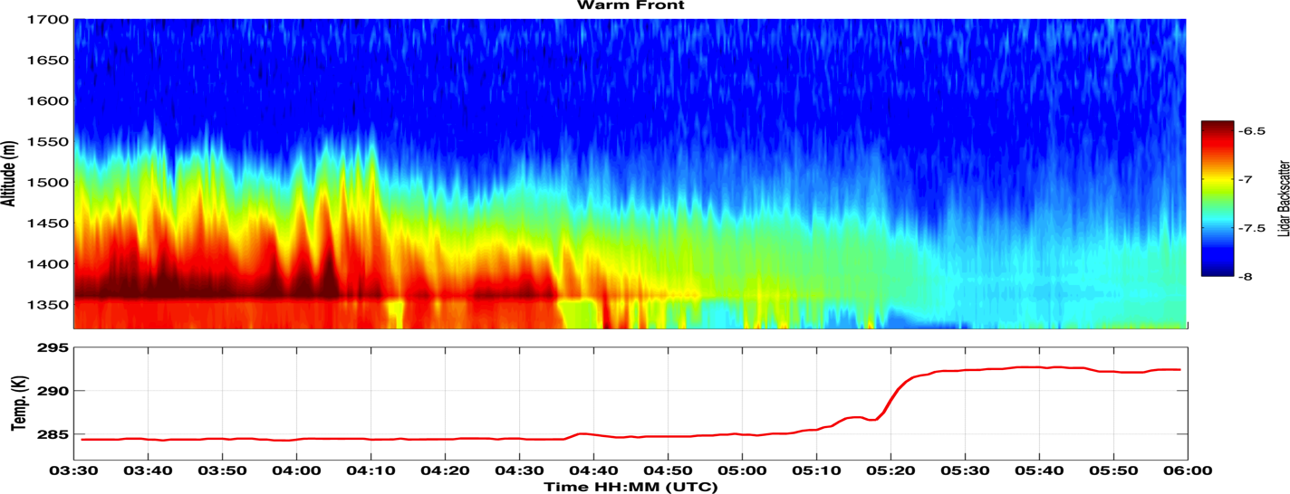
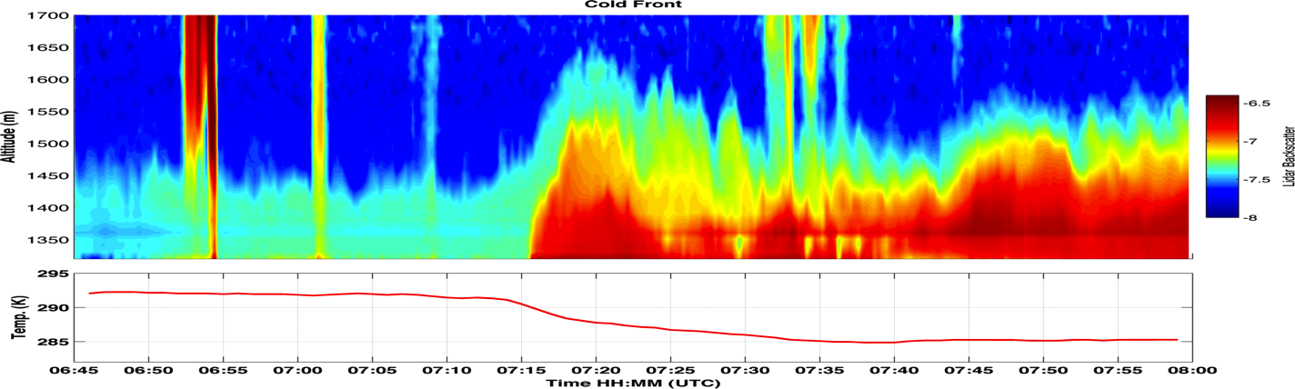
Advancing ~1.75 m/s
Advancing ~5.8 m/s
7-9 m/s
4-7 m/s
Notes:
Warm front slowly lowers towards surface. Resembles a saline wedge.
Zooming in to take a look at the details of the frontal passages:
Warn front is moving very slowly, ~ 1.75 m/s, has a gradual slope, resembles an arrested saline wdege
Moderately supressed turbulence as the front approaches
Reduced aerosol concentration after FROPA
Cold front shows a density current head and mixing behind the head. The flow behind the front is stronger
Appears to lift the upstream environmental fluid

Slide 46




Super Critical
Super Critical
Advancing ~5.8 m/s
7-9 m/s
4-7 m/s
Single Trapped Wave
Single Trapped Wave
White and Helfrich 2012 (JFM)
Notes:
Note the cold FROPA resembles the idealized experiments of White and helfrich that look at density current propagation into a two layer environment
In our case we seem to be in a partially blocked regime, which may favor a morphology similar to their single trapped wave at the density current front… though it is tough to say for certain in this case.

Slide 47


Turbulent Erosion: Kelvin-Helmholtz Instability
100 m
~ 3 min => ~1800 m (assuming v= 10 m/s)
Turbulent mixing occurs within the CAP!!! Not necessarily just along the top edge. Note: We do not know what is going on at the top edge due to the lack of aerosol.
Notes:
Top panel shows a sequence of KH waves that move past ISS. The waves are growing in amplitude in the sequenece and break down to smaller waves after 04:05.
The largest amplitudes are about 100 m, and the wave frequence is about once every 3 mins, giving a very rough spatial scale of >1500m
The waves extrude high aerosol air into the cleaner air aloft
Later, using a sounding, we can see that the waves occur WITHIN the two layered CAP structure where Ri<Ric, not necessarily acting as top down erosion, but instead internal erosion. This complicates the highly idealized scenarios of Petkovsek and Zhong.

Slide 48




Mountain Wave/CAP Displacement
Notes:
There is evidence of a mountain wave contributing to the CAP partial mix-out.
The top panels show the rapid development of an adiabatic profile along the traverse ridge, suggesting isentropes are following the terrain in a hydraulic type flow.
During the same period winds at the base of the range accelerate. Equaling and surpassing the winds at ridge crest.
It is during these hydraulic flow periods that the warm front mobilizes through the valley.
When the hydraulic flow subsides the CAP sloshes back to the south as a cold front with the density current nose described above.

Slide 49



CAP Tilting
3-Dec 11 UTC (04 MST)
Airport
NCAR-ISS
Traverse Mtn
Notes:
At 11 UTC the tilt of the CAP is pronounced.
Slope is about 400 m over 25 Km.

Slide 50
Event Summary
Short wave trough, enhanced pressure gradient, and strong winds aloft disturb the IOP-1 CAP
A warm (cold) front forms moving north (south) through the valley
The warm (cold) front advances slowly (quickly) acting as a density current.
KH Waves appear WITHIN the multi-layered CAP.
A mountain wave exerts control on the timing of frontal movement
The CAP shows a sloping surface throughout the valley.

Slide 51
RESEARCH TRAJECTORY

Slide 52
Large Eddy Simulations (LES)
Simulate and quantify the mountain wave, density current, tilting, and KHI impacts on CAP breakup
Explicitly resolve the inertial scale eddies most directly responsible for mixing in the CAP
  Avoid parameterized mixing
Notes:
Observations alone are insufficient to advance our knowledge of PCAPS destruction by dynamical processes. Modeling is required

Slide 53





Proof of Concept WRF-LES Runs
Upstream profile: Adiabatic with sheared boundary layer
CAP profile: Hyperbolic tangent for wind and temperature
Mtns: 400 m tall
Domain: 15 KM, dx=100, dz=50 m

Slide 54

TO DO:
-Define the parameter space (targeting scales of SLV and PCAPS)
-Accelerating winds
-Refinements to experiment design/resolution/etc.
-TKE and Heat Budget terms for the valley atmosphere during mix-out
-Compare results with PCAPS observations / Turbulence Statistics

Slide 55
Real Data Simulations
Model set up
Event:
NAM initialization
12.15 km/4.05 km/1.35 km
Tests with both YSU and MYJ boundary layers
IOP 9:
  Most data rich event
  Fog/clouds
  Strong winds
  Forecast challenge
Goal: Assess model fidelity as function of resolution to capture CAP dynamics

Slide 56

WRF IOP-9 Simulation

Slide 57
Research Timeline
December 2012-January 2013:
  Refine LES experiments, execute model runs
Feb-April:
  Process model results, re-runs, synthesize results with observations
May-July:
  Distill results into a conceptual model for CAP breakup.
  Prepare thesis
August:
  Thesis defense
  Prepare journal articles
Sept.
  Transition to post-doc or other employment opportunities

Slide 58


Slide 59

QUESTSIONS?
Acknowledgements: Joe Young for ceilometer data, Erik Crosman for modeling collaborations, the entire PCAPS team

Slide 60




MASTERS RESEARCH AND “SPIN OFFS”
Lareau and Horel 2012

