Slide 1
QausiGeostrophic Perspective
Cyclogensis perspectives

Slide 2
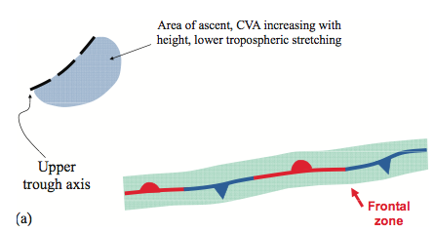
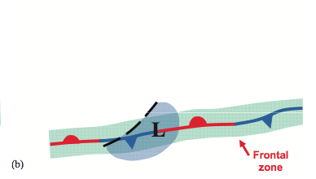
UPPER LEVEL TROUGH OVERTAKES A SURFACE BAROCLINIC ZONE:
1.) QG ASCENT LEADS TO COLUMN STRETCHING
2.) COLUMN STRETCHING “CONCENTRATES THE LOCAL VORTICITY” AND SPINS UP A SURFACE CYCLONE

Slide 3
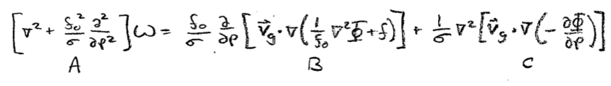
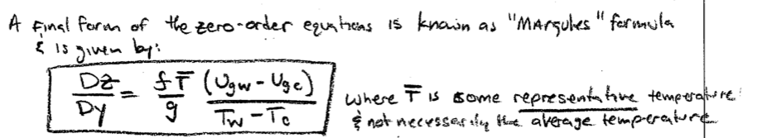
DIAGNOSE ASCENT WITH QG OMEGA EQUATION
DIAGNOSE VORTICITY WITH MARGULE’S FORMULA

Slide 4
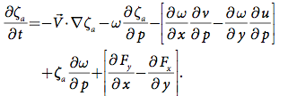
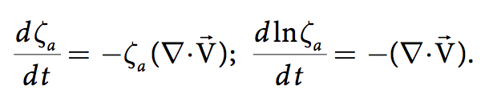
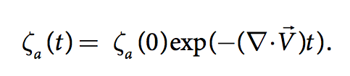

Slide 5
Potential Vorticity
Cyclogensis perspectives

Slide 6
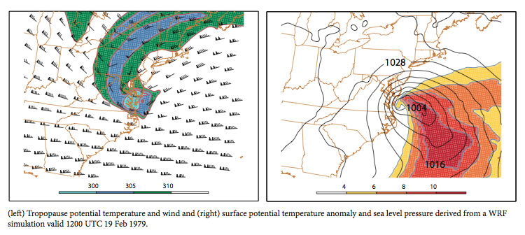
Lackman

Slide 7
Startospheric “extrusion” of high PV air (cyclonic PV anomaly aloft)
Upper tropospheric diabatic PV destruction-> builds the downstream ridge
Lower tropospheric diabatic PV max
Near Surface Warm Anomaly
Lets find an example on today’s weather maps!

Slide 8
SUMMARY OF PV DYNAMICS
Mutual Amplification:
  The circulations generated by the upper PV and lower thermal anomalies superimpose to increase the amplitude of both features
    “Essence” of baroclinic instability -> disturbance grows!!
Diabatic Growth:
  Intense latent heating can drastically alter PV distribution, enhancing near surface cyclonic anomalies and destroying PV aloft-> contributes to the development of the “PV hook” aloft and the intensity of the downstream ridge

Slide 9
OROGRAPHIC PERSPECTIVE
Cyclogenesis perspectives:

Slide 10
OROGRAPHIC PERSPECTIVE
PV: Column stretching on the leeward side of the range favors the spin up of cyclonic relative vorticity or an increase in absolute vorticity through southward displacement
PV: Column compression on the windward slopes suppresses cyclonic development

Slide 11
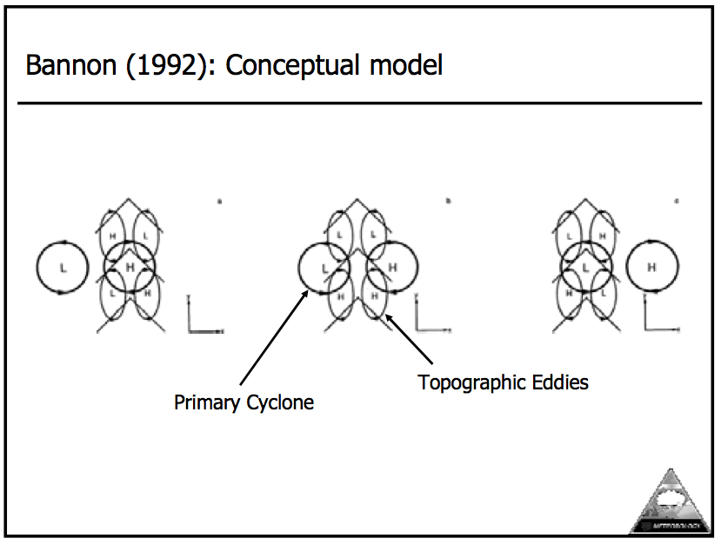

Slide 12
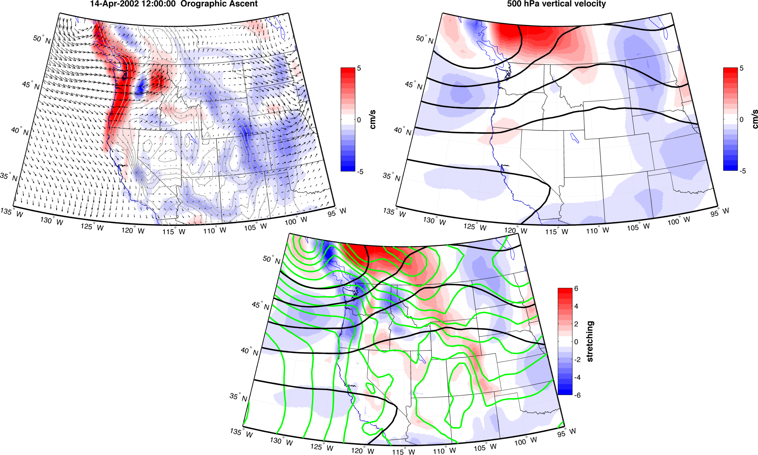

Slide 13
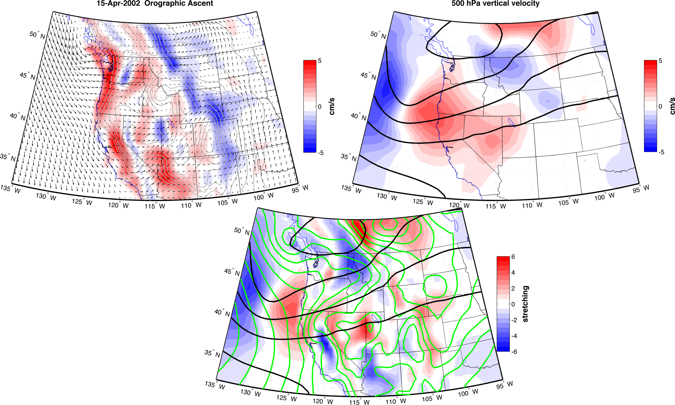

Slide 14
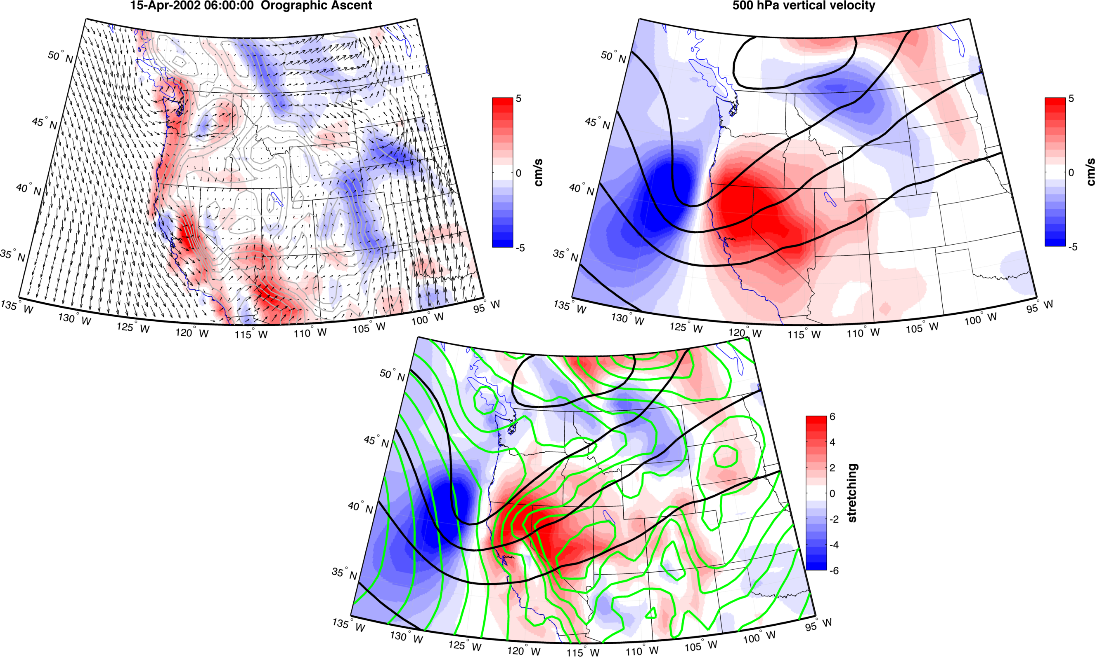

Slide 15
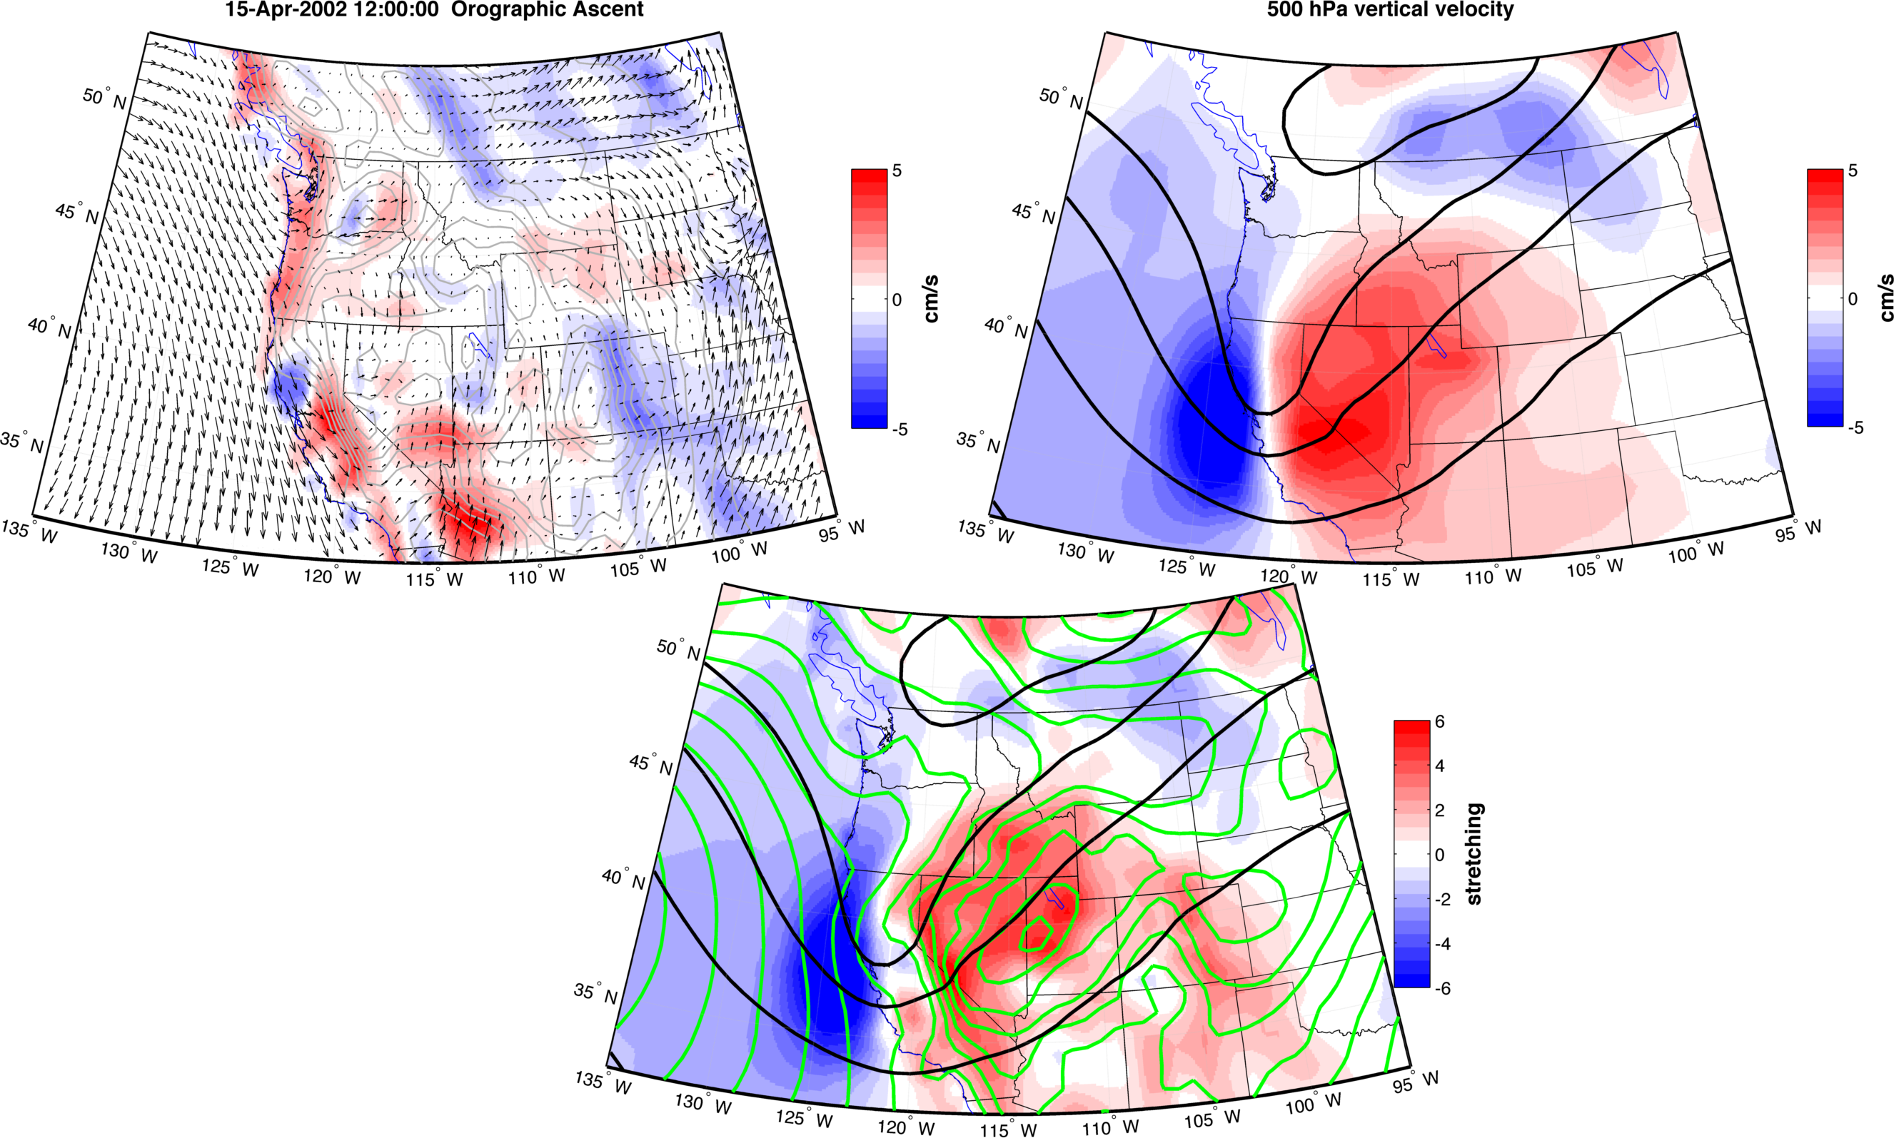

Slide 16
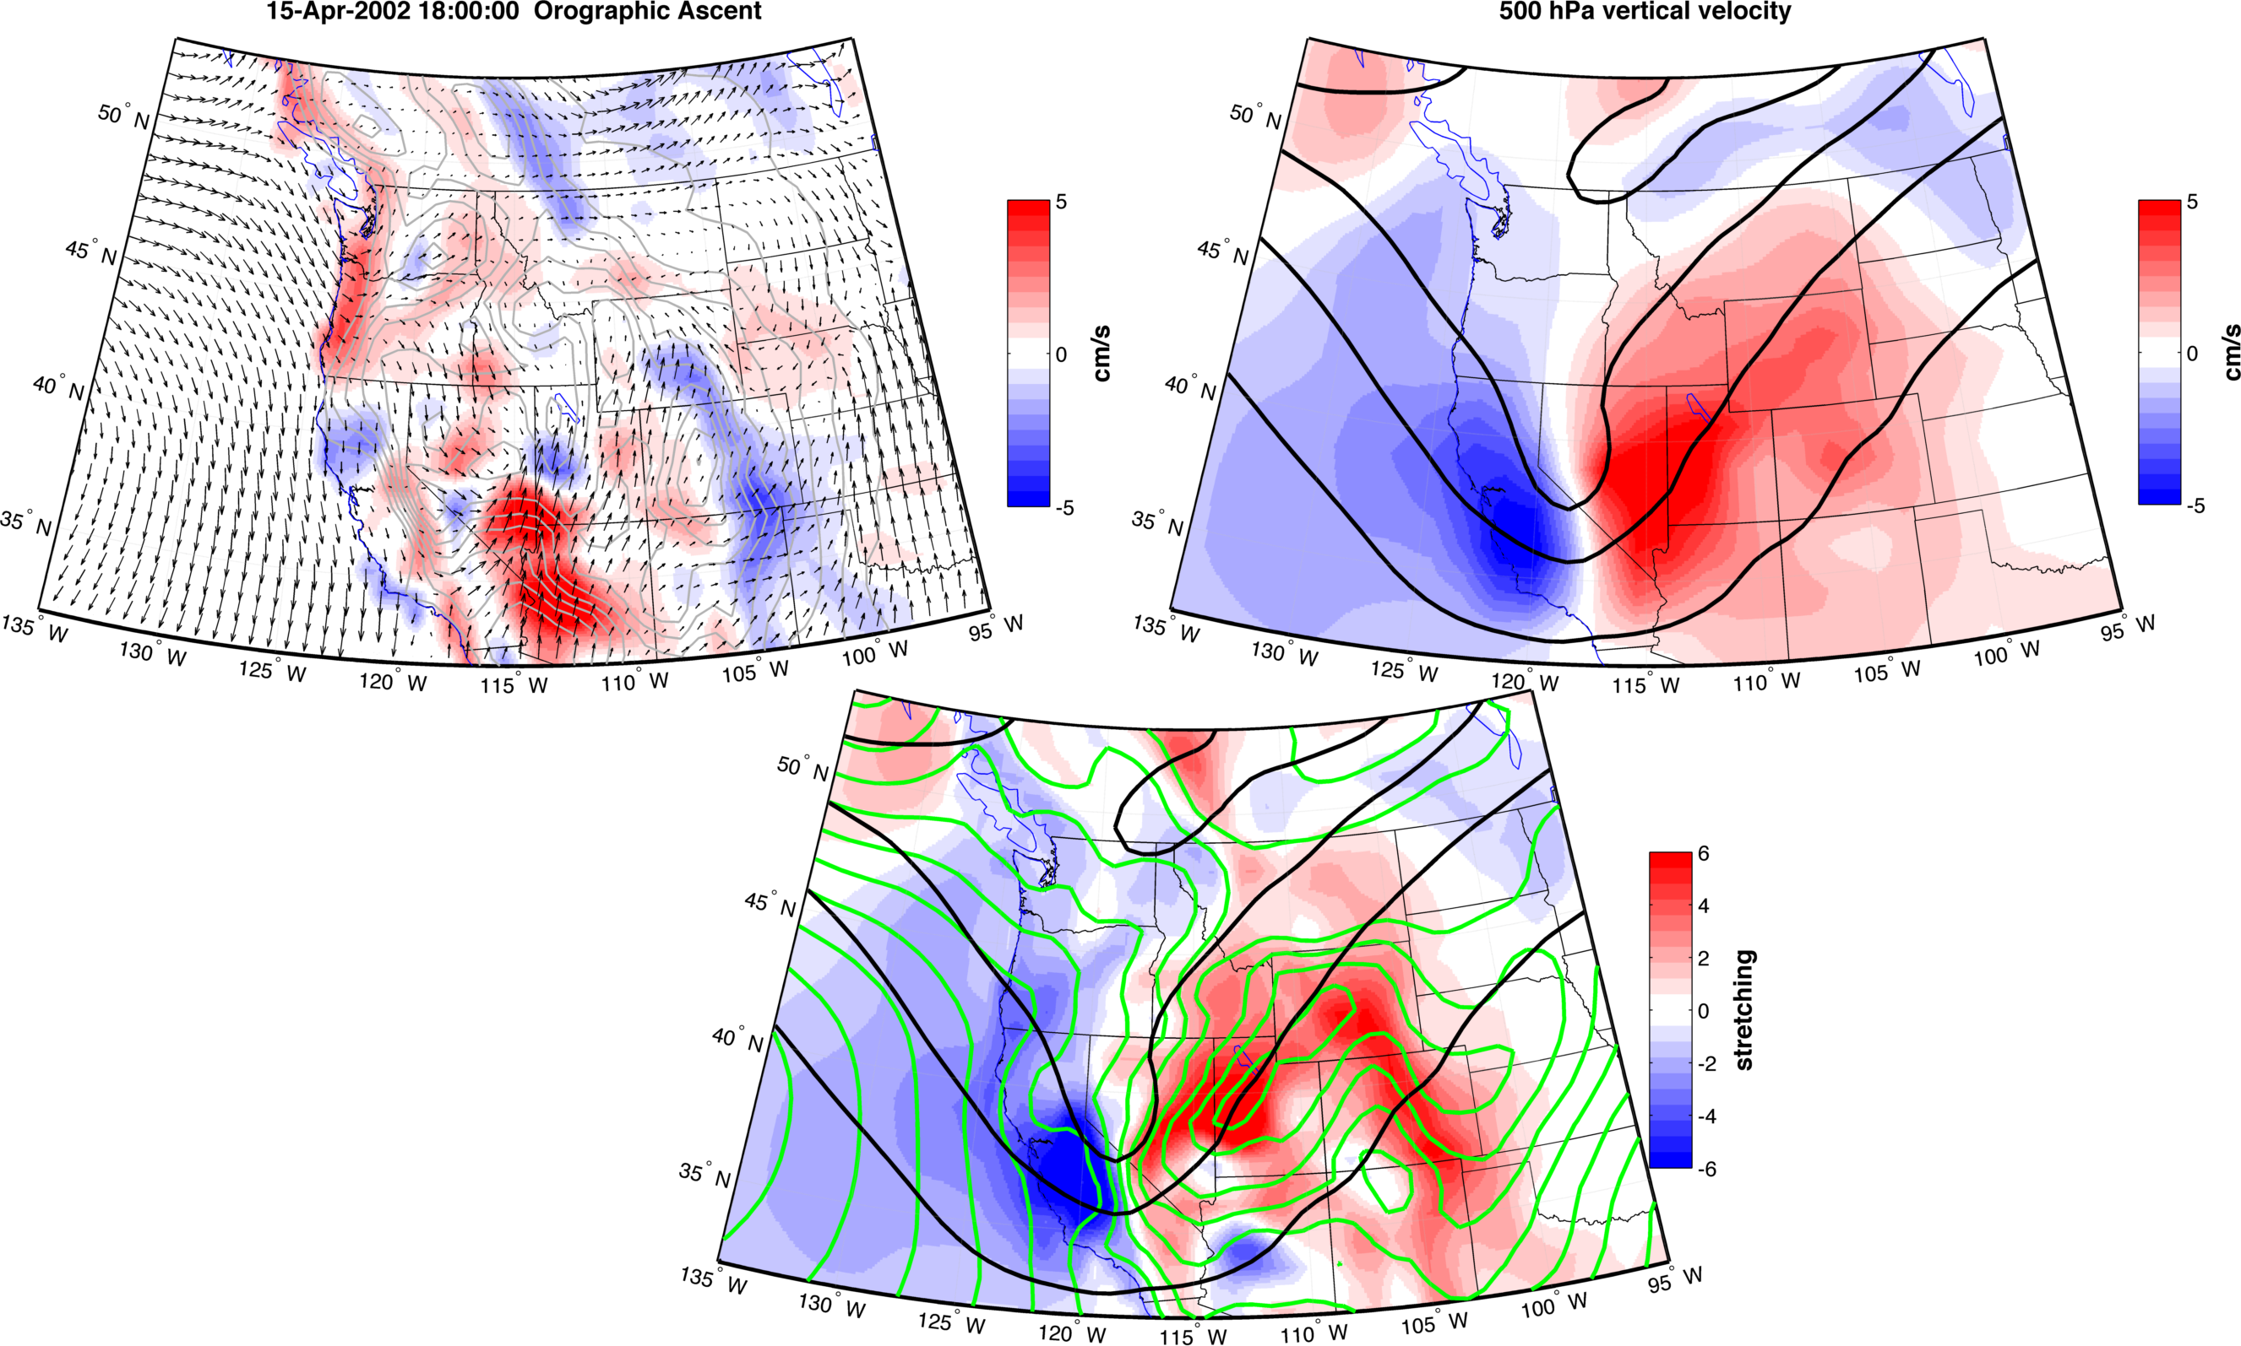

Slide 17
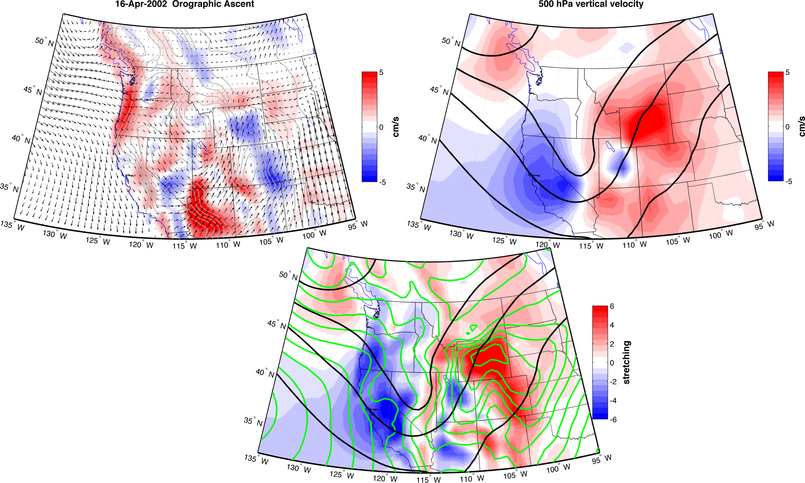

Slide 18
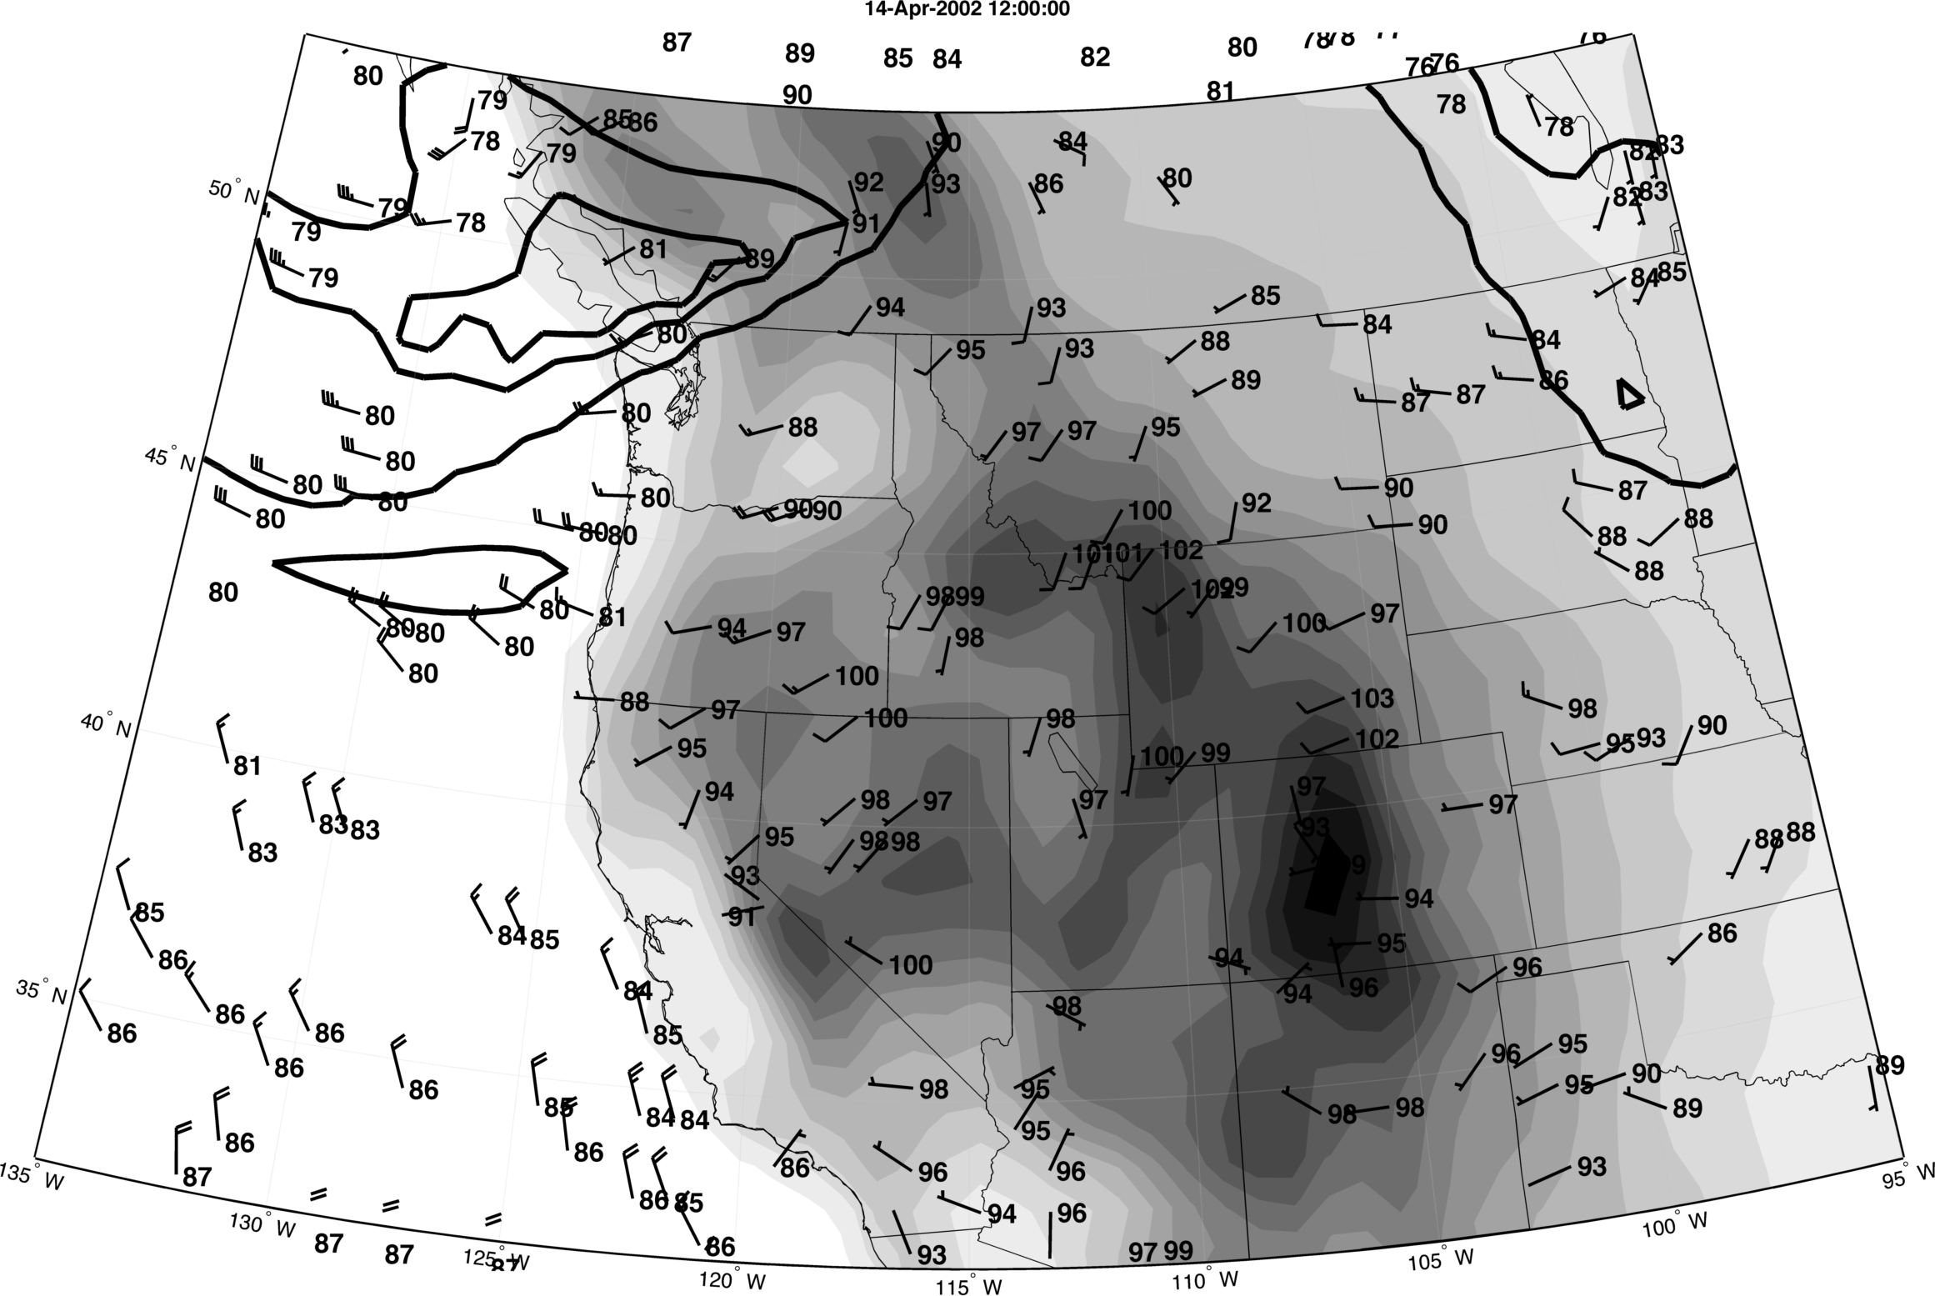

Slide 19
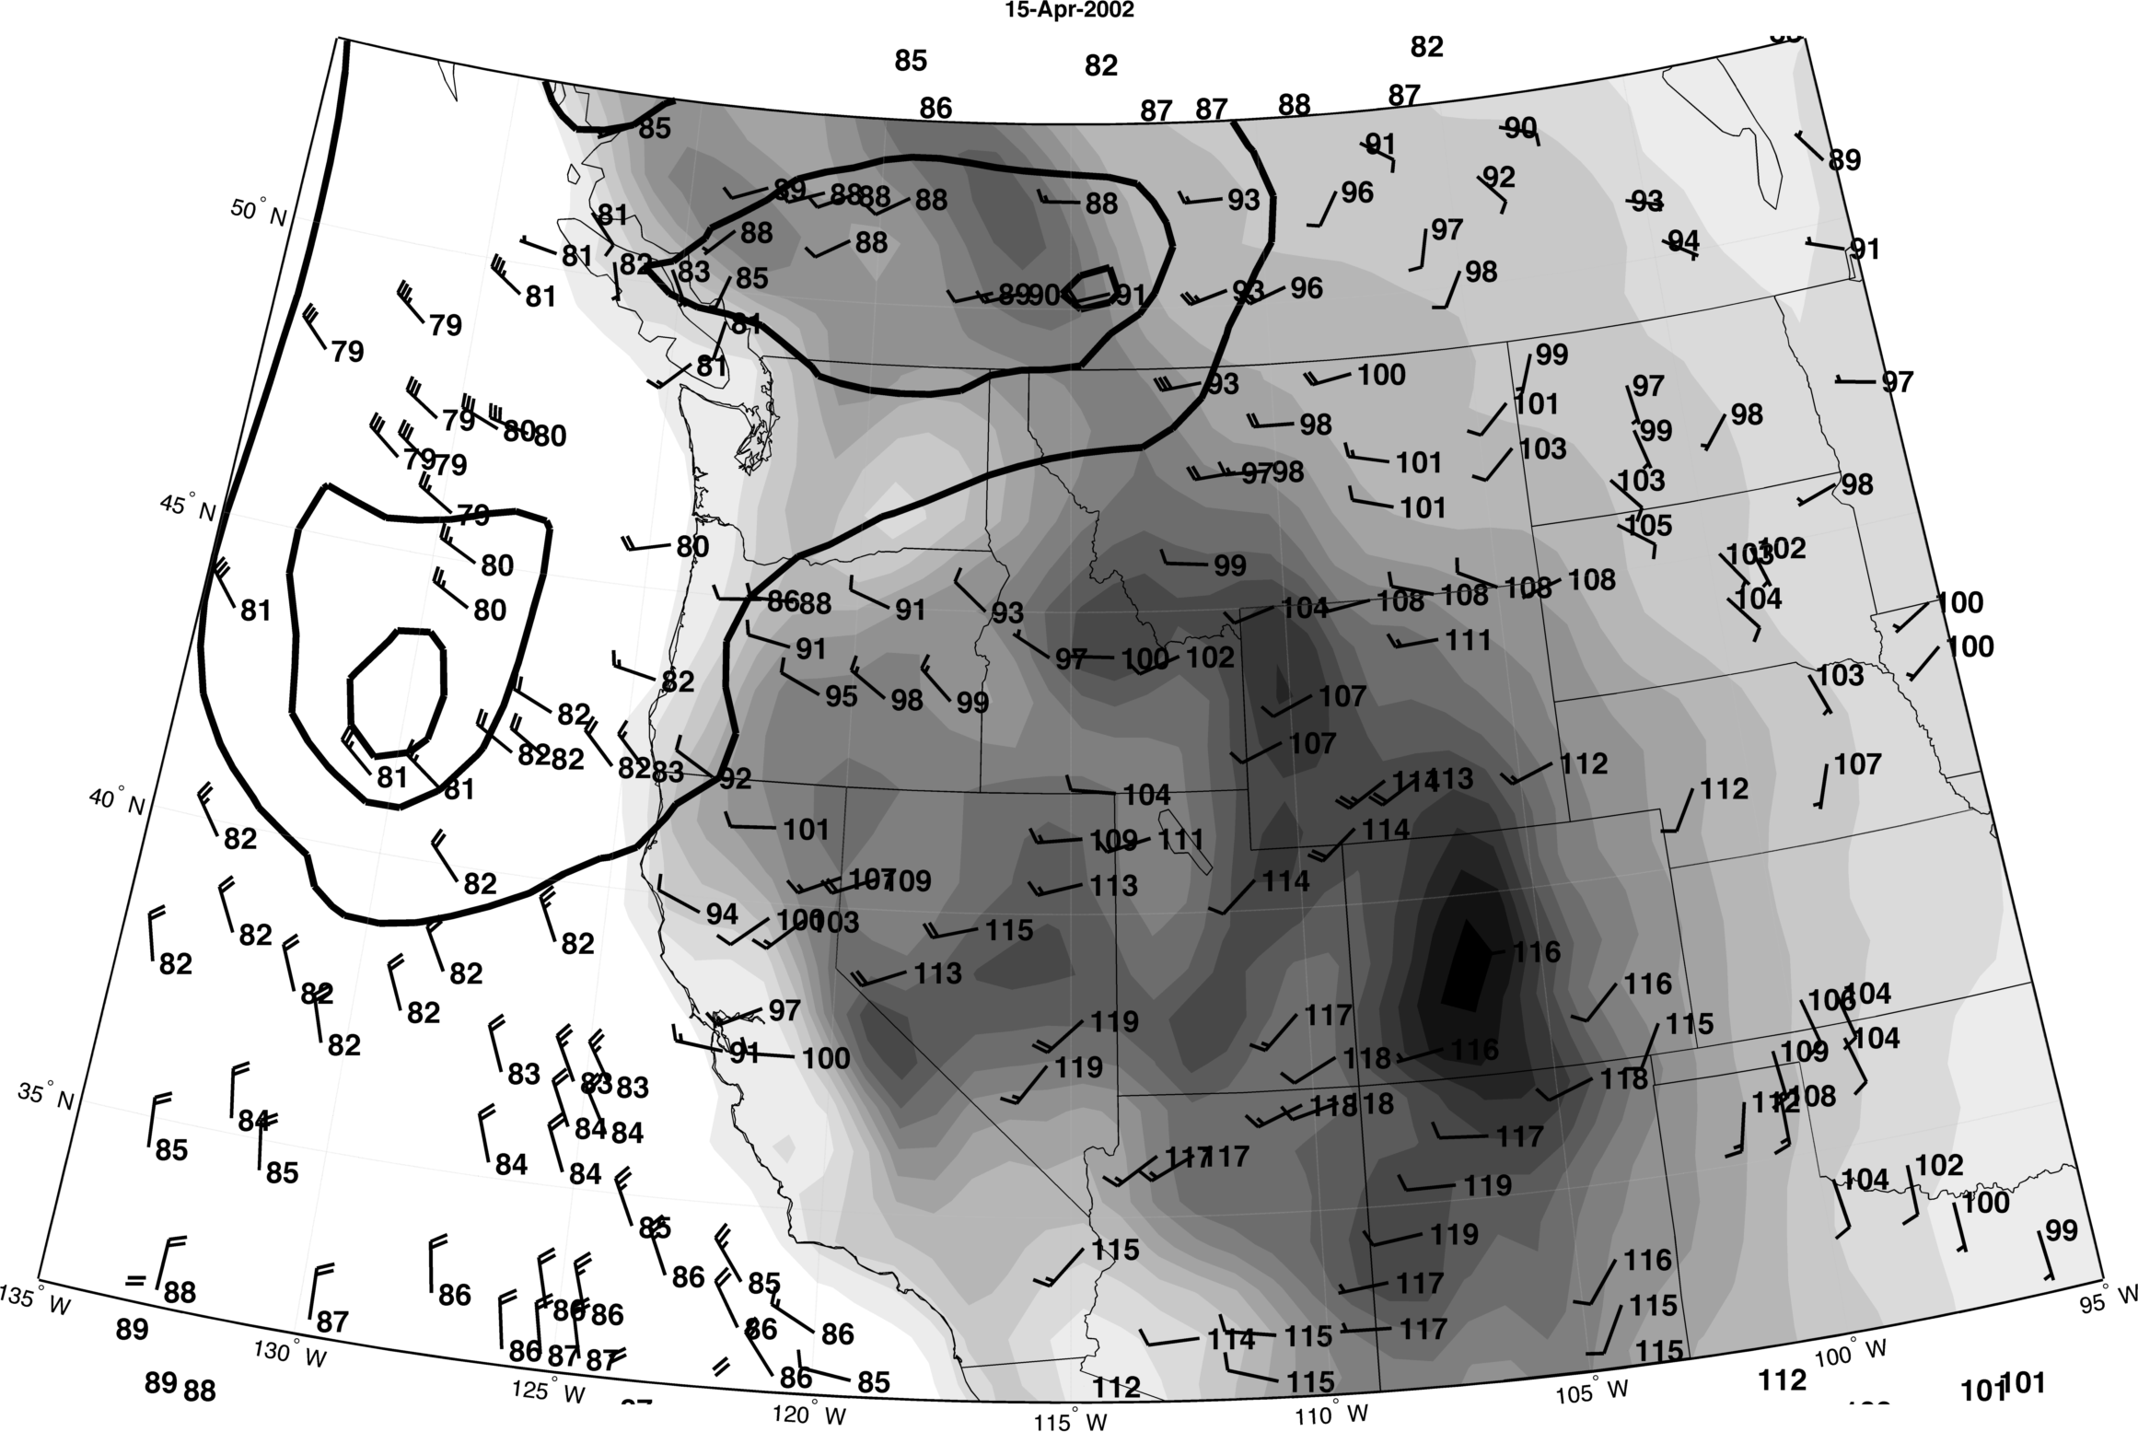

Slide 20
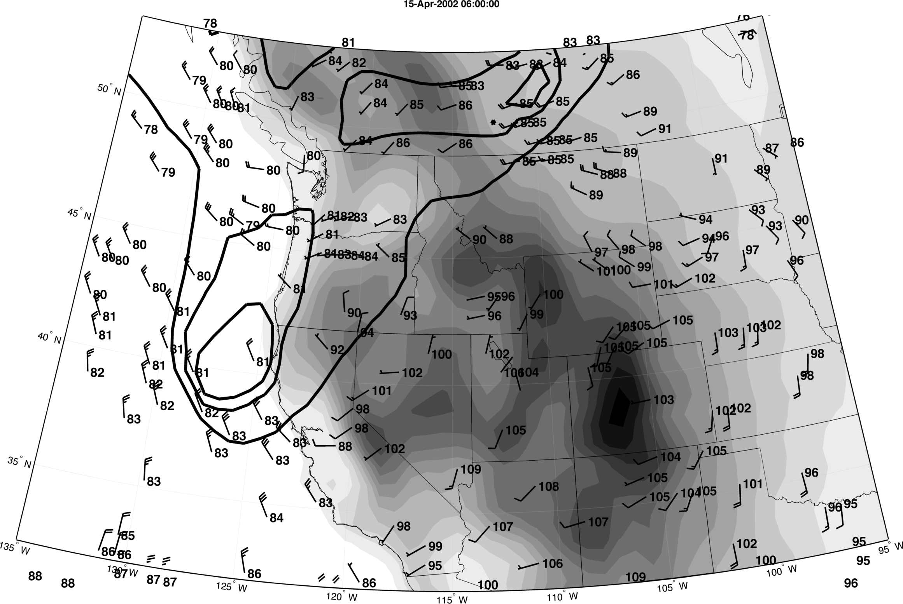
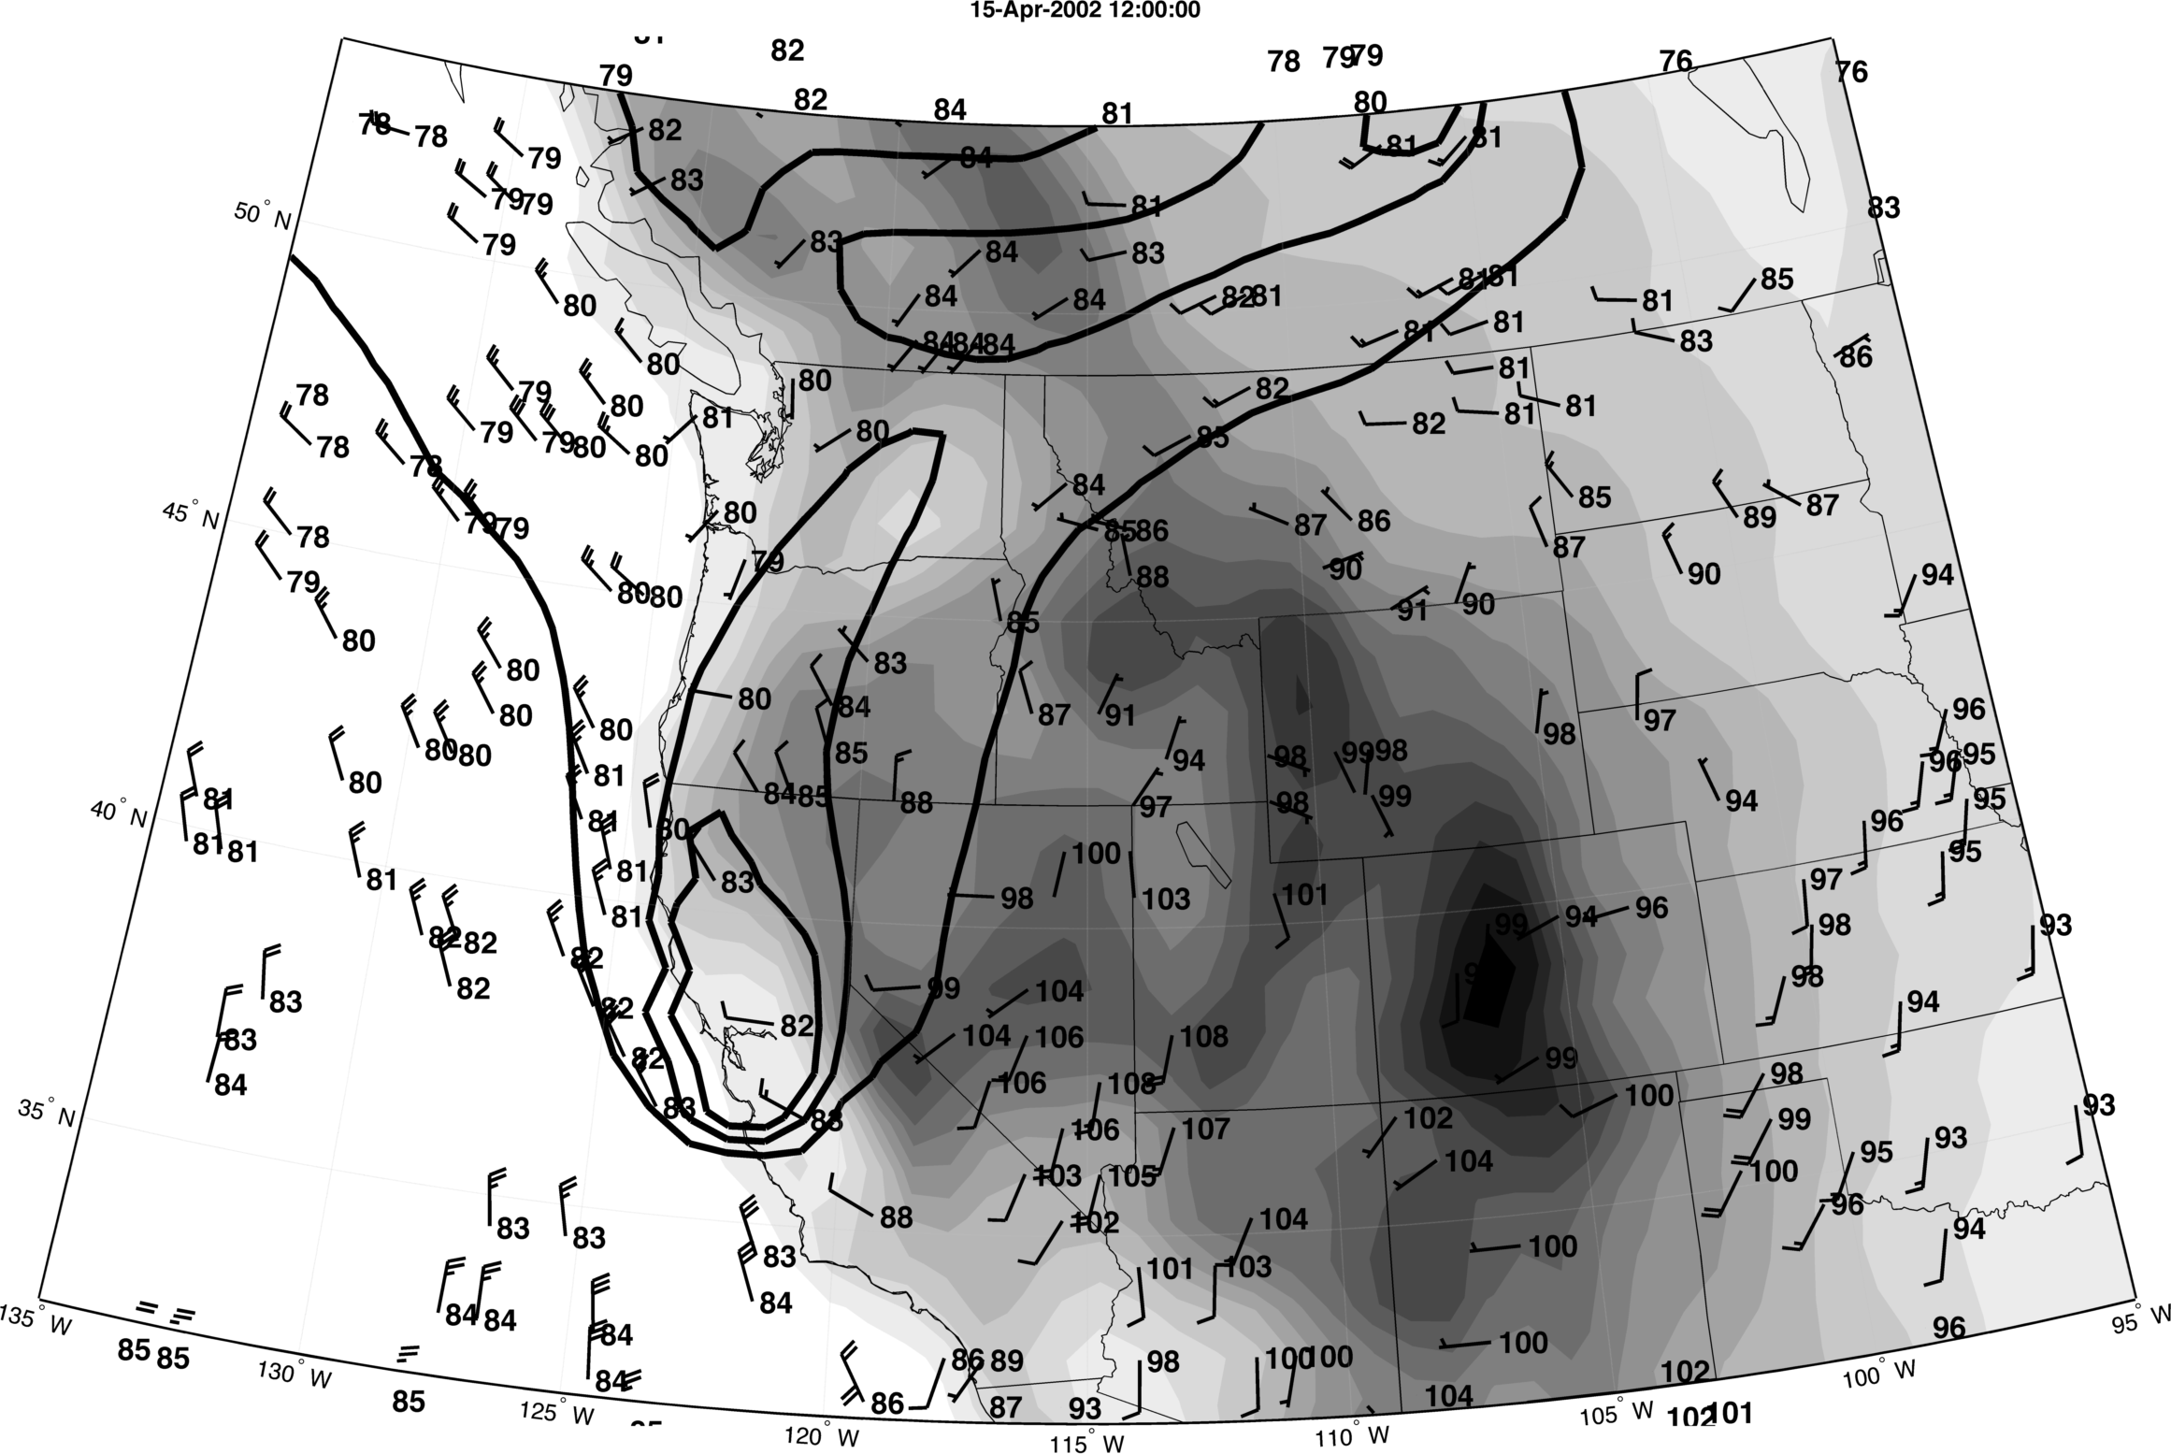

Slide 21
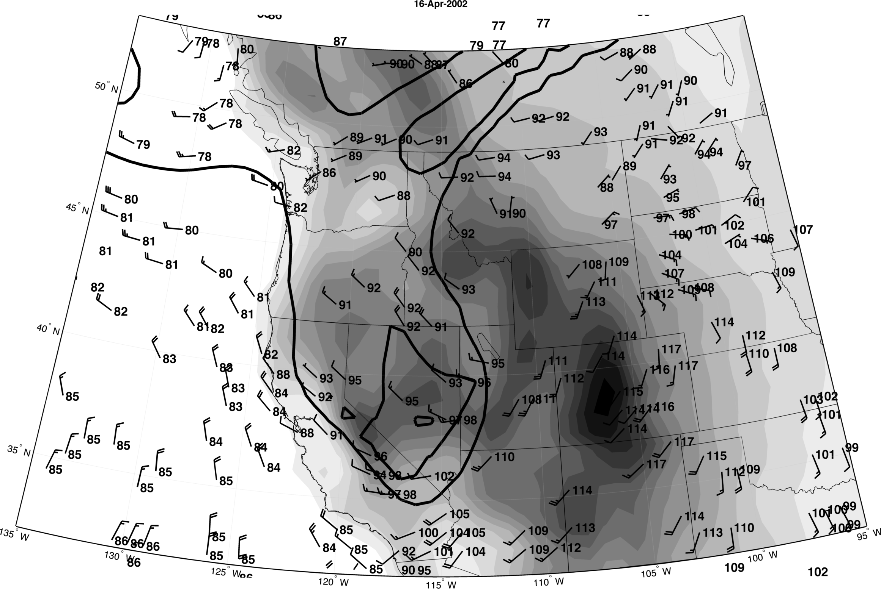

Slide 22
